Slide 1
Vault scalability
Vault Deployment
Designing the Vault Architecture
Copyright © 2021 by Elephant Scale, All Rights Reserved

Slide 2
Vault Deployment
Vault Deployment Designing the Vault Architecture
Copyright © 2021 by Elephant Scale, All Rights Reserved

Slide 3
Vault design
gathering business and technical requirements
selecting where Vault will be provisioned
practical planning phase.
Proper design =>
accelerate the deployment and
adoption of Vault.
Copyright © 2021 by Elephant Scale, All Rights Reserved
Notes:
This chapter is all about Vault design. From gathering business and technical requirements to selecting where Vault will be provisioned, this chapter will describe a practical planning phase. With a proper Vault design, organizations can accelerate the deployment and adoption of Vault.

Slide 4
What is needed
Gathering Requirements
Service Level Objectives and Indicators
Designing the Vault Architecture
Finalizing the Deployment Plan
Choosing the Support Team
Copyright © 2021 by Elephant Scale, All Rights Reserved

Slide 5
Gathering Requirements
Vault includes many features and integrations
Planning a Vault deployment is not simple
conversations with internal teams such
management,
development
security
operations
automation
even the network/security operations centers
Copyright © 2021 by Elephant Scale, All Rights Reserved
Notes:
As with the introduction of any platform, organizations need to understand both the business requirements and technical challenges that Vault is intended to solve. Vault includes many features and integrations and can quickly become the focal point for services that organizations depend on to run applications successfully and securely. Planning a Vault deployment is not as simple as reading the technical documentation and following a step- by-step guide; it requires conversations with internal teams such as management, development, security, operations, automation, and even the network/security operations centers. Defining these collections of both functional and non-functional requirements will help ensure a successful project.

Slide 6
Business Requirements
Business requirements are critical
Goals could include significant milestones such as
obtaining PCI-DSS certification
passing a HIPAA audit
internal goals
improving security
consolidation of tools
Copyright © 2021 by Elephant Scale, All Rights Reserved
Notes:
Requirement gathering happens in a layered approach, and each layer directly impacts the one beneath it. Commonly, requirements gathering starts with "the big picture" and works its way down to team-specific requirements. Therefore, the first functional requirements that need to be understood are the general business requirements. Business requirements are critical to understanding because they define the main objective of the overall project. Every organization is different, and each business has requirements that must be met due to events such as planning, the anticipation of new business or acquisitions, or the introduction of new offerings to its customers. Goals could include significant milestones such as obtaining PCI-DSS certification or passing a HIPAA audit down to internal goals such as improving security or consolidation of tools. Regardless of the goal, each should be taken into consideration when gathering requirements for a Vault implementation.

Slide 7
Technical Requirements
Once the business requirements are fully understood
Dictated by existing or inbound technologies and services used by the business
cloud platforms
container scheduling
the workloads that interact with Vault
Copyright © 2021 by Elephant Scale, All Rights Reserved
Notes:
Once the business requirements are fully understood, technical requirements are gathered to help drive the design of the overall Vault implementation. As the name implies, technical requirements are generally dictated by existing or inbound technologies and services used by the business, such as cloud platforms, container scheduling, or the workloads that interact with Vault. The technical requirements can also be driven by a service-level agreement (SLA), regional or international availability, or established security policies.

Slide 8
Tech requirements examples
Vault must be highly available and provide an SLA of 99.99%
Database secrets must not be valid for longer than 4 hours
Vault services must be available for both on-premises and cloud-based workloads
Copyright © 2021 by Elephant Scale, All Rights Reserved
Notes:
While gathering technical requirements, it is essential to discuss any constraints that may affect the design and implementation. An example of a constraint may be "Vault must be deployed in AWS," which may drastically change the Vault design instead of deploying Vault on-premises. Constraints can come in many different forms, including budgetary, technical, or time constraints. In addition to constraints, risks must be identified and documented to ensure all parties understand and agree to these risks. The potential increase in the cost of the underlying infrastructure in a public cloud is an excellent example of a risk that should be considered. It is essential to verify any assumptions made before or during the requirement gathering process to ensure there are no "unknowns" when moving into the design phase.

Slide 9
More requirements
Which version of Vault will be implemented, Enterprise or Open-Source?
Will Vault be deployed on a public cloud, on-premises, or both?
Will Vault be provisioned using Terraform, scripts, or manually?
Will Vault need to be highly available and deployed in a cluster?
Does Vault need to be available in multiple data centers or cloud regions?
What storage backend will Vault use to store its data?
What secrets engines will be initially consumed?
What performance and operational alerts should be configured?
Are consistent instance sizes available across all cloud providers?
Copyright © 2021 by Elephant Scale, All Rights Reserved

Slide 10
Security Requirements
Will access to the Vault nodes be permitted, or will nodes be treated as immutable?
How will the underlying operating system be secured?
What methods will be used to protect system memory where encryption keys are stored?
How are Vault audit logs ingested and correlated?
What system account does the Vault service use?
Are the Vault binaries, configuration files, and directories secured and audited?
Is the storage backend secured from unauthorized access and modification?
Is Vault secured by TLS?
Who has access to unseal/recovery keys?
Are TTLs minimized beyond a reasonable timeframe?
Are Vault policies written to follow the principle of least privilege?
Copyright © 2021 by Elephant Scale, All Rights Reserved
Notes:
Beyond the business and technical requirements, other requirements should be considered and identified for the design. Since Vault is a security product, security requirements must also be identified to ensure that the design not only follows the business' standards but may include extra precautions due to the confidential data stored and managed by Vault. These 29may include additional techniques such as environmental hardening, operating system hardening, and following best practices for Vault configuration and operations. All these combined helps provide a defense-in-depth approach when designing and implementing Vault in an environment. Security requirements that might be gathered may include:

Slide 11
End-User Requirements
How will users or applications authenticate to Vault?
What access is required within Vault once authenticated?
Can applications be directed to performance standbys for read-only access?
Does network and security infrastructure permit access to Vault from clients?
Which secrets engines are required?
What are the expectations around availability? How is degradation defined?
Are there features or components not currently in place that may impact future Vault needs?
Copyright © 2021 by Elephant Scale, All Rights Reserved
Notes:
It is essential to consider non-functional requirements as well. Often these can be determined by interviewing or participation of the end-users who will use Vault. These end- users could be various business units throughout the organization, DevOps teams who manage the CI/CD pipelines to automate application development or machine-to-machine authentication within an organization's application footprint. All these end-users are ultimately the Vault service consumers, and without understanding how these end-users will interact with Vault, it is impossible to run a thriving Vault service.
When gathering requirements from end-users, it might help to build a Service Level Requirements (SLR) template that teams can fill out before onboarding to Vault. The SLR helps the onboarding team consider how they will integrate with Vault but also helps the support team to understand the needs of each consuming team better.

Slide 12
Requirements Gathering Process
workshop-type approach
collaborative effort between management, development, security, operations, automation, and network teams
Input in business, technical, security, and end-user requirements
Copyright © 2021 by Elephant Scale, All Rights Reserved
Notes:
In many organizations, requirements gathering can be an unnecessarily complicated process due to either the organizational structure or the number of participants wishing to voice an opinion. To minimize conflicts and increase efficiency, a workshop-type approach is generally recommended to streamline the requirements gathering process and design the Vault architecture. This Vault design workshop should be a collaborative effort between management, development, security, operations, automation, and network teams. If it is not feasible to include all parties in the workshop, representatives from each team can be included in the workshop.
Note: Often, the workshop's participating members are defined as a virtual team that will see the project from the beginning to end. These virtual teams are created in place of a full-time team, as most participants still have day-to-day responsibilities. Members of this team frequently become part of the support team after the project is completed.
During the workshop, participants should provide input in determining the business, technical, security, and end-user requirements in which the Vault solution and architecture should meet. These critical decisions should be well documented and shared with all involved parties within the organization. After requirements are agreed upon and documented, the workshop should shift into the design phase. In this phase, the Vault 31architecture and related services are designed to meet the requirements. This phase likely includes whiteboarding, discussions, and documenting decisions based upon HashiCorp best practices, available technology, internal capabilities, and documented policies and procedures. Any unanswered (parking lot) items should be documented, and action items should be assigned to the responsible parties with expected dates for follow-up. Note: In almost all cases, there will be an aspect of education during the workshop to ensure all parties understand how Vault works, what the Vault platform can do, and how Vault is deployed and operationalized. Providing some level of education allows all participating parties to help make educated decisions.
After the design has been agreed upon, it should be well documented and shared with all parties. Not only does this encourage open communication and collaboration among teams, it also assists in solving disputes over agreed-upon service levels, requirements, and design aspects. The documentation can also serve as a reference both during and after the Vault architecture build-out. Service teams can reference the document as they develop Terraform configuration files or automation scripts. New IT employees can reference the documentation to understand why Vault is used in the organization, how it is deployed, and where to seek additional information.

Slide 13
Determining Service-Level Objectives
Availability - Vault can respond to a client request within a given timeframe
Throughput - Vault can handle the number of client requests within a given timeframe
Replication - Vault is replicating data between clusters at an acceptable rate
Recoverability - Vault data can be recovered in the event of a failure that meets or exceeds the organization's RTO
Response Time – Vault can respond to requests within a specific timeframe, such as 20ms.
Copyright © 2021 by Elephant Scale, All Rights Reserved
Notes:
To ensure the Vault service meets and exceeds its SLA, service-level objectives (SLOs) must be established to provide indisputable and measurable characteristics. These measurements may include the availability, performance, and throughput available to integrated applications when connecting to Vault. For example, Vault's SLO may indicate that Vault has higher than a 99.99% uptime because many of the applications connecting to Vault have a similar SLO. Using a service-level indicator (SLI), the historical uptime statistics can be measured and reported on to ensure that they meet or exceed the SLO for availability.

Slide 14
Designing the Vault Architecture
Vault Deployment Designing the Vault Architecture
Copyright © 2021 by Elephant Scale, All Rights Reserved

Slide 15
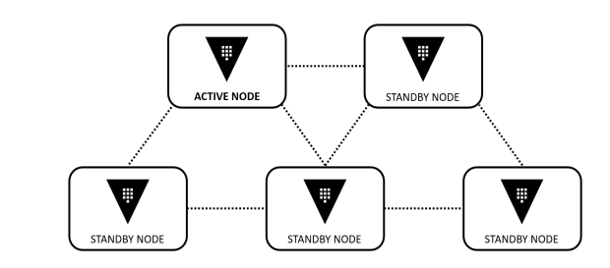
Scalability
Copyright © 2021 by Elephant Scale, All Rights Reserved
Notes:
Vault clustering is available in both the OSS and Enterprise version of Vault. In a traditional Vault cluster running OSS, only the active node services client requests, and all standby nodes forward or redirect client requests to the active node. While this type of architecture provides high availability within the cluster, it does not increase scalability, meaning that more standby nodes do not improve the performance of a Vault cluster. In a Vault Enterprise cluster, the standby nodes in a cluster can be used as Performance Standby nodes, which can service read-only requests for clients. Performance standby nodes continue to forward all write requests to the active node in the cluster. Regardless of the version, there is always one active node in a cluster

Slide 16
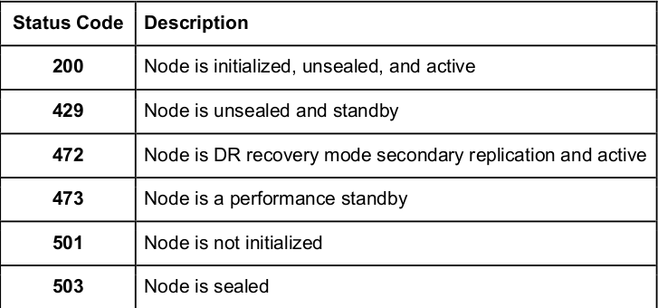
Accessing the Vault Service
Copyright © 2021 by Elephant Scale, All Rights Reserved
Notes:
Many customers will front-end a Vault cluster with a load balancer to target the cluster's active node. Providing a front-end load balancer for a Vault cluster allows a reference with a 'friendly' DNS name, simplifying access to the cluster. This configuration is generally how load balancers are used in a multi-node environment. In Vault's case, however, load balancers are used to provide high availability to the Vault service and not distribute requests across nodes. On the backend of the load balancer, health checks are used to determine the active node. Information on individual nodes can be obtained using Vault's dedicated health endpoint [/sys/health]. Each node responds with an HTTP status code that corresponds with its status and its node type within the cluster. As an example, a node that is initialized, unsealed, and is the active node returns an HTTP status code of 200. If a node is unsealed but a standby node, it returns a status code of 429. The dedicated health endpoint has multiple default status codes

Slide 17
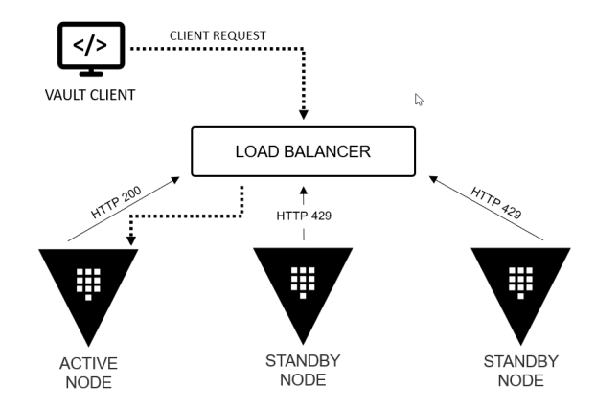
Vault cluster behind a load balancer
Copyright © 2021 by Elephant Scale, All Rights Reserved
Notes:
As an example, Figure 2-2 represents a Vault cluster behind a load balancer. While the standby nodes return an HTTP status code of 429, the active node returns a 200 and is the Vault node to which all client requests are forwarded

Slide 18
Consul Service Discovery
alternative to using a load balancer
opt to use HashiCorp Consul's service discovery
Each Vault node would be configured to register the Vault service with Consul
Copyright © 2021 by Elephant Scale, All Rights Reserved
Notes:
As an alternative to using a load balancer, organizations can opt to use HashiCorp Consul's service discovery feature to target Vault using DNS and service registration. Each Vault node would be configured to register the Vault service with Consul, and integrated health checks would allow Consul to determine each node's status and health. Consul automatically creates service registrations for both the active node as well as standby nodes. Once Vault nodes are registered, clients can access the service using the DNS records in which Consul is the authoritative server for responses to DNS queries. As an example, the Vault service could be accessed by sending a request to active.vault.service.consul, assuming the default Consul configurations are used. Many organizations opt to go this route if service discovery or service mesh technologies are already in use, or they are looking for the opportunity to deploy such a solution. Keep in mind, though, that the Consul cluster serving as the storage backend for Vault should not be used for other Consul services, such as service discovery. A separate cluster should be provisioned to manage these services.

Slide 19
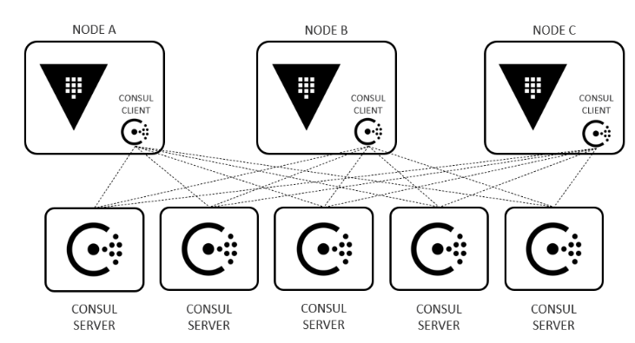
Consul Storage Backend
Copyright © 2021 by Elephant Scale, All Rights Reserved
Notes:
HashiCorp also supports Consul as a storage backend for Vault. This storage backend is reliant on a separate HashiCorp Consul cluster, in which Vault can store persistent data using Consul's key/value store. The Consul cluster comprises of multiple nodes running the Consul agent in server mode and is frequently provisioned alongside the Vault nodes to minimize latency for communication. Consul uses two main protocols to function: a gossip protocol and a consensus protocol:
Gossip Protocol: Consul uses a gossip protocol based on Serf to manage membership and communication within the cluster. Consul uses two different gossip pools: LAN connectivity (local) and WAN connectivity (cross data center requests). For a Vault implementation, only LAN is used for the storage backend.
Consensus Protocol: the consensus protocol is based on Raft and is responsible for managing the quorum, log entries, and cluster leadership. A node in a Consul cluster is either a leader or a follower. When Consul is started, each node starts as a follower, but servers work together to elect a leader using the Raft protocol. The leader is responsible for processing all new transactions. Once transactions are committed, the leader is responsible for replicating that data to all other server nodes in the cluster.

Slide 20
Configuring Vault components
Auth Methods
Secrets Engines
Vault Policies
Audit Devices
Copyright © 2021 by Elephant Scale, All Rights Reserved

Slide 21
Managing the Vault service
Vault Service Maintenance
Scaling and Optimizing Vault
Replication and Disaster Recovery
Common Issues and Solutions
Common Migration and Onboarding Patterns
Copyright © 2021 by Elephant Scale, All Rights Reserved

Slide 22
Extending and Integrating Vault
Integrating with Kubernetes
Consul for Service Discovery
Terraform Integration
Coding for Reliability
Copyright © 2021 by Elephant Scale, All Rights Reserved

