Slide 1
Ansible Playbook
Copyright © 2025 by Elephant Scale, All Rights Reserved

Slide 2

What is a Playbook?
A playbook is a list of plays
A playbook is a YAML-formatted file in Ansible that contains a series of tasks to automate configuration, deployment, and orchestration of IT infrastructure.
Playbooks define the desired state of a system, allowing Ansible to manage and maintain consistency across environments.
Copyright © 2025 by Elephant Scale, All Rights Reserved

Slide 3

Key Components of a Playbook
Plays: Organize tasks for a specific group of hosts.
Tasks: Execute a single action using Ansible modules (e.g., package installation, file creation).
Variables: Define custom or dynamic values to be used in tasks.
Handlers: Perform actions in response to specific triggers (e.g., restarting a service).
Templates: Dynamically generate configuration files using Jinja2 templating language.
Playbooks promote reusable, shareable, and maintainable code for infrastructure management.
We will discuss each of these components in detail in the following slides.
Copyright © 2025 by Elephant Scale, All Rights Reserved

Slide 4
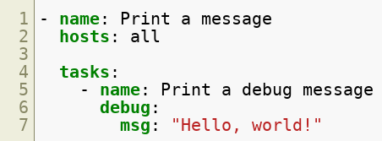
Playbook
Let's take a look at a simple playbook:
now, we're going to break down the playbook into its component parts.
Copyright © 2025 by Elephant Scale, All Rights Reserved

Slide 5

YAML header
The first line of the playbook is a YAML header that specifies the document type and version. In this case, it's a YAML document with no specific version:
Copyright © 2025 by Elephant Scale, All Rights Reserved

Slide 6

Play
The hosts and become directives are part of the first play defined in the playbook:
Copyright © 2025 by Elephant Scale, All Rights Reserved

Slide 7

What is a play?
A play is a set of tasks that run on a specific set of hosts.
In this case, the play is targeting the servers group of hosts,
Copyright © 2025 by Elephant Scale, All Rights Reserved

Slide 8

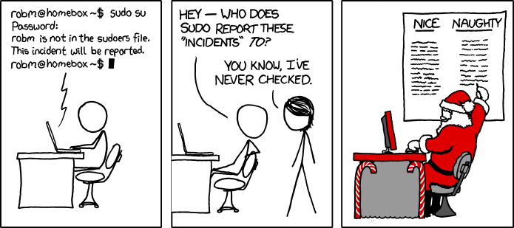
What is become?
become directive tells Ansible to run the tasks with elevated privileges.
Copyright © 2025 by Elephant Scale, All Rights Reserved

Slide 9
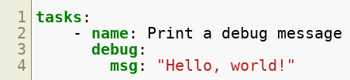
Task structure
Each task in a playbook has a name, a module, and any necessary module arguments.
The name directive is a human-readable label for the task, used for reporting and logging.
The module specifies the name of the Ansible module to use for the task, such as apt, yum, or copy.
Any necessary module arguments are specified as key-value pairs under the module.
Copyright © 2025 by Elephant Scale, All Rights Reserved

Slide 10

Task: Name
The name directive is used to give the task a human-readable label, which is used for reporting and logging purposes.
The name should be descriptive enough to provide context for the task being executed.
In the example playbook, the task is named "Print a debug message".
Copyright © 2025 by Elephant Scale, All Rights Reserved

Slide 11

Task: Module
The module directive specifies the name of the Ansible module to use for the task.
Modules are reusable, idempotent blocks of code that perform a specific action, such as managing packages, creating users, or copying files.
Ansible comes with hundreds of built-in modules, and you can also create your own custom modules.
Copyright © 2025 by Elephant Scale, All Rights Reserved

Slide 12
Lets Discuss Modules
Lets Discuss Modules Back to our playbook LAB Conditionals Loops Handlers Blocks Templates Ansible Vault Plugins Roles
Copyright © 2025 by Elephant Scale, All Rights Reserved

Slide 13

Task: Modules: arguments
Any necessary module arguments are specified as key-value pairs under the module.
Module arguments can include options such as package names, file paths, or user names and passwords.
In the example playbook, the apt module is used to install the apache2 package on the target hosts.
Copyright © 2025 by Elephant Scale, All Rights Reserved

Slide 14
Modules: Types
Core modules
Maintained by the Ansible team
Located in the /usr/lib/python3.6/site-packages/ansible/modules directory
Extra modules
Maintained by the Ansible community
Located in the /usr/lib/python3.6/site-packages/ansible/modules directory
Can be promoted to core modules
might be removed if they are not maintained
Can be installed using the ansible-galaxy command
Copyright © 2025 by Elephant Scale, All Rights Reserved

Slide 15
Modules: Index
The index of modules is located in the /usr/share/doc/ansible/html/modules_by_category.html directory
The index of modules is also available online at https://docs.ansible.com/ansible/2.9/modules/modules_by_category.html
Copyright © 2025 by Elephant Scale, All Rights Reserved

Slide 16
Modules: Documentation
The documentation for each module is located in the /usr/share/doc/ansible/html/modules/<module_name>.html directory
The documentation for each module is also available online at https://docs.ansible.com/ansible/2.9/modules/module_name>.html
The documentation for each module includes:
A description of the module
A list of the module's arguments
A list of the module's return values
A list of the module's examples
Copyright © 2025 by Elephant Scale, All Rights Reserved

Slide 17
Back to our playbook
Lets Discuss Modules Back to our playbook LAB Conditionals Loops Handlers Blocks Templates Ansible Vault Plugins Roles
Copyright © 2025 by Elephant Scale, All Rights Reserved

Slide 18
Playbook: Summary
The playbook contains a single play that targets all hosts in the inventory file.
The play contains a single task that uses the debug module to print a message to the console.
The task uses the msg argument to specify the message to print.
The playbook can be executed using the ansible-playbook command.
Copyright © 2025 by Elephant Scale, All Rights Reserved

Slide 19
Running the playbook
Once you've created your playbook, you can run it using the ansible-playbook command.
Ansible will connect to the target hosts and execute the tasks specified in the playbook.
You can use the -v option to enable verbose output, which will show you what Ansible is doing as it executes the playbook.
Copyright © 2025 by Elephant Scale, All Rights Reserved

Slide 20
LAB
Lets Discuss Modules Back to our playbook LAB Conditionals Loops Handlers Blocks Templates Ansible Vault Plugins Roles
Copyright © 2025 by Elephant Scale, All Rights Reserved

Slide 21
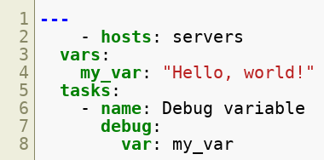
Variables and Facts
Let's take a look at a simple playbook that uses variables and facts:
Let's break down this playbook and explain each part in more detail
Copyright © 2025 by Elephant Scale, All Rights Reserved

Slide 22

Variables
Variables are used to store and reference data in Ansible.
You can define variables at the play or task level, or in an inventory file or variable file.
In this example, a variable named my_var is defined at the play level, with the value "Hello, world!".
Copyright © 2025 by Elephant Scale, All Rights Reserved

Slide 23

Task: Debug
The debug task is used to display the value of a variable or other data structure.
The var directive specifies the variable to display.
In this example, the debug task is used to display the value of the my_var variable.
Copyright © 2025 by Elephant Scale, All Rights Reserved

Slide 24
LAB
Copyright © 2025 by Elephant Scale, All Rights Reserved

Slide 25
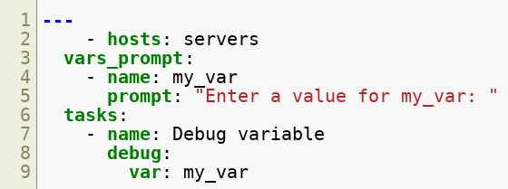
Prompt for input
Let's analyze a playbook that prompts the user for input:
Let's break down this playbook and explain each part in more detail
Copyright © 2025 by Elephant Scale, All Rights Reserved

Slide 26

Variables: Prompt
The vars_prompt section is used to prompt the user for variable values.
Each prompt is defined with a name and a prompt attribute.
In this example, a variable named my_var is defined with a prompt that asks the user to enter a value.
Copyright © 2025 by Elephant Scale, All Rights Reserved

Slide 27
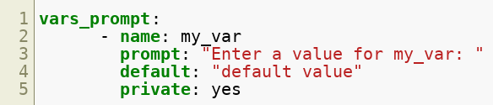
Structure of a prompt
name : variable name
prompt : prompt message
default : default if user skips the prompt
private : hide the input from the screen
Copyright © 2025 by Elephant Scale, All Rights Reserved

Slide 28
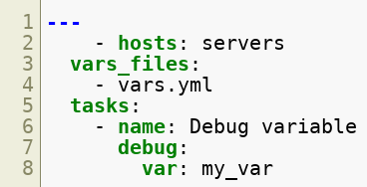
Variables: File
Variables can be defined in a separate file.
The file can be in any format, but the most common one is the YAML format.
The file must be located in the same directory or relative to the playbook.
The file must be named anything that you need.
The file must be defined in the vars_files section of the playbook.
There is a module called include_vars that can be used to include variables from a file as a task.
Copyright © 2025 by Elephant Scale, All Rights Reserved

Slide 29

Variables: Register
Variables can be registered to store the output of a task.
In this example, the output of the shell task is stored in the my_var variable.
Copyright © 2025 by Elephant Scale, All Rights Reserved

Slide 30
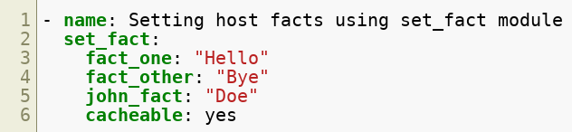
Variables: Set Fact
Variables can be set as facts to store the output of a task using set_fact module
these variables can be accessed like a normal variable
If you have redis installed, you can use cached to store these variables for later use.
Copyright © 2025 by Elephant Scale, All Rights Reserved

Slide 31
LAB
Copyright © 2025 by Elephant Scale, All Rights Reserved

Slide 32
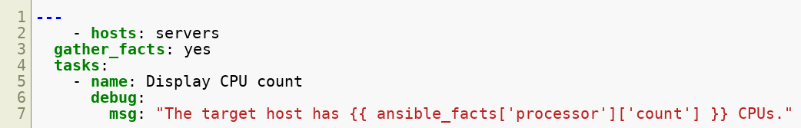
Ansible Facts
Facts are pieces of information about the remote hosts that Ansible collects when it runs a playbook.
Let's break down this playbook and explain each part in more detail
Copyright © 2025 by Elephant Scale, All Rights Reserved

Slide 33

Play: gather_facts
The gather_facts directive is used to gather system information (facts) from the target hosts.
By default, Ansible gathers a basic set of facts, such as the hostname and IP address of the target host.
You can also customize the set of facts to gather using the gather_subset directive.
In this example, the gather_facts directive is set to yes, which means Ansible will gather all available facts.
Copyright © 2025 by Elephant Scale, All Rights Reserved

Slide 34
Task: Debug
The debug task is used to display a message in the playbook output.
The msg directive specifies the message to display.
In this example, the msg directive includes a variable reference to ansible_facts['processor']['count'], which contains the number of CPUs on the target host.
Copyright © 2025 by Elephant Scale, All Rights Reserved

Slide 35
LAB
Copyright © 2025 by Elephant Scale, All Rights Reserved

Slide 36
Conditionals
Lets Discuss Modules Back to our playbook LAB Conditionals Loops Handlers Blocks Templates Ansible Vault Plugins Roles
Copyright © 2025 by Elephant Scale, All Rights Reserved

Slide 37
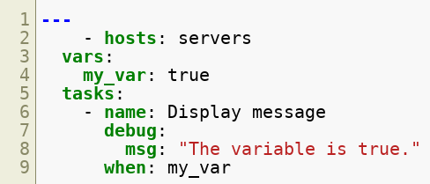

Conditionals
Let's break down this playbook and explain each part in more detail
Copyright © 2025 by Elephant Scale, All Rights Reserved

Slide 38

Variable: Define
Variables can be defined in a playbook using the vars keyword.
In this example, the my_var variable is defined with a value of true.
Copyright © 2025 by Elephant Scale, All Rights Reserved

Slide 39
Task: Debug
The debug task is used to display a message in the playbook output.
The msg directive specifies the message to display.
In this example, the msg directive displays a message if the my_var variable is true.
Copyright © 2025 by Elephant Scale, All Rights Reserved

Slide 40

Task: When
The when keyword is used to specify a condition for the task to run.
The task will only run if the condition is true.
In this example, the when keyword is used to specify that the task should only run if the my_var variable is true. Let's talk about the condition syntax.
Copyright © 2025 by Elephant Scale, All Rights Reserved

Slide 41
Conditions: Operators
Ansible supports the following operators:
and
or
not
==
!=
>
>=
<
<=
The condition can be defined as a Jinja2 expression.
The condition can be defined as a variable.
Copyright © 2025 by Elephant Scale, All Rights Reserved

Slide 42

Condition: Expressions
Ansible supports the following expressions:
true
false
none
The condition can be defined as a list.
The list must contain valid expressions.
and operator is used between each item of the list.
Copyright © 2025 by Elephant Scale, All Rights Reserved

Slide 43
Conditions: Variables
the following variables can be used in conditions:
ansible_facts
ansible_hostname
ansible_host
ansible_os_family
ansible_os_name
ansible_os_version
ansible_playbook_python
ansible_python
...
Copyright © 2025 by Elephant Scale, All Rights Reserved

Slide 44
LAB
Copyright © 2025 by Elephant Scale, All Rights Reserved

Slide 45
Loops
Lets Discuss Modules Back to our playbook LAB Conditionals Loops Handlers Blocks Templates Ansible Vault Plugins Roles
Copyright © 2025 by Elephant Scale, All Rights Reserved

Slide 46
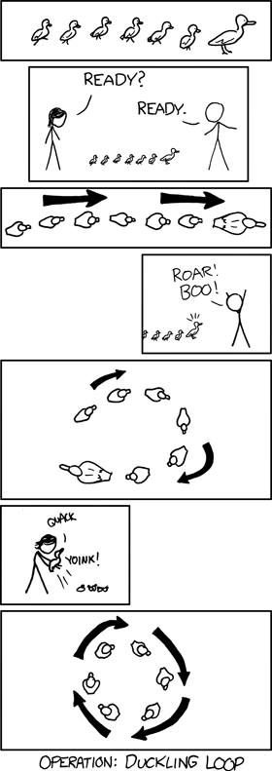
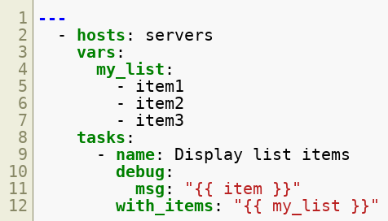
Loops
Let's break down this playbook and explain each part in more detail
Copyright © 2025 by Elephant Scale, All Rights Reserved

Slide 47
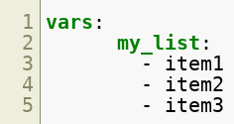
Variable: Define
Variables can be defined in a playbook using the vars keyword.
In this example, the my_list variable is defined as a list of items to be displayed using the debug module.
Copyright © 2025 by Elephant Scale, All Rights Reserved

Slide 48
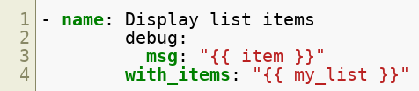
Task: Debug
The debug task is used to display a message in the playbook output.
The msg directive specifies the message to display.
The with_items directive specifies the list of items to loop over.
Copyright © 2025 by Elephant Scale, All Rights Reserved

Slide 49

Task: With Items
The with_items keyword is used to specify a list of items to iterate over.
The item keyword is used to refer to each item in the loop.
In this example, the with_items keyword is used with the debug module to loop over the my_list variable, displaying each item in the list.
Copyright © 2025 by Elephant Scale, All Rights Reserved

Slide 50
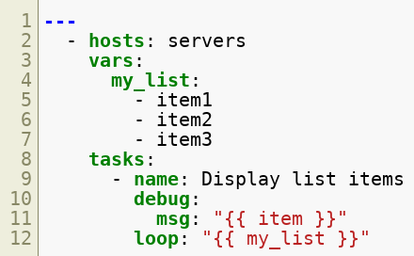
Loops:
The loop loop is a newer alternative to with_items loop, and it offers more flexibility and readability.
It allows you to loop over a list or dictionary of items, and use the item variable to access each item.
Copyright © 2025 by Elephant Scale, All Rights Reserved

Slide 51
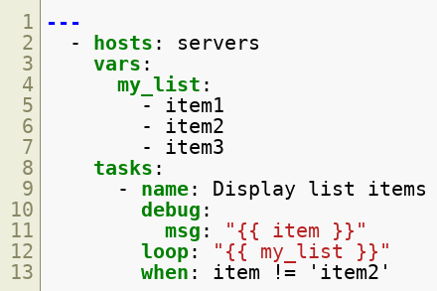
Using Loops with Conditionals
You can also use loops with conditionals to perform tasks based on certain conditions.
Copyright © 2025 by Elephant Scale, All Rights Reserved

Slide 52
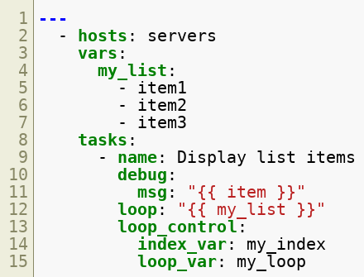
The loop_control Keyword
The loop_control keyword allows you to modify the behavior of the loop. For example, you can use it to set the loop index, skip items, or stop the loop.
Copyright © 2025 by Elephant Scale, All Rights Reserved

Slide 53
Conclusion
Loops in Ansible Playbook provide an efficient way to perform repetitive tasks. With the with_items and loop loops, you can iterate over a list of items or a dictionary, and use conditionals and loop_control keyword to modify the behavior of the loop.
Copyright © 2025 by Elephant Scale, All Rights Reserved

Slide 54
LAB
Copyright © 2025 by Elephant Scale, All Rights Reserved

Slide 55
Handlers
Lets Discuss Modules Back to our playbook LAB Conditionals Loops Handlers Blocks Templates Ansible Vault Plugins Roles
Copyright © 2025 by Elephant Scale, All Rights Reserved

Slide 56
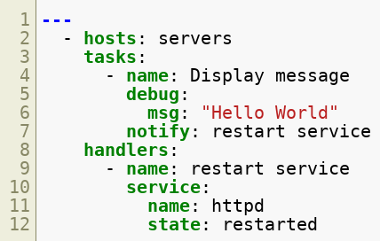
Handlers
Handlers are tasks that are triggered by notifications
Let's break down this playbook and explain each part in more detail
Copyright © 2025 by Elephant Scale, All Rights Reserved

Slide 57
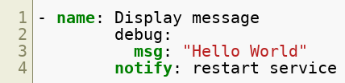
Task: Debug
The debug task is used to display a message in the playbook output but it also triggers a notification.
That notification is used to trigger the restart service handler.
Copyright © 2025 by Elephant Scale, All Rights Reserved

Slide 58
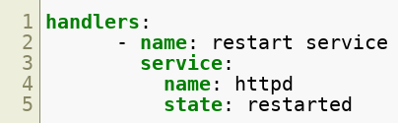
Handlers
The handlers keyword is used to define a list of handlers that can be triggered by notifications in the tasks.
handlers are normal tasks, but they are only executed when they are notified by another task in the playbook that changes the state of the system.
Important: Handlers are executed at the end of the play, after all the tasks have been executed.
Copyright © 2025 by Elephant Scale, All Rights Reserved

Slide 59
Best Practices
Handlers should be used to restart services, reload configuration files, and perform other tasks that need to be executed after a change in the system state.
Handlers should not be used to perform tasks that are idempotent, such as installing packages or creating users.
Copyright © 2025 by Elephant Scale, All Rights Reserved

Slide 60
Conclusion
Handlers are tasks that are triggered by notifications. They are used to restart services, reload configuration files, and perform other tasks that need to be executed after a change in the system state.
Copyright © 2025 by Elephant Scale, All Rights Reserved

Slide 61
LAB
Copyright © 2025 by Elephant Scale, All Rights Reserved

Slide 62
Blocks
Lets Discuss Modules Back to our playbook LAB Conditionals Loops Handlers Blocks Templates Ansible Vault Plugins Roles
Copyright © 2025 by Elephant Scale, All Rights Reserved

Slide 63
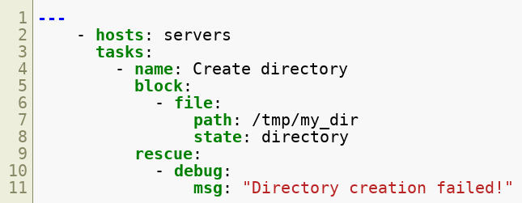
Blocks
Blocks are used to group tasks together and control the execution of the tasks in the block.
Let's break down this playbook and explain each part in more detail
Copyright © 2025 by Elephant Scale, All Rights Reserved

Slide 64
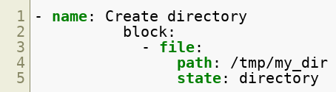
Task: Block
The block module is used to group multiple tasks together as a single block.
The tasks within the block are executed sequentially, and if any task fails, Ansible will move to the rescue section.
In this example, the block module is used to create a directory on the target hosts.
Copyright © 2025 by Elephant Scale, All Rights Reserved

Slide 65
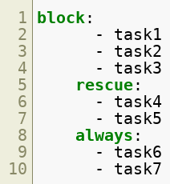
Syntax of Blocks in Ansible Playbook
The syntax for defining a block in an Ansible playbook is as follows:
The block keyword is used to define the set of tasks that should be grouped together
The rescue keyword is used to define a set of tasks to be run if any task in the block fails
The always keyword is used to define a set of tasks to be run regardless of whether the block succeeds or fails
Copyright © 2025 by Elephant Scale, All Rights Reserved

Slide 66
Benefits
Using blocks in an Ansible playbook can make the playbook more readable and easier to maintain by grouping related tasks together
Blocks can also make it easier to apply conditions, retries, and error handling to a set of tasks as a single unit
Using blocks can help to reduce duplication and make playbooks more modular
By using blocks, it is possible to write more robust and error-tolerant playbooks
Copyright © 2025 by Elephant Scale, All Rights Reserved

Slide 67
Templates
Lets Discuss Modules Back to our playbook LAB Conditionals Loops Handlers Blocks Templates Ansible Vault Plugins Roles
Copyright © 2025 by Elephant Scale, All Rights Reserved

Slide 68
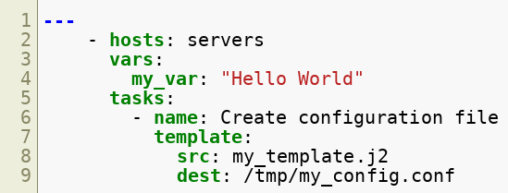

Templates
Using templates in Ansible Playbook is a very powerful feature that allows you to generate configuration files on the target hosts.
Let's break down this playbook and explain each part in more detail
Copyright © 2025 by Elephant Scale, All Rights Reserved

Slide 69

Variable: Define
Variables can be defined in a playbook using the vars keyword.
In this example, the my_var variable is defined as a string that will be used in the template.
Copyright © 2025 by Elephant Scale, All Rights Reserved

Slide 70
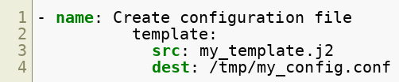
Task: Template
The template task is used to create a file from a Jinja2 template.
The src parameter specifies the path to the Jinja2 template file.
The dest parameter specifies the path and name of the file to be created on the target host.
Copyright © 2025 by Elephant Scale, All Rights Reserved

Slide 71
Jinja2 Template
The Jinja2 template is a text file that contains variables and expressions that are evaluated and replaced with the actual values when the template is rendered.
In this example, the my_template.j2 file is a Jinja2 template that contains a variable called my_var.
Copyright © 2025 by Elephant Scale, All Rights Reserved

Slide 72
Benefits
Using templates in an Ansible playbook can make it easier to create and maintain configuration files on the target hosts.
Templates can also be used to generate configuration files from templates that are stored in a version control system.
Using templates can help to reduce duplication and make playbooks more modular.
Copyright © 2025 by Elephant Scale, All Rights Reserved

Slide 73
Conclusion
Using templates in an Ansible playbook is a very powerful feature that allows you to generate configuration files on the target hosts.
Copyright © 2025 by Elephant Scale, All Rights Reserved

Slide 74
LAB
Copyright © 2025 by Elephant Scale, All Rights Reserved

Slide 75
Ansible Vault
Lets Discuss Modules Back to our playbook LAB Conditionals Loops Handlers Blocks Templates Ansible Vault Plugins Roles
Copyright © 2025 by Elephant Scale, All Rights Reserved

Slide 76
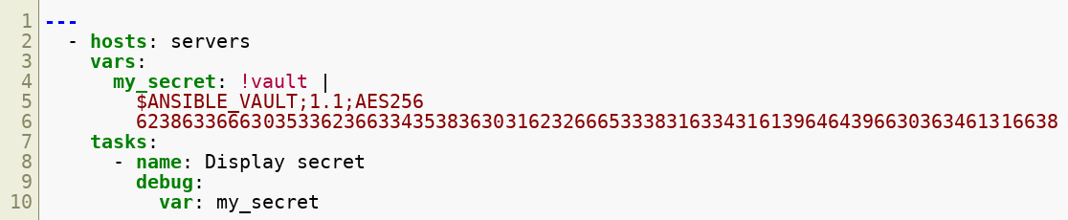
Ansible Vault
Ansible Vault is a feature that allows you to encrypt sensitive data in Ansible playbooks.
Ansible Vault is a part of Ansible, which means that it is installed by default when you install Ansible.
Ansible Vault is a command line.
Copyright © 2025 by Elephant Scale, All Rights Reserved

Slide 77
Encrypting Variables
In this example, the my_secret variable is defined as a sensitive string that has been encrypted using Ansible Vault.
Important: Ansible can encrypt any variables, files and playbooks, not just strings.
Copyright © 2025 by Elephant Scale, All Rights Reserved

Slide 78
Vault: Basic Vault Commands
create: ansible-vault create vault.yml => creates a new vault file
edit: ansible-vault edit vault.yml => opens the vault file in an editor
view: ansible-vault view vault.yml => displays the contents of the vault file
encrypt: ansible-vault encrypt vault.yml => encrypts an existing file
decrypt: ansible-vault decrypt vault.yml => decrypts an existing file
rekey: ansible-vault rekey vault.yml => rekeys an existing file
Copyright © 2025 by Elephant Scale, All Rights Reserved

Slide 79
Run Playbooks with Vault
ansible-playbook playbook.yml --ask-vault-pass
prompts for the vault password
ansible-playbook playbook.yml --vault-password-file vault_pass.txt
uses a file to store the vault password
Copyright © 2025 by Elephant Scale, All Rights Reserved

Slide 80
LAB
Copyright © 2025 by Elephant Scale, All Rights Reserved

Slide 81
Plugins
Lets Discuss Modules Back to our playbook LAB Conditionals Loops Handlers Blocks Templates Ansible Vault Plugins Roles
Copyright © 2025 by Elephant Scale, All Rights Reserved

Slide 82
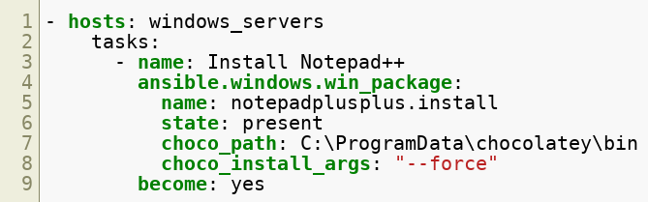
Plugins
Plugins are used to extend Ansible and execute on the Ansible controller before the play starts.
Let's break down this playbook and explain each part in more detail.
Copyright © 2025 by Elephant Scale, All Rights Reserved

Slide 83
Task: module and plugin
The ansible.windows.win_package module is used to manage software packages on Windows hosts.
The win_chocolatey plugin is used to install packages using the Chocolatey package manager.
In this example, the notepadplusplus.install package is installed using Chocolatey.
The choco_path parameter is used to specify the path to the Chocolatey binary on the target host.
The choco_install_args parameter is used to pass additional arguments to the Chocolatey install command.
Copyright © 2025 by Elephant Scale, All Rights Reserved

Slide 84
Plugins: Types
Action plugins
used to extend the functionality of modules
Callback plugins
used to extend the functionality of the output
Connection plugins
used to extend the functionality of the connection
Filter plugins
used to extend the functionality of the filters
Inventory plugins
used to extend the functionality of the inventory
Copyright © 2025 by Elephant Scale, All Rights Reserved

Slide 85
Plugins: Types
Lookup plugins
used to extend the functionality of the lookup
Module plugins
used to extend the functionality of the modules
Strategy plugins
used to extend the functionality of the strategy
Test plugins
used to extend the functionality of the tests
Terminal plugins
used to extend the functionality of the terminal
Var plugins
used to extend the functionality of the variables
Cache plugins
used to extend the functionality of the cache
Copyright © 2025 by Elephant Scale, All Rights Reserved

Slide 86
Roles
Lets Discuss Modules Back to our playbook LAB Conditionals Loops Handlers Blocks Templates Ansible Vault Plugins Roles
Copyright © 2025 by Elephant Scale, All Rights Reserved

Slide 87
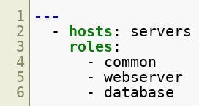
Roles
Roles are a way to organize playbooks and make them more modular and reusable. Also, roles encapsulate functionality for specific services or applications.
The roles keyword is used to specify the roles that should be applied to the target hosts.
Let's break down this playbook and explain each part in more detail.
Copyright © 2025 by Elephant Scale, All Rights Reserved

Slide 88
Role: Define
A role is a collection of tasks, files, templates, and variables that are organized in a specific directory structure.
The roles keyword in the playbook specifies the role or roles to be applied to the hosts.
In this example, the webserver role is applied to the web servers in the webservers group.
Copyright © 2025 by Elephant Scale, All Rights Reserved

Slide 89
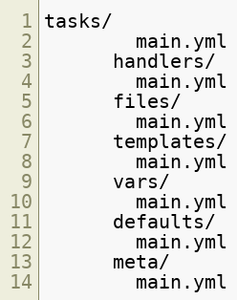
Role: Directory Structure
In order to create a role, you need to create a directory structure that contains the following directories:
Tasks: Define the actions to execute
Handlers: Manage service restarts or configuration reloads
Templates: Create dynamic configuration files using Jinja2
Files: Store static files required by the role
Vars: Define role-specific variables
Defaults: Set default variable values that can be overridden
Copyright © 2025 by Elephant Scale, All Rights Reserved

Slide 90
Benefits of Using Roles
Enhance code reusability and maintainability
Simplify playbook structure
Enable collaboration and sharing via Ansible Galaxy
Copyright © 2025 by Elephant Scale, All Rights Reserved

Slide 91
LAB
Copyright © 2025 by Elephant Scale, All Rights Reserved

