Slide 1
Defensive programming
Copyright © 2021 by Elephant Scale, All Rights Reserved

Slide 2
What is it
An approach to improve software and source code, in terms of:
general quality, reducing bugs
Making it comprehensible, or understandable
Predictable behavior against unexpected inputs or user actions
Copyright © 2021 by Elephant Scale, All Rights Reserved

Slide 3
Rules of defensive programming
Rule 1: Never assume anything
Rule 2: Use standards
Rule 3: Code simple
Copyright © 2021 by Elephant Scale, All Rights Reserved

Slide 4
Rule 1: Never Assume Anything
Rule 1: Never Assume Anything Rule 2: Use Standards Rule 3: Code Simple Error handling in Java EE Type annotation Checker Framework Application-layer security Transport-layer security Message-layer security Secure connection with SSL
Copyright © 2021 by Elephant Scale, All Rights Reserved

Slide 5
Input Validation
User's input and actions are not trustable
All input and actions must be validated
Handle exceptions:
Terminate
Retry
Warning
Copyright © 2021 by Elephant Scale, All Rights Reserved

Slide 6
Example
Imagine a bank transaction and answer these questions:
What kind of variable you need? int, float, string, etc
Is it going to be a large or small number?
Can it be a negative number?
and other questions
Copyright © 2021 by Elephant Scale, All Rights Reserved

Slide 7
Testing Strategy
Don't limit you testing process to "it works"
Test error cases
Test for the illogical input
Strange ASCII character
Rolling head
Ask others to test the application if possible
Copyright © 2021 by Elephant Scale, All Rights Reserved

Slide 8
Order of Precedence
Is the set order that statements are resolved
Sometimes it's difficult to see errors in the order of precedence
if(InVar=getc(input)!=EOF)
When in doubt, use proper parenthesis
Copyright © 2021 by Elephant Scale, All Rights Reserved

Slide 9
Size of Variables
Some primitive data types on different OSs or hardware platforms have different values
You should consider the siza of variables when coding
Copyright © 2021 by Elephant Scale, All Rights Reserved

Slide 10
Rule 2: Use Standards
Rule 1: Never Assume Anything Rule 2: Use Standards Rule 3: Code Simple Error handling in Java EE Type annotation Checker Framework Application-layer security Transport-layer security Message-layer security Secure connection with SSL
Copyright © 2021 by Elephant Scale, All Rights Reserved

Slide 11
Coding Standard
Makes code coherent and easy to understand
Debugging gets easier
Wide range of topics
Variable naming
Indentation
Position of brackets
Content of header files
Function declaration
And many more
Copyright © 2021 by Elephant Scale, All Rights Reserved

Slide 12
Variable Naming: Hungarian Notation
Is a Naming standard
Starts with one or more lower-case letters that are mnemonics for the type or purpose of the variable:
iAge: integer type age
szName: zero-terminated name string
Copyright © 2021 by Elephant Scale, All Rights Reserved

Slide 13
Numbers
Do not use constant values in the code
Difficult to understand
Difficult to maintain
example: int Fr = (4.3/1.25)*N;
Use constant variable instead
cons int PI = 3.1415
int Surface = PI * r * r;
Copyright © 2021 by Elephant Scale, All Rights Reserved

Slide 14
Rule 3: Code Simple
Rule 1: Never Assume Anything Rule 2: Use Standards Rule 3: Code Simple Error handling in Java EE Type annotation Checker Framework Application-layer security Transport-layer security Message-layer security Secure connection with SSL
Copyright © 2021 by Elephant Scale, All Rights Reserved

Slide 15
Contract
See functions as a contract
Given input, the execute a specific task
They should not able to do anything else rather than the specified task
Exception handling
Copyright © 2021 by Elephant Scale, All Rights Reserved

Slide 16
Refactoring
Is a technique for restructuring the code, changing its internal structure whithout any change in external behavior
Does not fix the bugs
Can be used for battling feature creep:
Added features during coding
Usually cause problems
Keeps your application simple
Copyright © 2021 by Elephant Scale, All Rights Reserved

Slide 17
Third-Party Libraries
Code reuse a safe choice
More stable and secure than what you make in a limited time
Copyright © 2021 by Elephant Scale, All Rights Reserved

Slide 18
Error handling in Java EE
Rule 1: Never Assume Anything Rule 2: Use Standards Rule 3: Code Simple Error handling in Java EE Type annotation Checker Framework Application-layer security Transport-layer security Message-layer security Secure connection with SSL
Copyright © 2021 by Elephant Scale, All Rights Reserved

Slide 19
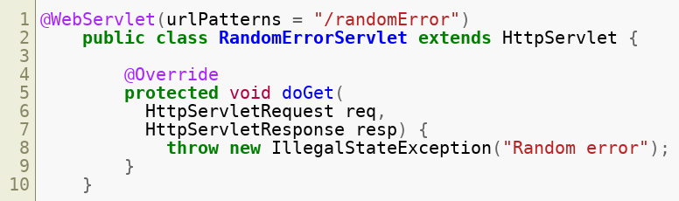
A servlet structure
Copyright © 2021 by Elephant Scale, All Rights Reserved

Slide 20
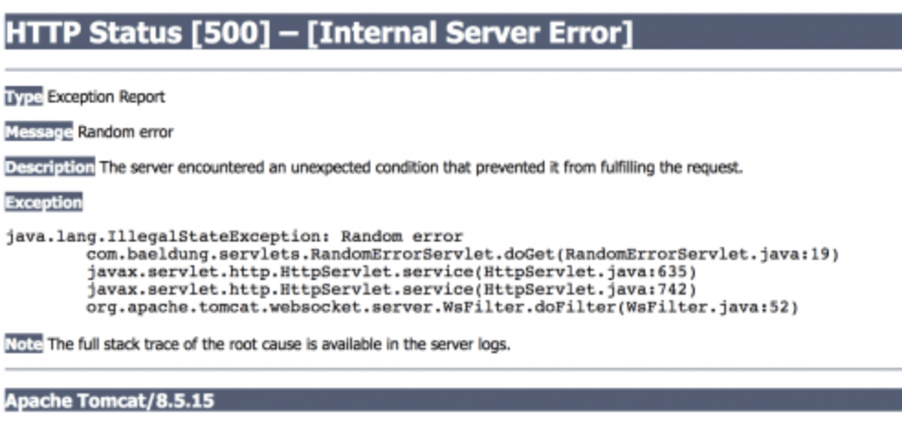
Default Error Handling
Let us deploy our servlet here
http://localhost:8080/javax-servlets
Now, let us look at the error here
http://localhost:8080/javax-servlets/randomError
What happens? We see the generic error
Copyright © 2021 by Elephant Scale, All Rights Reserved

Slide 21
Custom Error Handling
Custom error handling
Goes into web.xml file descriptor
Status code error handling
map HTTP error codes (client and server) to
a static HTML error page or
an error handling servlet
Exception type error handling
map exception types to
static HTML error pages or
an error handling servlet
Copyright © 2021 by Elephant Scale, All Rights Reserved

Slide 22
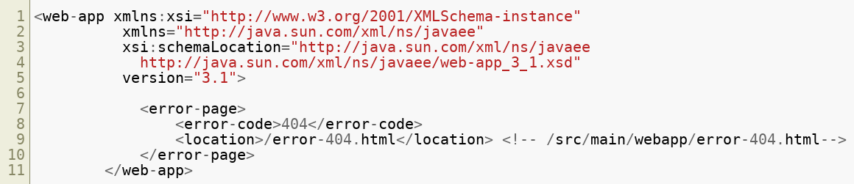
With an HTML Page
Copyright © 2021 by Elephant Scale, All Rights Reserved

Slide 23
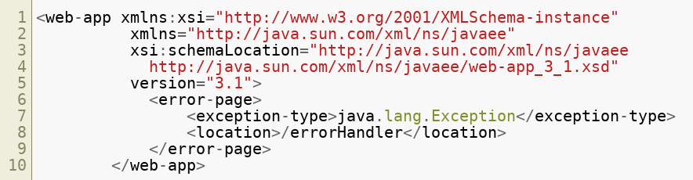
With a Servlet
Handling policy for java.lang.Exception
Copyright © 2021 by Elephant Scale, All Rights Reserved

Slide 24
Type annotation
Rule 1: Never Assume Anything Rule 2: Use Standards Rule 3: Code Simple Error handling in Java EE Type annotation Checker Framework Application-layer security Transport-layer security Message-layer security Secure connection with SSL
Copyright © 2021 by Elephant Scale, All Rights Reserved

Slide 25
Type Annotations
Annotations that can be placed anywhere you use a type
the new operator
type casts
implements clauses
throws clauses
Benefits
Improved analysis of Java
Stronger type checking
Copyright © 2021 by Elephant Scale, All Rights Reserved

Slide 26

Simple Type Annotations Examples
With constructors
For exceptions
Copyright © 2021 by Elephant Scale, All Rights Reserved

Slide 27
Checker Framework
Rule 1: Never Assume Anything Rule 2: Use Standards Rule 3: Code Simple Error handling in Java EE Type annotation Checker Framework Application-layer security Transport-layer security Message-layer security Secure connection with SSL
Copyright © 2021 by Elephant Scale, All Rights Reserved

Slide 28
Benefits of the Checker Framework
Helps get rid of
null pointer exceptions
unintended side effects
SQL injections
concurrency errors
mistaken equality tests
other run-time errors
Copyright © 2021 by Elephant Scale, All Rights Reserved

Slide 29
Installation
Download the Checker Framework distribution
Unzip it to create a checker-framework directory.
(Optional) Configure
IDE
build system
command shell to include the Checker Framework on the classpath
Copyright © 2021 by Elephant Scale, All Rights Reserved

Slide 30
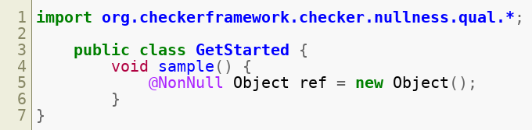
Using The Checker Framework
Copyright © 2021 by Elephant Scale, All Rights Reserved

Slide 31

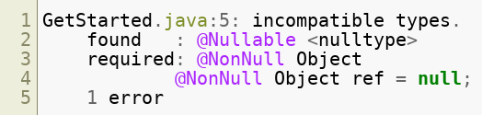
Introduce an Error
Get an error message
Copyright © 2021 by Elephant Scale, All Rights Reserved

Slide 32
Application-layer security
Rule 1: Never Assume Anything Rule 2: Use Standards Rule 3: Code Simple Error handling in Java EE Type annotation Checker Framework Application-layer security Transport-layer security Message-layer security Secure connection with SSL
Copyright © 2021 by Elephant Scale, All Rights Reserved

Slide 33
The application layer
A layer in the Open Systems Interconnection (OSI) seven-layer model
And in the TCP/IP protocol suite
Consists of protocols that focus on process-to-process communication
across an IP network
Provides a firm communication interface and end-user services
Security is provided through app-to-app negotiations
Copyright © 2021 by Elephant Scale, All Rights Reserved

Slide 34
Transport-layer security
Rule 1: Never Assume Anything Rule 2: Use Standards Rule 3: Code Simple Error handling in Java EE Type annotation Checker Framework Application-layer security Transport-layer security Message-layer security Secure connection with SSL
Copyright © 2021 by Elephant Scale, All Rights Reserved

Slide 35
Transport-layer Security
Cryptographic protocols
Designed to provide communications security
Over a computer network
Copyright © 2021 by Elephant Scale, All Rights Reserved

Slide 36
Where Transport-layer Security is Used
Web browsing
Email
Instant messaging
Voice over IP (VoIP)
Websites use TLS
To secure all communications
servers
web browsers
Copyright © 2021 by Elephant Scale, All Rights Reserved

Slide 37
Where Transport-layer Security is Used
Aims
Privacy
Data integrity
Properties
The connection is private (or secure)
Uses symmetric cryptography
to encrypt the data transmitted
The identity of the communicating parties can be authenticated
using public-key cryptography
The connection is reliable
Each message transmitted includes a message integrity check
Uses a message authentication code
Prevents undetected loss or alteration of the data
Copyright © 2021 by Elephant Scale, All Rights Reserved

Slide 38
Message-layer security
Rule 1: Never Assume Anything Rule 2: Use Standards Rule 3: Code Simple Error handling in Java EE Type annotation Checker Framework Application-layer security Transport-layer security Message-layer security Secure connection with SSL
Copyright © 2021 by Elephant Scale, All Rights Reserved

Slide 39
Securing the message
More flexible than TLS
parts of the message can be signed or encrypted
rather than the entire message
intermediaries are able to view parts of the message intended for them
Factor to Consider | Transport Layer | Message Layer
Your application interacts directly with the Web service | Transport layer HTTPS provides full message protection | Message layer message protection usually requires more work and overhead than transport layer
Copyright © 2021 by Elephant Scale, All Rights Reserved

Slide 40
Encryption
The encryption mechanism is a digital coding system to preserve confidentiality and integrity of data
Encoding plaintext data into a protected and unreadable format
Cipher: A standardized algorithm to transform original plaintext data into encrypted data ( ciphertext ) and vice versa
The cipher is publicly known
Encryption Key is used during the transformation
Usually secret and shared among authorized parties
Decryption is the revers function
Copyright © 2021 by Elephant Scale, All Rights Reserved

Slide 41
Encryption, cont'd
Protection against:
Traffic eavesdropping
Malicious intermediary
Insufficient authorization
Overlapping trust boundaries security threats
Two types of encryption:
Symmetric (same key to encrypt and decrypt)
Asymmetric (two keys,,one the inverse of the other)
Copyright © 2021 by Elephant Scale, All Rights Reserved

Slide 42
Symmetric Key Cryptography
Make use of a number of classical encryption techniques
Substitution
Each character in the text is replaced by another character of the same or different alphabet
Transposition
The order, but not the value, of the characters in the text is changed
Iteration of the same steps multiple times
Copyright © 2021 by Elephant Scale, All Rights Reserved

Slide 43
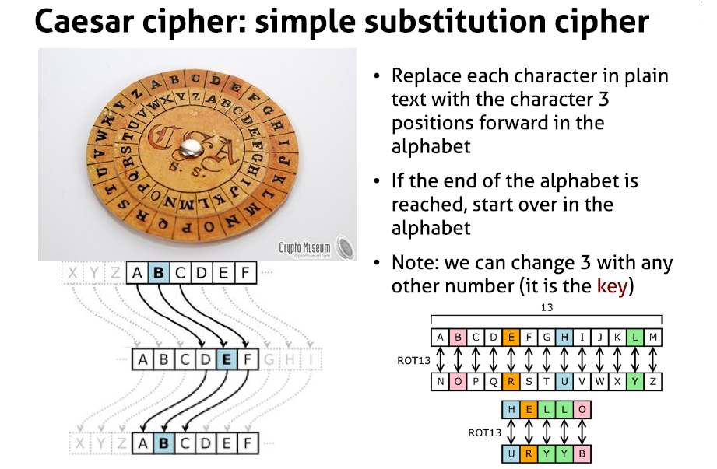
Example: An Old Technique
Copyright © 2021 by Elephant Scale, All Rights Reserved

Slide 44
Advantages Of Symmetric Cryptography
It is understandable and easy to use
It is efficient
Efficiency is a key consideration when messages are transmitted frequently and/or are lengthy
Can be used for many other applications (hash functions, pseudo-random number generators, digital signatures)
Can be easily combined
Copyright © 2021 by Elephant Scale, All Rights Reserved

Slide 45
Limitations
The users must share the same secret key
During transmission of the key, someone may intercept the key
The number of keys requires increases at a rapid rate as the number of users in the network increases
Because of these reasons, secret key management challenges are significant
A key distribution center (KDC) -a trusted third party- may be used for managing and distributing keys
Secret key cryptography cannot provide an assurance of authentication
Problem of non-repudiation
Copyright © 2021 by Elephant Scale, All Rights Reserved

Slide 46
Asymmetric Cryptography
A pair of private and public keys
Private key remains with the owner; public key is distributed
This solves the key distribution problem encountered in the use of secret keys
One may own more than one keys pairs
Knowledge of public key does not help in finding/deriving the related private key
Copyright © 2021 by Elephant Scale, All Rights Reserved

Slide 47
Asymmetric Cryptography, cont'd
Keys are related and complementary
Plaintext encrypted with a private key can be decrypted using the related public key, and vice versa
Public key encryption provides confidentiality, but does not offer integrity nor authenticity
This is the base for the digital signatures
Copyright © 2021 by Elephant Scale, All Rights Reserved

Slide 48
Asymmetric Encryption Cipher: RSA
Created by Rivest, Shamir, and Adelman, named RSA
Based on the notion that a product of two large prime numbers cannot be easily factored to determine the two prime numbers
That is, going from results (the product of prime numbers) to inputs (prime numbers) is a nearly impossible task
Although a public key is related to private key, it is nearly impossible to calculate the private key using the knowledge of its related public key
Copyright © 2021 by Elephant Scale, All Rights Reserved

Slide 49
RSA Principles
Consider blocks as large numbers
Example: 2048 bit long number ~617 decimal long nmber
Uses the modular arithmetic (residuals)
Example: 73 = 70 + 3 = 14 * 5 + 3 >> 73 mod 5 = 3
Encryption and decryption are based on the concept of modular inverses:
X is the inverse of Y modulo Z if X*Y=1 modulo Z
Then (m^x)^y = (m^y)^x = m^1 = m
Copyright © 2021 by Elephant Scale, All Rights Reserved

Slide 50
Advantages of Public Key Cryptography
There is no need to communicate private key
Related public key is widely distributed (not secret)
A sender who private-key encrypts the message or any part thereof can be authenticated because no one else is supposed to have the sender's private key
External parties can confidentially communicate with an owner of the key pair by sending a message encrypted using the owner's public key
A brute-force attack on a message is time consuming and is nearly impossible
Copyright © 2021 by Elephant Scale, All Rights Reserved

Slide 51
Limitations of Public Key Cryptography
The use of PKC takes a significant amount of processing power, it is computationally intensive
Therefore, it negatively affects efficiency of communication
It is used selectively
An entire message may not be encrypted using PKC
Published keys may be altered by someone
Additional measures to ensure that a valid public key of the owner is obtained before its use (PKI certificates)
Copyright © 2021 by Elephant Scale, All Rights Reserved

Slide 52
Secure connection with SSL
Rule 1: Never Assume Anything Rule 2: Use Standards Rule 3: Code Simple Error handling in Java EE Type annotation Checker Framework Application-layer security Transport-layer security Message-layer security Secure connection with SSL
Copyright © 2021 by Elephant Scale, All Rights Reserved

Slide 53
What Is It?
A protocol by Netscape
On Layer 4 (TCP) of OSI model
Copyright © 2021 by Elephant Scale, All Rights Reserved

Slide 54
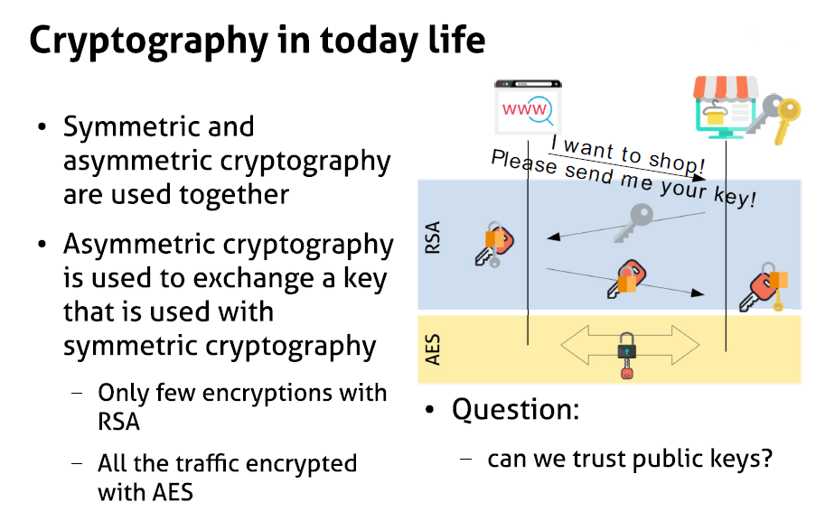
Cryptography Today
Copyright © 2021 by Elephant Scale, All Rights Reserved

Slide 55
What Is SSL
Is a standard security technology for establishing an encrypted link between a server and a client typically a web server (website) and a browser, or a mail server and a mail client (e.g., Outlook).
Copyright © 2021 by Elephant Scale, All Rights Reserved

Slide 56
What Does It?
Allows sensitive information like credit card information to be transmitted securely
Determines variables of the encryption for both the link and the data being transmitted
All browsers are able to interact with secured web servers using the SSL protocol
Needs SSL certificates
Copyright © 2021 by Elephant Scale, All Rights Reserved

Slide 57
How?
1 - Browser connects to a web server (website) secured with SSL (https). Browser requests that the server identify itself.
2 - Server sends a copy of its SSL Certificate, including the server’s public key.
3 - Browser checks the certificate root against a list of trusted CAs
Copyright © 2021 by Elephant Scale, All Rights Reserved

Slide 58
How? cont'd
Then it creates, encrypts, and sends back a symmetric session key using the server’s public key.
4 - Server decrypts the symmetric session key using its private key and sends back an acknowledgement encrypted with the session key to start the encrypted session.
5 - Server and Browser now encrypt all transmitted data with the session key.
Copyright © 2021 by Elephant Scale, All Rights Reserved

Slide 59
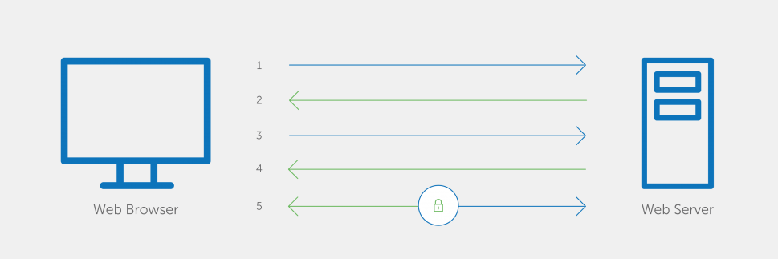
Flow Picture
Copyright © 2021 by Elephant Scale, All Rights Reserved

Slide 60
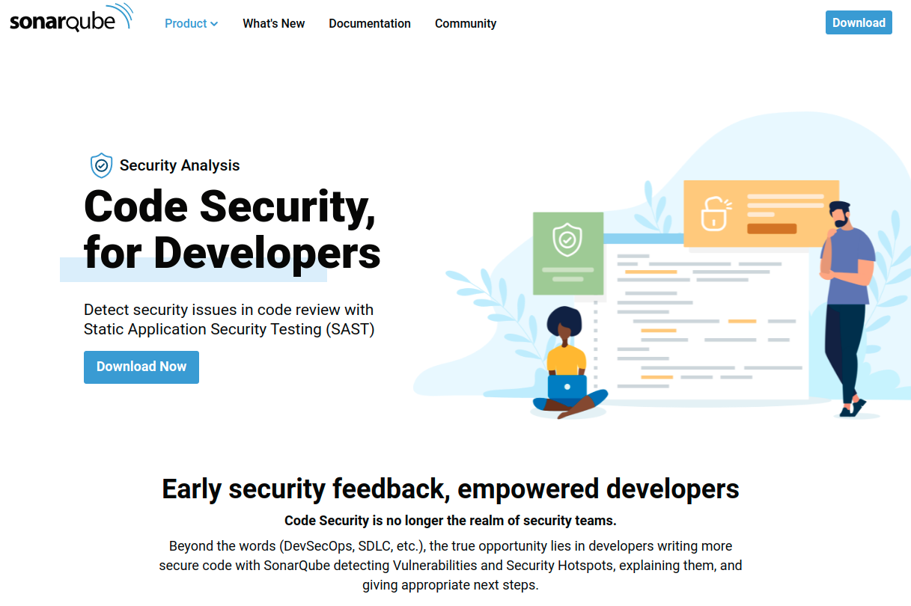
Static code scanners
Sonar Qube
https://www.sonarqube.org/features/security/
Copyright © 2021 by Elephant Scale, All Rights Reserved

Slide 61
Labs
SonarQube lab for static code analysis
https://github.com/elephantscale/secure-coding-labs/tree/main/sonarqube
Copyright © 2021 by Elephant Scale, All Rights Reserved

Slide 62
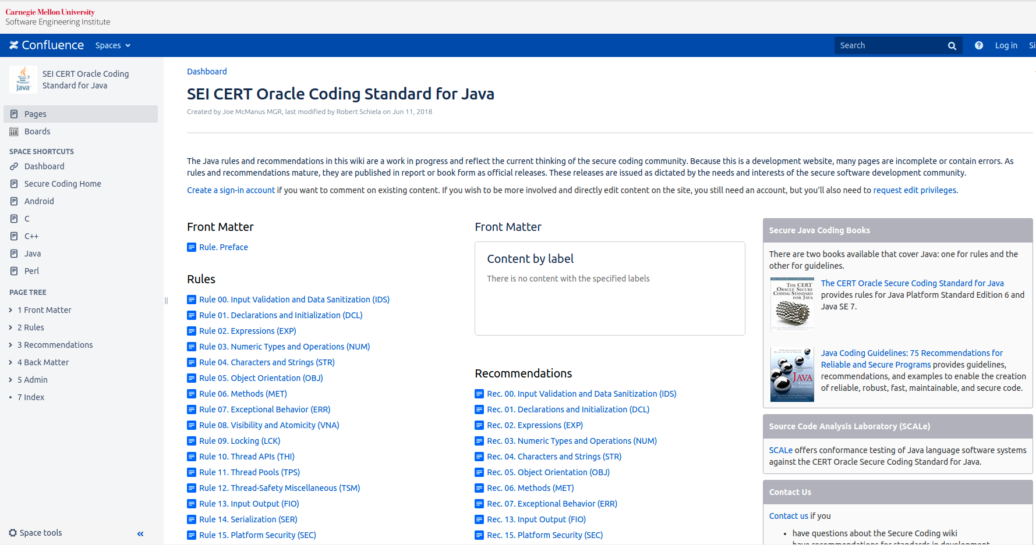
Labs
Labs for this section come from this link
https://wiki.sei.cmu.edu/confluence/display/java/SEI+CERT+Oracle+Coding+Standard+for+Java
Copyright © 2021 by Elephant Scale, All Rights Reserved

