Slide 1
REST Endpoint Security (OAuth2)
OAuth2
Java Implementations
Copyright © 2021 by Elephant Scale, All Rights Reserved

Slide 2
Lesson Objectives
Understand the needs that OAuth2 addresses
Be familiar with OAuth2 capabilities and advantages
Gain an understanding of a basic OAuth2 Implementation
Copyright © 2021 by Elephant Scale, All Rights Reserved

Slide 3
OAuth2
OAuth2 Java Implementations
Copyright © 2021 by Elephant Scale, All Rights Reserved

Slide 4
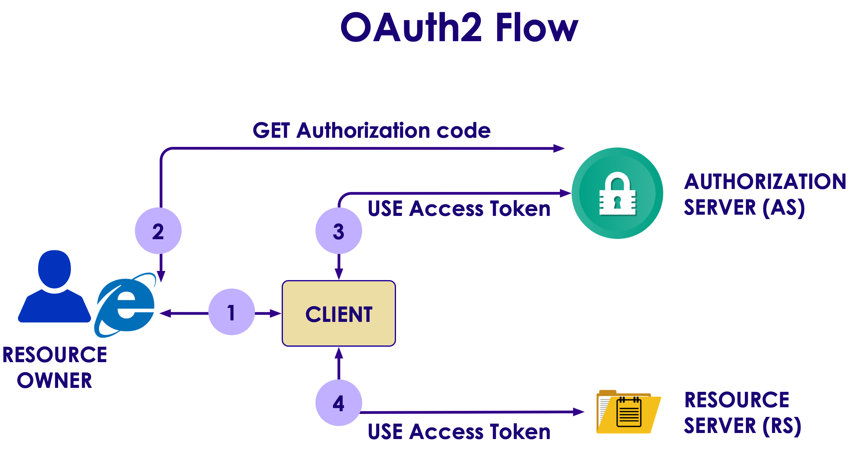
What Is It?
Copyright © 2021 by Elephant Scale, All Rights Reserved

Slide 5
Why OAuth?
Third party applications can access user's resources without knowing their credentials
Limits access to HTTP services
Softwares and packages don't store user's credentials anymore (only tokens)
Based on TLS/SSL
No backward compatibility
Easily revokable
Copyright © 2021 by Elephant Scale, All Rights Reserved

Slide 6
A Little of History
OAuth 1.0
Core specification - 2007
OAuth 1.0a
A security issue was fixed - 2009
OAuth 2.0
Standardized - 2012
More security and simplicity
Copyright © 2021 by Elephant Scale, All Rights Reserved

Slide 7
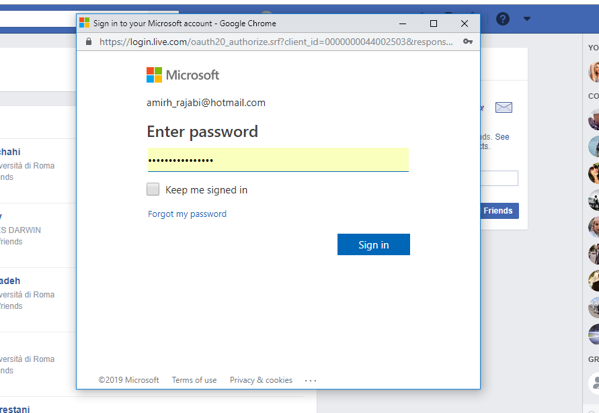
A Good Use Case
In some websites you can invite your friends by importing your contant list
Look at the address bar:
Copyright © 2021 by Elephant Scale, All Rights Reserved

Slide 8
Roles
Resource owner
Resource server
Client
Authorization server
Copyright © 2021 by Elephant Scale, All Rights Reserved

Slide 9
Grant Types
Authorization code (web applications)
Implicit (mobile and browser-based applications)
Resource owner password credentials (user + password)
Client credentials (application)
Device Code (electronic device)
Copyright © 2021 by Elephant Scale, All Rights Reserved

Slide 10
Authorization Code
This grant type is used by confidential and public clients
Exchanges an authorization code for an access token
User returns to the client through redirect URL
Then application gets the authorization code from URL
Then use it to request an access token
Copyright © 2021 by Elephant Scale, All Rights Reserved

Slide 11
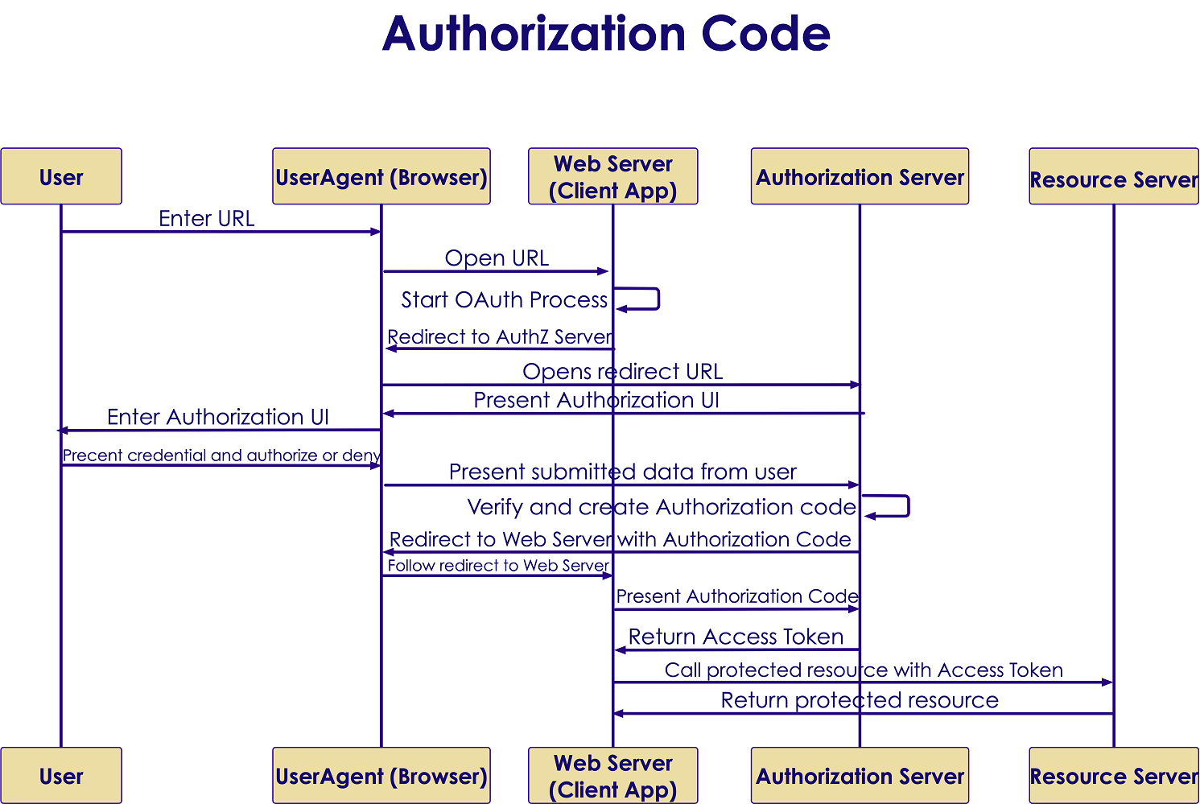
Authorization Code In A Picture
Copyright © 2021 by Elephant Scale, All Rights Reserved

Slide 12
Implicit
Used by public clients
Access token is returned without an extra authorization code exchange
Some servers ban this flow
It is not recommended
Copyright © 2021 by Elephant Scale, All Rights Reserved

Slide 13
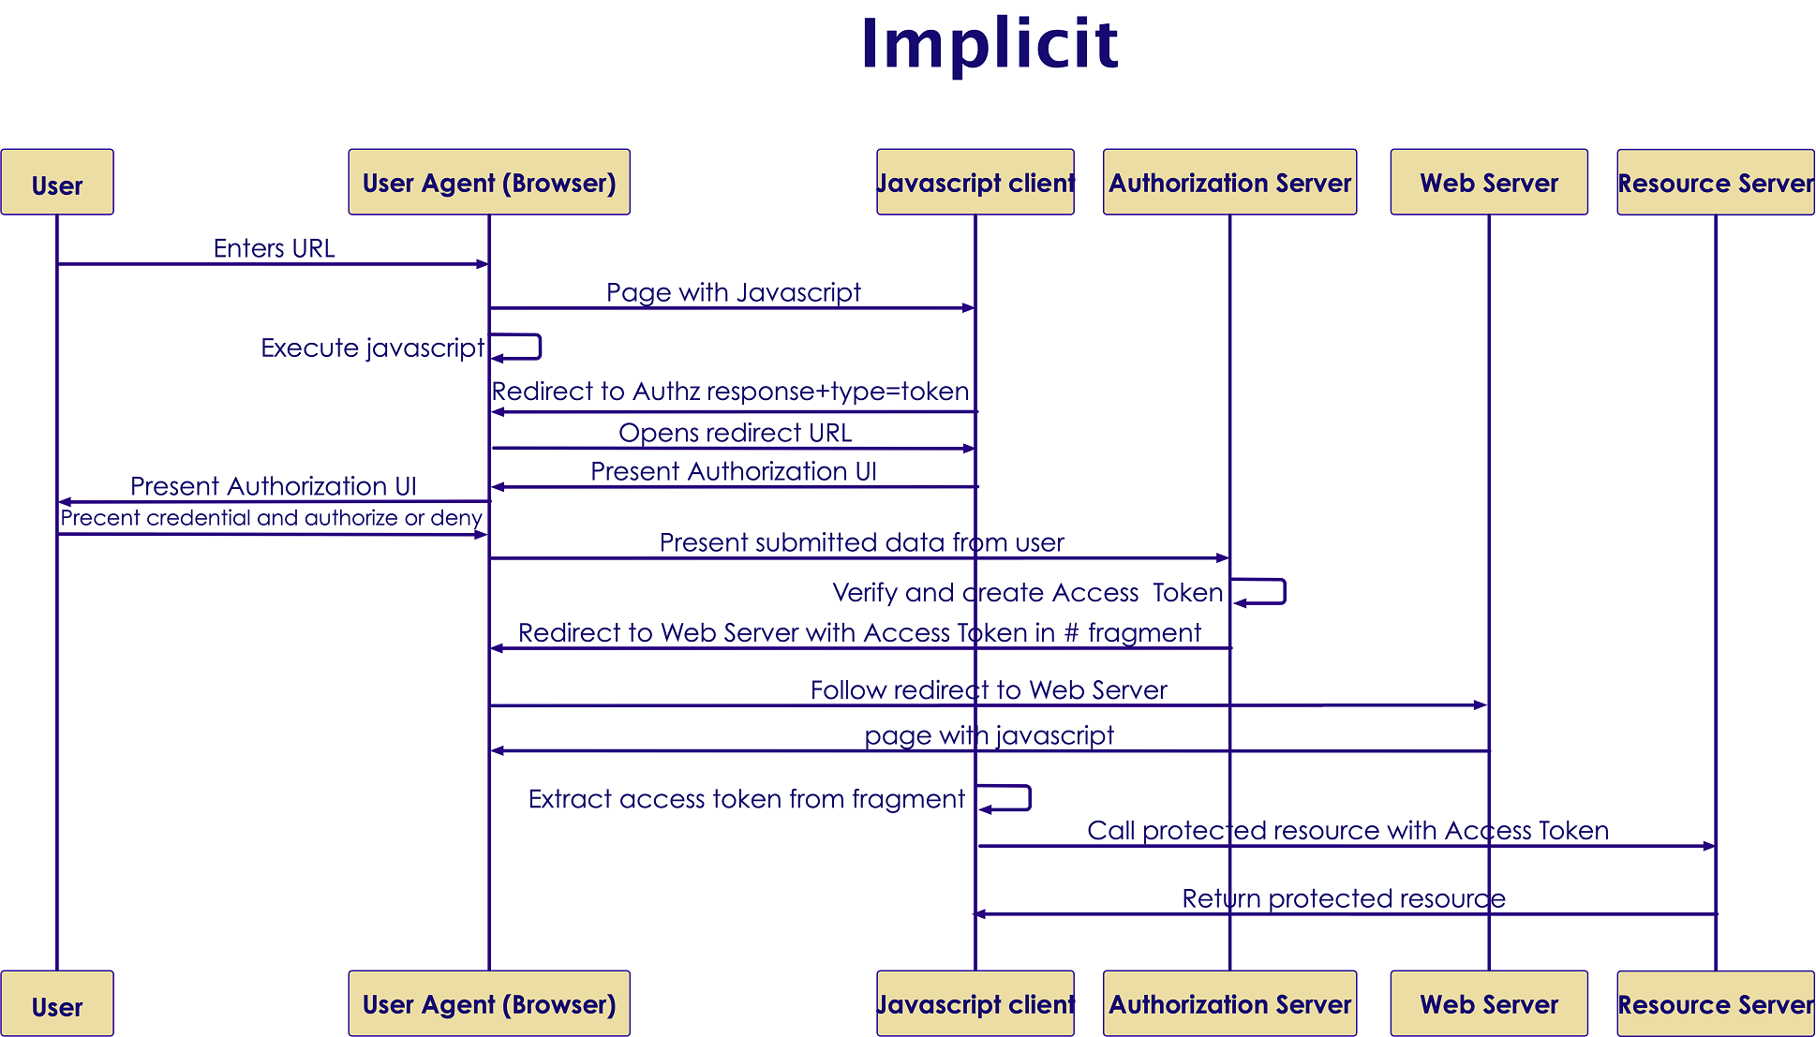
Implicit In A Picture
Copyright © 2021 by Elephant Scale, All Rights Reserved

Slide 14
Resource Owner Password Credentials
First-party clients use this type to exchange user's credential for a token
Asks the user for their credential
Don't let third party clients to use it
Username and password are exchanged directly for a token
Copyright © 2021 by Elephant Scale, All Rights Reserved

Slide 15
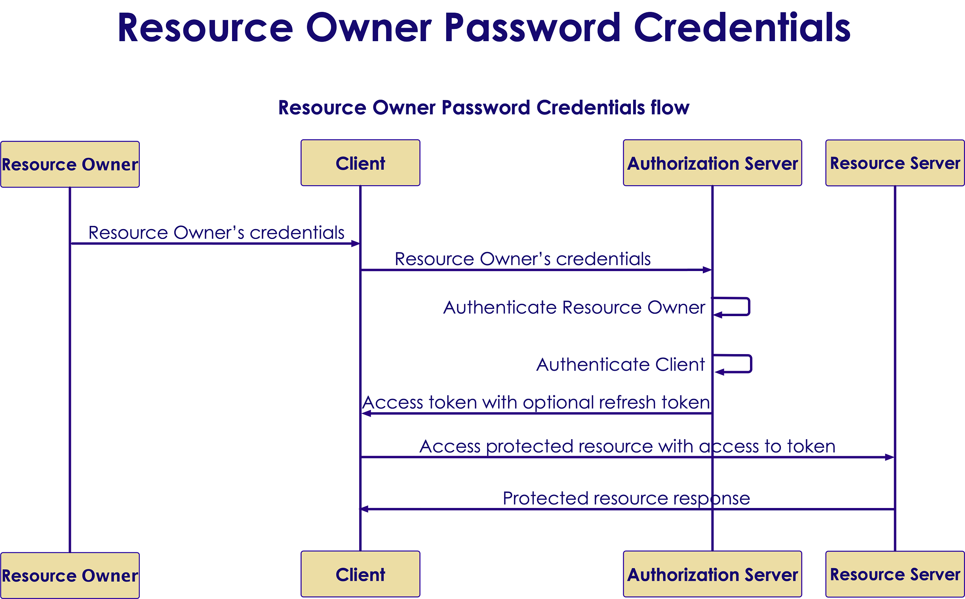
Password Credentials In A Picture
Copyright © 2021 by Elephant Scale, All Rights Reserved

Slide 16
Client credentials
Is used by clients to obtain a token out of the user's context
To access resources about themselves instead of accessing a user's resource
Copyright © 2021 by Elephant Scale, All Rights Reserved

Slide 17
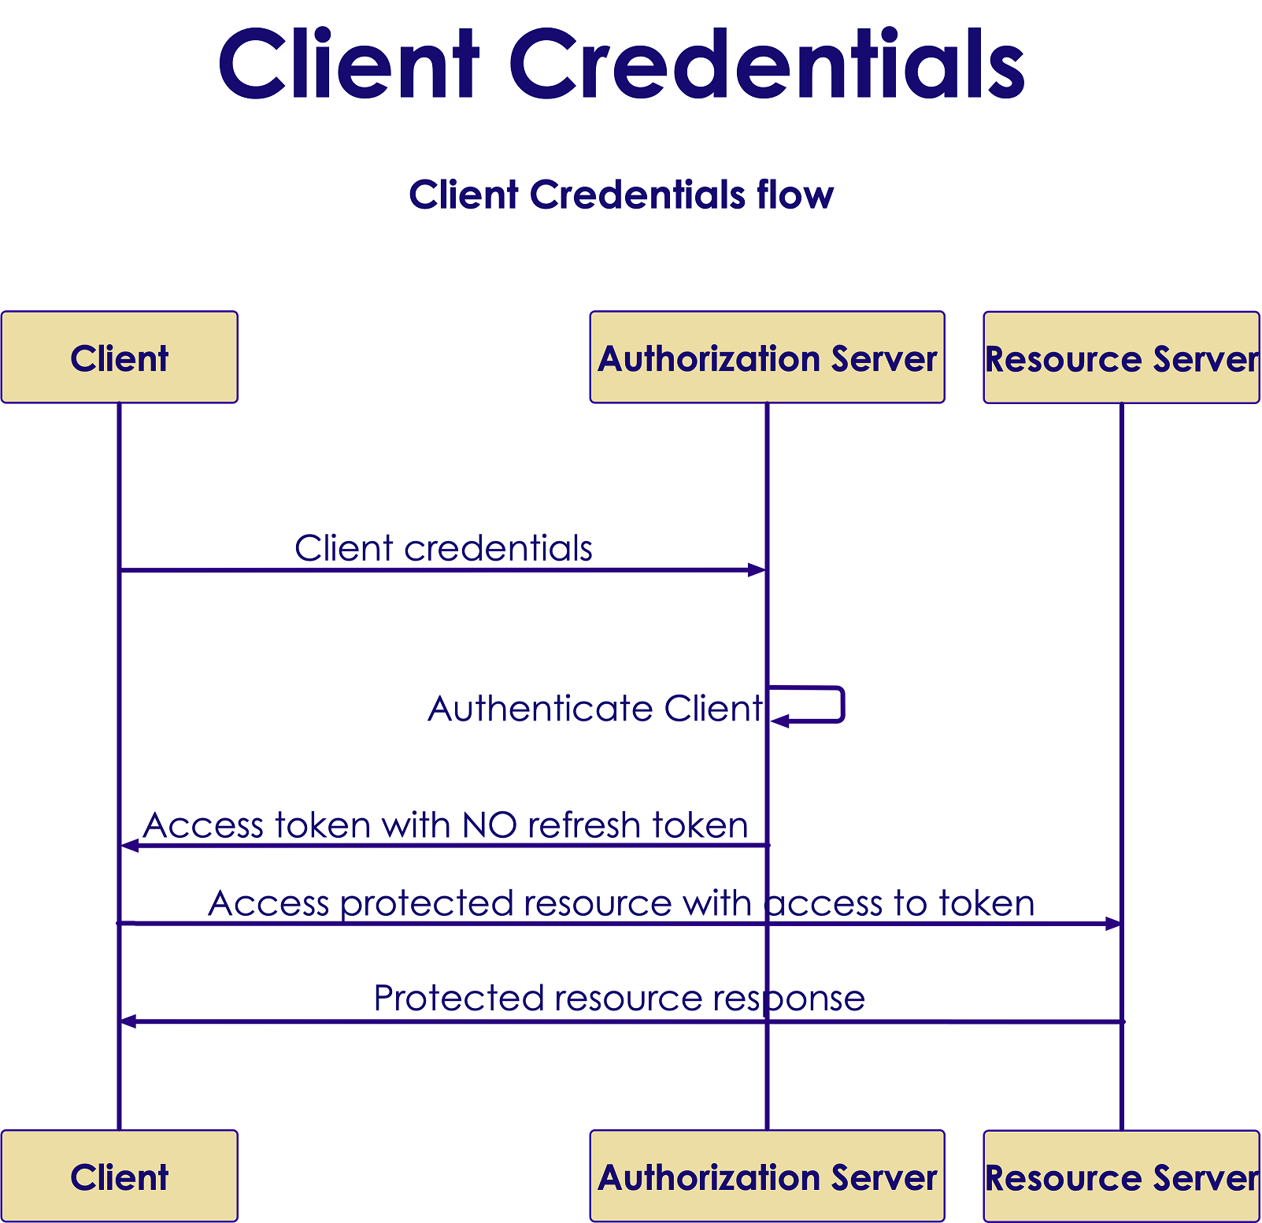
Client credentials In A Picture
Copyright © 2021 by Elephant Scale, All Rights Reserved

Slide 18
Device Code
Is used by browserless or input-constrained devices
To exchange a previously obtained device code for an access token
Value: urn:ietf:params:oauth:grant-type:device_code
Copyright © 2021 by Elephant Scale, All Rights Reserved

Slide 19
Tokens
Types according to properties
Bearer
Large random
Uses SSL to protect
It is stored as a hash on the server
Mac (Not Recommended)
Uses a nonce to prevent replay
Does not use SSL
OAuth 1.0 only supported
Types according the life cycle
Access token
Short
Refresh token
Long
Copyright © 2021 by Elephant Scale, All Rights Reserved

Slide 20
Bearer Token
Predominant type of access token
An opaque string, without any meaning
Some servers issue short string and some issue JSON Web Tokens
Copyright © 2021 by Elephant Scale, All Rights Reserved

Slide 21
Pros and Cons of OAuth2
Pros
Enables integration of third party applications to websites
Enables granting limited access either scope or duration
User does not have to enter password on third party site
Cons
Complexity in development of authorization server
Compatibility issues
Copyright © 2021 by Elephant Scale, All Rights Reserved

Slide 22
Java Implementations
OAuth2 Java Implementations
Copyright © 2021 by Elephant Scale, All Rights Reserved

Slide 23
Some Java Implementations
Jersey
Apache oltu
Spring security (Popular option)
Copyright © 2021 by Elephant Scale, All Rights Reserved

Slide 24
Jersey
It is an Open source RESTful web services framework
Supports and extends JAX-RS API and extends
Integrates with the Java EE standard security
@RolesAllowed
@PermitAll
@DenyAll
Supports entity filtering
@EntityFiltering
Only supports OAuth2 at client side
Copyright © 2021 by Elephant Scale, All Rights Reserved

Slide 25
Goals of Jersey Project
Track the JAX-RS API and provide regular releases of production quality Reference Implementations that ships with GlassFish
Provide APIs to extend Jersey & Build a community of users and developers; and finally
Make it easy to build RESTful Web services utilising Java and the Java Virtual Machine
Copyright © 2021 by Elephant Scale, All Rights Reserved

Slide 26
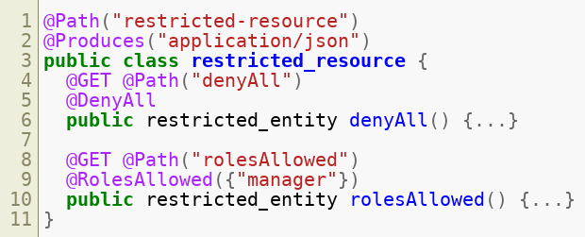
Java EE security integration
Copyright © 2021 by Elephant Scale, All Rights Reserved

Slide 27
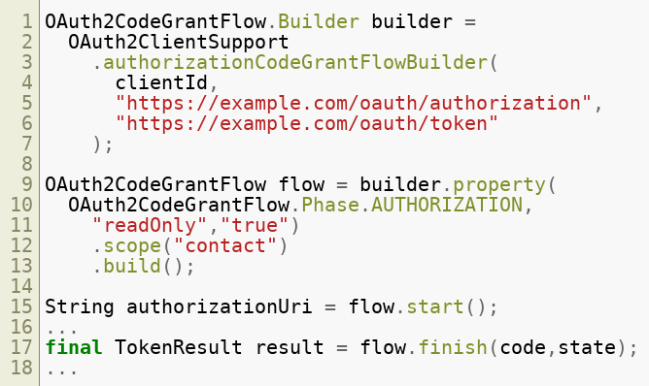
Client support
Copyright © 2021 by Elephant Scale, All Rights Reserved

Slide 28
Apache Oltu
Apache OAuth protocol implementation
Also covers other implementations
JSON Web Token (JWT)
JSON Web Signature (JWS)
OpenID connect
Supports OAuth2 features completely
Authorization server
Resource server
Client
Provides predefined OAuth2 client types
Github , Facebook , Google , etc
Copyright © 2021 by Elephant Scale, All Rights Reserved

Slide 29
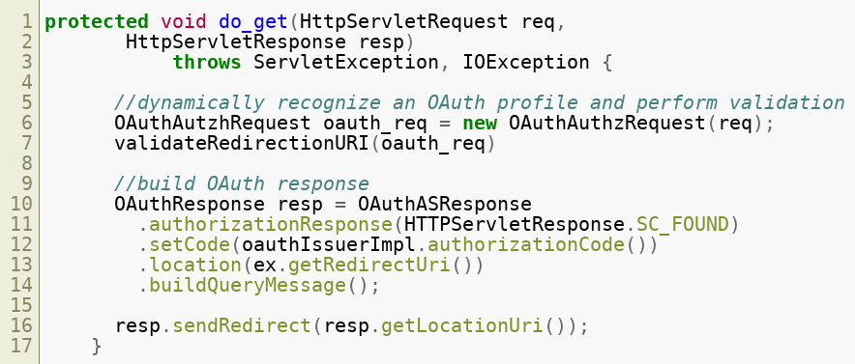
Authorization endpoint
Copyright © 2021 by Elephant Scale, All Rights Reserved

Slide 30
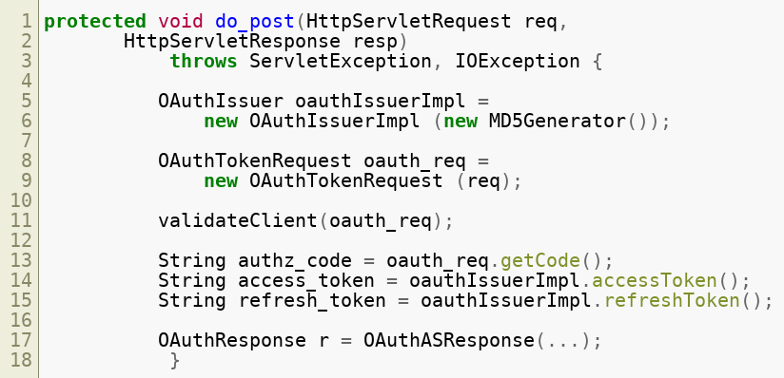
Token endpoint
Copyright © 2021 by Elephant Scale, All Rights Reserved

Slide 31
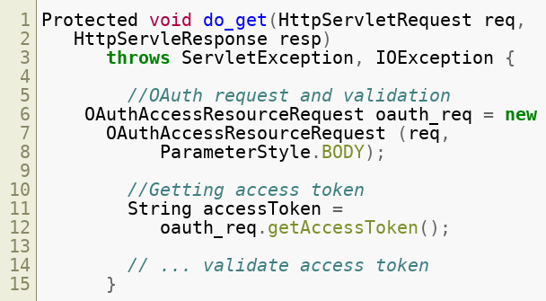
Protecting resources
Copyright © 2021 by Elephant Scale, All Rights Reserved

Slide 32
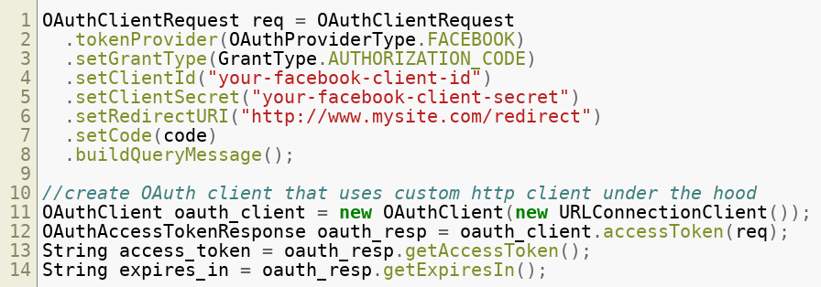
OAuth2 client
Copyright © 2021 by Elephant Scale, All Rights Reserved

Slide 33
Spring security OAuth
Supports OAuth (1a) and OAuth2
Implements 4 types of authorization grants
Supports all OAuth2 features:
Authorization server
Resources server
Client
Good integration with JAX-RS and Spring MVC
Configuration using annotation support
Integrates with the Spring platform
Copyright © 2021 by Elephant Scale, All Rights Reserved

Slide 34
Authorization server
@EnableAuthorizationServer
For configuring OAuth2 authorization server
XML configuration related: <authorization-server/>
ClientDetailsServiceConfigurer
Defines the client details service
In-memory or JDBC implementation
AuthorizationServerTokenServices
Operations to manage OAuth2 tokens
Tokens in-memory, JDBC or JSON Web Token (JWT)
AuthorizationServerEndpointConfigurer
Supports grant types
Password types not supported
Copyright © 2021 by Elephant Scale, All Rights Reserved

Slide 35
Resource server
can be the same as Authorization server or in a separate application
Authentication filter for web protection
@EnableResourceServer
For configuring OAuth2 resource server
XML config <resource-server/> *Supports expresson-based access control
#oauth2.clientHasRole
#oauth2.clientHasAnyRole
#oauth2.denyClient
Copyright © 2021 by Elephant Scale, All Rights Reserved

Slide 36
Client
Storing the current request and context by creating filter
Manages:
redirection to OAuth
redirection from OAuth
@EnableOAuth2Client
To configure OAuth2 client
XML config related <client/>
OAuth2RestTemplate
Wrapper client object to access the resources
Copyright © 2021 by Elephant Scale, All Rights Reserved

Slide 37
Lab
You will start with an insecure Spring install
Then you will secure it
Follow this guide https://spring.io/guides/gs/securing-web/
Copyright © 2021 by Elephant Scale, All Rights Reserved

