Slide 1
System Lifecycles and SDLCs
Copyright © 2021 by Elephant Scale, All Rights Reserved

Slide 2
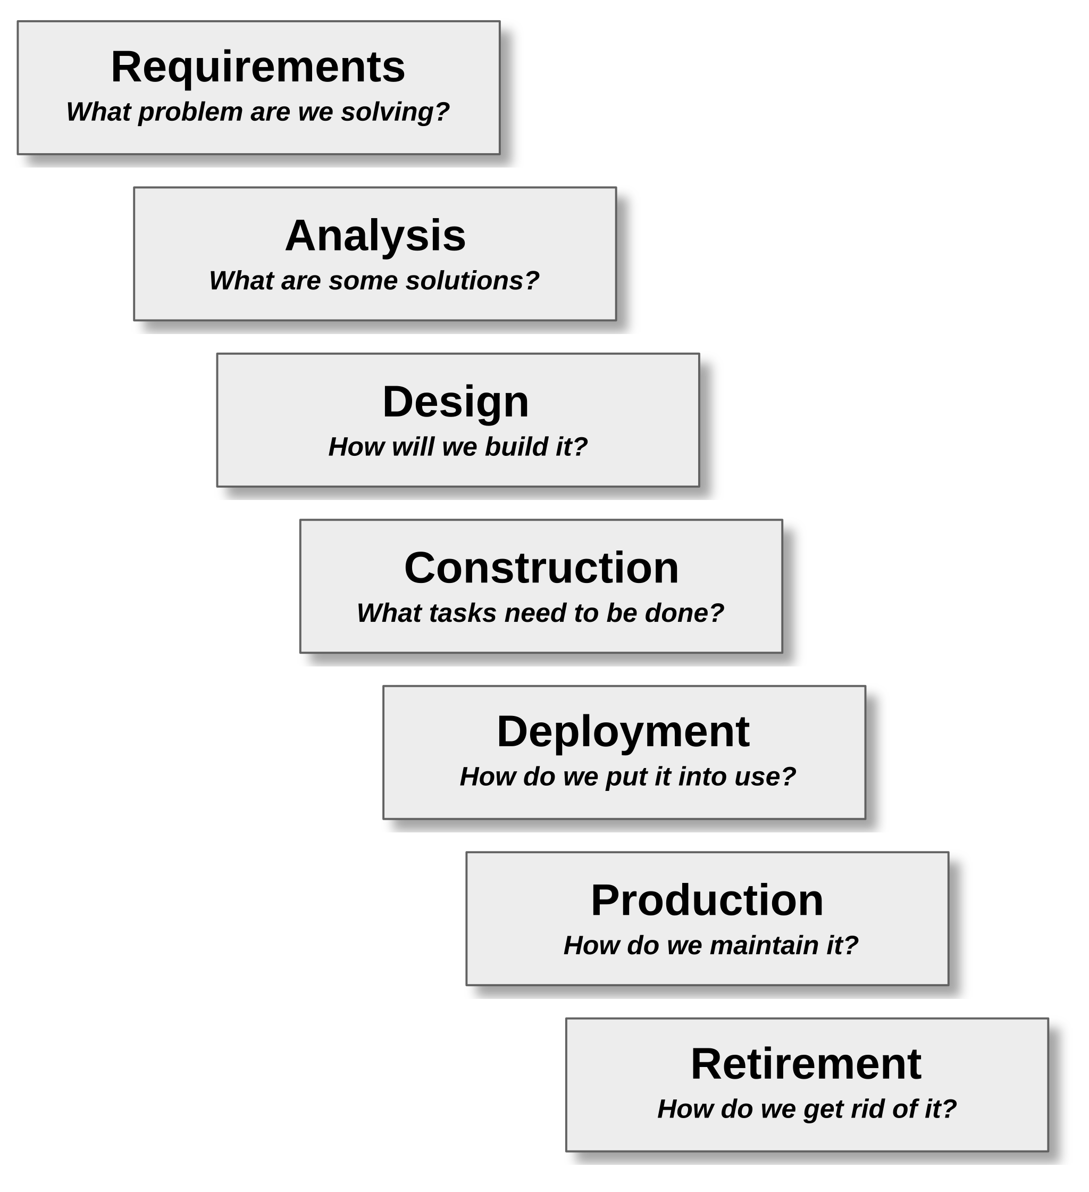
The Engineering Process
Used whenever a product or service is engineered
This includes software and IoT
Supported by
Classic software SDLCs
Including Agile and waterfall methodologies
SLC: System Lifecycle management
DevOps and DevSecOps
Copyright © 2021 by Elephant Scale, All Rights Reserved
Notes:
Image credit: https://superuser.com/questions/874393/what-protocol-is-used-to-transfer-a-message-in-a-http-application
Licensed for free use and sharing with attribution and without modification

Slide 3
Requirements
Identify the problem to be solved
What is needed by stakeholders
What factors constrain solutions
Acceptance criteria
How will we know the problem is solved?
Requirements types
Functional, non-functional (performance) and business
Security requirements are now considered separate from general non-functional requirements
Copyright © 2021 by Elephant Scale, All Rights Reserved
Notes:
Image credit: https://superuser.com/questions/874393/what-protocol-is-used-to-transfer-a-message-in-a-http-application
Licensed for free use and sharing with attribution and without modification

Slide 4
Analysis
Evaluate possible solutions
What would a solution look like?
How would it perform?
How would it be organized?
How would it be tested?
Evaluate possible architectural choices
High level design
Initial threat analysis
What sort of security and operational threats does the solution raise?
Copyright © 2021 by Elephant Scale, All Rights Reserved
Notes:
Image credit: https://superuser.com/questions/874393/what-protocol-is-used-to-transfer-a-message-in-a-http-application
Licensed for free use and sharing with attribution and without modification

Slide 5
Design
Only one solution can be built
What is possible with the available resources?
Define the concrete architecture
Design the components
Design how they interact
Choose technologies for construction of the components
Define the plan for construction phase
Identify the security vulnerabilities introduced by the choice of components
Copyright © 2021 by Elephant Scale, All Rights Reserved
Notes:
Image credit: https://superuser.com/questions/874393/what-protocol-is-used-to-transfer-a-message-in-a-http-application
Licensed for free use and sharing with attribution and without modification

Slide 6
Construction
Apply a development process
Roles and responsibilities
Testing, coding, etc.
Define the methodology
Agile/Scrum, etc.
Code, build, test
Identify new security issues as they arise during construction
Copyright © 2021 by Elephant Scale, All Rights Reserved
Notes:
Image credit: https://superuser.com/questions/874393/what-protocol-is-used-to-transfer-a-message-in-a-http-application
Licensed for free use and sharing with attribution and without modification

Slide 7
Deployment
Get the application into production
Roll out logistics
Continuous Deployment?
Beta test and acceptance test
Transition existing operations to the deployed app
Various deployment strategies can be used
Green/Blue
Canary, etc.
Goal is to ensure a successful transition to the application
Copyright © 2021 by Elephant Scale, All Rights Reserved
Notes:
Image credit: https://superuser.com/questions/874393/what-protocol-is-used-to-transfer-a-message-in-a-http-application
Licensed for free use and sharing with attribution and without modification

Slide 8
Production
Monitor performance
Manage changing requirements
Collect data for future development
Evaluate service level agreements
Look for “gotchas” in the real world
Identify new or emerging security threats
Exploits may be developed after deployment
Want to avoid 0-day exploits by getting patches and mitigations rolled out ASAP
Copyright © 2021 by Elephant Scale, All Rights Reserved
Notes:
Image credit: https://superuser.com/questions/874393/what-protocol-is-used-to-transfer-a-message-in-a-http-application
Licensed for free use and sharing with attribution and without modification

Slide 9
Retirement
How do we take the application out of production?
What are the implications for other systems that interact with our application?
How do we transition users to the application’s replacement?
Ensure that once the application is removed, there are no security holes left behind
Copyright © 2021 by Elephant Scale, All Rights Reserved
Notes:
Image credit: https://superuser.com/questions/874393/what-protocol-is-used-to-transfer-a-message-in-a-http-application
Licensed for free use and sharing with attribution and without modification

Slide 10
System Lifecycles and SDLCs
System Lifecycles

Slide 11
System Lifecycle Management
Also referred to as Application Lifecycle Management (ALM)
Most development processes only deal with activities up to the delivery of the finished product
SLC takes the larger view of treating any software-based product, or cyber-physical product, like any other product
The whole of the engineering process is managed
Does not replace a software development lifecycle (SDLC)
The application lifecycle is defined to be:
“the entire time an organization spends money of the product from the initial idea to the end of the application’s life when it is no longer in use.”
Also requires the evaluation of the product from three points of view:
The business perspective
The development perspective
The operations perspective

Slide 12
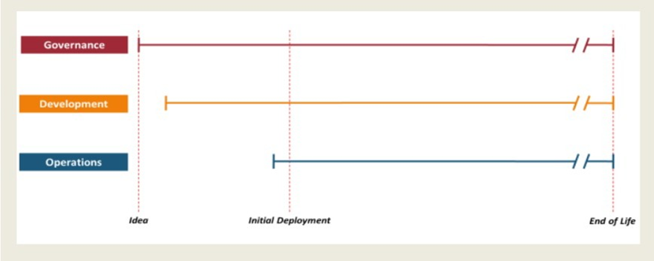
System Lifecycle Management
Three main milestones
Idea or Inception:
Before the start of the development process
Usually involves evaluating the business case, portfolio management issues and feasibility considerations
Provides a Go/NoGo decision before development starts

Slide 13
System Lifecycle Management
Deployment:
Occurs when the finished product is moved into production and made available to users
Retirement:
Ensures that at the end of life for the product, it can be taken out of production safely and without business or technical risk

Slide 14
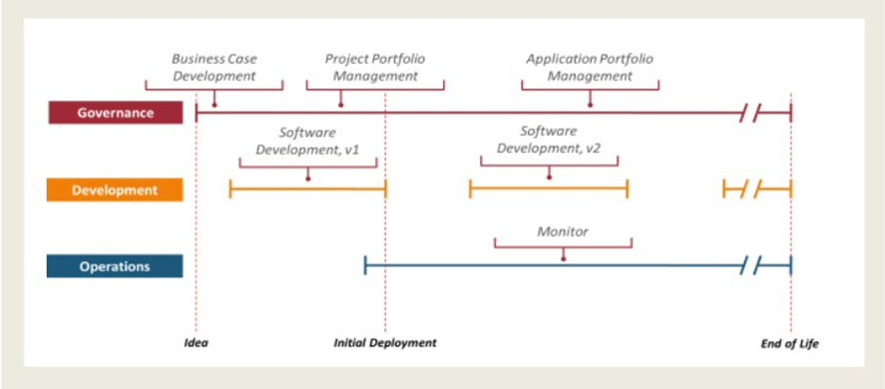
Governance
Begins with business case and feasibility studies
Portfolio management
Ensuring no overlap with other applications or any gaps that could create risk
Evaluation of risk, legal, social and other concerns
Makes mangement related decisions (like when to deploy)

Slide 15
Development
Only concerned about the choice of methodology
Integration with:
Records management, PM policies, security, etc.
Ensures that the development process is executed correctly
Requirements, Development, Test (RDT) is executed

Slide 16
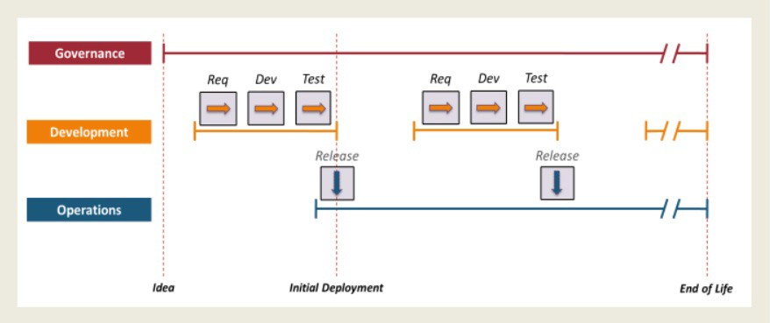
Development - Waterfall

Slide 17
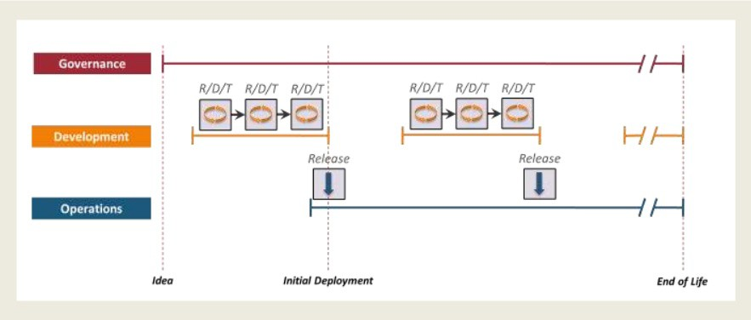
Development - Agile

Slide 18
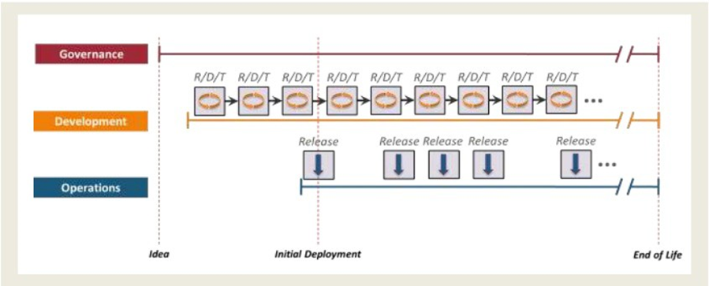
Development – Continuous Deliver

Slide 19
Operations
During deployment, governance makes decisions and development makes changes
Ops provides context for making dev and govern work together
Ops monitors usage, performance, service level targets, change requests and bug reports
Also monitors changes in the application’s technical environment that could impact the application

Slide 20
System Lifecycles and SDLCs
Software Development Lifecycles

Slide 21
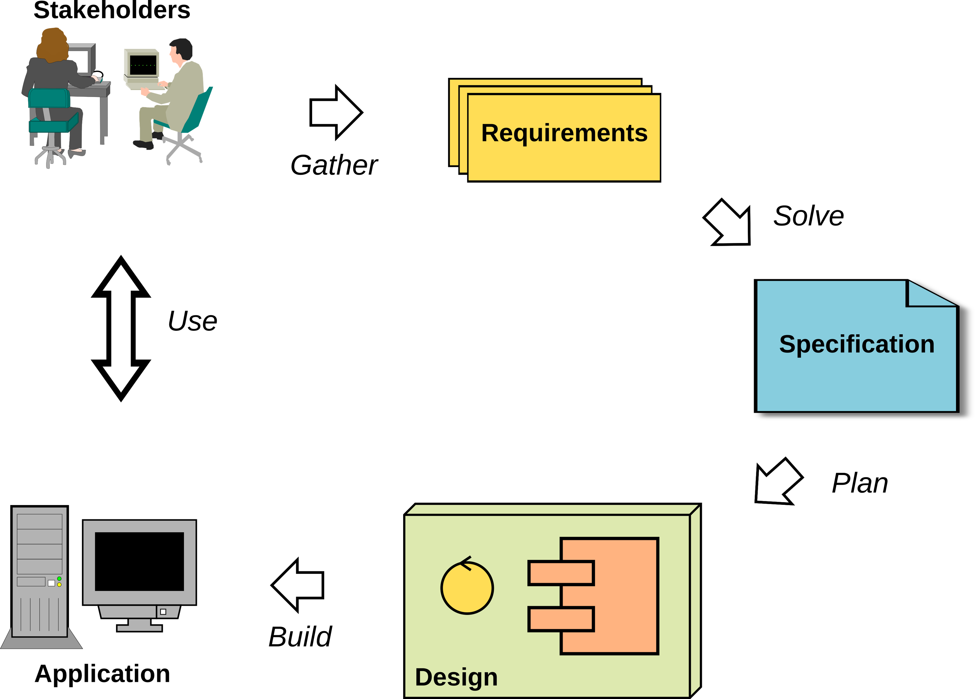
SDLC
Software Development Lifecycle
Defines the organization of work during the construction phase
Follows the Engineering process from requirements to deployment

Slide 22
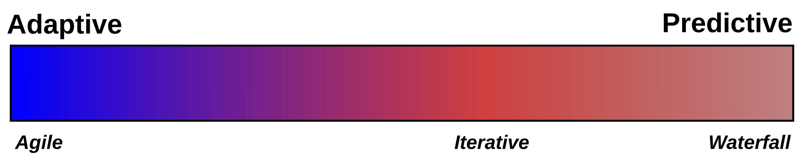
SDLC Types
Depends on how many of the requirements are knows at the start of the project
Two basic endpoints on a continuum:
Predictive: We know all the requirements so we can predict exactly what the delivered product should be
Adaptive: We only have partial requirements, so we deploy prototypes iteratively in order to explore unknown requirements
Most projects will lie somewhere on the scale of adaptability
Predictive methods go through the engineering process once
Adaptive method go through the engineering process multiple times
Each iteration adds an increment of development

Slide 23
Predictive Processes
All the requirements are known at the project start
Characteristic of projects that have high amounts of risk
Usually implemented as a waterfall SDLC
The final result or target can be accurately specified
Very important for mission critical systems like software that runs a nuclear reactor cooling system or a heart pacemaker
Often not suited for software that users interact with
Predictive SLDCs start to become very inefficient and ineffective when requirements change quickly or are not completely known
Especially true of new or innovative software

Slide 24
Adaptive Processes
Many of the requirements are not known at the project start
Very often we are focused on solving a problem but the nature of the solution is unknown
We must take a trial and error approach
We may be deploying new technology where requirements are not yet known
Stakeholders have no idea what their requirements would be and often need to have a prototype to play with to start to identify their requirements
Most commonly needed when requirements are fluid (like with user interfaces or automating interactions

Slide 25
Iterative Processes
Most of the requirements are known at the project start
Some new or some changes to requirements are anticipated
Process works in iterations which are mini-projects
At the end of each iteration, there is a re-evaluation of the requirements, specification and design
Tends to be used a lot in developing cyber-physical systems
Often used instead of a predictive process when risk is important but not all the requirements are available

Slide 26
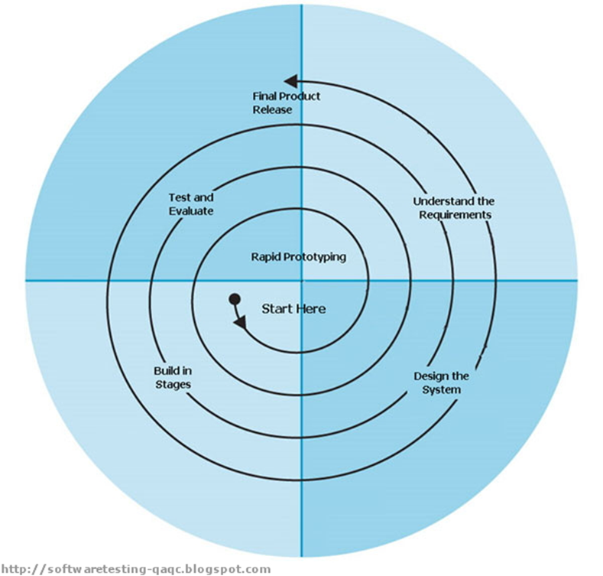
Non-Agile Adaptive SDLCs
Barry Boehm’s Spiral methodology from 1986 defined a series of iterations with the objective of producing prototypes which were used to provide inputs into the subsequent iterations.
Another adaptive methodology is James Martin’s Rapid Application Development (RAD) developed in the 1980s at IBM.
Both SDLCs was built around the idea that for some sorts of development, like working with user interfaces, the requirements are too fluid for a predictive approach.
The RAD approach, like the Spiral methodology, centred around getting a prototype into the hands of the users to start generating feedback that would be used to continuously develop the

Slide 27
The Specification
The specification is produced during the analysis activities
The specification describes how what is being build
Will function and perform
Will interact with users and other systems
Will interact with the organizational environment
The specification can take many forms
A common part of Agile specs is a complete set of acceptance tests
Role of the spec
Developers must define exactly how their code will work
Enables testers to develop the quality control criteria for testing
A critical part of the specification is how the system will meet the security and safety requirements
“If there is not enough information to write a test to a spec item, you don’t have enough information to write code to implement it.”

Slide 28

Test, Test and Test Again
More than the act of testing, the act of designing tests is one of the best bug preventers known.
The thinking that must be done to create a useful test can discover and eliminate bugs at every stage in the creation of software, from conception to specification, to design, coding and the rest.
If you can't test it, don't build it.
If you don't test it, rip it out.
Boris Beizer

Slide 29
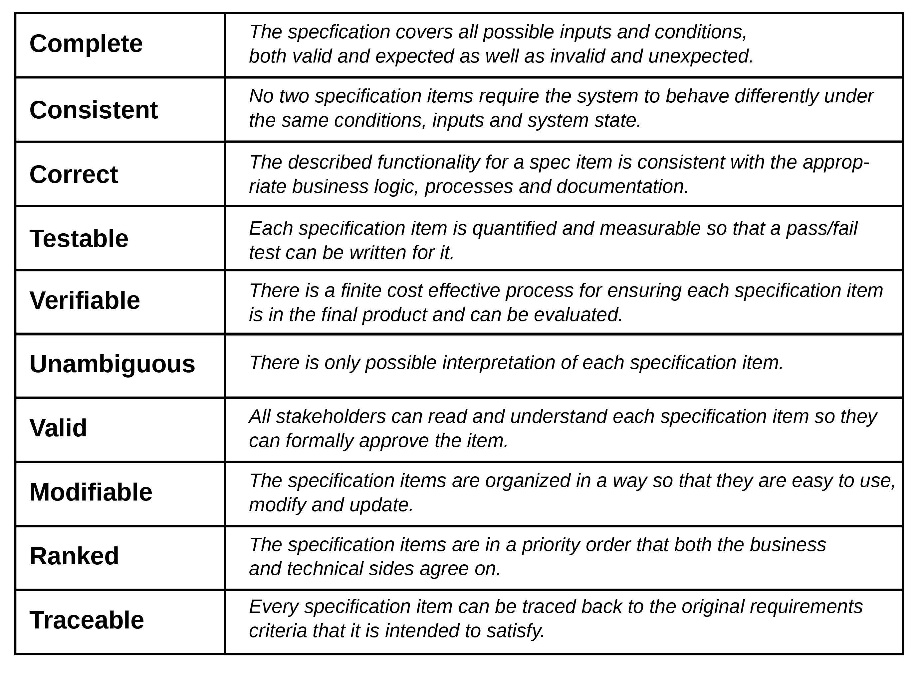
IEEE Best Practices for Specs
Notes:
Taken from the IEEE standard “Best Practices for Software Requirements Specifications”

Slide 30
System Lifecycles and SDLCs
DevOps and DevSecOps

Slide 31
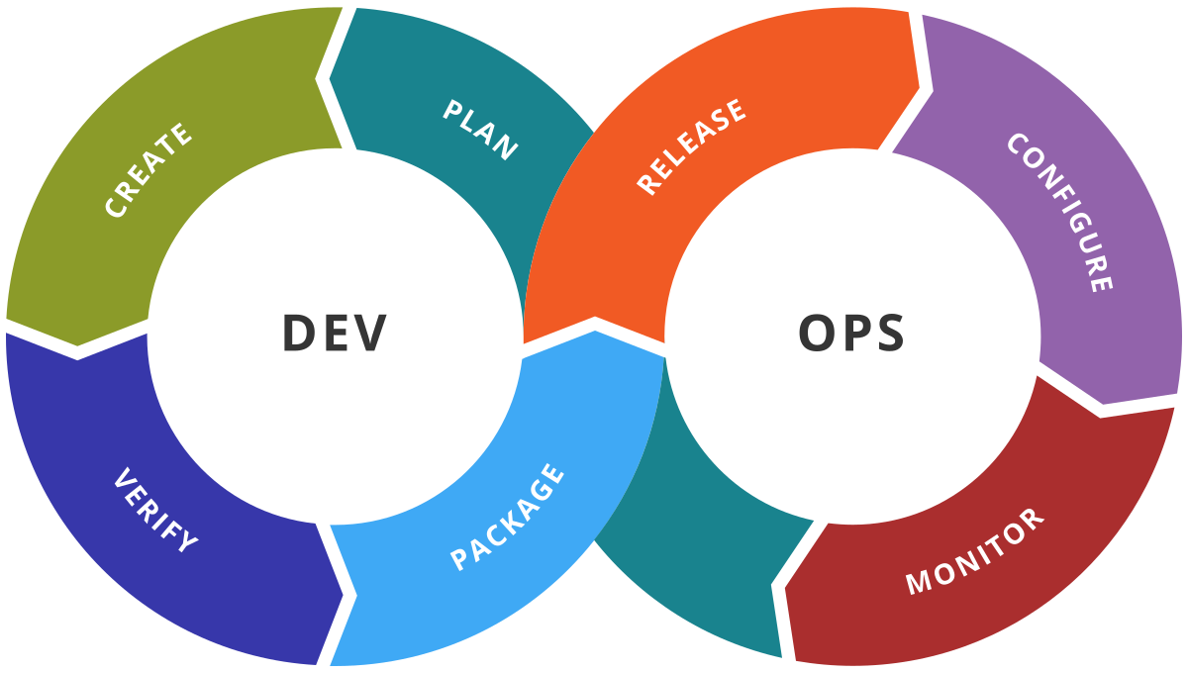
The Rise of DevOps
DevOps is not a development methodology
It is a response to the virtualization like cloud providers
Infrastructure is now developed virtually
E.g., Terraform, Ansible, etc.
Infrastructure as code (IaC)
DevOps is the merging of the roles of Dev and Ops
Developers write code, Ops now write code
DevOps integrates the two roles through common tools
Enables continuous integration and continuous deployment (CICD)

Slide 32
Why IaC?
Speed and simplicity
Entire deployments can be set up or torn down by running a script
Configuration consistency
Identical copies of configurations can be created for testing or development
Minimization of risk
Reduces human procedural errors
Allows for testing, reviews and other quality measures
Increased efficiency in development
Infrastructure code is not a bottleneck
Allows for more efficient development and operations management
Supported by main IoT development and operations platforms
Cloud IoT development environments
IioT development tools (e.g. IBM Engineering Lifecycle)

Slide 33
Why IaC?
Self-service
Infrastructure deployment with scripts does not rely on an administrator
Speed and safety
Infrastructure is deployment and updated faster and with fewer errors
Documentation
The IaC source files are infrastructure documentation
Version control
Previous deployments can be maintained in source control for regression or audit need, or to satisfy regulatory requirements
Validation
For every single change, code reviews and dynamic testing can be performed
Reuse
New infrastructure deployments can be derived quickly from previous deployments

Slide 34
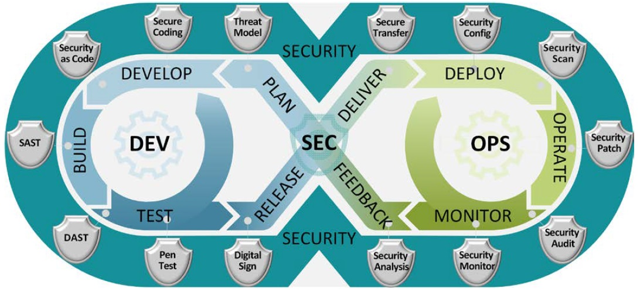
DevSecOps
Automatically bakes in security at every phase of the software development lifecycle
“The purpose and intent of DevSecOps is to build on the mindset that everyone is responsible for security with the goal of safely distributing security decisions at speed and scale to those who hold the highest level of context without sacrificing the safety required,” describes Shannon Lietz, co-author of the “DevSecOps Manifesto.”
Notes:
Image is from DoD Document – public domain

Slide 35
DevSecOps Advantages
Rapid, cost-effective software delivery
Security problems can lead to huge time delays
Fixing security issues can be time-consuming and expensive The rapid
DevSecOps saves time and reduces costs by minimizing the need to repeat a process to address security issues after the fact
Integrated security cuts out duplicative reviews and unnecessary rebuilds, resulting in more secure code
Improved, proactive security
Throughout development, code is reviewed, audited, scanned, and tested for security issues
Security problems are fixed before additional dependencies are introduced
Compatible with modern development
Cybersecurity testing can be integrated into an automated test suite for operations teams
Notes:
From the IBM website on devsecops

Slide 36
DevSecOps Advantages
Repeatable and adaptive process
Ensures security is applied consistently across the operational and development environment
As the environment changes, security development adapts to new security requirements

Slide 37
DevSecOps Best Practices
Shift left
Moves security from the end of a process left to the start of the development process
Security is an integral part of the development process from the start
Security education
Combination of engineering and compliance
Requires development engineers, operations teams, and compliance teams work together
Ensures everyone understands the required security posture and follows the same standards
Traceability, auditability, and visibility
Traceability: tracking configuration items across the development cycle from requirements to implemented code
Auditability: ensuring compliance with security protocols
Visibility: solid monitoring system in place during whole product lifecycle

