Slide 1
Common Attacks
Copyright © 2021 by Elephant Scale, All Rights Reserved

Slide 2
What this Module Covers
This module explores the following common attacks:
Cross site scripting (XSS)
Malicious file execution
Session hijacking
Encryption
Unsecured direct object reference
Failure to authorize/hidden URLs
Cross site request forgery (CSRF)
There are other attacks not covered in this module
OWASP maintains a project identifying the current top ten attacks
[OWASP Top Ten] https://owasp.org/www-project-top-ten/
Copyright © 2021 by Elephant Scale, All Rights Reserved

Slide 3
Cross Site Scripting (XSS)
A form of injection attack
Malicious scripts are injected into an HTTP response from a trusted website
Because the script is from a trusted source, the user's browser executes it as trusted code
The browser cannot determine that the script originated from an untrusted source
The XSS script has the same level of trust as the website the HTTP response originated from
XSS is a common attack for stealing information stored in the user's browser
And for "drive-by" installation of malware on a computer
Copyright © 2021 by Elephant Scale, All Rights Reserved

Slide 4
Types of XSS Attacks
There are three types of XSS attacks
Stored XSS: Also referred to as persistent or Type I attacks
Reflected XSS: Also referred to as Type II attacks
DOM XSS: Also referred to as Type 0 attacks
XSS attacks rely on users clicking on a link to an infected URL
Social Engineering refers to the manipulative methods used to induce users to take some action to trigger the XSS attack
Email phishing is one of the most common
Potential victims are sent an email with the infected URL and a deceptive description
Eg. Limited time promotion: claim your $100 discount on your next Amazon purchase!!
The source of the email is usually spoofed or made to look like a legitimate sender the victim would trust
Copyright © 2021 by Elephant Scale, All Rights Reserved

Slide 5
Persistent XSS Attack
An attacker injects or inserts a malicious script payload into a trusted website
Vulnerable websites fail to check if the input is executable code
Typical injection targets are blog comments and other user generated content
A victim accessing the infected page will download the script payload in the HTTP response
The victim's browser executes the XSS payload code as it loads the HTTP response
Email phishing is usually used to trick users into visiting the infected URL
Copyright © 2021 by Elephant Scale, All Rights Reserved

Slide 6
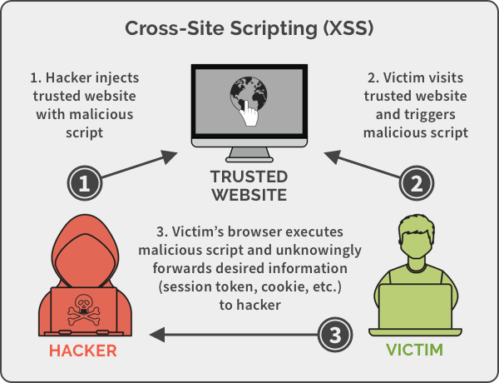
Persistent XSS Attack
Copyright © 2021 by Elephant Scale, All Rights Reserved
Notes:
Image credit: https://spanning.com/blog/cross-site-scripting-web-based-application-security-part-3/

Slide 7
Persistent XSS Attack Example
A trusted blog allows users to post comments exactly as entered by the users
An attacker posts the following comment which contains a malicious payload
When a victim goes to the page containing the comment, the payload in the comment executes
The attack payload remains in persistent storage on the server
Multiple users may become victims of the attack
Phishing is used to deceptively direct victims to the URL containing the payload
OMG!!!, can you believe what this guy wrote!!! (link to payload comment)
Copyright © 2021 by Elephant Scale, All Rights Reserved

Slide 8
Sammy's Worm
Sammy's worm was an early (2005) worm that propagated through the MySpace user community by using an XSS attack
The worm displayed the message "Sammy is my hero," then sent a friend request to the author Sammy Kamkar
When an infected profile page was viewed, the payload would be replicated on the viewer's MySpace page
Within 20 hours, the worm was on one million MySpace pages - Sammy was arrested shortly after
A code fragment from the attack is shown below - notice where the XSS payload is located
Copyright © 2021 by Elephant Scale, All Rights Reserved

Slide 9
Reflected XSS Attack
A victim is induced to click on a malformed URL to a trusted website
The malformed URL is crafted to produce some sort of error HTTP response
The attack payload is part the malformed URL
Vulnerable websites will echo the attack payload as part of the HTTP response
When the response is opened in the victim's browser, the payload executes
This has the effect of "bouncing" the attack payload off of a trusted website
Copyright © 2021 by Elephant Scale, All Rights Reserved

Slide 10
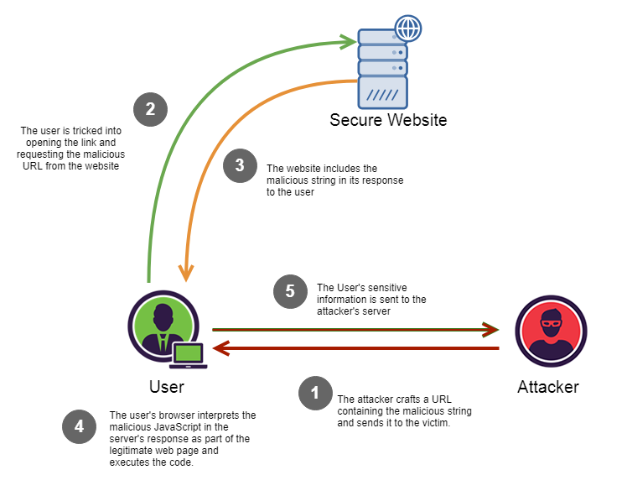
Reflected XSS Attack
Copyright © 2021 by Elephant Scale, All Rights Reserved
Notes:
Image Credit: https://medium.com/iocscan/reflected-cross-site-scripting-r-xss-b06c3e8d638a

Slide 11
Reflected XSS Attack Example
An attacker sends a link to a target in email which looks like:
Along with a deceptive description like Please review this suspicious transaction on your account
A vulnerable website will return the unfiltered content of the query in the error message
When the error page is loaded, the payload is executed in the victim's browser
Copyright © 2021 by Elephant Scale, All Rights Reserved

Slide 12
DOM XSS Attack
The attack payload is executed by modifying the DOM “environment” in the victim’s browser
The modification causes the original client side script to run in an “unexpected” manner
The HTTP responses is not affected, the HTML does not contain the attack payload
The payload is in the body of the page as part of the DOM tree
The client side code now executes differently because of the DOM modification
Generally executed by injecting malicious code as parameters or URI fragments
The malicious code is then incorporated into the existing page code
Copyright © 2021 by Elephant Scale, All Rights Reserved

Slide 13
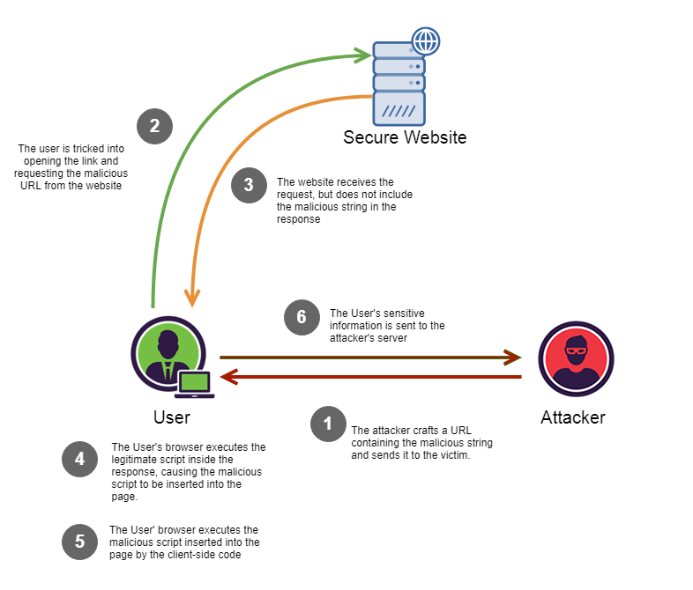
DOM XSS Attack
Copyright © 2021 by Elephant Scale, All Rights Reserved
Notes:
Image Credit: https://medium.com/iocscan/dom-based-cross-site-scripting-dom-xss-3396453364fd

Slide 14
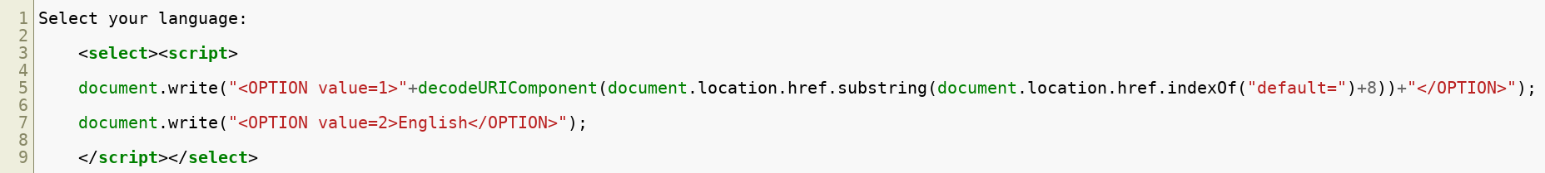
Example #1 - Parameter Insertion
A website allows users to select their language but uses English as the default:
This is processed by a script like this:
Note that the URI parameter "default=English" becomes part of the script
Copyright © 2021 by Elephant Scale, All Rights Reserved

Slide 15
Example #1 - Parameter Insertion
The attacker social engineers a victim to click on an altered link:
The original Javascript code in the page does not expect the default parameter to contain HTML markup
The markup is decoded and incorporated into the page's existing code
When browser renders the infected page, the incorporated attack payload is executed
The HTTP HTML response does not contain the payload
This payload is delivered in a modified client-side script
Copyright © 2021 by Elephant Scale, All Rights Reserved

Slide 16
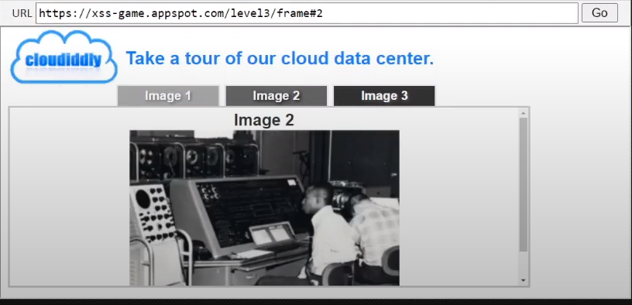
Example #2 - URI Fragment
The example above is a typical Single Page Application where the current user selection is indicated by a URI fragment
The user has selected image 2 so the URL is:
If the user selects image one, then the URL is:
Copyright © 2021 by Elephant Scale, All Rights Reserved

Slide 17
Example #2 - URI Fragment
Determining the current page is done in the browser without accessing the server
A DOM XSS attack would be to cause the underlying code to throw an error and supply error handler that executes the attack payload
The onerror executes whatever JavaScript immediately follows it
When this link is visited by a victim, the exploit will execute
Copyright © 2021 by Elephant Scale, All Rights Reserved

Slide 18

The eBay XSS Attack
In 2014, hackers exploited an XSS vulnerability in the eBay website
Users were redirected to a fake login page used to harvest their login credentials -BBC Report: eBay redirect attack puts buyers' credentials at risk https://www.bbc.com/news/technology-29241563
Other companies suffering major XSS attacks are Minecraft, Wordpress, Adobe and others
Copyright © 2021 by Elephant Scale, All Rights Reserved

Slide 19
Defences Against XSS Attacks
XSS relies on social engineering like phishing attacks to get victims to click on the link provided by the attacker
First line of defence is to train users to not click on unvetted links in emails or posts
Email filtering can block links or to allow only whitelisted links
The primary website defence against XSS is to remove the website vulnerabilities that allow the injection of malicious code
For persistent XSS, this means not allowing code to inserted as if it were data
For reflected XSS, this means not allowing user supplied HTML in website responses
For DOM XSS, this means that all potential invalid or unexpected inputs are handled correctly
Copyright © 2021 by Elephant Scale, All Rights Reserved

Slide 20
HTML Encoding
HTML encoding is the process of replacing HTML special characters with a coded replacements
This forces HTML to be treated as raw text and NOT as executable markup by the browser
For example "<" is encoded as " lt;"
In the persistent XSS example, the injected payload was
After HTML encoding, it is treated as text and looks like
Copyright © 2021 by Elephant Scale, All Rights Reserved

Slide 21
Other Defences Against XSS
Any content that does not come from trusted sources is flagged as untrusted content
Any untrusted content should be inserted only in specified and monitored locations
No untrusted content is used as content in an HTML element without being HTML encoded
This ensures the content is treated as data and not as markup
All attribute values must be attribute encoded
Attribute encoding is a subset of HTML encoding
A different encoding is used because attributes are parsed differently than HTML elements
Similar encoding rules exist for CSS and JavaScript
Copyright © 2021 by Elephant Scale, All Rights Reserved

Slide 22
Other Defences Against XSS
Sanitize all untrusted content
If some HTML markup is allowed in untrusted input, sanitizing removes all the illegal input
For example, a comment section for a blog allows <b> , <i> and <hr> tags
The uploaded HTML is
The sanitized versions is
Any untrusted content included in HTTP responses should be sanitized to prevent XSS reflection attacks
Copyright © 2021 by Elephant Scale, All Rights Reserved

Slide 23
Sanitizing Libraries
There are multiple libraries that can be used for code sanitization
Some standard libraries are:
HTML sanitizer from Google Closure Library (JavaScript/Node.js, docs)
https://developers.google.com/closure/library/
DOMPurify (JavaScript, requires jsdom for Node.js)
https://github.com/cure53/DOMPurify
PHP HTML Purifier
http://htmlpurifier.org/
Python Bleach
https://pypi.org/project/bleach/
Copyright © 2021 by Elephant Scale, All Rights Reserved

Slide 24
Other XSS Preventive Measures
Implement Content Security Policy
A browser side directive to specify allowed sources of content
The directive below allows JavaScript to be loaded only from the page's site and from static.domain.tld
Hold all user generated or untrusted content for review before writing
Copyright © 2021 by Elephant Scale, All Rights Reserved

Slide 25
Malicious File Execution
There are two basic types of malicious file execution
Client side attacks
Malicious code is inserted into the client machine to intercept communications between the browser and the browser security mechanisms
Often depends on social engineering to deceive users into installation
Server side attacks
Malicious code is inserted into the server environment to execute on the server or to interfere with the server operations
Often the result of poor security protocols on the server side
Copyright © 2021 by Elephant Scale, All Rights Reserved

Slide 26
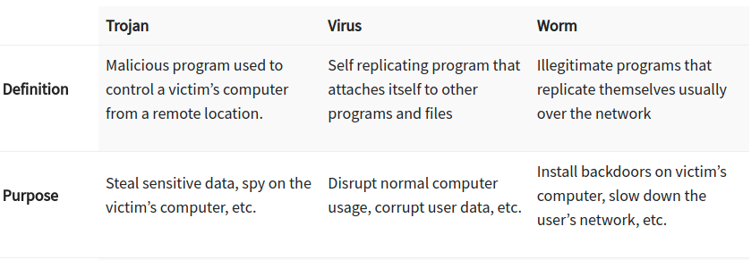
Client Side Attacks
The primary vector used in a client side attack is a Trojan
Trojans are malicious code masquerading a trusted application or modify existing trusted applications
One of the most common client side attacks
Enables other attacks like session hijacking and manipulator in the middle
Other client side attack components are worms and viruses
Worms and viruses are used to propagate malware across systems
The payload of a worm or virus is often a Trojan
Copyright © 2021 by Elephant Scale, All Rights Reserved
Notes:
Image Credit: www.guru99.com/learn-everything-about-trojans-viruses-and-worms.html

Slide 27
Common Types of Trojans - RATs
Remote Access Trojan (RAT): Allows attacker to take full control a computer
Often disguised as a utility or incorporates itself into an existing program
Social Engineering often used to gain access to a machine for installation of the RAT
Ef. The Windows Support Scam is a social engineering attack for RAT installation
Users are served a phony webpage, shown on the next slide, often from some phishing attack
After calling the number, victims give scammers remote access to their computer
The scammers install a RAT disguised as an anti-virus or other utility
The scammers have free access to the infected machine to perform other attacks
Copyright © 2021 by Elephant Scale, All Rights Reserved

Slide 28
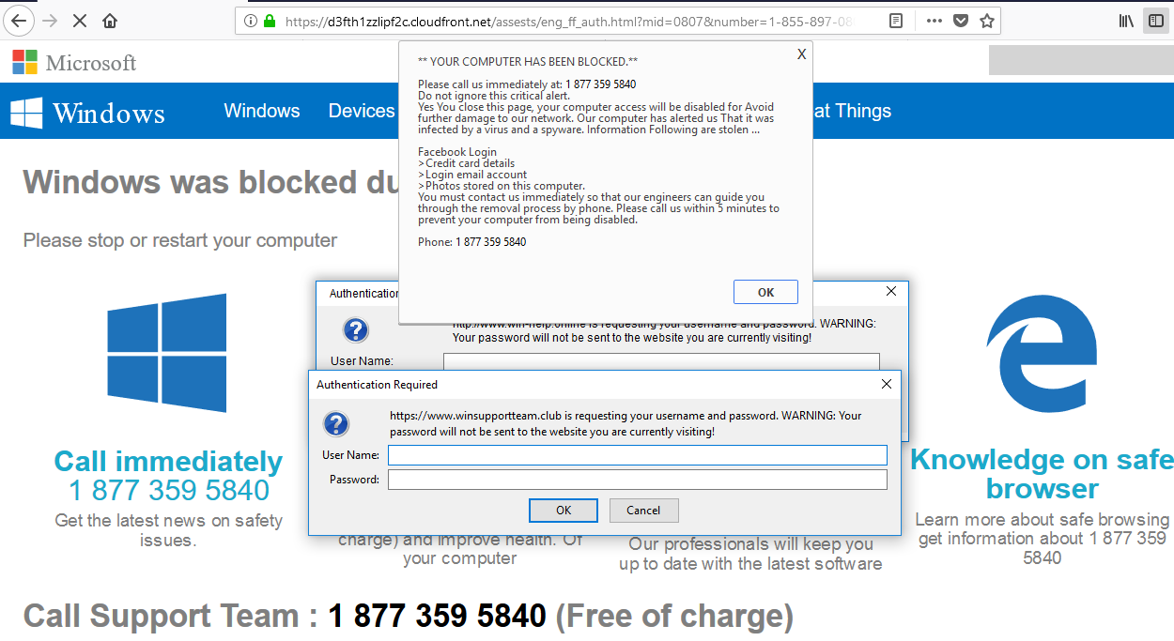
Windows Support Scam
Copyright © 2021 by Elephant Scale, All Rights Reserved
Notes:
Image Credit: wolfstreet.com/2018/08/19/scam-critical-alert-from-microsoft-iexplore-www-support-me-malware/

Slide 29
Common Types of Trojans - Loggers
Data Sending Trojan : Uses keylogger technology to capture sensitive data
Example passwords, credit card and banking information
The data is then sent to the attacker
Loggers are often part of malware with multiple functions or attacks
For example, collecting and sending all phone and computer data found on a computer
Often modifies the display of trusted web pages to request additional information to harvest
Login Trojans spoof legitimate login pages of well known sites to harvest user credentials
Copyright © 2021 by Elephant Scale, All Rights Reserved

Slide 30
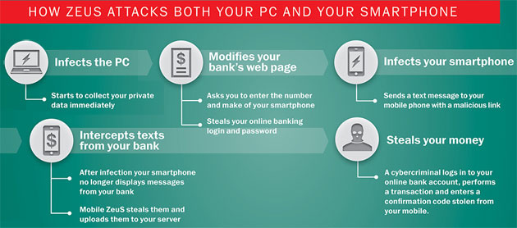
Zeus Trojan
The Zeus malware was a very widespread and highly damaging Trojans
The main attack vector was a phishing email that with a URL for an XSS attack
Victims who clicked on the URL would have Zeus installed on their computer
Zeus didn't masquerade as an application but rather modified existing applications
Currently, in "retirement," it is still the inspiration for many similar trojans
Copyright © 2021 by Elephant Scale, All Rights Reserved
Notes:
Image Credit: https://techieandwhatever.blogspot.com/2017/06/what-is-zeus-malware-and-how-does-it.html

Slide 31
Other Trojan Types
Destructive Trojan: Designed to destroy data stored a computer
Ransomware is variation on this since the encrypted data is essentially destroyed
Proxy Trojan: Uses the victim’s computer as a proxy server
Enables attackers to execute illicit acts from the infected computer
This is often used to creat BotNets or networks of controlled computers
FTP Trojan : Uses port 21 to enable FTP file uploads to tje victim’s computer
Security software disabler Trojan: Disables security software like firewall and antivirus software
Denial-of-Service attack Trojan: Designed to give the attacker ability to perform DOS attacks from victim’s computer.
Copyright © 2021 by Elephant Scale, All Rights Reserved

Slide 32
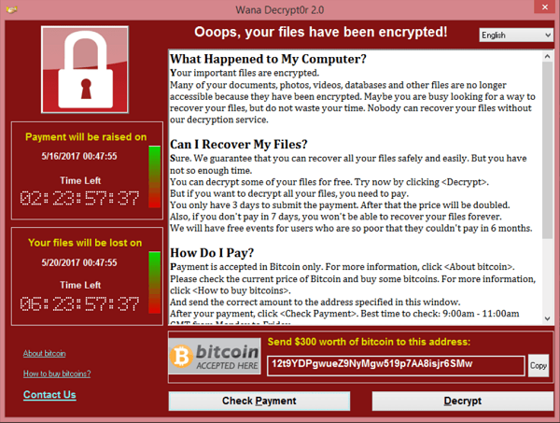
Ransomware - A Client Side Attack
Ransomware is the leading malware problems exemplified by 2021 cases like Colonial Pipeline, JBS Foods and the NBA
Typical attack vector is a phishing email using XSS attack to install the ransomware
Exploits vulnerabilities that allow running malicious code on the target computer (eg. unpatched security holes)
Ransomware can also be installed by a victim directly as part of what they believe is a legitimate application
Copyright © 2021 by Elephant Scale, All Rights Reserved
Notes:
Image Credit: en.wikipedia.org/wiki/WannaCry_ransomware_attack#/media/File:Wana_Decrypt0r_screenshot.png

Slide 33
Client Attack Defences
Since client attacks often start with an XSS attack, mitigating XSS attacks also helps prevent client side attacks
Trojans also spread via viruses and worms
Upto date anti-virus and malware scanning tools can block these vectors
Firewalls and other filtering tools can prevent access through open ports
Malware exploits unpatched security holes which can be mitigated by regular system updates
Users and programs should have only the level of access required
Eg. Administrative privileges for installing software are only granted for specific applications
Copyright © 2021 by Elephant Scale, All Rights Reserved

Slide 34
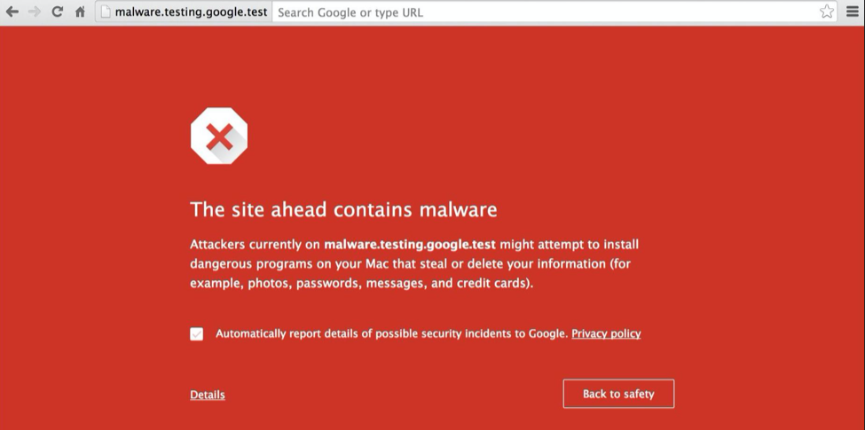
Client Attack Defences
Modern browsers have access to databases of know sources of malware
Following browser recommendations about unsafe sites mitigates XSS and other malware risks
Copyright © 2021 by Elephant Scale, All Rights Reserved

Slide 35
Server Side Attacks
Server side attacks have two primary modes
The first mode is to execute code on the server to control, damage or subvert the server
Installed malware can be used to harvest data, perform fraudulent actions or control the server
This often includes backdoors to allow attackers access to the system
Most of the scenarios and mitigations for client side attacks also apply
Some specific attacks are covered in session hijacking
The second mode is feed data to the server that is intended to cause existing programs on the server to be compromised
One goal of this mode is to render the server inoperable
Another is to put the server into an unstable state for further attacks
Copyright © 2021 by Elephant Scale, All Rights Reserved

Slide 36

OPM Hack and Data Breech
In 2015, the OPM disclosed that data on 21.5 million people had been stolen
Data stolen included millions of SF-86 forms
SF-86 forms contain the personal information used to process security clearances
Considered one of the most devastating cyberattack ever on the US Government
Copyright © 2021 by Elephant Scale, All Rights Reserved
Notes:
https://www.csoonline.com/article/3318238/the-opm-hack-explained-bad-security-practices-meet-chinas-captain-america.html https://www.opm.gov/cybersecurity/cybersecurity-incidents/

Slide 37
Office of Personal Management
How the hackers gained access has not been revealed
Likely through installation of malware by a compromised individual
Once access was gained, hackers exfiltrated technical and administrative manuals for the system
Keyloggers on database adminstrators' terminals were installed
A backdoor into the system was also installed
Before being shut down, hackers also stole top secret manuals and documents about OPM procedures for conducting security clearances
Copyright © 2021 by Elephant Scale, All Rights Reserved

Slide 38
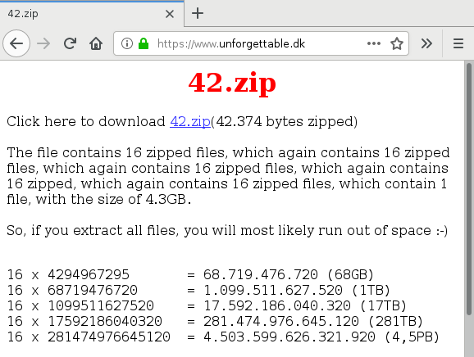
Decompression Bomb Attack
A decompression bomb is an archive file that is uploaded to a server
The file is designed so that unpacking the file overwhelms the system's resources
The 42.zip zip bomb file is 42 kilobytes in size but unpacks into 4.5 petabytes
Copyright © 2021 by Elephant Scale, All Rights Reserved
Notes:
Image Credit: www.bamsoftware.com/talks/woot19-zipbomb/

Slide 39
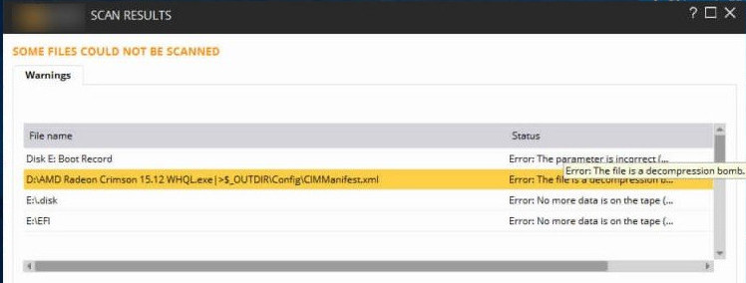
Decompression Bomb Attack
Decompression bomb attacks are designed to either crash the server or put it into a vulnerable state
Also used to disable anti-virus software
Older AV software will try to extract the contents of a zip bomb which results in the software crashing
Since the structure of zip bombs are well known, most up-to-date AV and threat scanning software can identify them
The threat is mitigated by banning archive files or performing scans for potential bombs
Copyright © 2021 by Elephant Scale, All Rights Reserved
Notes:
Image Credit: techbytesonline.com/what-actually-is-zip-bomb-zip-of-death/

Slide 40
Session Hijacking
HTTP is a stateless protocol but user interactions are usually stateful
For example, logging onto a web banking session
You have to be in an authenticated state before doing any banking
User session state is managed by some sort of session management token
This token identifies the client browser as the correct user for that session
Session hijack attacks involve stealing the token from a victim's session
The attacker can now take the place of the real user and perform actions the real user would be allowed to do in the session
For example, hijacking an on-line banking session and transferring funds to the attacker's account
There are different types of session hijack attacks
Copyright © 2021 by Elephant Scale, All Rights Reserved

Slide 41
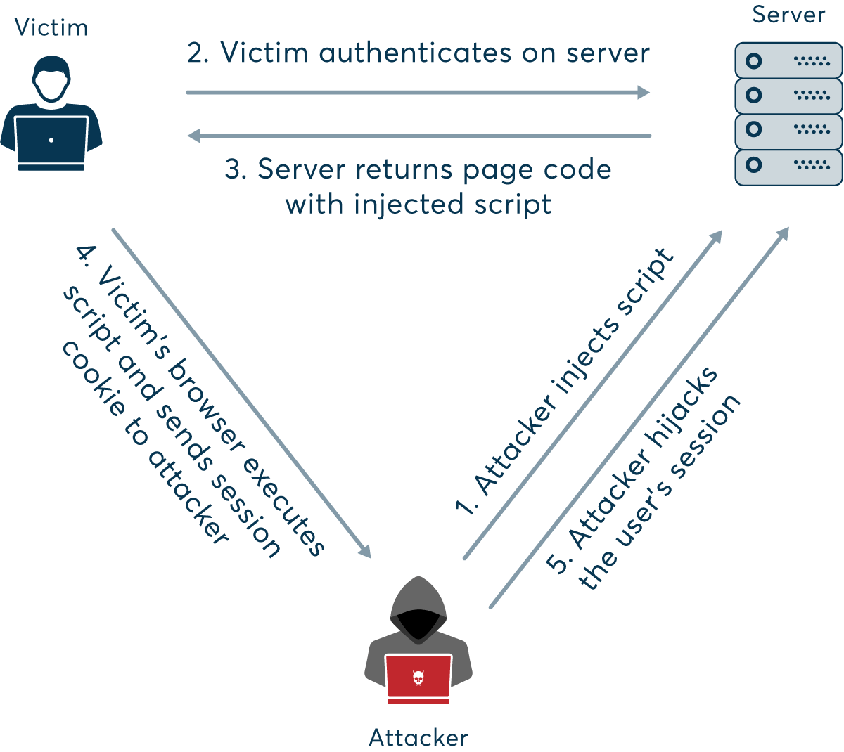
Session Hijacking
Copyright © 2021 by Elephant Scale, All Rights Reserved
Notes:
Image Credit: www.netsparker.com/blog/web-security/session-hijacking/

Slide 42
Session Hijacking
Session hijacking often requires obtaining the session token
There are several ways this is done
Predicable session tokens
Client side attacks, like XSS, to steal tokens
Trojans and malware on the client machine
Session sniffing
Session sniffing involves scanning HTTP traffic between a host and client to mine session tokens
Two common forms of attacks that are related to session hijacking are:
Man in the Middle Attack
Man in the Browser Attack
Copyright © 2021 by Elephant Scale, All Rights Reserved

Slide 43
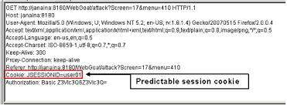
Predicable Session Tokens
Vulnerability is due to poor security design
Eg. using the user ID or other piece of data as the session token
Short tokens are easier to guess or use brute force to spoof
Tokens that follow a predicable sequence can be predicted
To avoid this specific vulnerability
Use long and randomly generated session tokens
Change the token after each request or at random times
Copyright © 2021 by Elephant Scale, All Rights Reserved
Notes:
Image Credit: owasp.org/www-community/attacks/Session_Prediction

Slide 44
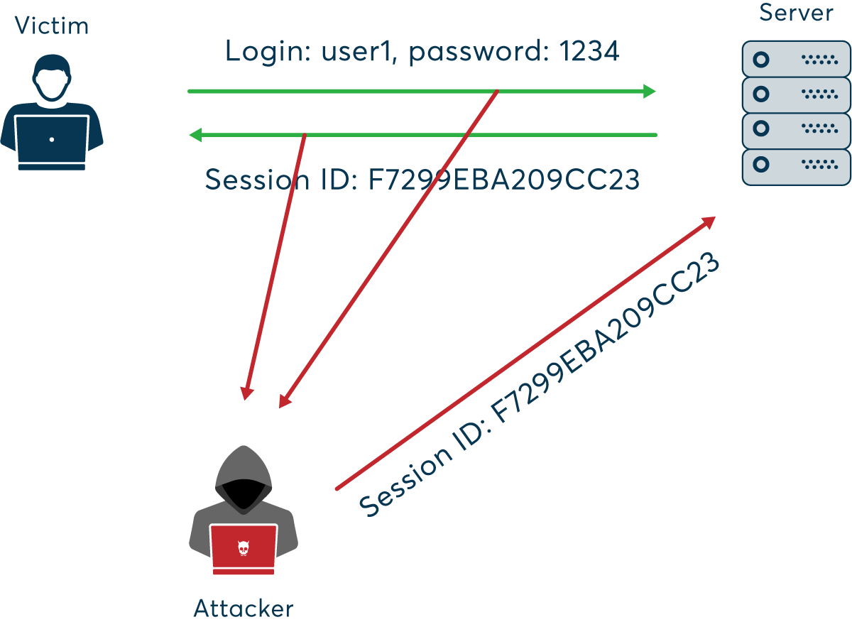
Sniffing
Copyright © 2021 by Elephant Scale, All Rights Reserved
Notes:
Image Credit: www.netsparker.com/blog/web-security/session-hijacking/

Slide 45
Sniffing
Attacker uses packet sniffing to monitor HTTP traffic and mine session tokens and credentials
To avoid this specific vulnerability:
Use HTTPS for all traffic - all of the session traffic will be encrypted including tokens
Use HTTPOnly to prevent access to stored cookies on the client machine
Constantly changing session keys to invalidate any captured tokens
Use a VPN - All traffic move through and "encrypted channel" that cannot be sniffed
Avoid unsecured WiFi networks since you don't know who is listening
Don't rely on just session keys to establish ID - use URLs, usage patterns or other identifying data
Copyright © 2021 by Elephant Scale, All Rights Reserved

Slide 46
Man in the Middle Attack
Occurs when an attacker places themselves in a conversation between a victim and application
often used to eavesdrop on communications
Allows the attacker to collect credentials and other information
Typical target are interactions between users and financial institutions
Or any application that requires authentication
Also used to "spoof" or impersonate one of the parties
Often used to create a vulnerability to be exploited by a later attack
For example, spoofing wikipedia to install malware on the target's computer
Copyright © 2021 by Elephant Scale, All Rights Reserved
Notes:
Image Credit: www.imperva.com/learn/application-security/man-in-the-middle-attack-mitm/

Slide 47
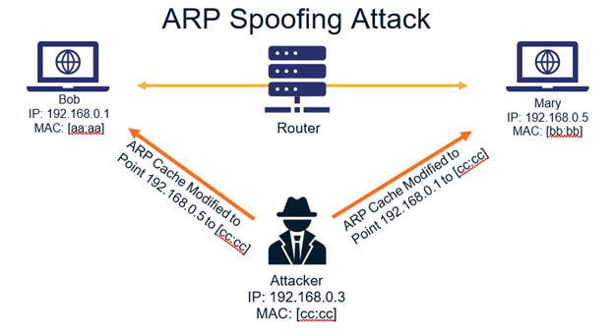
Spoofing Attacks
Man in the middle attacks can be initiated by a spoofing attack
IP Spoofing: Addresses in packet headers are altered so that traffic is routed to the attackers IP address
ARP Spoofing: Links attackers MAC address to a user's IP address on a network by using fake ARP messages
DNS Spoofing: Involves altering a DNS record so that users are sent to the attackers IP address
Copyright © 2021 by Elephant Scale, All Rights Reserved
Notes:
Image Credit: thesslstore.com/blog/everything-you-need-to-know-about-arp-spoofing/

Slide 48
Mitigating MitM Attacks
Users should not use unsecured WiFi connections
Browser warning about unsecured websites may be an attempted MitM attack
Avoid using public networks - using VPNs is more secure
Servers should use robust communications protocols and encryption (TSL and HTTP) for every page
Timeouts to terminate idle applications
Copyright © 2021 by Elephant Scale, All Rights Reserved

Slide 49
Man in the Browser Attacks
1
MitB attacks uses trojans to manipulate traffic before it reaches the browser
Often done by infected libraries, browser extensions or helper applications
Enables manipulation of traffic before it goes through security layers
This is mitigated in the same way as other Trojan attacks
Copyright © 2021 by Elephant Scale, All Rights Reserved
Notes:
Image Credit: doubleoctopus.com/security-wiki/threats-and-tools/man-in-the-browser-attack/

Slide 50
Encryption Attacks
Encryption attacks take a number of different forms
The most obvious is to find weaknesses where:
Encryption is not used - data or messages are clear text
Sensitive data is stored in accessible logs or caches
Weak or old cryptographic algorithms are in use
Weak or easily cracked cryptographic keys and passwords ("qwerty123") are in use
Other weakness occur when:
Encryption is done poorly or inconsistently
Failure to authenticate SSL certificates
Copyright © 2021 by Elephant Scale, All Rights Reserved

Slide 51
Ecryption Attack Examples
Data is automatically decrypted when retrieved via an SQL query
Attacker could use an SQL injection attack to obtain information in clear text
Simple hashes are used to store data
Attacker can crack hashes by brute force computation
Rainbow tables are precomputed tables of output of hashing functions
Poor key management
Attacker can gain access to the directories where keys are stored
Attacker can sniff keys included in messages or headers
Keys can be altered or destroyed to cause the system to fail
Mobile applications are especially susceptible
Copyright © 2021 by Elephant Scale, All Rights Reserved

Slide 52
Encryption Attack Mitigation
Keys are never hardcoded into applications
Logging and caching of keys or other cryptographic data is blocked
All sensitive data is encrypted at rest
Ensure all cryptographic algorithms and tools are up-to-date and support strong encryption
Avoid key leakage by using a secrets' manager like Hashicorp Vault
Keep all unnecessary sensitive data (eg. old credit card info) in an inaccessible location
Encrypt all data in transit and enforce with protocols like HSTS - HTTP Strict Transport Security
Enforce strong and regularly changed passwords
Copyright © 2021 by Elephant Scale, All Rights Reserved

Slide 53
Advanced Cryptographic Attacks
HTTPS spoofing sends a fake certificate when the initial connection request to a secure site is made
Fake has a copy of the thumbprint associated with the compromised application
Can be used as part of a Man in the Middle attack
SSL BEAST exploits TLS version 1.0 vulnerability in SSL
The victim is infected with malicious JavaScript that captures encrypted cookies and enables the attacker cookies and authentication tokens.
SSL hijacking is when an attacker passes forged authentication keys to both the user and application
Sets up what appears to be a secure connection when but it's actually a MitM attack
SSL stripping downgrades a HTTPS connection to HTTP by intercepting the TLS authentication
Copyright © 2021 by Elephant Scale, All Rights Reserved

Slide 54
Insecured Direct Access Attacks
This is a general category of several attacks
Direct Object Access: Attackers can access configuration files and other system resource
Insecure Direct Object Reference: Attackers can access files or resources they shouldn't by looking for access patterns
Directory Traversal: Attacker can drop into underlying file system and manipulate system files and directories
Web Shell: Attacker is able to gain access to the command shell on the host system
Copyright © 2021 by Elephant Scale, All Rights Reserved

Slide 55
Direct Object Access Attack
Exploits a badly configured server environment
Configuration and other files that manage the server are accessible to users
A common cause is keeping these files in the document root directory or a subdirectory
The contents of the file can be accessed via a web shell attack
Particularly dangerous when the attacker can run exectuable files
Mitigated by following best practices for servers and application configuration
Copyright © 2021 by Elephant Scale, All Rights Reserved

Slide 56
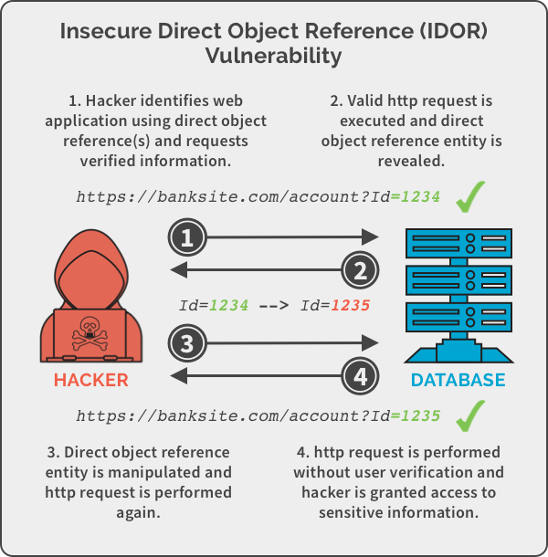
Insecure Direct Object Reference
Copyright © 2021 by Elephant Scale, All Rights Reserved
Notes:
Image Credit:panning.com/blog/insecure-direct-object-reference-web-based-application-security-part-6/

Slide 57
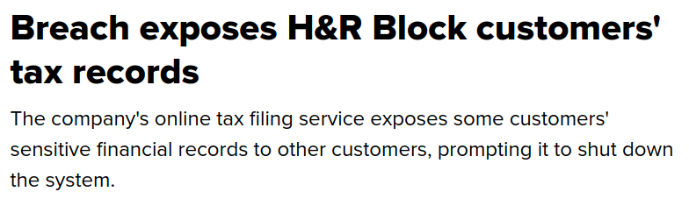
Insecure Direct Object Reference
Attacker is able to access implementation objects directly by guessing at their reference
For example, guessing that the administrator account has account id "1" in the previous slide
Cause of a 2002 data breech at H&R Block where users' account number appeared in the URL
Changing the number in the URL allowed access to other customers' accounts
Copyright © 2021 by Elephant Scale, All Rights Reserved
Notes:
Image Credit: www.cnet.com/tech/services-and-software/breach-exposes-h-r-block-customers-tax-records/

Slide 58
Insecure Direct Object Reference Mitigations
Copyright © 2021 by Elephant Scale, All Rights Reserved

Slide 59
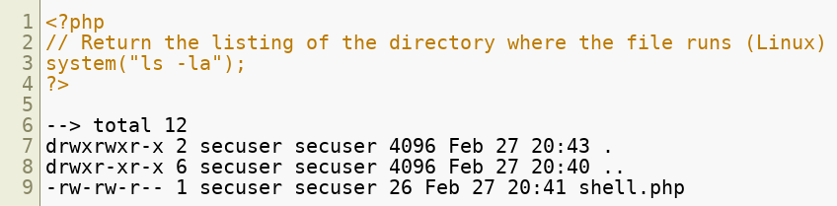
WebShell Attack
A webshell attack occurs when an attacker is able to run shell commands on a server
Intent is to gain escalation of privileges and persistent access to the machine
Exploits the ability of web programming languages to run shell commands
For example, accessing shell commands via php:
Copyright © 2021 by Elephant Scale, All Rights Reserved

Slide 60
Encryption
Copyright © 2021 by Elephant Scale, All Rights Reserved

Slide 61
Unsecured Direct Object Access
Happens when implementation objects are exposed
Eg. Configuration files, credentials, SQL queries
These objects can then be modified or destroyed
If implementation directories are accessible
Attackers can add new files to compromise the system
Copyright © 2021 by Elephant Scale, All Rights Reserved

Slide 62
Hidden URL Authorization Failure
Copyright © 2021 by Elephant Scale, All Rights Reserved

Slide 63
Cross Site Request Forgery
Copyright © 2021 by Elephant Scale, All Rights Reserved

Slide 64
Labs
Goat labs
Copyright © 2021 by Elephant Scale, All Rights Reserved

