Slide 1
Java Secure Coding
Denial of Service (DoS)
Input Validation
Mutability
Variable Scope
Thread Safety
Exception Handling
Role-Based Authentication
Copyright © 2021 by Elephant Scale, All Rights Reserved

Slide 2
What We Will Cover
Denial of Service (DoS)
Input Validation
Mutability
Variable Scopes
Thread Safety
Exception Handling
Role-Based Authentication
Copyright © 2021 by Elephant Scale, All Rights Reserved

Slide 3
Denial of Service (DoS)
Denial of Service (DoS) Input Validation Mutability Variable Scope Thread Safety Exception Handling Role-Based Authentication
Copyright © 2021 by Elephant Scale, All Rights Reserved

Slide 4
DoS Resources Attacked
Affects Resources
CPU
Memory
Disk Space
etc.
Copyright © 2021 by Elephant Scale, All Rights Reserved

Slide 5
DoS Examples
Requesting images with large size
Failure of Sanity checking of sizes by integer overflow errors
Memory allocation to an object graph much more than usual
Zip bombs: Huge decompressed file from a tiny zip file
Billion laughs attack: Growing XML documents dramatically during parsing
Copyright © 2021 by Elephant Scale, All Rights Reserved

Slide 6
DoS Examples, cont'd
Increasing executing cost for example from O(n) to O(n^2)
Exhibiting catastrophic backtracking by regular expression
Processor time may be consumed by XPath expressions
Infinite loops
and many more ...
Copyright © 2021 by Elephant Scale, All Rights Reserved

Slide 7
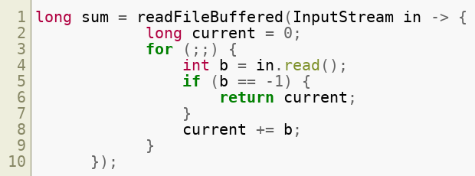
(DoS): Release Resources
A good sample pattern to extracting the paired acquire and release operations in Java SE 8:
Copyright © 2021 by Elephant Scale, All Rights Reserved

Slide 8
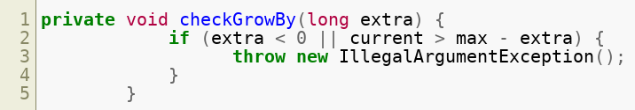
DoS: Integer Overflow
The following piece of code avoids overflow:
Copyright © 2021 by Elephant Scale, All Rights Reserved

Slide 9
Input Validation
Denial of Service (DoS) Input Validation Mutability Variable Scope Thread Safety Exception Handling Role-Based Authentication
Copyright © 2021 by Elephant Scale, All Rights Reserved

Slide 10
Validate All Inputs
Inpute Sources:
Method Arguments
External Streams
If from untrusted sources, validate it
Copyright © 2021 by Elephant Scale, All Rights Reserved

Slide 11
Validate Output From Objects As Input
Example: Class object returned by ClassLoaders
ClassLoader instances which
get passed as arguments
or are set in Thread context can be controled by attacker
So, don't make many assumptions when calling this method
Copyright © 2021 by Elephant Scale, All Rights Reserved

Slide 12
Define Wrappers Around Native Methods
Java code unlike native methods is secure, so :
Do not make a native method public
Instead expose the functionality through a public java-based wrapper method
Example: Next slide
Copyright © 2021 by Elephant Scale, All Rights Reserved

Slide 13
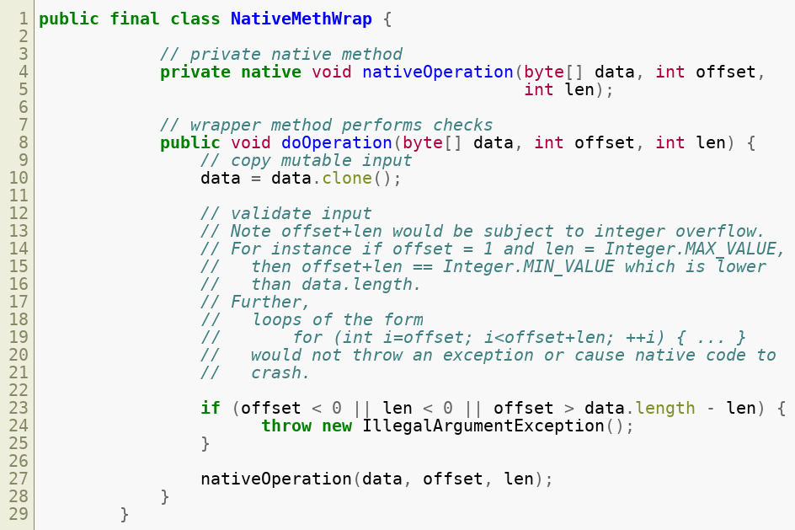
Example of Wrapper
Copyright © 2021 by Elephant Scale, All Rights Reserved

Slide 14
Quiz
What is DoS?
(in the context of security)
What areas of Java SE can be attacked?
What are the defences against DoS?
Copyright © 2021 by Elephant Scale, All Rights Reserved

Slide 15
Lab
Input validation:
Overview: A Java code to set Boiler temperature using JNI implementation
Requirements: Linux, JDK 64bit, gcc compiler 64-bit
Approximate time: 60 minutes
Instructions: labs/java-security-validation/labs/input_validation.md
https://github.com/elephantscale/secure-coding-labs/blob/main/java_security_validation/labs/input_validation.md
Copyright © 2021 by Elephant Scale, All Rights Reserved

Slide 16
Mutability
Denial of Service (DoS) Input Validation Mutability Variable Scope Thread Safety Exception Handling Role-Based Authentication
Copyright © 2021 by Elephant Scale, All Rights Reserved

Slide 17
Introduction
Mutable object: it is possible to change the state and fields after creation
Immutable object: you cannot change anything after creation
Most classes are created as mutable
Mutable classes may result in a variety of security issues
Copyright © 2021 by Elephant Scale, All Rights Reserved

Slide 18
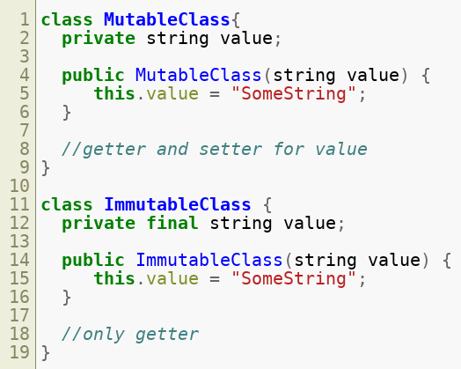
How to Create Mutable and Immutable
Copyright © 2021 by Elephant Scale, All Rights Reserved

Slide 19
Immutability In Value Types
Should not be subclassable
Hiding constructors helps more flexibility in creation of instances
Is a protection against mutable inputs and outputs
Copyright © 2021 by Elephant Scale, All Rights Reserved

Slide 20
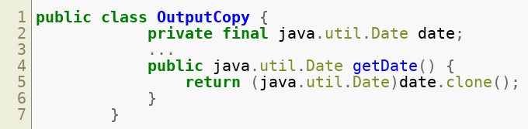
Copy Mutable Output Values
Example of copying a trusted mutable object:
Copyright © 2021 by Elephant Scale, All Rights Reserved

Slide 21
Copies of Mutable Classes
Mutable objects can be changed during and after execution of the method or constructor call
Types which are subclassed can behave incorrectly
Following example creates a copy of mutable object, calls a copy constructor
Copyright © 2021 by Elephant Scale, All Rights Reserved

Slide 22
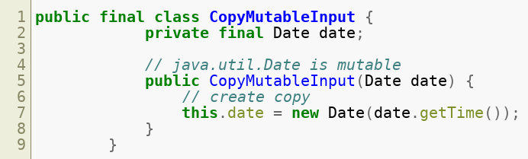
Copy of Mutable as Subclass
Copyright © 2021 by Elephant Scale, All Rights Reserved

Slide 23
Support Copy Functionality
Let it be possible creating safe copy
Static creation method, a copy constructor and public copy method for final classes may help in this regard
Do not use java.lang.Cloneable mechanism
Copyright © 2021 by Elephant Scale, All Rights Reserved

Slide 24
Overridable Identity Equality
Overridable methods sometimes behave strange
You may get True value from two different objects by Object.equal
Example: When using key in a Map , an object may be able to pass itself off as a different object that it should not have access to
Solution: If possible collection implementation that enforces identity equality like IdentityHashMap
Copyright © 2021 by Elephant Scale, All Rights Reserved

Slide 25
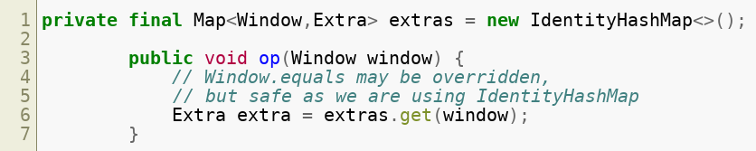
Collection Implementation Example
Copyright © 2021 by Elephant Scale, All Rights Reserved

Slide 26
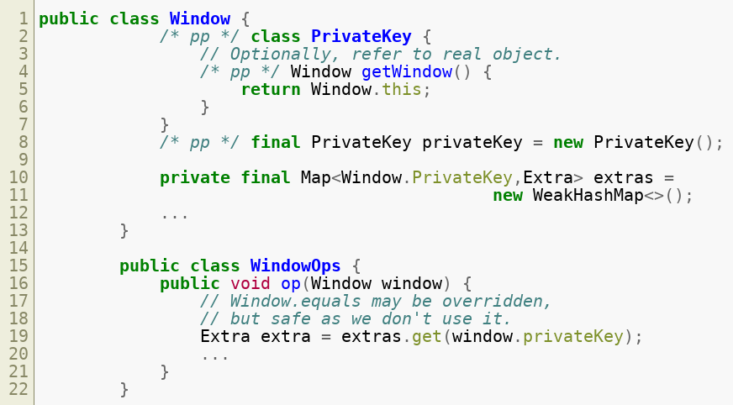
Package Private Key
If such a collection is not available: Package private key helps
Copyright © 2021 by Elephant Scale, All Rights Reserved

Slide 27
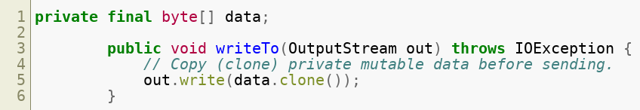
Input to Untrusted Object As Output
Previous instructions on output objects are applicable when passed to untrusted objects
Apply proper copying
Copyright © 2021 by Elephant Scale, All Rights Reserved

Slide 28
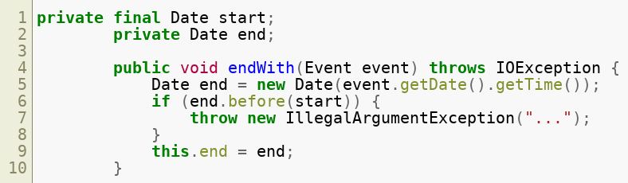
Output From Untrusted Objects As Input
Previous instructions on input objects are applicable when returned from untrusted objects
Apply proper copying and validation
Copyright © 2021 by Elephant Scale, All Rights Reserved

Slide 29
Wrapper Methods
If you need public access to a internal state of calss declaring a private field and enabling access via public wrapper method would help
If you need access from sublclsses declaring a private field and enabling access via protected wrapper method is a good idea
Wrapper methods enable us validate input before setting a new value
Copyright © 2021 by Elephant Scale, All Rights Reserved

Slide 30
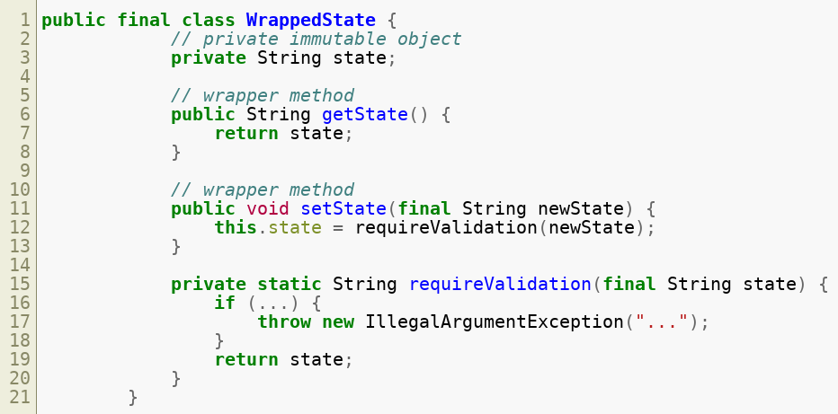
Example of Wrapped State
Copyright © 2021 by Elephant Scale, All Rights Reserved

Slide 31
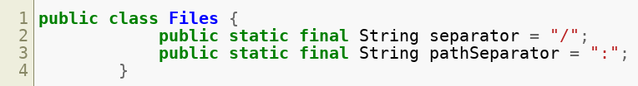
Making Public Static Fields Final
Copyright © 2021 by Elephant Scale, All Rights Reserved

Slide 32
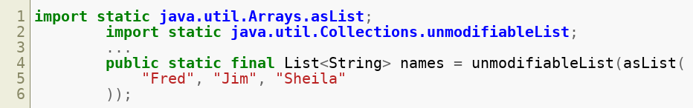
Public Static Final Field Values
Only immutable and unmodifiable values should be stored in public static fields
Following example shows prevention the list from being modified
Copyright © 2021 by Elephant Scale, All Rights Reserved

Slide 33
Variable Scope
Denial of Service (DoS) Input Validation Mutability Variable Scope Thread Safety Exception Handling Role-Based Authentication
Copyright © 2021 by Elephant Scale, All Rights Reserved

Slide 34
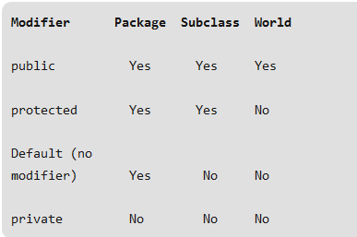
Class Level Scope
Also called member variables
Are declared inside the class but outside any function
Can be access outside the class with these rules:
Copyright © 2021 by Elephant Scale, All Rights Reserved

Slide 35
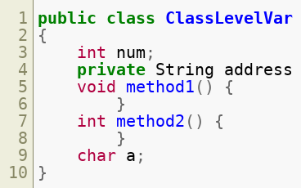
Class Level Declaration
Copyright © 2021 by Elephant Scale, All Rights Reserved

Slide 36
Method Level Scope
Also called local variables
Declared inside the method
Only accessible inside the method
When execution of the method finishes, they disapear
Copyright © 2021 by Elephant Scale, All Rights Reserved

Slide 37
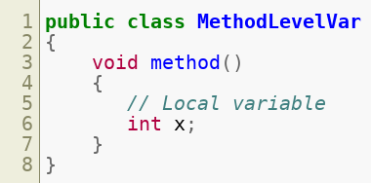
Method Level Declaration
Copyright © 2021 by Elephant Scale, All Rights Reserved

Slide 38
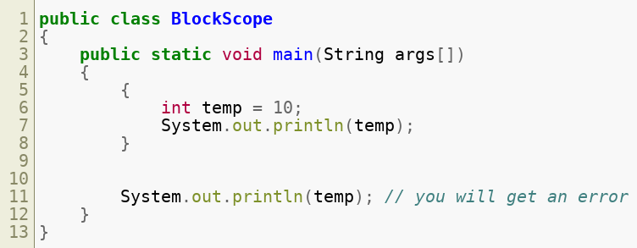
Block Scope
Also called Loop variables
Are declared inside brackets {}
Are valid only inside the bracket
Example:
Copyright © 2021 by Elephant Scale, All Rights Reserved

Slide 39
Method Scopes
The discussion of scopes for methods follows the same guidelines as for variables
Copyright © 2021 by Elephant Scale, All Rights Reserved

Slide 40
Class Scopes
Public and package access
Private class dosn't make sense
Default modifier is package access
Copyright © 2021 by Elephant Scale, All Rights Reserved

Slide 41
Thread Safety
Denial of Service (DoS) Input Validation Mutability Variable Scope Thread Safety Exception Handling Role-Based Authentication
Copyright © 2021 by Elephant Scale, All Rights Reserved

Slide 42
Introduction
Many techniques provide secure threading some of them are:
No state
No shared state (one of the best ways)
Message passing
Immutable state
Synchronized blocks
Volatile fields
Copyright © 2021 by Elephant Scale, All Rights Reserved

Slide 43
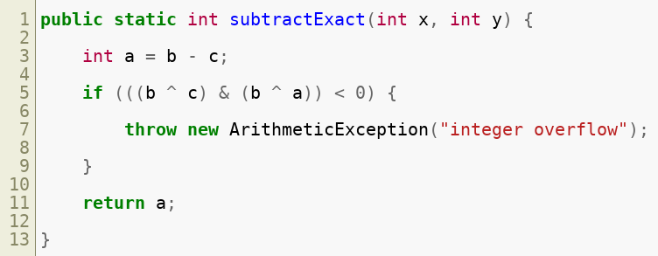
No State
an instance or static variable may be used by multiple threads
Avoid instance or static variables
Example: (part of class.lang.Math )
Copyright © 2021 by Elephant Scale, All Rights Reserved

Slide 44
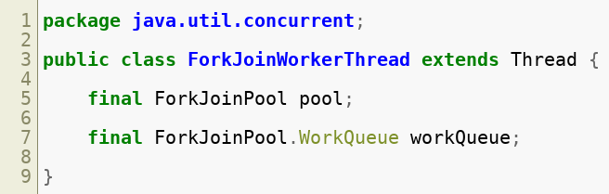
No Shared State
You cannot avoid state? At least don't share it
One way is extending the thread class and adding an instance variable
Pool and workQueue are local to a single worker thread in the example
Example:
Copyright © 2021 by Elephant Scale, All Rights Reserved

Slide 45
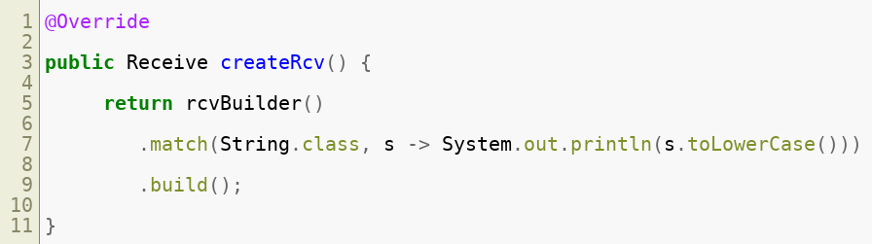
Message Passing
You don't want to share the state? Let the threads communicate
How? pass messages between them
An example of sending a message with Akka framework:
And receive a message:
Copyright © 2021 by Elephant Scale, All Rights Reserved

Slide 46
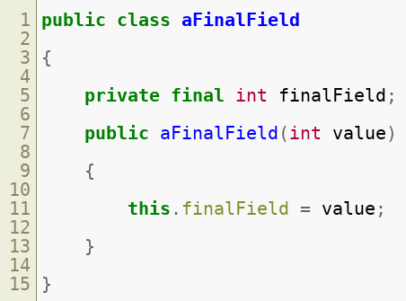
Immutable State
If you don't want the message to be changed by another thread make it immutable
When implementing an immutable class, declare its fields as final
Example:
Copyright © 2021 by Elephant Scale, All Rights Reserved

Slide 47
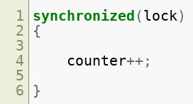
Synchronized Blocks
Put a lock inside a sync block
To be sure two threads won't execute this section simultaneously
Copyright © 2021 by Elephant Scale, All Rights Reserved

Slide 48
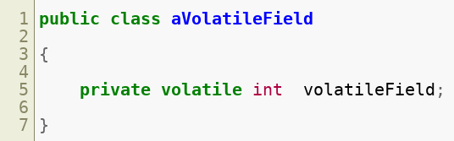
Volatile Fields
By declaration of a variable you tell the JVM and the compiler to return the latest written value
Copyright © 2021 by Elephant Scale, All Rights Reserved

Slide 49
Lab
Thread safety:
Overview: A Railway Ticket Booking System for explaining the Thread-safe and Exception Handling.
Requirements: Linux, JDK 1.8 and Apache Maven 3.5.4
Approximate time: 60 minutes
Instructions: labs/thread-safety-labs/labinfo/thread_safe.md & thread_unsafe.md
https://github.com/elephantscale/secure-coding-labs/tree/main/thread-safety-labs/labinfo
Copyright © 2021 by Elephant Scale, All Rights Reserved

Slide 50
Exception Handling
Denial of Service (DoS) Input Validation Mutability Variable Scope Thread Safety Exception Handling Role-Based Authentication
Copyright © 2021 by Elephant Scale, All Rights Reserved

Slide 51
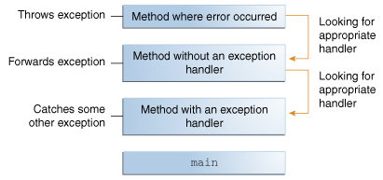
What Is An Exception?
Exception = exceptional event
A disruption during normal flow of program's instruction
An object is created containing information about the error
Copyright © 2021 by Elephant Scale, All Rights Reserved

Slide 52
Kinds of Exception?
Checked exception; subject to exception handling
Error
Runtime exception
An exception must be enclosed by one of these:
try statement
throws clause
Copyright © 2021 by Elephant Scale, All Rights Reserved

Slide 53
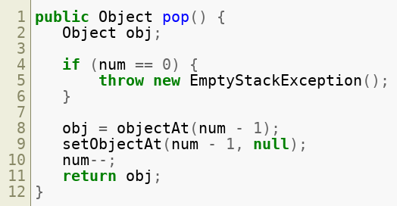
How to Throw an Exception?
It's done by throw statement:
Copyright © 2021 by Elephant Scale, All Rights Reserved

Slide 54
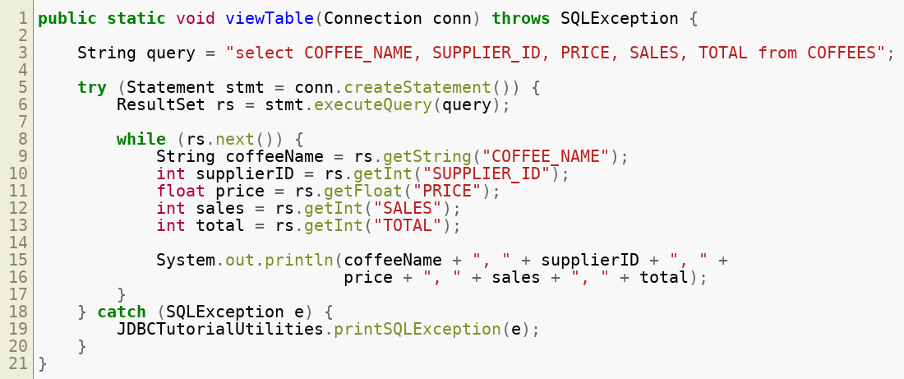
The try-with-resources Statement
Ensures that the resource will be closed at the end
Example:
Copyright © 2021 by Elephant Scale, All Rights Reserved

Slide 55
Advantages of Exceptions
Separating error-handling code from regular code
Propagating errors up the call stack
Grouping and differentiating error types
Copyright © 2021 by Elephant Scale, All Rights Reserved

Slide 56
Role-Based Authentication
Denial of Service (DoS) Input Validation Mutability Variable Scope Thread Safety Exception Handling Role-Based Authentication
Copyright © 2021 by Elephant Scale, All Rights Reserved

Slide 57
Introduction
Allows user to authenticate to a role
For every instance of authentication specify the following attributes:
Conflict resolution level
Autentication configuration
Login success URL
Authentication post processing classes
Copyright © 2021 by Elephant Scale, All Rights Reserved

Slide 58
Login URLs
Can be specified in The User Interface Login URL.
Calls the role authentication module
Redirection :
Upon successful or failed login, Access Manager redirects the user to the right page
Copyright © 2021 by Elephant Scale, All Rights Reserved

