Slide 1
Introduction to OAuth2 in JavaScript
Basics
Authorizing Access To API
OpenID Connect
OpenID Connect On Clients
Impersonating The User
Credentials
Copyright © 2021 by Elephant Scale, All Rights Reserved

Slide 2
Basics
Basics Authorizing Access To API OpenID Connect OpenID Connect On Clients Impersonating The User Credentials
Copyright © 2021 by Elephant Scale, All Rights Reserved

Slide 3
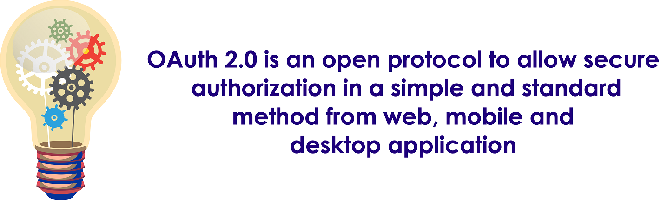
What Is It
Copyright © 2021 by Elephant Scale, All Rights Reserved

Slide 4
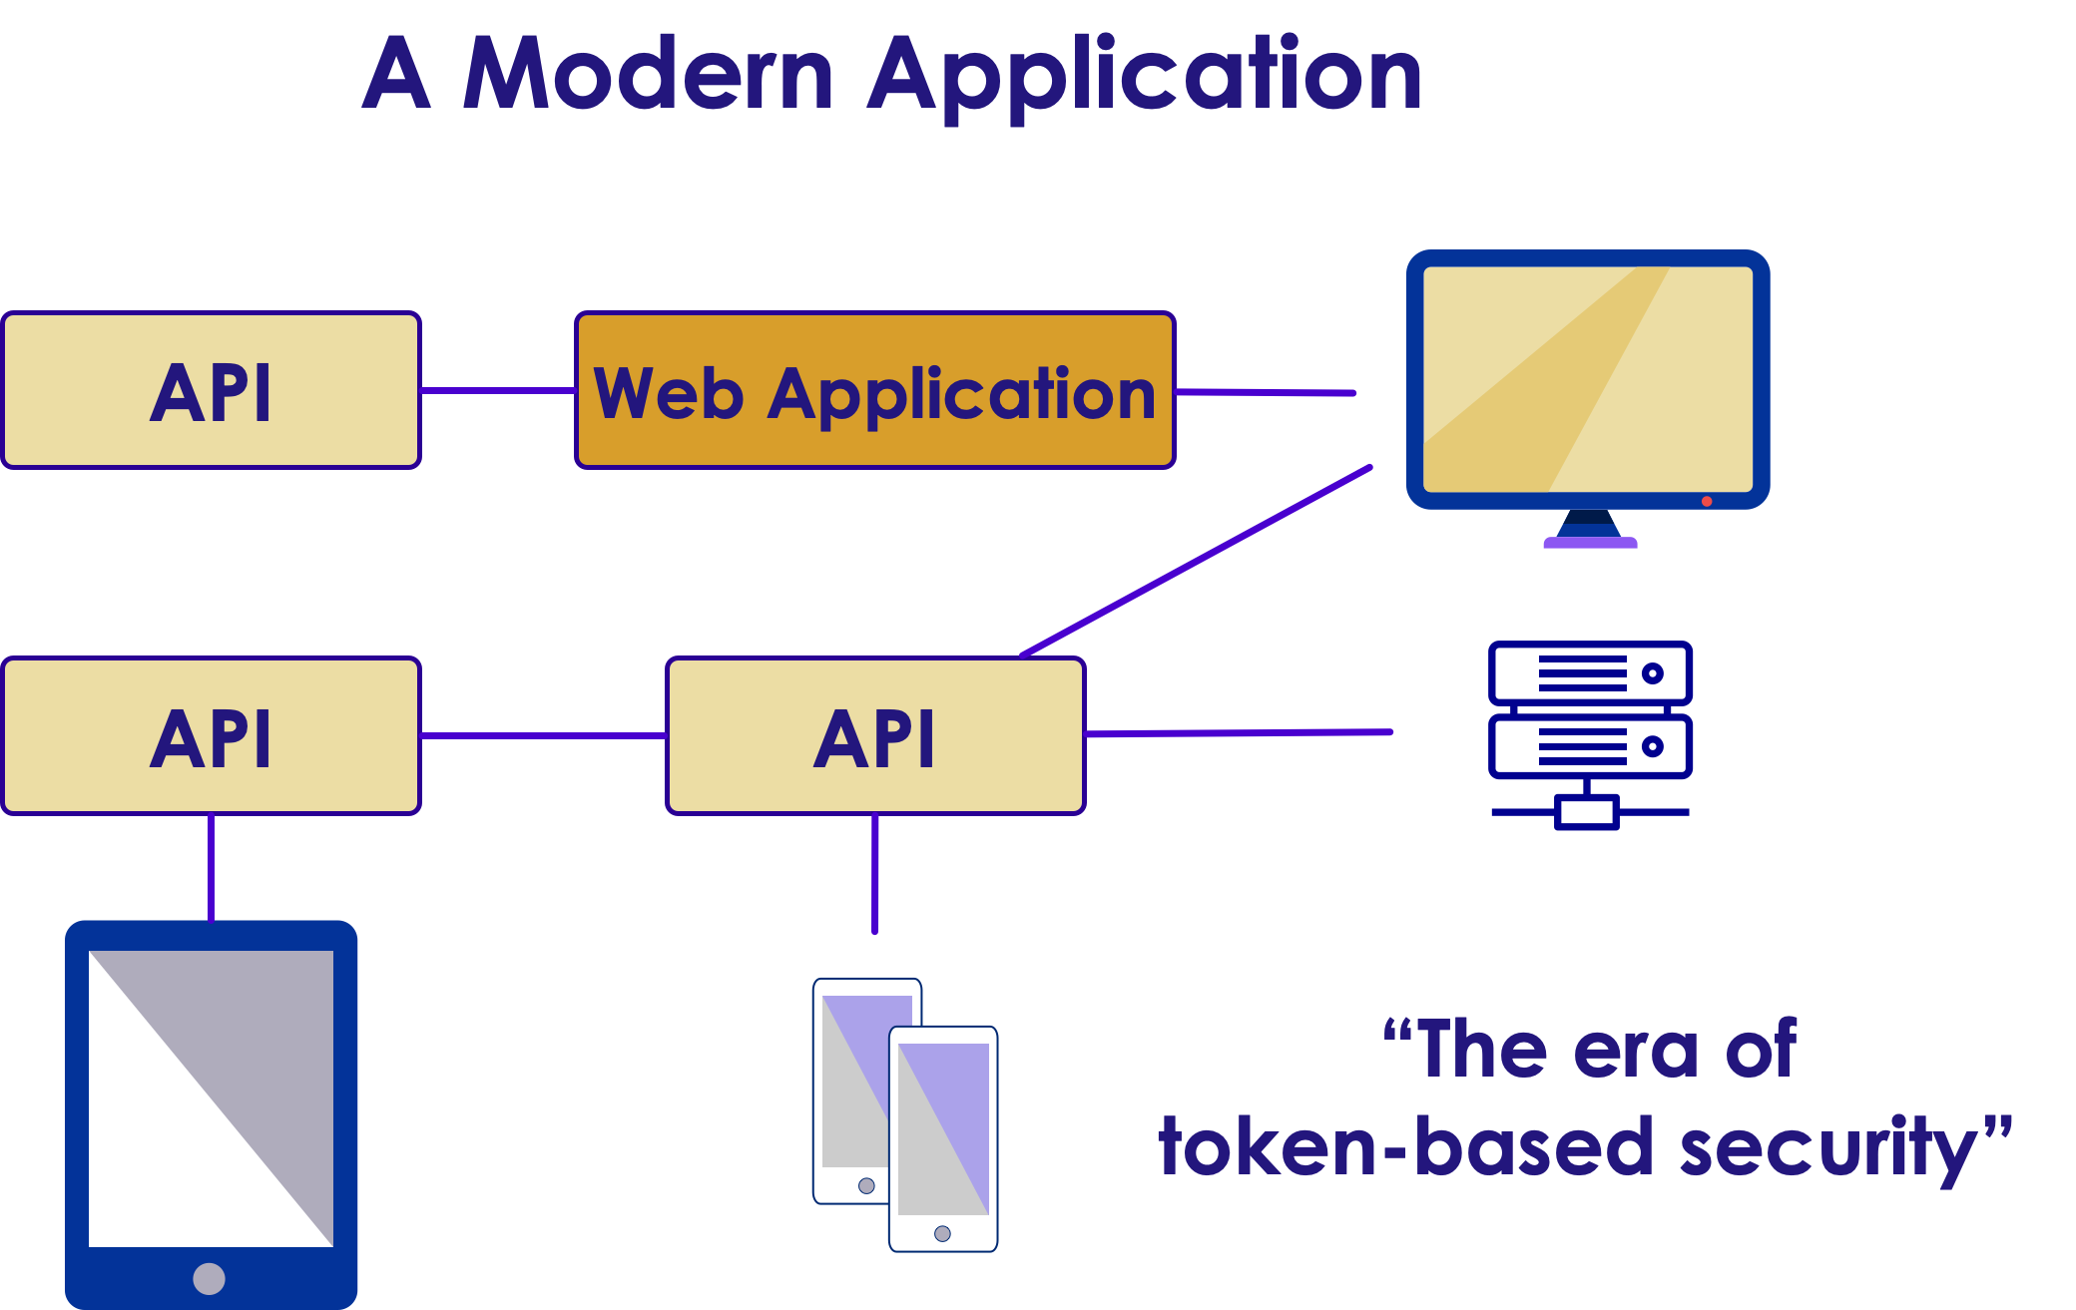
Application
Copyright © 2021 by Elephant Scale, All Rights Reserved

Slide 5
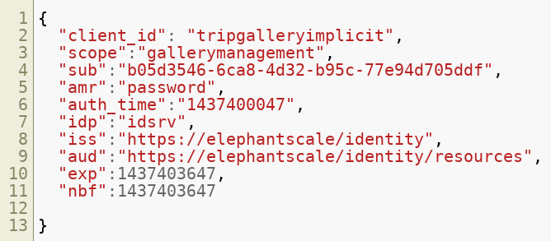
Typical Payload of OAuth2 Access Token
Copyright © 2021 by Elephant Scale, All Rights Reserved

Slide 6
Defining OAuth 2.0
Is not an authentication method
Is an authorization method
Standard is silent about the user
RFC6749
Copyright © 2021 by Elephant Scale, All Rights Reserved

Slide 7
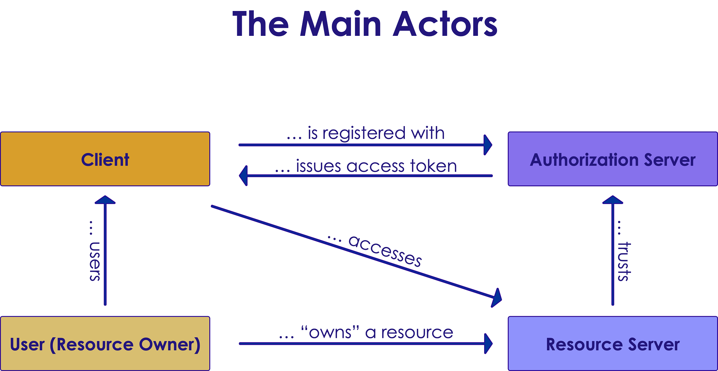
Actors
Copyright © 2021 by Elephant Scale, All Rights Reserved

Slide 8
Simple Questions
Different types of applications require different means to achieve authorization
Where can the token be delivered to?
Can the client application safely store secrets?
Copyright © 2021 by Elephant Scale, All Rights Reserved

Slide 9
Making Decision
How can you safely achieve authorization?
By answering to this question choose your type of application you are building:
Client Credentials
Implicit
Authorization Code
Resource Owner Password Credentials
Device Code
Copyright © 2021 by Elephant Scale, All Rights Reserved

Slide 10
Clients
Confidential clients:
Clients that can maintain the confidentiality of their credentials
Example: web applications
Public clients:
Clients that cannot maintain the confidentiality of their credentials
Copyright © 2021 by Elephant Scale, All Rights Reserved

Slide 11
Client Examples
JavaScript clients
Native apps
iOS
Android
Windows Phone apps built in a native or compile to native language
User-Agent based apps
JavaScript apps
Copyright © 2021 by Elephant Scale, All Rights Reserved

Slide 12
Endpoints: On Authorization Server
Authorization endpoint
Used by the client to get authorization the owner of resource through user-agent redirection
Token endpoint
Client uses this token to exchange an authorization grant for an access tokent usualy with client authentication
Copyright © 2021 by Elephant Scale, All Rights Reserved

Slide 13
Endpoints: On Client
Redirection endpoint
Authorization server uses it to return responses containing authorization credentials to the client through resource owner user=agent
Copyright © 2021 by Elephant Scale, All Rights Reserved

Slide 14
What About Authorization server?
We don't have to implement Authorization server
Identity server
For example: @leastprivilege and @brockallen Implement OAuth 2.0 and OpenID Connect
Copyright © 2021 by Elephant Scale, All Rights Reserved

Slide 15
Authorizing Access To API
Basics Authorizing Access To API OpenID Connect OpenID Connect On Clients Impersonating The User Credentials
Copyright © 2021 by Elephant Scale, All Rights Reserved

Slide 16
Client Credentials Flow
Machine to machine communication
No human or username and password involved
Can be used to get access token using client credentials
Is used only by confidential clients
A public client doesn't safely store the client secret
Copyright © 2021 by Elephant Scale, All Rights Reserved

Slide 17
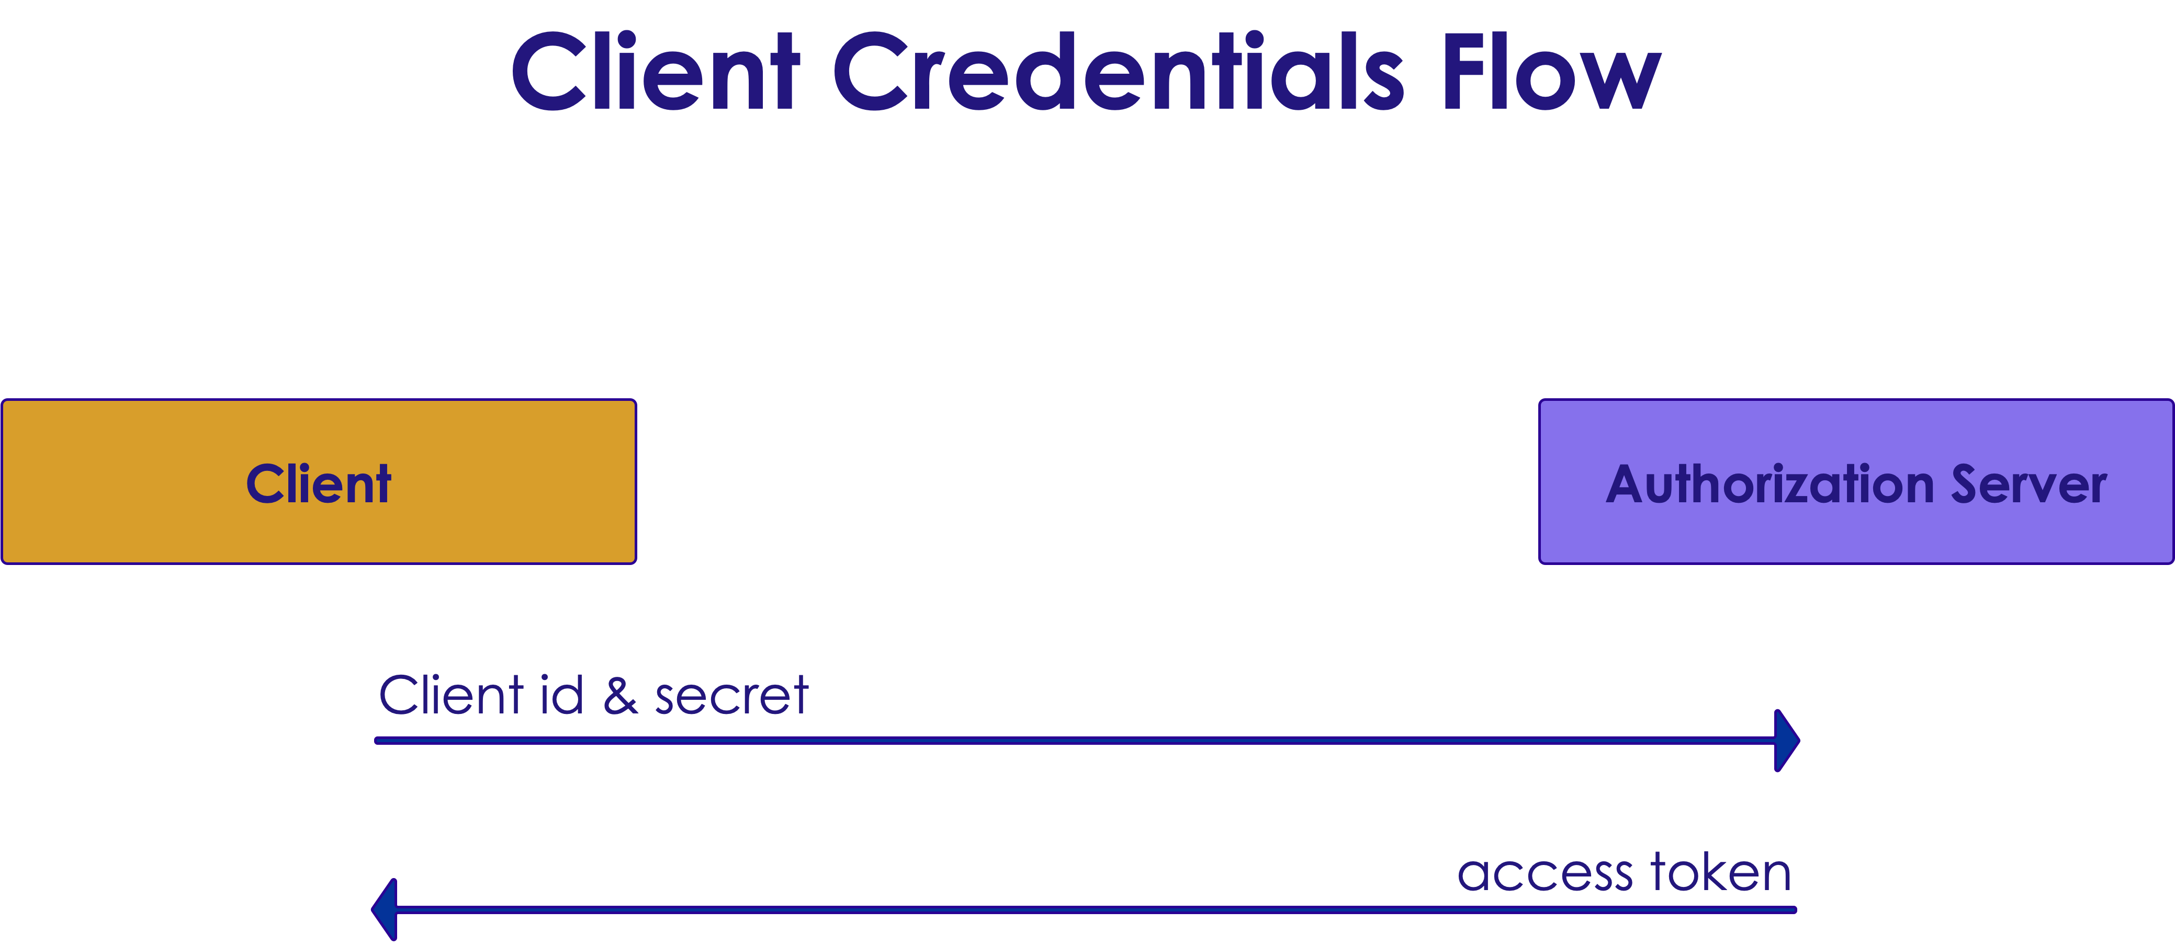
Flow In A Picture
Copyright © 2021 by Elephant Scale, All Rights Reserved

Slide 18
How About Angular?
Question: Can we use client credential for our Angular applications?
Answer: Yes but * It is not safe *
It's like to lock the door but leave the key on it
Copyright © 2021 by Elephant Scale, All Rights Reserved

Slide 19
Implicit Flow
For public clients at predefined redirection URI and also might used by confidential clients (JavaScript or Angular apps)
To obtain access tokens not refresh tokens
No client authentication because a public user cannot store the secret safely
Copyright © 2021 by Elephant Scale, All Rights Reserved

Slide 20
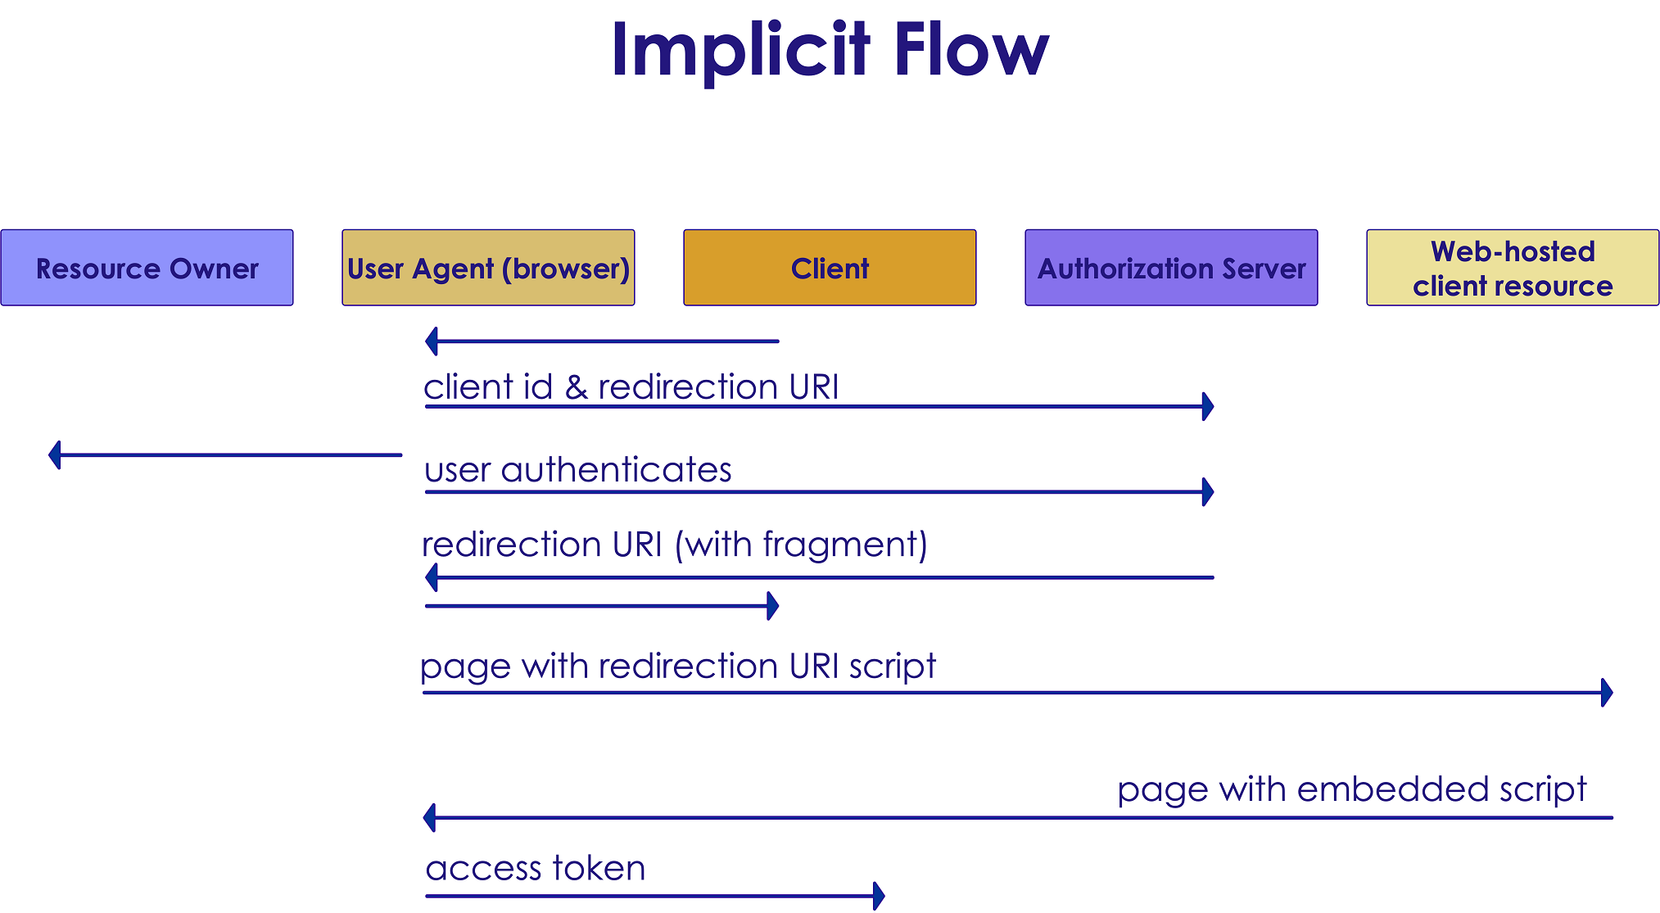
Implicit Flow In A Picture
Copyright © 2021 by Elephant Scale, All Rights Reserved

Slide 21
Authorization Code Flow
Optimized for confidential and public clients
To get access and refresh tokens
Includes a client authentication step
Copyright © 2021 by Elephant Scale, All Rights Reserved

Slide 22
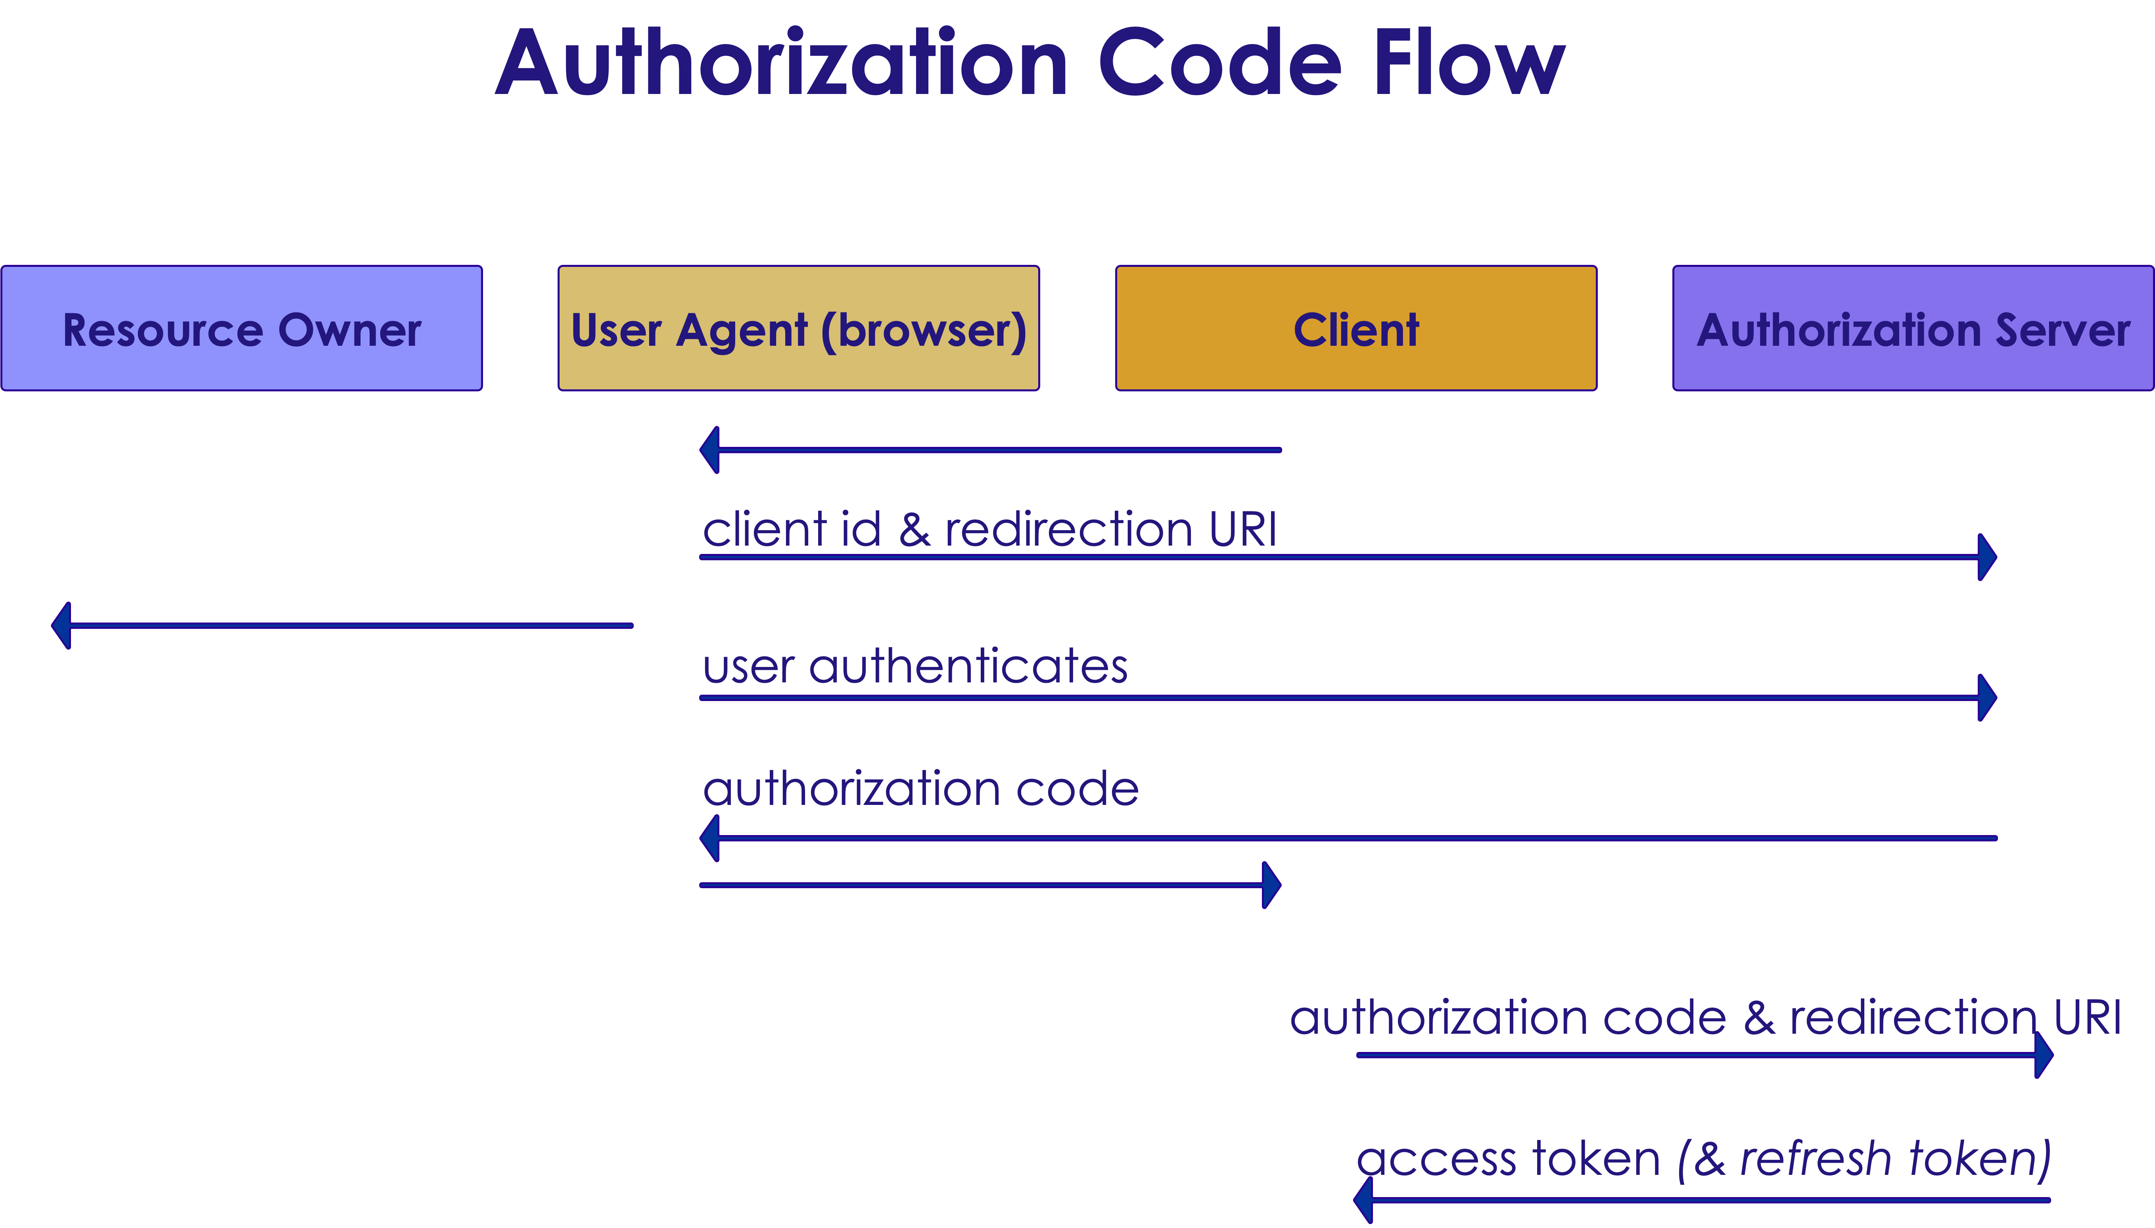
Authorization Code Flow In A Picture
Copyright © 2021 by Elephant Scale, All Rights Reserved

Slide 23
Resource Owner Password Credentials Flow
Client has to be able to obtain the resource owner's credentials (for example via in-app login screen)
Just for trusted applications
Is used to obtain access and refresh tokens
Inludes a client authentication step
High risk in compared to other flows so it is the last choice
Copyright © 2021 by Elephant Scale, All Rights Reserved

Slide 24
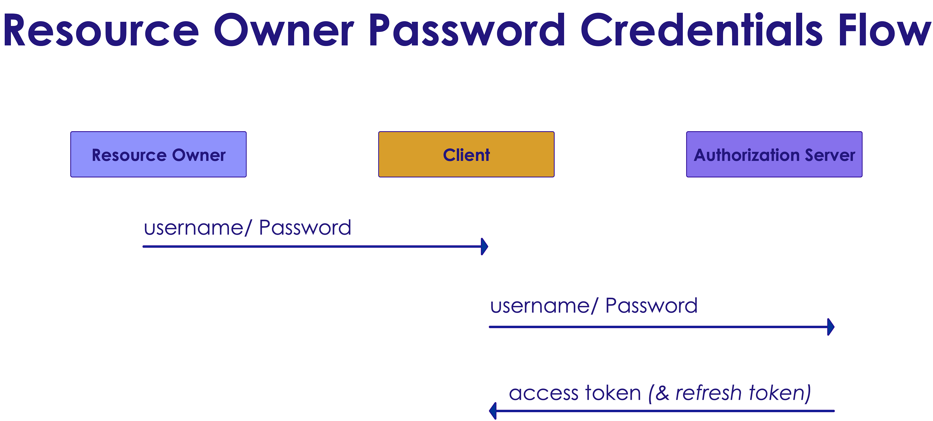
Flow In A Picture
Copyright © 2021 by Elephant Scale, All Rights Reserved

Slide 25
Device Code Flow
Between devices that have Internet connection but not browser
Flow between smart TVs, media consols, etc.
Copyright © 2021 by Elephant Scale, All Rights Reserved

Slide 26
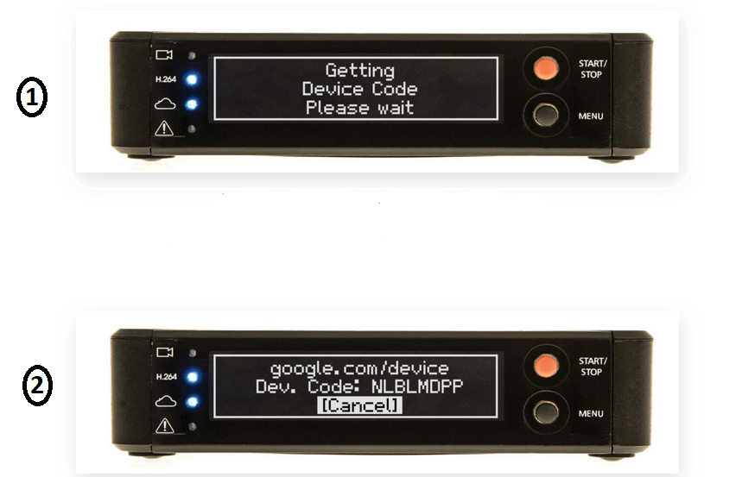
Device Code Flow In A Picture
Copyright © 2021 by Elephant Scale, All Rights Reserved

Slide 27
Angular And Cross-Origin Resource Sharing
Browsers prevent the web page from making AJAX requests to another domain
Cross-Origin Resource Sharing (CORS) is W3C standard
Allows server to relax the same origin policy
Copyright © 2021 by Elephant Scale, All Rights Reserved

Slide 28
Example:
Origin: http://elephantscale.com
Different domain: http://elephantscale.org
Different port: http://elephantscale.com:2546
Different scheme: https://elephantscale.com
Different subdomain: http://www.elephantscale.com
Copyright © 2021 by Elephant Scale, All Rights Reserved

Slide 29
OpenID Connect
Basics Authorizing Access To API OpenID Connect OpenID Connect On Clients Impersonating The User Credentials
Copyright © 2021 by Elephant Scale, All Rights Reserved

Slide 30
Problem?
OAuth 2 has to do with authorization
How can we can handle authentication?
How can we get information regarding identity
Solution: OpenID Connect
Copyright © 2021 by Elephant Scale, All Rights Reserved

Slide 31
OpenID Connect
A simple identity layer on the OAuth 2 protocol
Core functionality:
Authentication
Claims about the user
Copyright © 2021 by Elephant Scale, All Rights Reserved

Slide 32
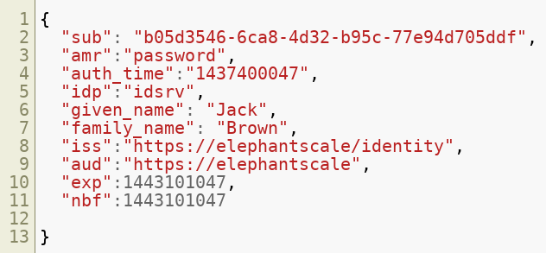
How It Works?
New type of token : ID token
Example: A typical ID token:
Copyright © 2021 by Elephant Scale, All Rights Reserved

Slide 33
OpenID Connect token
id_token contains claims about the authentication of an end user (and other requested claims)
id_token can be used for signing in to an application
Access tokens are for accessing resources
UserInfo endpoint:
Can be used by the client to get more user information of the authenticated user
These claims are requested with the access_token
Copyright © 2021 by Elephant Scale, All Rights Reserved

Slide 34
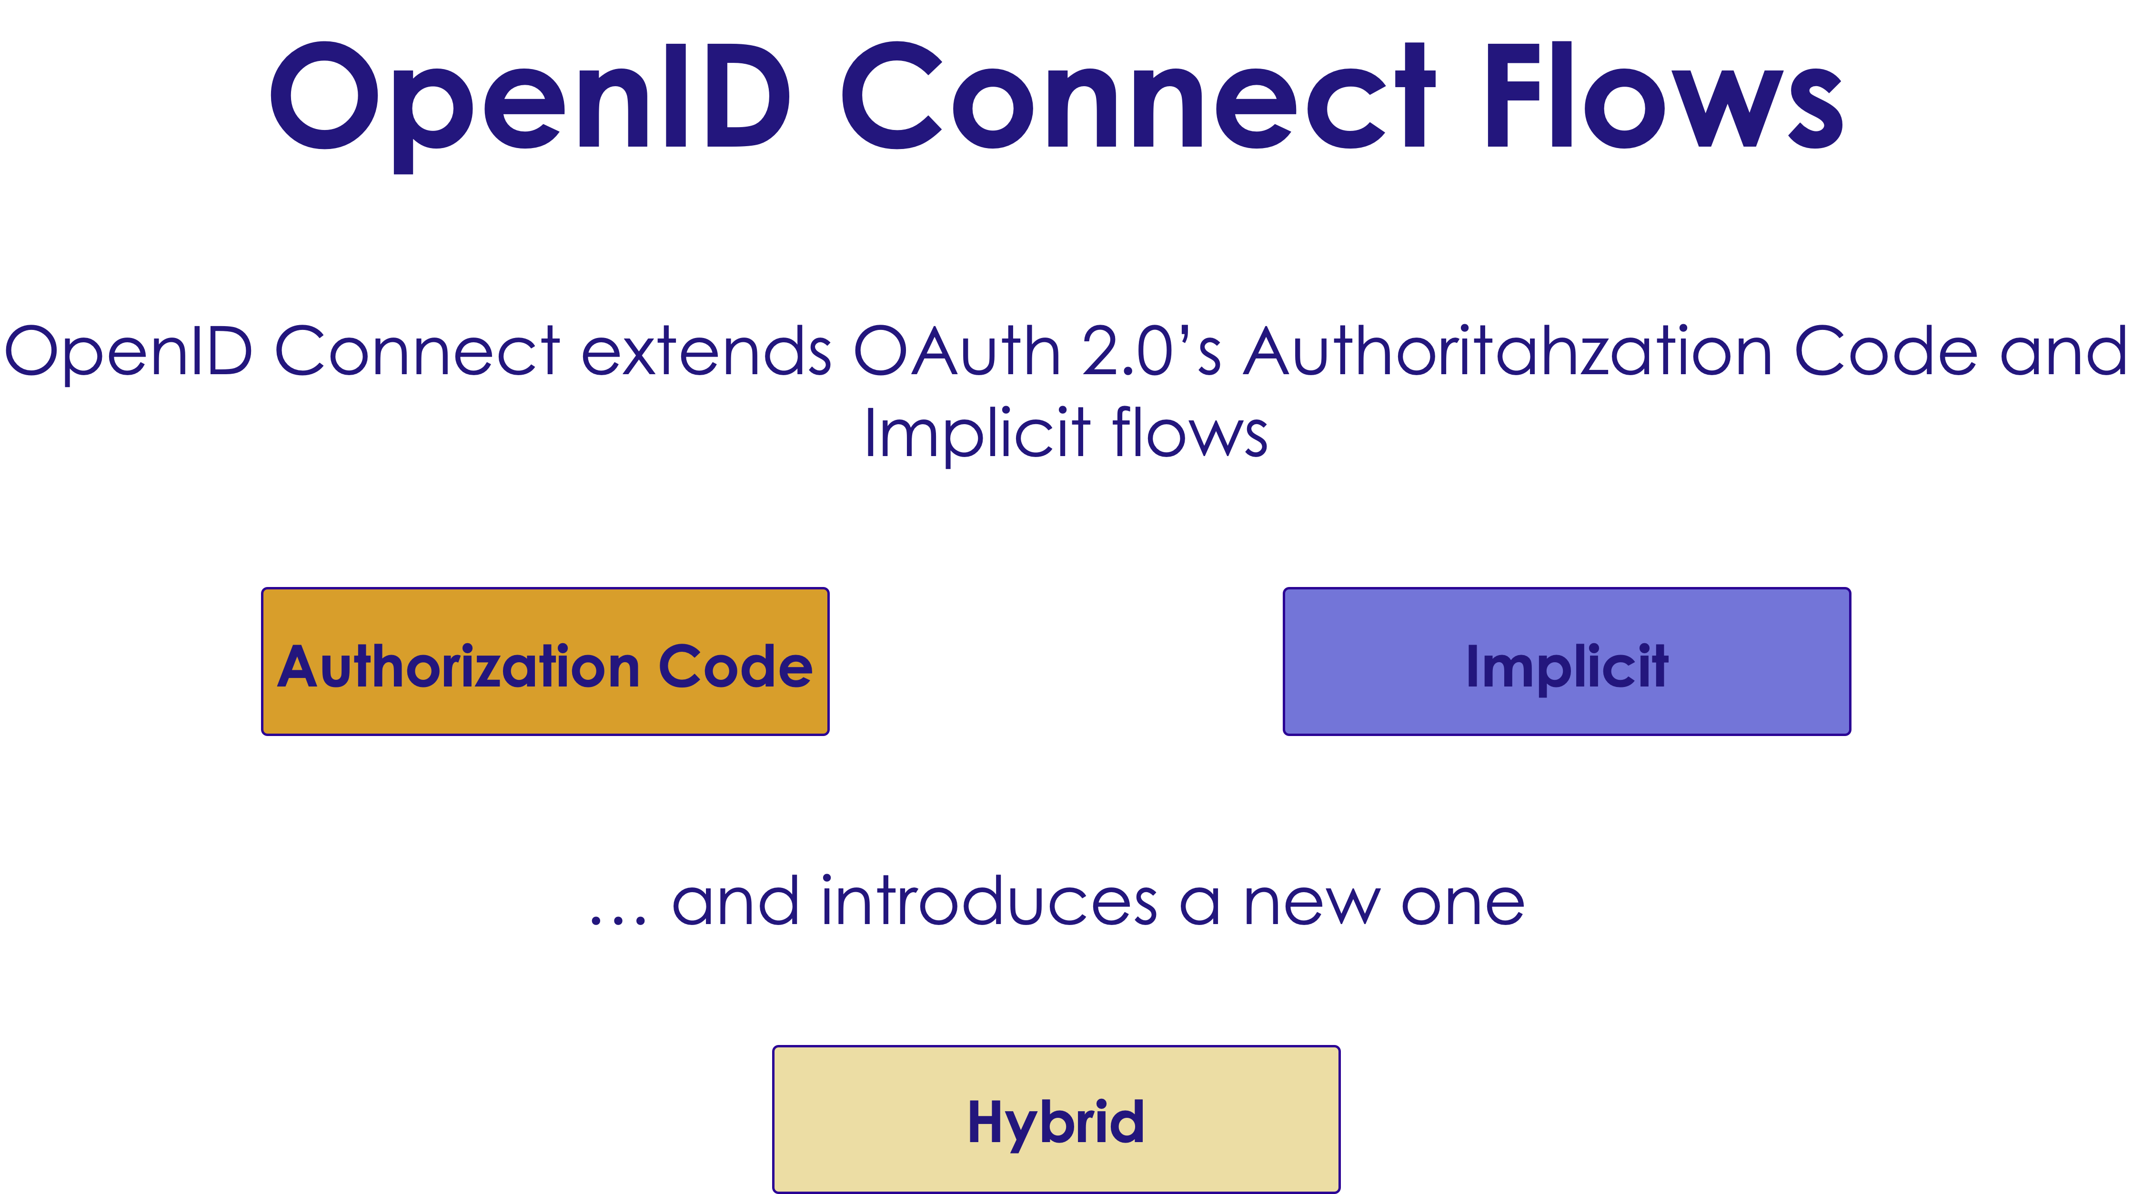
OpenID Connect Flow
Extends authorization code of OAuth 2 and implicit flow
Copyright © 2021 by Elephant Scale, All Rights Reserved

Slide 35
Scopes And Claims
OpenID Connect adds identity scopes to OAuth 2.0 resource scopes
Example:
profile scope:
name
family-name
middle-name
...
Copyright © 2021 by Elephant Scale, All Rights Reserved

Slide 36
Scopes And Claims, cont'd
Copyright © 2021 by Elephant Scale, All Rights Reserved - email scope: - email - verified-email - phone scope: - phone-num - verified-num

Slide 37
OpenID Connect On Clients
Basics Authorizing Access To API OpenID Connect OpenID Connect On Clients Impersonating The User Credentials
Copyright © 2021 by Elephant Scale, All Rights Reserved

Slide 38
Choosing The Right Flow
Depends on the response_type is requested
Authorization code: Confidential clients
Implicit: Public clients
Hybrid: Confidential or public clients if you send auth code to the server not user agent
Copyright © 2021 by Elephant Scale, All Rights Reserved

Slide 39
Helper Components
Helper components for JavaScript : - oidc client - oidc token manager bash https://github.com/IdentityModel/oidc-client https://github.com/IdentityModel/oidc-token-manager
Copyright © 2021 by Elephant Scale, All Rights Reserved

Slide 40
Impersonating The User
Basics Authorizing Access To API OpenID Connect OpenID Connect On Clients Impersonating The User Credentials
Copyright © 2021 by Elephant Scale, All Rights Reserved

Slide 41
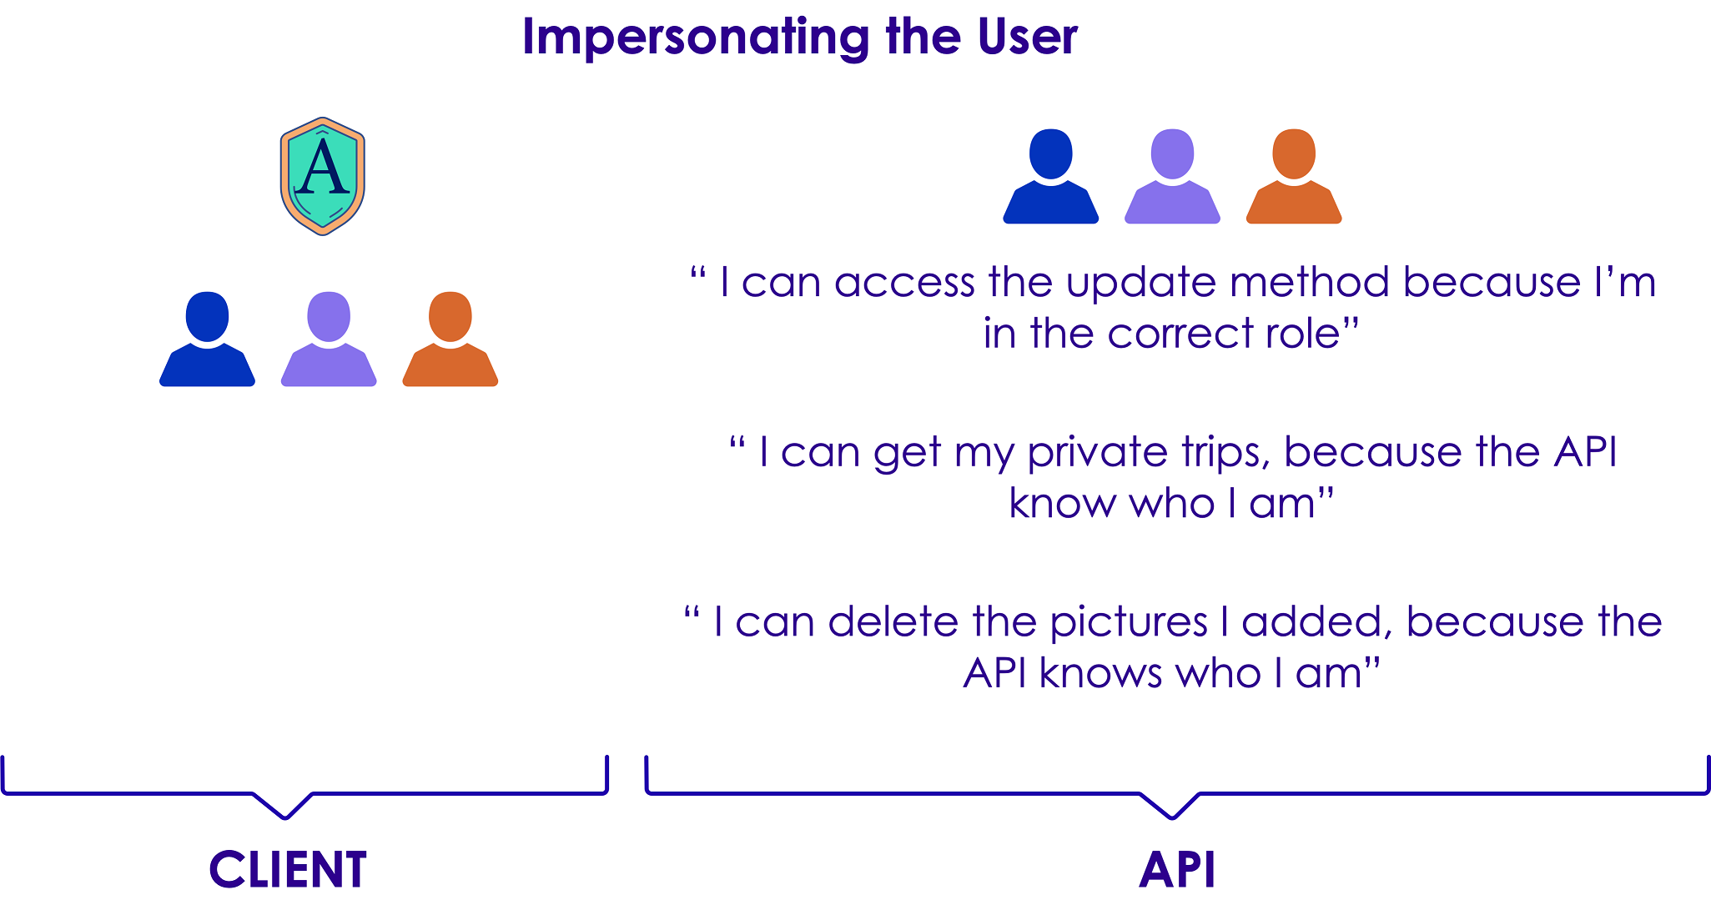
A Bit API Level
Copyright © 2021 by Elephant Scale, All Rights Reserved

Slide 42
Role-Based Authentication
We are not authorizing access to actions depending on the user (Because of functional requirements)
We can add additional claims in the acces token and use them for authorization
A role claim is an example, and allows role-based authorization
Copyright © 2021 by Elephant Scale, All Rights Reserved

Slide 43
Credentials
Basics Authorizing Access To API OpenID Connect OpenID Connect On Clients Impersonating The User Credentials
Copyright © 2021 by Elephant Scale, All Rights Reserved

Slide 44
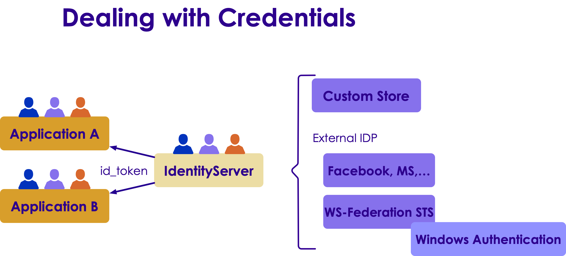
Diagram
Copyright © 2021 by Elephant Scale, All Rights Reserved

Slide 45

Two-Factor Authentication
2FA provides identification of users by means of the combination of two different components
Something you know, something you posses, something that's inseparable from you
Not all applications might require 2FA
Use acr_values parameter (to authorization endpoint)
Copyright © 2021 by Elephant Scale, All Rights Reserved

Slide 46
Additional Resources
Entity Framework Persistence Layer
Identity Manager
Copyright © 2021 by Elephant Scale, All Rights Reserved

