Slide 1
Your First Agent with Amazon Bedrock
Setup
Connecting Your Agent to a CRM
Adding Calculations
Guardrails for Your Agent
Using a Knowledge Base
Copyright © 2024 by Elephant Scale, All Rights Reserved

Slide 2
Setup
Setup Connecting Your Agent to a CRM Adding Calculations Guardrails for Your Agent Using a Knowledge Base
Copyright © 2024 by Elephant Scale, All Rights Reserved

Slide 3
Introduction
Build a simple cloud-based agent with Amazon Bedrock.
Understand agent setup, invocation, and tracing.
Copyright © 2024 by Elephant Scale, All Rights Reserved

Slide 4
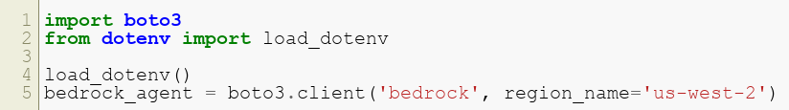
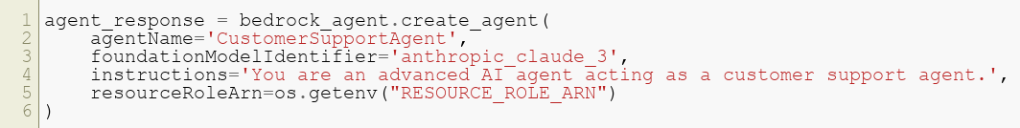
Steps to Create an Agent
Import required libraries:
Create an agent:
Prepare and configure the agent.
Copyright © 2024 by Elephant Scale, All Rights Reserved

Slide 5
Observing the Agent Workflow
Transition through states: creating , not-prepared , and prepared .
Assign an alias to invoke the agent.
Use the runtime client to interact with the agent.
Copyright © 2024 by Elephant Scale, All Rights Reserved

Slide 6
Key Takeaways
Agents require configuration for production use.
Aliases ensure stability and version control for deployment.
Copyright © 2024 by Elephant Scale, All Rights Reserved

Slide 7
Connecting Your Agent to a CRM
Setup Connecting Your Agent to a CRM Adding Calculations Guardrails for Your Agent Using a Knowledge Base
Copyright © 2024 by Elephant Scale, All Rights Reserved

Slide 8
Introduction
Enable your agent to integrate with external systems, such as CRMs.
Use Lambda functions to handle customer data and support requests.
Copyright © 2024 by Elephant Scale, All Rights Reserved

Slide 9
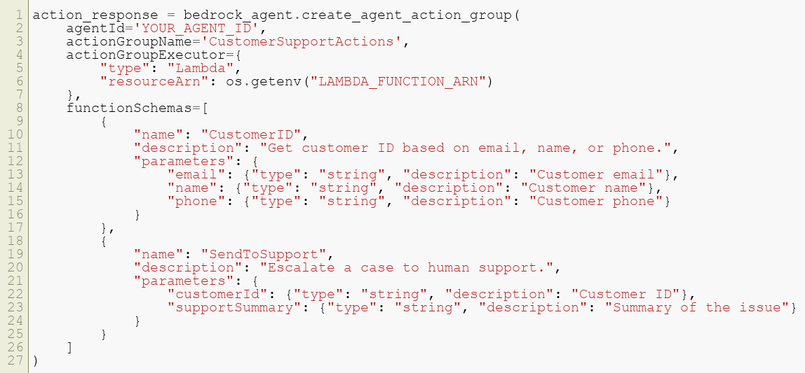
Setting Up Actions and Action Groups
Define action groups:
Copyright © 2024 by Elephant Scale, All Rights Reserved

Slide 10
Observing the Agent in Action
Agents dynamically call functions to retrieve or log data.
Example: Resolve a refund request by combining multiple steps.
Copyright © 2024 by Elephant Scale, All Rights Reserved

Slide 11
Key Takeaways
Actions expand the agent's utility and connectivity.
Ensure descriptions and parameters align with expected workflows.
Copyright © 2024 by Elephant Scale, All Rights Reserved

Slide 12
Adding Calculations
Setup Connecting Your Agent to a CRM Adding Calculations Guardrails for Your Agent Using a Knowledge Base
Copyright © 2024 by Elephant Scale, All Rights Reserved

Slide 13
Introduction
Extend the agent's capabilities by enabling code execution for calculations.
Use the ephemeral Code Interpreter feature for precise logic.
Copyright © 2024 by Elephant Scale, All Rights Reserved

Slide 14
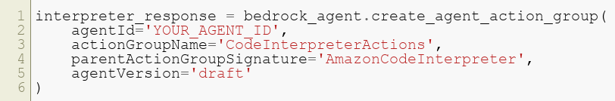
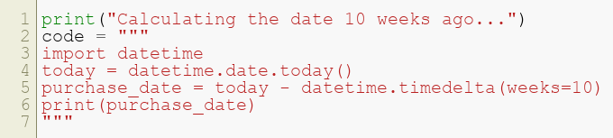
Setting Up Code Interpreter
Add a new action group for the Code Interpreter:
Observe the agent write and execute code:
Copyright © 2024 by Elephant Scale, All Rights Reserved

Slide 15
Key Takeaways
Code Interpreter enables advanced logic within workflows.
Outputs are ephemeral and improve decision-making accuracy.
Copyright © 2024 by Elephant Scale, All Rights Reserved

Slide 16
Guardrails for Your Agent
Setup Connecting Your Agent to a CRM Adding Calculations Guardrails for Your Agent Using a Knowledge Base
Copyright © 2024 by Elephant Scale, All Rights Reserved

Slide 17
Introduction
Protect your agent from inappropriate behavior and sensitive data leakage.
Implement guardrails as a safety net.
Copyright © 2024 by Elephant Scale, All Rights Reserved

Slide 18
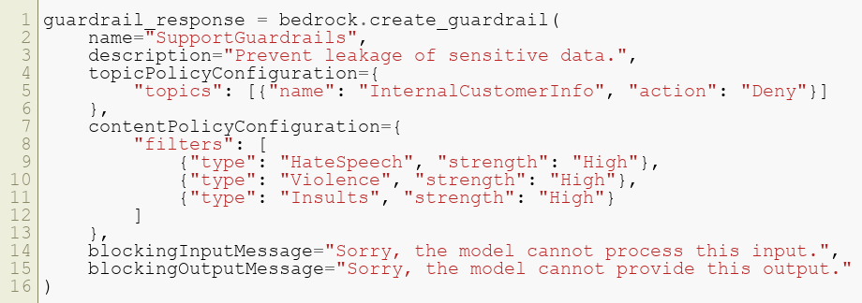
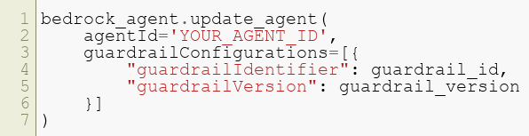
Creating Guardrails
Define topic and content policies:
Connect the guardrail to your agent:
Copyright © 2024 by Elephant Scale, All Rights Reserved

Slide 19
Key Takeaways
Guardrails act as a last line of defense for agent safety.
Combine with prompt engineering for robust control.
Copyright © 2024 by Elephant Scale, All Rights Reserved

Slide 20
Using a Knowledge Base
Setup Connecting Your Agent to a CRM Adding Calculations Guardrails for Your Agent Using a Knowledge Base
Copyright © 2024 by Elephant Scale, All Rights Reserved

Slide 21
Introduction
Integrate a knowledge base to empower your agent with direct answers.
Allow the agent to handle simple queries autonomously.
Copyright © 2024 by Elephant Scale, All Rights Reserved

Slide 22
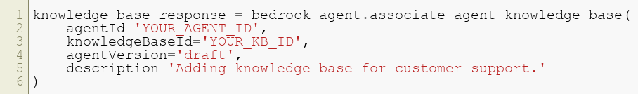
Setting Up a Knowledge Base
Associate a knowledge base with your agent:
Prepare the agent for deployment:
Copyright © 2024 by Elephant Scale, All Rights Reserved

Slide 23
Observing the Agent in Action
Handle simple issues like "My mug is chipped. What can I do?"
Escalate complex issues like refund requests to human workflows.
Copyright © 2024 by Elephant Scale, All Rights Reserved

Slide 24
Key Takeaways
Knowledge bases reduce the need for human intervention.
Enable the agent to address FAQs effectively.
Copyright © 2024 by Elephant Scale, All Rights Reserved

