Slide 1
Terraform - Introduction
Copyright © 2021 by Elephant Scale, All Rights Reserved

Slide 2
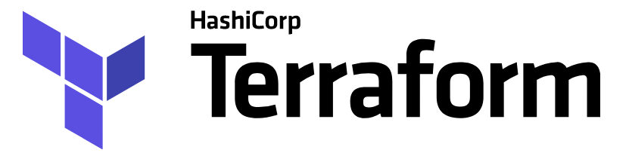
Why Terraform?
IaC (Infrastructure as Code) is one of the most important developments in application deployment in many years.
Terraform is a maverick who appeared on the scene a few years ago and became more popular than all other IaC implementations
Terraform is open source and can be used with any cloud provider, such as Amazon Web Services, IBM Cloud, Google Cloud Platform, Microsoft Azure, etc.
Terraform is declarative and idempotent . These are good design principles, and many competitors have also implemented Terraform ideas, making Terraform a de facto standard
Copyright © 2021 by Elephant Scale, All Rights Reserved

Slide 3
Terraform - Bird's Eye View
What is Terraform?
How does it compare to other similar tools?
What is its place in the IaC ecosystem
IaC = Infrastructure as Code
Copyright © 2021 by Elephant Scale, All Rights Reserved

Slide 4
What We Will Discuss
The rise of DevOps
What is infrastructure as code?
The benefits of infrastructure as code
How Terraform works
How Terraform compares to other infrastructure as code tools
Copyright © 2021 by Elephant Scale, All Rights Reserved

Slide 5

The Rise of DevOps - Before
To build a software company
Set up cabinets and racks
Load them up with servers, etc.
Set up "Devs" team, set up "Ops" team
Copyright © 2021 by Elephant Scale, All Rights Reserved

Slide 6
The Rise of DevOps - Now
There are AWS, Azure, GCP, etc.
There are Chef, Puppet, Terraform, and Docker
Sysadmins write code
Devs write code
Ops write code - so DevOps is born
The goal of DevOps is to make software delivery vastly more efficient
What if I do not have teams of admins, devs, ops?
Say, my team is a multi-skilled group at a university?
DevOps as a movement is popular here as well, if not more
Borrowing on the ideas from the enterprise folks
Copyright © 2021 by Elephant Scale, All Rights Reserved

Slide 7
With DevOps
Nordstrom
number of features it delivered per month +100%
reduce defects by 50%
reduce lead times by 60%
HP’s LaserJet Firmware
time its developers spent on developing new features went from 5% to 40%
overall development costs were reduced by 40%
Four core values in the DevOps movement
culture, automation, measurement, and sharing (CAMS)
DevOps is now a lifestyle
In research - ResearchOps in next
Copyright © 2021 by Elephant Scale, All Rights Reserved

Slide 8
ResearchOps
IBM paper
"ResearchOps: The case for DevOps in scientific applications"
Real-life projects at the IBM Research Brazil Lab
May just as well apply to other research institutions
Paper link
Copyright © 2021 by Elephant Scale, All Rights Reserved

Slide 9
What Is Infrastructure as Code?
There are five broad categories of IAC tools:
Ad hoc scripts
Configuration management tools
Server templating tools
Orchestration tools
Provisioning tools
Copyright © 2021 by Elephant Scale, All Rights Reserved

Slide 10
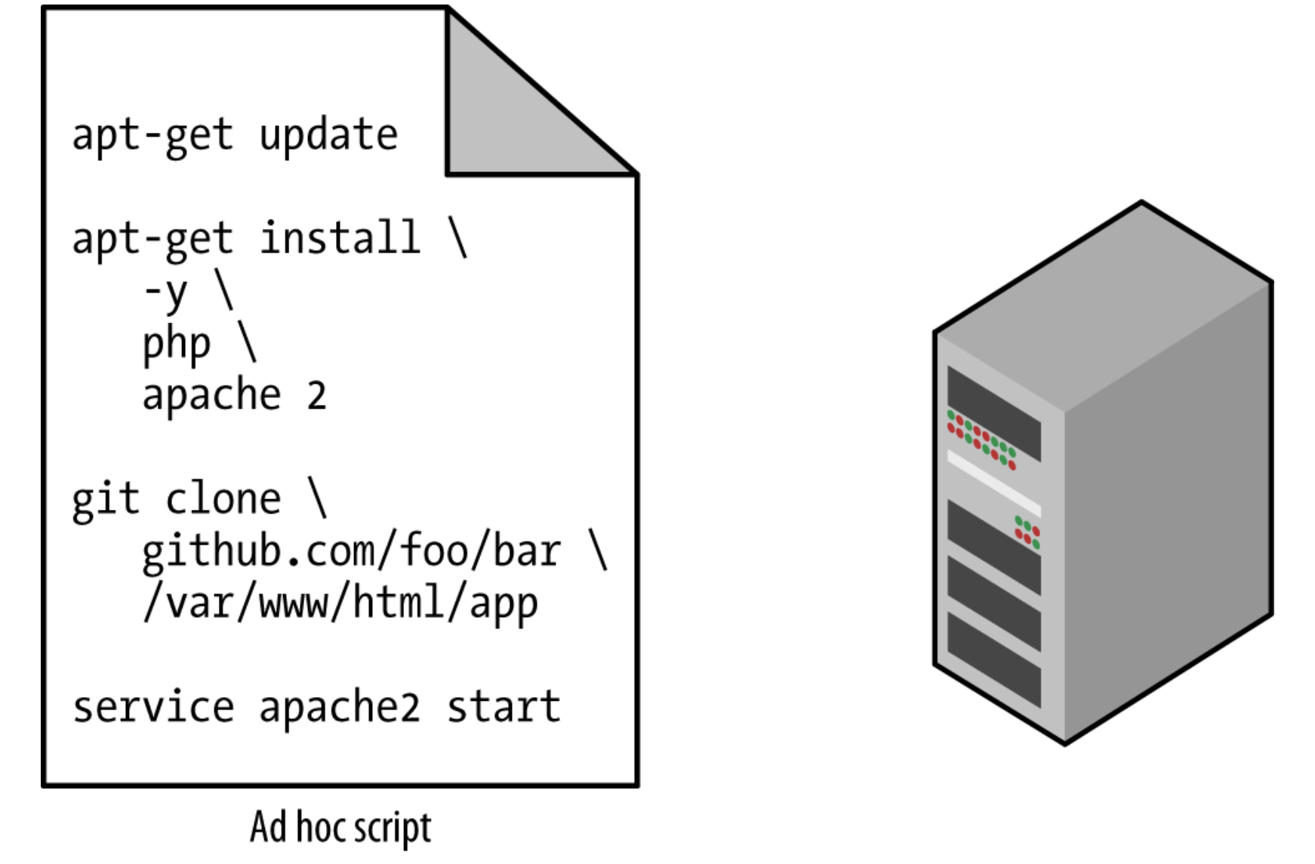
Ad Hoc Scripts
Copyright © 2021 by Elephant Scale, All Rights Reserved

Slide 11
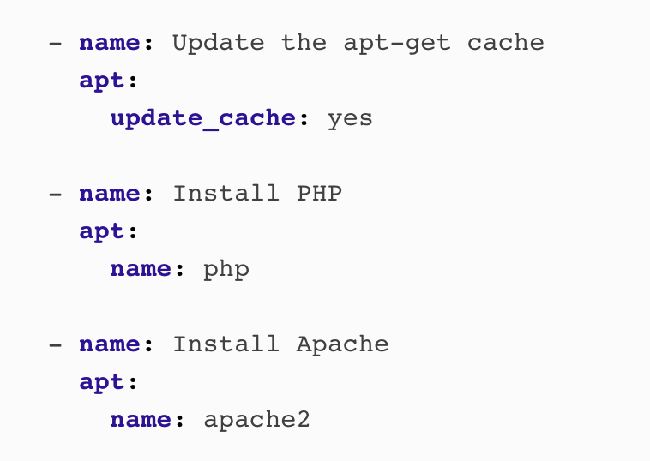
Configuration Management Tools
Chef, Puppet, Ansible, and SaltStack
Example of Ansible script
Copyright © 2021 by Elephant Scale, All Rights Reserved

Slide 12
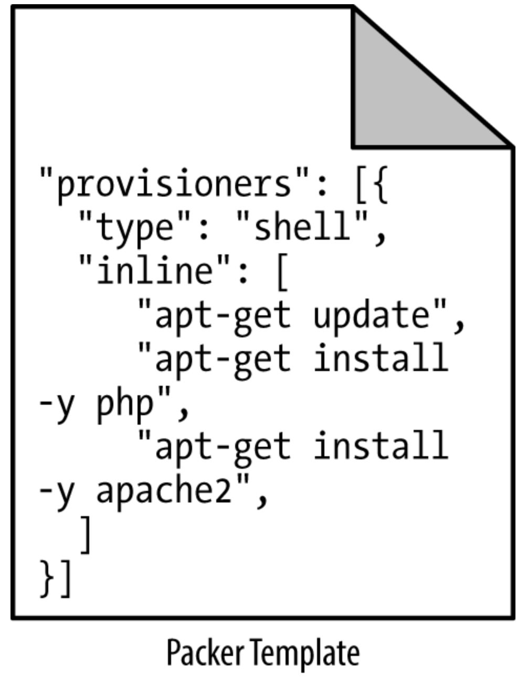
Server Templating Tools
Docker, Packer, and Vagrant.
Copyright © 2021 by Elephant Scale, All Rights Reserved

Slide 13
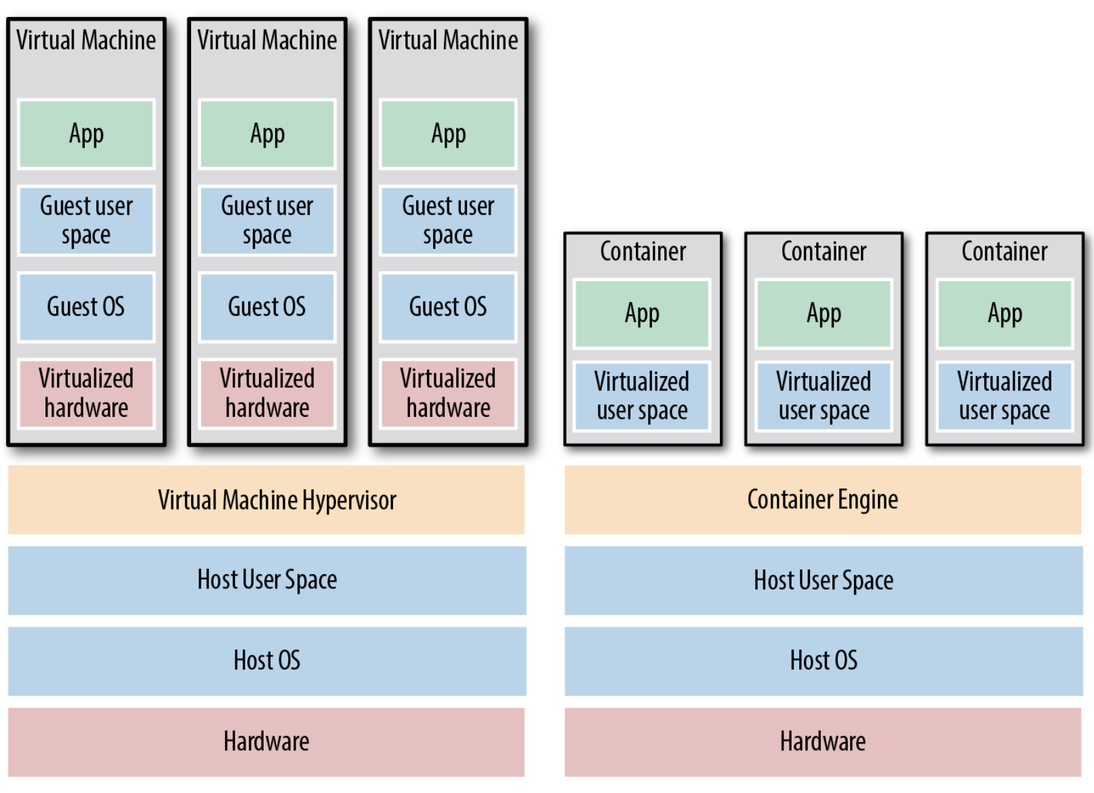
Images and Containers
Copyright © 2021 by Elephant Scale, All Rights Reserved

Slide 14
Virtual Machines vs Containers
Virtual machines
A virtual machine (VM) emulates an entire computer system, including the hardware. You run a hypervisor, such as VMWare, VirtualBox, or Parallels, to virtualize (i.e., simulate) the underlying CPU, memory, hard drive, and networking.
Benefit: complete isolation
Drawback: waste of resources
You can define VM images as code using tools such as Packer and Vagrant.
Containers
A container emulates the user space of an OS. You run a container engine, such as Docker, CoreOS rkt, or cri-o, to create isolated processes, memory, mount points, and networking.
Benefit: you run on top of the container engine can see only its own user space
Benefit: of the containers running on a single server share, milliseconds boot time
Copyright © 2021 by Elephant Scale, All Rights Reserved

Slide 15

Happiness with IaC
Happiness
Deploying code and managing infrastructure manually is repetitive and tedious
No one will take notice—until that one day when you mess it up
That creates a stressful and unpleasant environment
Here is a painting of a happy man (see notes)
Copyright © 2021 by Elephant Scale, All Rights Reserved
Notes:
Painting: Democritus by Hendrick ter Brugghen, 1628.
Some philosophers consider happiness the goal of people's life
Democritus
Democritus (c. 460 – c. 370 BC) is known as the 'laughing philosopher' because of his emphasis on the value of 'cheerfulness'.
Plato
Sees a type of happiness stemming from social justice through fulfilling one's social function
Aristotle
described eudaimonia (Greek: εὐδαιμονία) as the goal of human thought and action. Eudaimonia is often translated to mean happiness
Cynicism (Antisthenes)
rejected any conventional notions of happiness involving money, power, and fame, to lead entirely virtuous, and thus happy, lives

Slide 16
Why Infrastructure as Code?
Q: With all the different flavors of IaC why bother IaC (i.e. Terraform)?
Why learn a bunch of new languages and tools and encumber yourself with yet more code to manage?
A: Code is powerful
you get dramatic improvements in your ability to deliver software
organizations that use DevOps practices, such as IaC
deploy 200 times more frequently
recover from failures 24 times faster
have lead times that are 2,555 times lower.
D: Discuss
How much does this apply to your use cases?
Say you are a researcher who seldom uses dev and prod environment. Do you still see the benefits of IaC? Where?
Again, ResearchOps paper
Copyright © 2021 by Elephant Scale, All Rights Reserved
Notes:
Source: 2016 State of DevOps Report

Slide 17
The Benefits of Infrastructure as Code
Self-service
Infrastructure deployment with the scripts, not your admin
Speed and safety
The computer will do a deployment faster and with less errors
Documentation
You can represent the state of your infrastructure in source files
Version control
You can store your IaC source files in version control
Validation
For every single change, you can perform a code review
Reuse
You can build on top of known, documented pieces
Copyright © 2021 by Elephant Scale, All Rights Reserved

Slide 18
How Terraform Works
Terraform is an open source tool created by HashiCorp and written in the Go programming language
The Go code compiles down into a single binary called terraform
You can use this binary to deploy infrastructure from your laptop or a build server
You don’t need to run any extra infrastructure to make that happen
The terraform binary makes API calls on your behalf to one or more providers
AWS
Azure
Google Cloud
DigitalOcean
OpenStack, and more
Copyright © 2021 by Elephant Scale, All Rights Reserved

Slide 19
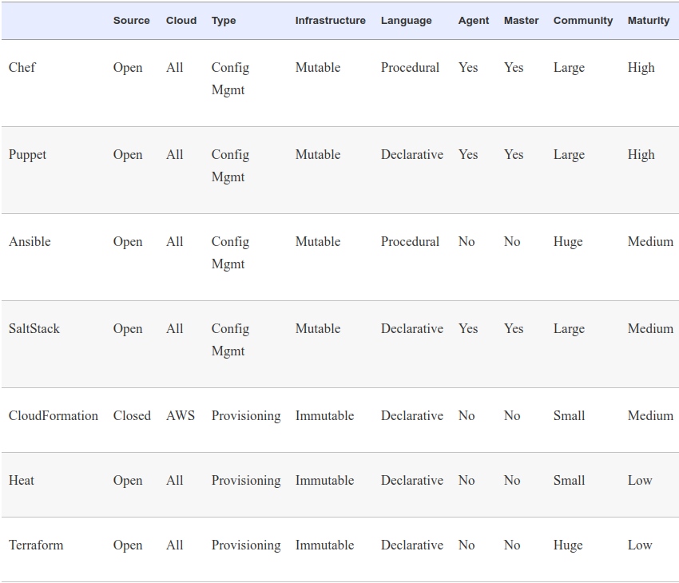
Terraform and Other Tools
Copyright © 2021 by Elephant Scale, All Rights Reserved
Notes:
Source: The book

