Slide 1
Your First AI Database Agent
Setup
Manipulating CSV Files
Working with SQL Databases
Integrating Azure OpenAI
Enhancing SQL Interactions
Copyright © 2024 by Elephant Scale, All Rights Reserved

Slide 2
Setup
Setup Manipulating CSV Files Working with SQL Databases Integrating Azure OpenAI Enhancing SQL Interactions
Copyright © 2024 by Elephant Scale, All Rights Reserved

Slide 3
Introduction
Learn how to build and interact with an AI agent using LangChain.
Key steps covered:
Connecting to the Azure OpenAI endpoint.
Preparing prompts for interaction.
Receiving and processing model responses.
Why this is important :
AI agents automate repetitive tasks and improve efficiency in real-world applications like translation and summarization.
Copyright © 2024 by Elephant Scale, All Rights Reserved

Slide 4
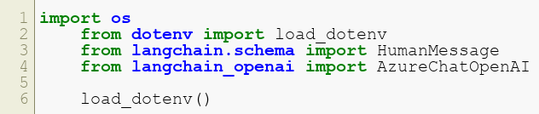
Setup
Import necessary libraries:
What you’ll learn :
How to set up your Python environment to interact with Azure OpenAI using LangChain.
Securely manage sensitive data like API keys and credentials without hardcoding them in your scripts.
Copyright © 2024 by Elephant Scale, All Rights Reserved

Slide 5
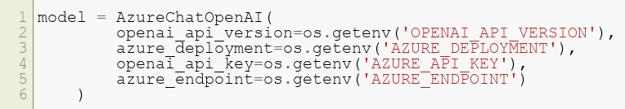
Connecting to Azure OpenAI
Initialize the Azure OpenAI model:
Key concept :
Establishing a connection is the first step to leveraging the power of Azure OpenAI for building AI agents.
Copyright © 2024 by Elephant Scale, All Rights Reserved

Slide 6
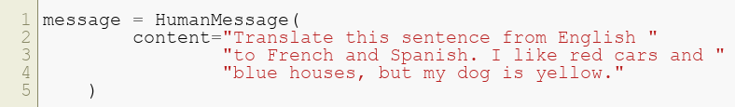
Preparing your prompt
Define your input message:
Why prompts matter :
Clear and specific prompts help AI agents deliver accurate and contextually relevant outputs.
Copyright © 2024 by Elephant Scale, All Rights Reserved

Slide 7

Engaging the model to receive a response
Invoke the model with your prompt:
What happens here :
The AI model processes your input prompt and generates responses in both French and Spanish.
Copyright © 2024 by Elephant Scale, All Rights Reserved

Slide 8
Next Steps
Experiment with different prompts:
Translation
Summarization
Creative writing
Extend the agent’s functionality:
Connect to APIs for real-world applications.
Incorporate context-based interactions using LangChain tools.
Why it matters :
Expanding functionality enhances your AI agent’s adaptability for diverse tasks.
Copyright © 2024 by Elephant Scale, All Rights Reserved

Slide 9
Manipulating CSV Files
Setup Manipulating CSV Files Working with SQL Databases Integrating Azure OpenAI Enhancing SQL Interactions
Copyright © 2024 by Elephant Scale, All Rights Reserved

Slide 10
Introduction
Learn how to interact with CSV data files using Python.
Key steps covered:
Reading CSV files into Python.
Manipulating data using pandas.
Writing processed data back to a CSV file.
Handling edge cases such as missing or malformed data.
Why CSV manipulation is essential :
CSV files are a common format for data exchange in analytics, making this a vital skill.
Copyright © 2024 by Elephant Scale, All Rights Reserved

Slide 11

Setup
Import necessary libraries:
Why pandas :
Pandas simplifies reading, processing, and analyzing structured data efficiently.
Copyright © 2024 by Elephant Scale, All Rights Reserved

Slide 12
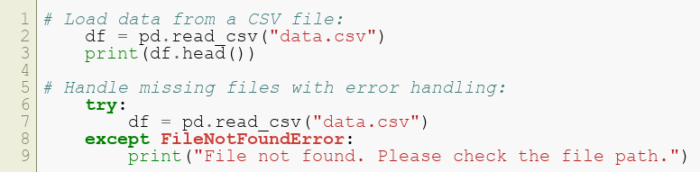
Reading a CSV File
Why this is critical :
Ensures your program handles unexpected scenarios gracefully, improving reliability.
Copyright © 2024 by Elephant Scale, All Rights Reserved

Slide 13

Manipulating Data
Example: Filter rows where the "Age" column is greater than 30.
Additional operations :
Renaming columns:
Adding new columns:
Key takeaway :
Data manipulation allows for creating more meaningful datasets tailored to specific use cases.
Copyright © 2024 by Elephant Scale, All Rights Reserved

Slide 14
Writing to a New CSV File
Save processed data to a new CSV file:
Ensure UTF-8 encoding for compatibility:
Why this is important :
Exporting clean, processed data ensures compatibility and usability in downstream applications.
Copyright © 2024 by Elephant Scale, All Rights Reserved

Slide 15
Next Steps
Experiment with additional operations:
Data aggregation (e.g., group by categories).
Sorting, ranking, and deduplication.
Automate CSV processing in workflows using Python scripts or cron jobs.
Visualize data trends using libraries like Matplotlib or Seaborn.
Why it matters :
Automating and visualizing data insights drives efficiency and informed decision-making.
Copyright © 2024 by Elephant Scale, All Rights Reserved

Slide 16
Working with SQL Databases
Setup Manipulating CSV Files Working with SQL Databases Integrating Azure OpenAI Enhancing SQL Interactions
Copyright © 2024 by Elephant Scale, All Rights Reserved

Slide 17
Introduction
Learn how to connect and interact with SQL databases using Python.
Key steps covered:
Setting up a connection to a SQL database.
Executing queries to retrieve and manipulate data.
Using pandas for data analysis with SQL results.
Why SQL is foundational :
SQL is critical for managing and querying structured data in most real-world applications.
Copyright © 2024 by Elephant Scale, All Rights Reserved

Slide 18

Setup
Import necessary libraries:
What this enables :
Combines database interactions with data manipulation for end-to-end analytics.
Copyright © 2024 by Elephant Scale, All Rights Reserved

Slide 19

Connecting to the Database
Key insight :
Connections form the bridge between Python and your database for seamless interaction.
Copyright © 2024 by Elephant Scale, All Rights Reserved

Slide 20
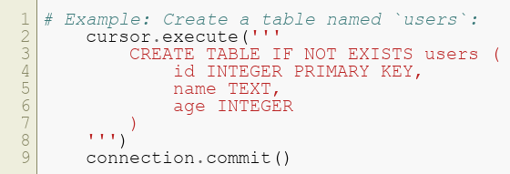
Creating a Table
Why this matters :
Structuring data in tables is the backbone of relational database design.
Copyright © 2024 by Elephant Scale, All Rights Reserved

Slide 21
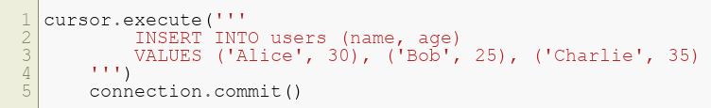
Inserting Data
Insert rows into the users table:
Why it’s useful :
Populating tables with data enables queries and analytics on real-world datasets.
Copyright © 2024 by Elephant Scale, All Rights Reserved

Slide 22
Querying Data
Retrieve data from the table:
Key takeaway :
Querying allows extracting meaningful insights from your database efficiently.
Copyright © 2024 by Elephant Scale, All Rights Reserved

Slide 23

Using pandas for SQL Queries
Read SQL query results into a pandas DataFrame:
Perform pandas operations on the retrieved data:
Why combine SQL and pandas :
It bridges structured database storage with powerful Python-based data analytics.
Copyright © 2024 by Elephant Scale, All Rights Reserved

Slide 24

Closing the Connection
Close the database connection to free resources:
Best practice :
Always release database connections to prevent resource leaks and ensure system stability.
Copyright © 2024 by Elephant Scale, All Rights Reserved

Slide 25
Next Steps
Explore advanced SQL operations:
Joins, nested queries, and window functions.
Using ORMs like SQLAlchemy for complex applications.
Optimize database performance:
Indexing and query optimization.
Why it matters :
Mastery of SQL and database management is essential for scalable and efficient applications.
Copyright © 2024 by Elephant Scale, All Rights Reserved

Slide 26
Integrating Azure OpenAI
Setup Manipulating CSV Files Working with SQL Databases Integrating Azure OpenAI Enhancing SQL Interactions
Copyright © 2024 by Elephant Scale, All Rights Reserved

Slide 27
Introduction
Learn how to use the Azure OpenAI Function Calling feature.
Key steps covered:
Setting up an Azure OpenAI environment.
Registering and invoking serverless functions.
Integrating with external APIs and services.
Why use function calling :
Enables automation of workflows and seamless integration with external systems.
Copyright © 2024 by Elephant Scale, All Rights Reserved

Slide 28
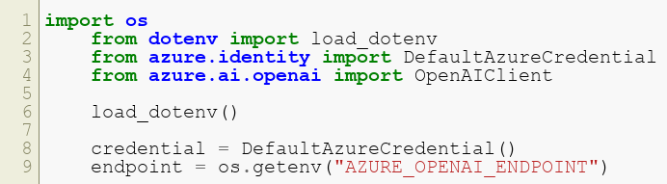
Setup
Import required libraries:
Load environment variables securely using dotenv:
Set up Azure credentials:
Copyright © 2024 by Elephant Scale, All Rights Reserved

Slide 29
Connecting to Azure OpenAI
Initialize the OpenAI client:
What this does :
Sets up your application to interact with Azure OpenAI services programmatically.
Copyright © 2024 by Elephant Scale, All Rights Reserved

Slide 30
Defining a Function
Define a function for specific tasks:
Key insight :
Custom functions enable modular, reusable components in larger workflows.
Copyright © 2024 by Elephant Scale, All Rights Reserved

Slide 31
Registering the Function with Azure
Register the function:
Why register functions :
It provides a structured way to integrate external logic into Azure workflows.
Copyright © 2024 by Elephant Scale, All Rights Reserved

Slide 32
Invoking the Function
Call the registered function:
Why this matters :
Function calling automates repetitive tasks, enabling efficient processing at scale.
Copyright © 2024 by Elephant Scale, All Rights Reserved

Slide 33
Next Steps
Extend Azure Function capabilities:
Register advanced functions for data analysis and transformation.
Integrate with cloud-hosted databases and APIs.
Build end-to-end workflows with serverless architecture.
Real-world impact :
Azure Function Calling unlocks scalable, real-time automation for enterprise applications.
Copyright © 2024 by Elephant Scale, All Rights Reserved

Slide 34
Enhancing SQL Interactions
Setup Manipulating CSV Files Working with SQL Databases Integrating Azure OpenAI Enhancing SQL Interactions
Copyright © 2024 by Elephant Scale, All Rights Reserved

Slide 35
Introduction
Learn how to use Assistant APIs to interact with SQL databases efficiently.
Key steps covered:
Setting up and authenticating the Assistant API.
Querying SQL databases using natural language.
Automating data retrieval and updates with API workflows.
Why it matters :
Natural language interfaces simplify complex database interactions for non-technical users.
Copyright © 2024 by Elephant Scale, All Rights Reserved

Slide 36
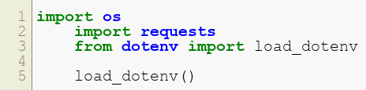
Setup
Import necessary libraries:
What this does :
Ensures secure configuration for API-based SQL interactions.
Copyright © 2024 by Elephant Scale, All Rights Reserved

Slide 37

Authenticating the API
Authenticate with the Assistant API using API keys:
Why authentication :
Secures access to the API, ensuring only authorized users can interact with your database.
Copyright © 2024 by Elephant Scale, All Rights Reserved

Slide 38
Sending a Query
Send a SQL query to the Assistant API:
Key insight :
The API enables seamless execution of complex SQL queries with minimal code.
Copyright © 2024 by Elephant Scale, All Rights Reserved

Slide 39
Automating Queries
Automate SQL queries with natural language inputs:
Why this is valuable :
Automating query workflows reduces manual effort and accelerates data analysis.
Copyright © 2024 by Elephant Scale, All Rights Reserved

Slide 40
Next Steps
Expand capabilities with advanced features:
Automate data pipelines using API queries.
Build dashboards to visualize query results in real time.
Ensure secure database operations:
Validate queries to prevent injection attacks.
Use role-based access control.
Why it’s critical :
Secure, automated SQL workflows empower businesses to derive insights efficiently and safely.
Copyright © 2024 by Elephant Scale, All Rights Reserved

