Slide 1
Langchain
Model, Prompts, and Parsers
Memory
Chain
QnA
Evaluation
Functional Conversations
Copyright © 2024 by Elephant Scale, All Rights Reserved

Slide 2
Model, Prompts, and Parsers
Model, Prompts, and Parsers Memory Chain QnA Evaluation Functional Conversations
Copyright © 2024 by Elephant Scale, All Rights Reserved

Slide 3
Introduction
This lesson explores foundational concepts for interacting with AI models.
Key objectives:
Understanding how to craft effective prompts.
Exploring the role of parsers in processing model outputs.
Demonstrating practical examples of prompts and parsers.
Why this is important :
Effective prompts and parsers ensure that AI models deliver accurate, usable results.
Combining the right prompts with parsers transforms unstructured AI outputs into actionable insights.
Copyright © 2024 by Elephant Scale, All Rights Reserved

Slide 4
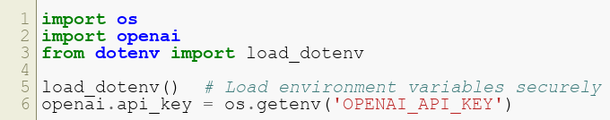
Setup
Import required libraries:
Key Insight :
This setup avoids hardcoding sensitive information like API keys, ensuring security and flexibility.
Copyright © 2024 by Elephant Scale, All Rights Reserved

Slide 5
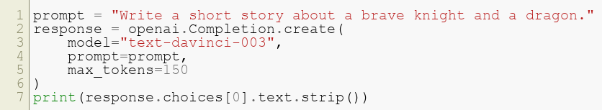
Crafting Effective Prompts
Example of a simple prompt:
Key Insight :
Clear and concise prompts improve the relevance and quality of model responses.
This example demonstrates creative content generation, showcasing OpenAI’s capability for storytelling.
Copyright © 2024 by Elephant Scale, All Rights Reserved

Slide 6
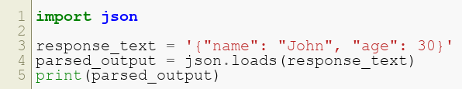
Using Parsers
Parse model outputs for structured results:
Why Parsers Matter :
AI outputs are often free-form text; parsers convert them into structured formats like JSON for easier downstream processing.
Parsing enhances automation and usability, especially in workflows requiring integration with databases or analytics.
Copyright © 2024 by Elephant Scale, All Rights Reserved

Slide 7
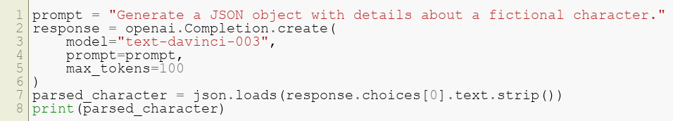
Combining Prompts and Parsers
Example workflow:
What this does :
This combination allows seamless interaction between natural language prompts and structured outputs, bridging the gap between human-readable and machine-readable formats.
Copyright © 2024 by Elephant Scale, All Rights Reserved

Slide 8
Next Steps
Experiment with different prompt structures to optimize results.
Explore advanced parsing techniques for specific use cases.
Real-World Applications :
Automated content generation.
Generating structured data for analytics.
Building tools for summarization and classification.
Copyright © 2024 by Elephant Scale, All Rights Reserved

Slide 9
Memory
Model, Prompts, and Parsers Memory Chain QnA Evaluation Functional Conversations
Copyright © 2024 by Elephant Scale, All Rights Reserved

Slide 10
Introduction
This lesson explores memory components in AI systems and how to manage context.
Key objectives:
Implement memory for conversational agents.
Understand techniques to handle context over multiple interactions.
Why this is important :
Memory enables continuity in conversations, making interactions more human-like and personalized.
Copyright © 2024 by Elephant Scale, All Rights Reserved

Slide 11
Setup
Import required libraries:
What this does :
Sets up the tools needed to store and retrieve conversation history for creating coherent multi-turn interactions.
Copyright © 2024 by Elephant Scale, All Rights Reserved

Slide 12
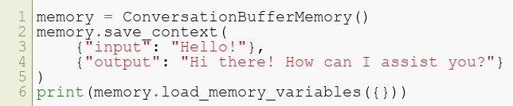
Creating Memory
Example of a conversation buffer memory:
What this does :
Stores interactions to maintain context across a session, ensuring responses are contextual and relevant.
Copyright © 2024 by Elephant Scale, All Rights Reserved

Slide 13
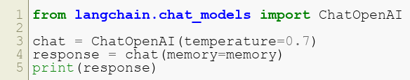
Advanced Memory Techniques
Combine memory with conversational agents:
Why this matters :
Enhances user experience by maintaining a history of interactions, enabling more meaningful and personalized conversations.
Copyright © 2024 by Elephant Scale, All Rights Reserved

Slide 14
Next Steps
Experiment with different memory types:
ConversationBufferMemory: For a full transcript.
ConversationSummaryMemory: For concise history summaries.
Applications :
Personalized customer support bots.
Persistent virtual assistants.
Copyright © 2024 by Elephant Scale, All Rights Reserved

Slide 15
Chain
Model, Prompts, and Parsers Memory Chain QnA Evaluation Functional Conversations
Copyright © 2024 by Elephant Scale, All Rights Reserved

Slide 16
Introduction
This lesson introduces chains in LangChain to connect multiple steps in workflows.
Key objectives:
Learn how to use chains to create multi-step interactions.
Implement custom chains for complex tasks.
Why this is important :
Chains simplify the design of workflows by linking multiple steps logically and sequentially.
Copyright © 2024 by Elephant Scale, All Rights Reserved

Slide 17
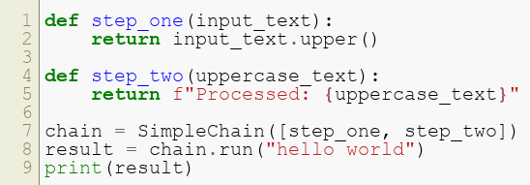
Creating a Chain
Example of a simple chain:
What this does :
Combines multiple functions into a single pipeline, making workflows modular and easier to manage.
Copyright © 2024 by Elephant Scale, All Rights Reserved

Slide 18
Next Steps
Explore advanced chains like SequentialChain and TransformChain.
Combine chains with tools for dynamic task handling.
Real-World Applications :
Multi-step data processing.
Automated workflows for content generation and transformation.
Copyright © 2024 by Elephant Scale, All Rights Reserved

Slide 19
QnA
Model, Prompts, and Parsers Memory Chain QnA Evaluation Functional Conversations
Copyright © 2024 by Elephant Scale, All Rights Reserved

Slide 20
Introduction
Learn how to implement QnA systems using OpenAI models.
Key objectives:
Build simple question-and-answer pipelines.
Extend capabilities with context-aware responses.
Why this is important :
QnA systems are foundational for chatbots, knowledge bases, and AI-driven assistants.
Copyright © 2024 by Elephant Scale, All Rights Reserved

Slide 21
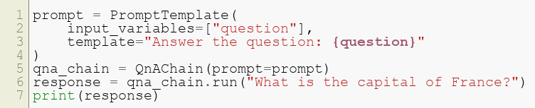
Building a QnA System
Example:
What this does :
Simplifies the process of retrieving precise answers to user queries by leveraging well-constructed prompts.
Copyright © 2024 by Elephant Scale, All Rights Reserved

Slide 22
Next Steps
Combine QnA systems with memory for multi-turn interactions.
Integrate external knowledge bases for domain-specific applications.
Applications :
Chatbots, FAQs, and support systems.
Copyright © 2024 by Elephant Scale, All Rights Reserved

Slide 23
Evaluation
Model, Prompts, and Parsers Memory Chain QnA Evaluation Functional Conversations
Copyright © 2024 by Elephant Scale, All Rights Reserved

Slide 24
Introduction
This lesson covers evaluation techniques for AI workflows.
Key objectives:
Implement methods to test and refine AI outputs.
Automate evaluation metrics for efficiency.
Copyright © 2024 by Elephant Scale, All Rights Reserved

Slide 25

Evaluation Workflow
Example of evaluating outputs:
Why this is important :
Evaluation ensures that workflows meet quality standards and function correctly.
Copyright © 2024 by Elephant Scale, All Rights Reserved

Slide 26
Next Steps
Explore advanced metrics for evaluating generative models.
Implement feedback loops for continuous improvement.
Applications :
Testing and monitoring production AI systems.
Building feedback-driven improvement systems.
Copyright © 2024 by Elephant Scale, All Rights Reserved

Slide 27
Functional Conversations
Model, Prompts, and Parsers Memory Chain QnA Evaluation Functional Conversations
Copyright © 2024 by Elephant Scale, All Rights Reserved

Slide 28
Introduction
Learn how to implement functional conversations in AI workflows.
Key objectives:
Use functions to enhance interaction capabilities.
Handle complex tasks with modular components.
Copyright © 2024 by Elephant Scale, All Rights Reserved

Slide 29
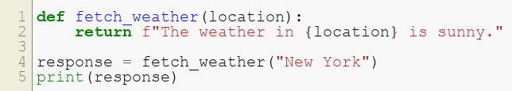
Example Workflow
Example:
Why this is important :
Functional components allow AI systems to handle tasks dynamically and flexibly.
Copyright © 2024 by Elephant Scale, All Rights Reserved

Slide 30
Next Steps
Combine functional conversations with multi-turn memory for dynamic interactions.
Integrate APIs for real-time functionality.
Applications :
Virtual assistants with task execution capabilities.
Domain-specific AI agents for business operations.
Copyright © 2024 by Elephant Scale, All Rights Reserved

