Slide 1
Python Intro
Introduction
IDEs
Jupyter Notebook
Copyright © 2022 by Elephant Scale, All Rights Reserved

Slide 2
Lesson Objectives
Get a brief introduction to Python, it's history, differences from other languages and use cases
Install Python
Learn about Python Integrated Development Environments (IDEs)
Learn, Install and Use Jupyter Notebooks
Copyright © 2022 by Elephant Scale, All Rights Reserved

Slide 3
Introduction
Introduction IDEs Jupyter Notebook
Copyright © 2022 by Elephant Scale, All Rights Reserved

Slide 4
About Python
Python is a general-purpose, object-oriented, dynamic programming language
Python is also language & environment for data science computing and graphics
Open source
Rich ecosystem (lots of libraries)
Great for modeling, machine learning, ad-hoc analytics
Used by app developers, web developers, but also popular among scientists and now data scientists
Python Website - https://www.python.org/
Copyright © 2022 by Elephant Scale, All Rights Reserved
Notes:
Python Website

Slide 5
Why Python
Comprehensive
Pretty much any development can be done in Python
State-of-the-art graphics capabilities
Because picture IS worth a thousand words
Designed for interactive analysis
Most analysis is done this way
No time consuming edit / compile / run cycle
Can support scripting too
Open source
Commercial packages costs thousands
Copyright © 2022 by Elephant Scale, All Rights Reserved

Slide 6
Why Python
Python can import from variety of formats (csv, excel, db, ...)
Python is extensible
Thousands of libraries in PyPI (open source)
Python usually gets 'bleeding edge' routines before other commercial packages!!
Power of open source
Free IDEs (Spyder, Pycharm) are available
Easy to use / program
Runs on multiple platforms (Mac, Windows, Linux)
Copyright © 2022 by Elephant Scale, All Rights Reserved

Slide 7
The Zen of Python
Beautiful is better than ugly.
Explicit is better than implicit.
Simple is better than complex.
Complex is better than complicated.
Flat is better than nested.
Sparse is better than dense.
Readability counts.
Special cases aren't special enough to break the rules.
Although practicality beats purity.
Errors should never pass silently.
Unless explicitly silenced.
In the face of ambiguity, refuse the temptation to guess.
Copyright © 2022 by Elephant Scale, All Rights Reserved
Notes:
Source: https://www.python.org/dev/peps/pep-0020/
Long time Pythoneer Tim Peters succinctly channels the BDFL's guiding principles for Python's design into 20 aphorisms, only 19 of which have been written down.

Slide 8
The Zen of Python
There should be one -- and preferably only one -- obvious way to do it.
Although that way may not be obvious at first unless you're Dutch.
Now is better than never.
Although never is often better than right now.
If the implementation is hard to explain, it's a bad idea.
If the implementation is easy to explain, it may be a good idea.
Namespaces are one honking great idea -- let's do more of those!
Copyright © 2022 by Elephant Scale, All Rights Reserved
Notes:
Source: https://www.python.org/dev/peps/pep-0020/

Slide 9
Python History
Created By Guido Von Rossom in 1991
Designed as an alternative to "scripting languages" like Perl
Fully OOP (Object Oriented Programming)
Dynamically Typed Language
"Duck Typing" – if it walks like a duck..
Automatic type conversion
JIT (Just in Time)
Code compiles and runs in real time
No compile – package – deploy – cycle
REPL Shell
Real time shell for analysis.
Read-Evaluate-Print-Loop Shell
Copyright © 2022 by Elephant Scale, All Rights Reserved
Notes:
The language was called Python because of Guido's fascination with the Monty Python TV show. Python's association with snakes gave rise to snake-like names, such as Anaconda. Study source on Python

Slide 10
Python Versions
Python v1.x: Not used, (1994-2000)
Python v.2.x: Still Used! (2000-2007+)
Still some older libraries are Python 2.x only
Lots of older legacy code
Most new features back-ported into Python 2.x
Python x.3.x: Current Version(2007-Present)
Most new features
Most libraries support python 3 now
Copyright © 2022 by Elephant Scale, All Rights Reserved
Notes:
Python history

Slide 11
Python 2 vs Python 3 Incompatibilities
 | Python 2 | Python 3
print semantics (important) | Statement print x # no parenthesis | Built-in function: print(x) note parenthesis
input vs raw_input() (important) | input() evaluates input as code. `raw_input` returns data as `str` | input() returns data as `str`; There is no `raw_input`.
reduce | Statement | Built-in function in functools namespace
Annotations | Specified annotation only | User-defined annotations
Unicode | separate `str` (ascii) vs `unicode` types | All strings are internally stored as Unicode
Integer Division, (important) | 5 / 2` is `2 | 5 / 2` is `2.5` int to float auto-conversio
 |  | 5 // 2` is `2` note the // for integer divisio
Copyright © 2022 by Elephant Scale, All Rights Reserved
Notes:
*Latest announcement
January 1st 2020 Python 2 End of Life Announced as January 1st 2020. After spreading the news at conferences, on the Python announcement list, and on countless blog posts and books, the Python Software Foundation has finally taken the step to formally announce Python 2 will reach end of life (EOL) on January 1st, 2020.

Slide 12
Should you use Python 2 or Python 3?
You should use python 2 only if you have the following:
You inherit a large codebase of legacy python 2 code
You need a python package that only supports python 2
(These are becoming increasingly rare)
The community will continue to support Python 2 indefinitely
But new features will always show up in Python 3 first
Python 3 is the future (and present) of Python
New development done here
Copyright © 2022 by Elephant Scale, All Rights Reserved
Notes:
For further research, go here

Slide 13
Python Versus R
Python | R
General Purpose Language | Specialized for Statistics and Analytics
Object-Oriented Approach | Mixed Paradigm: Procedural/Functional
Large Package Repository: PyPI | Huge Package Repository; CRAN
Dynamic Language | Dynamic Language
Uses various editors, IDEs | Rstudio is highly integrated IDE for R
Favored by Computer Scientists | Favored By Statisticians
Summary: General Purpose Language now used widely in analytics | Summary: Specialized Language for Statistical Programming now used widely in analytics
Copyright © 2022 by Elephant Scale, All Rights Reserved
Notes:
More on R vs Python here

Slide 14
Python Versus Java
Python | Java
Dynamically Typed Language | Statically Typed Language
Interactive REPL Shell | No REPL
Can't build dependencies into object | Can build dependencies into a FAT JAR.
Good for interactive analytics | Good for "productionizing" analytics.
Relatively slow | Faster (but not as fast as native code).
Interpreted (from bytecode) | Usually JIT compiled.
Copyright © 2022 by Elephant Scale, All Rights Reserved
Notes:
More on Python vs Java here

Slide 15
Python vs Javascript/Node
 | Python | Javascript
Typing | Dynamic | Dynamic
Code Execution | Interpreted from Bytecode | V8: Interpreted from Bytecode
Runs client-side code in browser | No | Yes
Runs server side code | Yes | Yes (using node.js)
Standard Library | Extensive | Minimalistic
Package Management | via pip | via npm
Code Legibility | Generally good | Can be very unreadable
Native Code | Usually use native code in packages | Not common.
Summary | Good for science, data science, AI/machine learning, data munging | Good for web services and back-end for web development
Copyright © 2022 by Elephant Scale, All Rights Reserved
Notes:
More on Python vs Javascript here

Slide 16
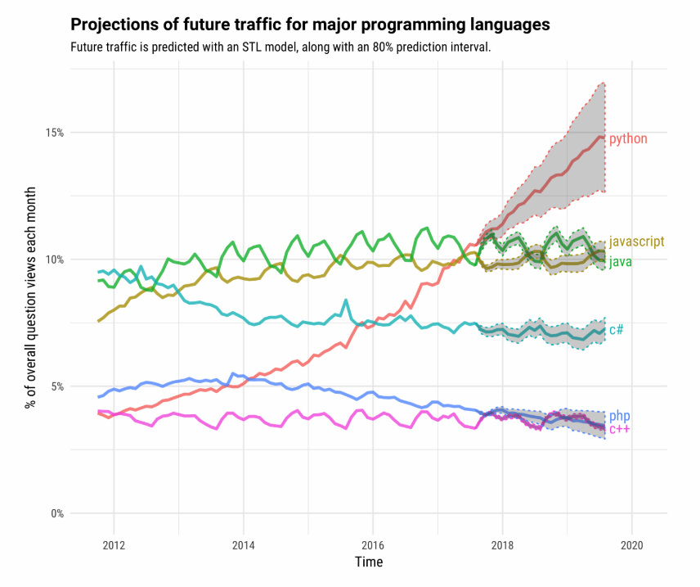
Python Popularity
Python Most popular language in 2018 on Stack Overflow
Copyright © 2022 by Elephant Scale, All Rights Reserved
Notes:
Python reaching aspiring to be the second popular language here

Slide 17
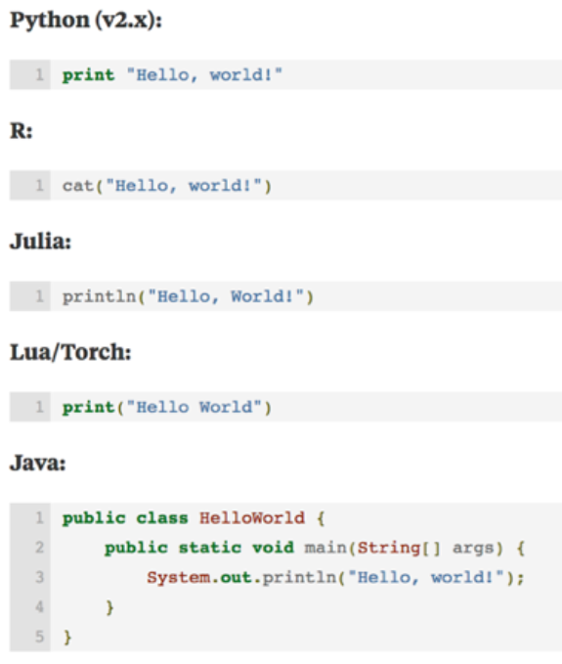
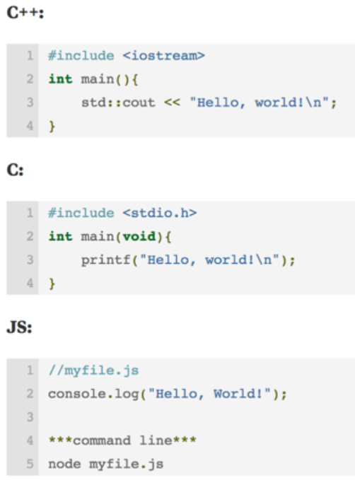
A simple "Hello, world!" comparison
Copyright © 2022 by Elephant Scale, All Rights Reserved

Slide 18
Python Use Cases
Who uses Python?
Python is very commonly used in the following areas:
Web Programming
Web Scraping
Microservices
System Automation Tasks
Scientific Programming
Data Analysis / Data Science
Machine Learning/Deep Learning and AI
Copyright © 2022 by Elephant Scale, All Rights Reserved
Notes:
To study Python uses cases in-depth, here

Slide 19
Is Python Interpreted?
Standard Python (CPython) is byte-code interpreted
This means it will first just-in-time (JIT) compile the code to bytecode. (.pyc code)
Then, it will interpret (rather than compile) the bytecode
This allows for dynamic code and environment.
Cython (C + Python) is compiled much like C/C++
Cython will first translate the Python code into C/C++
It will then combine that code with custom C/C++ code
It will then compile it into native code.
Copyright © 2022 by Elephant Scale, All Rights Reserved
Notes:
Python converts source code written by the programmer into intermediate language which is again translated into the native language / machine language that is executed. So Python is an Interpreted language. It is processed at runtime by the interpreter. The program need not be compiled before its execution.
For an extended discussion, see here

Slide 20
Is Python Fast?
Pure python code is fairly slow
Faster than purely interpreted languages (LISP, Smalltalk, shell scripts)
But slower than managed languages like Java, .NET
And much slower than pure native code like C/C++/Fortran.
Python does allow users to write native code
Python integrates with C, C++, Fortran, etc.
Typically performance sensitive code is written in native code (usually C/C++)
Cython compiler: allows you to mix C, C++ and python code
Native code is Fast!
Write Native code (C/C++) for performance sensitive parts,
Everything else, pure python! Much easier
Copyright © 2022 by Elephant Scale, All Rights Reserved
Notes:
In terms of raw performance, Python is definitely slower than Java, C# and C/C++. However, there are other things that matter for the user/observer such as total memory usage, initial startup time, etc. For most things, Python is fast enough ;)
See more discussion here

Slide 21
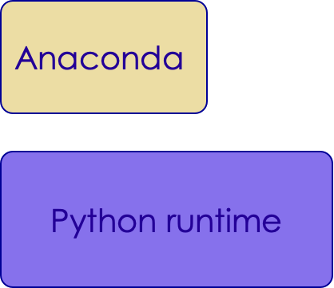
Installation
Copyright © 2022 by Elephant Scale, All Rights Reserved

Slide 22
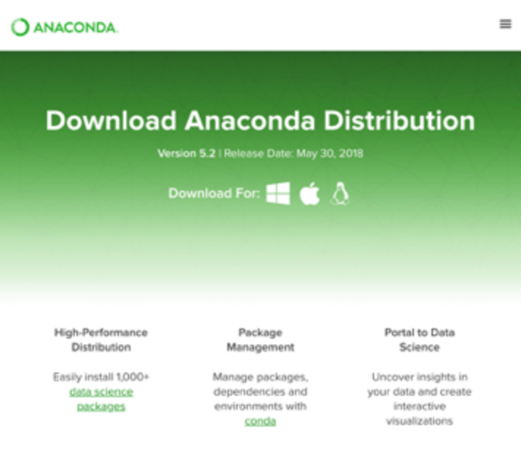
Installing Python
We recommend downloading Anaconda from Continuum Analytics
[https://www.anaconda.com/]
Download the free version of Anaconda Distribution for Windows / Mac / Linux at [http://www.anaconda.com/download]
Ensure to get the Python 3.* version
Copyright © 2022 by Elephant Scale, All Rights Reserved
Notes:
There are definitely are many ways to install Python
If you want a deeper view, go here

Slide 23
Why Anaconda?
Anaconda has hundreds of the most commonly used DS packages already built!
No need for C/C++ compilers
Good for Windows Users! (Hard to build on Windows)
Easy to Install Bundle
Platform Native bundling (MSI: Windows, DMG: Mac, etc)
Commercially Available Support
Good for Enterprise Users
Easy for IT Services to "Certify" entire distribution including packages
Separate from System Python
Anaconda is separate from your system python
So it won't break anything else you may be doing on your machine in Python
Copyright © 2022 by Elephant Scale, All Rights Reserved
Notes:
Benefits of Using Python Anaconda
It is free and open-source.
It has more than 1500 Python/R data science packages.
Anaconda simplifies package management and deployment.
It has tools to easily collect data from sources using machine learning and AI.
To go deeper, see here

Slide 24
Do I really need Anaconda?
No, using your system python is fine (if you have one)
Most Mac and Linux users already have Python
However, it may not be the latest version
On Linux, python 3.x is often called python3
You may want to use "virtualenv" to create a virtual environment for your data science work
You will have to download and install your own packages as-needed
Copyright © 2022 by Elephant Scale, All Rights Reserved
Notes:
In this course, we are usually using Anaconda installed. Yes, you have your choice, and if you want to experiment, then start with Anaconda, and later try your experiments.

Slide 25
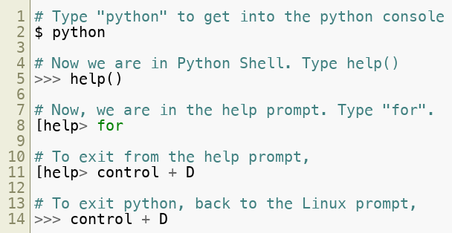
Python Console
We can also use Python from console
Though Spyder is a much better interface
Copyright © 2022 by Elephant Scale, All Rights Reserved
Notes:
Please experiment with the command line beyond what is shown in the slides. It's your creativity that counts. Then share with your fellow students and the instructor.

Slide 26
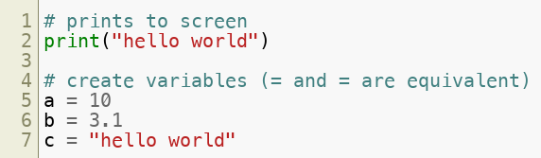
Getting Started With Python REPL (Lab)
Lab: 01-helloworld/1.1-REPL.md
Copyright © 2022 by Elephant Scale, All Rights Reserved
Notes:
Try other commands in the REPL.
Again, what does REPL stand for?

Slide 27
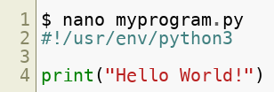

Running Python
To run Python, we can just run the from the command line.
Copyright © 2022 by Elephant Scale, All Rights Reserved
Notes:
Additional task: change the code in the scripts and run it. How long did it take you?

Slide 28
Lab: Run a Script
Overview:
Quick intro to running a script.
Approximate time:
10 mins
Instructions:
01-helloworld / 1.2-Script.md
Copyright © 2022 by Elephant Scale, All Rights Reserved
Notes:
Experiment with the script in the lab.

Slide 29
Lab: Writing a Python Script
Overview::
Write a python script
Approximate time:
10 mins
Instructions:
02__pythonIntro | 2.2-script.md
02__pythonIntro | helloworld.py
Copyright © 2022 by Elephant Scale, All Rights Reserved

Slide 30
IDEs
Introduction IDEs Jupyter Notebook
Copyright © 2022 by Elephant Scale, All Rights Reserved

Slide 31
IDEs
Python Has Many IDEs
We will discuss some common ones:
Spyder
PyCharm
PyDev
Visual Studio Code
Sublime Text / Other Text Editors.
Copyright © 2022 by Elephant Scale, All Rights Reserved
Notes:
In this course, we will introduce every development environment (IDE) My personal preference is JetBrains PyCharm. I use multiple languages and I find it convenient to have the same style of the interface for all of them, which I get by using JetBrains products. So yes, I have a professional license. To me, it's worth it. I get everything from one source, and the subscription price goes down in the second and third year.

Slide 32
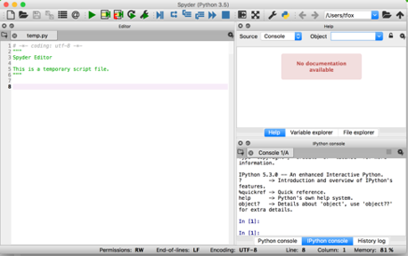
Spyder
Rstudio-like IDE for data science and scientific programming
Lightweight
Included with Anaconda
Website - https://github.com/spyder-ide/spyder
Copyright © 2022 by Elephant Scale, All Rights Reserved
Notes:
At the very least, try that. It came with your Anaconda anyway.

Slide 33
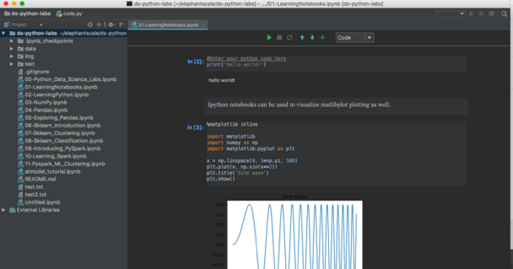
Pycharm
There are many other IDEs:
Example: PyCharm from JetBrains
Pretty Heavyweight
Copyright © 2022 by Elephant Scale, All Rights Reserved
Notes:
As mentioned above, this is my personal preference.

Slide 34
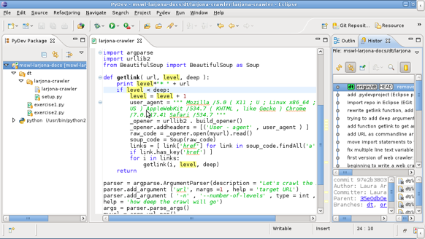
PyDev / Eclipse
PyDev is an extension to eclipse
Website - http://www.pydev.org/
Copyright © 2022 by Elephant Scale, All Rights Reserved
Notes:
Would make sense if you do Java with Eclipse

Slide 35
PyDev / Eclipse
PyDev is an extension to eclipse
Copyright © 2022 by Elephant Scale, All Rights Reserved

Slide 36
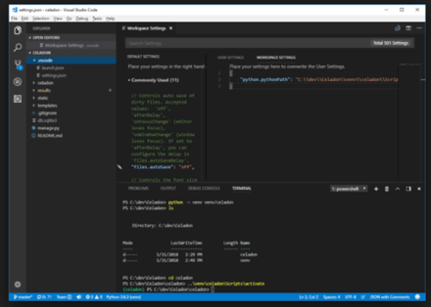
Visual Studio Code
For all the Microsoft Fans out there:
Surprisingly lightweight, but fully-featured IDE!
Website - https://code.visualstudio.com/
Copyright © 2022 by Elephant Scale, All Rights Reserved
Notes:
VS Code is a very popular IDE from Microsoft.
Visual Studio Code is a source-code editor developed by Microsoft for Windows, Linux and macOS.[6] It includes support for debugging, embedded Git control and GitHub, syntax highlighting, intelligent code completion, snippets, and code refactoring. It is highly customizable, allowing users to change the theme, keyboard shortcuts, preferences, and install extensions that add additional functionality. The source code is free and open-source, released under the permissive MIT License.[7] The compiled binaries are freeware for any use.[8]
In the Stack Overflow 2019 Developer Survey, Visual Studio Code was ranked the most popular developer environment tool, with 50.7% of 87,317 respondents claiming to use it.[9]
See more about it here

Slide 37
Other options
Some just like text editors
Vi(m)
Sublime Text
Advantages:
Lightweight and agile
Fast
Limited interactive debugging / breakpoints
Copyright © 2022 by Elephant Scale, All Rights Reserved
Notes:
It is worth it to learn the 'vi' editor. It is not going anywhere after almost 50 year, being written by Bill Joy. See more about it here

Slide 38
Jupyter Notebook
Introduction IDEs Jupyter Notebook
Copyright © 2022 by Elephant Scale, All Rights Reserved

Slide 39
Jupyter Notebooks
Jupyter notebooks are a great way to showcase working python code.
Jupyter Notebooks allow us to combine:
Text
HTML / Images
Visualizations
Runnable Python Code
Document Centric View
We do Jupyter notebooks in this class!
NOT an IDE.
Good for exploratory data analysis
Showcasing code
Copyright © 2022 by Elephant Scale, All Rights Reserved
Notes:
Jupyter notebook is one of the simplest and most popular IDE's. But that is exactly its problem: Jupyter notebooks are the first thing student learn, and it is the least suited to production deployment.

Slide 40
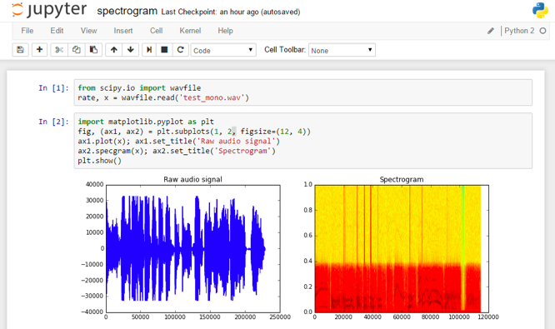
Jupyter Notebooks
Example:
Copyright © 2022 by Elephant Scale, All Rights Reserved

Slide 41
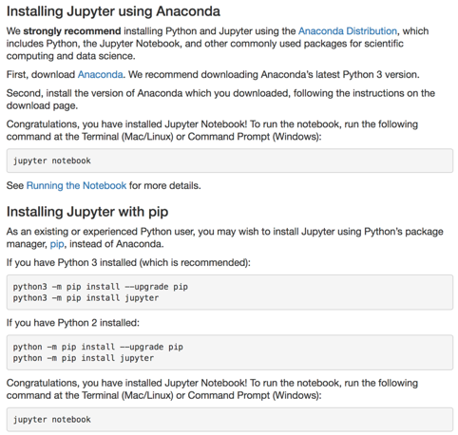
Jupyter Notebook Installation
Project Jupyter Website - https://jupyter.org/
Installation recommended using Anaconda, but Jupyter can be installed individually too - https://jupyter.org/install
Copyright © 2022 by Elephant Scale, All Rights Reserved

Slide 42
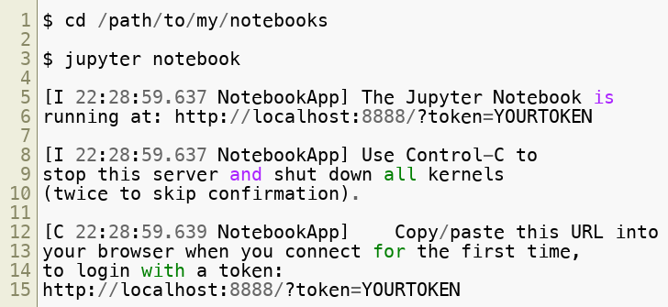
Using Jupyter Notebooks
Go to directory and type jupyter notebook
The Jupyter notebook by default starts at http://localhost:8888
Copyright © 2022 by Elephant Scale, All Rights Reserved
Notes:
Jupyter notebooks come with a lot of help. You can become quite proficient in their use by reading the help files.

Slide 43
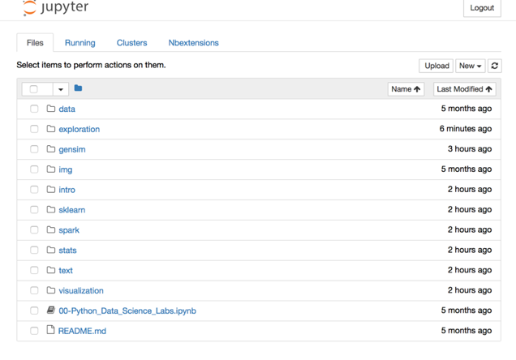
Browser for Jupyter Notebook
Copyright © 2022 by Elephant Scale, All Rights Reserved

Slide 44
Lab: Running Jupyter
Overview:
Run Jupyter Notebook
Approximate time:
10 mins
Instructions:
02-notebooks / 2.1-install-jupyter.md
Copyright © 2022 by Elephant Scale, All Rights Reserved

Slide 45
Lab: Introducing Notebooks
Overview:
Quick intro lab to Jupyter Notebook
Approximate time:
10 mins
Instructions:
02-notebooks / 2.2-LearningNotebooks.ipynb
Copyright © 2022 by Elephant Scale, All Rights Reserved

Slide 46
Lab: Introducing Jupyter Notebook
Overview:
Introduction to Jupyter Notebook
Approximate time:
10 mins
Instructions:
02__pythonIntro | 2.4-startingJupyter.md
02__pythonIntro | learningJupyter.ipynb
Copyright © 2022 by Elephant Scale, All Rights Reserved
Notes:
In the future, you will spend a lot of time in the notebooks, so don't worry if you do not get it all right away.

