Slide 1
Python Language Basics
Operators
Data Types
Control Flow and Comprehensions
Functions
Strings
Exceptions
Files and Exception Handling
Multithreaded Programming
Multithreaded programming
Copyright © 2022 by Elephant Scale, All Rights Reserved

Slide 2
Lesson Objectives
Operators and Data Types
Control Flow – Conditionals and Loops
List Comprehensions
Functions and Modular Programming
Strings
Files and Exception Handling
Multithreaded Programming
Object Oriented Programming Concepts
Copyright © 2022 by Elephant Scale, All Rights Reserved

Slide 3
Operators
Operators Data Types Control Flow and Comprehensions Functions Strings Exceptions Files and Exception Handling Multithreaded Programming Multithreaded programming
Copyright © 2022 by Elephant Scale, All Rights Reserved

Slide 4
Python Operators (Assignments / Boolean)
Operation | Operator | Example
Assignment | = | a = 10
Logical
And | and | a and b
Or | or | a or b
Not | not | not a
Copyright © 2022 by Elephant Scale, All Rights Reserved

Slide 5
Python Operators: Arithmetic
Operation | operator | Example
Addition | + | a + b
Subtraction | - | a - b
Multiply | * | a * b
Division | / | a / b =? 5/2 = 2.5
Exponent | `**` | `a ** 2`
Modulus | % | 5 % 2 is 1
Integer Division | // | 5 // 2 is 2
Copyright © 2022 by Elephant Scale, All Rights Reserved

Slide 6
Python Operators: Bitwise
Operation | operator | Example
Bitwise And | & | a & b
Bitwise Or | ｜ | a ｜ b
Bitwise Xor | ^ | a ^ b
Bitwise 1's complement | ~ | ~a
Logical shift left | << n | a << 2
Logical Shift Right | >> n | a >> 2
Copyright © 2022 by Elephant Scale, All Rights Reserved

Slide 7
Python Operators: Comparison
Comparison | operator | Example
less | < | a < b
Greater | > | a > b
Less than equal | <= | a <= b
Greater than equal | >= | a >=b
Equal | == | a == b
Notequal | != | a != b
Copyright © 2022 by Elephant Scale, All Rights Reserved

Slide 8
Data Types
Operators Data Types Control Flow and Comprehensions Functions Strings Exceptions Files and Exception Handling Multithreaded Programming Multithreaded programming
Copyright © 2022 by Elephant Scale, All Rights Reserved

Slide 9
Python Data Types
Python has no value types or primitive types
Everything is an object.
Objects are referred to by reference.
Even simple integers are references.
Variables are always references
References are untyped. (loose typing)
References can point to anything.
Some types are immutable (can't be changed)
most numeric types
Strings
tuples
Copyright © 2022 by Elephant Scale, All Rights Reserved

Slide 10
Python Data Types
Scalar
float (3.1)
int (10)
long (10L)
complex (1+3j)
bool (True / False)
str ("hello world")
Complex
list: [1, 2, 2, 3]
set {1, 2, 3} #No dups
tuple (1,"hello")
dict {"cat": 3, "dog", 4}
Copyright © 2022 by Elephant Scale, All Rights Reserved

Slide 11
Converting types
Some types can be auto-converted without a warning
There is a hierarchy:
bool -> int -> long -> float -> complex
Upcasting is never a problem.
Downcasting requires loss of information.
Explicit conversion / casting
Casting is accomplished by passing the value to the constructor
Example: int(3.1) # float is passed into the constructor of int
Casting always copies the data and makes a new object.
Copyright © 2022 by Elephant Scale, All Rights Reserved

Slide 12
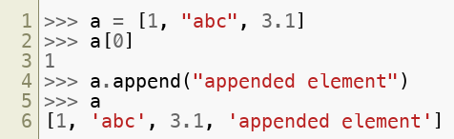
Lists
Lists are mutable ordered collection of objects
Can mix and match types (unlike NumPy Arrays)
Copyright © 2022 by Elephant Scale, All Rights Reserved

Slide 13
More About Lists
Lists are stored as references to objects
Not the objects themselves!
Remember EVERYTHING in Python is an object!
no value or primitive types.
If the objects pointed to change, the values in the list will change too!
Copyright © 2022 by Elephant Scale, All Rights Reserved

Slide 14
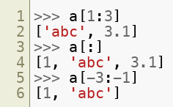
Slicing Lists
Slicing - [m:n] returns copy of sub-list from m to n-1 (zero based index)
Copyright © 2022 by Elephant Scale, All Rights Reserved

Slide 15

Sets
Sets are an unordered collection of objects, with no dupes
Can mix and match types, just like lists
Copyright © 2022 by Elephant Scale, All Rights Reserved

Slide 16
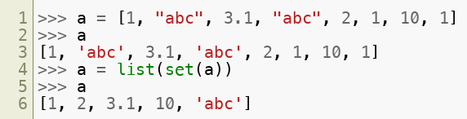
Sets
Sets can be used to de-dup a list
Frozen Sets
Copyright © 2022 by Elephant Scale, All Rights Reserved

Slide 17
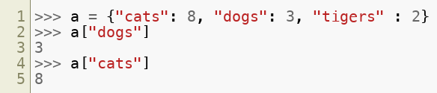
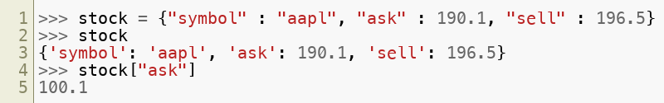
Dictionaries
Dictionaries are groups of key-value pairs
Objects can be of ANY type (mix and match)
Copyright © 2022 by Elephant Scale, All Rights Reserved

Slide 18
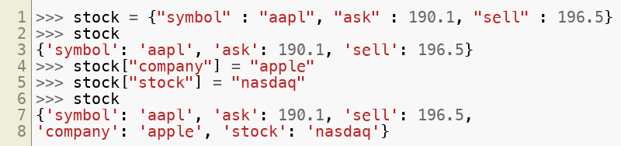
Dictionaries: Adding New Attributes
New attributes or key/value pairs can be added as follows
Dictionaries are important in Python
Copyright © 2022 by Elephant Scale, All Rights Reserved

Slide 19

Tuples
Tuples are groups of data
How is a tuple different from a list?
Tuples are immutable (can't be changed in any way)
Tuples aren't able to be iterated over.
Tuples are fixed length
Used for:
Returning more than one thing from a function
- Forcing mutable data to be immutable
Copyright © 2022 by Elephant Scale, All Rights Reserved

Slide 20
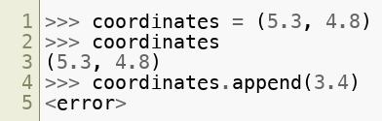
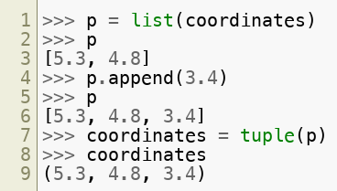
Tuples
Example – To convert 2D to 3D coordinates
Copyright © 2022 by Elephant Scale, All Rights Reserved

Slide 21
Arrays
Python has no native array functionality
List will serve in a pinch, but is very S-L-O-W
The package numpy introduces a native array,
We will discuss shortly.
Copyright © 2022 by Elephant Scale, All Rights Reserved

Slide 22
Lab: Python datatypes
Overview:
Quick intro lab to Python
Approximate time:
10 mins
Instructions:
03-languageintro / types
Copyright © 2022 by Elephant Scale, All Rights Reserved

Slide 23
Lab: Python Data Types
Overview:
Introduction Python Data Types
Approximate time:
10 mins
Instructions:
03__pythonLanguageBasics | 3.1-types.ipynb
Copyright © 2022 by Elephant Scale, All Rights Reserved

Slide 24
Ranges
range(5) creates a sequence from 0 to 4
range(start, stop step) function is more flexible
range (1,10, 2) => 1,3,5,7,9
range (0, 0.1, 0.01) => 0.0, 0.01, ..., 0.10
More options: ?range
Copyright © 2022 by Elephant Scale, All Rights Reserved

Slide 25
Control Flow and Comprehensions
Operators Data Types Control Flow and Comprehensions Functions Strings Exceptions Files and Exception Handling Multithreaded Programming Multithreaded programming
Copyright © 2022 by Elephant Scale, All Rights Reserved

Slide 26
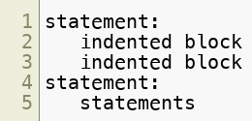
Blocks in Python
Python does not have curly braces (like Java)
Blocks are delimited by indentation
Whitespace matters! But why?
Because it's good style to use indentation (in Java too!)
Why not have it do meaning too, instead of just ignored.
Curly braces are redundant, and can cause unexpected errors.
Copyright © 2022 by Elephant Scale, All Rights Reserved

Slide 27
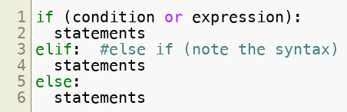
Control Flow: IF-Else
Copyright © 2022 by Elephant Scale, All Rights Reserved

Slide 28
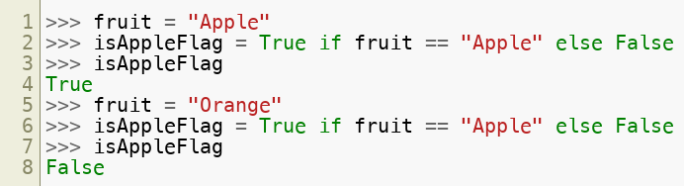
Control Flow – Conditionals - One Liners
It is possible to condense code from an if-else statement into just one line
This is similar to the c++/Java ternary operator, but arguably more readable.
Copyright © 2022 by Elephant Scale, All Rights Reserved

Slide 29
Lab: Conditionals
Overview:
Conditional Statements in Python lab
Approximate time:
10 mins
Instructions:
03-languageintro / Conditionals
Copyright © 2022 by Elephant Scale, All Rights Reserved

Slide 30
Lab: Python Control Flow - Conditionals
Overview:
Write conditionals in Python
Approximate time:
10 mins
Instructions:
03__pythonLanguageBasics | 3.2-conditionals.ipynb
Copyright © 2022 by Elephant Scale, All Rights Reserved

Slide 31
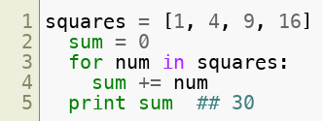

For loops and lists
For loops are designed to operate over lists
Can also operate over strings
In by itself tests membership in a list
Copyright © 2022 by Elephant Scale, All Rights Reserved

Slide 32

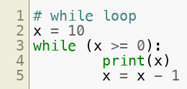
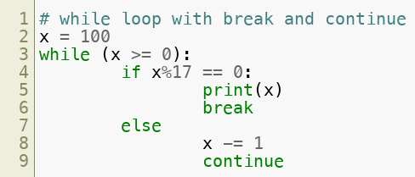
Control Flow – Loops – for and while loops
The following is the syntax for loops in Python
Copyright © 2022 by Elephant Scale, All Rights Reserved

Slide 33
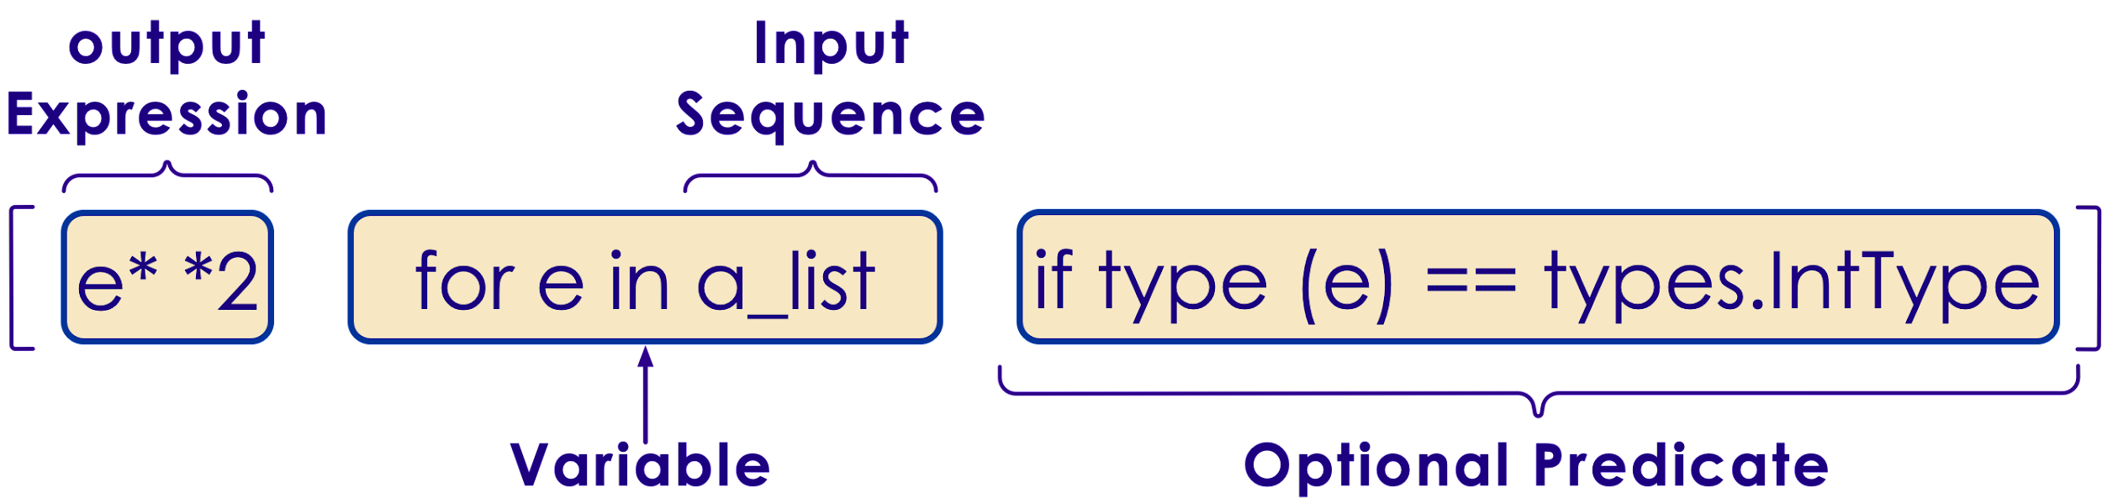
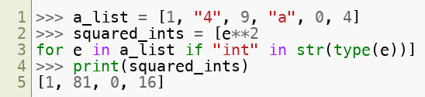
Comprehensions
Python allows an elegant way to iterate through ranges and lists called comprehensions.
The example below is a list comprehension
Copyright © 2022 by Elephant Scale, All Rights Reserved

Slide 34
Lab: Control Loops
Overview:
Quick intro lab to Python
Approximate time:
10 mins
Instructions:
03-languageintro / control loops
Copyright © 2022 by Elephant Scale, All Rights Reserved

Slide 35
Lab: Python Control Flow - Loops
Overview:
Write loops in Python
Approximate time:
10 mins
Instructions:
03__pythonLanguageBasics | 3.3-loops.ipynb
Copyright © 2022 by Elephant Scale, All Rights Reserved

Slide 36
Functions
Operators Data Types Control Flow and Comprehensions Functions Strings Exceptions Files and Exception Handling Multithreaded Programming Multithreaded programming
Copyright © 2022 by Elephant Scale, All Rights Reserved

Slide 37
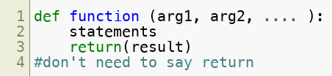
User Functions
Easy to write custom user functions and extend Python.
Return type can by any type : scalar / object / NULL
If end of function is reached without explicit return,
The value of last evaluated expression is returned.
Copyright © 2022 by Elephant Scale, All Rights Reserved

Slide 38
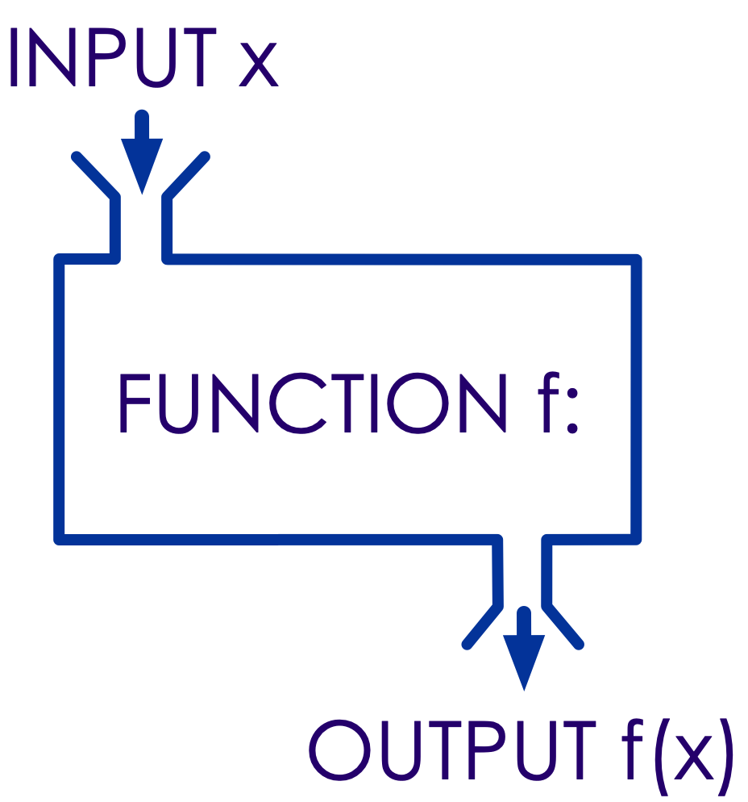

User Functions
Concept of modular programming
Easy to write custom user functions and extend Python
"return" statements are optional
Copyright © 2022 by Elephant Scale, All Rights Reserved

Slide 39
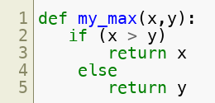
User Function Example
Copyright © 2022 by Elephant Scale, All Rights Reserved

Slide 40
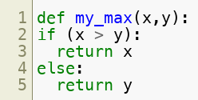

User Functions
Return type can be any type - scalar/complex data type or user defined object / None
If end of function is reached without explicit return, the value of last evaluated expression is returned.
Copyright © 2022 by Elephant Scale, All Rights Reserved

Slide 41
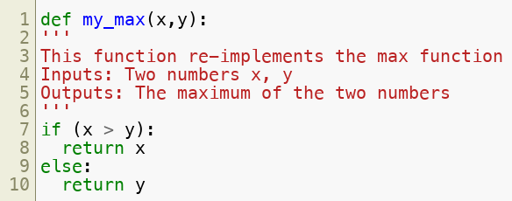
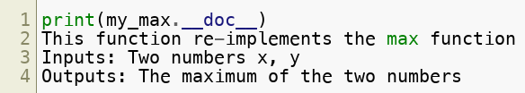
DocStrings
Functions can (and should) define a docstring to help understand the inputs and outputs of the function
Copyright © 2022 by Elephant Scale, All Rights Reserved

Slide 42

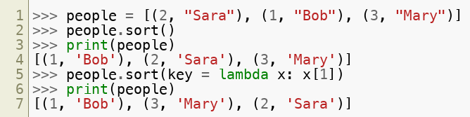
Lambda
"Lambda Function" is an anonymous function.
Usually used as an argument to another function
The syntax is as follows:
Many functions require other functions as parameters. For example, sorting a list of tuples by the second element in the tuple
Copyright © 2022 by Elephant Scale, All Rights Reserved

Slide 43

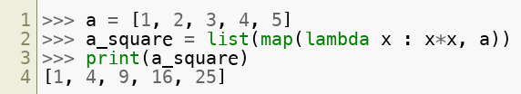
Map
Performs an operation on any list type for each element
The syntax is as follows:
Example:
Note that map returns a map-object that is converted to a list, set, etc.
Copyright © 2022 by Elephant Scale, All Rights Reserved

Slide 44
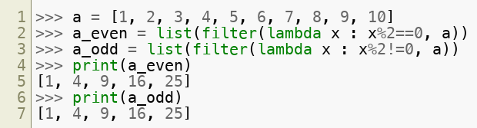
Filter
Performs a filter operation on any list type and returns an object, that can be converted to a sub-list
The syntax is as follows:
Example:
Copyright © 2022 by Elephant Scale, All Rights Reserved

Slide 45
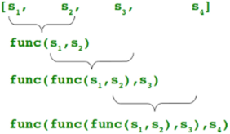

Reduce
Performs a reduce operation on any list type. It continually applies a function to the input sequence and returns a single result.
Example: One line statement to find the maximum number from a sequence
Copyright © 2022 by Elephant Scale, All Rights Reserved

Slide 46
Lab: Functions
Overview:
Quick intro lab to Python
Approximate time:
10 mins
Instructions:
03-languagebasics / functions
Copyright © 2022 by Elephant Scale, All Rights Reserved

Slide 47
Lab: Functions
Overview:
Write functions in Python
Approximate time:
10 mins
Instructions:
03__pythonLanguageBasics | 3.4-functions.ipynb
Copyright © 2022 by Elephant Scale, All Rights Reserved

Slide 48
Strings
Operators Data Types Control Flow and Comprehensions Functions Strings Exceptions Files and Exception Handling Multithreaded Programming Multithreaded programming
Copyright © 2022 by Elephant Scale, All Rights Reserved

Slide 49
Strings
Class str()
Immutable arrays of variable length
All strings Unicode in Python 3
No separate "char" type – just single length string
Examples of literal strings:
'single quotes'
"double quotes"
"""triple quotes""" # allows multi-line
b'\xea' # binary escaped characters
u'नमस्ते ' # Unicode characters
r'\d\d' # Raw string, good for regexes
Copyright © 2022 by Elephant Scale, All Rights Reserved

Slide 50

Formatted strings
Uses C (not C++) style printf syntax
Use parenthesis for longer formatted strings (as shown above)
Copyright © 2022 by Elephant Scale, All Rights Reserved

Slide 51
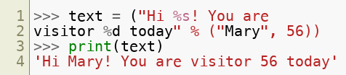
Formatted strings
Python uses C style formatting syntax – printf(x)
Python doesn't use C++ style formatting syntax – cout << x
Use parenthesis for longer formatted strings (as shown above)
Copyright © 2022 by Elephant Scale, All Rights Reserved

Slide 52
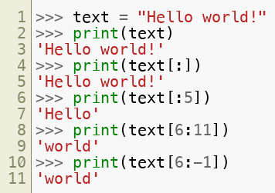
Referencing Strings
String slicing is similar to lists:
'Hello'[1:3] gives el # start from 1 up to but not including 3
'Hello'[1:-1] gives ell # start from 1 up to but not including last
Copyright © 2022 by Elephant Scale, All Rights Reserved

Slide 53
String Methods
Method | Description
.lower(), .upper() | Changes to lower/upper case
.strip() | Removes whitespace from beginning and end.
.startswith('abc'), .endswith('abc') | Tests whether string starts with or ends with the given string.
.isalpha('abc'), .isdigit(), .isspace() | Tests if all charcatersin string are alpha/digit/whitespace
.find('abc') | Will find index of substring `'abc'` and return index, or `-1` if not found (NOT a regex)
.replace('old','new') | Will replace string with another string (NOT regex)
.split(',') | Returns a list of strings given by delimiter (comma in this case),"a,b,c,d" => ['a','b','c','d']
.join(['a','b','c',d'] | Will join the list using the string itself as delimiter: ",".join(['a','b','c','d'])
Copyright © 2022 by Elephant Scale, All Rights Reserved

Slide 54
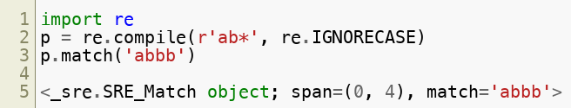
Regular Expressions
Python has very powerful (and fast) regex engine
Copyright © 2022 by Elephant Scale, All Rights Reserved

Slide 55
Regex
re.match('pattern') – matches regex at beginning of sring
re.search('pattern') – matches regex anywhere in string
re.findall('pattern') – matches regex
re.sub('pattern', 'replace') – does regex substtitution
Copyright © 2022 by Elephant Scale, All Rights Reserved

Slide 56
Lab: String
Overview:
Quick intro lab to Python
Approximate time:
10 mins
Instructions:
03-languagebasics / strings
Copyright © 2022 by Elephant Scale, All Rights Reserved

Slide 57
Lab: Strings
Overview:
Play with strings in Python
Approximate time:
10 mins
Instructions:
03__pythonLanguageBasics | 3.5-strings.ipynb
Copyright © 2022 by Elephant Scale, All Rights Reserved

Slide 58
Exceptions
Operators Data Types Control Flow and Comprehensions Functions Strings Exceptions Files and Exception Handling Multithreaded Programming Multithreaded programming
Copyright © 2022 by Elephant Scale, All Rights Reserved

Slide 59
Files and Exception Handling
Operators Data Types Control Flow and Comprehensions Functions Strings Exceptions Files and Exception Handling Multithreaded Programming Multithreaded programming
Copyright © 2022 by Elephant Scale, All Rights Reserved

Slide 60
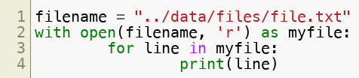
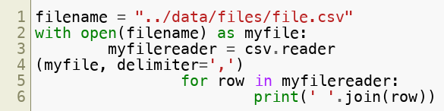
Files
Syntax to open a file – txt
Syntax to open a file – csv
Copyright © 2022 by Elephant Scale, All Rights Reserved

Slide 61
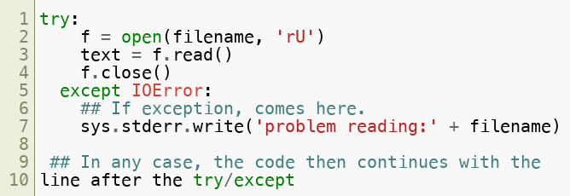
Python Exceptions
Python can throw exceptions.
We should catch Exceptions
Copyright © 2022 by Elephant Scale, All Rights Reserved

Slide 62
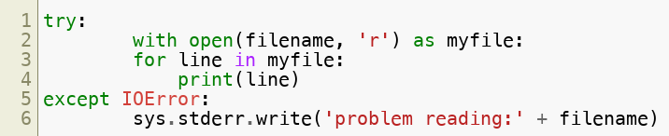
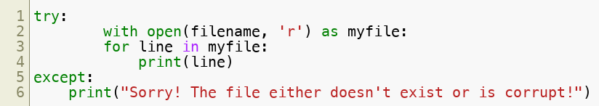
Python Exception Handling
Python can throw exceptions
Exception handling helps in attempts to open non-existent files, corrupt files etc
Copyright © 2022 by Elephant Scale, All Rights Reserved

Slide 63
Lab: Files
Overview:
Play with files in Python
Approximate time:
10 mins
Instructions:
03__pythonLanguageBasics | 3.6-files.ipynb
Copyright © 2022 by Elephant Scale, All Rights Reserved

Slide 64
Multithreaded Programming
Operators Data Types Control Flow and Comprehensions Functions Strings Exceptions Files and Exception Handling Multithreaded Programming Multithreaded programming
Copyright © 2022 by Elephant Scale, All Rights Reserved

Slide 65
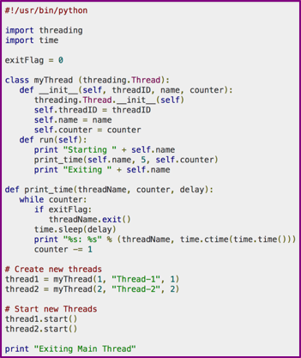
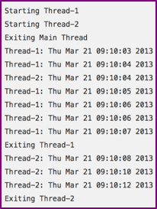
Multithreaded programming
Python supports multithreaded programming
Works very similar to Java (identical interface)
The threading class is used
Copyright © 2022 by Elephant Scale, All Rights Reserved

Slide 66
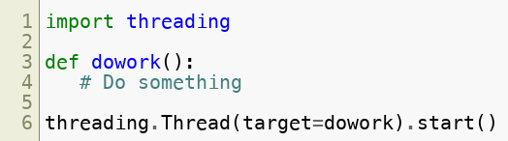

Threads
Python supports multithreaded programming
Works very similar to Java (identical interface)
Can also inherit from Thread class
Copyright © 2022 by Elephant Scale, All Rights Reserved

Slide 67
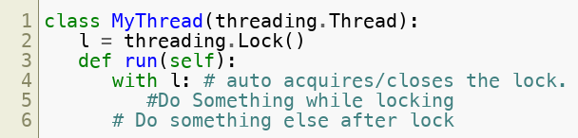
Thread Safety
Immutability is very nice when we have threads!
tuple/frozenset are a thread-safe collection type.
Strings and numerics (ints, floats) are thread-safe.
Otherwise, we need to use lock, semaphore, etc.
Copyright © 2022 by Elephant Scale, All Rights Reserved

Slide 68
Multithreaded programming
Operators Data Types Control Flow and Comprehensions Functions Strings Exceptions Files and Exception Handling Multithreaded Programming Multithreaded programming
Copyright © 2022 by Elephant Scale, All Rights Reserved

Slide 69
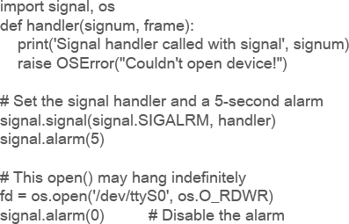
Events / Callbacks
Event handling is multiple threads of another type
Code in event handlers will be run on different thread
Need to keep thread safety in mind in callbacks.
Python provides the signal class to handle messaging.
Copyright © 2022 by Elephant Scale, All Rights Reserved

