Slide 1
Python – Web Programming
OOP Intro
Classes/Objects
Copyright © 2022 by Elephant Scale, All Rights Reserved

Slide 2
Lesson Objectives
Learn Python language OOP
Copyright © 2022 by Elephant Scale, All Rights Reserved

Slide 3
OOP Intro
OOP Intro Classes/Objects
Copyright © 2022 by Elephant Scale, All Rights Reserved

Slide 4
What is OOP?
Most languages today follow the principles of Object-Oriented Programming.
What are the Principles of OOP?
Classes vs. Objects
Encapsulation
Inheritance
Polymorphism
Data Abstraction and Access Modifiers
Exception Handling
Copyright © 2022 by Elephant Scale, All Rights Reserved

Slide 5
Classes/Objects
OOP Intro Classes/Objects
Copyright © 2022 by Elephant Scale, All Rights Reserved

Slide 6
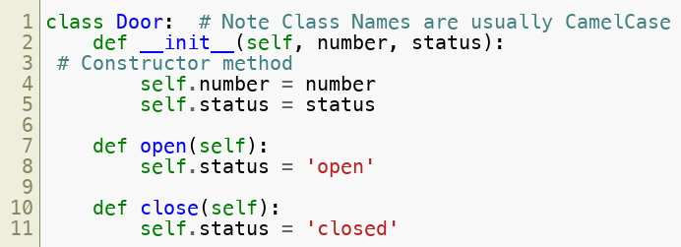
Classes and Objects
Python allows Classes to be defined.
Classes are instantiated as objects.
Methods are defined inside the class.
Copyright © 2022 by Elephant Scale, All Rights Reserved

Slide 7
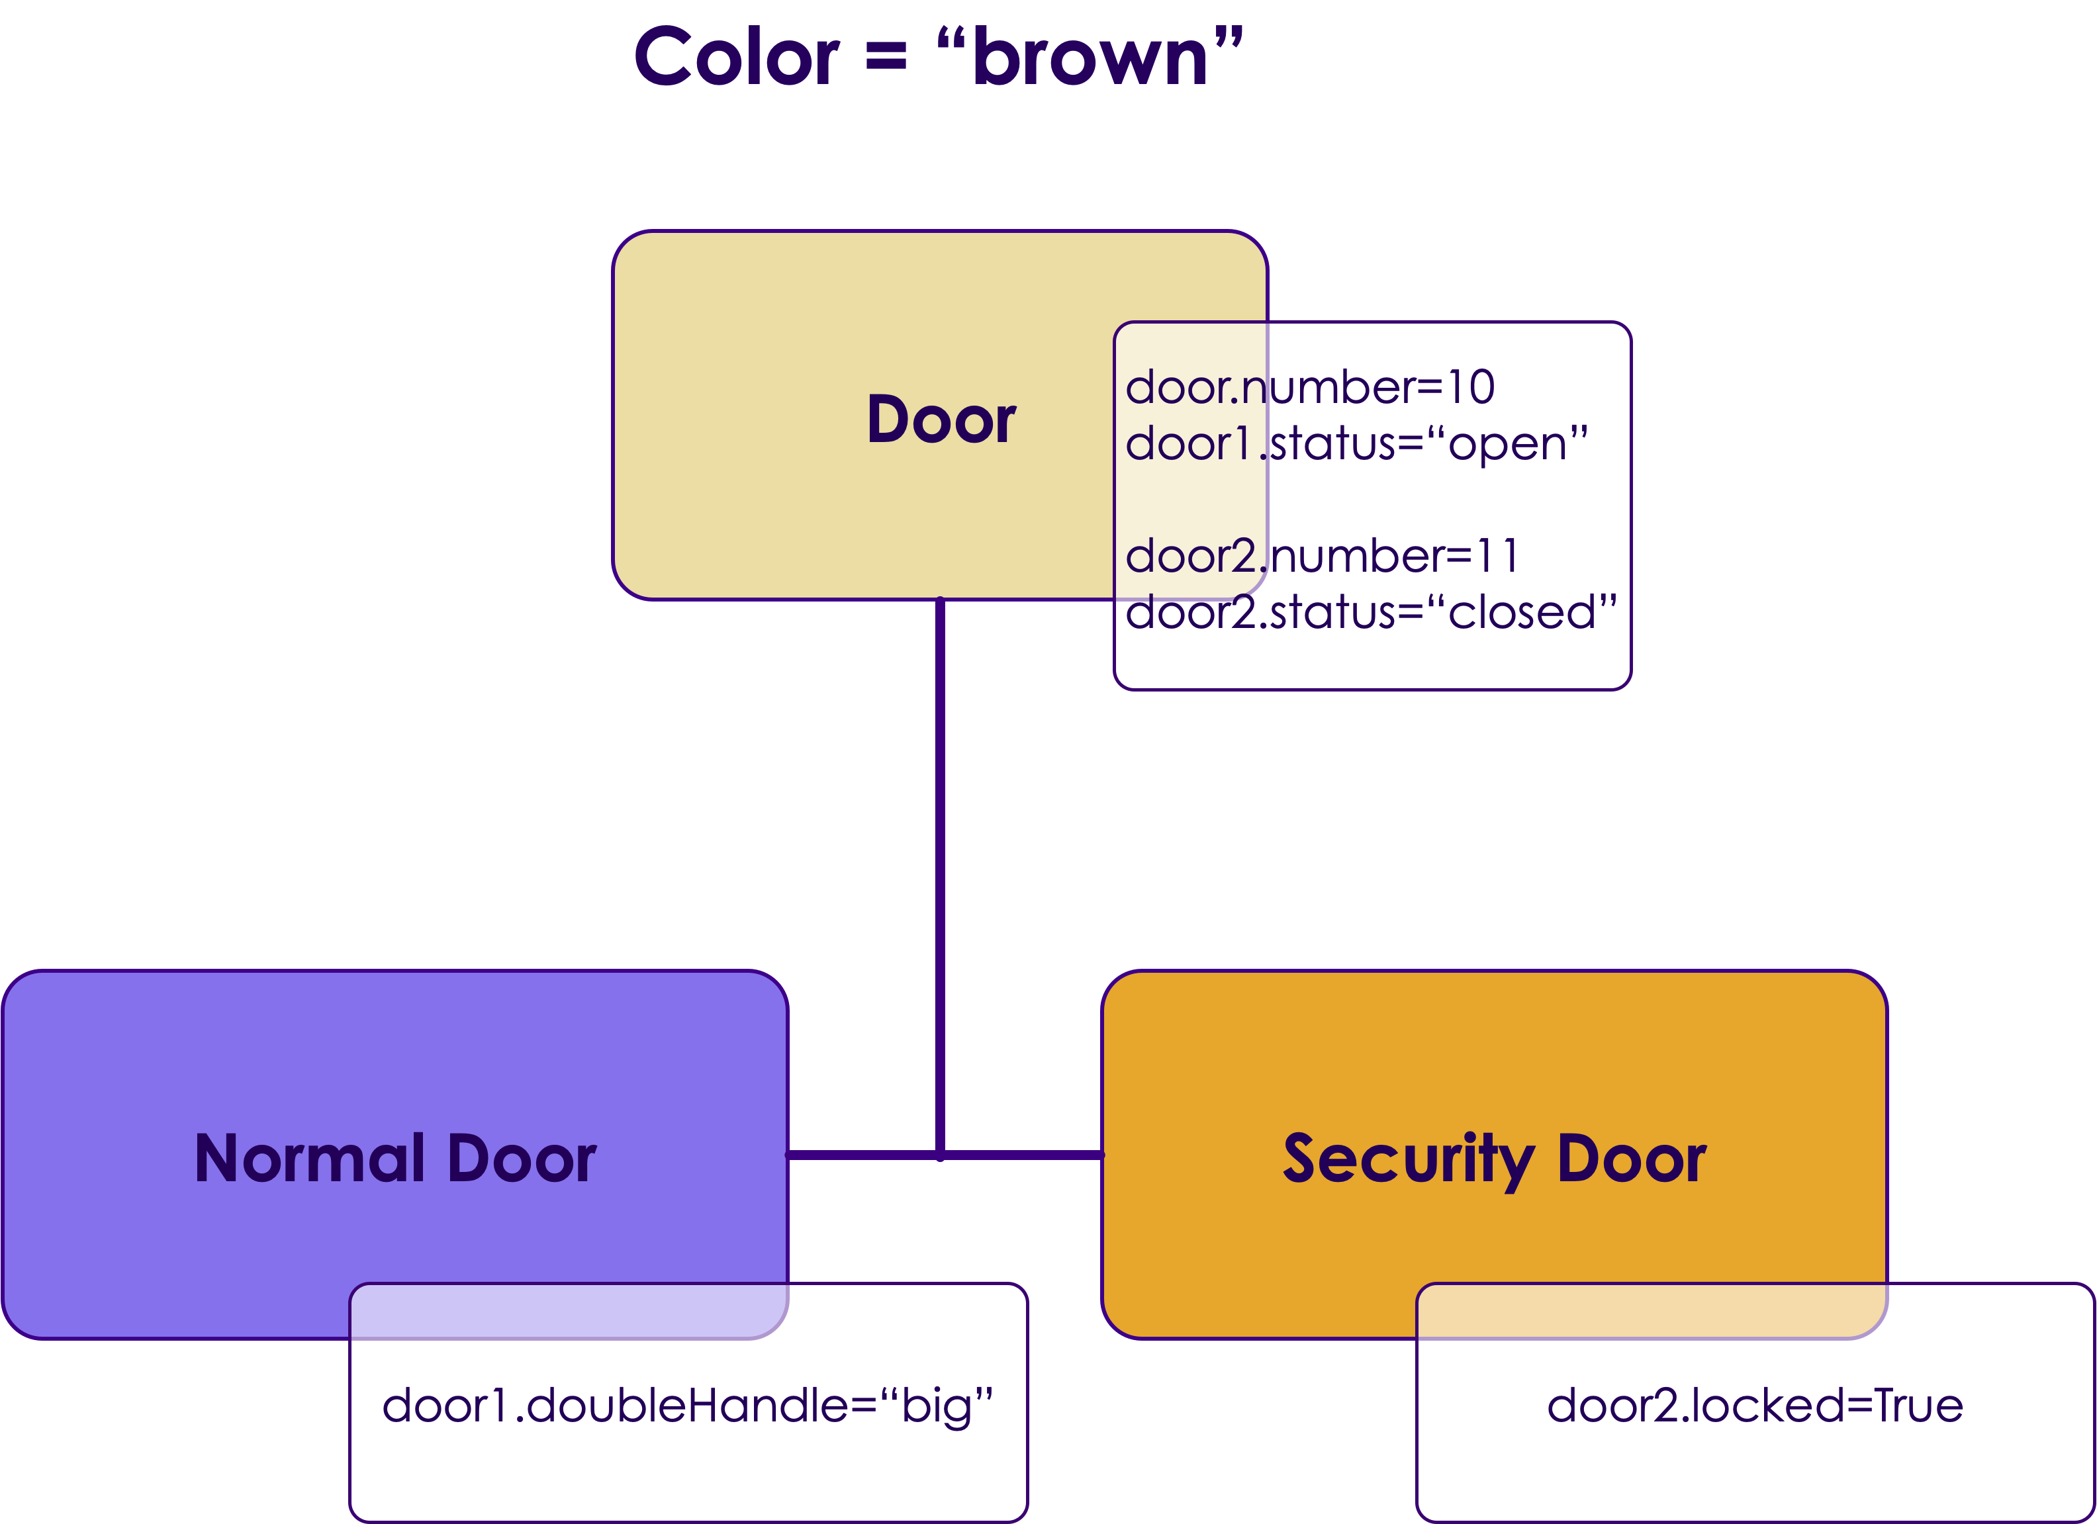
Example: The Door Class
CONSTRAINTS
All Doors are brown
All Doors have unique number and a status ("open"/"closed")
Normal Doors have double handles and can be "big"/"small"
Security Doors have a locked variable (True/False)
Copyright © 2022 by Elephant Scale, All Rights Reserved

Slide 8
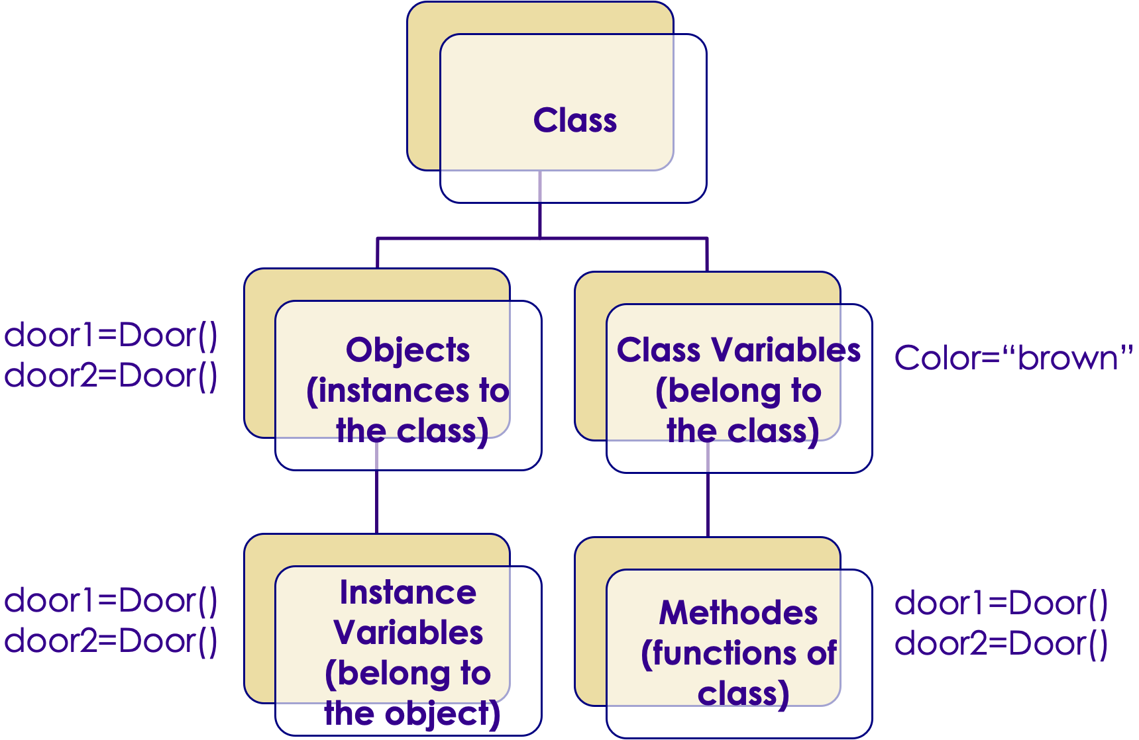
OOP in Python
Copyright © 2022 by Elephant Scale, All Rights Reserved

Slide 9
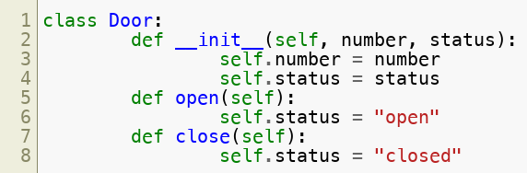

Class, Object, Instance Variable, Method
Python allows Classes to be defined
Classes are instantiated as Objects
Each object can have Instance Variables
Methods are defined inside the class
Class names are usually CamelCase
Copyright © 2022 by Elephant Scale, All Rights Reserved

Slide 10
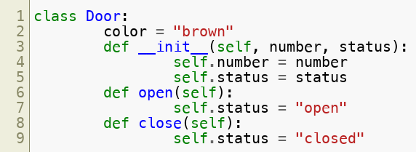
Classes Variable
Python allows Class Variables to be defined
These variables are common to any object / instance of the class
Changing the class variable or class attribute will change the value of the variable for all instances of the class.
Copyright © 2022 by Elephant Scale, All Rights Reserved

Slide 11
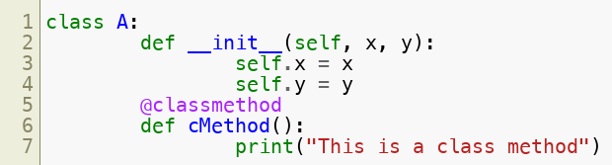
Class Methods
Static methods are known as Class Methods
The decorator @classmethod is used to denote a static method that is common to all instances of the class
This will give us a reference to the static class (not the object)
Example:
Copyright © 2022 by Elephant Scale, All Rights Reserved

Slide 12
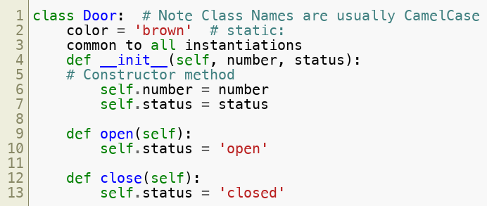
Attributes
Classes can have attributes called class attributes
These are static to the class (not to the object)
Changing one instance attribute will change it on entire class
Copyright © 2022 by Elephant Scale, All Rights Reserved

Slide 13
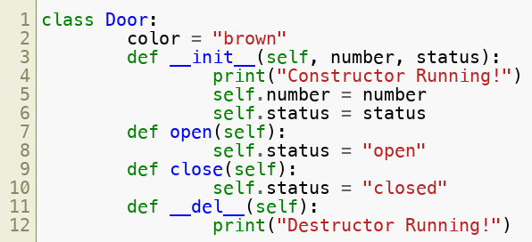

Accessing Attributes
Copyright © 2022 by Elephant Scale, All Rights Reserved

Slide 14
Members
Member variables are referred to by with reference to self
Copyright © 2022 by Elephant Scale, All Rights Reserved

Slide 15
Access Modifiers
Unlike in C++/Java/C#, Access is not strictly enforced.
However, we can declare access in the following way;
public: MyClass.my_member #public
Protected MyClass._my_member # protected
Private: MyClass.__my_member #private
This is a convention
But it is supported in the language
Protected members are renamed "behind the scenes" so a class knows the difference between an inherited member and a local member.
Protected and Private members are not shown in metadata to outside users, and an exception is throne if users attempt to use them.
But there are ways around this.
Copyright © 2022 by Elephant Scale, All Rights Reserved

Slide 16
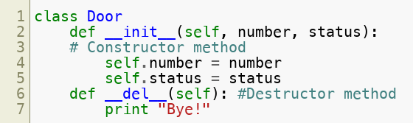
Constructors and Destructors
Classes can define a constructor and destructor
Strictly speaking, constructors are called after and not before the class is instantiated.
Constructor
Name is init ()
Constructors should completely initialize all class members
Destructor
Called at GC time
Name is del ()
Copyright © 2022 by Elephant Scale, All Rights Reserved

Slide 17
Constructor and Destructor
Example:
Copyright © 2022 by Elephant Scale, All Rights Reserved

Slide 18
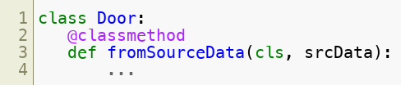
Class Methods
Static methods are known as class methods
We can use a decorator @classmethod
This will give us a reference to the static class (not the object)
Example usage: Factory Method
Copyright © 2022 by Elephant Scale, All Rights Reserved

Slide 19
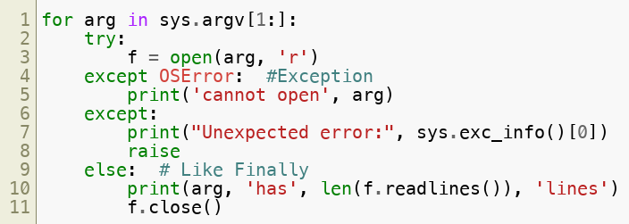
Exception Handling
We can catch exceptions using try/except/raise/else
Copyright © 2022 by Elephant Scale, All Rights Reserved

Slide 20
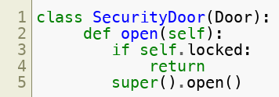
Inheritance
Python allows us to inherit from base classes
Super() refers to the superclass (or superclasses)
Copyright © 2022 by Elephant Scale, All Rights Reserved

Slide 21

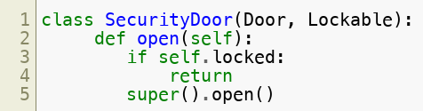
Multiple Inheritance
Python has multiple inheritance
Therefore, does not need interface contracts
What about the "diamond problem"?
Use name resolution:
Specify the base class by name instead of super()
Copyright © 2022 by Elephant Scale, All Rights Reserved

Slide 22
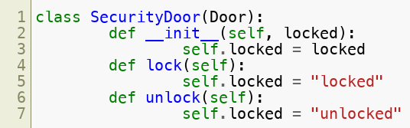
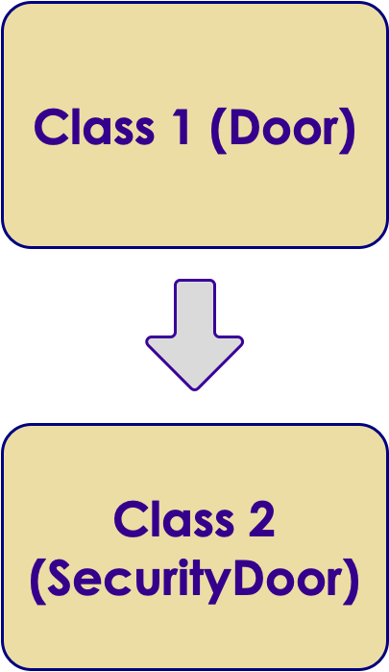

Inheritance
Python allows us to inherit attributes from one or more base classes
Example:
Copyright © 2022 by Elephant Scale, All Rights Reserved

Slide 23
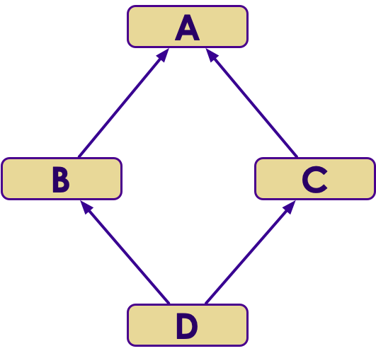
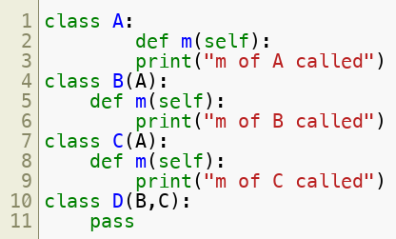
Multiple Inheritance
Python has multiple inheritance (can inherit from multiple parent classes)
Example of the "diamond problem":
Copyright © 2022 by Elephant Scale, All Rights Reserved

Slide 24
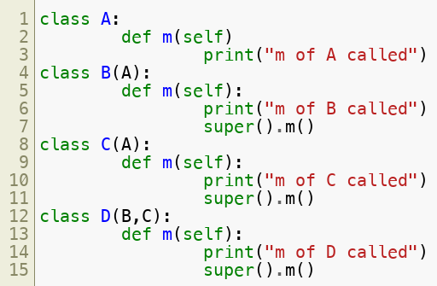
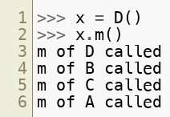
Multiple Inheritance – super()
Example usage of super()
Copyright © 2022 by Elephant Scale, All Rights Reserved

Slide 25
Encapsulation
Encapsulation is the idea of wrapping data and operations that are performed on that data into one entity
This allows more secured access of data
The idea of writing <class object>.<instance variable> is itself encapsulation
Data Abstraction has a subtle difference from encapsulation
Copyright © 2022 by Elephant Scale, All Rights Reserved

Slide 26
Data Abstraction and Access Modifiers
Abstraction is the process of separation of presentation details from implementation details
Unlike in C++/Java/C#, access is not strictly enforced and there are well defined access modifiers
Members are by default Public, and can be accessed from anywhere
Protected members can be accessed from within class or sub-classes (Preceded by single underscore)
Private members accessible only within class (Preceded by double underscore)
Protected and Private members are not shown in metadata to outside users
An exception is thrown if users attempt to use them
Methods have the same access modifier conventions as members
Copyright © 2022 by Elephant Scale, All Rights Reserved

Slide 27
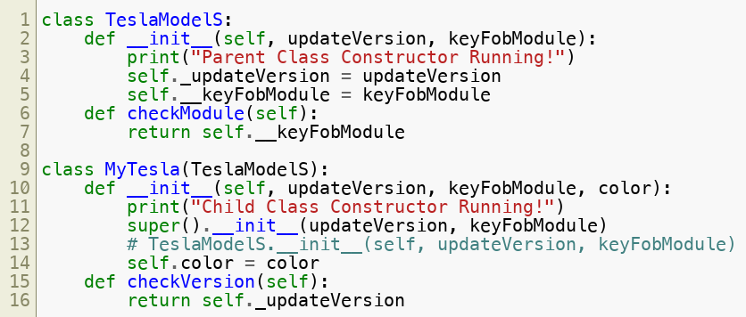
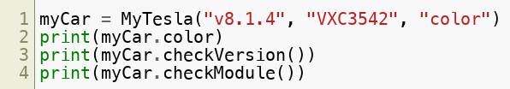
Data Abstraction and Access Modifiers
Copyright © 2022 by Elephant Scale, All Rights Reserved

Slide 28
Lab: OOP
Overview:
Learn Object Oriented Programming in Python
Approximate time:
10 mins
Instructions:
03__pythonLanguageBasics | 3.7-oop.ipynb
Copyright © 2022 by Elephant Scale, All Rights Reserved

