Slide 1
Python – Web Programming
Python Web Frameworks
Flask
RESTFul API With Flask
Copyright © 2022 by Elephant Scale, All Rights Reserved

Slide 2
Lesson Objectives
Learn about Python Web Applications
Learn about Django versus Flask
Web Services with Flask
Copyright © 2022 by Elephant Scale, All Rights Reserved

Slide 3
Python Web Frameworks
Python Web Frameworks Flask RESTFul API With Flask
Copyright © 2022 by Elephant Scale, All Rights Reserved

Slide 4
Python Web Frameworks
Framework | Features
Light Weight
WSGI | - Python's Web Server Gateway Interface (WSGI) is part of Python installation. - Very basic functionality. - Also look at Werkzeug framework.
Falcon | - Very fast - Bare bones functionality
Flask | - Light weight - Got basic features
Full Featured
Django | - Feature rich - Very popular
Web2Py
TurboGears
Copyright © 2022 by Elephant Scale, All Rights Reserved

Slide 5
Flask
Python Web Frameworks Flask RESTFul API With Flask
Copyright © 2022 by Elephant Scale, All Rights Reserved

Slide 6
Flask
Simple, but powerful web framework
Provides server and debugger
"Do one thing and do it well" philosophy
Copyright © 2022 by Elephant Scale, All Rights Reserved

Slide 7
Django Vs Flask
 | Django | Flask
Philosophy | Everything Included | Plugin model
DI/IOC Container | Included | Not Supported
Web Content Framework | Included | Various Plugins Available
RESTFUL Web Services | Included | Included
User Authentication | Django Model | Various Plugins for Authentication Scenarios
Content Versioning | Django Model | Not Supported
Browsable Web Service API | Included | Not Supported
ORM | Built-in ORM | Plugin support for SQLAlchemy and others.
Speed | Acceptable Speed | Faster Speed
Summary | Good for big webapps and heavy-weight services where all-inclusive is good | Good for lightweight apps, Microservices, and places where speed is essential.
Copyright © 2022 by Elephant Scale, All Rights Reserved

Slide 8
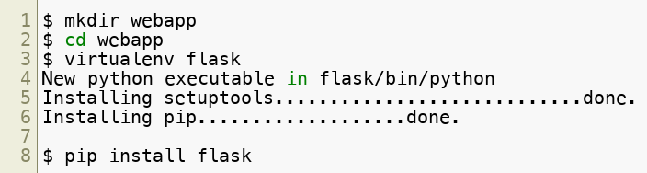
Getting Started With Flask
Flask is part of Anaconda
For vanilla python installations, we recommend a virtual-env setup
Copyright © 2022 by Elephant Scale, All Rights Reserved

Slide 9
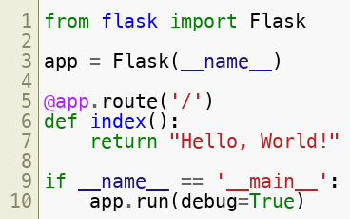

Flask App
app.py :
Copyright © 2022 by Elephant Scale, All Rights Reserved

Slide 10
RESTFul API With Flask
Python Web Frameworks Flask RESTFul API With Flask
Copyright © 2022 by Elephant Scale, All Rights Reserved

Slide 11
Basic REST Concepts
Client-Server Architecture:
Client and Server are separated.
Server offers a 'service.
Client consumes it.
Stateless
Client requests must contain all information to serve that particular request
Caching
Server will provide on guidance on caching requests
Copyright © 2022 by Elephant Scale, All Rights Reserved

Slide 12
RESTFul WebService
HTTP Method | Description
GET | Get resource listing or resource info
POST | Create a new resource
PUT | Update a resource
DELETE | Delete a resource
Copyright © 2022 by Elephant Scale, All Rights Reserved

Slide 13
Lab: Building A WebService
Overview:
Build a web service server and client
Approximate time:
1 hr
Instructions:
Please follow instructions from
Web/web-1
Web/web-2
Web/web-3
To Instructor:
help the class
Copyright © 2022 by Elephant Scale, All Rights Reserved

Slide 14
Review Questions
Copyright © 2022 by Elephant Scale, All Rights Reserved

