Slide 1
Python Testing
Test approaches
Different kinds of test runners
PyCharm IDE
Visual Studio Code IDE
Copyright © 2022 by Elephant Scale, All Rights Reserved

Slide 2
Lesson Objectives
Being familiar with different testing platforms and IDEs
Running a few simple test to see real application
Copyright © 2022 by Elephant Scale, All Rights Reserved

Slide 3
Test approaches
Test approaches Different kinds of test runners PyCharm IDE Visual Studio Code IDE
Copyright © 2022 by Elephant Scale, All Rights Reserved

Slide 4
Automated vs. Manual Testing
Manual testing = exploratory testing
There is no plan
In automated testing we have a plan for test regarding"
Parts of the application
The order
The expected response
Script instead of a human
Copyright © 2022 by Elephant Scale, All Rights Reserved

Slide 5
Unit test vs. integration test
Integration test: checks if the components in the application work with each other or not
Unit test: checks a small component in the application
It's possible to write either unit or integration tests in Python
Example:
Checks if the built-in function sum works properly
Copyright © 2022 by Elephant Scale, All Rights Reserved

Slide 6
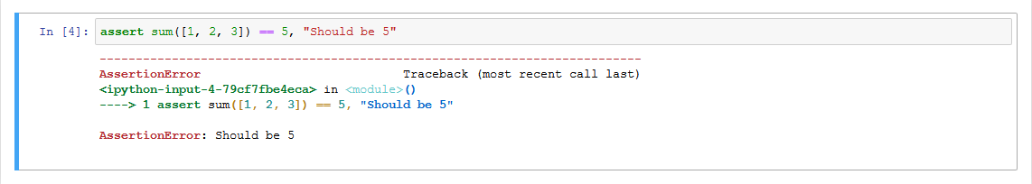
A failed example
If everything is OK nothing comes up
In case of any problem with the code we get an error
Copyright © 2022 by Elephant Scale, All Rights Reserved

Slide 7
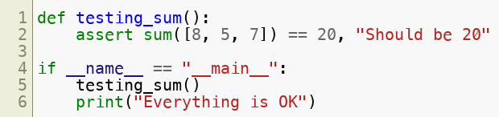

Test Python file
Putting the test into a Python file:
To execute the Python file:
Copyright © 2022 by Elephant Scale, All Rights Reserved

Slide 8
Different kinds of test runners
Test approaches Different kinds of test runners PyCharm IDE Visual Studio Code IDE
Copyright © 2022 by Elephant Scale, All Rights Reserved

Slide 9
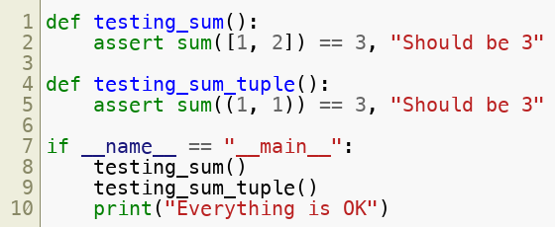
Why test runner
Consider the following file: test_sum_tuple.py
Copyright © 2022 by Elephant Scale, All Rights Reserved

Slide 10
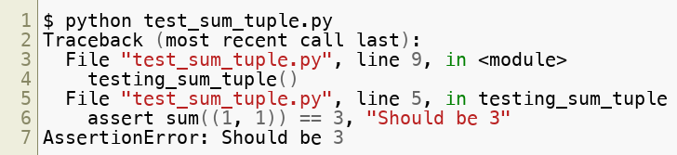
Why test runner (contd)
The output:
Here we have just one mistake. What if we have more than one mistake? Answer is test runner
Copyright © 2022 by Elephant Scale, All Rights Reserved

Slide 11
Choosing a test runner
The most common test runners are:
unittest
nose or nose2
pytest
Copyright © 2022 by Elephant Scale, All Rights Reserved

Slide 12



Enabling test runners
For unittest :
For pytest :
For nose :
Copyright © 2022 by Elephant Scale, All Rights Reserved

Slide 13
unittest
Built into the Python standard library
Contains either a testing framework and a test runner
Requires that:
Putting the test into classes as methods
Using a series of special assertion methods in the unittest.TestCase class instead of the built-in assert statement
Copyright © 2022 by Elephant Scale, All Rights Reserved

Slide 14
Converting previous example to unittest
Import unittest
import unittest
Create a class called TestSum
Convert the test functions into methods by adding self as the first argument
Change the assertions to use the self.assertEqual() method on the TestCase class
Change the command-line entry point to call unittest.main()
Copyright © 2022 by Elephant Scale, All Rights Reserved

Slide 15
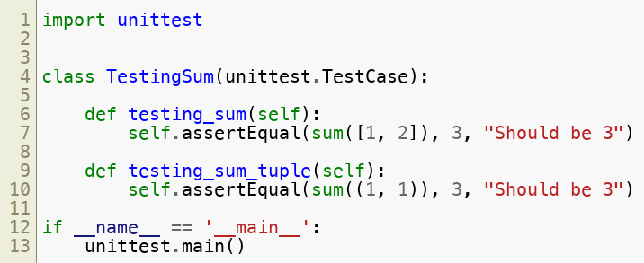
Example
FileName = test_sum_unittest.py
Copyright © 2022 by Elephant Scale, All Rights Reserved

Slide 16
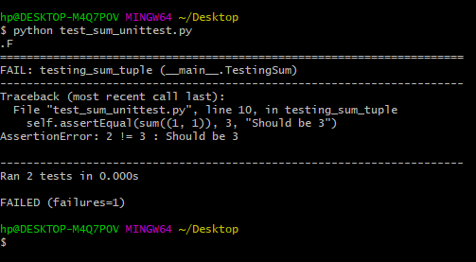
The output
Copyright © 2022 by Elephant Scale, All Rights Reserved

Slide 17
nose
Is compatible with tests created by unittest
As a drop-in replacement for unittest
nose2 is recommended
Copyright © 2022 by Elephant Scale, All Rights Reserved

Slide 18
How to run?
Install nose2 from PyPI
pip install nose2
Execute it on the command line
python -m nose2
Discovers test scripts like test*.py and test cases inheriting from unittest.TestCase in the current directory
Copyright © 2022 by Elephant Scale, All Rights Reserved

Slide 19

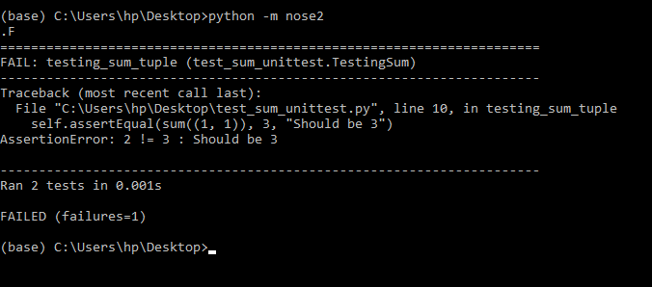
Example
Input:
Output:
Copyright © 2022 by Elephant Scale, All Rights Reserved

Slide 20
Pytest
Supports execution of unittest test cases
Advantage of pytest is writing pytest test cases
These are some functions in a Python file starting with test_ in their names
Other characteristics:
Support for the built-in assert statement instead of using special self.assert*() methods
Support for filtering for test cases
Ability to rerun from the last failing test
An ecosystem of hundreds of plugins to extend the functionality
Copyright © 2022 by Elephant Scale, All Rights Reserved

Slide 21
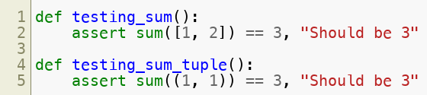
Example
Writing a TestSum test case for pytest looks like:
Copyright © 2022 by Elephant Scale, All Rights Reserved

Slide 22
PyCharm IDE
Test approaches Different kinds of test runners PyCharm IDE Visual Studio Code IDE
Copyright © 2022 by Elephant Scale, All Rights Reserved

Slide 23
A simple project
Let's create a simple project in python and run unittest on it
Copyright © 2022 by Elephant Scale, All Rights Reserved

Slide 24
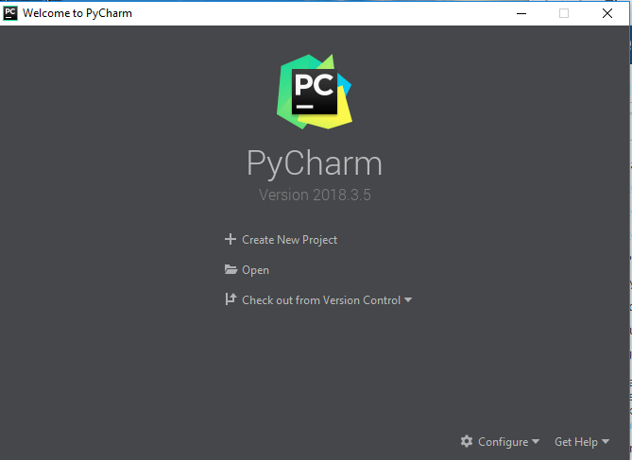
Creating a Python project
Choose File > New Project and set the path and the name of the project
Then right click on the left panel and choose new and then Python File
Name the file Solver
Copyright © 2022 by Elephant Scale, All Rights Reserved

Slide 25
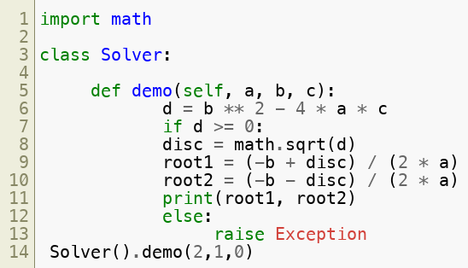
Code
The following code creates a simple script which solves a quadratic equation.
Copyright © 2022 by Elephant Scale, All Rights Reserved

Slide 26
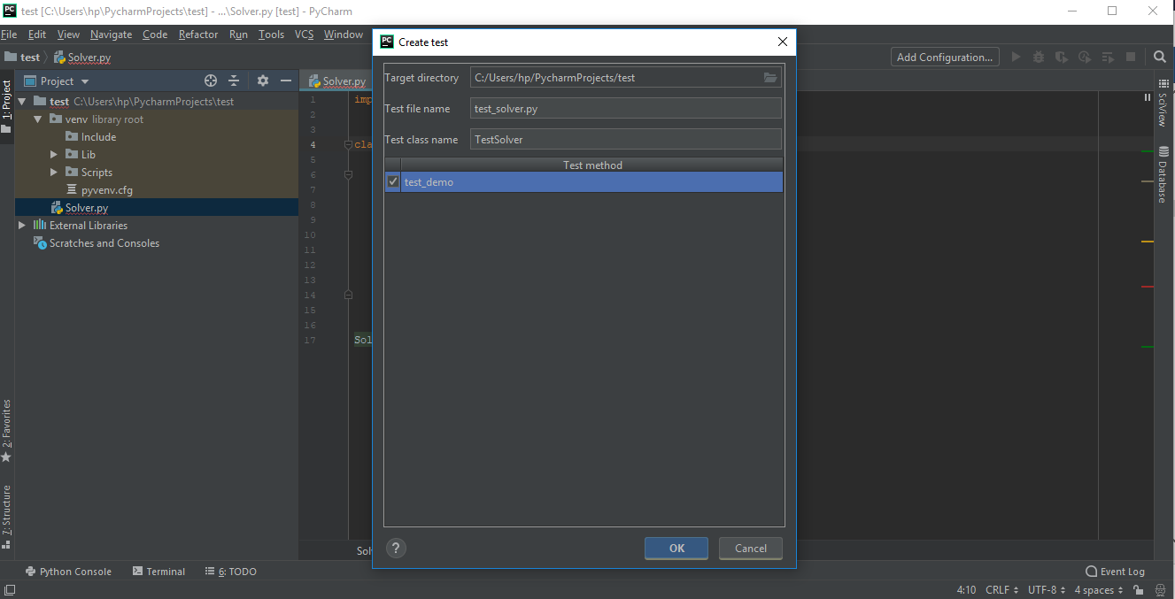
Creating the test
Click on Solver and press Ctrl+Shift+T and click on Create New Test
Check the test_demo and click on OK
Copyright © 2022 by Elephant Scale, All Rights Reserved

Slide 27
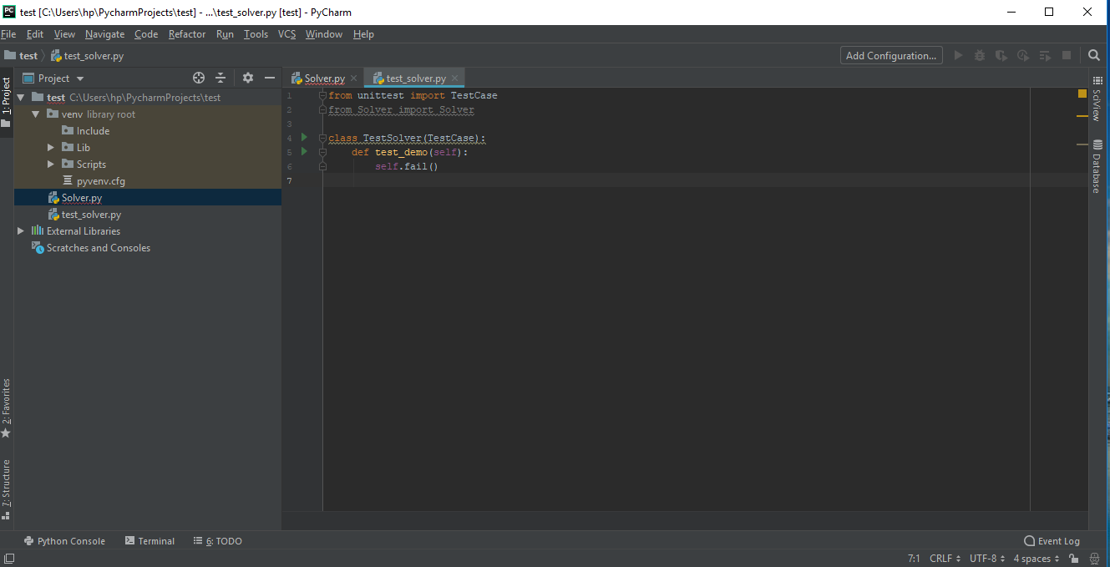
Changing the script
We need to add an import:
Copyright © 2022 by Elephant Scale, All Rights Reserved

Slide 28
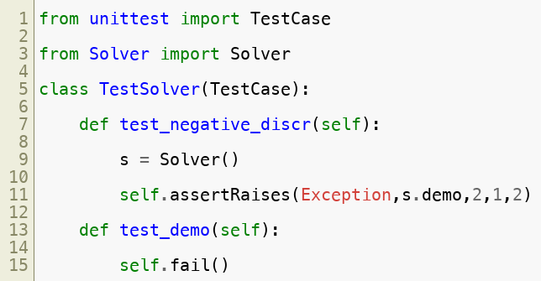
Creating a test method
The final code on the screen would be
Copyright © 2022 by Elephant Scale, All Rights Reserved

Slide 29
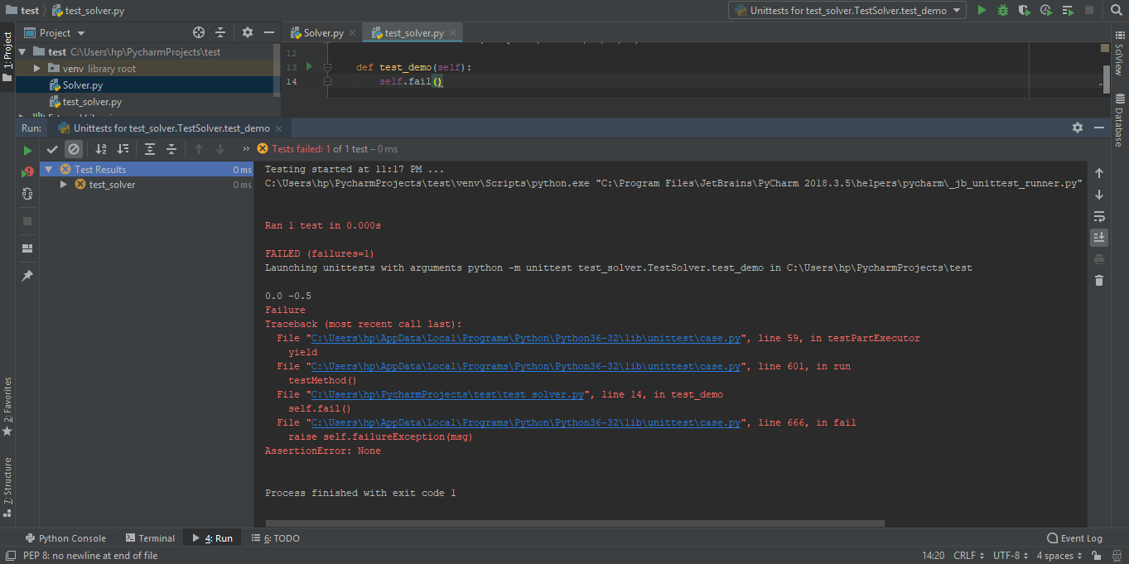
Running the test
Just press Ctrl+Shift+F10 to run the test
Copyright © 2022 by Elephant Scale, All Rights Reserved

Slide 30
Visual Studio Code IDE
Test approaches Different kinds of test runners PyCharm IDE Visual Studio Code IDE
Copyright © 2022 by Elephant Scale, All Rights Reserved

Slide 31
Test discovery
Uses currently enabled testing framework
It can be triggered at any time
By default python.unitTest.autoTestDiscoverOnSaveEnabled is true
python.unitTest.unittestArgs Searches for python test files with test included in their names in root folder
python.unitTest.pyTestArgs Searches for the same files with test_ in the beginning or _test at the end of the file name
Copyright © 2022 by Elephant Scale, All Rights Reserved

Slide 32
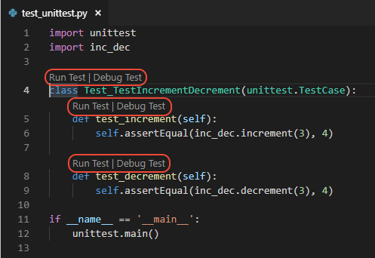
CodeLens adornment
After recognizing test files, some items appear in the window
You can easily click on them to run the test
If discovery fails a notification shows up
Copyright © 2022 by Elephant Scale, All Rights Reserved

Slide 33
Running test
There are four ways:
By opening test file and using CodeLens
By selecting Run Tests on the status bar (which can change appearance based on results). Then selecting one of the commands like Run All Unit Tests or Run Failed Unit Tests
By right-clicking a file in Explorer and select Run All Unit Tests
By selecting any of the run unit test commands in the Command Palette . (Ctrl+Shift+P)
Copyright © 2022 by Elephant Scale, All Rights Reserved

