Slide 1
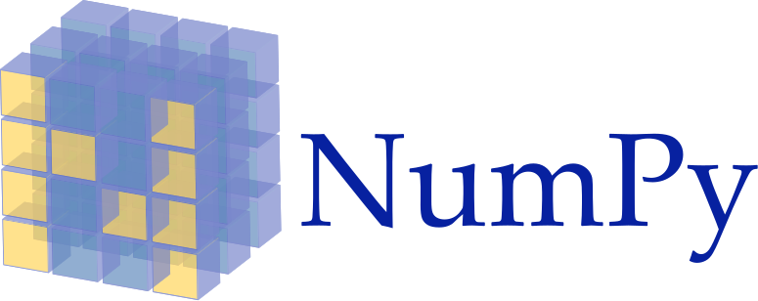
PYTHON NumPy
Introduction
Arrays
Advanced Array Operations
Matrices
Copyright © 2022 by Elephant Scale, All Rights Reserved

Slide 2
Lesson Objectives
Introduction to NumPy and why its needed
Creating NumPy arrays
Multidimensional Arrays
Upcasting and Broadcasting
Indexing and Slicing
Advanced Array Operations
Matrices
Sparse Matrices
Copyright © 2022 by Elephant Scale, All Rights Reserved

Slide 3
Introduction
Introduction Arrays Advanced Array Operations Matrices
Copyright © 2022 by Elephant Scale, All Rights Reserved

Slide 4
About NumPy and Python
Python is a rich language with ecosystem.
Open source
Rich package ecosystem (lots of libraries)
Great for modeling, machine learning, ad-hoc analytics
Used by scientists, now very popular among data scientists / analysts
Copyright © 2022 by Elephant Scale, All Rights Reserved

Slide 5
Why NumPy
It adds support for large, multi-dimensional arrays and matrices
Fast
NumPy does numeric computation in native code
(Fast C++)
Full Featured
Has a large collection of high-level mathematical functions to operate on these arrays
Does many types of linear algebra functions
Matrix Manipulation
Helps Support More Advanced Analytics
Most advanced analytics are built on top of NumPy
NumPy website - http://www.numpy.org/
Copyright © 2022 by Elephant Scale, All Rights Reserved

Slide 6
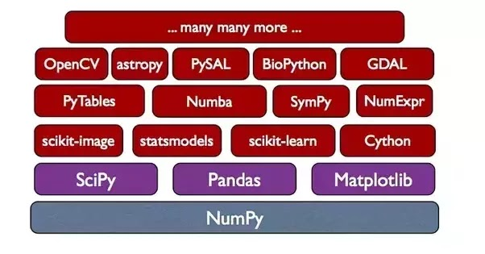
NumPy and SciPy
SciPy is a companion package to NumPy
Scientific computing
Built on top of NumPy
Some features:
Integrals, Differentiation
Linear Algebra
FFT
Basis of MANY other packages:
Link
Copyright © 2022 by Elephant Scale, All Rights Reserved
Notes:
- https://www.scipy.org/topical-software.html

Slide 7
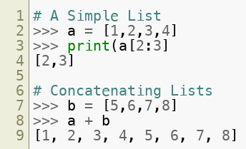
Lists in Python
Python has a native type of sequence: the list.
Good for storing small data
Not good for multi-dimensional data.
Very slow "at scale"
Copyright © 2022 by Elephant Scale, All Rights Reserved

Slide 8
Arrays
Introduction Arrays Advanced Array Operations Matrices
Copyright © 2022 by Elephant Scale, All Rights Reserved

Slide 9
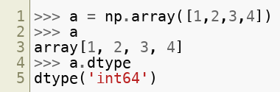
NumPy ndarray
NumPy Arrays are fast:
Native code (C++)
N-dimensional arrays
Homogeneously typed (usually numeric types: int64, float64, etc.)
NumPy needs to be imported
import numpy as np
Syntax to initialize a NumPy array and check its data type
Copyright © 2022 by Elephant Scale, All Rights Reserved

Slide 10
Enter the Ndarray
NumPy Arrays are fast:
Native Code (C++)
Fast vectorized operations.
Homogeneously typed (usually numeric types: int64, float64, etc.)
Copyright © 2022 by Elephant Scale, All Rights Reserved

Slide 11
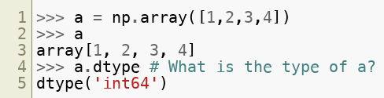
An ndarray
Here is an example of how to create the array
The name of the class is np.ndarray )
Copyright © 2022 by Elephant Scale, All Rights Reserved

Slide 12
Array Types
Arrays have types: ( np.int64 , np.float64 , np.complex etc.)
Types can be inferred implicitly. For Example, NumPy infers the following as np.int64
Copyright © 2022 by Elephant Scale, All Rights Reserved

Slide 13
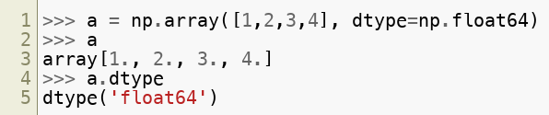
Array Types
Types can also be specified explicitly. For Example: NumPy may infer the following as np.int64 , but we explicitly set the data type to be np.float64
Copyright © 2022 by Elephant Scale, All Rights Reserved

Slide 14
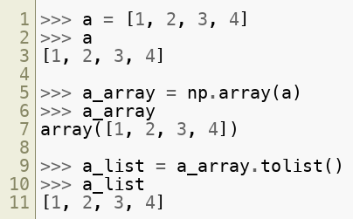
Creating Arrays - List to ndarray
We can convert plain Python list to ndarray:
Result will be possibly nested (if multi-dimensional)
Single dimensional ndarray (vectors) will be non-nested
Copyright © 2022 by Elephant Scale, All Rights Reserved

Slide 15
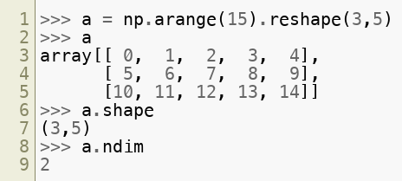
Multi-Dim Arrays – shape, reshape, ndim
Arrays can be multidimensional
Example of a 2D array:
<npArray>.reshape – Reshapes array into desired dimensions
<npArray>.shape – Returns shape of the array
<npArray>.ndim – Returns rank or number of dimensions in array
Copyright © 2022 by Elephant Scale, All Rights Reserved

Slide 16
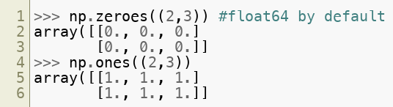
Creating Arrays
There are many ways to create arrays:
Convert from list: np.array(mylist)
Pre-initialized with np.zeroes or np.ones – type float64
Copyright © 2022 by Elephant Scale, All Rights Reserved

Slide 17

Creating Arrays
Range with np.arange
Linspace (n numbers from a to b)
Copyright © 2022 by Elephant Scale, All Rights Reserved

Slide 18
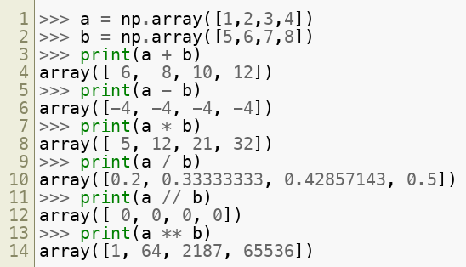
Element-wise operations
Basic arithmetic ( + , - , * , / , // , ** ) is performed element-wise (on arrays)
Copyright © 2022 by Elephant Scale, All Rights Reserved

Slide 19
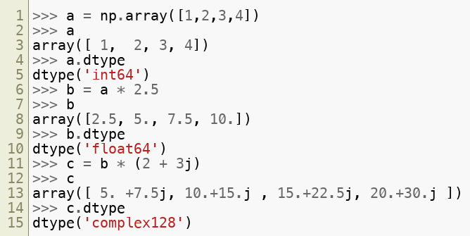
Upcasting
When mixing types on arrays, results are always "Upcasted"
Upcasting order: int -> float -> complex
Copyright © 2022 by Elephant Scale, All Rights Reserved

Slide 20
Broadcasting
What if arrays have different shapes? How do operations on these arrays work?
Broadcasting allows arrays to be extended for element-wise operation in some cases
Compatibility scenarios:
Arrays have exactly the same shape: perform element-wise operation (Example – a(3,5) * b(3,5))
Array operated on by scalar value: perform element-wise operation using scalar (Example – a(3,5) * 2.5)
Arrays with the same number of dimensions (like either 1D/2D/3D and so on) and the length of each dimension is either a common length or 1 (Example – a(3,5) * b(1,5))
Arrays with too few dimensions is broadcasted up (Example – a(3,5,2) * b(5) becomes a(3,5,2) * b(1,5))
Copyright © 2022 by Elephant Scale, All Rights Reserved

Slide 21
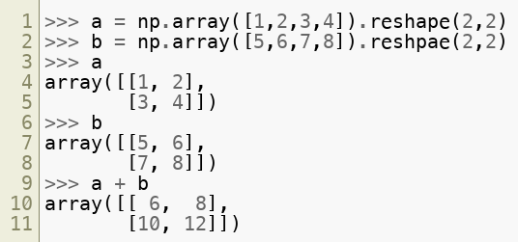
Broadcasting Scenario 1
Arrays have exactly the same shape.
Perform Element-wise
Copyright © 2022 by Elephant Scale, All Rights Reserved

Slide 22
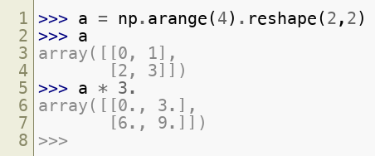
Broadcasting Scenario 2:
Array times a scalar
Notice how scalar product is element-wise
Copyright © 2022 by Elephant Scale, All Rights Reserved

Slide 23
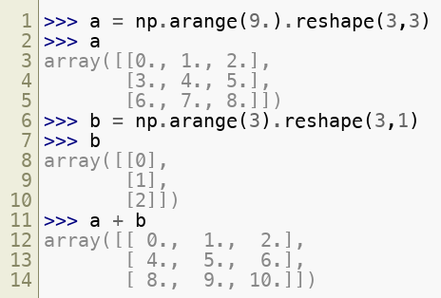
Broadcasting Scenario 3:
Matching in one dimension, 1 in other dimension
Copyright © 2022 by Elephant Scale, All Rights Reserved

Slide 24
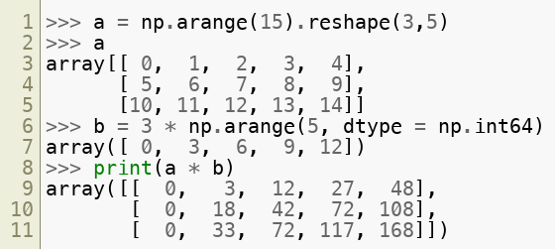
Broadcasting Scenario 4:
Example for broadcasting in 2D arrays
Copyright © 2022 by Elephant Scale, All Rights Reserved

Slide 25

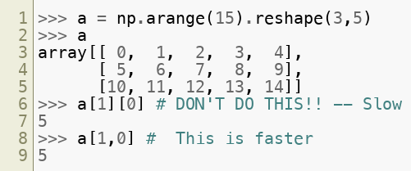
Indexing
Single Dimensions can be indexed as follows:
Multiple Dimensions: use array[m,n] syntax
Copyright © 2022 by Elephant Scale, All Rights Reserved

Slide 26
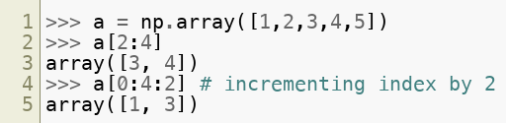
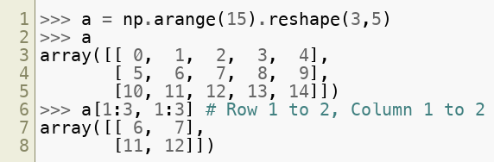
Slicing
Syntax: <npArray>[m : n : i] – NumPy slices the array from index "m" to index "n-1" while incrementing the index by "i"
Multi-dimensional array: (separate slices by commas)
Copyright © 2022 by Elephant Scale, All Rights Reserved

Slide 27
Advanced Array Operations
Introduction Arrays Advanced Array Operations Matrices
Copyright © 2022 by Elephant Scale, All Rights Reserved

Slide 28
Arrays
One-dimensional arrays
Holds ordered collection of objects
Objects all have to be of the SAME TYPE (no mix-match)
Arrays are created using np.array() function
v1 = np.array([0,1,2,3,4,5])
Access elements from Array using indexes
Indexes start with 0: v1[3] => 3
v1[np.array([1,3])] => 1,3
v1[2:4] => 2,3
Copyright © 2022 by Elephant Scale, All Rights Reserved

Slide 29
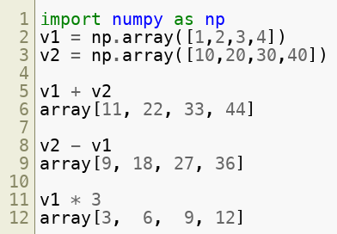
NumPy Array Operations
Arrays can be operated on just like first class variables
Copyright © 2022 by Elephant Scale, All Rights Reserved

Slide 30
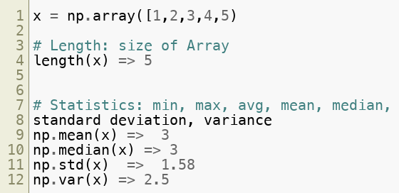
NumPy Array Operations
Copyright © 2022 by Elephant Scale, All Rights Reserved

Slide 31
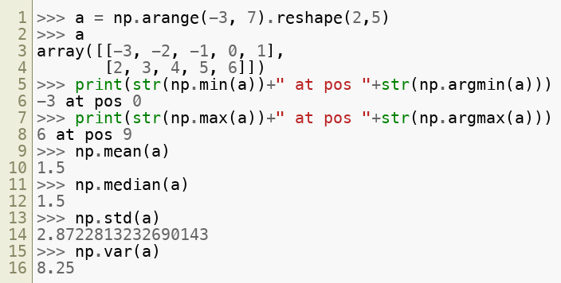
Advanced Array Operations
NumPy calculates max, min, mean, median, standard deviation and variance by simple function calls
Copyright © 2022 by Elephant Scale, All Rights Reserved

Slide 32
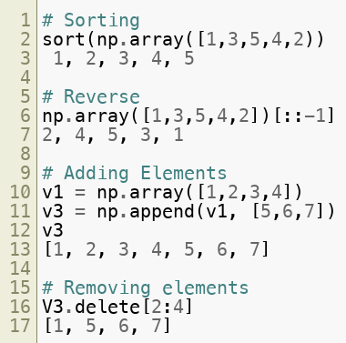
NumPy Operations
Copyright © 2022 by Elephant Scale, All Rights Reserved

Slide 33
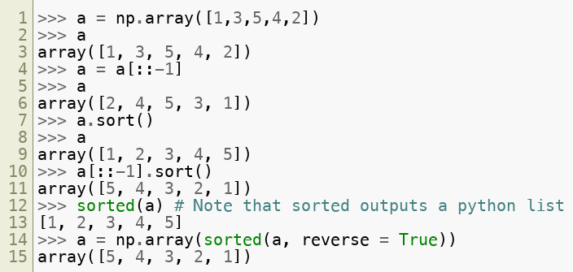
Advanced Array Operations
NumPy works with Python to reverse or sort elements by simple function calls
Copyright © 2022 by Elephant Scale, All Rights Reserved

Slide 34
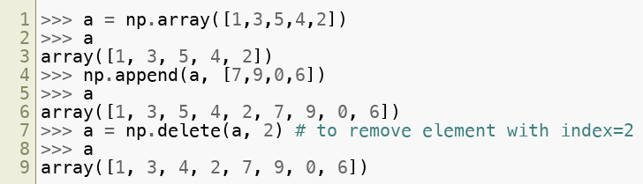
Advanced Array Operations
NumPy works with Python to append or delete elements by simple function calls
Copyright © 2022 by Elephant Scale, All Rights Reserved

Slide 35
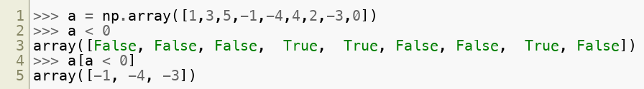
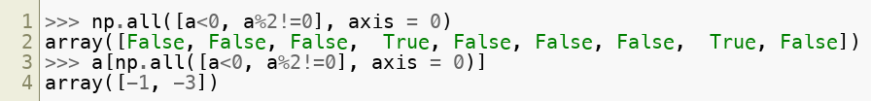
Advanced Array Operations - Filtering
Filtering is an important NumPy operation
np.any() and np.all() help in 'or' and 'and' operations
It helps in selecting a portion or subset of the original array
Example: select only the negative odd number elements
Copyright © 2022 by Elephant Scale, All Rights Reserved

Slide 36
Matrices
Introduction Arrays Advanced Array Operations Matrices
Copyright © 2022 by Elephant Scale, All Rights Reserved

Slide 37
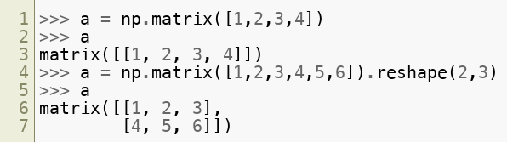
Matrices
NumPy has a special matrix class which differs slightly from the array class
Matrices in NumPy are basically 2-D arrays (with one difference)
They contain elements of the SAME type.
Copyright © 2022 by Elephant Scale, All Rights Reserved

Slide 38
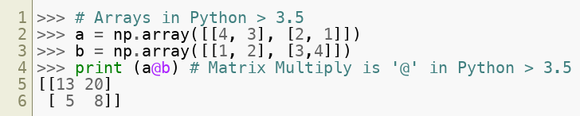
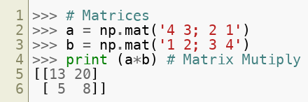
Matrix Manipulation
NumPy can represent matrices 2 ways:
As 2-D ndarrays ( preferred for Python > 3.5 )
np.mat class (subclassed from ndarray) (Python 2.x)
Main difference is matrix multiply syntax: ( * vs @ )
Copyright © 2022 by Elephant Scale, All Rights Reserved

Slide 39
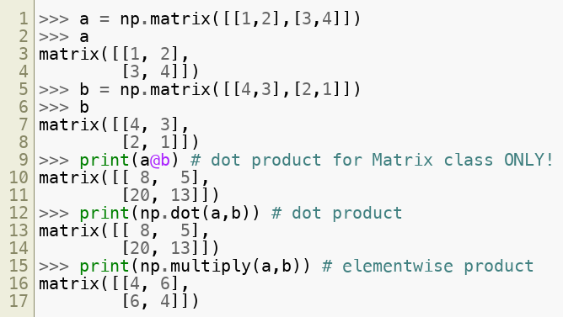
Matrix Manipulation
NumPy represents matrices as 2D ndarrays in Python >3.5
Copyright © 2022 by Elephant Scale, All Rights Reserved

Slide 40
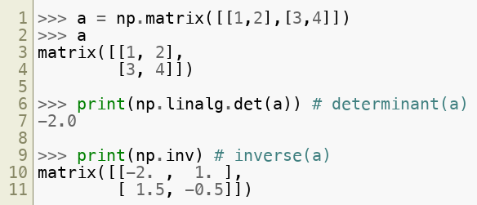
Matrix Manipulation
NumPy represents matrices as 2D ndarrays in Python >3.5
Internally, NumPy stores matrices the same way as 2-D ndarrays in Python > 3.5
Copyright © 2022 by Elephant Scale, All Rights Reserved

Slide 41
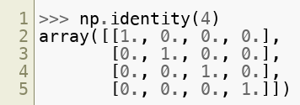
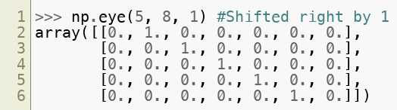
Identity Matrix
Create a basic identity matrix with np.identity(rank)
Create custom diagonals with np.eye(n, m, k)
Copyright © 2022 by Elephant Scale, All Rights Reserved

Slide 42
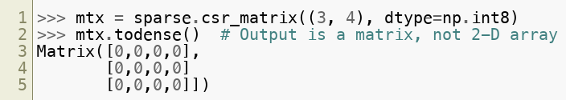
Sparse Matrices
The scipy.sparse namespace has a sparse matrix
Great for times where we have a large matrix
With few items entered.
scipy.parse.csr_matrix : row oriented matrix
scipy.sparse.csc_matrix : column oriented matrix.
Copyright © 2022 by Elephant Scale, All Rights Reserved

Slide 43
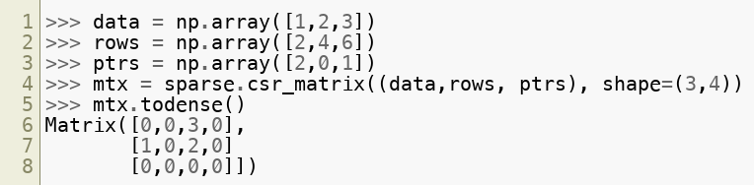
Entering values for CSR/CSC matrix
Here is how we enter the values:
We pass in a tuple of the following:
The raw data
The indices in the matrix that are to be nonzero
The corresponding pointers to the raw data.
Copyright © 2022 by Elephant Scale, All Rights Reserved

Slide 44
Lab: NumPy
Overview:
Use NumPy
Approximate time:
5 mins
Instructions:
numpy/1-numpy.ipynb
Copyright © 2022 by Elephant Scale, All Rights Reserved

