Slide 1

PYTHON:Pandas
Introduction
Series
DataFrame
Operations on DataFrame
Using lambda
Statistics Operations
Advanced Operations
Pandas and Files
Copyright © 2022 by Elephant Scale, All Rights Reserved

Slide 2
Lesson Objectives
Introduction to Pandas and why its needed
Creating Pandas Series and DataFrame
Conducting various operations with a DataFrame
Descriptive Statistics operations
More advanced operations like merging, concatenating, sorting etc.
Working with Pandas and Files
Reading a real world dataset into pandas and doing some data exploration
Copyright © 2022 by Elephant Scale, All Rights Reserved

Slide 3
Introduction
Introduction Series DataFrame Operations on DataFrame Using lambda Statistics Operations Advanced Operations Pandas and Files
Copyright © 2022 by Elephant Scale, All Rights Reserved

Slide 4
Why Pandas
It adds support for data manipulation, data munging and data preparation and is highly flexible
Fast
Has an efficient "DataFrame" object
Has default and customized indexing
Full Featured
Has label based indexing, slicing and subsetting of large datasets
Can insert columns, append rows etc easily
Can group by data for aggregations and transformations
Pandas website - https://pandas.pydata.org/
Copyright © 2022 by Elephant Scale, All Rights Reserved

Slide 5
Series
Introduction Series DataFrame Operations on DataFrame Using lambda Statistics Operations Advanced Operations Pandas and Files
Copyright © 2022 by Elephant Scale, All Rights Reserved

Slide 6
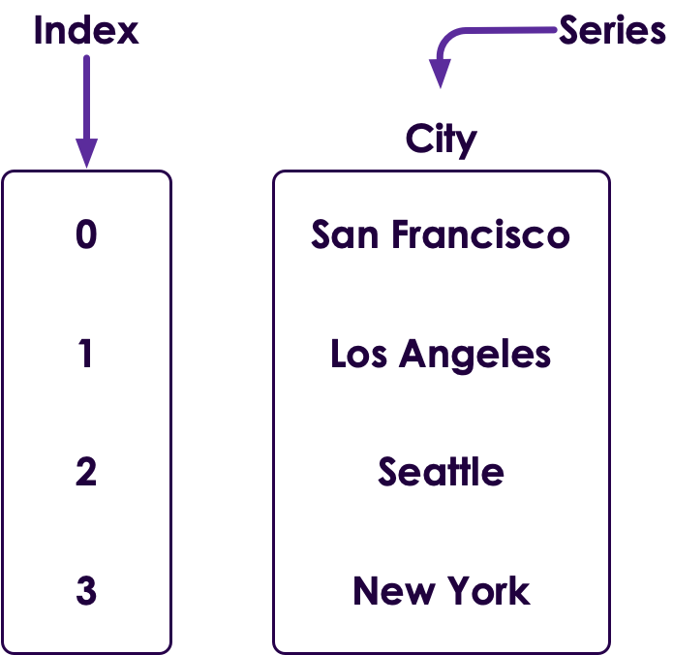
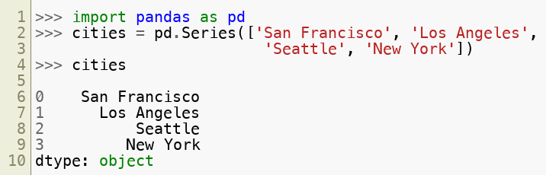
Series
Pandas has a Series type (single column in a database table)
All elements in a Series must be of same type (NaN is okay)
Defaults to float64 (notice that it is converted!)
Pandas needs to be imported
Copyright © 2022 by Elephant Scale, All Rights Reserved

Slide 7
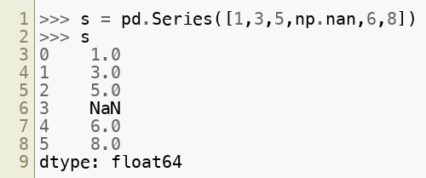
Series
Pandas has a Series type (single column in a database table)
All elements in a Series must be of same type (NaN is okay)
Defaults to float64 (notice that it is converted!)
Pandas needs to be imported
import pandas as pd
Example - Creating a Series
Copyright © 2022 by Elephant Scale, All Rights Reserved

Slide 8
Dtypes
Series in pandas have a dtype :
types of np.number ( float, int ) of lengths 8 , 16 , 32 , 64 (e.g. float64 , int8 )
bool (Boolean)
datetime types ( datetime64 , timedelta64 )
Sn (fixed width string) - not commonly used.
category : an enum or factor type variable.
object (a pointer to any object, including a string)
Same type (no mix and match)
Though object types can include pointers to any python object
Copyright © 2022 by Elephant Scale, All Rights Reserved

Slide 9
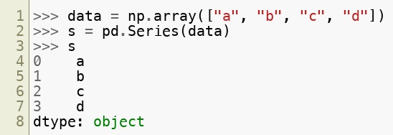
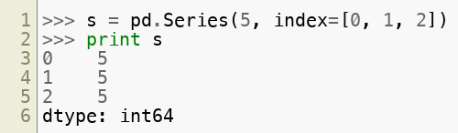
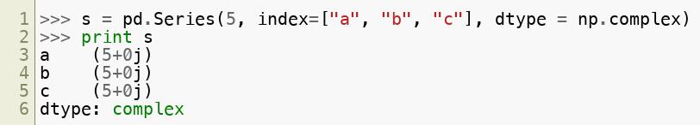
Creating Series
Here are more examples of creating Series:
Copyright © 2022 by Elephant Scale, All Rights Reserved

Slide 10
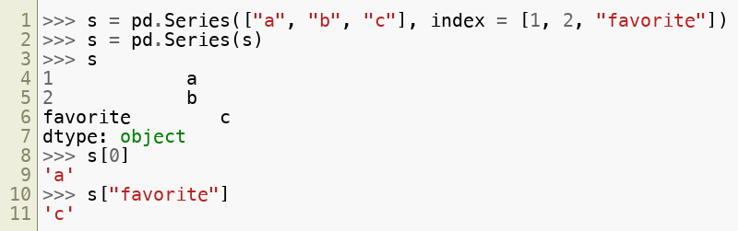
Retrieving data from Series
Here's how we retrieve data
Copyright © 2022 by Elephant Scale, All Rights Reserved

Slide 11
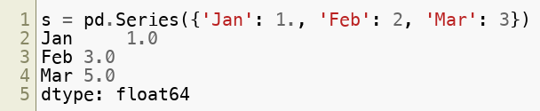
Index
Series always have an index (like a virtual column)
Index can be of any type (str, int, float)
Default index is an int starting with zero (0,1,2...)
New rows will have a new index
(similar to auto-incrementing primary key)
Indexes do NOT have to be unique
But it is usually better if they are
Exception will be raised at data access time if not unique
Example of custom index:
Copyright © 2022 by Elephant Scale, All Rights Reserved

Slide 12
Numpy Array versus Pandas Series
 | Numpy Array | Pandas Series
Is it typed? | Yes, same type. | Yes, same type, but can use "object" type that can point to different objects.
Multi-Dimensional? | Any number of dimensions | Single Dimensional
Has Index? | implicitly an integer index myarray[0] | Explicitly has an settable index. myseries['abc'], defaults to integer index.
Follows NumPy interface? | Yes | Yes
Convert to numpy array? | Already is! | Series.values
Copyright © 2022 by Elephant Scale, All Rights Reserved

Slide 13
DataFrame
Introduction Series DataFrame Operations on DataFrame Using lambda Statistics Operations Advanced Operations Pandas and Files
Copyright © 2022 by Elephant Scale, All Rights Reserved

Slide 14
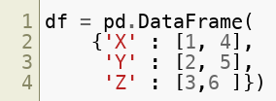
Data Frame
Data frames hold 'tabular' data.
Think 'Excel spreadsheet' or 'database table.'
Rows & columns
Each column can be a different type.
Each row must have same length.
X | Y | Z
1 | 2 | 3
4 | 5 | 6
Copyright © 2022 by Elephant Scale, All Rights Reserved

Slide 15
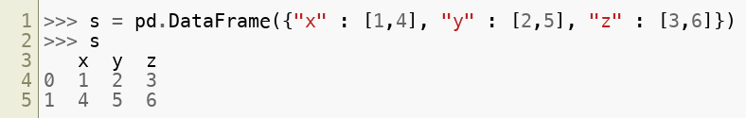
DataFrame
DataFrame is a 2D data structure to hold 'tabular' data
Think of an 'Excel spreadsheet' or a 'database table' with rows and columns
Each column can be a different data type
Each row must have same length
Example - Creating a DataFrame
Number | Language | Version
1 | python | 3.7
2 | java | 10
Copyright © 2022 by Elephant Scale, All Rights Reserved

Slide 16
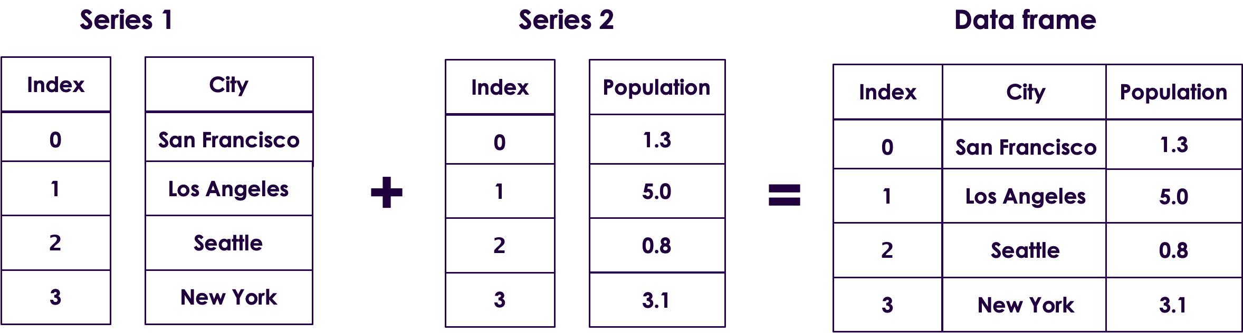
Dataframe
Dataframe is a collection of series
Copyright © 2022 by Elephant Scale, All Rights Reserved

Slide 17
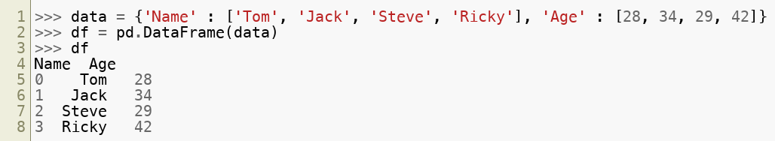

Creating DataFrame
Here are more examples of creating a DataFrame
 | Name | Age
0 | Tom | 28
1 | Jack | 34
2 | Steve | 29
3 | Ricky | 42
Copyright © 2022 by Elephant Scale, All Rights Reserved

Slide 18
Operations on DataFrame
Introduction Series DataFrame Operations on DataFrame Using lambda Statistics Operations Advanced Operations Pandas and Files
Copyright © 2022 by Elephant Scale, All Rights Reserved

Slide 19
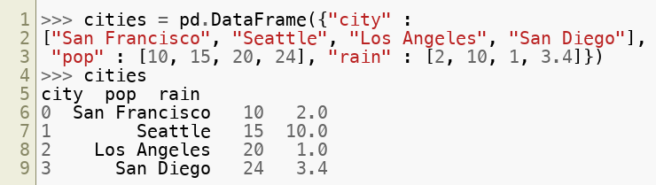
Operations on DataFrame - Create
Creating a DataFrame for all operations henceforth:
 | city | pop | rain
0 | San Francisco | 10 | 2
1 | Seattle | 15 | 10
2 | Los Angeles | 20 | 1
3 | San Diego | 24 | 3.4
Copyright © 2022 by Elephant Scale, All Rights Reserved

Slide 20
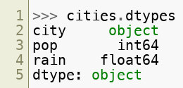
Operations on DataFrame - dtypes
Checking Data Types in a DataFrame
 | city | pop | rain
0 | San Francisco | 10 | 2
1 | Seattle | 15 | 10
2 | Los Angeles | 20 | 1
3 | San Diego | 24 | 3.4
Copyright © 2022 by Elephant Scale, All Rights Reserved

Slide 21
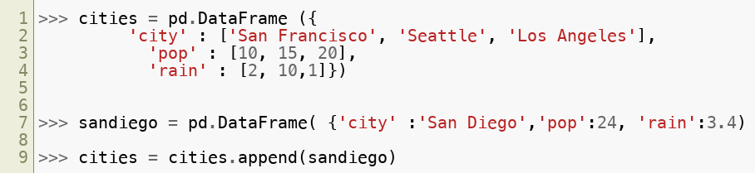
Data Frame: Appending a New Row
city | pop | rain
San Francisco | 10 | 2
Seattle | 15 | 10
Los Angeles | 20 | 1
San Diego | 24 | 3.4
Copyright © 2022 by Elephant Scale, All Rights Reserved

Slide 22
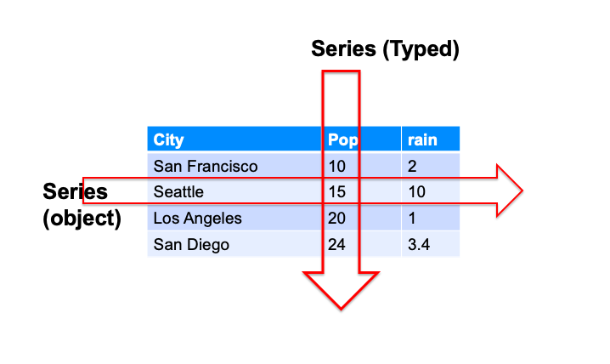
Slicing Data Frames
Copyright © 2022 by Elephant Scale, All Rights Reserved

Slide 23
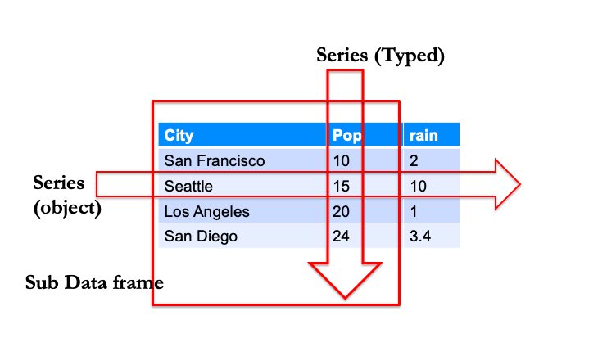
Data Frame Slicing
Copyright © 2022 by Elephant Scale, All Rights Reserved

Slide 24
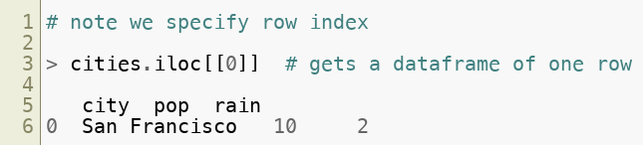
Accessing a Data Frame by numeric index
city | pop | rain
San Francisco | 10 | 2
Seattle | 15 | 10
Los Angeles | 20 | 1
San Diego | 24 | 3.4
Copyright © 2022 by Elephant Scale, All Rights Reserved

Slide 25
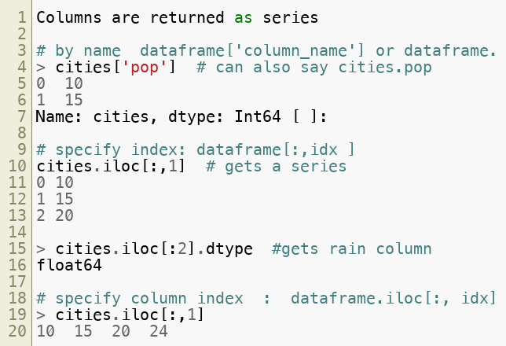
Accessing a Data Frame
city | pop | rain
San Francisco | 10 | 2
Seattle | 15 | 10
Los Angeles | 20 | 1
San Diego | 24 | 3.4
Copyright © 2022 by Elephant Scale, All Rights Reserved

Slide 26
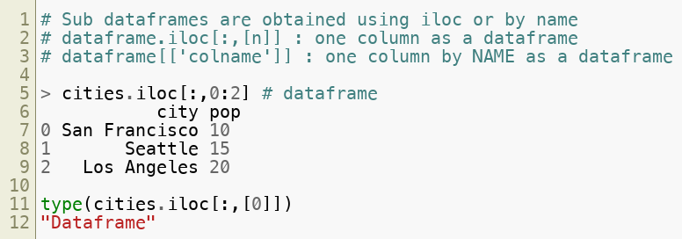
Accessing a Data Frame using .iloc
city | pop | rain
San Francisco | 10 | 2
Seattle | 15 | 10
Los Angeles | 20 | 1
San Diego | 24 | 3.4
Copyright © 2022 by Elephant Scale, All Rights Reserved

Slide 27
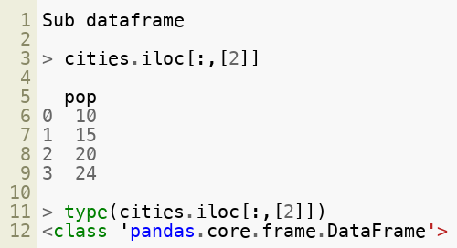
Accessing Dataframes : Series vs. Sub Dataframe
Raw | city | pop | rain
0 | San Francisco | 10 | 2
1 | Seattle | 15 | 10
2 | Los Angeles | 20 | 1
3 | San Diego | 24 | 3.4
Copyright © 2022 by Elephant Scale, All Rights Reserved

Slide 28
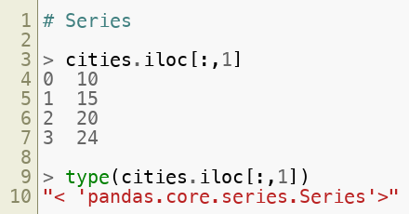
Accessing Dataframes : Series vs. Sub Dataframe
city | pop | rain
San Francisco | 10 | 2
Seattle | 15 | 10
Los Angeles | 20 | 1
San Diego | 24 | 3.4
Copyright © 2022 by Elephant Scale, All Rights Reserved

Slide 29
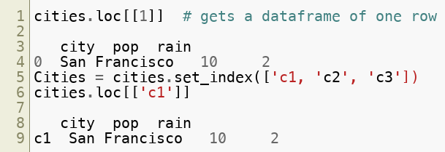
Accessing Dataframe by Index
Dataframes, like Series, have an index.
By default auto-incrementing integer type.
Access with .loc[] (not iloc[] )
Access
Copyright © 2022 by Elephant Scale, All Rights Reserved

Slide 30
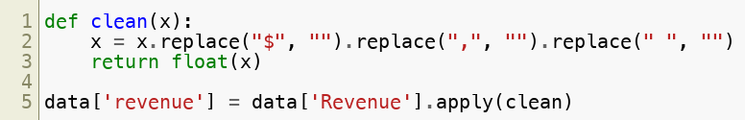
Apply function
How to do some operation on a column or group of columns?
Copyright © 2022 by Elephant Scale, All Rights Reserved

Slide 31
Using lambda
Introduction Series DataFrame Operations on DataFrame Using lambda Statistics Operations Advanced Operations Pandas and Files
Copyright © 2022 by Elephant Scale, All Rights Reserved

Slide 32

Using lambda
Copyright © 2022 by Elephant Scale, All Rights Reserved

Slide 33
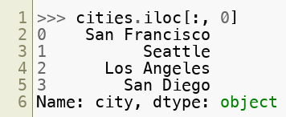
Operations on DataFrame - column slicing
Slicing a column from a DataFrame - Using <df>.iloc[] (outputs a Series)
 | city | pop | rain
0 | San Francisco | 10 | 2
1 | Seattle | 15 | 10
2 | Los Angeles | 20 | 1
3 | San Diego | 24 | 3.4
Copyright © 2022 by Elephant Scale, All Rights Reserved

Slide 34
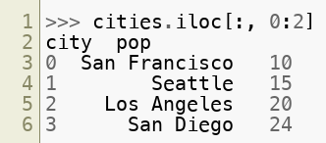
Operations on DataFrame - column slicing
Slicing multiple columns from a DataFrame - Using <df>.iloc[] (outputs a DataFrame)
 | city | pop | rain
0 | San Francisco | 10 | 2
1 | Seattle | 15 | 10
2 | Los Angeles | 20 | 1
3 | San Diego | 24 | 3.4
Copyright © 2022 by Elephant Scale, All Rights Reserved

Slide 35
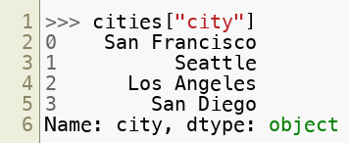
Operations on DataFrame - column slicing
Slicing a column from a DataFrame (outputs a Series)
 | city | pop | rain
0 | San Francisco | 10 | 2
1 | Seattle | 15 | 10
2 | Los Angeles | 20 | 1
3 | San Diego | 24 | 3.4
Copyright © 2022 by Elephant Scale, All Rights Reserved

Slide 36
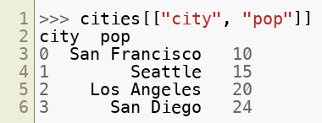
Operations on DataFrame - column slicing
Slicing multiple columns from a DataFrame (outputs a DataFrame)
 | city | pop | rain
0 | San Francisco | 10 | 2
1 | Seattle | 15 | 10
2 | Los Angeles | 20 | 1
3 | San Diego | 24 | 3.4
Copyright © 2022 by Elephant Scale, All Rights Reserved

Slide 37
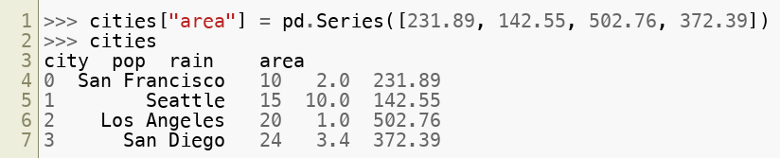
Operations on DataFrame - column addition
Adding a column to a DataFrame
 | city | pop | rain
0 | San Francisco | 10 | 2 | 231.89
1 | Seattle | 15 | 10 | 142.55
2 | Los Angeles | 20 | 1 | 502.76
3 | San Diego | 24 | 3.4 | 372.39
Copyright © 2022 by Elephant Scale, All Rights Reserved

Slide 38
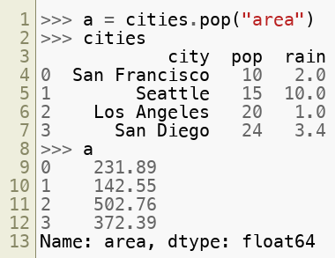
Operations on DataFrame - column deletion
Deleting a column from a DataFrame
Copyright © 2022 by Elephant Scale, All Rights Reserved

Slide 39
Operations on DataFrame - column deletion
 | city | pop | rain
0 | San Francisco | 10 | 2 | 231.89
1 | Seattle | 15 | 10 | 142.55
2 | Los Angeles | 20 | 1 | 502.76
3 | San Diego | 24 | 3.4 | 372.39
231.89
142.55
502.76
372.39
Copyright © 2022 by Elephant Scale, All Rights Reserved

Slide 40

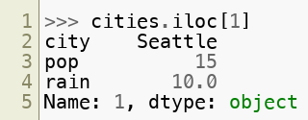
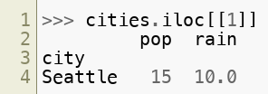
Operations on DataFrame - row slicing
Slicing a row from a DataFrame - Using <df>.iloc[]
Copyright © 2022 by Elephant Scale, All Rights Reserved

Slide 41
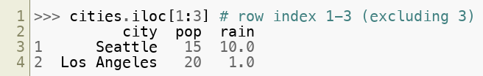
Operations on DataFrame - row slicing
Slicing multiple rows from a DataFrame - Using <df>.iloc[]
 | city | pop | rain
0 | San Francisco | 10 | 2
1 | Seattle | 15 | 10
2 | Los Angeles | 20 | 1
3 | San Diego | 24 | 3.4
Copyright © 2022 by Elephant Scale, All Rights Reserved

Slide 42
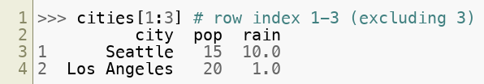
Operations on DataFrame - row slicing
Slicing rows from a DataFrame (outputs a DataFrame)
 | city | pop | rain
0 | San Francisco | 10 | 2
1 | Seattle | 15 | 10
2 | Los Angeles | 20 | 1
3 | San Diego | 24 | 3.4
Copyright © 2022 by Elephant Scale, All Rights Reserved

Slide 43
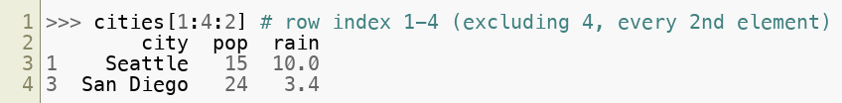
Operations on DataFrame - row slicing
 | city | pop | rain
0 | San Francisco | 10 | 2
1 | Seattle | 15 | 10
2 | Los Angeles | 20 | 1
3 | San Diego | 24 | 3.4
Copyright © 2022 by Elephant Scale, All Rights Reserved

Slide 44
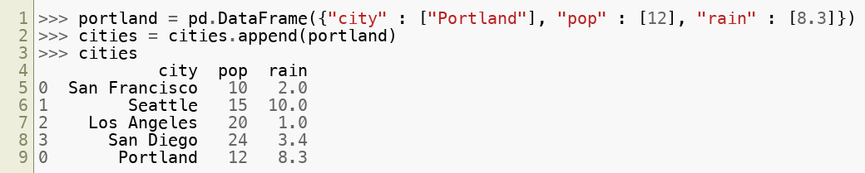
Operations on DataFrame - row addition
Appending a row to a DataFrame:
 | city | pop | rain
0 | San Francisco | 10 | 2
1 | Seattle | 15 | 10
2 | Los Angeles | 20 | 1
3 | San Diego | 24 | 3.4
0 | Portland | 12 | 8.3
Copyright © 2022 by Elephant Scale, All Rights Reserved

Slide 45
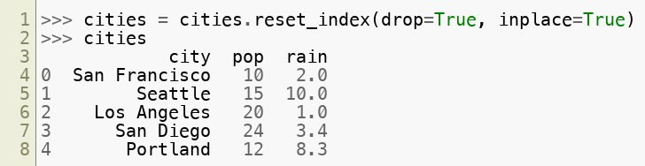
Operations on DataFrame - reset_index()
Reassigning indices in a DataFrame (notice the index of "Portland" changes)
 | city | pop | rain
0 | San Francisco | 10 | 2
1 | Seattle | 15 | 10
2 | Los Angeles | 20 | 1
3 | San Diego | 24 | 3.4
4 | Portland | 12 | 8.3
Copyright © 2022 by Elephant Scale, All Rights Reserved

Slide 46
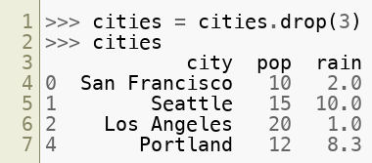
Operations on DataFrame - row deletion
Deleting a row from a DataFrame:
 | city | pop | rain
0 | San Francisco | 10 | 2
1 | Seattle | 15 | 10
2 | Los Angeles | 20 | 1
3 | San Diego | 24 | 3.4
4 | Portland | 12 | 8.3
Copyright © 2022 by Elephant Scale, All Rights Reserved

Slide 47
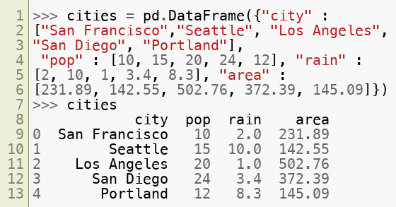
Operations on DataFrame - Sub-setting
Re-initializing our DataFrame
Copyright © 2022 by Elephant Scale, All Rights Reserved

Slide 48
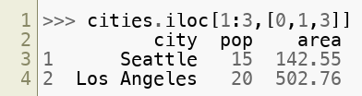
Operations on DataFrame - Sub-setting
Sub-setting - Compare population and land area of Seattle and Los Angeles
Copyright © 2022 by Elephant Scale, All Rights Reserved

Slide 49
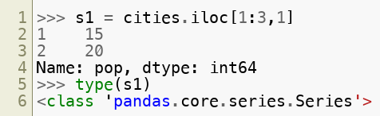
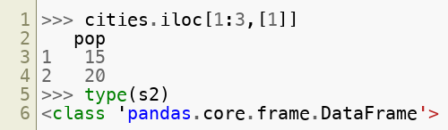
Operations on DataFrame - Sub-setting
Compare iloc outputs of Series and sub-DataFrame
Copyright © 2022 by Elephant Scale, All Rights Reserved

Slide 50
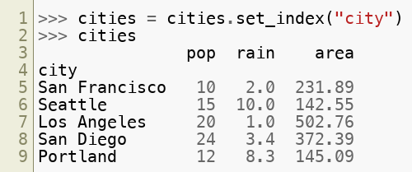
Operations on DataFrame - set_index()
Set a DataFrame column as the index:
city | pop | rain | area
San Francisco | 10 | 2.0 | 231.89
Seattle | 15 | 10.0 | 142.55
Los Angeles | 20 | 1.0 | 502.76
San Diego | 24 | 3.4 | 372.39
Portland | 12 | 8.3 | 145.09
Copyright © 2022 by Elephant Scale, All Rights Reserved

Slide 51
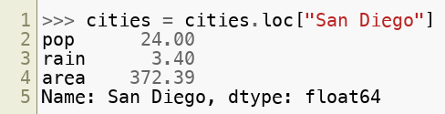
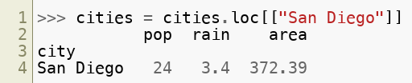
Operations on DataFrame - loc[]
Access a single DataFrame row with labels as the index:
city | pop | rain | area
San Francisco | 10 | 2.0 | 231.89
Seattle | 15 | 10.0 | 142.55
Los Angeles | 20 | 1.0 | 502.76
San Diego | 24 | 3.4 | 372.39
Portland | 12 | 8.3 | 145.09
Copyright © 2022 by Elephant Scale, All Rights Reserved

Slide 52
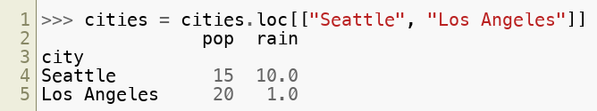
Operations on DataFrame - loc[]
Access multiple DataFrame rows with labels as the index:
city | pop | rain
San Francisco | 10 | 2
Seattle | 15 | 10
Los Angeles | 20 | 1
San Diego | 24 | 3.4
Copyright © 2022 by Elephant Scale, All Rights Reserved

Slide 53
Statistics Operations
Introduction Series DataFrame Operations on DataFrame Using lambda Statistics Operations Advanced Operations Pandas and Files
Copyright © 2022 by Elephant Scale, All Rights Reserved

Slide 54
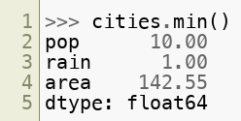
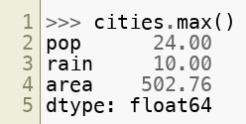
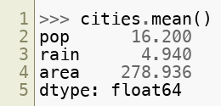
Statistics Operations
Statistical operations like max, min, mean, median, standard deviation and variance are made simple with function calls
Copyright © 2022 by Elephant Scale, All Rights Reserved

Slide 55
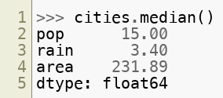


Statistics Operations
Copyright © 2022 by Elephant Scale, All Rights Reserved

Slide 56

Statistics Operations
The describe() function gives a summary of the dataset from a statistical viewpoint
Copyright © 2022 by Elephant Scale, All Rights Reserved

Slide 57

Lab: Statistics
Overview:
Practice Stats functions in Pandas / Numpy
Approximate Time:
10 mins
Instructions
Lab : Basic Stats
Location:
stats/1-stats-basics.ipynb
Copyright © 2022 by Elephant Scale, All Rights Reserved

Slide 58
Advanced Operations
Introduction Series DataFrame Operations on DataFrame Using lambda Statistics Operations Advanced Operations Pandas and Files
Copyright © 2022 by Elephant Scale, All Rights Reserved

Slide 59
Working With Raw Data
Datasets are seldom in a format to be used.
A big part of data science is:
Cleaning data up
Combining, Merging, Sorting and manipulating data sets
Dealing with missing values
This is probably the 'not so sexy part of data science'
Copyright © 2022 by Elephant Scale, All Rights Reserved

Slide 60

Dealing With Missing Values
Missing Data is always a problem in real life datasets
Missing values can often skew analysis
Fields like Machine Learning often see lower accuracy in model predictions due to missing values
Python represents them with NA (Not Available)
Copyright © 2022 by Elephant Scale, All Rights Reserved

Slide 61
Dealing With Missing Values
Use <df>.dropna() to remove rows containing at least one NA value
Use <df>.fillna() to fill them with a scalar value
Copyright © 2022 by Elephant Scale, All Rights Reserved

Slide 62

Row or Column wise function application
Pandas allows operations to be done on a column/row or a group of columns/rows using apply()
A single operation or a single function can be applied to the entire DataFrame too. This is done using a function similar to apply(), called applymap()
Copyright © 2022 by Elephant Scale, All Rights Reserved

Slide 63

Sorting - Rows - by values
Pandas allows sorting (by values) to be done on the entire DataFrame using sort_values()
Copyright © 2022 by Elephant Scale, All Rights Reserved

Slide 64

Sorting - Rows - by index
Pandas allows sorting (by index) to be done on the entire DataFrame using sort_index()
Copyright © 2022 by Elephant Scale, All Rights Reserved

Slide 65
Sorting - Rows - by index
The ascending parameter can be set to False for sorting in descending order
Copyright © 2022 by Elephant Scale, All Rights Reserved

Slide 66

Sorting - Columns - by column header
Pandas allows sorting (by column header) to be done on the entire DataFrame using sort_index(axis = 1)
Copyright © 2022 by Elephant Scale, All Rights Reserved

Slide 67

Splitting data into groups
The following adds another column "state" to our DataFrame
city | area | pop | popPerArea | rain | state
Los Angeles | 502.76 | 20 | 0.039780 | 1.0 | CA
Portland | 145.09 | 12 | 0.082707 | 8.3 | OR
San Diego | 372.39 | 24 | 0.064449 | 3.4 | CA
San Francisco | 231.89 | 10 | 0.043124 | 2.0 | CA
Seattle | 142.55 | 15 | 0.105226 | 10.0 | WA
Copyright © 2022 by Elephant Scale, All Rights Reserved

Slide 68

Splitting data into groups
The following splits our DataFrame into groups
city | area | pop | popPerArea | rain | state
Los Angeles | 502.76 | 20 | 0.039780 | 1.0 | CA
Portland | 145.09 | 12 | 0.082707 | 8.3 | OR
San Diego | 372.39 | 24 | 0.064449 | 3.4 | CA
San Francisco | 231.89 | 10 | 0.043124 | 2.0 | CA
Seattle | 142.55 | 15 | 0.105226 | 10.0 | WA
Copyright © 2022 by Elephant Scale, All Rights Reserved

Slide 69



Concatenating DataFrames
The following first creates two new DataFrames
Copyright © 2022 by Elephant Scale, All Rights Reserved

Slide 70

Concatenating DataFrames - row-wise
The following concatenates DataFrames row-wise
Copyright © 2022 by Elephant Scale, All Rights Reserved

Slide 71

Concatenating DataFrames - column-wise
The following concatenates DataFrames column-wise
Copyright © 2022 by Elephant Scale, All Rights Reserved

Slide 72

Merging DataFrames
The following creates one more DataFrame
Copyright © 2022 by Elephant Scale, All Rights Reserved

Slide 73

Merging DataFrames
The following merges "concat0 "+"toMerge" to one DataFrame
Notice that pd.merge() takes into account common values
Copyright © 2022 by Elephant Scale, All Rights Reserved

Slide 74
Lab: Dataframes in Pandas
Overview:
Learn Python Data frames
Approximate time:
15 minutes
Instructions:
pandas/1-intro
Copyright © 2022 by Elephant Scale, All Rights Reserved

Slide 75
Pandas and Files
Introduction Series DataFrame Operations on DataFrame Using lambda Statistics Operations Advanced Operations Pandas and Files
Copyright © 2022 by Elephant Scale, All Rights Reserved

Slide 76

Reading Data From Files
Python can read from a variety of files.
Text : CSV, TSV - pd.read_csv() , pd.read_table()
JSON: pd.read_json- pd.read_json()
Excel spreadsheets - pd.read_excel()
Stata/SAS files - pd.read_stata() , pd.read_sas()
More handy functions in read_*
Copyright © 2022 by Elephant Scale, All Rights Reserved

Slide 77
Reading data from files - Schema Inference
pd.read_csv() will try to infer the data schema
Column Header
It will infer first line as header
No header? => Sets header = None
Can also explicitly set column headers with the names attribute
pd.read_csv(fileName, names=['one', 'two', 'three'])
pd.read_json() , pd.read_parquet() will read metadata
No need for header or column names
Copyright © 2022 by Elephant Scale, All Rights Reserved

Slide 78
Inferring types
Pandas read_csv and similar functions will try to infer types
Strings and types that appear to be mixed are treated as type object (pointer to value) - which are basically strings.
Dirty data may lead to numeric columns being wrongly interpreted as type object
May need to do some cleanup here.
It is possible to explicitly define data type for a Series
Copyright © 2022 by Elephant Scale, All Rights Reserved

Slide 79
Reading From Databases
Pandas has good connectivity with databases.
Any DB-API compliant database package will work.
example: pyodbc (ODBC Protocol)
various other packages
Importing large datasets (> 1GB) from DB could be slow.
For faster imports:
export data out of DB as CSV etc.
then import the file into Python
Copyright © 2022 by Elephant Scale, All Rights Reserved

Slide 80

Reading from Databases
Example: Open connection to sqllite database, then call pandas
Copyright © 2022 by Elephant Scale, All Rights Reserved

Slide 81
Saving data to files
df.to_* family supports exporting to multiple formats
Can use <df>.to_csv("fileName") , <df>.to_excel("fileName") , <df>.to_dict("fileName") , <df>.to_json("fileName") etc
Example:
Note :
Separator is ',' by default, but can be changed to '\t' etc
Encoding can be changed, UTF-8 preferred.
Python will write the index too, unless you say (index = False)
There are many other pd.to_*() type functions
Copyright © 2022 by Elephant Scale, All Rights Reserved

Slide 82

Dealing With Missing Values
Question:
Is the rainfall in Los Angeles in March zero?
Missing values can often 'skew' analysis.
Python represents them with np.nan , also known as NA (Not Available).
Use df.dropna() to remove NA values.
Use df.fillna() to fill them with a value (more on this later)
Copyright © 2022 by Elephant Scale, All Rights Reserved

Slide 83

Combining Datasets: concat()
concat() will merge two DataFrames column-wise
Copyright © 2022 by Elephant Scale, All Rights Reserved

Slide 84

Combining Dataframes : merge()
merge() will try to take into account common column names and row names
Copyright © 2022 by Elephant Scale, All Rights Reserved

Slide 85
Dealing With Duplicates
Often data sets have duplicates
It is a good practice to check for duplicates as part of the cleanup phase
This is called 'de-duping'
Use df.drop_duplicates() function
Copyright © 2022 by Elephant Scale, All Rights Reserved

Slide 86

Sorting Data Frames : sort_values()
sort_values() function can help you sort a DataFrame by columns
Copyright © 2022 by Elephant Scale, All Rights Reserved

Slide 87

Sorting Data Frames : sort_values()
Reverse sorting
Copyright © 2022 by Elephant Scale, All Rights Reserved

Slide 88

describe() function
describe() function gives you a quick glance of data
Tells us: Min, max, median, ...
Gives a 'good feel' for the data
Also tells quantiles (25%, 50%, 75%)
Copyright © 2022 by Elephant Scale, All Rights Reserved

Slide 89
Dealing With Categorical Variables
Pandas can help us in dealing with categorical variables
type="category"
factorize()
Indexes and converts data into a index
get_dummies()
Converts into a group of "one-hot" encoded variables.
Copyright © 2022 by Elephant Scale, All Rights Reserved

Slide 90
Exploring Data
Pandas is a great tool for exploring datasets
We are going to view the NYCFlights13 dataset
All flights to or from NYC airports in 2013
Think of some interesting analytics that YOU can do with this data
Copyright © 2022 by Elephant Scale, All Rights Reserved

Slide 91
Pandas Visualization
Pandas allows us to do some quick visualizations
Wraps content in matplotlib (covered later)
We will do some basic Pandas visualizations in this lab.
Copyright © 2022 by Elephant Scale, All Rights Reserved

Slide 92
Lab: Exploring Pandas
Overview:
Explore NYC flights dataset, and do some
Approximate time:
45 minutes
Instructions:
pandas/2-Exploring_Pandas
Copyright © 2022 by Elephant Scale, All Rights Reserved

Slide 93
Review Questions
What are the main data models in Pandas?
How is Numpy Array different from Pandas Series?
When do you use a Pandas Dataframe?
Copyright © 2022 by Elephant Scale, All Rights Reserved

