Slide 1
Python: Visualization
Pandas Visualization
Matplotlib
Advanced Matplotlib
Seaborn
Examples
Other Visualization
Copyright © 2022 by Elephant Scale, All Rights Reserved

Slide 2
Lesson Objectives
Learn about Python Visualization
Many different packages and options.
Copyright © 2022 by Elephant Scale, All Rights Reserved

Slide 3
Lesson Objectives
Learn about Python visualization
Introduction to different packages and available options
pandas
matplotlib
seaborn
ggplot
plotly
dash
bokeh
Comparison on a few statistical graphs
Copyright © 2022 by Elephant Scale, All Rights Reserved

Slide 4
Pandas Visualization
Pandas Visualization Matplotlib Advanced Matplotlib Seaborn Examples Other Visualization
Copyright © 2022 by Elephant Scale, All Rights Reserved

Slide 5
Pandas Visualization
Pandas has built-in visualization.
Basically aliases similar functionality in matplotlib
Good for representing plots of dataframes
Can do things like add labels, etc through matplotlib.pyplot
"pandas" website - https://pandas.pydata.org/pandas-docs/stable/visualization.html
Copyright © 2022 by Elephant Scale, All Rights Reserved
Notes:
Pandas: https://pandas.pydata.org/pandas-docs/stable/visualization.html

Slide 6
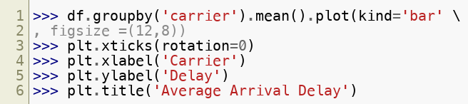
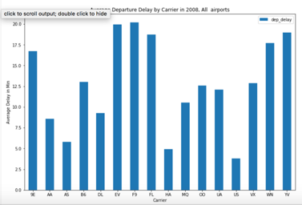
Pandas visualization
Copyright © 2022 by Elephant Scale, All Rights Reserved

Slide 7
Matplotlib
Pandas Visualization Matplotlib Advanced Matplotlib Seaborn Examples Other Visualization
Copyright © 2022 by Elephant Scale, All Rights Reserved

Slide 8

Matplotlib plots
"matplotlib" is python's native plotting library
It is powerful, with lots of options, not focused on aesthetics
"matplotlib" website - https://matplotlib.org/
"matplotlib" needs to be imported
import matplolib.pyplot as plt
Plotting data in "x", "y"
Copyright © 2022 by Elephant Scale, All Rights Reserved
Notes:
"matplotlib" website - https://matplotlib.org/

Slide 9
Matplotlib plots
To show plots
plt.show()
Will pop up a window with the plot
Except when running in a Jupyter Notebook.
Saving plots to a file
plt.savefig("test.png") # uses extension
Use the file extension
To show plots in jupyter notebook:
%matplotlib inline%
This is a cell magic for jupyter, NOT a line of python code!
Do NOT have to write plt.show() if you have this.
Copyright © 2022 by Elephant Scale, All Rights Reserved

Slide 10
Matplotlib plot options
To set x axis label
plt.xlabel("x label")
To set y axis label
plt.ylabel("y label")
To set title on plot
plt.title("title")
To turn grid on/off plot
plt.grid(True/False)
Copyright © 2022 by Elephant Scale, All Rights Reserved

Slide 11
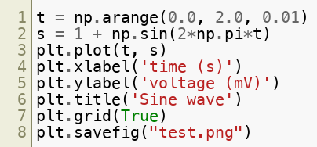
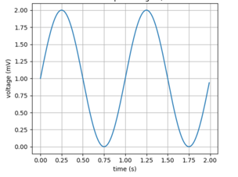
Matplotlib Simple Example
Copyright © 2022 by Elephant Scale, All Rights Reserved

Slide 12
Visualizing Data
Method | Description
Boxplot | A quick way to visualize the data
Frequency table | Count number of data points that fall into intervals (bins)
histogram | Plot of frequency table
Density plot | Smoothed version of histogram. (Kernel Density Estimate)
Copyright © 2022 by Elephant Scale, All Rights Reserved

Slide 13
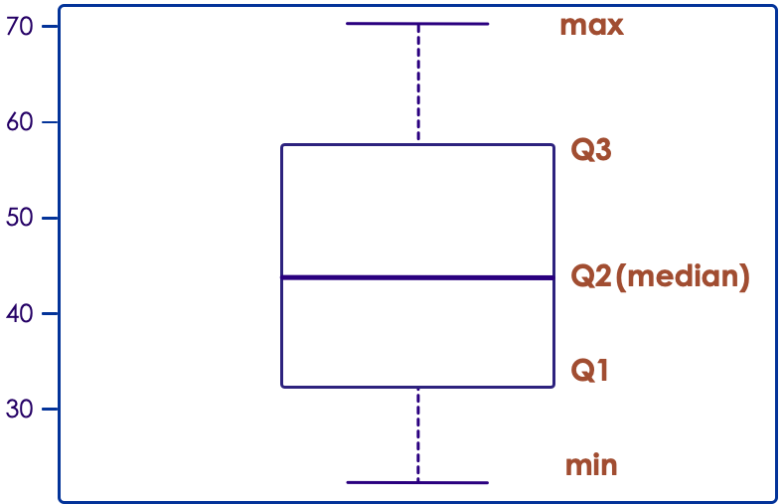
Boxplot / Box-and-Whisker Plot
Boxplot displays 5 measures: min, Q1, Q2 (median), Q3, max
Q1, Q2, Q3 are the first, second and third quartiles
Smallest / Largest values are measured within upper/lower fences
Fences are usually 1.5 times IQR (Q3 - Q1)
Copyright © 2022 by Elephant Scale, All Rights Reserved

Slide 14
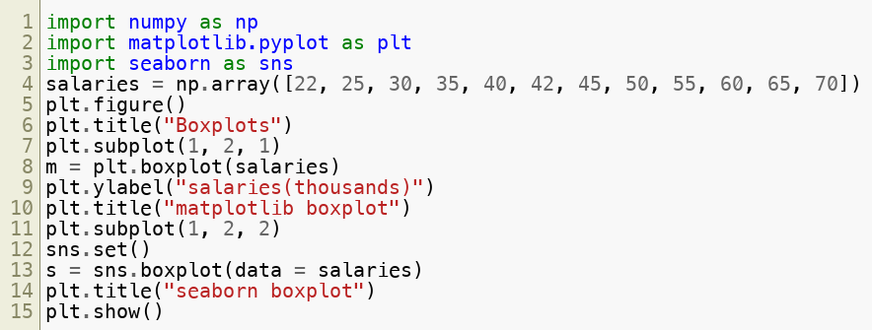
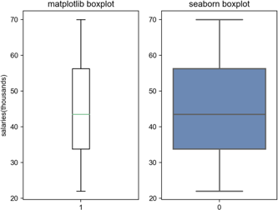
Boxplot / Box-and-Whisker Plot
Example: Boxplot for income data (sorted) [22k, 25k, 30k, 35k, 40k, 42k, 45k, 50k, 55k, 60k, 65k, 70k]
Copyright © 2022 by Elephant Scale, All Rights Reserved

Slide 15
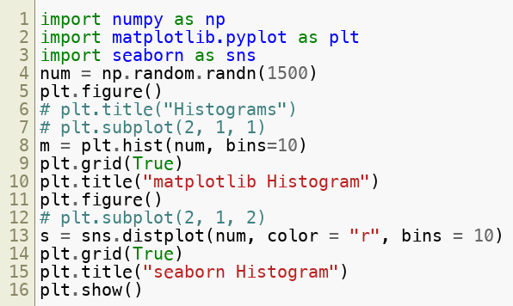
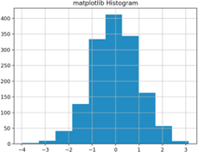
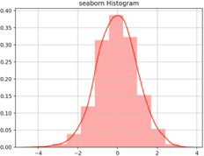
Histograms
Example: Histogram for np.random.randn() data
Copyright © 2022 by Elephant Scale, All Rights Reserved

Slide 16
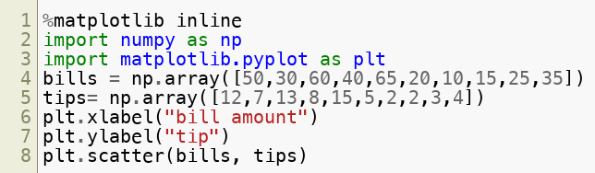
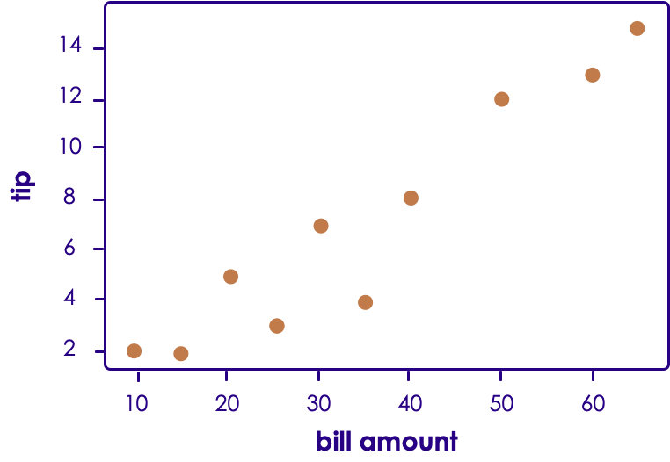
Scatter Plot (Python)
Histogram counts data points per bin
Copyright © 2022 by Elephant Scale, All Rights Reserved

Slide 17
Lab: matplotlib - intro
Overview:
Intro to matplotlib
Approximate time:
10 mins
Instructions:
visualization/1-viz-intro.ipynb
Copyright © 2022 by Elephant Scale, All Rights Reserved

Slide 18
Advanced Matplotlib
Pandas Visualization Matplotlib Advanced Matplotlib Seaborn Examples Other Visualization
Copyright © 2022 by Elephant Scale, All Rights Reserved

Slide 19
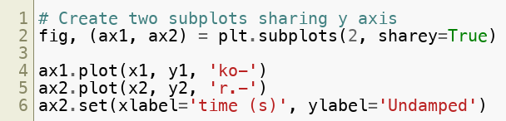
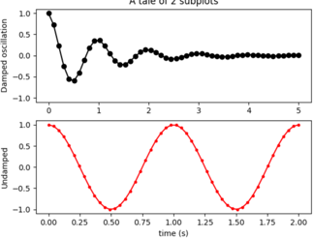
Matplotlib subplots
Matplotlib allows us to create subplots
Copyright © 2022 by Elephant Scale, All Rights Reserved

Slide 20


Figure Versus Axes
The figure object is the entire plot
Typically used if we want to save the figure
The axes represent the plots
We can have more than one (subplots)
Here's how we get one:
More than one (subplots)
Copyright © 2022 by Elephant Scale, All Rights Reserved

Slide 21
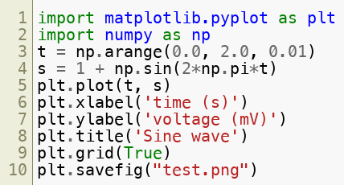
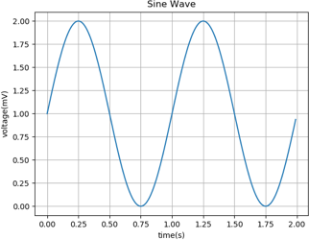
Matplotlib - plot()
Voltage vs Time using plot() :
Copyright © 2022 by Elephant Scale, All Rights Reserved

Slide 22
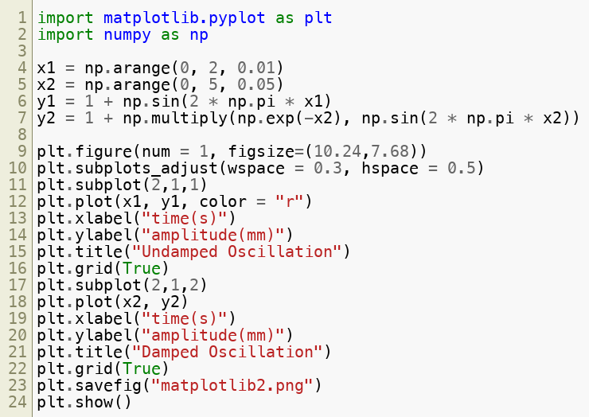
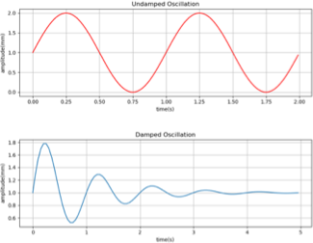
Matplotlib - subplot()
Undamped vs Damped oscillations using subplot():
Copyright © 2022 by Elephant Scale, All Rights Reserved

Slide 23
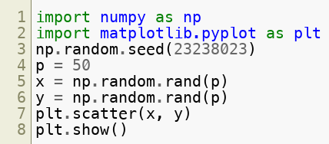
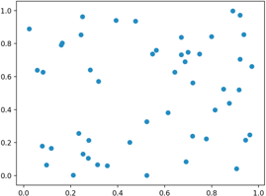
Matplotlib - scatter()
Random numbers using scatter() :
Copyright © 2022 by Elephant Scale, All Rights Reserved

Slide 24
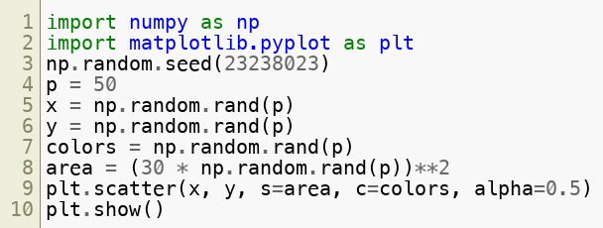
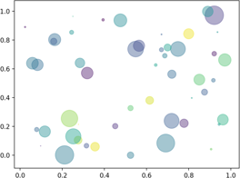
Matplotlib - scatter()
Random numbers using scatter() :
Notice colors/shapes:
Copyright © 2022 by Elephant Scale, All Rights Reserved

Slide 25
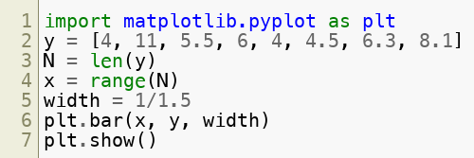
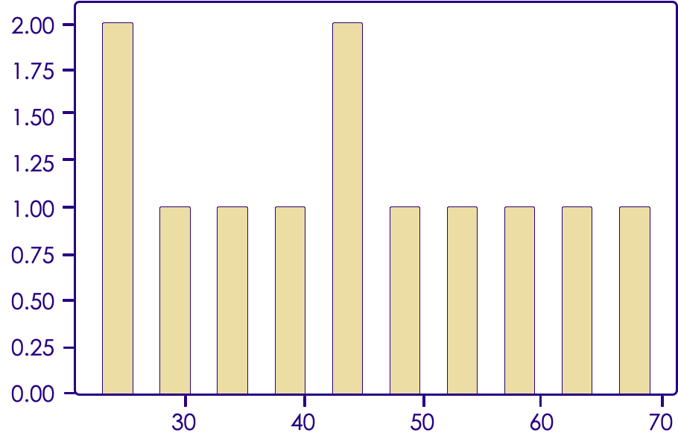
Matplotlib - bar()
Bar plot using matplotlib:
Copyright © 2022 by Elephant Scale, All Rights Reserved

Slide 26
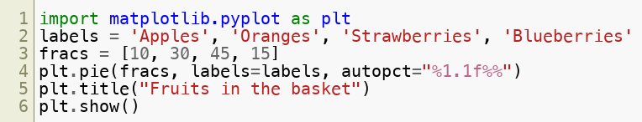
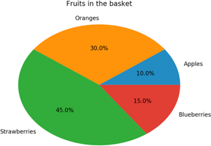
Matplotlib - pie()
Pie Chart using matplotlib:
Copyright © 2022 by Elephant Scale, All Rights Reserved

Slide 27
Seaborn
Pandas Visualization Matplotlib Advanced Matplotlib Seaborn Examples Other Visualization
Copyright © 2022 by Elephant Scale, All Rights Reserved

Slide 28
Seaborn: pretty graphs
Matplotlib graphs are powerful but not very beautiful.
Seaborn makes some pretty plots
Based on Matplotlib
Allows a number of aesthetic parameters.
Copyright © 2022 by Elephant Scale, All Rights Reserved

Slide 29
Seaborn pretty plots
"matplotlib" graphs are powerful but not very beautiful
"seaborn" makes some pretty plots
It is based on "matplotlib"
It allows a number of aesthetic parameters
"seaborn" website - https://seaborn.pydata.org/
"seaborn" needs to be imported
import seaborn as sns
Copyright © 2022 by Elephant Scale, All Rights Reserved

Slide 30
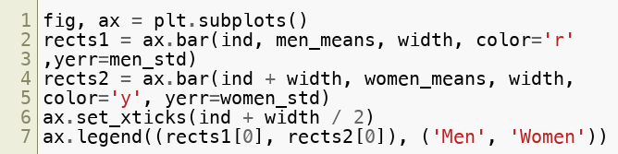
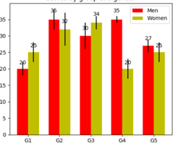
Seaborn - barplot() - Ease of use
Bar plot example - comparison of matplotlib / seaborn code
Lengthier code in matplotlib
Copyright © 2022 by Elephant Scale, All Rights Reserved

Slide 31
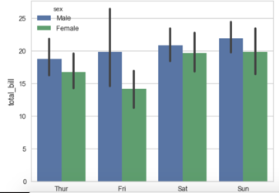
Seaborn - barplot() - Ease of use
Bar plot example - comparison of matplotlib / seaborn code
Condensed shorter code in seaborn for the same plot
ax = sns.barplot(x="day", y="total_bill", hue="sex", data=tips)
Copyright © 2022 by Elephant Scale, All Rights Reserved

Slide 32
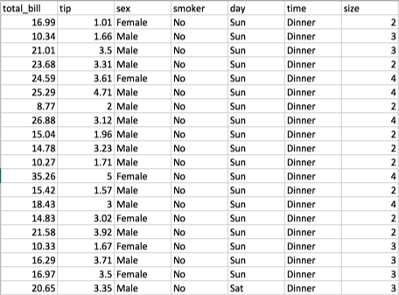
Seaborn - regplot()
Regression plot example
Take a look at the tips.csv dataset (used in example below)
Copyright © 2022 by Elephant Scale, All Rights Reserved

Slide 33
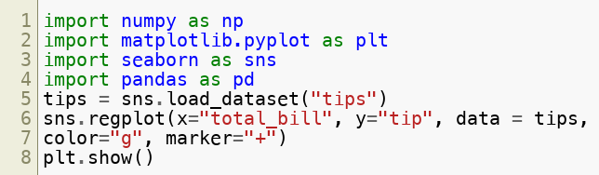
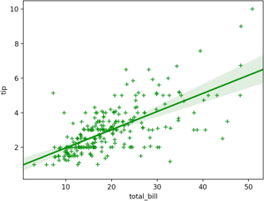
Seaborn - regplot()
Regression plot example
Copyright © 2022 by Elephant Scale, All Rights Reserved

Slide 34
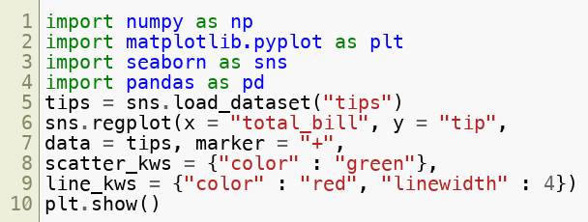
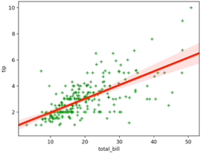
Seaborn - regplot()
Changing colors and pen thickness:
Copyright © 2022 by Elephant Scale, All Rights Reserved

Slide 35
Lab: matplotlib/seaborn - cars
Overview:
Learn matplotlib and seaborn by exploration of the cars dataset
Approximate time:
20 mins
Instructions:
visualization/2-plot-cars.ipynb
Copyright © 2022 by Elephant Scale, All Rights Reserved

Slide 36
Examples
Pandas Visualization Matplotlib Advanced Matplotlib Seaborn Examples Other Visualization
Copyright © 2022 by Elephant Scale, All Rights Reserved

Slide 37
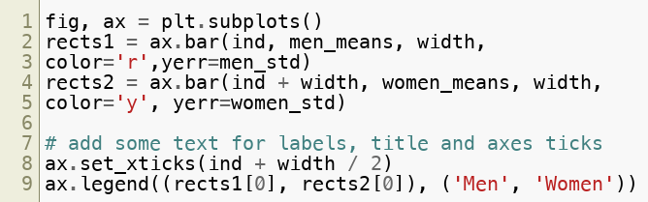
Bar Plots: Matplotlib
Example of a barplot
Copyright © 2022 by Elephant Scale, All Rights Reserved

Slide 38
Barplot: Seaborn
Seaborn is easier!
Copyright © 2022 by Elephant Scale, All Rights Reserved

Slide 39
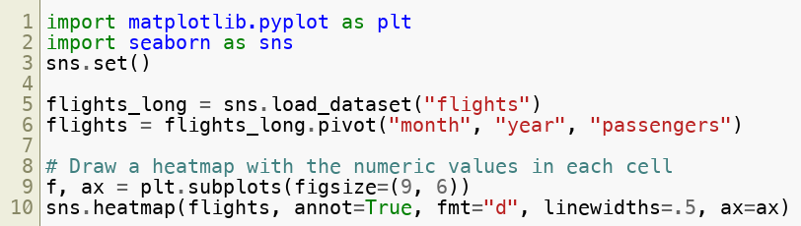
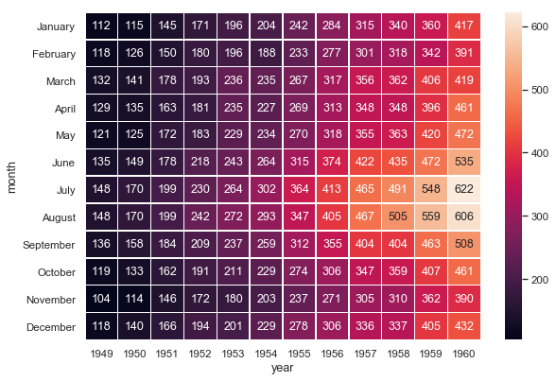
Heatmap
We can do Heatmaps in seaborn
Copyright © 2022 by Elephant Scale, All Rights Reserved

Slide 40
Lab: Heatmaps
Overview:
Heatmap with Seaborn
Approximate time:
30 minutes
Instructions:
visualization/3-heatmap.ipynb
Copyright © 2022 by Elephant Scale, All Rights Reserved

Slide 41
Other Visualization
Pandas Visualization Matplotlib Advanced Matplotlib Seaborn Examples Other Visualization
Copyright © 2022 by Elephant Scale, All Rights Reserved

Slide 42
ggplot
ggplot package is a very popular graphics package
Based on ggplot2 package in R
use BOTH R and Python!
Provides very readable graphics
Has a 'grammar' to describe graph
Excels at graphing complex data sets
Mastering ggplot can be 'challenging' (though extremely powerful)
Recommended book : "ggplot2: Elegant Graphics for Data Analysis"
Link
Copyright © 2022 by Elephant Scale, All Rights Reserved
Notes:
http://www.ling.upenn.edu/~joseff/rstudy/summer2010_ggplot2_intro.html

Slide 43
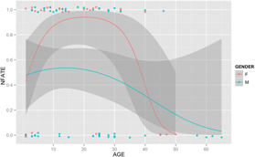
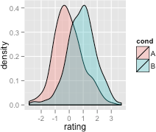
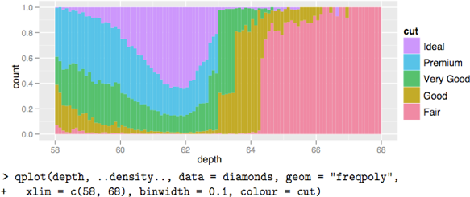
ggplot examples
Copyright © 2022 by Elephant Scale, All Rights Reserved

Slide 44
Ggplot - general syntax
Syntax
Involves Data, Aesthetics and Layers
ggplot (data, aes, layers)
data
can be DataFrame, vector, etc.
aes
Maps how elements get converted to graph
x position / x-y position / shape / color
layers
Geometric shapes
Points / lines / bars
Copyright © 2022 by Elephant Scale, All Rights Reserved

Slide 45
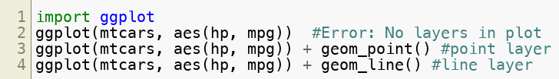
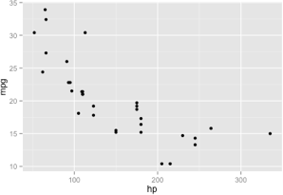
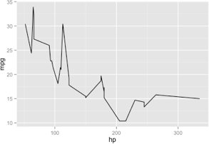
Ggplot point and line plots
Quick example of point and line plots:
Copyright © 2022 by Elephant Scale, All Rights Reserved

Slide 46
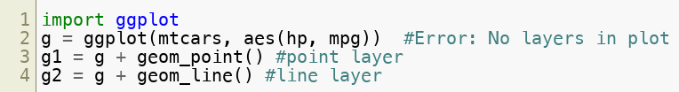
Ggplot point and line plots
Same example of point and line plots (w/ variable assignment)
Copyright © 2022 by Elephant Scale, All Rights Reserved

Slide 47
Lab: Graphs / ggplot
Overview:
Exploring graphing with Python
Approximate time:
30 minutes
Instructions:
visualization/4-ggplot.ipynb
Copyright © 2022 by Elephant Scale, All Rights Reserved

Slide 48
Plotly
Plotly is a cross-platform plotting and charting library for python
Cross-Platform:
R
Matplab
Python
Javascript
It consists of two parts:
plotly.js - client-side library for webpage
plotly python package: python bindings.
Copyright © 2022 by Elephant Scale, All Rights Reserved

Slide 49
Dash
Dash is a webapp framework on top of plotly and python
Runs on top of "Flask" web service framework.
Similar to Shiny in R.
Copyright © 2022 by Elephant Scale, All Rights Reserved

Slide 50
Bokeh
Bokeh is a plotting library for web-based interactive visualizations
Excellent for dashboarding and interactive web and mobile visualizations
Copyright © 2022 by Elephant Scale, All Rights Reserved

Slide 51

Review
Copyright © 2022 by Elephant Scale, All Rights Reserved

