Slide 1
NLTK
NLTK
TextBlob
Copyright © 2022 by Elephant Scale, All Rights Reserved

Slide 2
Lesson Objectives
Learn Python libraries for text analytics
Copyright © 2022 by Elephant Scale, All Rights Reserved

Slide 3
Text Analytics / NLP Libraries for Python
Library | Pros | Cons
NLTK | 'the' librar modula | Can be steep learning curv Might not be high performan
TextBlob Built on top of NLT | Easily accessibl Fast prototypin | Performance may not be hig
Stanford Core *Core java library with python wrapper NLP | Fas Lot of use in productio
SpaCy Ne
Gensim Topic modelin
Copyright © 2022 by Elephant Scale, All Rights Reserved

Slide 4
NLTK
NLTK TextBlob
Copyright © 2022 by Elephant Scale, All Rights Reserved

Slide 5
Python Libraries
NLTK – Natural Language Tool Kit
Very popular and versatile library
http://www.nltk.org/
https://github.com/nltk
NLTK Features:
Supports multiple algorithms
Lexical analysis: tokenization of text
Ngram analytics
Named entity recognition
Comes with data (50+ corpora / lexicons)
Copyright © 2022 by Elephant Scale, All Rights Reserved

Slide 6
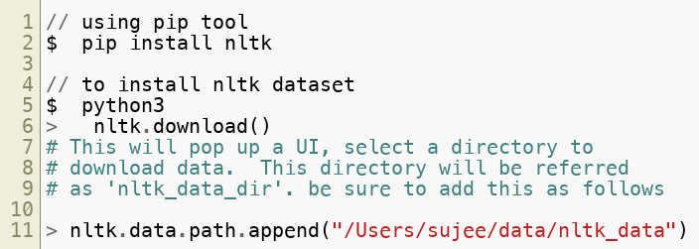
Installing NLTK
NLTK is part of modern python stacks (like 'anaconda')
Installing NLTK
Copyright © 2022 by Elephant Scale, All Rights Reserved

Slide 7
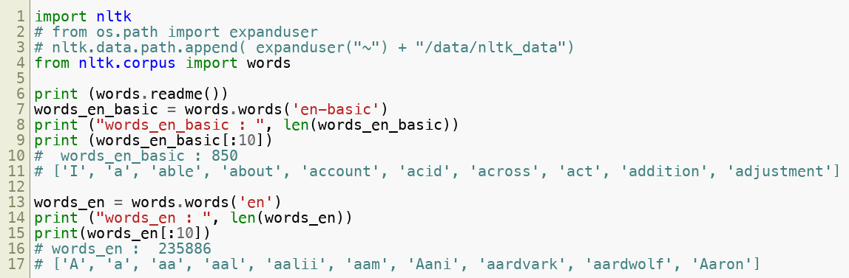
NLTK Dataset / Corpus
NLTK (data) comes with pretty interesting datasets / corpus
This is part of 'nltk.corpus' package
Copyright © 2022 by Elephant Scale, All Rights Reserved

Slide 8
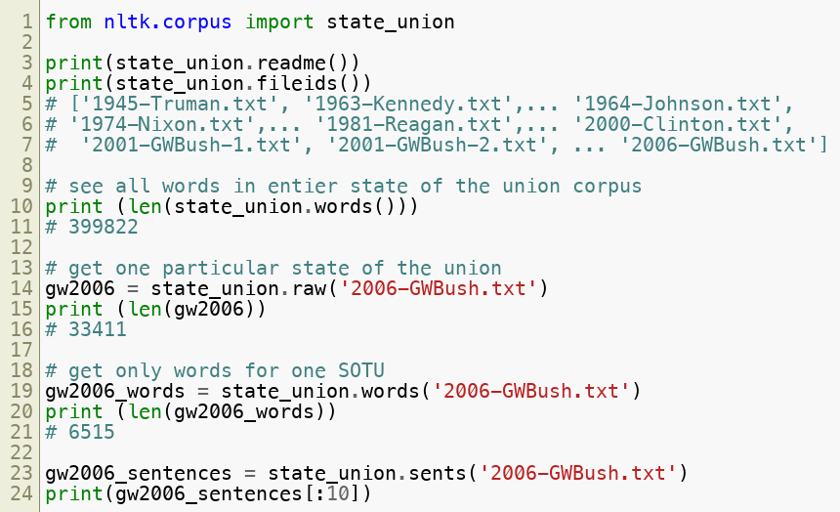
NLTK Corpus: State of the Union
Each corpus has a 'readme()' function
State of the Union addresses from 1945 to 2006
Copyright © 2022 by Elephant Scale, All Rights Reserved

Slide 9
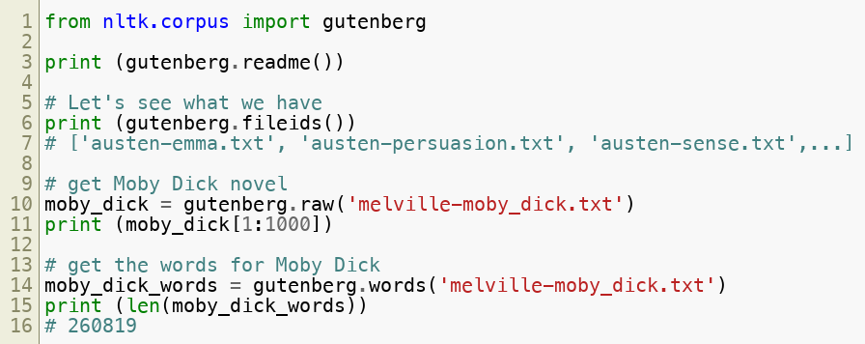
NLTK Corpus: Novels
These are public domain novels from Gutenberg project
Copyright © 2022 by Elephant Scale, All Rights Reserved

Slide 10
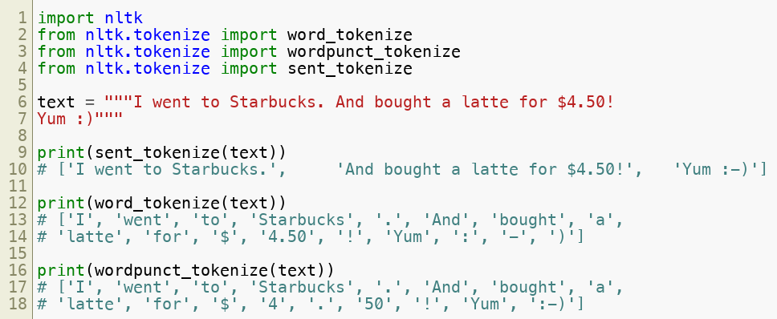
NLTK Tokenizing Text
First step in analyzing text is splitting raw text into words
Called tokenizing
Nltk.tokenize package offers few handy ones
word_tokenize : gives out words
wordpunct_tokenize : numbers and punctuations in their own words
sent_tokenize : splits into sentences
Copyright © 2022 by Elephant Scale, All Rights Reserved

Slide 11
Lab: NLTK-1: NLTK Intro
Overview:
Get to know NLTK library
Builds on previous labs:
None
Approximate time:
15 mins
Instructions:
NLTK-1-Intro
Copyright © 2022 by Elephant Scale, All Rights Reserved

Slide 12
Lab: NLTK-2: Bag of Words
Overview:
Analyzing raw text with NLTK library
Builds on previous labs:
TEXT-1: NLTK intro
Approximate time:
15 mins
Instructions:
2-analyzing-text-with-nltk
Copyright © 2022 by Elephant Scale, All Rights Reserved

Slide 13
Lab: Text-3 : Ngrams
Overview:
Analyzing text for Ngrams
Builds on previous labs:
TEXT-2: NLTK
Approximate time:
15 mins
Instructions:
3-ngrams
Copyright © 2022 by Elephant Scale, All Rights Reserved

Slide 14
TextBlob
NLTK TextBlob
Copyright © 2022 by Elephant Scale, All Rights Reserved

Slide 15
TextBlob
Simplified library for text processing in Python
Built on NLTK & Pattern
Features
Tokenization
Word / Phrase frequencies (ngrams)
Noun phrase extraction
Sentiment analysis
Classification
https://textblob.readthedocs.io/en/dev/
https://github.com/sloria/TextBlob/
Copyright © 2022 by Elephant Scale, All Rights Reserved

Slide 16
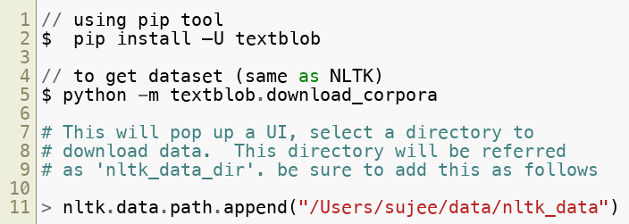
Installing TextBlob
Copyright © 2022 by Elephant Scale, All Rights Reserved

Slide 17
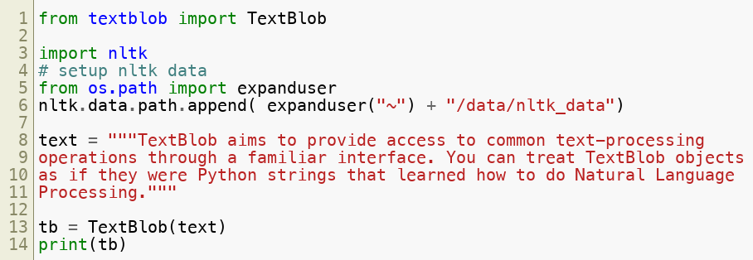
TextBlob Usage
Copyright © 2022 by Elephant Scale, All Rights Reserved

Slide 18
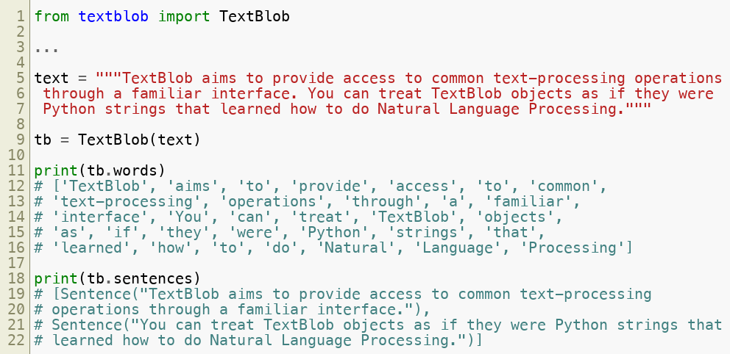
TextBlob Usage: Tokenizing
Copyright © 2022 by Elephant Scale, All Rights Reserved

Slide 19
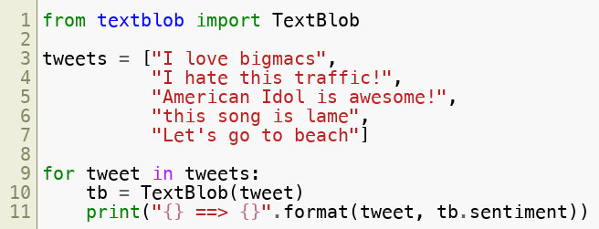
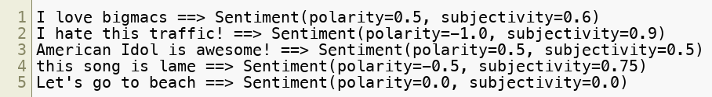
TextBlob Usage: Sentiment Analysis
'sentiment' returns a tuple (polarity, subjectivity)
Polarity ranges from -1.0 (very negative) to +1.0 (very positive)
Subjectivity ranges from 0.0 (very objective) to +1.0 (very subjective)
Copyright © 2022 by Elephant Scale, All Rights Reserved

Slide 20
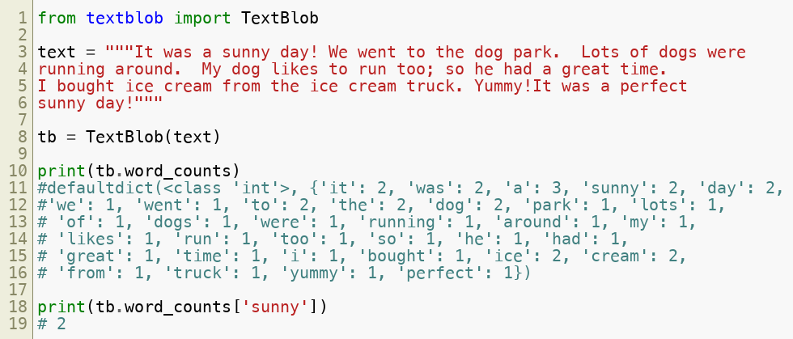
TextBlob Usage : Word Counts
Copyright © 2022 by Elephant Scale, All Rights Reserved

Slide 21
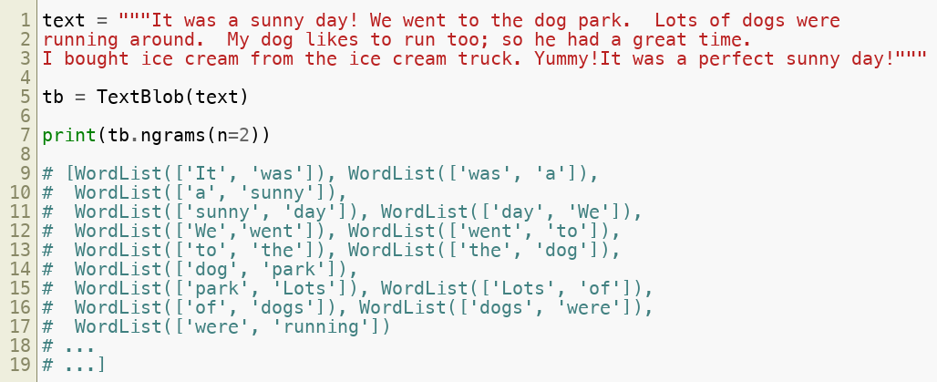
TextBlob Usage : Ngrams
Copyright © 2022 by Elephant Scale, All Rights Reserved

Slide 22
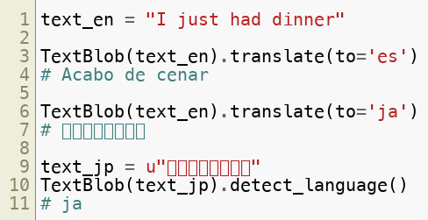
TextBlob Usage: Language Detection and Translation
Detect languages and even translate!
Translation is powered by Google Translate API
Copyright © 2022 by Elephant Scale, All Rights Reserved

Slide 23
Lab: Text-4: TextBlob
Overview:
Get familiar with TextBlob API
Builds on previous labs:
None
Approximate time:
15 mins
Instructions:
4-ngrams
Copyright © 2022 by Elephant Scale, All Rights Reserved

Slide 24
Lesson Summary
Learned Python libraries: NLTK, TextBlob
Implemented text analytics algorithms in Python
Copyright © 2022 by Elephant Scale, All Rights Reserved

