Slide 1

Introduction to spaCy
Backup Slides
Copyright © 2022 by Elephant Scale, All Rights Reserved

Slide 2
NLP Libraries
By Ecosystem:
Python: NLTK, spaCy, gensim
JVM: OpenNLP, CoreNLP, Spark NLP, UIMA, GATE, Mallet
Others: tm for R, SAS, Watson, Matlab, ...
By Design:
Raw functionality: NLTK, OpenNLP
Annotation libraries: spaCy, Spark NLP, UMIA, GATE
Industrial Grade, Open Source, Supported:
spaCy
Spark NLP
Copyright © 2022 by Elephant Scale, All Rights Reserved

Slide 3
Spacy Intro
Spacy is a Python library for advanced natural language processing (NLP)
Open-source ( MIT License )
High performance library -- written in Cython
Include neural network models for superior performance
Also supports deep learning workflows -- supports TensorFlow and PyTorch
Copyright © 2022 by Elephant Scale, All Rights Reserved

Slide 4
Applications
Advanced NLP (Natural Languae Processing)
Web and social information extraction
Pre-process text for deep learning
Copyright © 2022 by Elephant Scale, All Rights Reserved

Slide 5
Features And Capabilities
Tokenization
POS (Part Of Speech) tagging
Dependency parsing
Lemmatization
Sentence Boundary Detection (SBD)
Named Entity Recognition (NER)
Copyright © 2022 by Elephant Scale, All Rights Reserved

Slide 6
Features And Capabilities, cont'd
Similarity
Text Classification
Rule-based Matching
Training
Serialization
Cool visualizers!
Copyright © 2022 by Elephant Scale, All Rights Reserved

Slide 7
Feature Comparison
Programming language | Python | Python | Java/Python
Neural network models | Yes | No | Yes
Integrated word vectors | Yes | No | No
Multi-language support | Yes | Yes | Yes
Tokenization | Yes | Yes | Yes
part-of-speech tagging | Yes | Yes | Yes
Sentence segmentation | Yes | Yes | Yes
Dependency parsing | Yes | No | Yes
Entity recognition | Yes | Yes | Yes
Entity linking | No | No | No
Co-reference resolution | No | No | Yes
Copyright © 2022 by Elephant Scale, All Rights Reserved

Slide 8
Spacy Advantages
New deep learning-powered models for spaCy's tagger, parser and entity recognizer
The new models are 10× smaller, 20% more accurate require under 1 GB of memory per process
Easier to customize the pipeline with your own components
Add text categorization models to spaCy pipelines
Improved word vectors support with the new Vectors class
Serialization API made consistent across classes and objects
Copyright © 2022 by Elephant Scale, All Rights Reserved

Slide 9
Spacy Languages
supported fully | alpha 1 | alpha 2
English | Swedish | Romanian
French | Finnish | Croatian
German | Norwegian | Turkish
Spanish | Danish | Hebrew
Portuguese | Hungarian | Persian
Italian | Polish | Irish
Dutch | Russian | Bengali
Copyright © 2022 by Elephant Scale, All Rights Reserved

Slide 10
More Spacy (Alpha) Languages, cont'd
Hindi
Indonesian
Thai
Chinese
Japanese
Vietnamese
Copyright © 2022 by Elephant Scale, All Rights Reserved

Slide 11
Alpha Languages Status
Most alpha languages have tokenization support
Immature language models:
Stop Words
Stemming
Copyright © 2022 by Elephant Scale, All Rights Reserved

Slide 12
Statistical Models
One of the cool features of Spacy is that it has pre-trained language models.
These Are used for predicting linguistic annotations
Available for many languages
These give Spacy an edge compared to other NLP tool kits
Implemented in Python modules
Not all features require statistical models to be loaded
Copyright © 2022 by Elephant Scale, All Rights Reserved

Slide 13
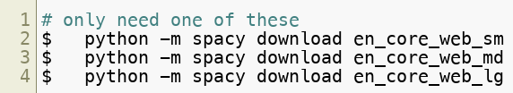
Downloading Spacy Models
First step to use Spacy is to grab the language models available
Models are language and genre specific
For example: en_core_web_sm
English language
Core vocabulary
Trained on Web text (others could news )
Size small ( sm for small, __md__for medium, lg for large)
Model sizes (for English)
small: ~ 50 MB
medium: ~120 MB
large: ~850 MB
Copyright © 2022 by Elephant Scale, All Rights Reserved

Slide 14
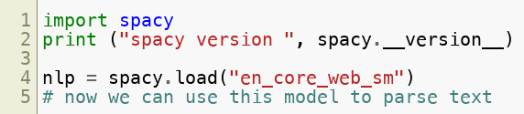
Using a Model
Copyright © 2022 by Elephant Scale, All Rights Reserved

Slide 15
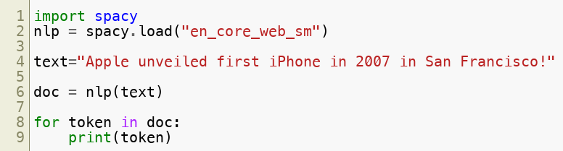
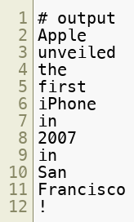
Tokenization
Separating words and punctuations
Copyright © 2022 by Elephant Scale, All Rights Reserved

Slide 16
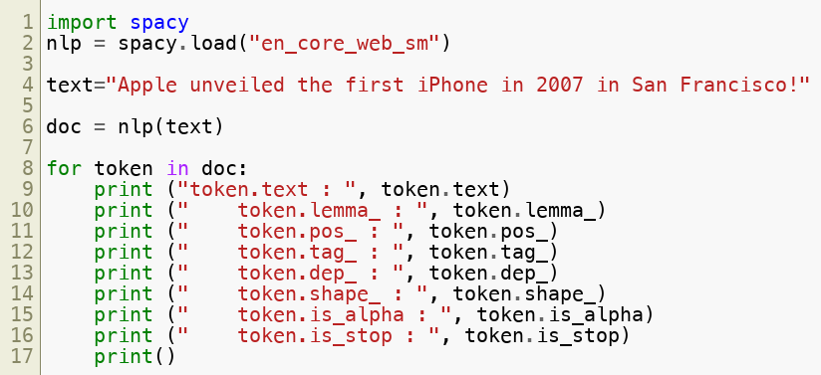
Parsing And Tagging
Needs statistical model
Predicts which label most likely applies in the context.
spaCy encodes all strings to hash values
to reduce memory usage
to improve efficiency
output next slide
Copyright © 2022 by Elephant Scale, All Rights Reserved

Slide 17
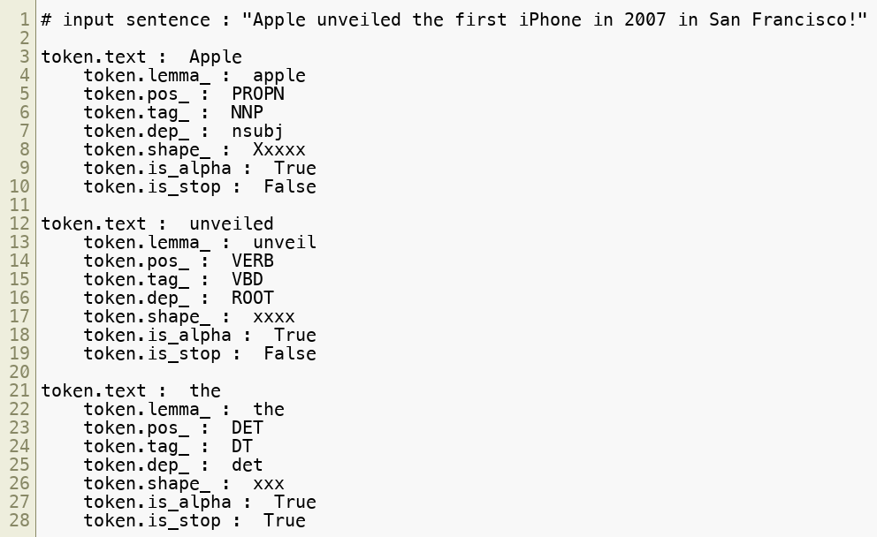
Token Attributes
Copyright © 2022 by Elephant Scale, All Rights Reserved

Slide 18
Parsing And Tagging, cont'd
Attributes | Description
text | The original word text.
lemma | The base form of the word
pos | The simple part-of-speech tag
tag | The detailed part-of-speech tag
dep | Syntactic dependency, i.e. the relation between tokens
shape | The word shape – capitalization, punctuation, digits
is alpha | Is the token an alpha character?
is_stop | Is the token part of a stop list, i.e. the most common words of the language?
Copyright © 2022 by Elephant Scale, All Rights Reserved

Slide 19
Entity Recognition
Entity: a person, a place, date, Organization
Needs statistical model to predict
We can see entities are recognized as
Organization: Apple
Geographical (GPE: Countries, Cities, Sates) : San Francisco & California
Person : Steve Jobs
Question for class : Can you recognize an entity that is classified incorrectly? :-)
Copyright © 2022 by Elephant Scale, All Rights Reserved

Slide 20
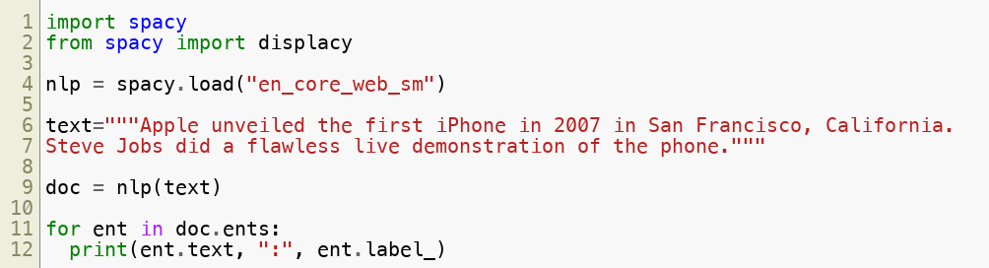
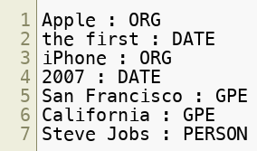
Entity Recognition Sample Code
Copyright © 2022 by Elephant Scale, All Rights Reserved

Slide 21
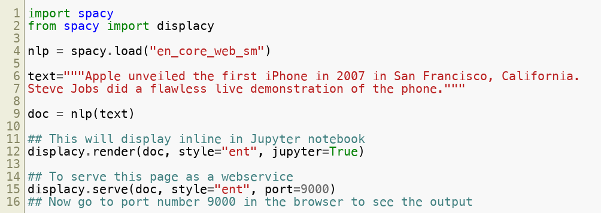
Displaying Entities
Copyright © 2022 by Elephant Scale, All Rights Reserved

Slide 22
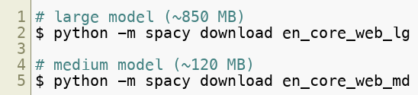
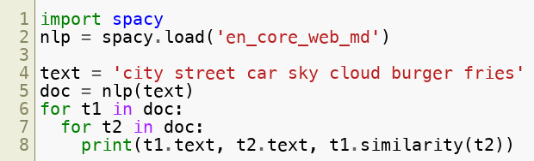
Similarity
Also needs statistical model
Creates word vectors using word2vec
Compares word vectors
For better result we should use large model
Output next slide
Copyright © 2022 by Elephant Scale, All Rights Reserved

Slide 23
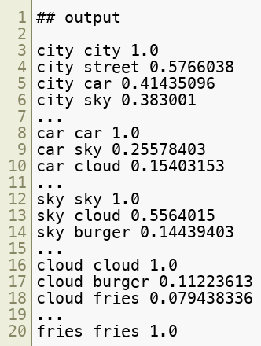
Similarity Output
Copyright © 2022 by Elephant Scale, All Rights Reserved

Slide 24
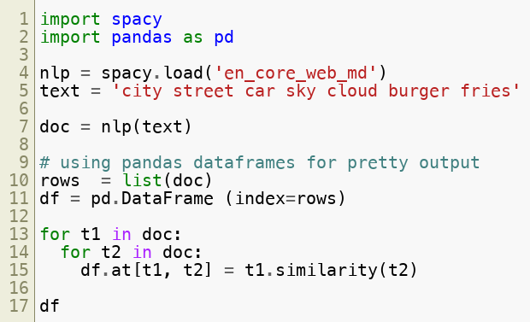
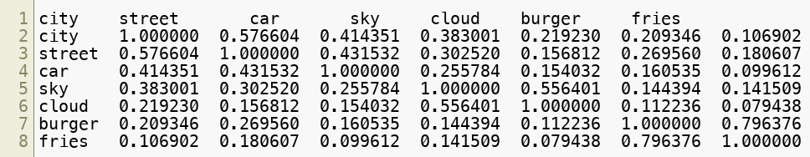
Similarity Prettier Output
Copyright © 2022 by Elephant Scale, All Rights Reserved

Slide 25
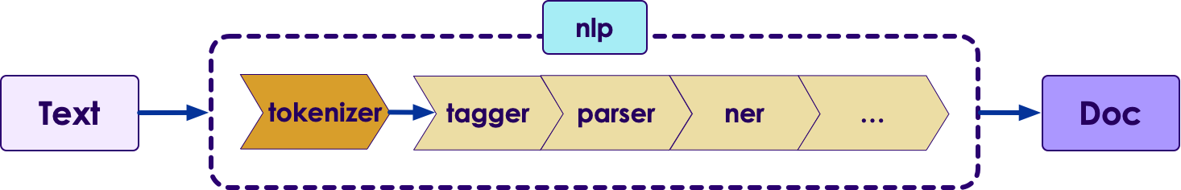
Making pipeline
Pipeline component delivers document to a component in order to process and passes the processed document to the next step
Encourages code re-use
No need to do the same operations over and over again
Copyright © 2022 by Elephant Scale, All Rights Reserved

Slide 26
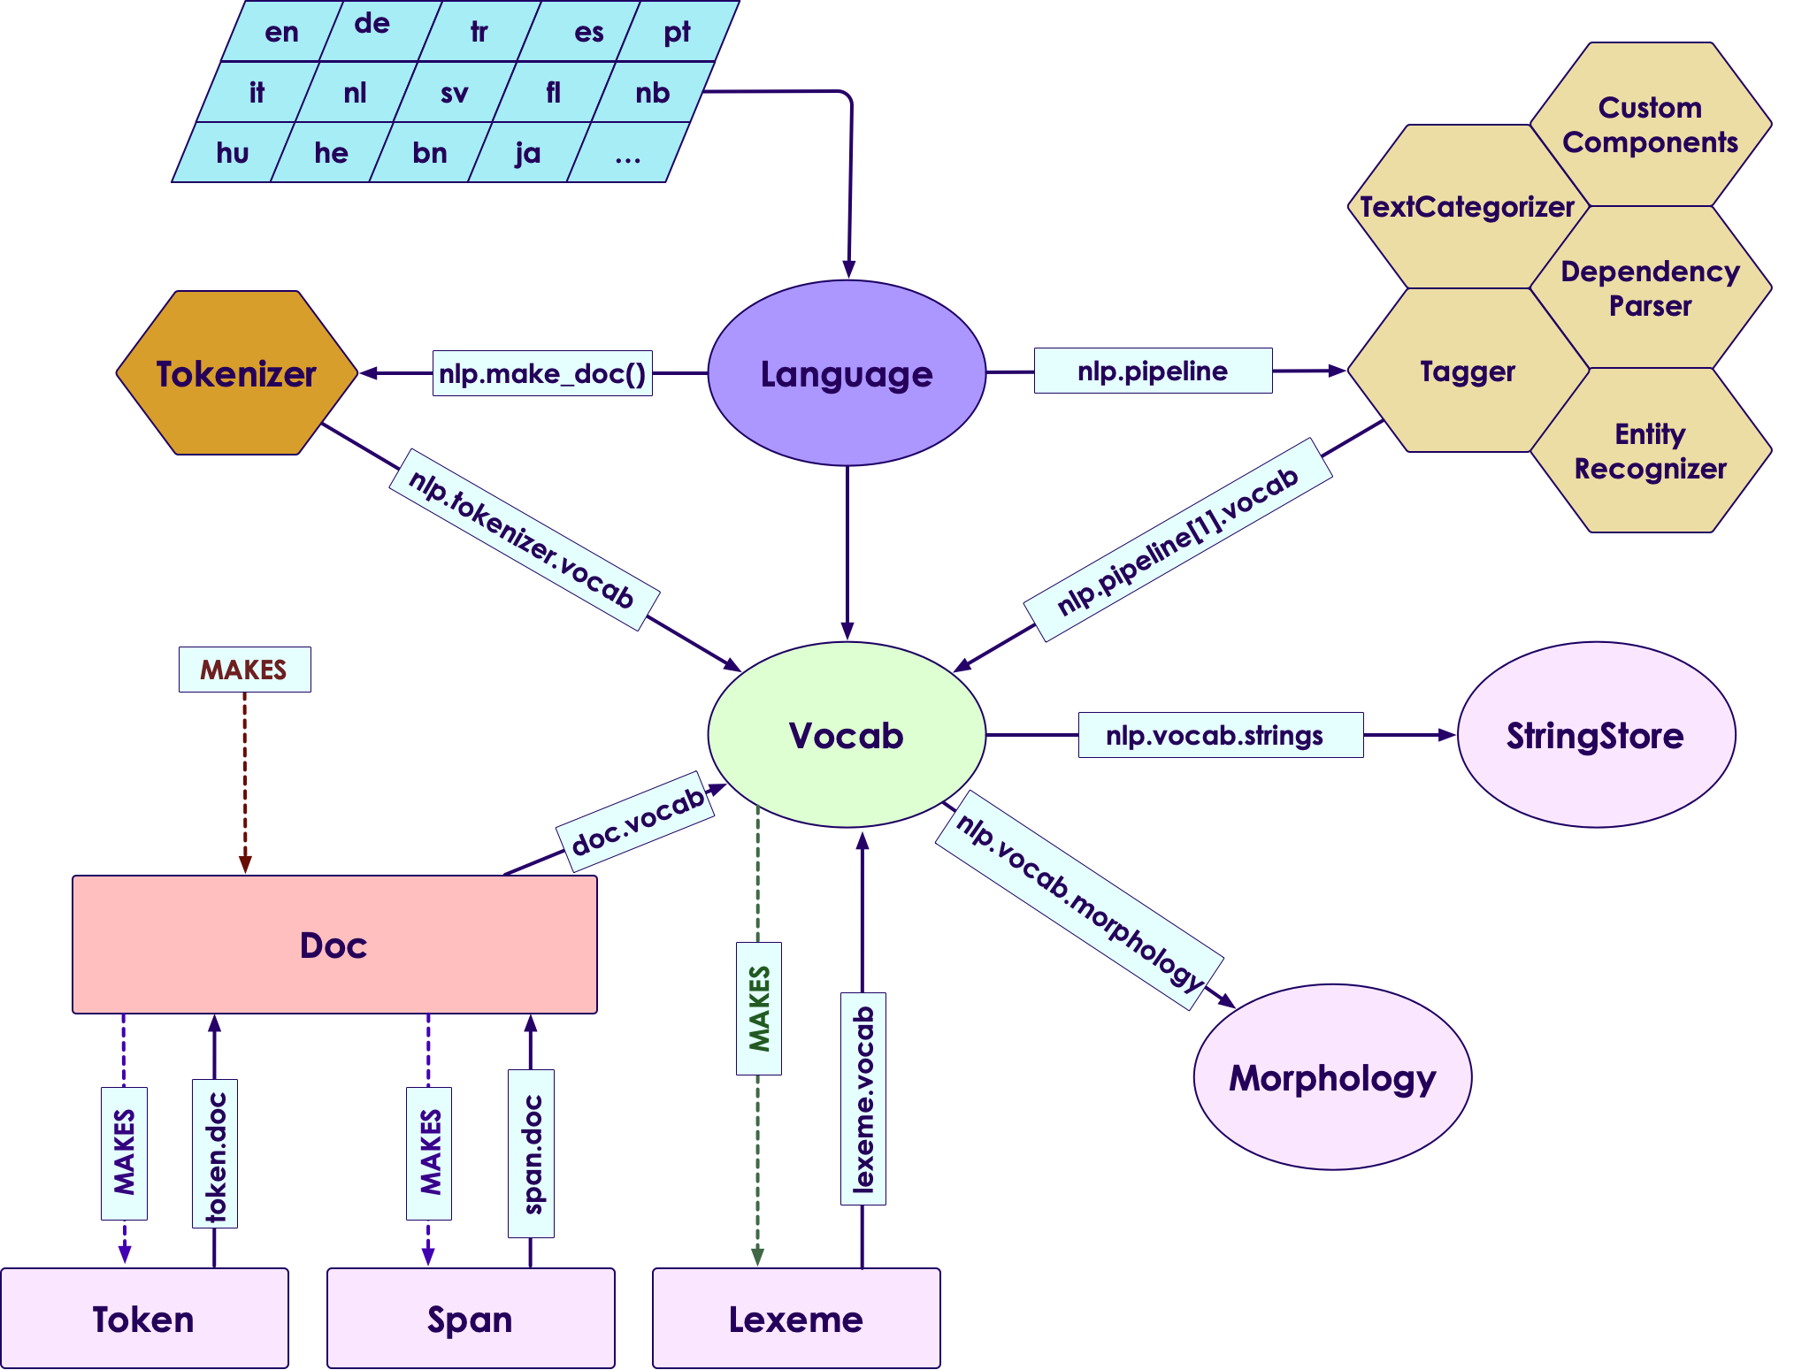
Architecture
Copyright © 2022 by Elephant Scale, All Rights Reserved

Slide 27

Lab: Spacy Labs
Overview:
Get familiar with Spacy
Approximate Time:
1 hr
Instructions:
Instructor: Please demo the first lab
Spacy-1: Spacy Intro
Spacy-2: Working with Spacy
Copyright © 2022 by Elephant Scale, All Rights Reserved

Slide 28
Backup Slides
Backup Slides
Copyright © 2022 by Elephant Scale, All Rights Reserved

Slide 29
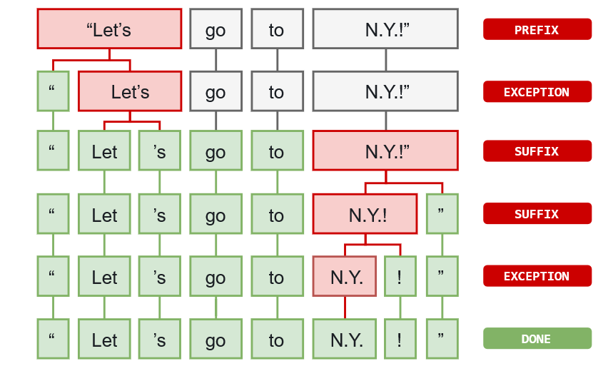
Tokenizer Exception
Exception rules to split a string into tokens:
Prefix: e.g. $ , ( , " .
Suffix: e.g. km . ) . " . ! .
Infix: e.g. - , -- , / , ... .
Copyright © 2022 by Elephant Scale, All Rights Reserved

Slide 30
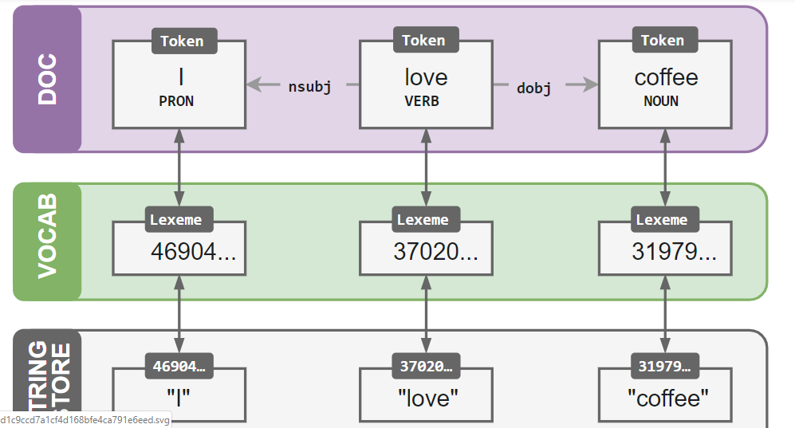
Vocab
Data is stored in vocab when possible
Vocab is shared by multiple documents
Vocab is encoded to hash values in order to save memory
Copyright © 2022 by Elephant Scale, All Rights Reserved

Slide 31
Serialization
Used for saving modified pipeline, vocab, vectors, entities and models
Supports pickle protocol
Copyright © 2022 by Elephant Scale, All Rights Reserved

Slide 32
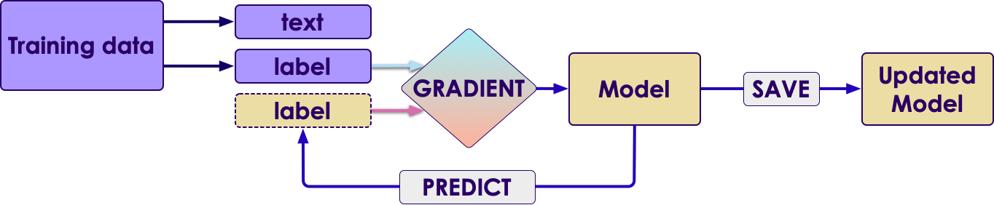
Training and Prediction
Used for prediction
Training phase on training data
Predicting phase on unlabeled data
Copyright © 2022 by Elephant Scale, All Rights Reserved

Slide 33
Language data
Exceptions and special cases are seen in all languages
Some exceptions are common among languages
Some exceptions are language specific
Language specific data is stored in lang module
Copyright © 2022 by Elephant Scale, All Rights Reserved

Slide 34
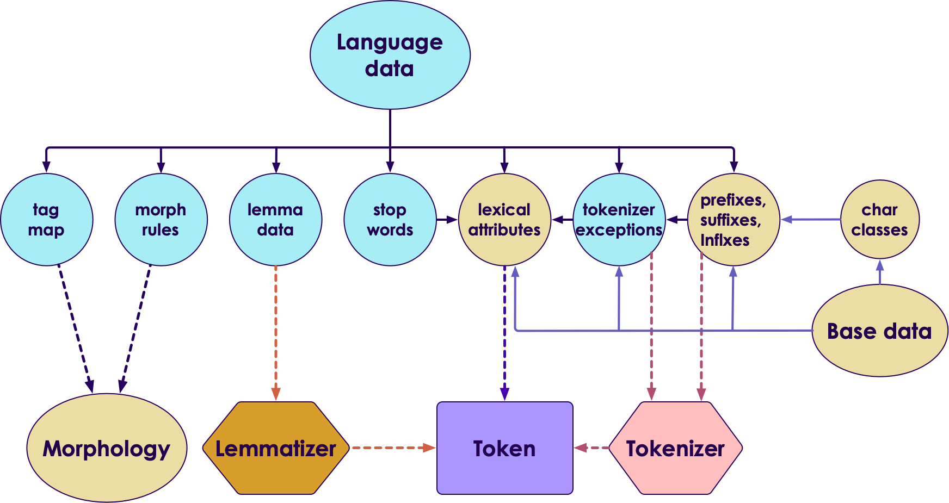
Structure of language data
Copyright © 2022 by Elephant Scale, All Rights Reserved

