Slide 1
Python + Reactive
Reactive Programming
Asynchronous responses
RxPY: Reactive Python
Copyright © 2022 by Elephant Scale, All Rights Reserved

Slide 2
Reactive Programming
Reactive Programming Asynchronous responses RxPY: Reactive Python
Copyright © 2022 by Elephant Scale, All Rights Reserved

Slide 3
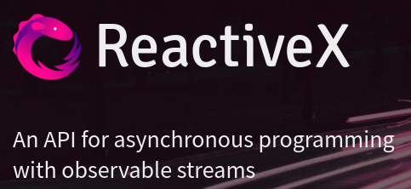
What is reactive programming?
Popular since 2010
Mostly due to the Reactive X project
The Observer pattern done right
ReactiveX is a combination of the best ideas from
the Observer pattern
the Iterator pattern
and functional programming
Cure for
state machines or callback hell
Copyright © 2022 by Elephant Scale, All Rights Reserved
Notes:
http://reactivex.io/

Slide 4
ReactiveX Languages
Java: RxJava
JavaScript: RxJS
C#: Rx.NET
C#(Unity): UniRx
Scala: RxScala
Clojure: RxClojure
C++: RxCpp
Lua: RxLua
Ruby: Rx.rb
Python: RxPY
Copyright © 2022 by Elephant Scale, All Rights Reserved

Slide 5
Reactive Languages cont'd
Go: RxGo
Groovy: RxGroovy
JRuby: RxJRuby
Kotlin: RxKotlin
Swift: RxSwift
PHP: RxPHP
Elixir: reaxive
Dart: RxDart
Copyright © 2022 by Elephant Scale, All Rights Reserved

Slide 6
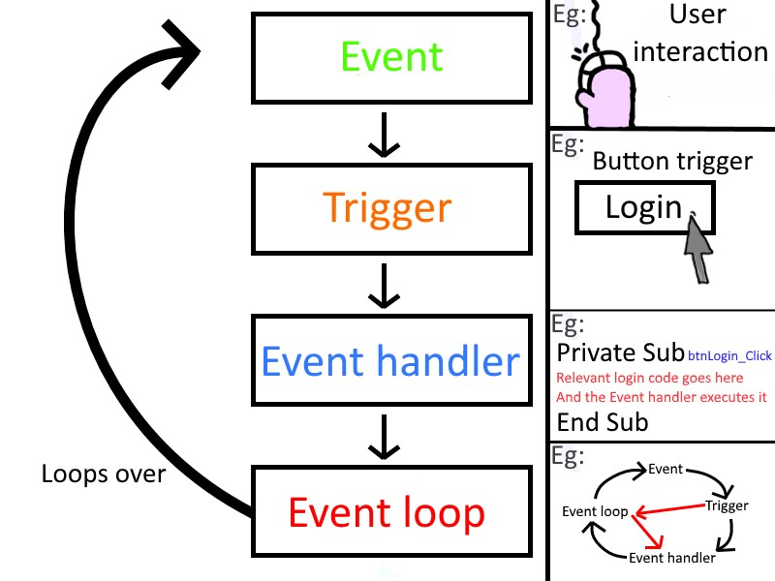
Event-driven programming
Copyright © 2022 by Elephant Scale, All Rights Reserved
Notes:
https://commons.wikimedia.org/wiki/File:Event_driven_programming_Simply_Explained.jpg

Slide 7
Event-driven Programming Incarnations
Implementations:
State machines
Petri net
Kahn Process Networks
Observer design pattern
callbacks
pipes
publish/subscribe
futures
promises
streams
Copyright © 2022 by Elephant Scale, All Rights Reserved

Slide 8
Event-driven programming is hard
That is, hard to use correctly. Why?
Instead of a sequence of actions
The beginning of an action starts when an event occurs
The actions that are triggered are often dispersed within the program
Copyright © 2022 by Elephant Scale, All Rights Reserved

Slide 9
Event-driven programming in GUI
Graphical user interfaces (GUIs):
Objective-C on NextStep and macOS
C++ on Windows
C or eventually C++ on Unix (with X11)
Java
Copyright © 2022 by Elephant Scale, All Rights Reserved

Slide 10
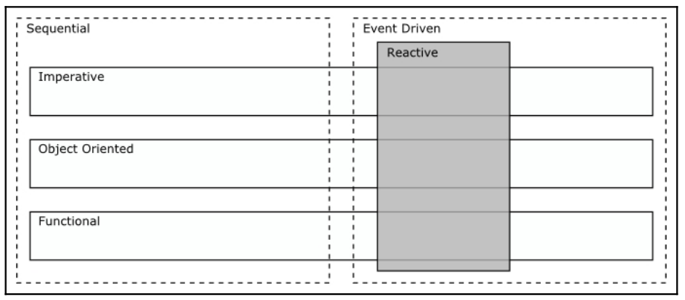
Sequential vs. Event-Driven Programming
Copyright © 2022 by Elephant Scale, All Rights Reserved
Notes:
Image from book

Slide 11
How a Reactor Works
The Reactor design principle
Reactor
Event handler
Event demultiplexer
Copyright © 2022 by Elephant Scale, All Rights Reserved

Slide 12
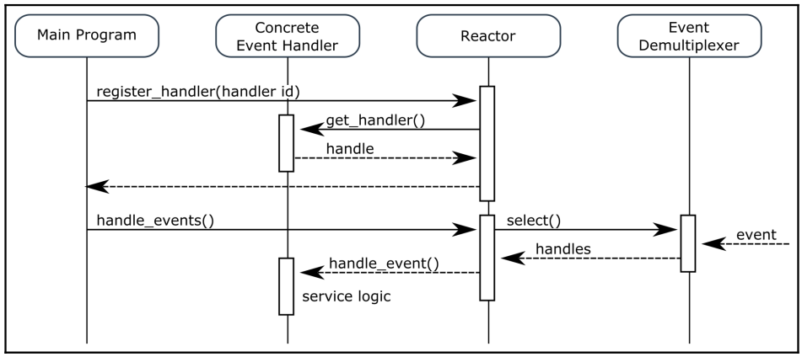
The Reactor Design Principle
Copyright © 2022 by Elephant Scale, All Rights Reserved

Slide 13
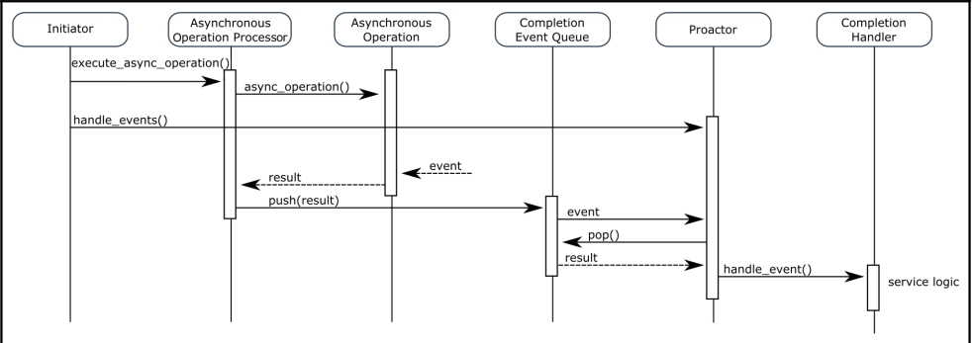
The Proactor Design Principle
Copyright © 2022 by Elephant Scale, All Rights Reserved

Slide 14
What is Reactive After All?
We cover RxPY, Reactive Programming framework
But
This does not automatically give you a Reactive system
Reactive systems are described in
The Reactive Manifesto
Copyright © 2022 by Elephant Scale, All Rights Reserved

Slide 15
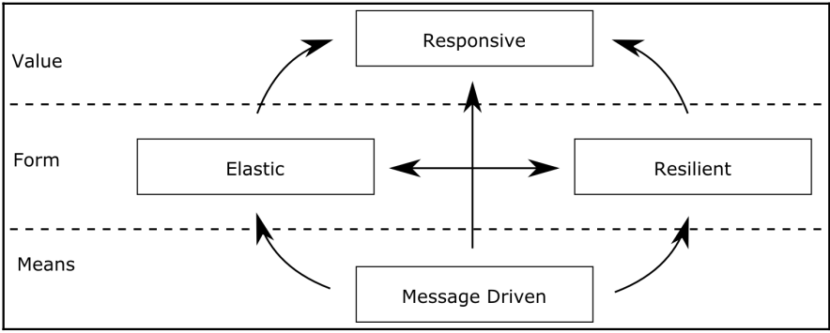
Reactive Systems
Copyright © 2022 by Elephant Scale, All Rights Reserved

Slide 16
Reactive System Are
Responsive:
responds to events and user interactions
Resilient
stays responsive even in the event of failure
resilience can be achieved in several ways
replication
isolation
Elastic
stays responsive when the workload varies
vertically and horizontally scalable
Message-driven
components communicate via asynchronous message channels
allows to isolate components
saturation is controlled via back-pressure.
Copyright © 2022 by Elephant Scale, All Rights Reserved

Slide 17
Asynchronous responses
Reactive Programming Asynchronous responses RxPY: Reactive Python
Copyright © 2022 by Elephant Scale, All Rights Reserved

Slide 18
AsyncIO
The official asynchronous framework for Python
(Twisted and Gevent are also popular, but)
Since the release in Python 3.4, AsyncIO has become very popular a de-facto standard
Python philosophy: There should be only one obvious way to do something
AsyncIO is it
Copyright © 2022 by Elephant Scale, All Rights Reserved

Slide 19
AsynIO Components
Futures
represent values that will be available later
Co-routines
allow you to execute asynchronous actions
Event loops
schedule the execution of the active tasks
Copyright © 2022 by Elephant Scale, All Rights Reserved

Slide 20
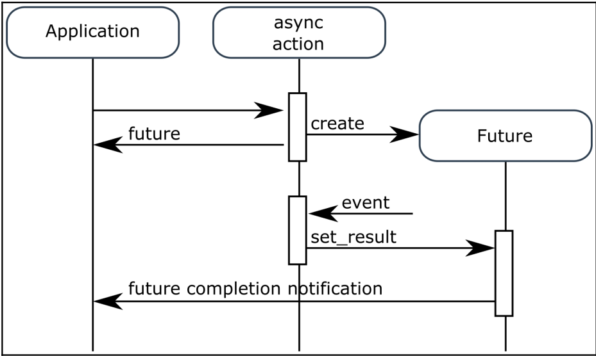
Use of Futures
Copyright © 2022 by Elephant Scale, All Rights Reserved

Slide 21
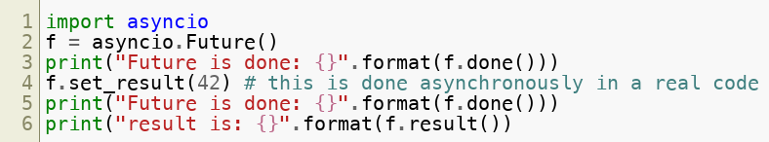

Future Code
Output
Copyright © 2022 by Elephant Scale, All Rights Reserved

Slide 22
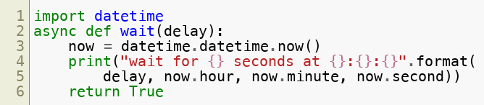

Co-routines
Output
Copyright © 2022 by Elephant Scale, All Rights Reserved

Slide 23
Event Loop
Entity of AsyncIO
Scheduling all asynchronous actions
executing concurrently
An infinite loop
waits for some events
execute handlers associated with these events
these handlers are co-routines
Copyright © 2022 by Elephant Scale, All Rights Reserved

Slide 24


Event Loop Code
Output
Copyright © 2022 by Elephant Scale, All Rights Reserved

Slide 25
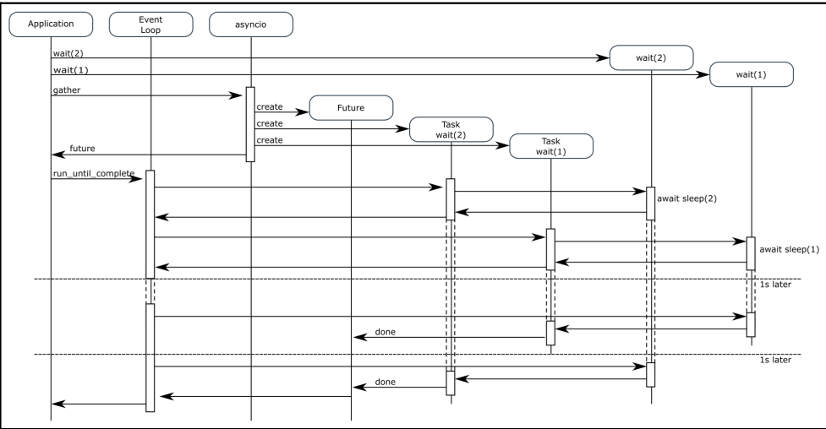
Executing co-routines
Copyright © 2022 by Elephant Scale, All Rights Reserved

Slide 26
RxPY: Reactive Python
Reactive Programming Asynchronous responses RxPY: Reactive Python
Copyright © 2022 by Elephant Scale, All Rights Reserved

Slide 27
RxPY Lab
Please do the RxPY lab
Copyright © 2022 by Elephant Scale, All Rights Reserved

