Slide 1
Python: MS Office Automation
Installation
Use
MS Office Invocation
Copyright © 2022 by Elephant Scale, All Rights Reserved

Slide 2
Lesson Objectives
Introduction to MS Office Automation
python-docx
python-pptx
xlsxwriter
Pandas Integration
Win32 / COM integration
Copyright © 2022 by Elephant Scale, All Rights Reserved

Slide 3
Introduction to MS Office Integration
Python allows automating the creation of Microsoft Office Documents
Generally NOT developed or supported by Microsoft
Does NOT require Microsoft Office to use.
Copyright © 2022 by Elephant Scale, All Rights Reserved

Slide 4
Why Use MS Office from Python
Automating the creation of a MS Word document from an application
Scripting the creation of a powerpoint presentation.
Exporting data to/from Pandas into Excel.
Copyright © 2022 by Elephant Scale, All Rights Reserved

Slide 5
Python vs Microsoft AUtomation tools
Microsoft Office can be automated through Microsoft TEchnologies:
VBScript
VBA
.NET (C#, VB.NET)
C++
These technologies generally DO require a copy of office
Essentially they remote control Office itself using COM/DCOM
Copyright © 2022 by Elephant Scale, All Rights Reserved

Slide 6
Advantages
Accuracy : results will be guarunteed to look correct in Word/Powerpoint/Excel
MS Office file formats are proprietary and nearly impossible to duplicate without resorting to automation
Copyright © 2022 by Elephant Scale, All Rights Reserved

Slide 7
Disadvantages
Scalability limitations
Not very stable
Not recommended or supported for server-side programming
Headaches of license administration
COM is a very archaic tecnnology
Only runs on Windows
Does NOT run on Python
Copyright © 2022 by Elephant Scale, All Rights Reserved

Slide 8
Using COM from Python
We can use COM on Python to control Office
This has many of the same advantages and disadvantages
NOT supported by Microsoft
Possibly violates license if used server-side
Windows Only
Copyright © 2022 by Elephant Scale, All Rights Reserved

Slide 9
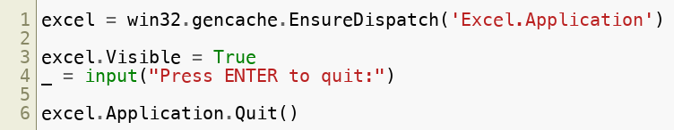
Example
Copyright © 2022 by Elephant Scale, All Rights Reserved

Slide 10
Why use COM?
Mainly for testing
If you want to use python to
Copyright © 2022 by Elephant Scale, All Rights Reserved

Slide 11
Summary
AUtomation technologies are not recommended for server-side use.
Primarily used for developers to automate or script office releated tasks on the desktop.
Microsoft strongly discourages developers from doing any sort of automation on the server.
Licensing issues are also very difficult to solve as both clients and server are supposed to have the same versions of office.
Copyright © 2022 by Elephant Scale, All Rights Reserved

Slide 12
Installation
Installation Use MS Office Invocation
Copyright © 2022 by Elephant Scale, All Rights Reserved

Slide 13
Installing packages
The packages here can generally be installed with pip
pip install python-docx
pip install python-pptx
pip install xlsxwriter
Copyright © 2022 by Elephant Scale, All Rights Reserved

Slide 14
MS Office XML file formats
In 2007, Microsoft introduced the open standard XML file formats in office.
In theory, this allows any software to open and write MS Office documents.
However, MS doesn't want competitors like OpenOffice to be able to create documents with 100% compatibility with office
In practice, it is nearly impossible to create and edit documents that look identical to what Office itself would do.
Copyright © 2022 by Elephant Scale, All Rights Reserved

Slide 15
Use
Installation Use MS Office Invocation
Copyright © 2022 by Elephant Scale, All Rights Reserved

Slide 16
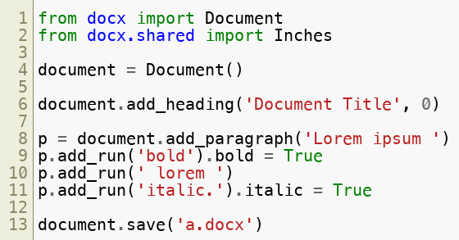
Microsoft Word
Copyright © 2022 by Elephant Scale, All Rights Reserved

Slide 17
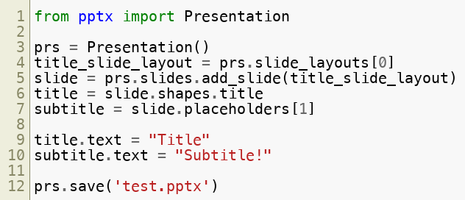
Microsoft Powerpoint
Copyright © 2022 by Elephant Scale, All Rights Reserved

Slide 18
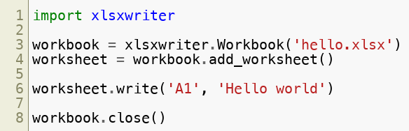
Microsoft Excel
Copyright © 2022 by Elephant Scale, All Rights Reserved

Slide 19
MS Office Invocation
Installation Use MS Office Invocation
Copyright © 2022 by Elephant Scale, All Rights Reserved

Slide 20
Opening the MS Office Application from Python
There is no platform independent way to open up office applications from Python.
Each OS has to be handled separately.
Windows: os.startfile()
Mac: subprocess.call(('open', filepath))
Linux: `subprocess.call(('xdg-open', filepath))
Copyright © 2022 by Elephant Scale, All Rights Reserved

Slide 21
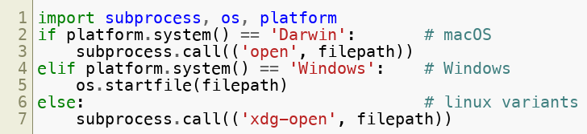
Python
Copyright © 2022 by Elephant Scale, All Rights Reserved

