Slide 1
Python: Selenium
Installation
Example
Copyright © 2022 by Elephant Scale, All Rights Reserved

Slide 2
Lesson Objectives
Introduction to Selenium
Installing Selenium
Copyright © 2022 by Elephant Scale, All Rights Reserved

Slide 3
Introduction to Selenium
Selenium is an automation software for browsers commonly used for testing.
Allows you to automated and test web applications, websites, and other browser
Copyright © 2022 by Elephant Scale, All Rights Reserved

Slide 4
Why Selenium
Key advantage - Provides a very user friendly API to automate browser tasks
Python provides a no-fuss easy API for controlling selenium.
Copyright © 2022 by Elephant Scale, All Rights Reserved

Slide 5
Installation
Installation Example
Copyright © 2022 by Elephant Scale, All Rights Reserved

Slide 6
Installing Selenium
3 steps:
Install browser plugins on selected browser of choice
Install Java selenium server (if you want to run non-locally)
Install Python package pip install selenium
Copyright © 2022 by Elephant Scale, All Rights Reserved

Slide 7
Example
Installation Example
Copyright © 2022 by Elephant Scale, All Rights Reserved

Slide 8
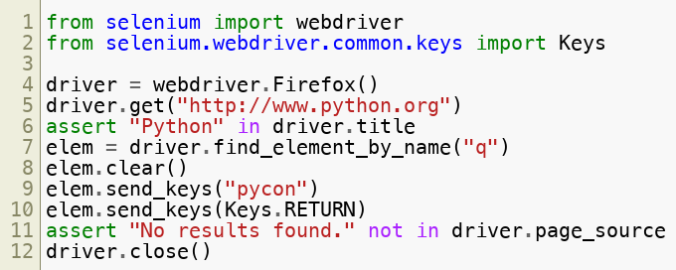
Selenium Example
Copyright © 2022 by Elephant Scale, All Rights Reserved

Slide 9
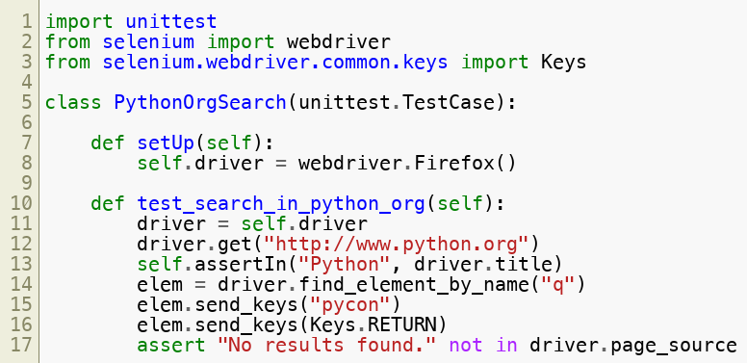
Writing a Unit Test
Copyright © 2022 by Elephant Scale, All Rights Reserved

Slide 10
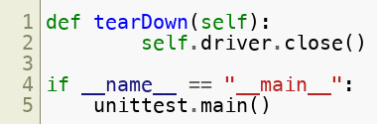
Writing a Unit Test
Copyright © 2022 by Elephant Scale, All Rights Reserved

Slide 11
Running Headless
You may not want to run the browser GUI
Headless mode allows you to avoid that
Good for testing on servers or in cloud where there is no GUI
Copyright © 2022 by Elephant Scale, All Rights Reserved

