Slide 1

Spark Core
Spark Core
Spark Shell
Core Data Model
Anatomy of Spark Job
Caching
Copyright © 2022 by Elephant Scale, All Rights Reserved

Slide 2
Objectives
Learn Spark Core
Using Spark Shell
Copyright © 2022 by Elephant Scale, All Rights Reserved

Slide 3
Spark Core
Spark Core Spark Shell Core Data Model Anatomy of Spark Job Caching
Copyright © 2022 by Elephant Scale, All Rights Reserved

Slide 4
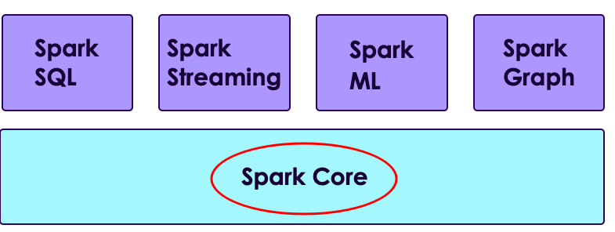
Spark Core
Spark Core handles
Task allocation
memory management
Data APIs
Copyright © 2022 by Elephant Scale, All Rights Reserved

Slide 5
Spark Shell
Spark Core Spark Shell Core Data Model Anatomy of Spark Job Caching
Copyright © 2022 by Elephant Scale, All Rights Reserved

Slide 6
Spark Shell
Spark Shell is an interactive environment to work with Spark
Enables very quick iterative development - no edit/save/compile/run cycle
Various shells for languages:
spark/bin/pyspark : Python
spark/bin/spark-shell : Scala and Java
spark/bin/sparkR : R
spark/bin/spark-sql : SQL
Copyright © 2022 by Elephant Scale, All Rights Reserved

Slide 7
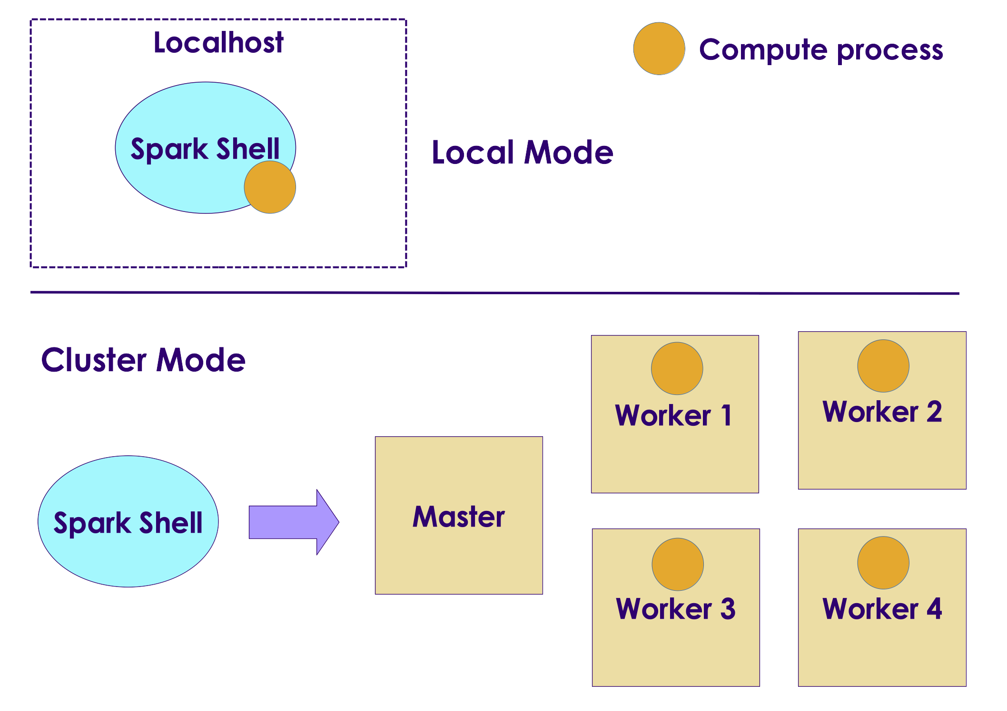
Spark Shell Execution Modes
Spark Shell can be run in either local or cluster mode
Local mode:
Every thing runs on a single machine
Great for developing and debugging
Cluster mode:
Jobs run on a cluster
Production
Copyright © 2022 by Elephant Scale, All Rights Reserved

Slide 8



Running Spark Shell (Scala)
Start on single thread mode (default)
Start with 4 worker threads
Start worker threads for each CPU core
Connect to a Spark cluster
Connect to a YARN cluster
See all options
Copyright © 2022 by Elephant Scale, All Rights Reserved

Slide 9



Running PySpark Shell (Python)
Start on single thread mode (default)
Start with 4 worker threads
Start worker threads for each CPU core
Connect to a Spark cluster
Connect to a YARN cluster
See all options
Copyright © 2022 by Elephant Scale, All Rights Reserved

Slide 10
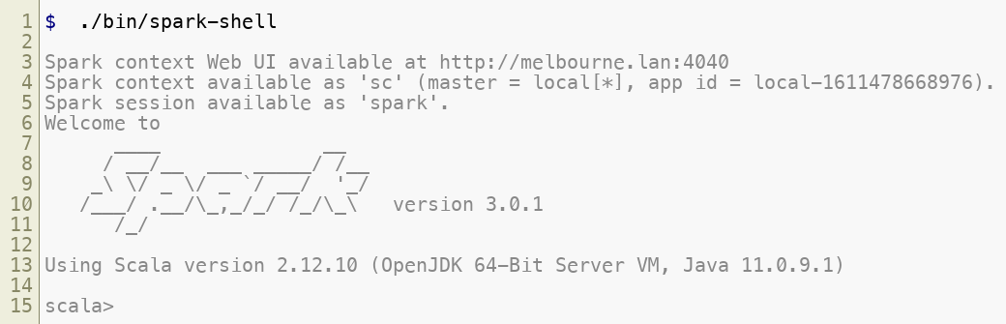
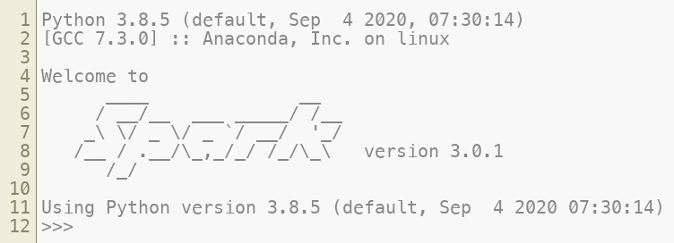
Running Spark Shell
Spark Shell
Pyspark
Copyright © 2022 by Elephant Scale, All Rights Reserved

Slide 11
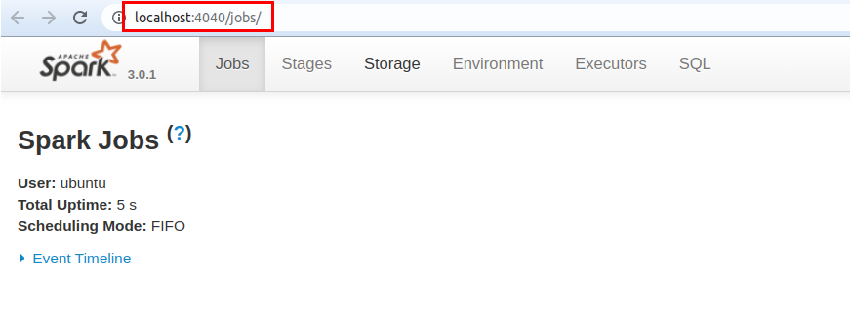
Spark Shell UI
When Spark Shell is running, it publishes a dashboard starting on port number 4040
This UI provides tons of details about:
Jobs running in the shell
CPU / memory usage
Caching details
Copyright © 2022 by Elephant Scale, All Rights Reserved

Slide 12
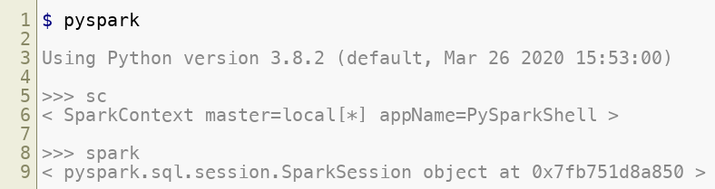
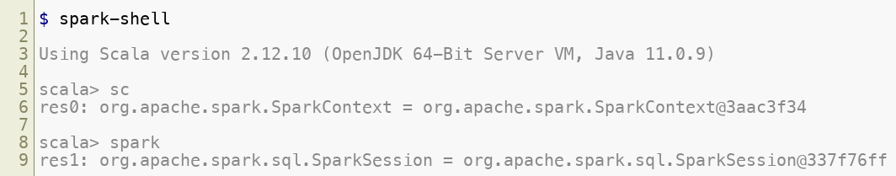
Spark API
Within Spark shell there are two Spark API points
SparkContext : classic API
SparkSession : newer, recommended API
Copyright © 2022 by Elephant Scale, All Rights Reserved

Slide 13
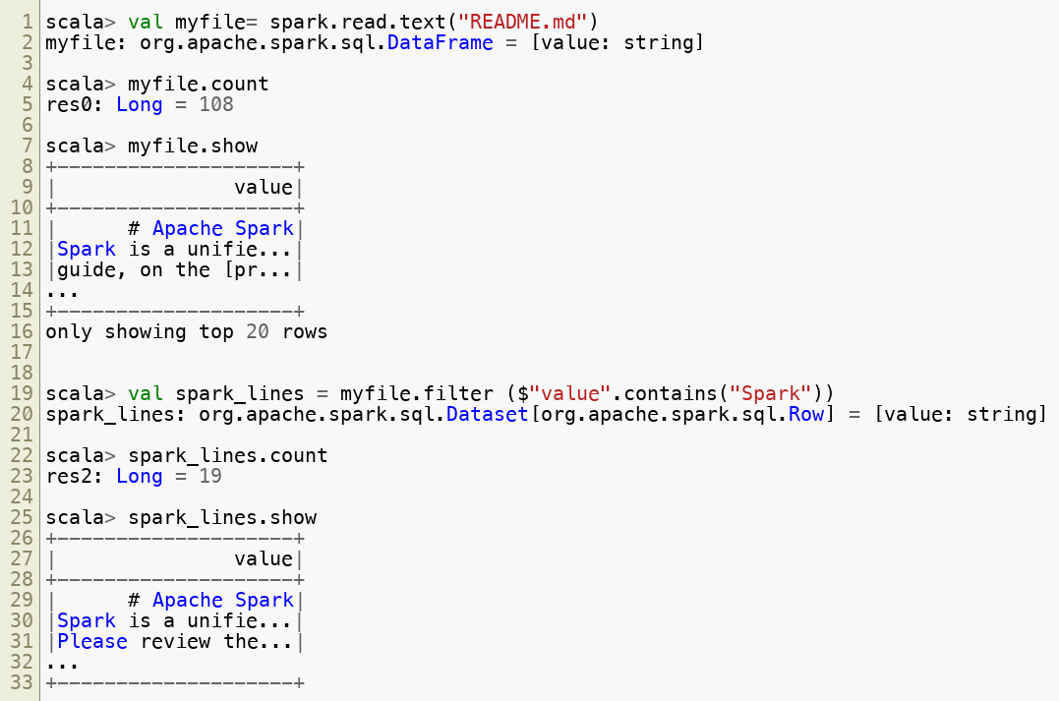
Loading Data in Spark (Scala)
Copyright © 2022 by Elephant Scale, All Rights Reserved

Slide 14
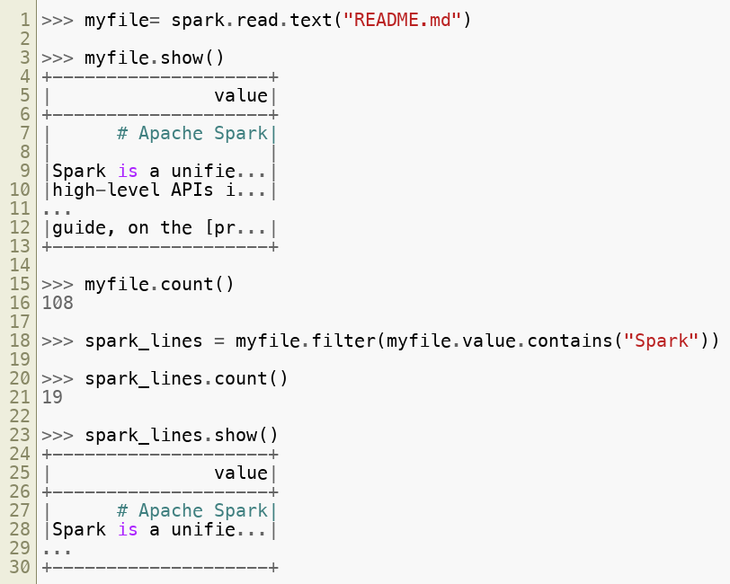
Loading Data in PySpark (Python)
Copyright © 2022 by Elephant Scale, All Rights Reserved

Slide 15
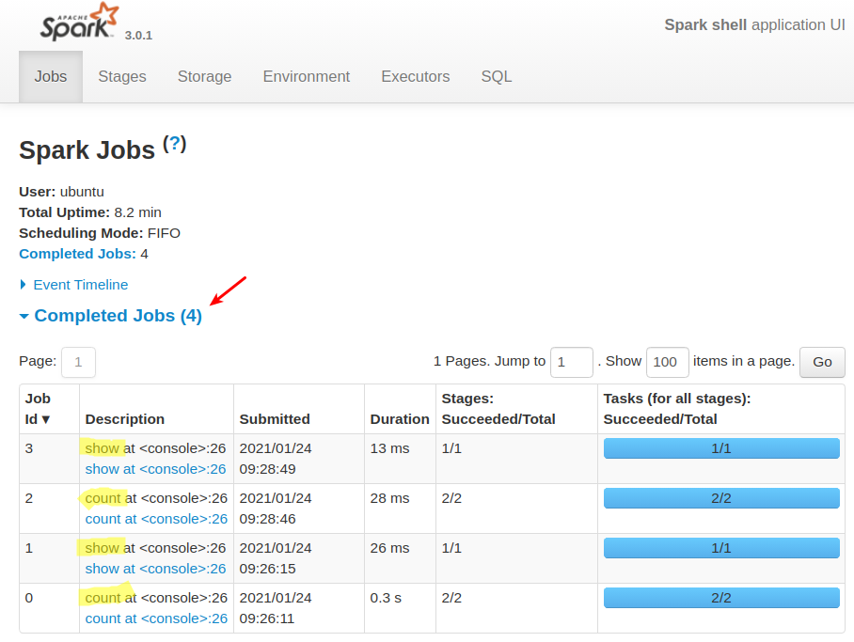
Spark Shell UI
Here is how the Spark Shell UI, note the jobs running
Copyright © 2022 by Elephant Scale, All Rights Reserved

Slide 16
Spark Read Functions
Spark supports wide variety of data formats
Function | Description
spark.read.text | Plain text files
spark.read.csv | CSV files
spark.read.json | JSON files
spark.read.parquet | Parquet files
Copyright © 2022 by Elephant Scale, All Rights Reserved

Slide 17

Lab: Spark Shell
Overview:
Get used to Spark Shell
Approximate run time:
20-30 mins
Instructions:
SHELL-1: Use Spark Shell
Copyright © 2022 by Elephant Scale, All Rights Reserved

Slide 18
Core Data Model
Spark Core Spark Shell Core Data Model Anatomy of Spark Job Caching
Copyright © 2022 by Elephant Scale, All Rights Reserved

Slide 19
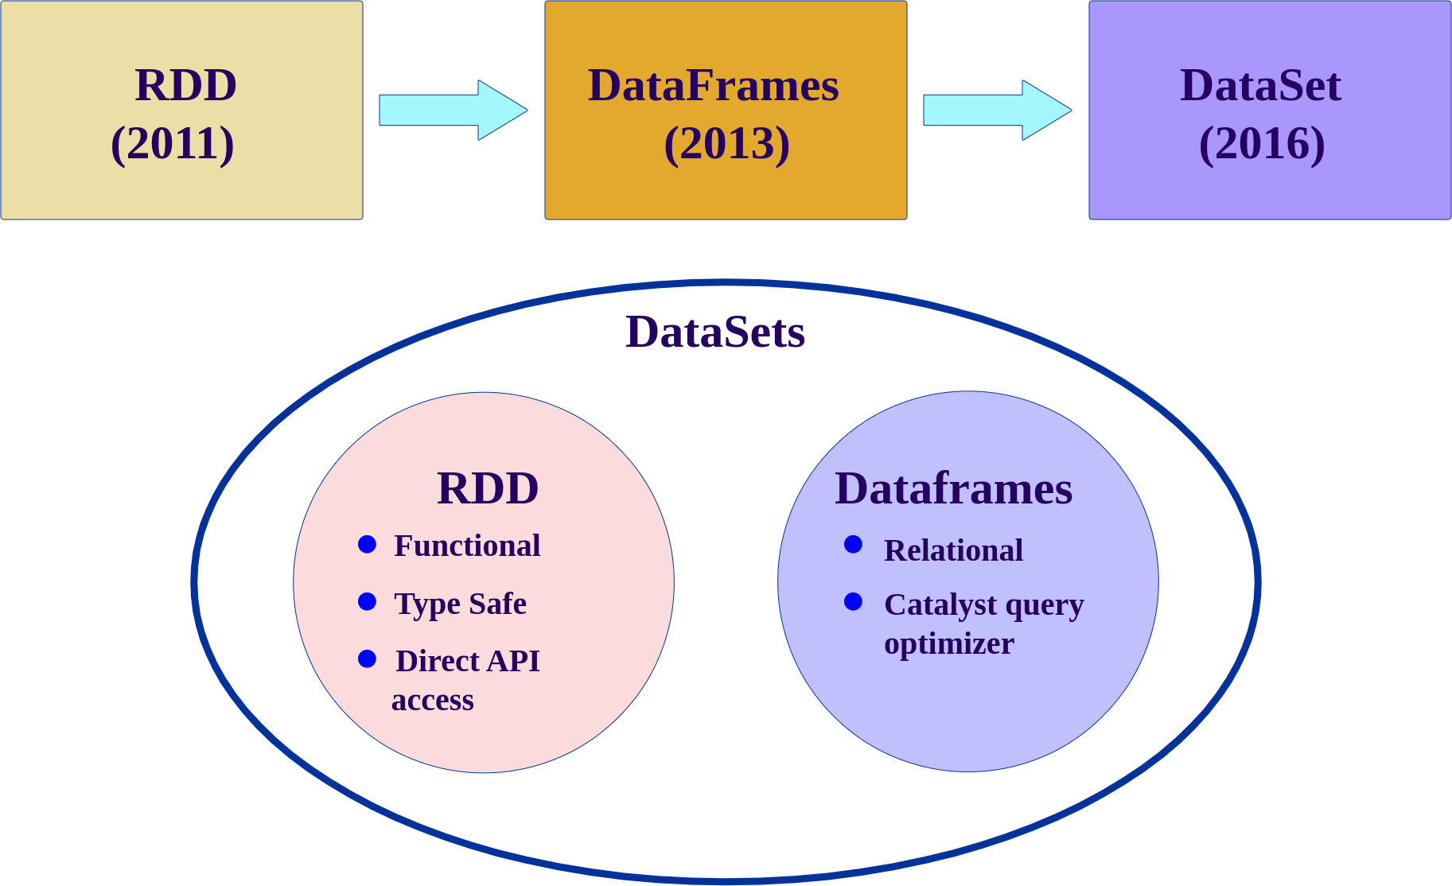
Spark Data Model Evolution
Spark data models have evolved over the years
Copyright © 2022 by Elephant Scale, All Rights Reserved

Slide 20
Spark Data Models Comparison
References:
A Tale of Three Apache Spark APIs: RDDs vs DataFrames and Datasets
Converting Spark RDD to DataFrame and Dataset
 | RDD | Dataframe | Dataset
Since | Since v1 | Since Spark 1.3 | Since Spark v2
Data Representation | Distributed data | Represents a table in a database or a Dataframe in Pandas/R | Distributed data
Typing | Typed | Generic | Strong typing
Suited for | Unstructured data | Structured Data | Semi-structured and structured data.
Optimizations | Minimal. User is responsible for optimizations | Offers exceptional optimization | Offers exceptional optimization
Languages | Java, Scala, Python | Java, Scala, Python | Java, Scala, Python (partial support)
Copyright © 2022 by Elephant Scale, All Rights Reserved

Slide 21

RDD (Resilient Distributed Datasets)
RDDs are the original (classic) API
Low level API
Even though it is still supported, they not the preferred API post Spark 2+
Dataframes/Datasets APIs are the recommended ones
Copyright © 2022 by Elephant Scale, All Rights Reserved

Slide 22
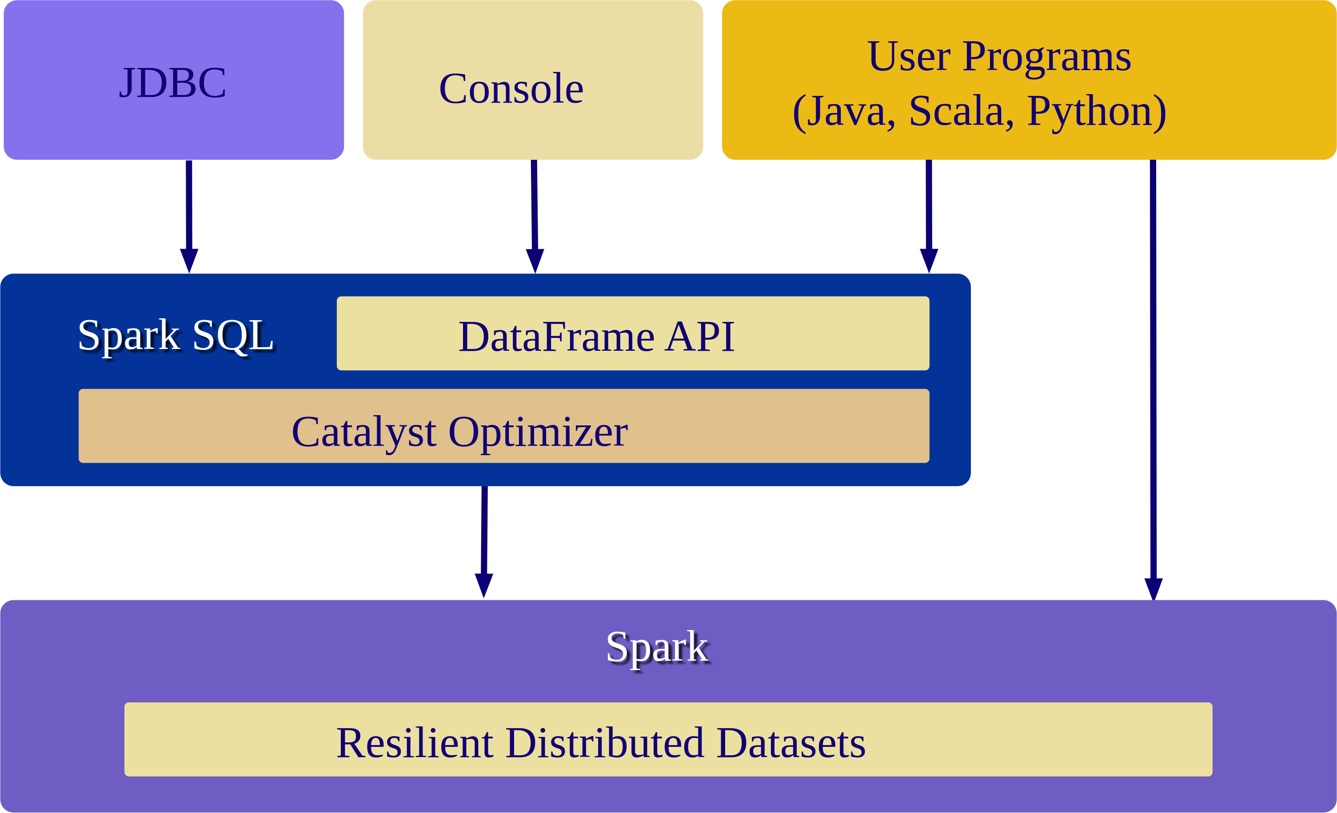

Dataframes
Dataframes are created for providing easy to use APIs for structured data
Dataframes work very similar to Pandas and R Dataframes
But Spark dataframes are distributed (can be very large!)
Spark DF does not need to fit in one machine's memory like Pandas DF
Dataframes are 'untyped' or 'generic'
Dataframes are highly efficient
Catalyst Optimizer does very good job of optimizing of user code/queries
Copyright © 2022 by Elephant Scale, All Rights Reserved

Slide 23
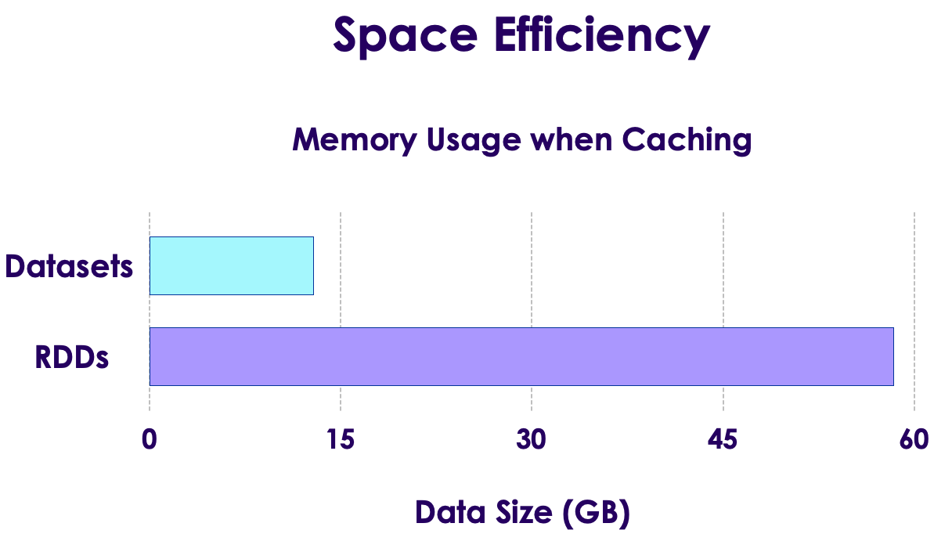
Dataset
Datasets were introduced in Spark 2
They provide a unified APIs
Datasets can support strongly typed data (Customer type, Order type ..etc)
Strong typing is only available on Java and Scala
Only partial support in Python, as Python is not a strongly typed language
Datasets are highly efficient
Here we see how Datasets are very memory efficient compared to RDDs
Copyright © 2022 by Elephant Scale, All Rights Reserved

Slide 24
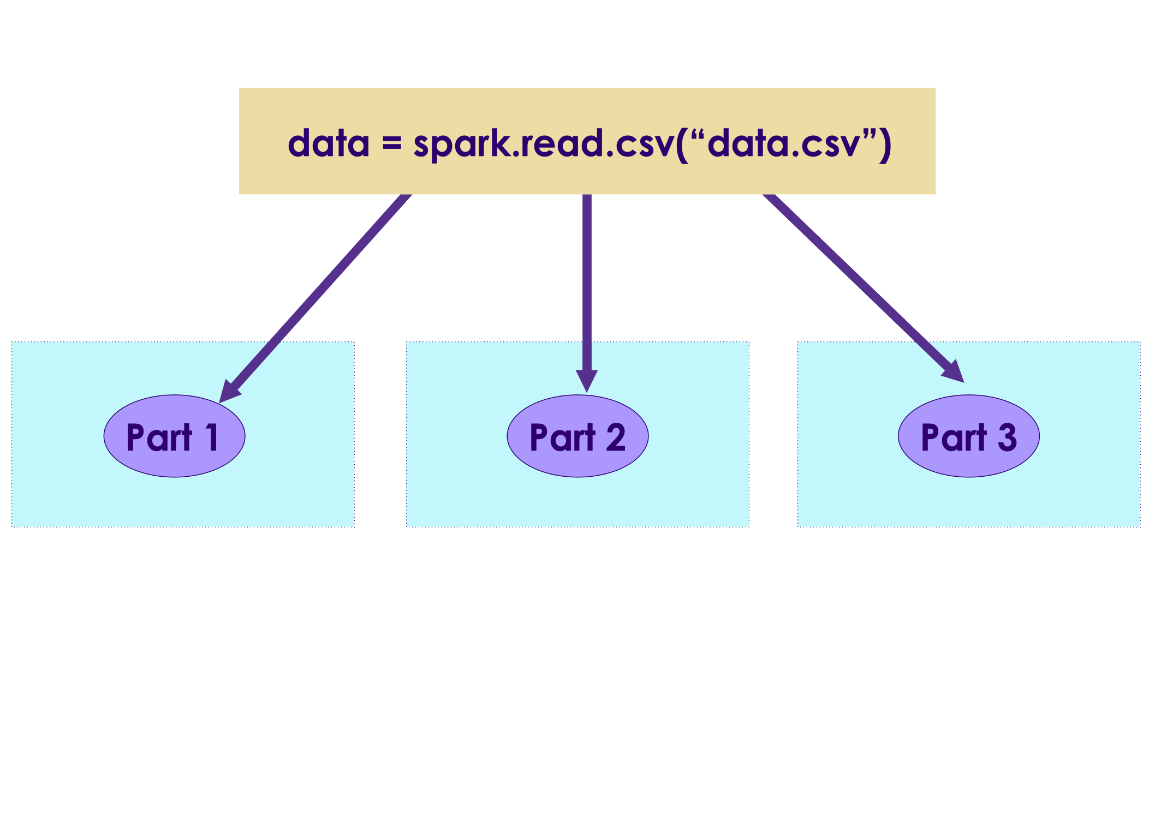
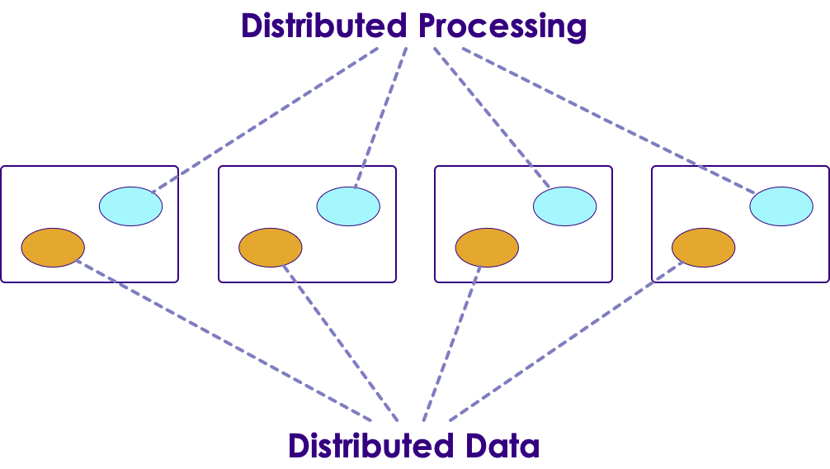
Spark Datamodel Features
Spark data is distributed - they can be spread across the cluster
They don't have to fit on a single machine memory
Once data is read, it is immutable , it can not be changed
This may seem like a limitation, but it really helps with parallel operations by avoiding race conditions
Data can be processed in parallel operations
There are two kinds of operations:
Transformation: Changing one dataset into another
Action: gathering results
Copyright © 2022 by Elephant Scale, All Rights Reserved

Slide 25
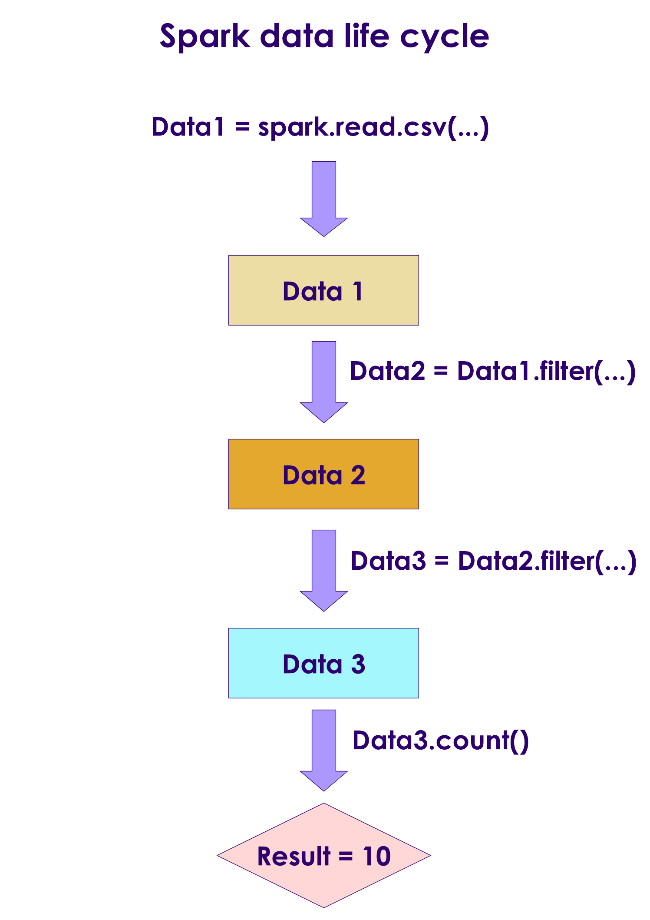
Spark Data Lifecycle
We are loading a file: data1
Then a filter is applied to data1
Since Spark data can not be modified in place, this filter operation creates another dataset data2
Another filter is applied to data2 resulting in another dataset data3
The copying is done very effectively - Spark only creates copies of modified data; Non-modified data is referenced by pointers
Copyright © 2022 by Elephant Scale, All Rights Reserved

Slide 26
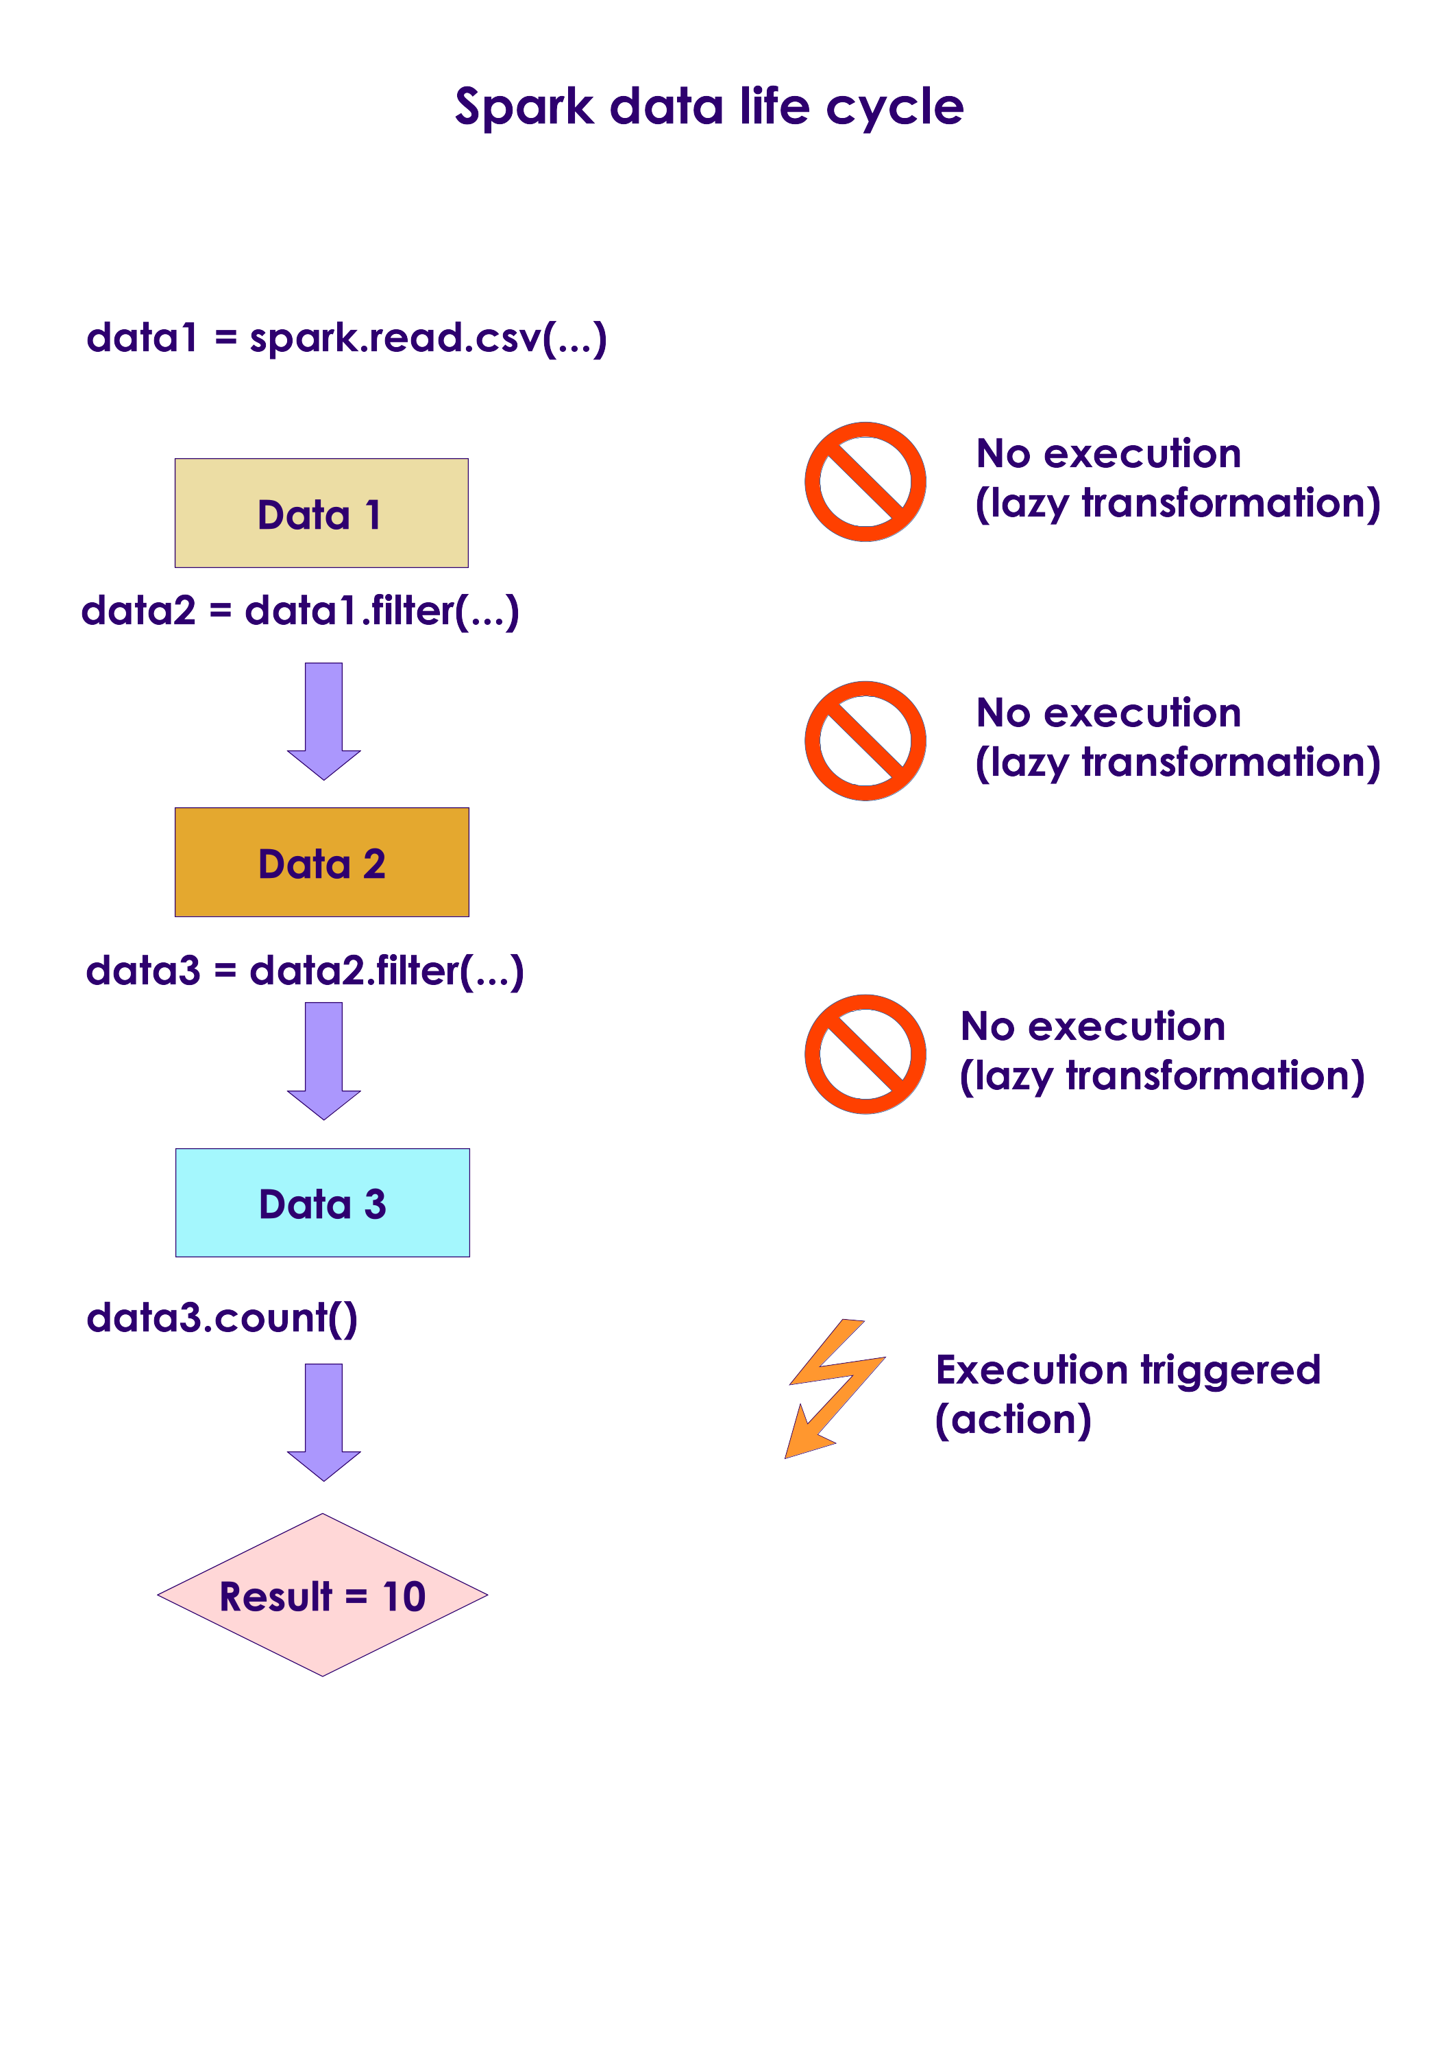
Lazy Transformations
Spark lazily evaluates transformations
Here all operations read and filter are lazy operations - they are not executed right away
Spark will defer these transformations
When an action is encountered, Spark will execute all pending transformations
This is done so Spark can effectively execute a batch of transformations
Spark may do optimizations by combining operations
Copyright © 2022 by Elephant Scale, All Rights Reserved

Slide 27
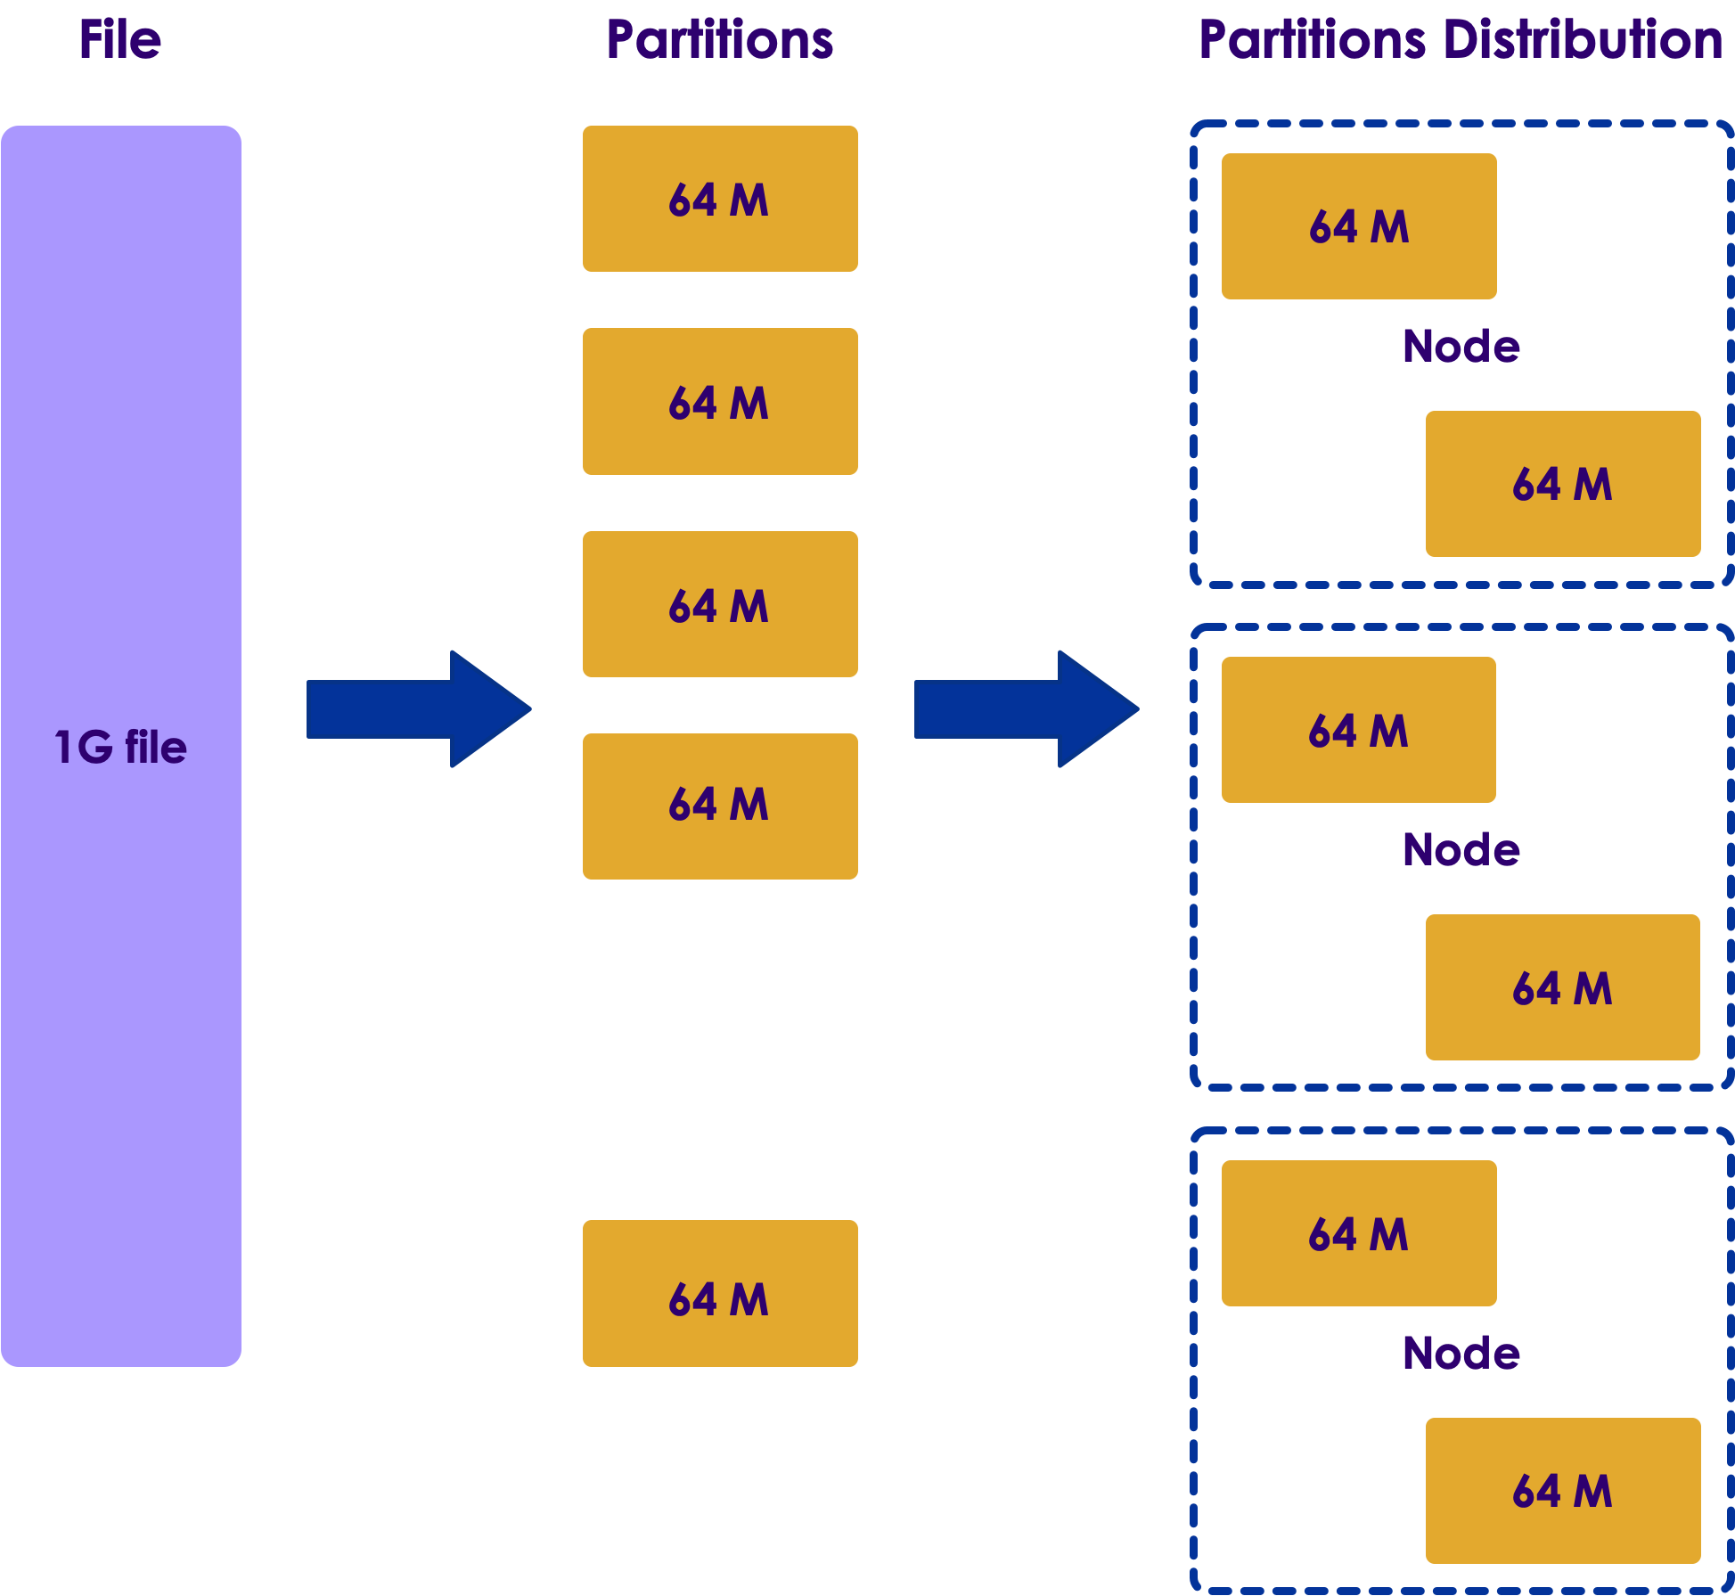
Distributed Data and Partitions
Distributed file systems will be store data on multiple nodes
Here we see a 1G file being split into many chunks/partitions/blocks
Here partition size is 64M (configurable)
Question for class : What is default block size in HDFS?
And the partitions are distributed across many nodes
Copyright © 2022 by Elephant Scale, All Rights Reserved

Slide 28
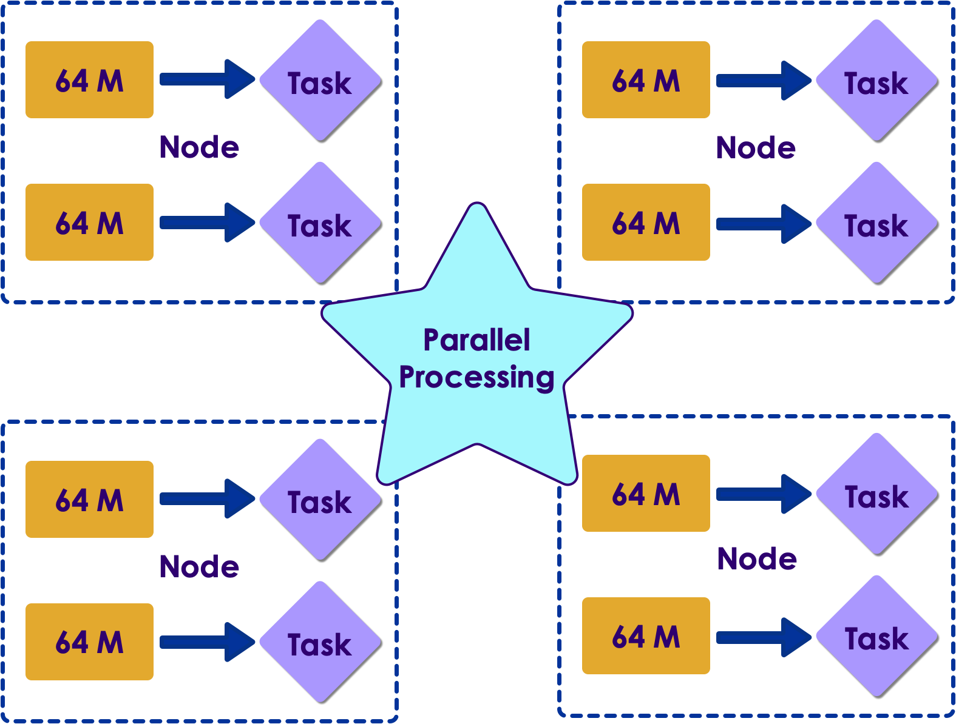
Distributed Processing
When Spark is processing data, it will examine the file partitions
And will spin up one task per partition
So partitions can be processed in parallel!
Copyright © 2022 by Elephant Scale, All Rights Reserved

Slide 29
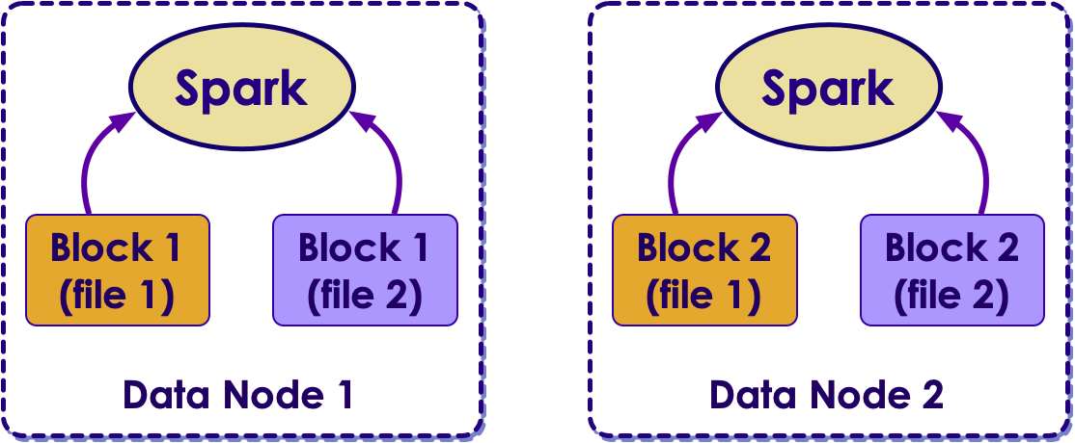
Spark and HDFS
When Spark is processing data in HDFS, it will use 'location hints' provided by HDFS
And then Spark will place tasks on nodes, where data is available
Spark strives to process local data as much as possible
This is called data local processing
Processing local data can yield very high IO throughput
This is a key factor in Hadoop + Spark working well together
Copyright © 2022 by Elephant Scale, All Rights Reserved

Slide 30
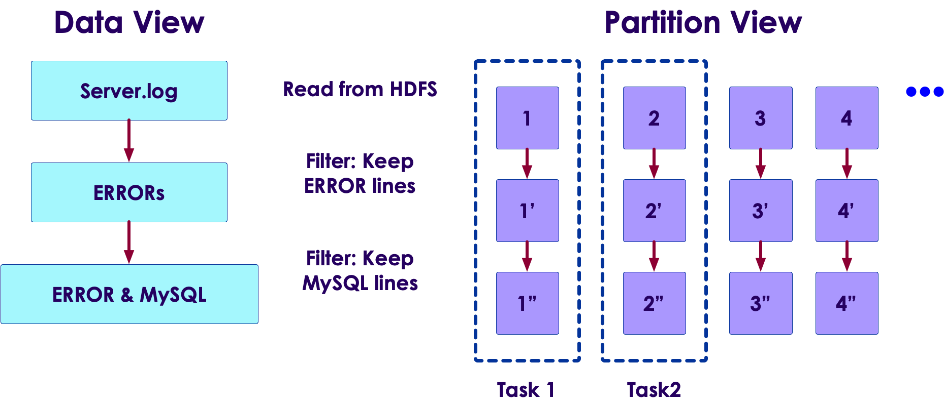
Transformation and Partitions
Since data is split into partitions, Spark operations happen at partition level
Here the filter operations are applied per partition level
And they are execute in parallel
Copyright © 2022 by Elephant Scale, All Rights Reserved

Slide 31
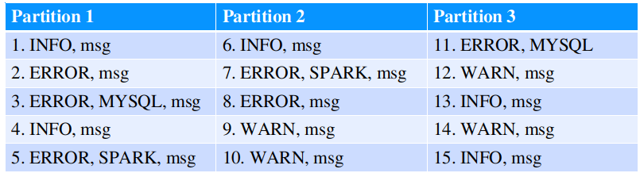
An Example
Let's run through an example
We have a log file that is split into 3 partitions
Copyright © 2022 by Elephant Scale, All Rights Reserved

Slide 32
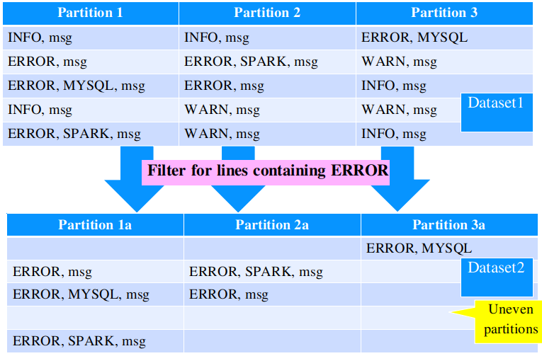
An Example
Copyright © 2022 by Elephant Scale, All Rights Reserved

Slide 33
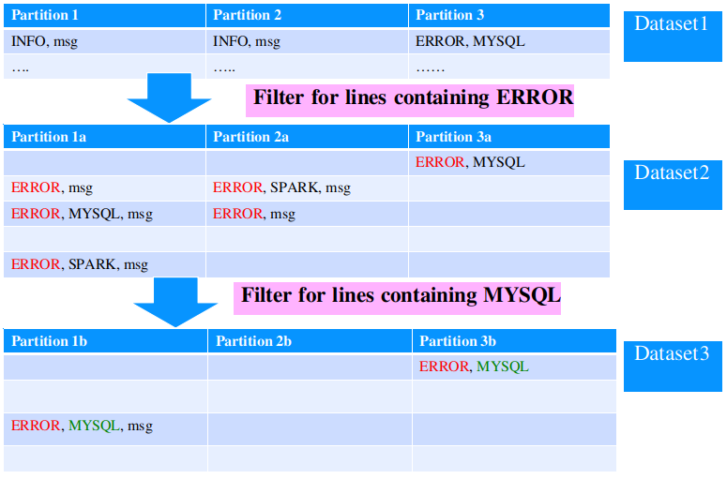
An Example
Copyright © 2022 by Elephant Scale, All Rights Reserved

Slide 34
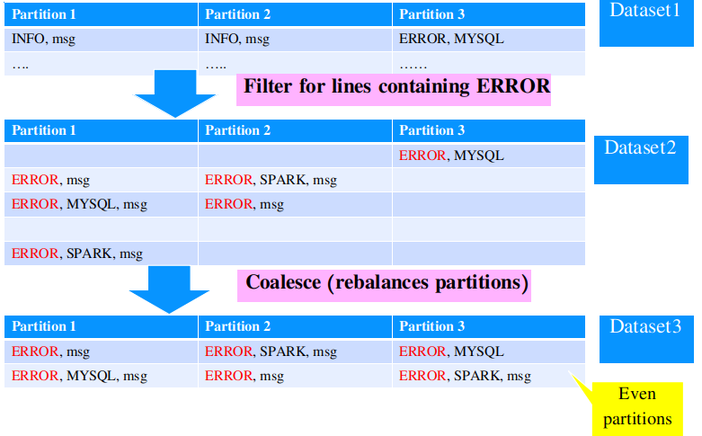
An Example
Copyright © 2022 by Elephant Scale, All Rights Reserved

Slide 35
Re-balancing Partitions
During a multi-step workflow, partitions might get uneven
We can use the following methods to rebalance partitions:
repartition: can increase/decrease partition count
coalesce: only decreases partitions, and more efficient
Rebalancing partitions, will involve streaming data between nodes. This is called shuffling
Shuffling data can be expensive, at large scale
Copyright © 2022 by Elephant Scale, All Rights Reserved

Slide 36
Anatomy of Spark Job
Spark Core Spark Shell Core Data Model Anatomy of Spark Job Caching
Copyright © 2022 by Elephant Scale, All Rights Reserved

Slide 37
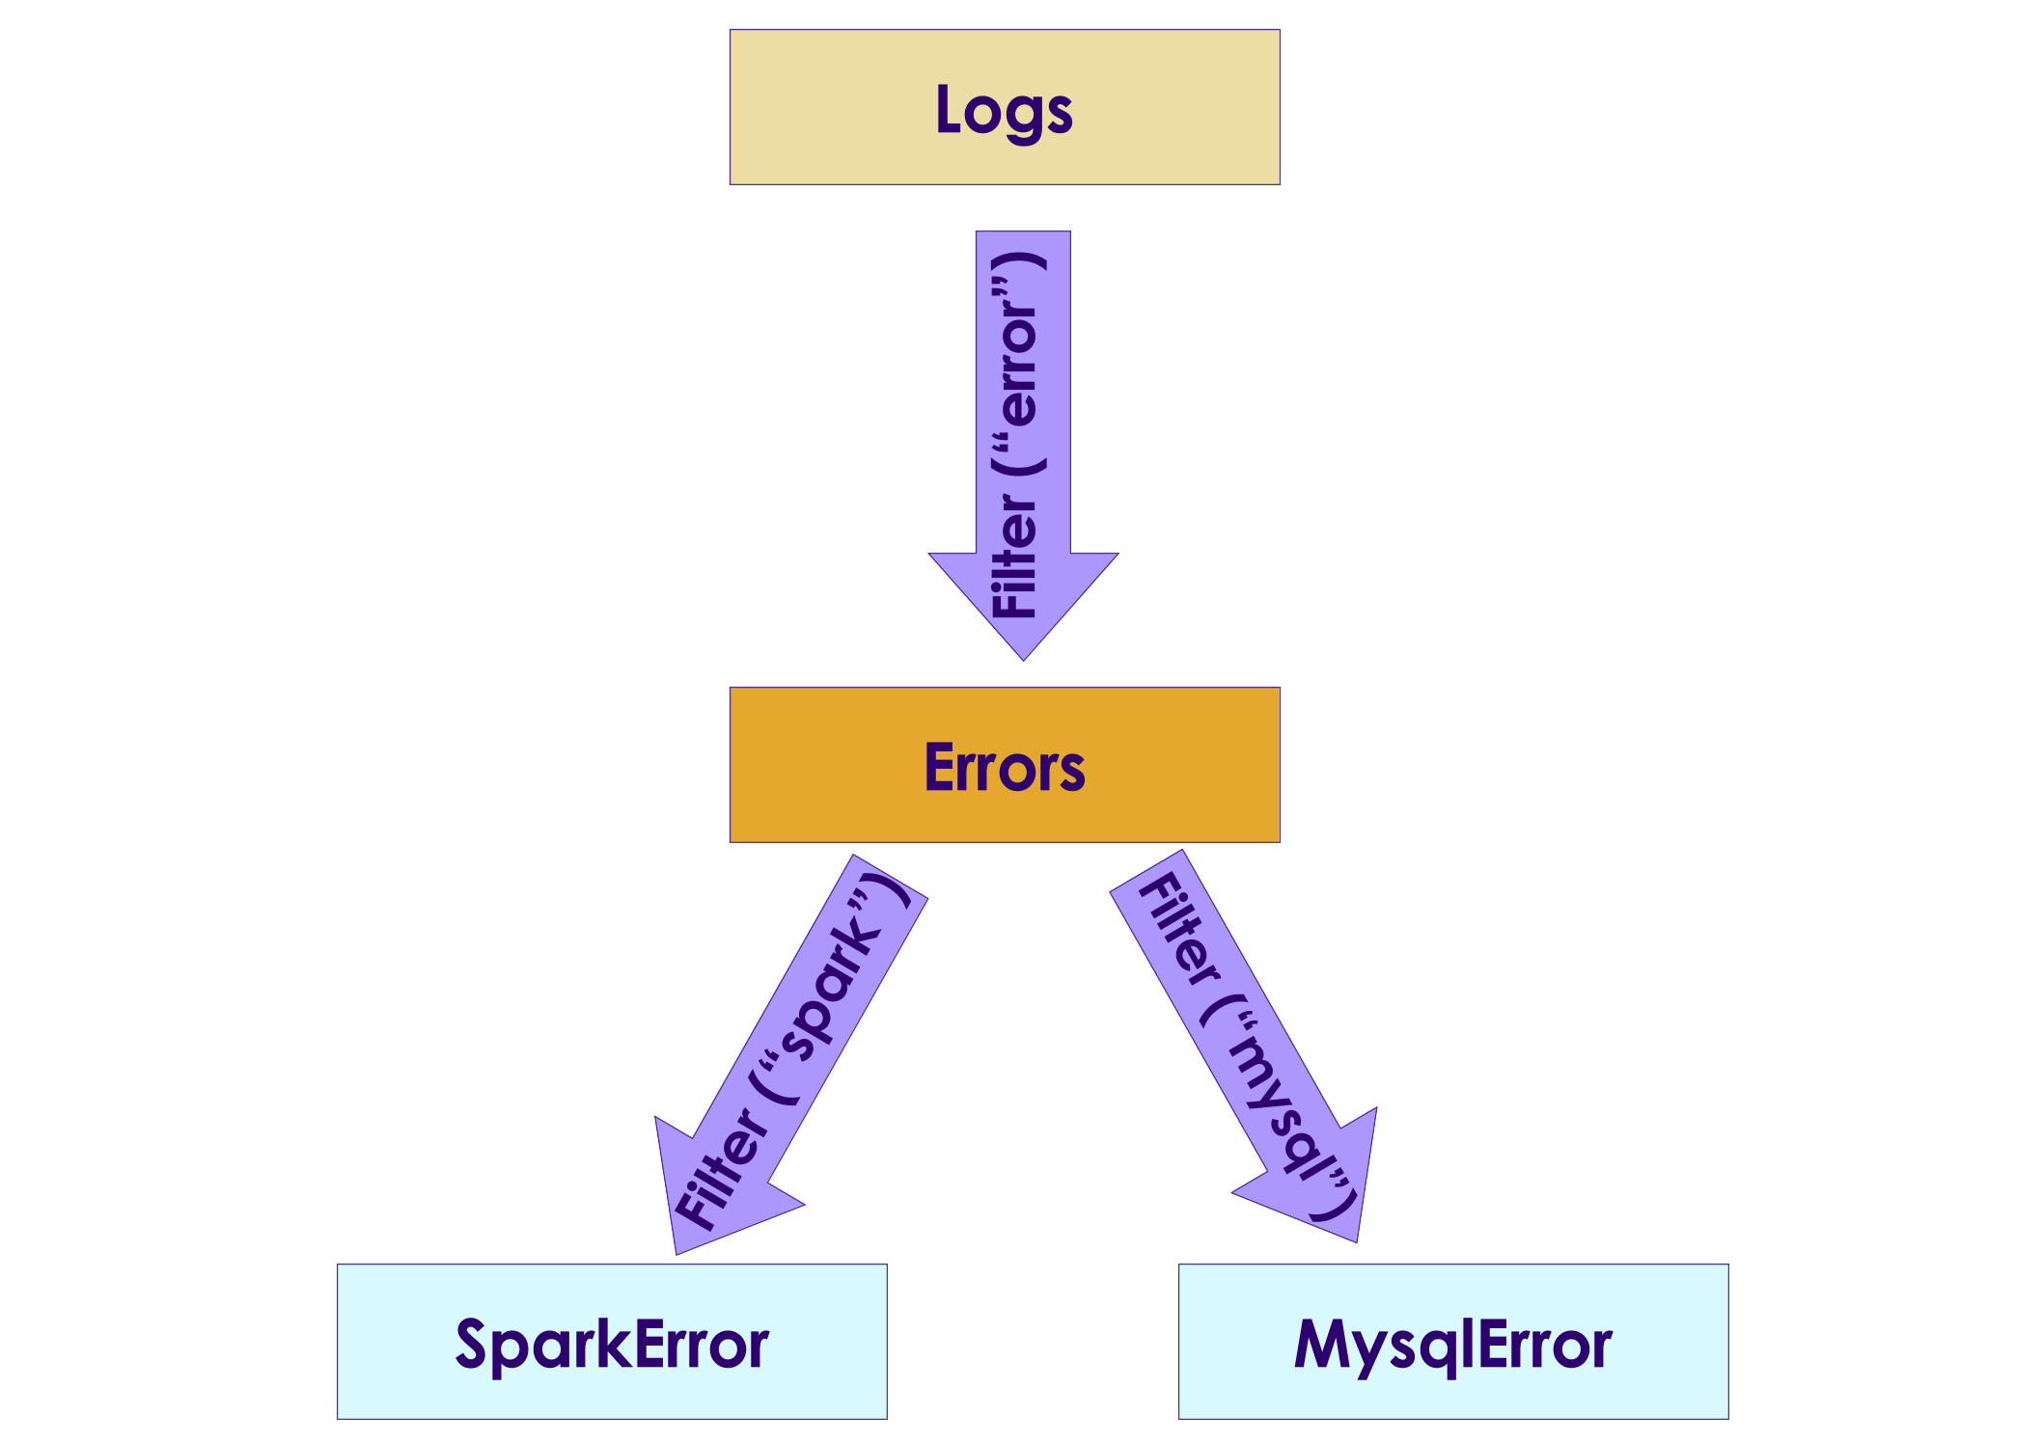
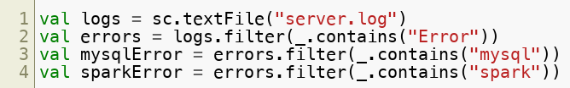
Anatomy of a Spark Job
Spark executes the workflow as a DAG (Direct Acyclic Graph)
Directed (data flows in a certain direction
Acyclic (no cycles/loops)
You can see DAGs from Spark UI
Copyright © 2022 by Elephant Scale, All Rights Reserved

Slide 38
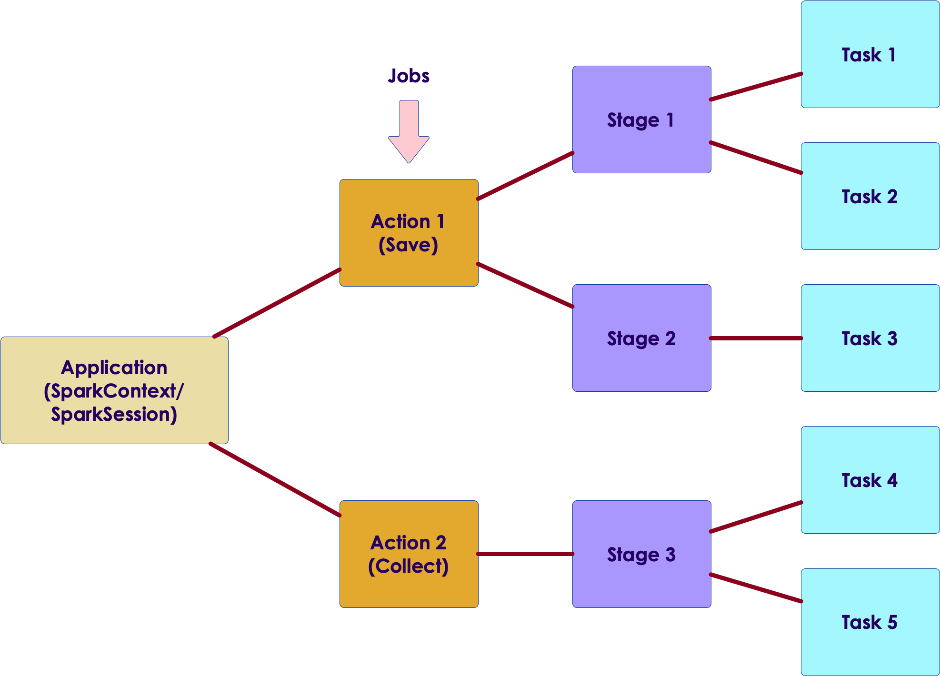
Anatomy of a Spark Job
Application can have many actions ( count , save ..etc)
Each action is a job
A Job may be executed in one or many stages (depending on the complexity)
A Stage may have one or more tasks
Copyright © 2022 by Elephant Scale, All Rights Reserved

Slide 39
Anatomy of a Spark Job - Stage
Stage is collection of tasks that can be executed in ONE Executor without talking to another Executor
If network communication is required then another stage begins
E.g. shuffle operation
Operations that cause a shuffle operation: Sort, groupByKey, Join
Stages for a Job are usually executed in sequence
One Stage's output is fed as input another Stage
Copyright © 2022 by Elephant Scale, All Rights Reserved

Slide 40
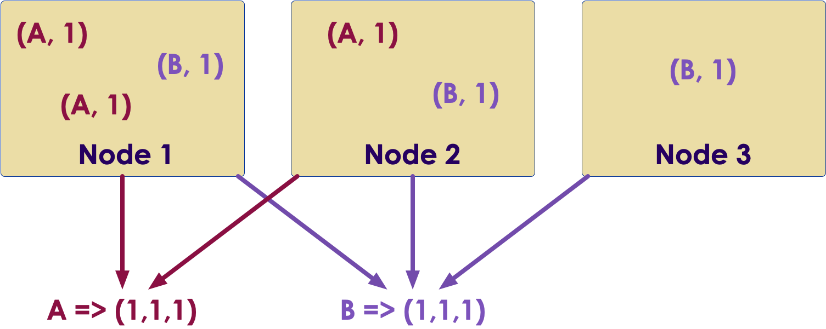
Shuffles
In the diagram below, key-value pairs are scattered across the nodes
If we want to group the data by keys (A, B), we need to exchange/stream data across nodes over the network
This is called shuffle
Shuffles tend to be slower operations than reading local data
Some operations needing shuffle : join, sort, group by
Copyright © 2022 by Elephant Scale, All Rights Reserved

Slide 41
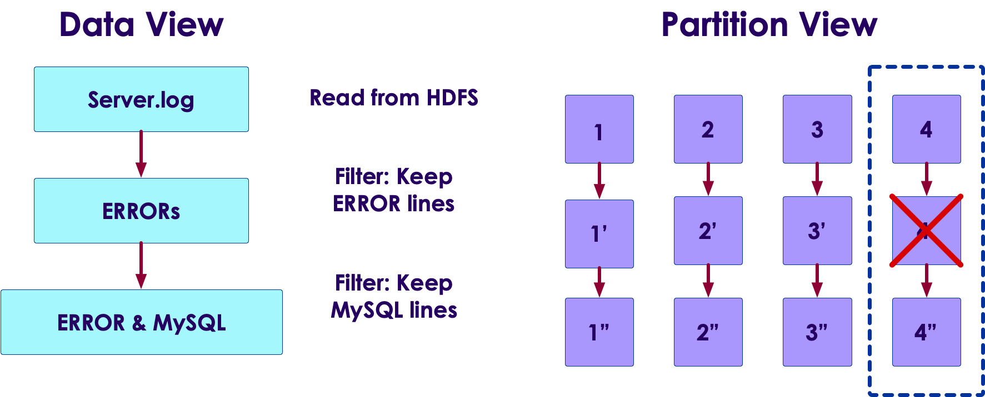
Fault Tolerance
Failures do happen (when, not if) in distributed computing
Machines can crash, processes can crash (running out of memory ..etc)
Question for the class: What other failure scenarios can you think of?
Spark can automatically recover from run time errors!
No intervention required from devs or admins
Spark tracks transformation lineage
So if a partition is missing, it can be re-calculated from its parents
Here if partition 4' is missing (due to a crash) it can be recomputed from 4
Spark can re-read partition 4 from storage (HDFS or Cloud storage) and recompute 4'
Copyright © 2022 by Elephant Scale, All Rights Reserved

Slide 42
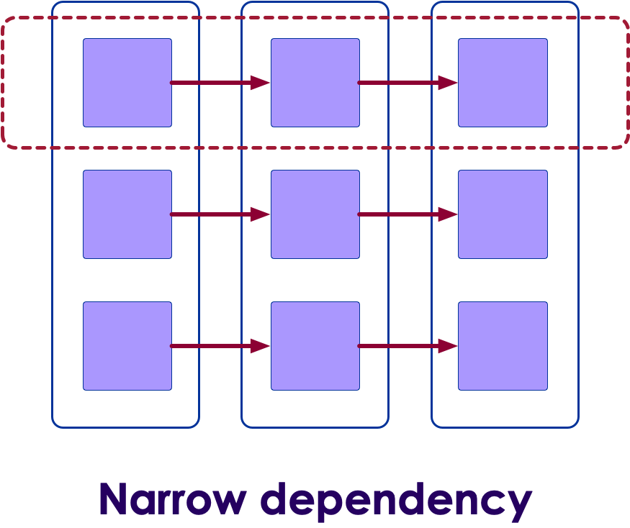
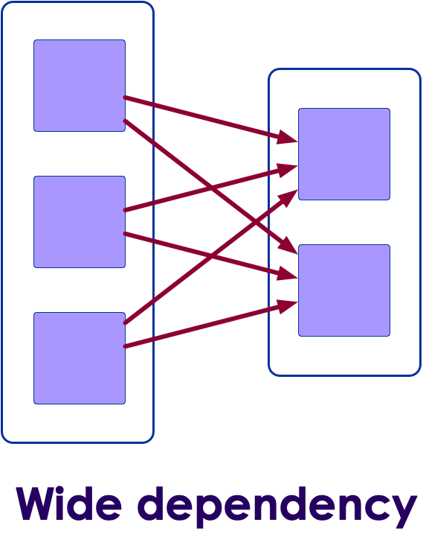
Narrow / Wide Dependencies
Narrow dependency examples: filter, distinct
Wide dependency examples: join, merge, sort
Narrow dependency lineages are quicker to recover than wide dependencies
Question for the class:
Why are narrow dependencies easier to recover in failure?
Copyright © 2022 by Elephant Scale, All Rights Reserved
Notes:
Narrow dependencies are easier to recover, because the amount of data to re-read is smaller

Slide 43

Failure Recovery
Spark can recover from run-time failures
Nodes crashing
Tasks crashing
How ever it can not recover from 'user code' errors :-)
Question for class : how can the following code fail?
Copyright © 2022 by Elephant Scale, All Rights Reserved

Slide 44
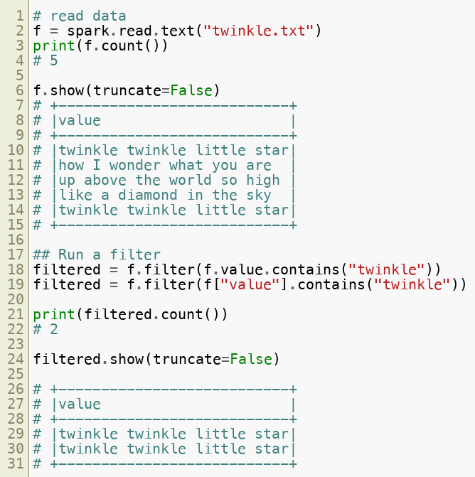
Spark Sample Program (Python)
Copyright © 2022 by Elephant Scale, All Rights Reserved

Slide 45
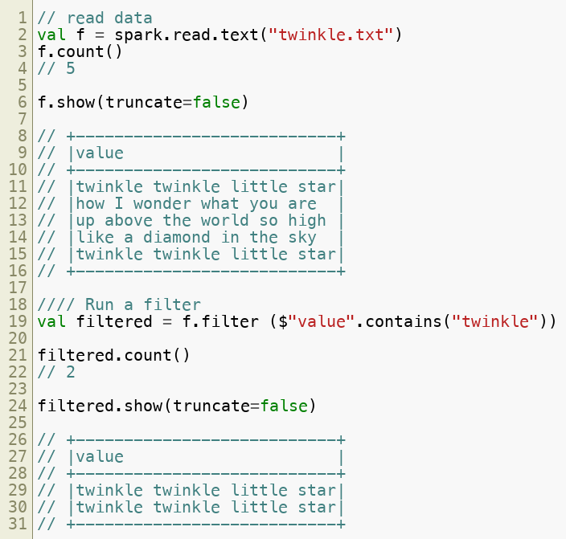
Spark Sample Program (Scala)
Copyright © 2022 by Elephant Scale, All Rights Reserved

Slide 46
Lab: Spark Data Loading / Spark UI
Overview:
Loading datasets in Spark and getting familiar with Spark UI
Approximate run time:
15-20 mins
Instructions:
Lab 3.2
Copyright © 2022 by Elephant Scale, All Rights Reserved

Slide 47
Caching
Spark Core Spark Shell Core Data Model Anatomy of Spark Job Caching
Copyright © 2022 by Elephant Scale, All Rights Reserved

Slide 48
Caching
In real world scenarios, we load the data from disks
If we try to load the same data again, caching from OS will speed things up a bit
Imagine loading the same word document again; It will be faster second time around
How ever a generic caching from OS, may not understand usage patterns of our data
Spark can cache data natively - for more efficient operations
Copyright © 2022 by Elephant Scale, All Rights Reserved

Slide 49
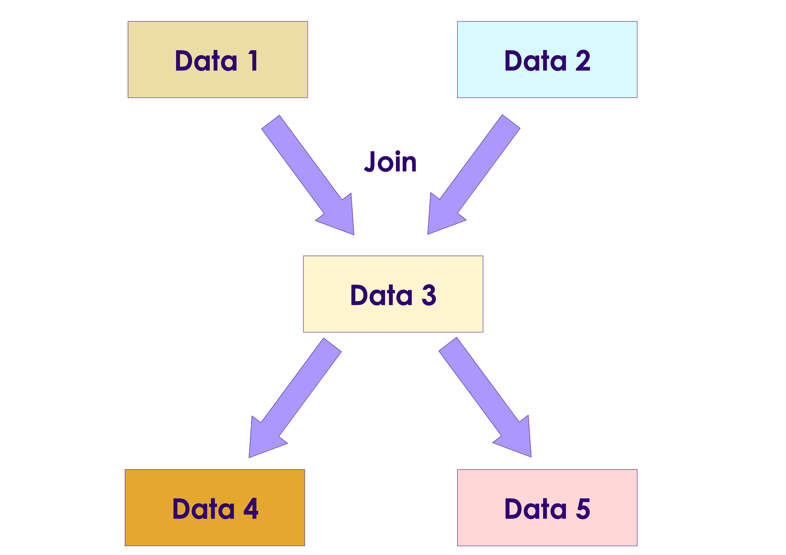
Spark Caching
Spark can cache data in
Memory
Disk
Across nodes
or various combinations
Why cache data on disk?
Some times we don't want to repeat expensive operations like join, multiple times
Do it once and cache the results (e.g. data3 )
Why cache on more than one node?
Prevent data loss, in case a node goes down
Copyright © 2022 by Elephant Scale, All Rights Reserved

Slide 50
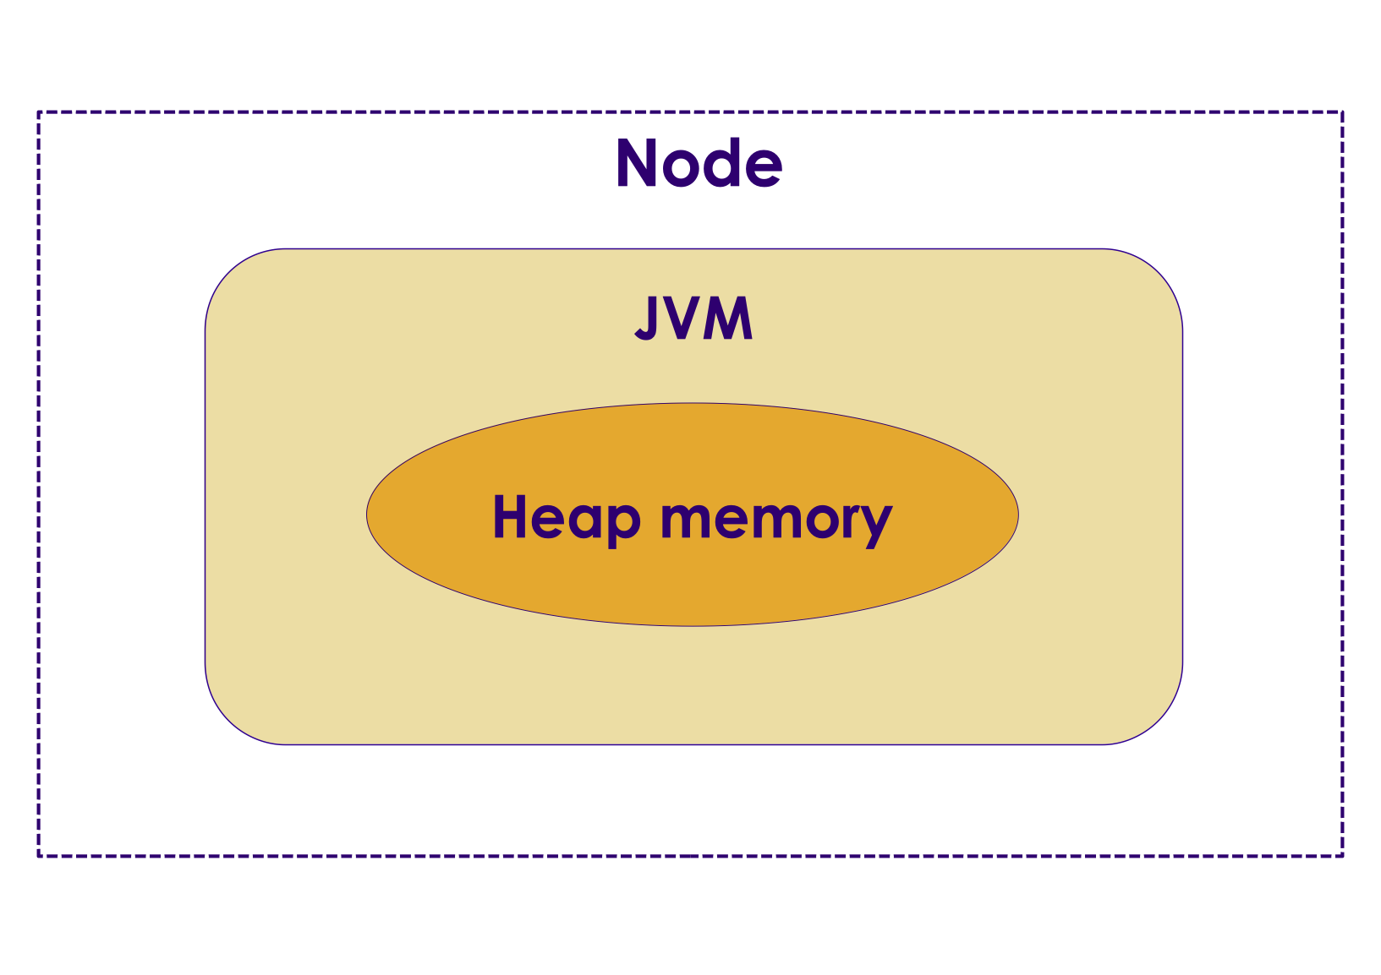
Spark Caching in Memory
Earlier Spark versions (pre v2), Spark cached data in Java Heap memory
While this was fast (because code and data are within the same memory space), it wasn't scalable
When caching in JVMs we have to contend with garbage collector
JVM garbage collectors are not good at dealing with large memory amounts (100 of Gigs)
These days memory is cheap, Spark servers can have lot of memory (256 G, 512 G and more)
New generation garbage collectors like G1 are more effective, but still don't scale to 100s of Gigs of memory pools
JVM memory issue has been a limiting factor for Big Data applications written in Java (Hadoop, Cassandra, Spark)
Copyright © 2022 by Elephant Scale, All Rights Reserved

Slide 51
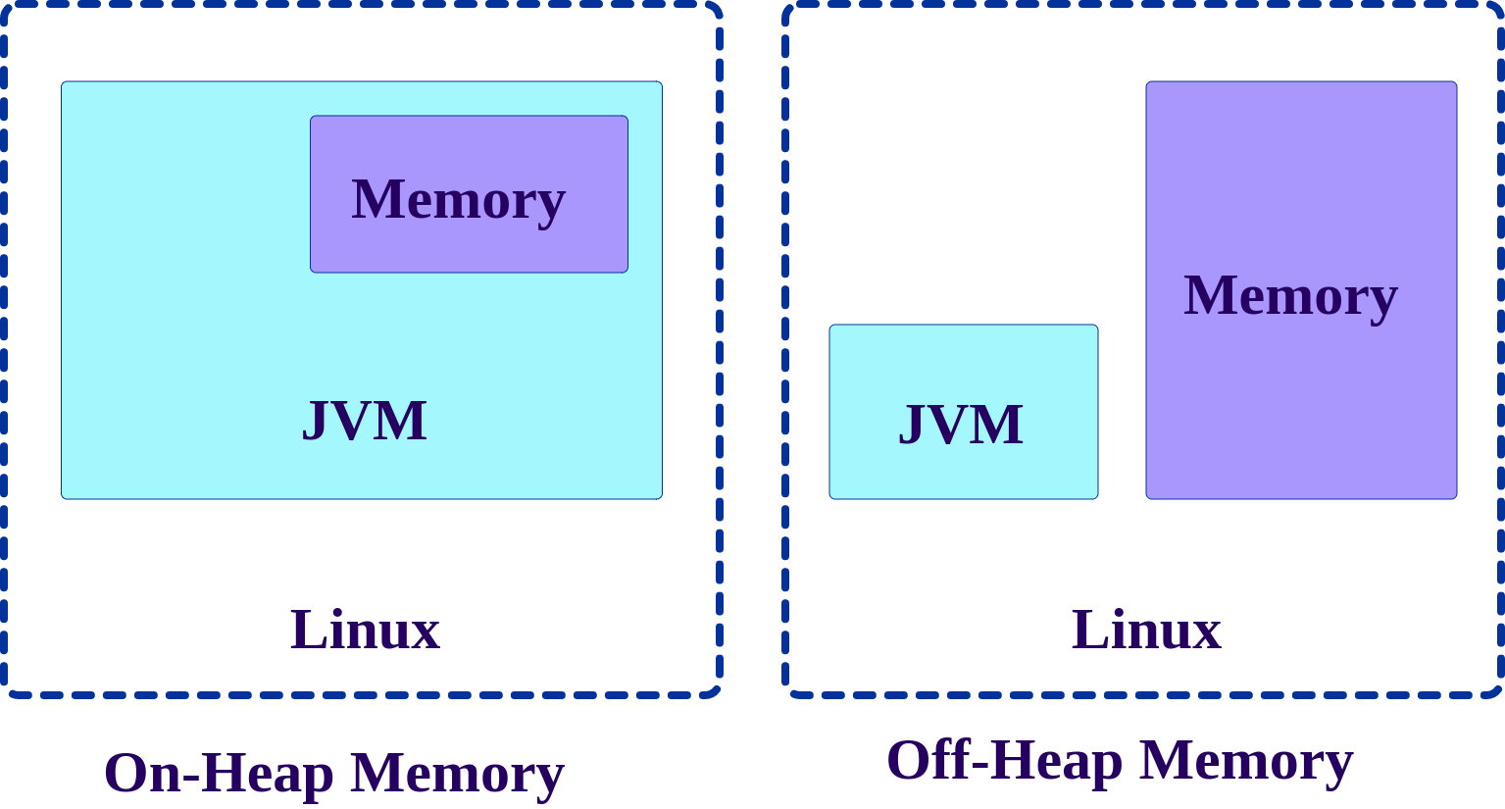
Off Heap Caching
To overcome large memory issues in JVM, a new technique is developed to allocate memory outside JVM
This is off heap caching
This method by passes JVM and allocates memory directly on Linux
This eliminates garbage collector contention issues
Starting with Spark v2, the Tungsten engine, uses this memory allocation scheme by default
Copyright © 2022 by Elephant Scale, All Rights Reserved

Slide 52
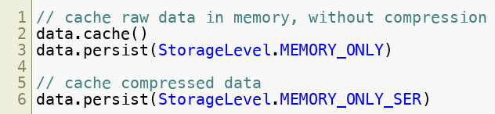
Caching in Memory
Data can be cached in memory raw (un-compressed) or compressed
Text data (CSV, JSON) compresses pretty well
5 - 10x compression possible
So 10G data, can be cached in 1G memory space (10x compression)
Binary data (parquet data, photos ..etc) don't compress well - they are already in compressed format
So caching these data types will take just as much space in memory
Don't recommend compressing them again for caching (CPU cycles wasted, but don't result in any meaningful compression)
Copyright © 2022 by Elephant Scale, All Rights Reserved

Slide 53
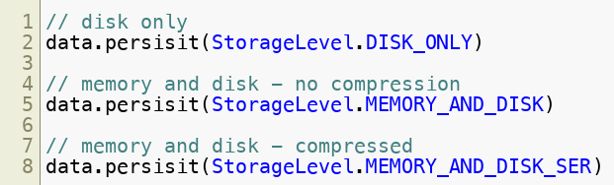
Caching in Disk
If data is large, we may not have enough memory to cache it
So disk cache may be an option, to cache results of expensive operations (join, sort)
We can also cache both in memory and disk
If not enough memory is available, Spark will evict previously cached data to make room for new data
This will result in data thrashing or swapping , resulting in very bad performance
So save both in memory and disk. Even data is evicted from memory cache, it can be found in disk cache
Copyright © 2022 by Elephant Scale, All Rights Reserved

Slide 54
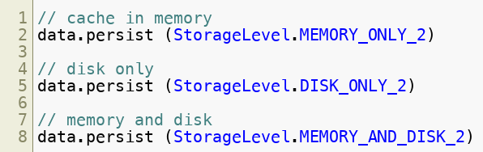
Caching on Two Nodes
Data can be cached in two nodes
Protects against data loss if a node goes down
Copyright © 2022 by Elephant Scale, All Rights Reserved

Slide 55
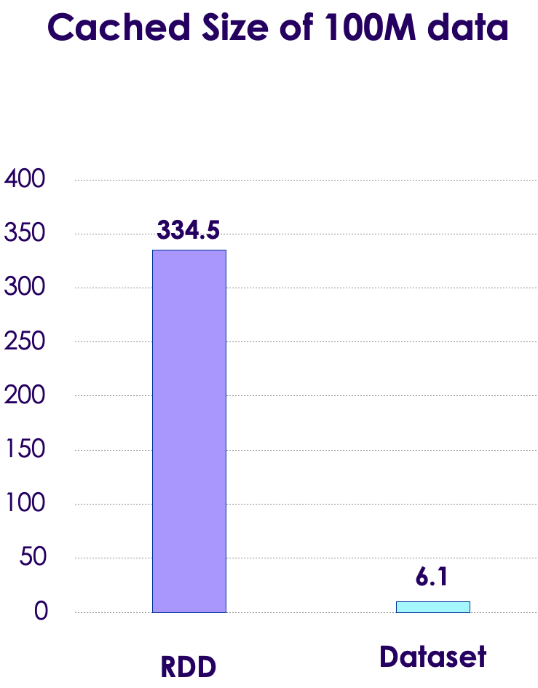
Spark Caching Performance RDD vs Dataset
Here we see caching stats from Spark v1 and Spark v2 (using Tungsten engine)
Original datafile is 100M of CSV data
RDD takes 334 M memory (3.3 x overhead)
Dataset only taks 6.1 M (highly compressed, text data compresses well)
Tungsten provides highly effective caching:
Compresses data smartly (e.g text data is compressed, not binary data)
Uses off heap caching to allocate memory outside JVM
Copyright © 2022 by Elephant Scale, All Rights Reserved

Slide 56
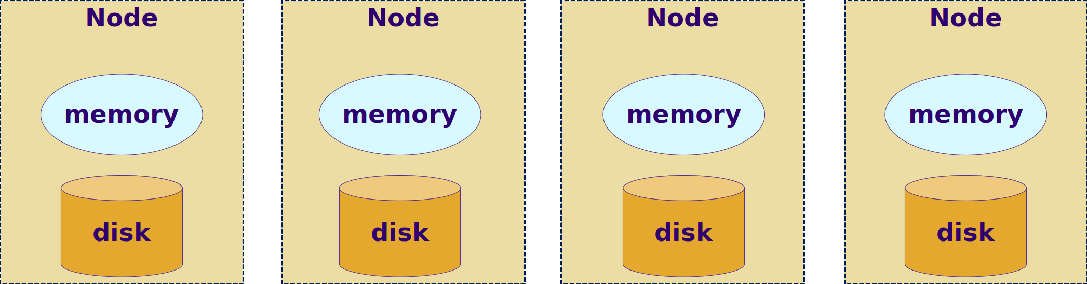
In Memory File Systems
Memory is the new disk
Memory prices have been falling
Year 2000 = $1000/GB
Year 2016 = $3/GB
Typical Hadoop/Spark node has 100–300 G memory
10 node cluster @ 256 GB each = 2 TB of distributed memory!
In-memory processing is very attractive for iterative workloads like machine learning
Baidu uses 100 node spark cluster with 2 PB of memory
Copyright © 2022 by Elephant Scale, All Rights Reserved

Slide 57
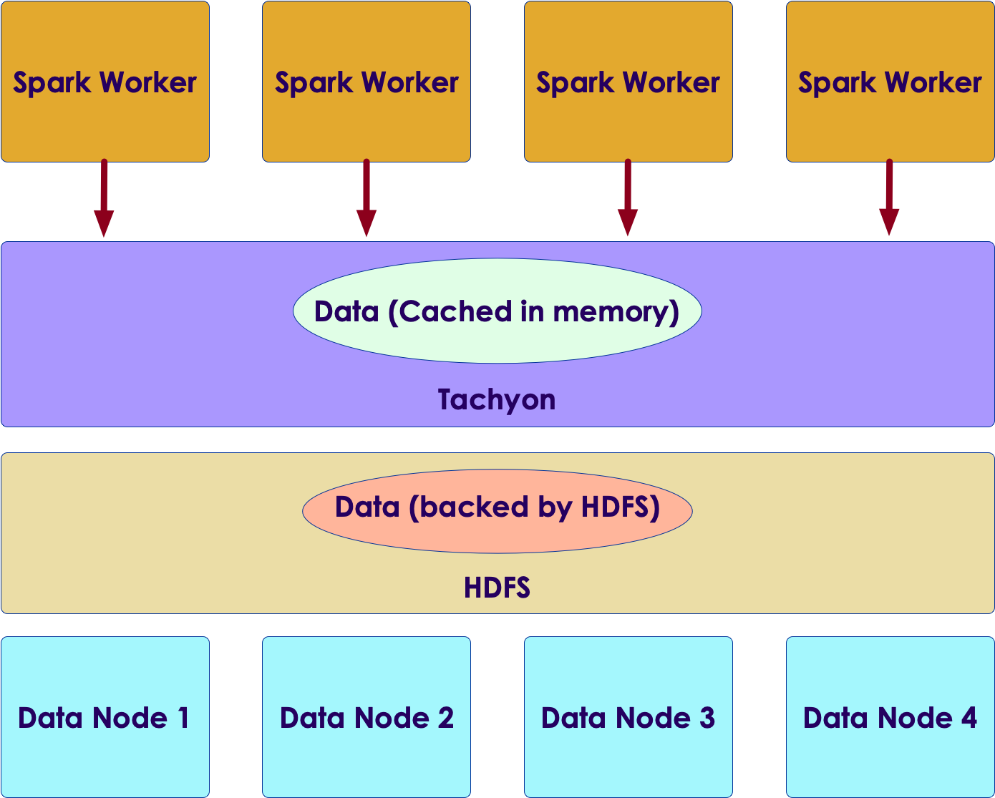
In Memory File Systems
We are seeing in memory file systems coming mainstream
Tachyon (Alluxio)
Ignite from Gridgain
These in-memory file systems act as a giant, distributed cache between Spark and file systems (HDFS or Cloud file systems)
Copyright © 2022 by Elephant Scale, All Rights Reserved

Slide 58
Lab: Spark Caching
Overview:
Understand Spark caching
Approximate run time:
20-30 mins
Instructions:
3.3
Copyright © 2022 by Elephant Scale, All Rights Reserved

Slide 59


Review and Q&A
Let's go over what we have covered so far
Any questions?
Copyright © 2022 by Elephant Scale, All Rights Reserved

