Slide 1

Machine Learning with Spark
Machine Learning Primer
Spark ML Intro
Clustering with Spark ML
Copyright © 2022 by Elephant Scale, All Rights Reserved

Slide 2
Objectives
Machine learning overview
Algorithm overview
Learn about Spark ML
Copyright © 2022 by Elephant Scale, All Rights Reserved

Slide 3
Machine Learning Primer
Machine Learning Primer Spark ML Intro Clustering with Spark ML
Copyright © 2022 by Elephant Scale, All Rights Reserved

Slide 4
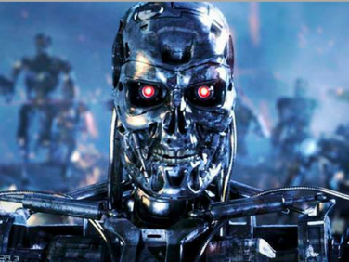
Machine Learning is Taking Over the World
Think of something you did today / this week that is AI powered
Copyright © 2022 by Elephant Scale, All Rights Reserved

Slide 5
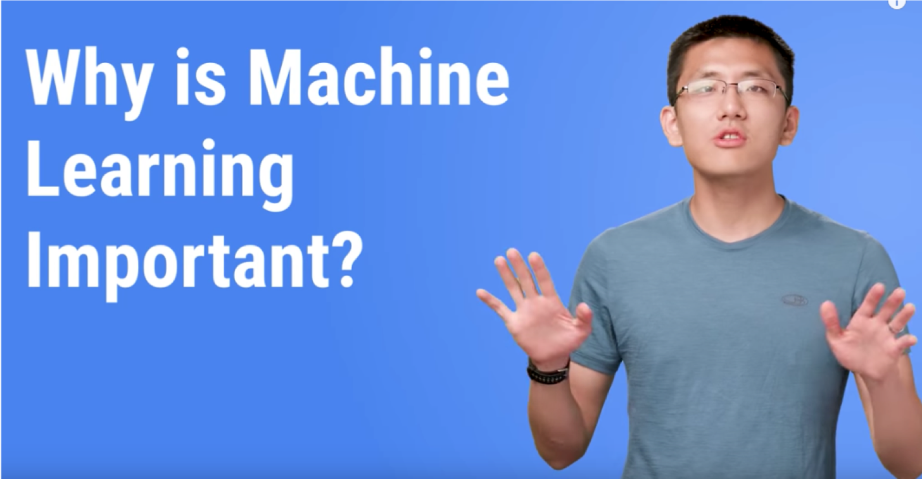
Why Machine Learning Matters?
Link
Copyright © 2022 by Elephant Scale, All Rights Reserved
Notes:
https://www.youtube.com/watch?v=HcqpanDadyQ

Slide 6
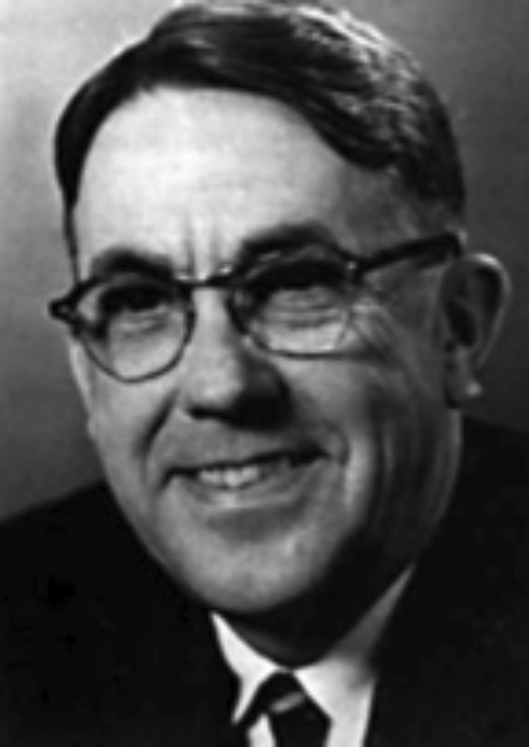
What is Machine Learning
"The field of study that gives computers the ability to learn without being explicitly programmed." -- Arthur Samuel
Copyright © 2022 by Elephant Scale, All Rights Reserved

Slide 7
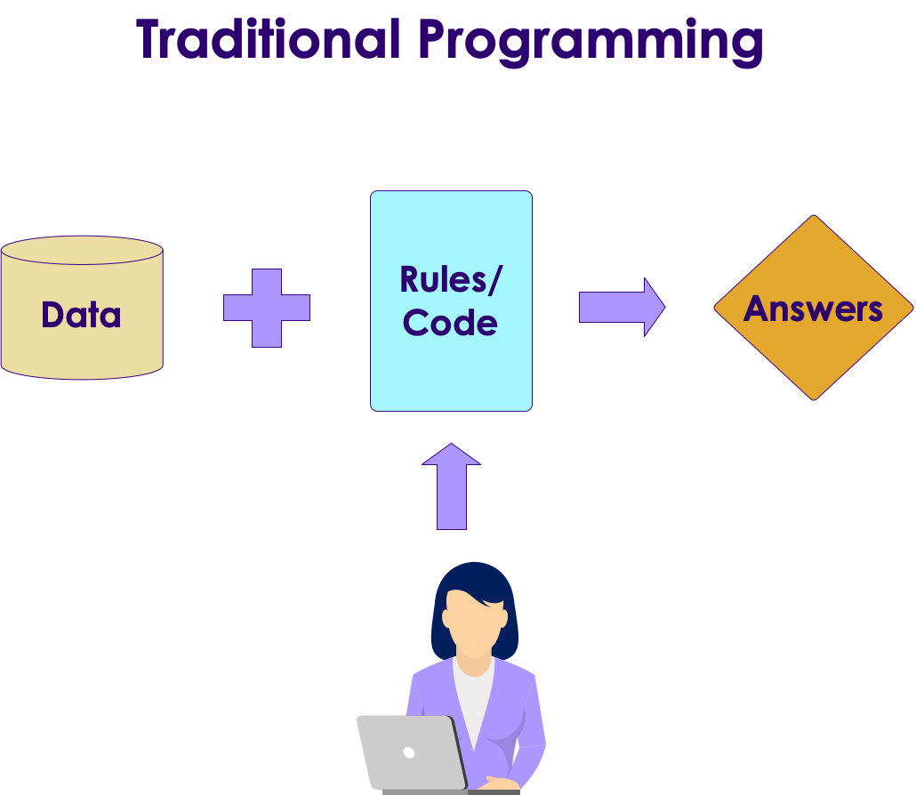
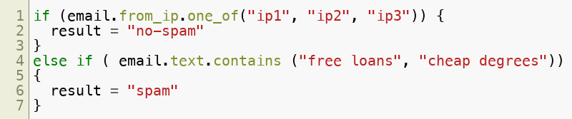
Traditional Programming vs. Machine Learning
Here is an example of spam detection rule engine
The rules are coded by developers
There could be 100s of 1000s of rules!
Copyright © 2022 by Elephant Scale, All Rights Reserved

Slide 8
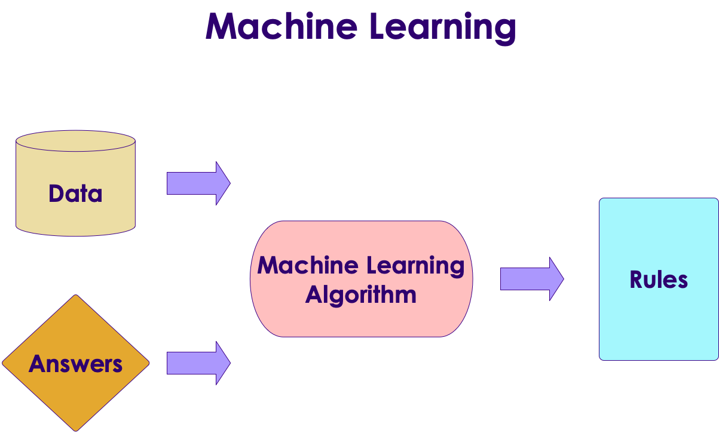
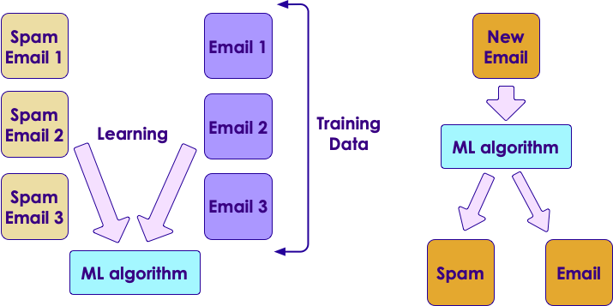
Traditional Programming vs. Machine Learning
Here is how we detect spam using ML
We don't explicitly write rules
Instead, we show the algorithm with spam and non-spam emails
Algorithm 'learns' which attributes are indicative of spam
Then algorithm predicts spam/no-spam on new email
Copyright © 2022 by Elephant Scale, All Rights Reserved

Slide 9
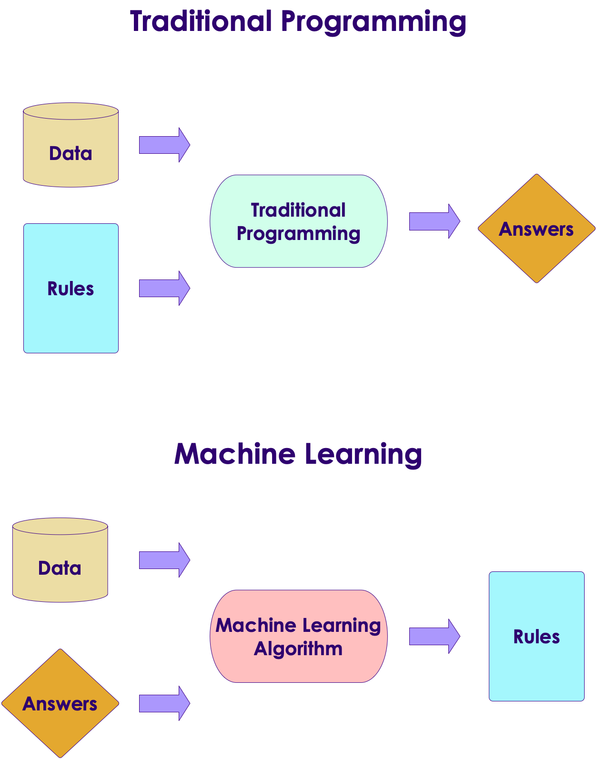
Traditional Programming vs. Machine Learning
As data size grows so much, ability to humans to write rules to analyze all data can't keep up
How ever, we can have machines analyze large amount of data and create comprehensive rules!
These rules can be applied to provide answers to new questions
Copyright © 2022 by Elephant Scale, All Rights Reserved

Slide 10
Learning From Data
Let's start with simple housing sales data
So our formula for predicting SalePrice is something like this:
Saleprice = f (Bedrooms, Bathrooms, Size)
We need to figure out what f is
Bedrooms (input 1) | Bathrooms (input 2) | Size (input 3) | Sale Price (in thousands) (we are trying to predict)
3 | 1 | 1500 | 230
3 | 2 | 1800 | 320
5 | 3 | 2400 | 600
4 | 2 | 2000 | 500
4 | 3.5 | 2200 | 550
Copyright © 2022 by Elephant Scale, All Rights Reserved

Slide 11

Let's Play a Guessing Game!
Look at the data below. Come up with a formula linking X and Y
So what is the formula?
Y = ???
Answer next slide
X | Y
1 | 2
2 | 5
Copyright © 2022 by Elephant Scale, All Rights Reserved

Slide 12
Guessing Game
I have 2 possible formulas (there may be more)
Y = 3X - 1
Y = X^2 + 1
X | Y
1 | 2
2 | 5
Copyright © 2022 by Elephant Scale, All Rights Reserved

Slide 13
Guessing Game
Let me provide more data
Now, what would be the formula?
Answer next slide
X | Y
1 | 2
2 | 5
3 | 10
4 | 17
Copyright © 2022 by Elephant Scale, All Rights Reserved

Slide 14
Guessing Game
With more data, we can finalize on a formula
Y = X^2 + 1
Lesson: More (quality) data we have, we can come up with a more precise formula
This is the essense of machine learning!
X | Y
1 | 2
2 | 5
3 | 10
4 | 17
Copyright © 2022 by Elephant Scale, All Rights Reserved

Slide 15
Learning From Data
An machine learning algorithm learns from the above data, and then tries to predict house prices on new data
Bedrooms (input 1) | Bathrooms (input 2) | Size (input 3) | Predicted Sale Price (in thousands)
3 | 2 | 1900 | ???
4 | 3 | 2300 | ???
Copyright © 2022 by Elephant Scale, All Rights Reserved

Slide 16
Machine Learning Use Cases
Finance | Healthcare | Retail | Manufacturing | Network & Security
Fraud Detection | Diagnosis | Recommendations | Identify defects | Identify security breach
Algorithmic trading | Patient care | Customer retentions | Fully automated assemblies | Facial recognition
Credit Approvals | Treatment recommendations
Copyright © 2022 by Elephant Scale, All Rights Reserved

Slide 17
Machine Learning Algorithms
Regressions
When we need to predict numbers
Examples: house prices, stock prices ...etc
Classifications
When we need to categorize things
Examples: classifying emails as spam or not; categorizing credit card transactions as fraud or not
Clustering
When we need to segment things
Examples: segmenting network traffic
Copyright © 2022 by Elephant Scale, All Rights Reserved

Slide 18
Regression
Let's calculate house price from a few inputs
Here we have some data points we can learn from, and then we predict on new data
Typically 'learning data' can be 100s or 1000s of data points. Large data can be millions of data points
Bedrooms (input 1) | Bathrooms (input 2) | Size (input 3) | Predicted Sale Price (in thousands)
3 | 1 | 1500 | 230
3 | 2 | 1800 | 320
5 | 3 | 2400 | 600
4 | 2 | 2000 | ???
4 | 3.5 | 2200 | ???
Copyright © 2022 by Elephant Scale, All Rights Reserved

Slide 19
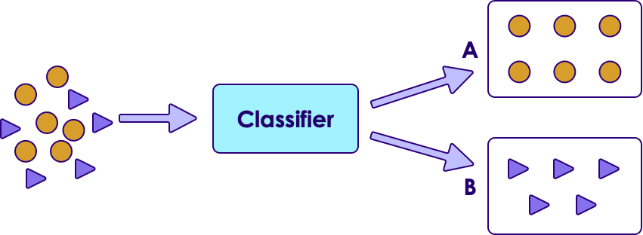
Classification
Classification is a model that predicts data into "buckets"
Email is SPAM or HAM (not-SPAM)
A cell is cancerous or healthy
Hand-written numbers -> any digits -1, 0, 1,..., 8
Classification algorithm learns from training data (Supervised learning) and predicts on new data
In the example below, we input mixed data to the model, and the model classifies them into A or B
Copyright © 2022 by Elephant Scale, All Rights Reserved

Slide 20
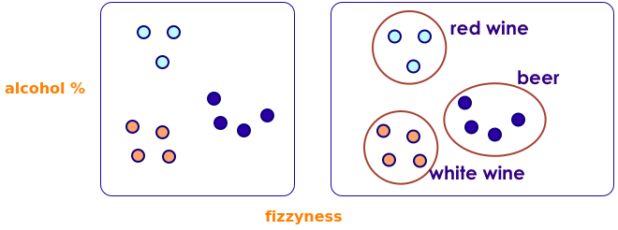
Clustering
Clustering finds natural groupings in data
Here we are grouping alcohol beverages according to 2 dimensions (alcohol %, fizziness); And we see similar drinks fall into natural groups
In real world applications, we could be clustering by many dimensions (10s or 100s)
Copyright © 2022 by Elephant Scale, All Rights Reserved

Slide 21
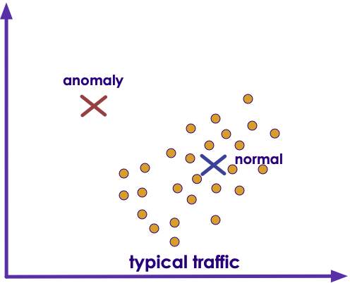
Clustering Application: Fraud/Anomaly Detection
Anomaly detection is used to:
Find fraud
Detect network intrusion attack
Discover problems on servers
Here we see an anomaly (top left) that doesn't fall into the usual pattern (bottom right)
Copyright © 2022 by Elephant Scale, All Rights Reserved

Slide 22
Spark ML Intro
Machine Learning Primer Spark ML Intro Clustering with Spark ML
Copyright © 2022 by Elephant Scale, All Rights Reserved

Slide 23
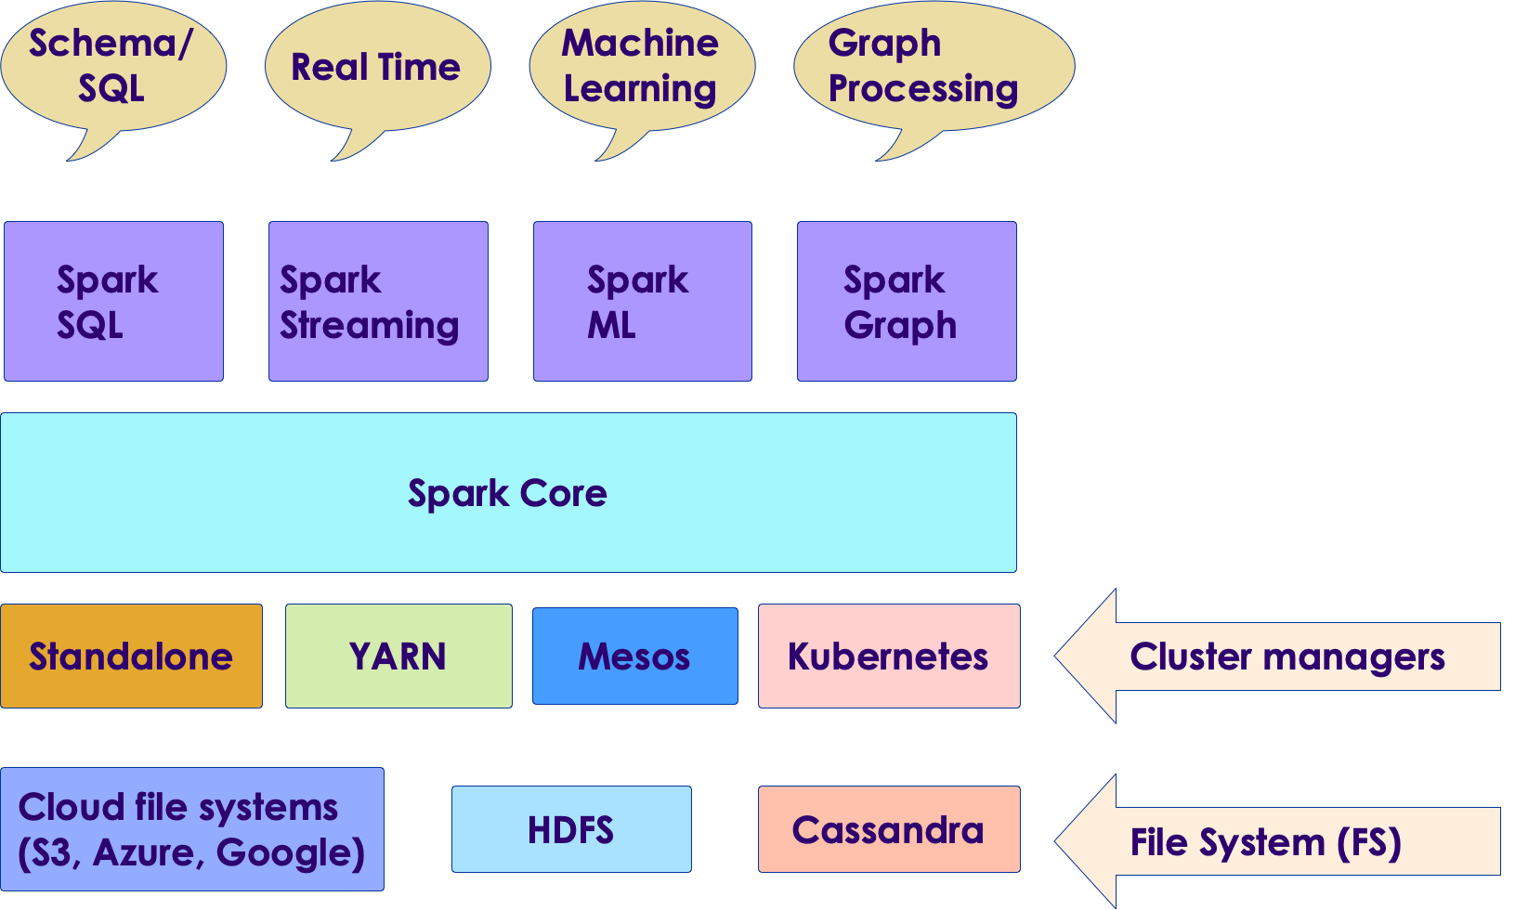
Spark Components
Copyright © 2022 by Elephant Scale, All Rights Reserved

Slide 24
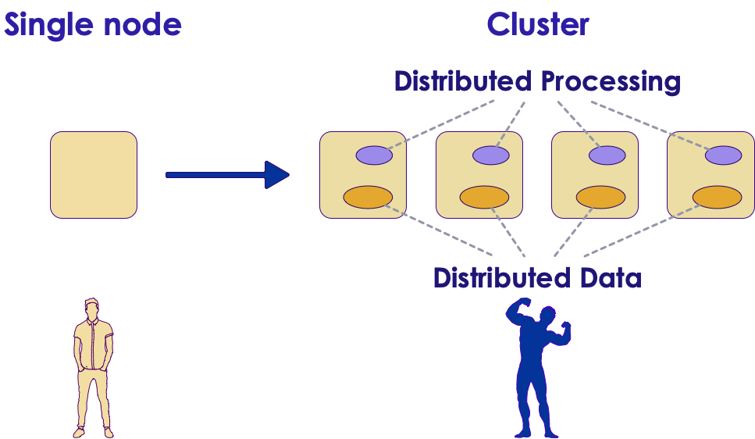
Machine Learning @ Scale
Traditionally ML has been performed on small set of data, usually on a single machine
As the data volume started going up, we needed scale
And distributed systems like Hadoop/Spark offered a great platform to build scalable ML
Copyright © 2022 by Elephant Scale, All Rights Reserved

Slide 25
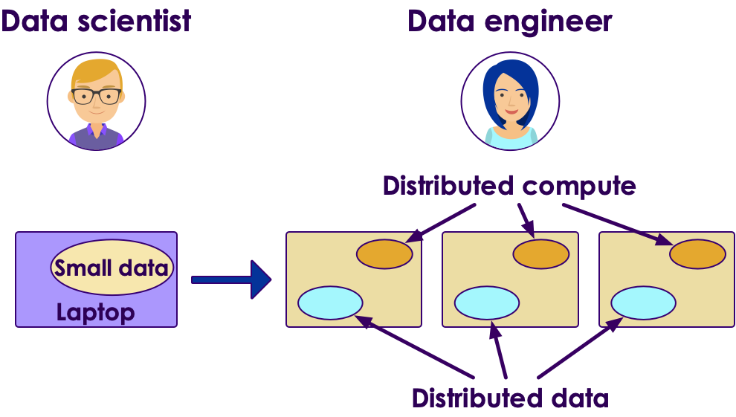
Machine Learning @ Scale
Going from laptop to cluster requires lot of effort
Usually involves multiple teams
Spark enables laptop-->cluster
Develop on laptop
Deploy on cluster
Cloud vendors are trying simplify this too
Copyright © 2022 by Elephant Scale, All Rights Reserved

Slide 26
Scalable ML with Hadoop
Hadoop was the first popular distributed platform
'Mahout' is a machine learning library built on top of Hadoop's MapReduce (MR) engine
How ever, MR wasn't so great for iterative algorithms (machine learning)
Copyright © 2022 by Elephant Scale, All Rights Reserved

Slide 27
Scalable ML on Spark
One of the design goals of Spark was to be a distributed ML Engine
Spark engine is much faster than MR; it does great at iterative tasks
Lot of ML algorithms iterate over data to find convergence
Spark includes a native ML library
Includes lot of popular algorithms out of the box!
And the implementations are parallelized!
Spark supports caching datasets in memory:
Datasets can be entirely cached in memory
And then do in-memory compute --> Super fast!
Multiple language APIs are supported: Java / Scala / Python / R
Spark + Python is a very popluar combination
Copyright © 2022 by Elephant Scale, All Rights Reserved

Slide 28
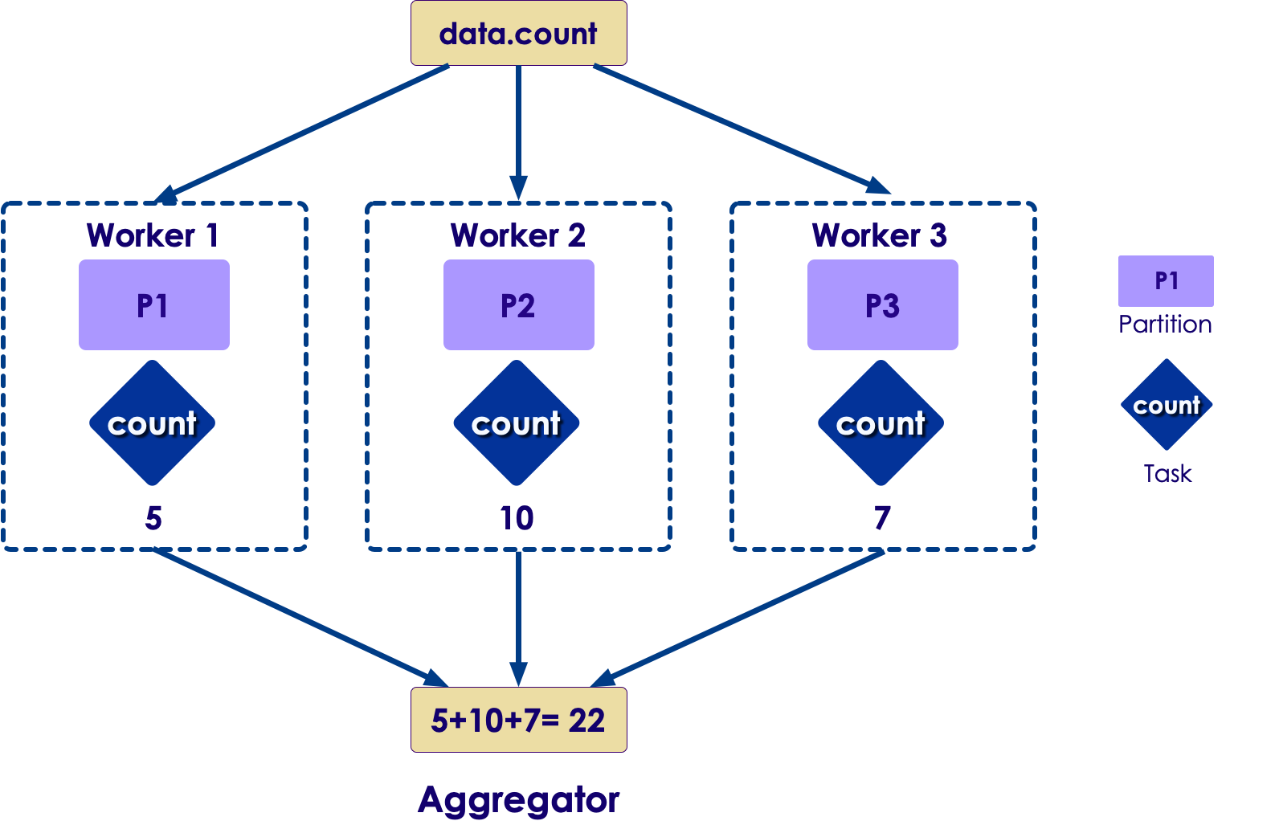
Parallelizing Computations
Here is a simple example of doing a COUNT in a distributed way
Each worker computes the count for the data it has
And then an 'aggregator (reducer)' combines the results from multiple workers to produce a final count
Machine learning computations are more complex; But Spark handles the parallelism
Copyright © 2022 by Elephant Scale, All Rights Reserved

Slide 29
Spark ML Library Evolution
Earlier version of Spark ML implementation is Spark MLLib
It is built on RDD data structures
Not the highest performance
Newer implementation is Spark ML
Uses newer/faster data structures ('dataframes/datasets')
Recommended to use the newer ML library
The older library is in maintenance mode
Copyright © 2022 by Elephant Scale, All Rights Reserved

Slide 30
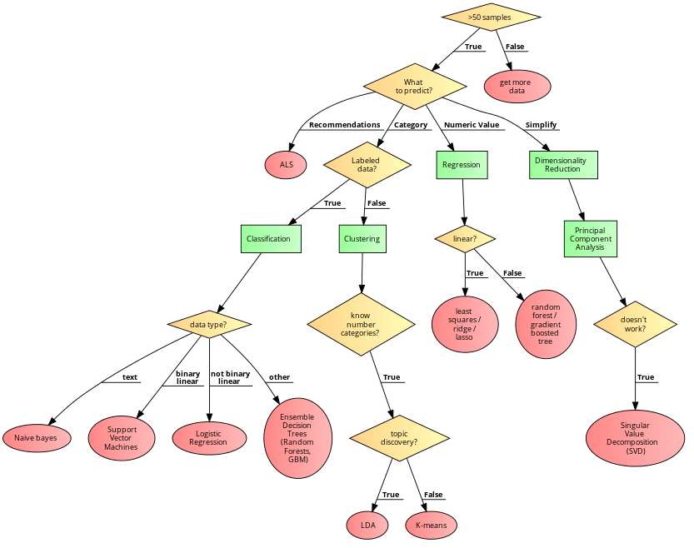
SparkML Algorithm Overview
Copyright © 2022 by Elephant Scale, All Rights Reserved

Slide 31
Clustering with Spark ML
Machine Learning Primer Spark ML Intro Clustering with Spark ML
Copyright © 2022 by Elephant Scale, All Rights Reserved

Slide 32
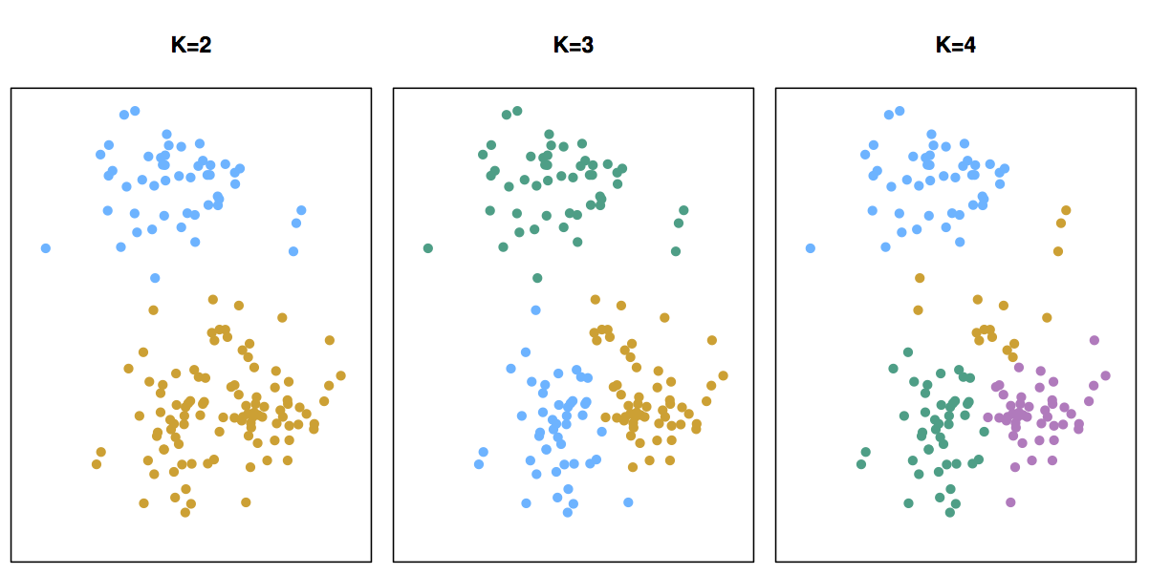
KMeans Clustering
K-means will partition a data set into K distinct, non-overlapping segments/clusters
To start K-Means, we need to specify the number of clusters (K)
Visualizations: viz1 , viz2
Copyright © 2022 by Elephant Scale, All Rights Reserved

Slide 33
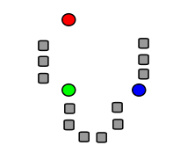
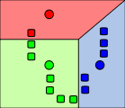
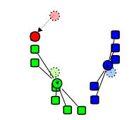
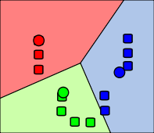
K-Means Clustering Walkthrough
Step 1: Centroids are randomly seeded in the data. Example: 3 centroids (red, green, blue)
Step 2: Each point in the dataset is associated with its nearest centroid, as determined by a distance measurement.
Step 3: The centroid (geometric center) of the clustered points becomes the new centroid of that cluster. Each centroid updated.
Step 4: Repeat steps 2 and 3 until convergence is reached (the points move less than the threshold amount).
Copyright © 2022 by Elephant Scale, All Rights Reserved

Slide 34
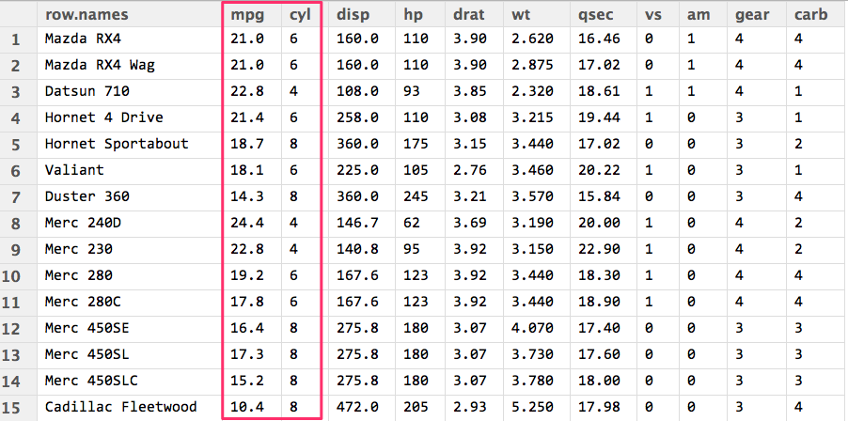
MTCars Clustering
We are going to cluster cars using two attributes: MPG & CYL
This is mtcars dataset, has 32 data points
Attributes
name - name of the car
mpg - Miles/(US) gallon
cyl - Number of cylinders
disp - Displacement (cu.in.)
hp - Gross horsepower
drat - Rear axle ratio
Copyright © 2022 by Elephant Scale, All Rights Reserved

Slide 35
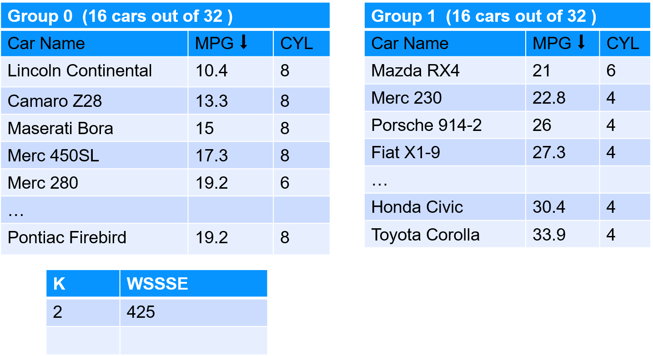
Starting With K = 2 (Find 2 clusters)
Copyright © 2022 by Elephant Scale, All Rights Reserved

Slide 36
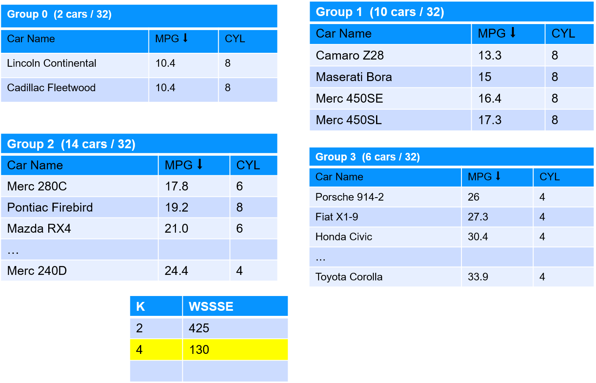
Starting With K = 4 (Find 4 clusters)
Copyright © 2022 by Elephant Scale, All Rights Reserved

Slide 37
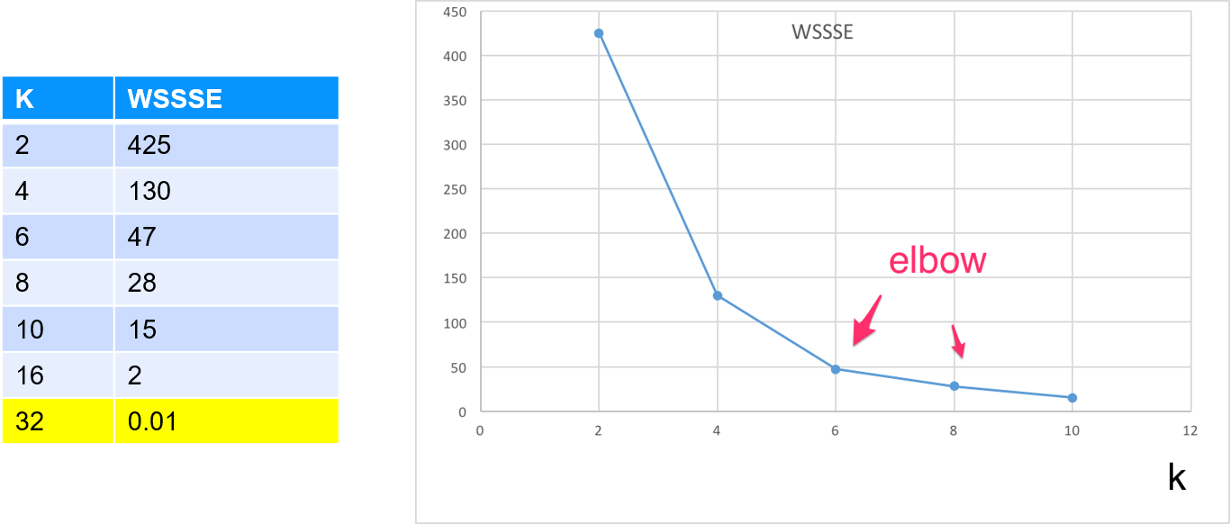
Evaluating K-Means With WSSSE
Goal is to minimize WSSSE with reasonable effort
We look for elbows - that indicates a reasonable clustering
After the elbow, the improvement is minimal
Question for class: At k=32 we have achieved WSSSE=0 , as in perfect fit !How is that?
Copyright © 2022 by Elephant Scale, All Rights Reserved

Slide 38

Lab: KMeans with Spark
Overview:
Run KMeans algorithm with Spark
Approximate run time:
20-30 mins
Instructions:
Follow KMeans instructions
Copyright © 2022 by Elephant Scale, All Rights Reserved

Slide 39

Review and Q&A
Let's go over what we have covered so far
Any questions?
Copyright © 2022 by Elephant Scale, All Rights Reserved

