Slide 1
Python C Extensions
Cython
Copyright © 2022 by Elephant Scale, All Rights Reserved

Slide 2
Why an Extension?
Pure Python code is interpreted and not very fast
Most of the time, this doesn't really matter.
However, sometimes we need to write code that is performance sensitive
Highly Iterative
Lots of Number Crunching
Another reason is that we need to reference an external library that is (or can talk to) C/C++
Copyright © 2022 by Elephant Scale, All Rights Reserved

Slide 3
Extensions
Extensions are very normal in Python
Most commonly used packages have some extension code
NumPy, Pandas, etc
C/C++ code is by far the most common
Fortran still used in some scientific programming contexts
Copyright © 2022 by Elephant Scale, All Rights Reserved

Slide 4
Building Extensions with
distutils is a python package for building python modules
Python mechanism for building a package
Most pip installable packages are built with this standard
Copyright © 2022 by Elephant Scale, All Rights Reserved

Slide 5
Source vs Binary Packages
Source Packages include the source files
Example: .c and .h files
Requires users to have C Compiler
Linux: sudo apt install build-essential
Mac: Install XCode
Windows: Need Visual C++ Installed
Binary Packages
Prebuilt for Users CPU / OS
example: win-amd64 ,
Copyright © 2022 by Elephant Scale, All Rights Reserved

Slide 6
Prerequisites
You will need to have developer versions of python installed
Ubuntu: sudo apt install python3-dev
Mac: brew install python3-dev
Anaconda: Already has python-dev installed
Copyright © 2022 by Elephant Scale, All Rights Reserved

Slide 7

Header file
The header file required is simply the following:
That should be sufficient
Copyright © 2022 by Elephant Scale, All Rights Reserved

Slide 8
PyObject
C references python objects using PyObject*
Notice this is a pointer (reference)!
ALL Python functions must return PyObject
Notice this is not a pointer but the actual object
Copyright © 2022 by Elephant Scale, All Rights Reserved

Slide 9
Function Definitions
C functions must contain the following:
must be defined as static
must be defined as type *PyObject (pointer to type PyObject)
must contain a pointer reference to itself (usually PyObject *self )
must return type *PyObject (no void functions)
usually contain arguments (but not necessarily)
Example:
static PyObject *MyFunction( PyObject *self, PyObject *args);
Copyright © 2022 by Elephant Scale, All Rights Reserved

Slide 10
Types of Function Definitions
There are only 4 types of function definitions
Function With No Arguments
static PyObject *MyFunction( PyObject *self);
Function with Exactly One Argument
static PyObject *MyFunction( PyObject *self, PyObject *arg);
arg here represents a pointer to PyObject with exactly one argument
Function With Positional Arguments
static PyObject *MyFunction( PyObject *self, PyObject *args);
Allows a variable number of arguments
args here represents a pointer to PyObject with multiple arguments
Function With Keyword Arguments and Positional Arguments
static PyObject *MyFunction( PyObject *self, PyObject *args, PyObject *kwargs);
This allows both Positional arguments and keyword arguments
Copyright © 2022 by Elephant Scale, All Rights Reserved

Slide 11
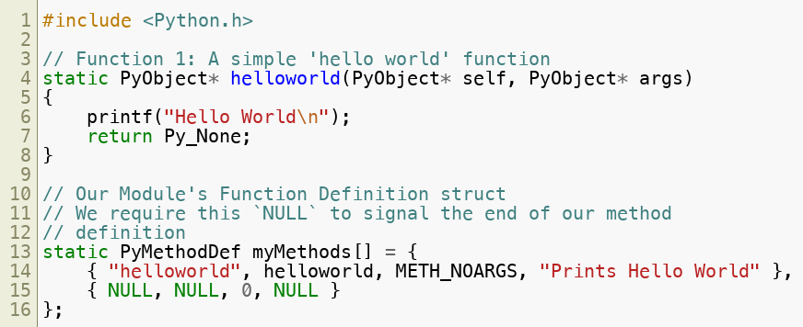
Sample Code
Copyright © 2022 by Elephant Scale, All Rights Reserved

Slide 12
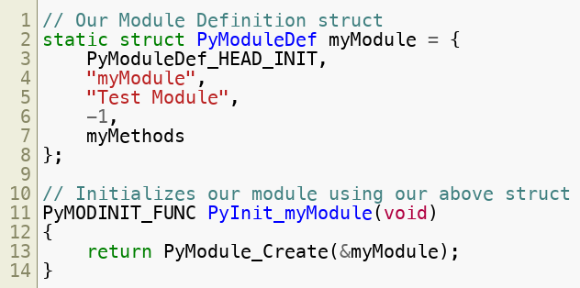
Sample Code
Copyright © 2022 by Elephant Scale, All Rights Reserved

Slide 13

Performing the Build
You need a setup.py file
This is kind of like the "Makefile" of Python
Example:
Copyright © 2022 by Elephant Scale, All Rights Reserved

Slide 14
Cython
Cython
Copyright © 2022 by Elephant Scale, All Rights Reserved

Slide 15
About Cython
Cython is a generator of Python code to C code
The generator produces code that can be easily extended with vanilla C code
Cython is technically a superset of Python
Copyright © 2022 by Elephant Scale, All Rights Reserved

Slide 16
Coding Cython
You need to generate a .pyx file
This indicates the code is Cython and not Python
You then will be able to convert the code to a generated .c file
The generated .c file will be then compiled as any other C program
Copyright © 2022 by Elephant Scale, All Rights Reserved

Slide 17
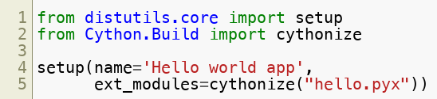
Setup.py file
We need to set up a setup.py file similar to this:
Remember that setup.py is like the Makefile of python
Copyright © 2022 by Elephant Scale, All Rights Reserved

Slide 18

An example code
We can create a hello_cython.pyx file as follows:
Then we can create the setup.py file:
Copyright © 2022 by Elephant Scale, All Rights Reserved

Slide 19

Build and run
We can build as follows:
And then import and run the module from python:
Copyright © 2022 by Elephant Scale, All Rights Reserved

