Slide 1
Zeppelin Notebooks
Copyright © 2022 by Elephant Scale, All Rights Reserved

Slide 2
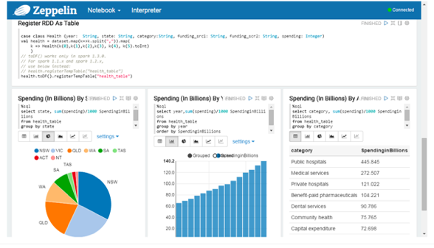
Zeppelin Notebooks
Zeppelin notebooks are another solution for data visualization with coding and collaboration in one tool
Apache Zeppelin provides Apache Spark integration
Copyright © 2022 by Elephant Scale, All Rights Reserved

Slide 3
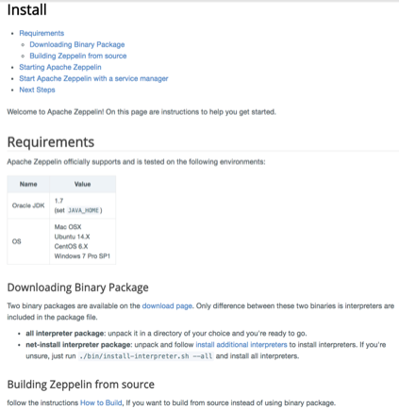
Zeppelin Notebook Installation
Apache Foundation Website - http://www.apache.org/
Apache Zeppelin - http://zeppelin.apache.org/
Ensure you have JDK - https://www.oracle.com/ technetwork/java/javase /downloads/index.html
Copyright © 2022 by Elephant Scale, All Rights Reserved

Slide 4
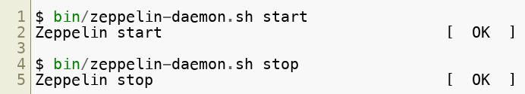
Using Zeppelin Notebooks
Go to the zeppelin install directory and type "bin/zeppelin-daemon.sh start"
The zeppelin noteboook by default starts at http://localhost:8080
To stop zeppelin, go to the zeppelin install directory and type "bin/ zeppelin-daemon.sh stop"
Copyright © 2022 by Elephant Scale, All Rights Reserved

Slide 5
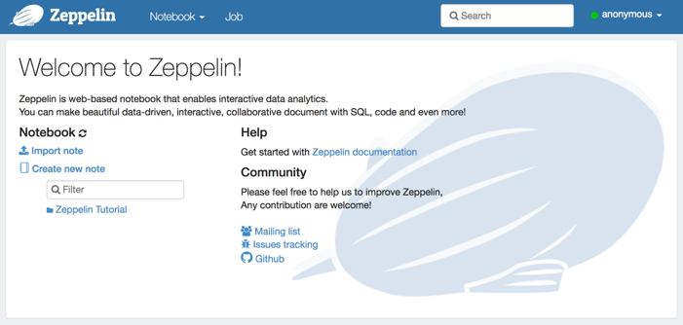
Browser for Zeppelin Notebook
Copyright © 2022 by Elephant Scale, All Rights Reserved

Slide 6
Jupyter Notebook vs Zeppelin Notebook
https://www.linkedin.com/pulse/comprehensive-comparison-jupyter-vs-zeppelin-hoc-q-phan-mba-
https://stackshare.io/stackups/jupyter-vs-zeppelin
Copyright © 2022 by Elephant Scale, All Rights Reserved

Slide 7

Review
Copyright © 2022 by Elephant Scale, All Rights Reserved

