Slide 1
About Intermediate Python
Copyright © 2024 by Elephant Scale, All Rights Reserved

Slide 2
Agenda - day 1
Python Basics Review
Installing Python
Python Versions
IDEs
Jupyter Notebook
NumPy
Introducing NumPy
Numpy Arrays and Matrices
SciPy
Introducing SciPy
Using SciPy
Stats in Python
Statsmodels
Doing Stats in Python
Visualization
Matplotlib
Seaborn
Copyright © 2024 by Elephant Scale, All Rights Reserved

Slide 3
Agenda - day 2
Advanced Pandas
DataFrames
Schema inferences
Data exploration
Python – DB Programming
Database Connectivity
Pandas and DB
ORM
Python – Web Programming
Python Web Frameworks
Flask
Restful API with Flask
Copyright © 2024 by Elephant Scale, All Rights Reserved

Slide 4
Agenda - day 3
Python Packages
Making Your Own Packages
Deployment
Environments
Python and Containers
How to use Containers with Python
Dockerizing Python
Python – Interop
Writing C Modules
Using Python with Other Languages
Python – Testing
TDD and Python
Unit test Frameworks
Conclusion
Best practices-Future
Copyright © 2024 by Elephant Scale, All Rights Reserved

Slide 5
Pre-requisites for Python Class
No Basic Python knowledge is assumed (but you might have taken an intro)
Some software development experience (languages, databases, …)
Have a Python development environment
We will set this up in class
Curiosity!
Ask a lot of questions
This is an intermediate-level class.
Copyright © 2024 by Elephant Scale, All Rights Reserved

Slide 6
Our Teaching Philosophy
Emphasis on concepts & fundamentals
API
Highly interactive (questions and discussions are welcome)
Hands-on (learn by doing)
Copyright © 2024 by Elephant Scale, All Rights Reserved

Slide 7
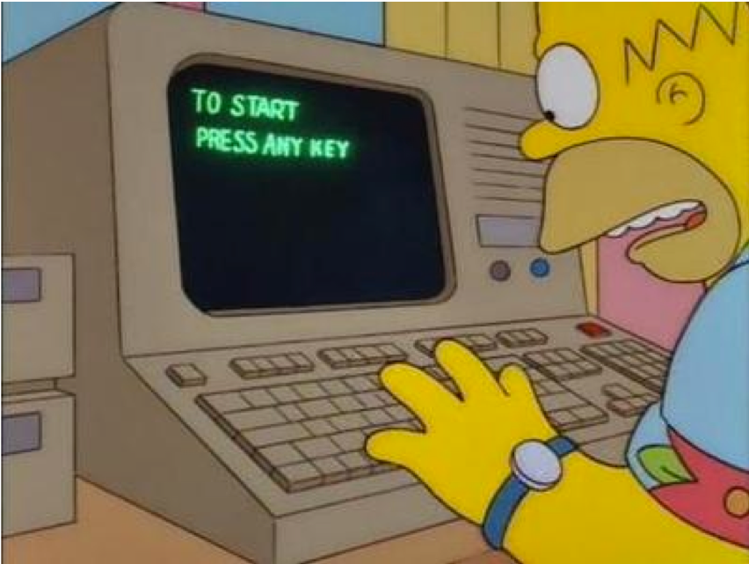
Lots of Labs: Learn By Doing
Where is the ANY key?
Copyright © 2024 by Elephant Scale, All Rights Reserved

Slide 8
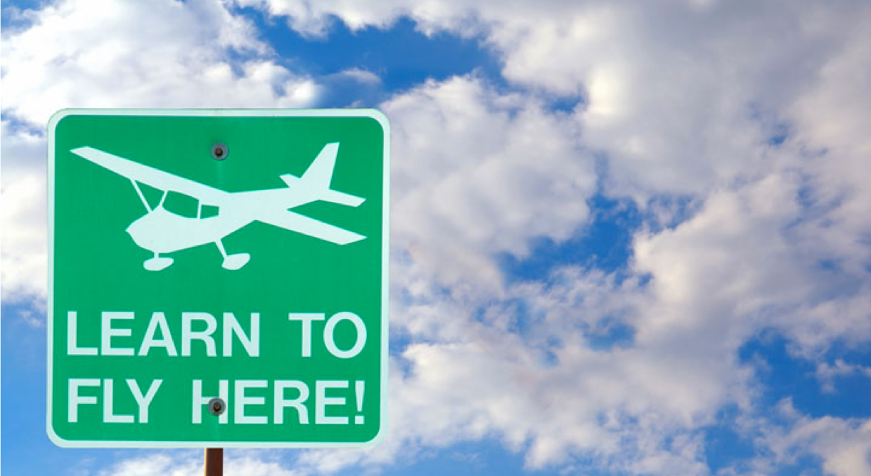
Analogy: Learning To Fly…
Copyright © 2024 by Elephant Scale, All Rights Reserved

Slide 9
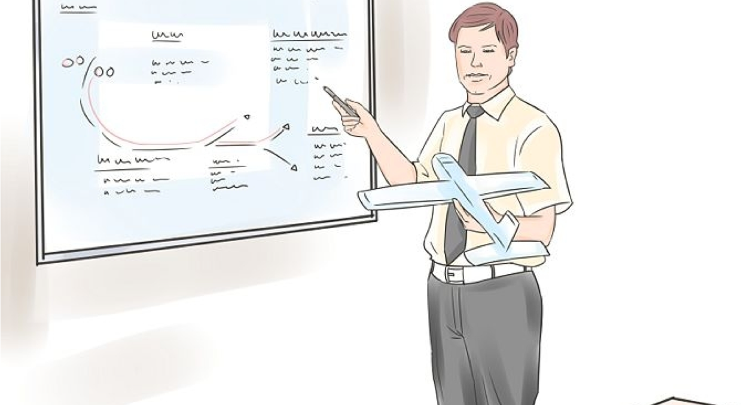
Instruction
Copyright © 2024 by Elephant Scale, All Rights Reserved
Notes:
http://aviation-schools.regionaldirectory.us/learn-to-fly-720.jpg

Slide 10
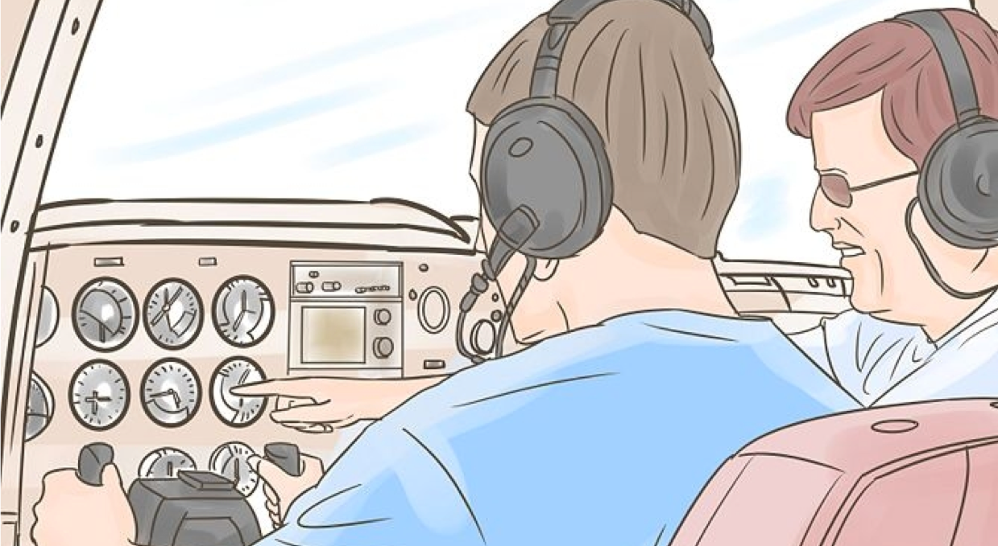
+ Flight Time
Copyright © 2024 by Elephant Scale, All Rights Reserved
Notes:
http://www.wikihow.com/Become-a-Certified-Flight-Instructor

Slide 11
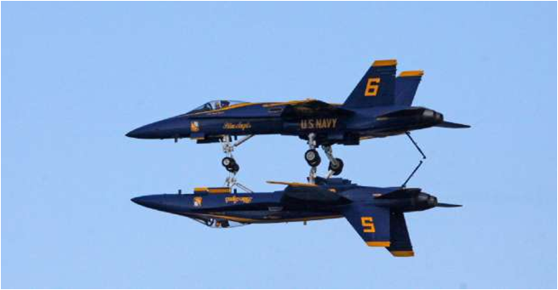
This Will Take A Lot Of Practice ☺
Copyright © 2024 by Elephant Scale, All Rights Reserved

Slide 12
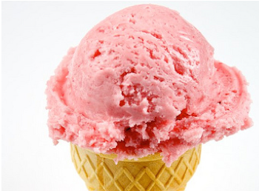

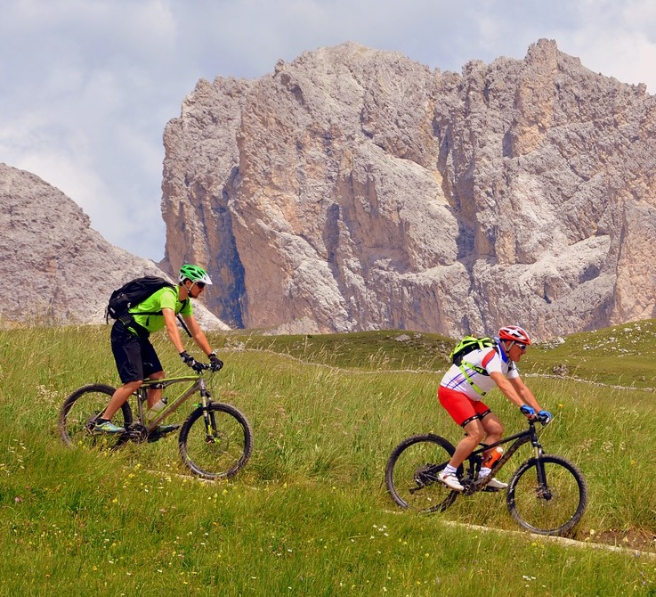
About You And Me
About Instructor
About you
Your Name
Your background (developer, admin, manager, …)
Technologies you are familiar with
Familiarity with Python (scale of 1 – 4 ; 1 – new, 4 – expert)
Something non-technical about you!(favorite ice cream flavor / hobby…)
Copyright © 2024 by Elephant Scale, All Rights Reserved

