Slide 1
Spring Cloud
Copyright © 2025 by Elephant Scale, All Rights Reserved

Slide 2
Agenda
Introduction to Spring Cloud | Resilience and Fault Tolerance | CI/CD and Deployment with Spring Cloud
Spring Cloud Config: Centralized Config Mgmt | Circuit Breakers with Hystrix | Setting Up Jenkins for Microservices
Lab: Spring Cloud Config | Lab: Implement Circuit Breakers using Hystrix | Lab: CI Pipeline with Jenkins
Secure Secrets with Spring Cloud Vault | Resilience4j: Patterns for Fault Tolerance | Containerizing Microservices with Docker
Lab: Spring Cloud Vault | Lab: Resilience Patterns with Resilience4j | Lab: Containerizing with Docker
Service Discovery | Routing and Messaging | Deploying Microservices on Kubernetes
Eureka: Service Registration and Discovery | Spring Cloud Gateway: API Gateway | Deploying Microservices to Kubernetes
Lab: Service Discovery with Eureka | Lab: Build an API Gateway | Lab: Deployment on Kubernetes
Consul: Service Discovery with Key-Value | Spring Cloud Bus for Distributed Messaging | Distributed Tracing with Sleuth and Zipkin
Lab: Service Discovery with Consul | Lab: Event-Based Messaging with Spring Cloud Bus | Lab: Distributed Tracing with Sleuth and Zipkin
Zookeeper: Distributed Config and Sync | Spring Cloud Stream: Event-Driven Architecture | Advanced Deployment with Kubernetes
Lab: Distributed Config with Zookeeper | Lab: Implement Event-Driven Microservices | Lab: Kubernetes Auto-Scaling
Copyright © 2025 by Elephant Scale, All Rights Reserved

Slide 3
Instructor Introduction
Instructor, please introduce yourself
Talk about your background and your experience in the subject
Copyright © 2025 by Elephant Scale, All Rights Reserved

Slide 4
Pre-requisites & Expectations
Intended audience:
Admins, developers, architects
Basic Linux knowledge is assumed
Some software development experience (languages, databases, ...)
Curiosity!
Ask a lot of questions
This is an intro-intermediary class.
Copyright © 2025 by Elephant Scale, All Rights Reserved

Slide 5
Our Teaching Philosophy
Emphasis on concepts & fundamentals
API - no need to learn anything by heart
Highly interactive (questions and discussions are welcome)
Hands-on (learn by doing)
Copyright © 2025 by Elephant Scale, All Rights Reserved

Slide 6
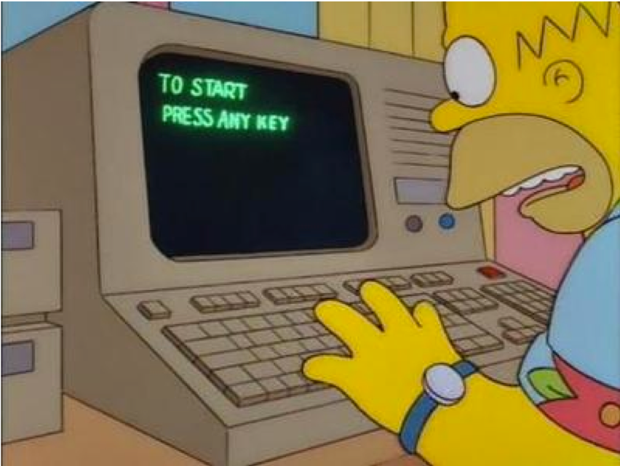
Lots of Labs: Learn By Doing
Where is the ANY key?
Copyright © 2025 by Elephant Scale, All Rights Reserved

Slide 7



Class Introductions
Run a quick background survey if applicable, and go over the responses
Students please introduce yourself (time permitting)
Your Name
Your background (developer, admin, manager, etc.)
Technologies you are familiar with
Familiarity with Microservices (scale of 1 - 4 ; 1 - new, 2 - know some concepts, 3 - took a course, 4 - using it at work)
Something non-technical about you! (favorite ice cream flavor / hobby...etc)
Copyright © 2025 by Elephant Scale, All Rights Reserved

