Slide 1
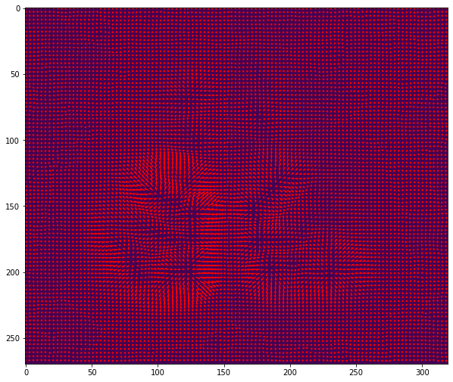
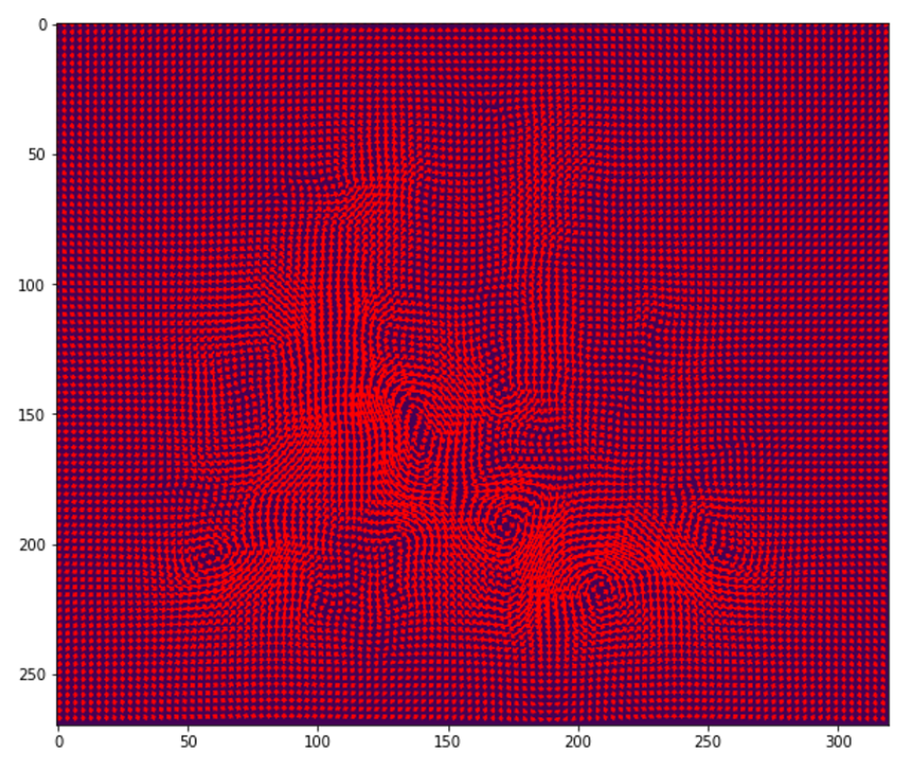
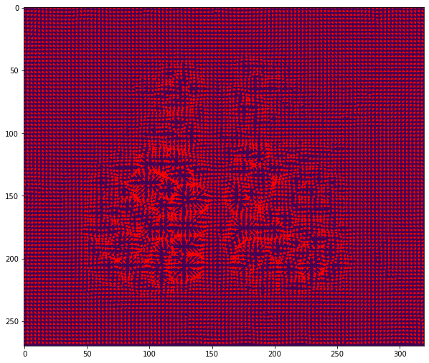
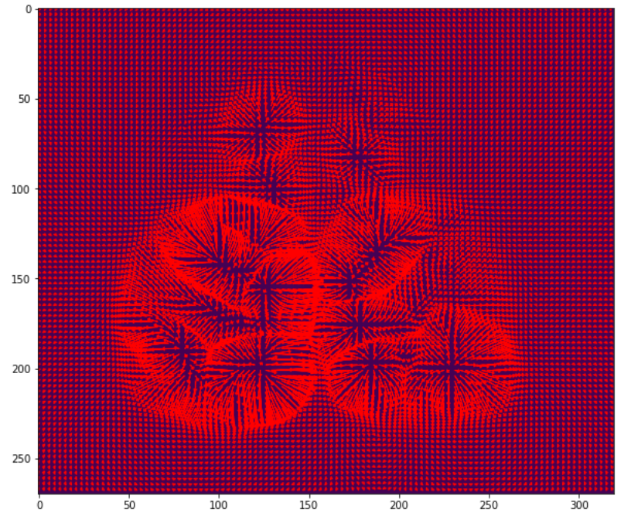
Optical flow for upwards motion computed using Horn & Schunck’s method
None of the vector fields retrieved using Helmholtz-Decomposition captures the apparent upwards motion

