Slide 1
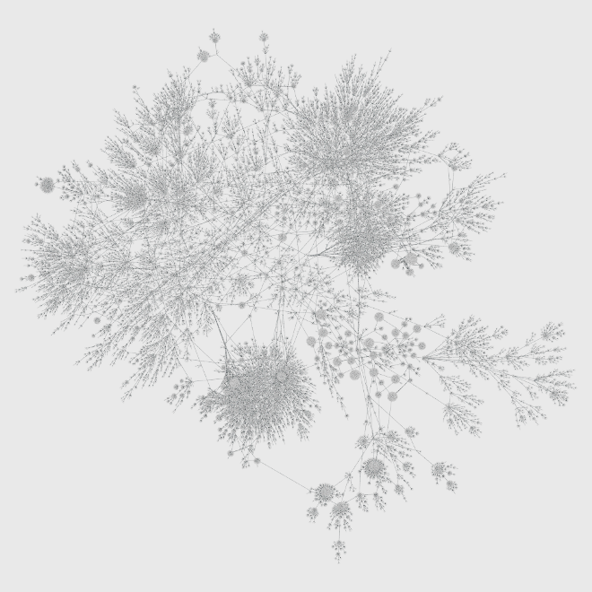

Tracking temporospatial patterns in neural signals at different stages of alertness
Computer vision and machine learning for the analysis of neuroimaging data
Michael Gerstenberger 2020

