Slide 1

Optical Flow and Autoencoders for the characterization of slow-waves
Temporospatial pattern detection for neuroimaging revisited
As part of the project: Information integration in the brain under anaesthesia
Michael Gerstenberger 2020
Notes:
Okay Hello everybody and welcome to my presentation.
Let me start by saying two sentences about myself and my background. So I study cognitive science in Osnabrück and in my master I put a focus on neuroscience as well as computer vision and machine learning. And yeah thats why I joined the project about Information integration in the brain under anaesthesia.
I focus on the methodological aspect and want to find out how autoencoders cluster tracking and optical flow can be used to detect and classify temporospatial patterns in neural recordings.

Slide 2
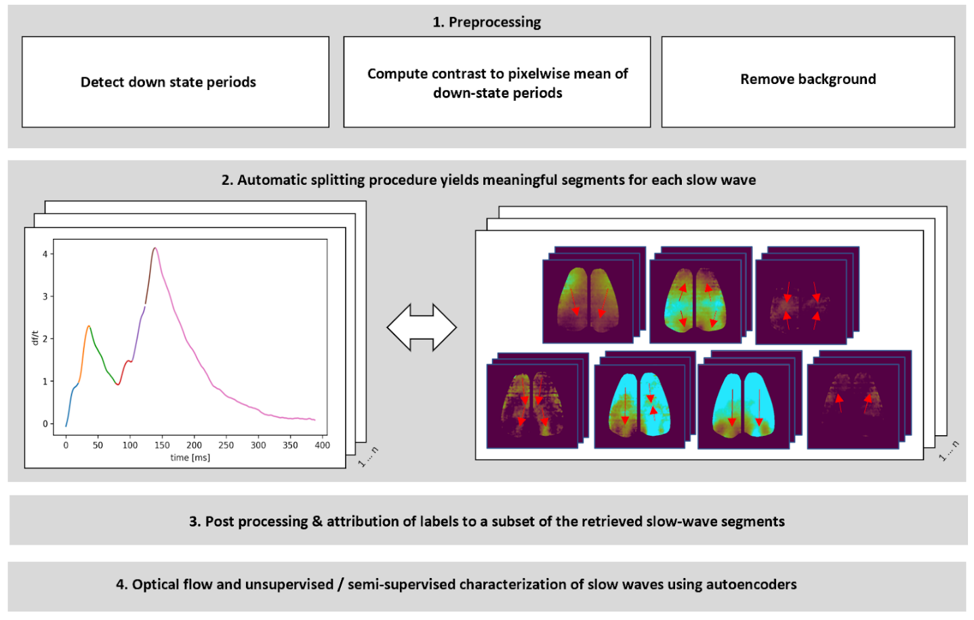
1. Motivation & interest of research
→ Slow wave subsections can be considered as the atomic units for further analysis
→ Waiting for approval to register Master Thesis
Notes:
So let me start by motivating these questions a little bit.
------------------
Ever since neuroimaging techniques have been used, we found out a lot about the functional division of the brain. We know that there are distinct regions that are necessary to accomplish certain tasks, process features of the perceptual input, direct actions or ensure that memories are formed. From this point of view it looks a lot like the brain is functionally segregated.
However on the other side it is known that the brain is a highly recurrent network. This can be quantified e.g. by electrophysiological recordings or retrograde tracer studies. Here I reported a connectivity matrix for the mouse brain and as you can see it’s a very dense one. Projections especially to far away regions are weaker but exist between almost all of them.
So taken together this throws up the question how information is spatially integrated!
----------------------------------------------------------------
Besides the structural connectivity we can also consider the results of functional connectivity studies. A well known example is the default mode network which relates to a group of brain regions who’s activity correlates at wakeful rest e.g. using fMRI. In other words one investigates the temporal dynamics of information processing.
The fact that a default mode network exists is astonishing, however, by simply computing correlation strength one looses a lot of information about how the information spreads in cortex.
So one can ask how the temporal dynamics can be captures more adequately?
----------------------------------------------------------------
I mentioned that the default mode network relates to wakeful rest, however one may speculate that there are different modes of information integration at different levels of alertness. At slow wave sleep other patterns might occur that potentially relate to processes of memory consolidation. So it’s important to ask: What are the modes of information integration? How can state transitions be investigated in space and time?
These questions are also important because they relate to the big topic of consciousness.
--------------------
To answer these questions we need new means to analyse temporospatial patterns.

Slide 3
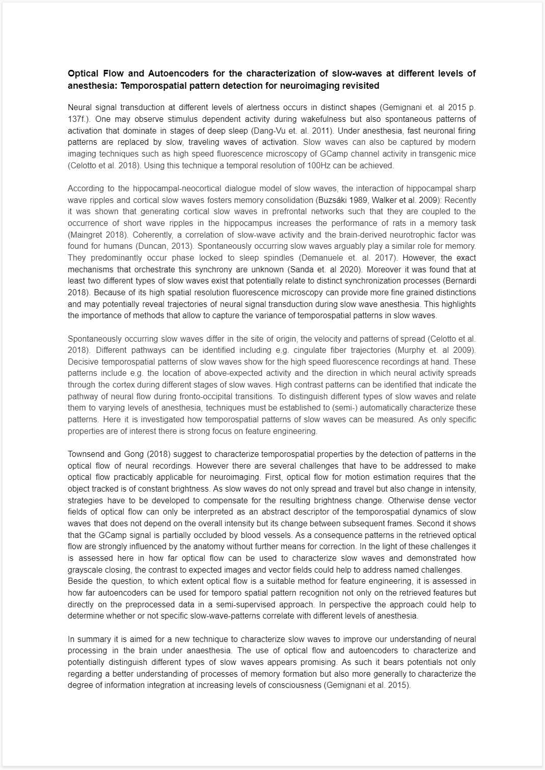
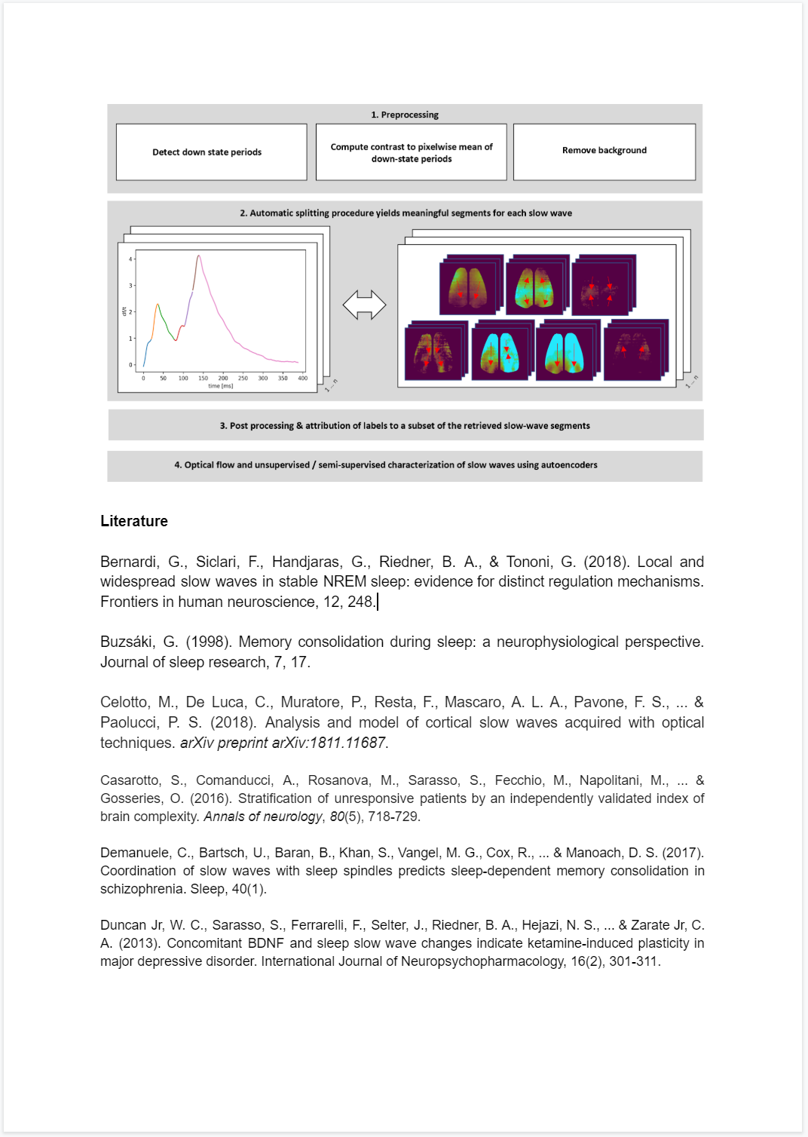
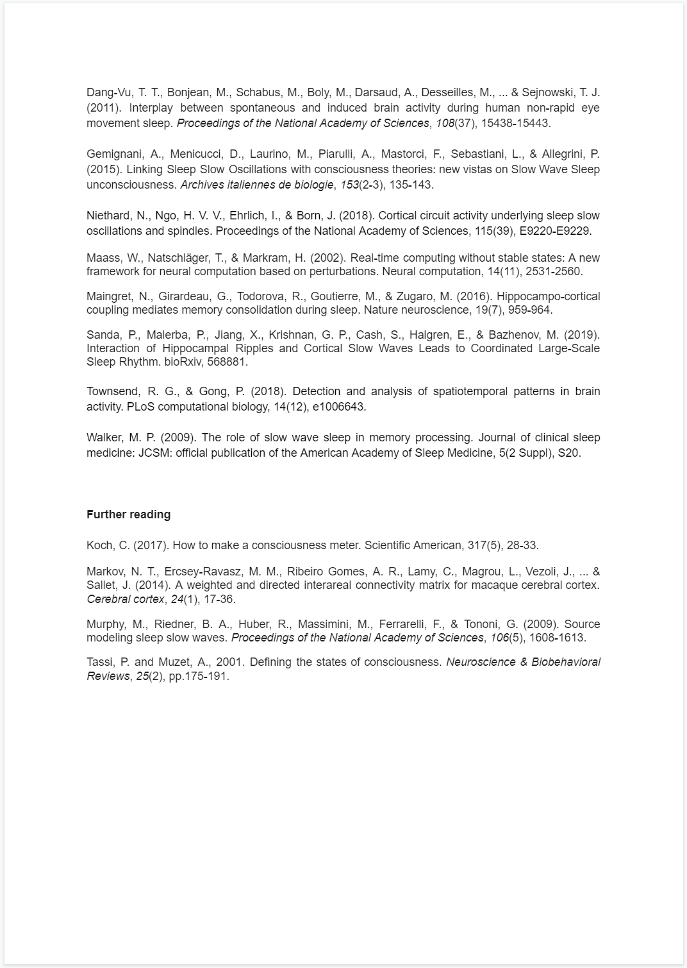
2. Background research on slow waves & proposal
→ Slow waves are crucial for memory consolidation; Temporospatial patterns are poorly undersood → Waiting for approval
Notes:
So let me start by motivating these questions a little bit.
------------------
Ever since neuroimaging techniques have been used, we found out a lot about the functional division of the brain. We know that there are distinct regions that are necessary to accomplish certain tasks, process features of the perceptual input, direct actions or ensure that memories are formed. From this point of view it looks a lot like the brain is functionally segregated.
However on the other side it is known that the brain is a highly recurrent network. This can be quantified e.g. by electrophysiological recordings or retrograde tracer studies. Here I reported a connectivity matrix for the mouse brain and as you can see it’s a very dense one. Projections especially to far away regions are weaker but exist between almost all of them.
So taken together this throws up the question how information is spatially integrated!
----------------------------------------------------------------
Besides the structural connectivity we can also consider the results of functional connectivity studies. A well known example is the default mode network which relates to a group of brain regions who’s activity correlates at wakeful rest e.g. using fMRI. In other words one investigates the temporal dynamics of information processing.
The fact that a default mode network exists is astonishing, however, by simply computing correlation strength one looses a lot of information about how the information spreads in cortex.
So one can ask how the temporal dynamics can be captures more adequately?
----------------------------------------------------------------
I mentioned that the default mode network relates to wakeful rest, however one may speculate that there are different modes of information integration at different levels of alertness. At slow wave sleep other patterns might occur that potentially relate to processes of memory consolidation. So it’s important to ask: What are the modes of information integration? How can state transitions be investigated in space and time?
These questions are also important because they relate to the big topic of consciousness.
--------------------
To answer these questions we need new means to analyse temporospatial patterns.

Slide 4
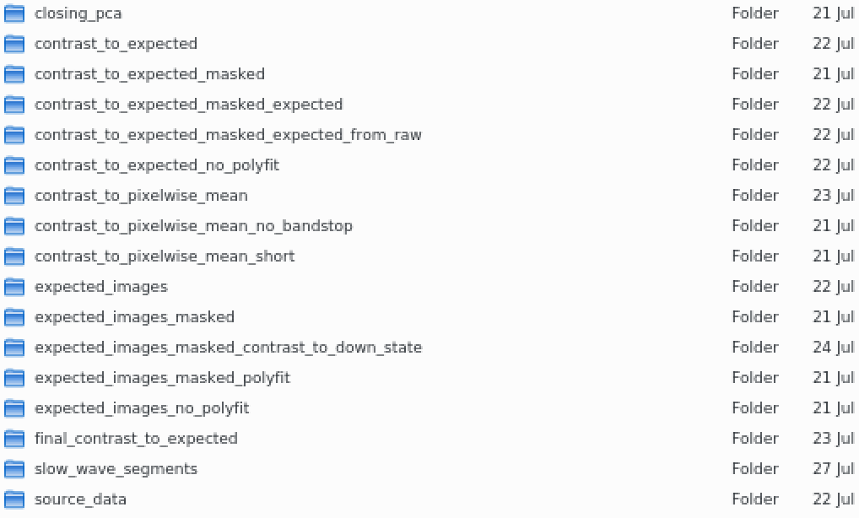
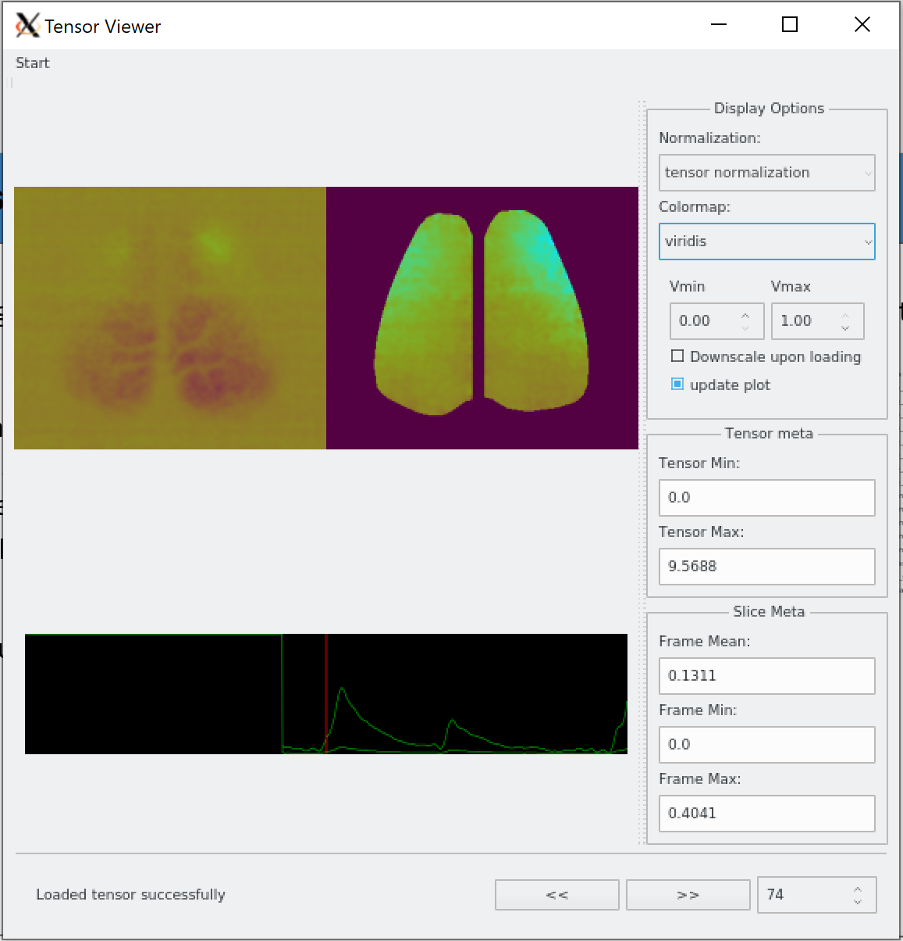
3. Systematic search in parameter space for optimal preprocessing
Several preprocessing parameters can be optimized (e.g. frequency filtering, smooting etc.)
Big Data!
Implementation of parameterized preprocessing scripts
Expected Images (with/without interpolation, different bin sizes)
Contrast to expected Images for a given overall brightness (median/mean)
Contrast to the pixelwise mean (of sample / of down-state periods)
Qualitative evaluation using TensorViewer
Contrast to down state can be used & result can be devided by background
Removal of artifacts due to blood vessels
Working memory restrictions; When will I have access to Helmholtz server?
Notes:
So let me start by motivating these questions a little bit.
------------------
Ever since neuroimaging techniques have been used, we found out a lot about the functional division of the brain. We know that there are distinct regions that are necessary to accomplish certain tasks, process features of the perceptual input, direct actions or ensure that memories are formed. From this point of view it looks a lot like the brain is functionally segregated.
However on the other side it is known that the brain is a highly recurrent network. This can be quantified e.g. by electrophysiological recordings or retrograde tracer studies. Here I reported a connectivity matrix for the mouse brain and as you can see it’s a very dense one. Projections especially to far away regions are weaker but exist between almost all of them.
So taken together this throws up the question how information is spatially integrated!
----------------------------------------------------------------
Besides the structural connectivity we can also consider the results of functional connectivity studies. A well known example is the default mode network which relates to a group of brain regions who’s activity correlates at wakeful rest e.g. using fMRI. In other words one investigates the temporal dynamics of information processing.
The fact that a default mode network exists is astonishing, however, by simply computing correlation strength one looses a lot of information about how the information spreads in cortex.
So one can ask how the temporal dynamics can be captures more adequately?
----------------------------------------------------------------
I mentioned that the default mode network relates to wakeful rest, however one may speculate that there are different modes of information integration at different levels of alertness. At slow wave sleep other patterns might occur that potentially relate to processes of memory consolidation. So it’s important to ask: What are the modes of information integration? How can state transitions be investigated in space and time?
These questions are also important because they relate to the big topic of consciousness.
--------------------
To answer these questions we need new means to analyse temporospatial patterns.

Slide 5
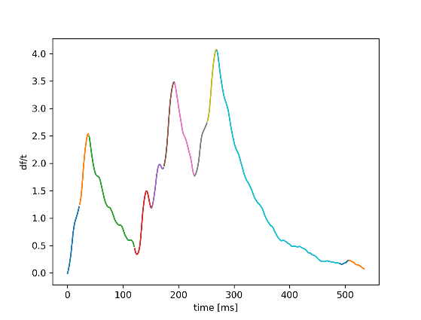
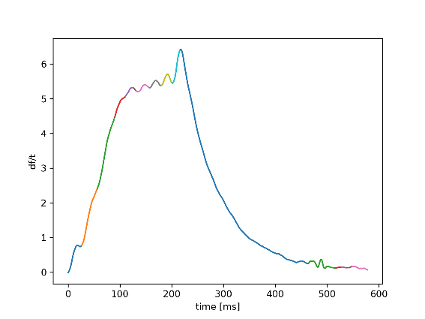
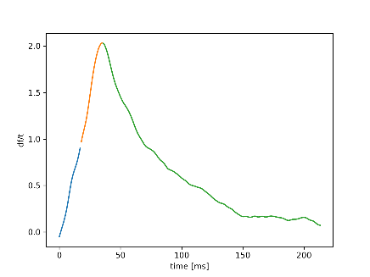
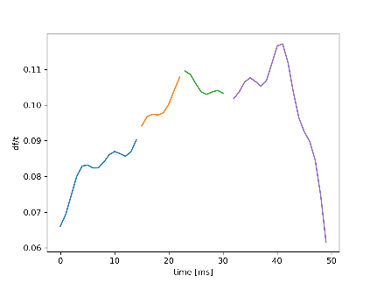
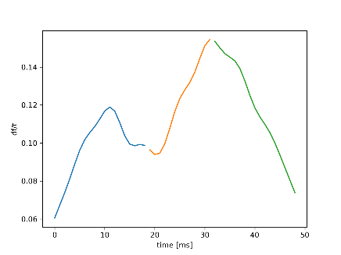
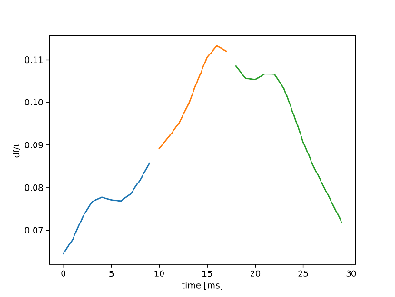
4. Automatic splitting of slow waves
1. Detection of slow waves via thresholding (>25 percentile; removal of short periods)
2. Segmentation into rising and falling phases (via detection of local maxima)
3. Segmentation of rising phases according to saddle points (via optima of derivative)
→ Further optimization & debugging required
→ When will I have access to computation power and full datasets?
Notes:
So let me start by motivating these questions a little bit.
------------------
Ever since neuroimaging techniques have been used, we found out a lot about the functional division of the brain. We know that there are distinct regions that are necessary to accomplish certain tasks, process features of the perceptual input, direct actions or ensure that memories are formed. From this point of view it looks a lot like the brain is functionally segregated.
However on the other side it is known that the brain is a highly recurrent network. This can be quantified e.g. by electrophysiological recordings or retrograde tracer studies. Here I reported a connectivity matrix for the mouse brain and as you can see it’s a very dense one. Projections especially to far away regions are weaker but exist between almost all of them.
So taken together this throws up the question how information is spatially integrated!
----------------------------------------------------------------
Besides the structural connectivity we can also consider the results of functional connectivity studies. A well known example is the default mode network which relates to a group of brain regions who’s activity correlates at wakeful rest e.g. using fMRI. In other words one investigates the temporal dynamics of information processing.
The fact that a default mode network exists is astonishing, however, by simply computing correlation strength one looses a lot of information about how the information spreads in cortex.
So one can ask how the temporal dynamics can be captures more adequately?
----------------------------------------------------------------
I mentioned that the default mode network relates to wakeful rest, however one may speculate that there are different modes of information integration at different levels of alertness. At slow wave sleep other patterns might occur that potentially relate to processes of memory consolidation. So it’s important to ask: What are the modes of information integration? How can state transitions be investigated in space and time?
These questions are also important because they relate to the big topic of consciousness.
--------------------
To answer these questions we need new means to analyse temporospatial patterns.

