Slide 1
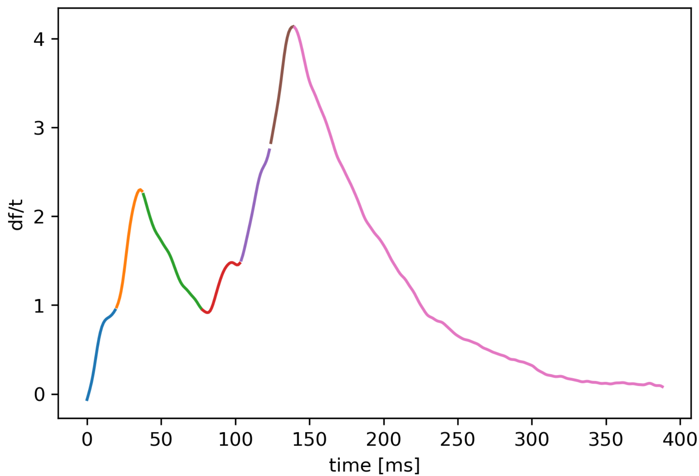
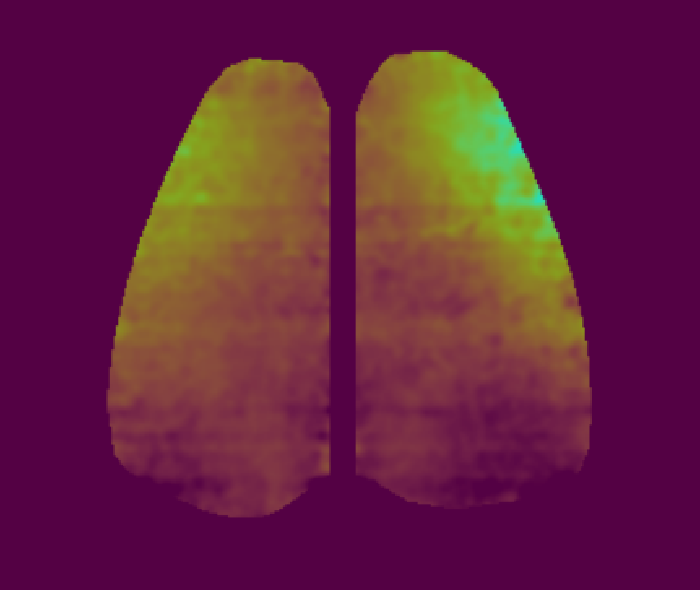
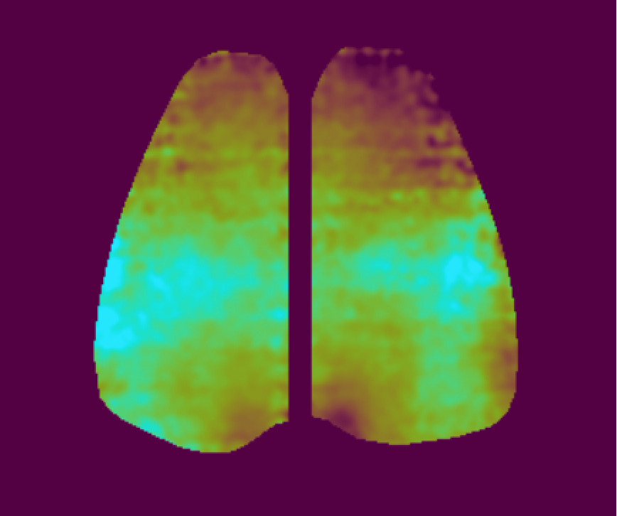
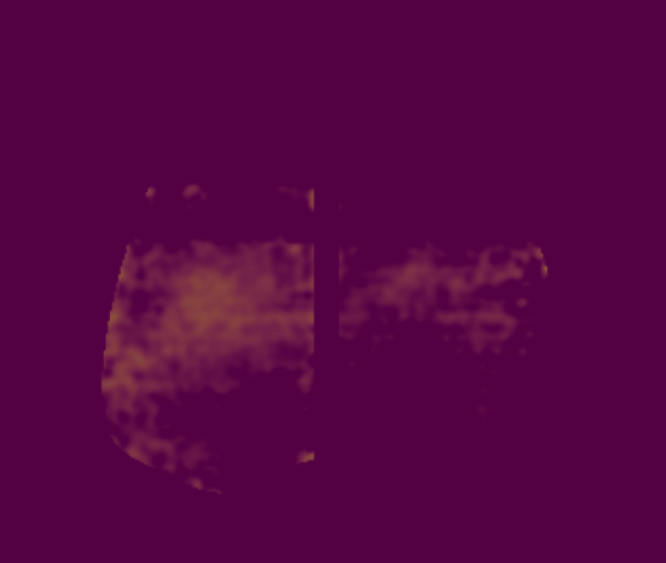
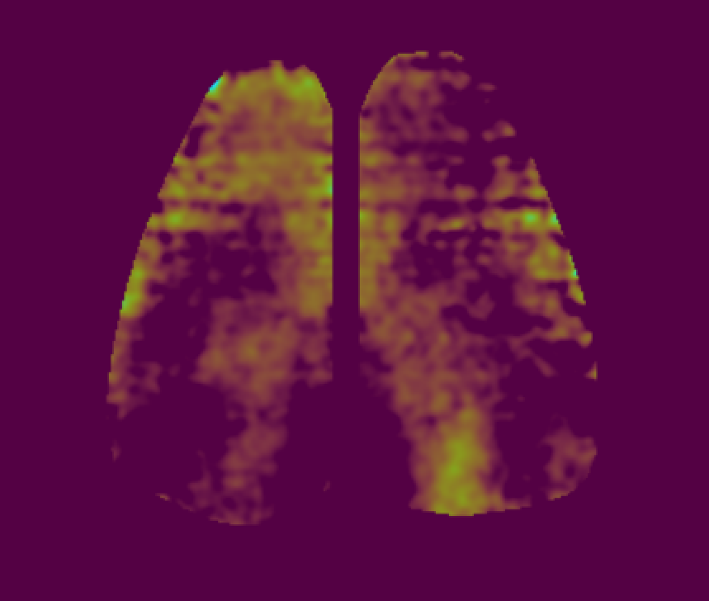
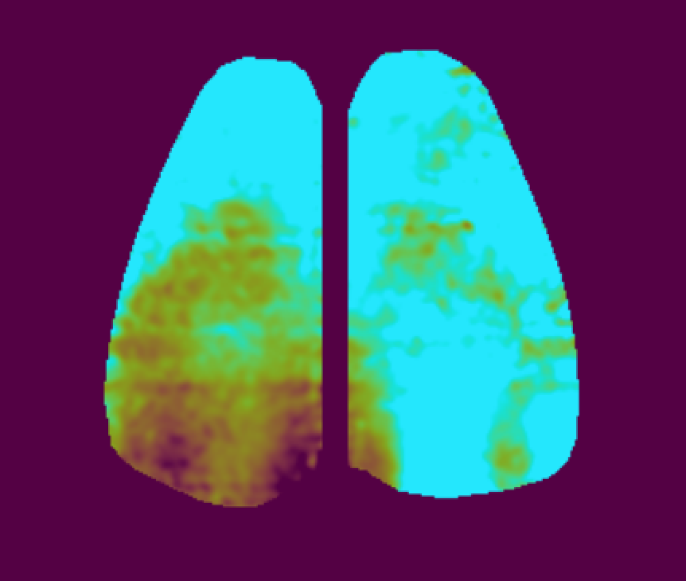
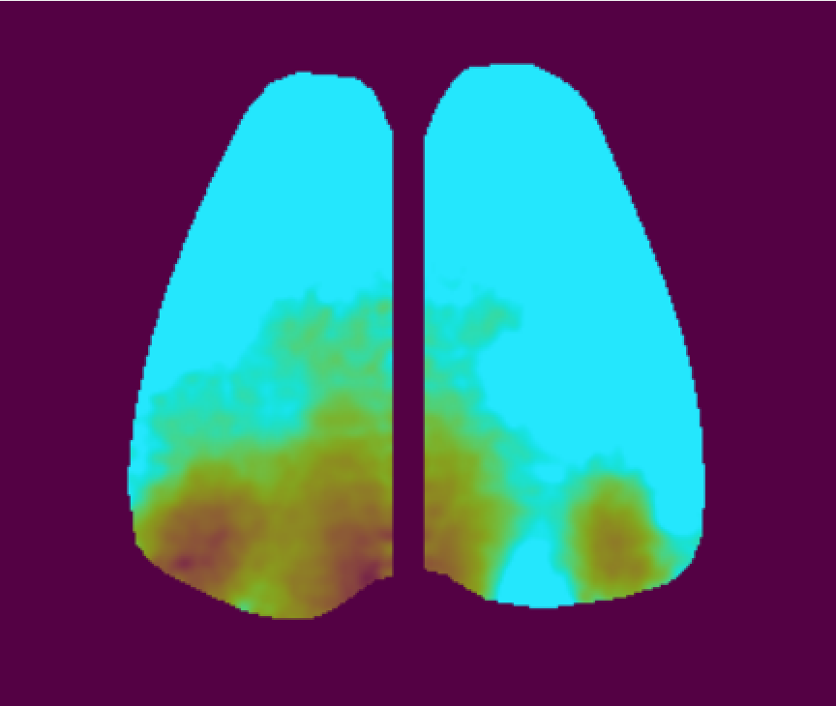
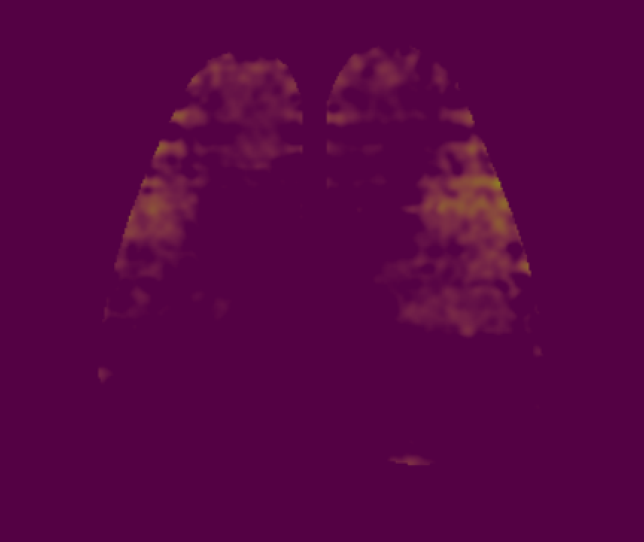
1. Preprocessing
Detect down state periods
Compute contrast to pixelwise mean of down-state periods
Remove background
2. Automatic splitting procedure yields meaningful segments for each slow wave
1 … n
1 … n
3. Post processing & attribution of labels to a subset of the retrieved slow-wave segments
4. Optical flow and unsupervised / semi-supervised characterization of slow waves using autoencoders

