Slide 1

SDN-Oriented DDoS Blocking Scheme for Botnet-Based Attacks
Antonio LE CALDARE
Edoardo SASSU
Elena SCARSELLI

Slide 3
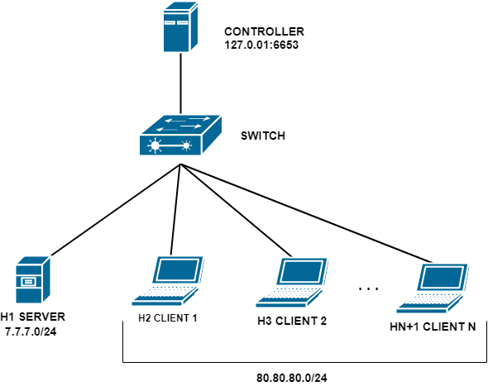
TESTING SYSTEM

