Slide 1

SDN-Oriented DDoS Blocking Scheme for Botnet-Based Attacks
Antonio LE CALDARE
Edoardo SASSU
Elena SCARSELLI

Slide 2
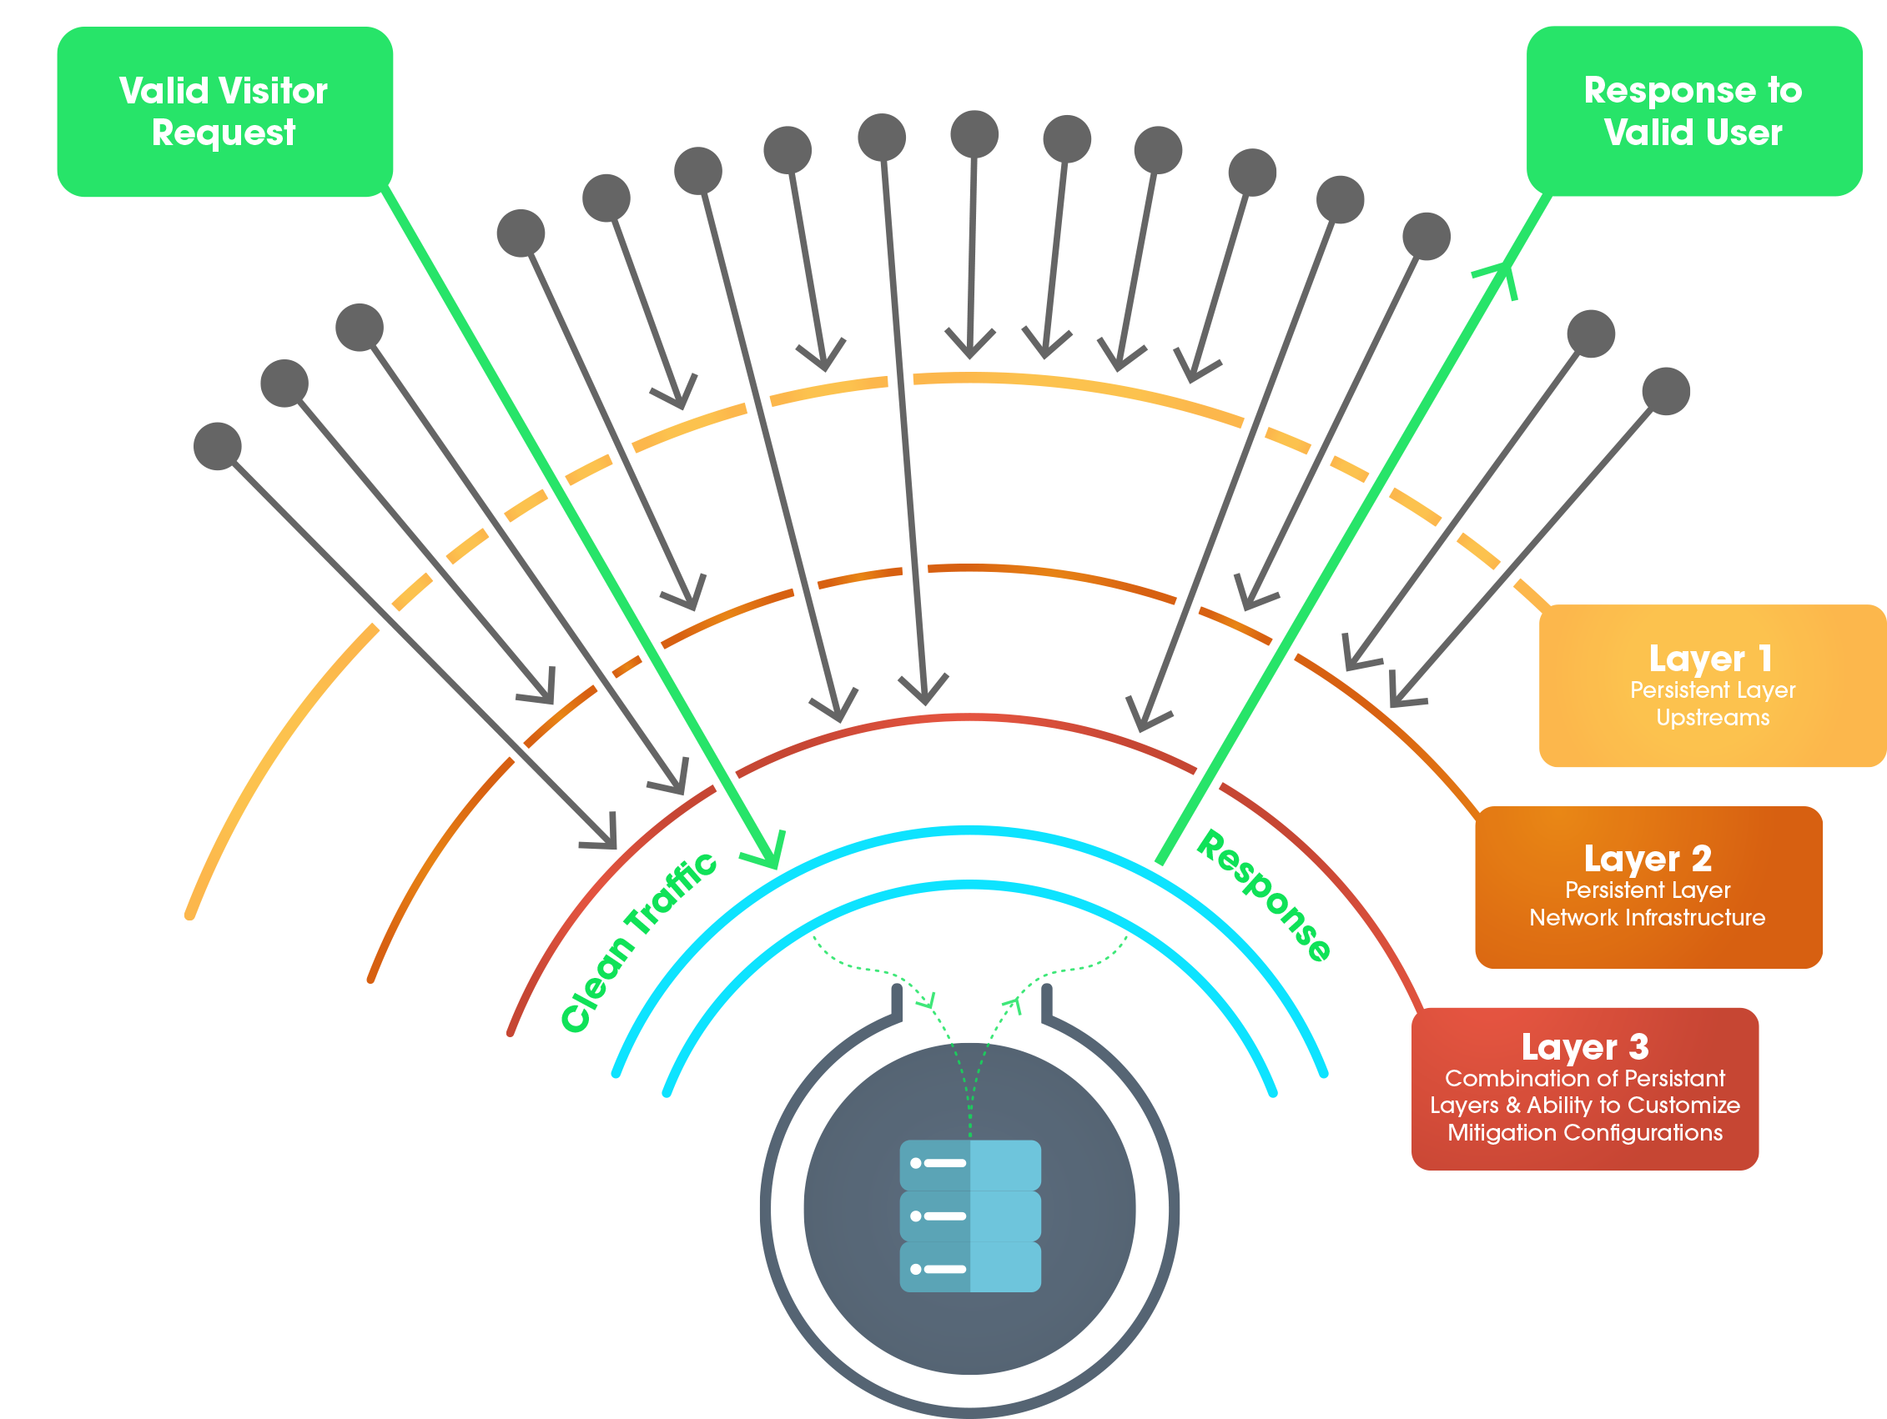
How protection works
Server changes the listening address to a new one when is under attack;
The connections requests to the old server address are counted;
If the number of connection requests of a client, goes above a certain threshold θ, the client is classified as a bot and all its packets are dropped.

Slide 3
Why Learning Switch
The learning switch is used in order to avoid the re-implementation of L2 switching functionalities in our controller
Switch will perform also auto-learning functionalities.
For our purposes, this behaviour must be applied only to ARP and ICMP packets
ARP for enabling packets sending between clients and server;
ICMP for testing purposes (ping and error messages).
Our model does not include L3 forwarding
Packet coming from clients and server are forwarded by default to the switch.

Slide 5
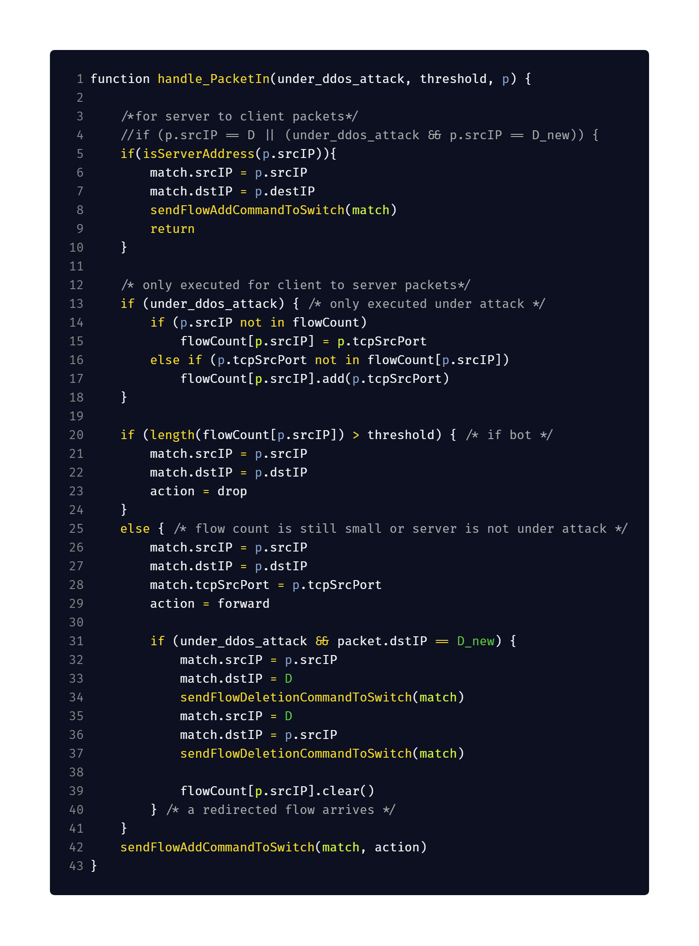
Our Pseudocode
Differences:
Add rules for packets coming from the server to clients.
Packets coming from server need only to be forwarded, then execution can stop after adding the server forwarding rule.

Slide 6
Our Pseudocode
Differences:
Checking for connection coming from clients to new server address must be done only when protection is enabled.
The dictionary of clients connecitons must be cleared when connection to new server address is detected.

Slide 7
Implementatio Issues
Execution order of floodlight modules here.
The normal rule (action.normal) does not work for non hybrid switches.
Learning switch:
Add interface to retreive MAC addresses from the learning switch controller
Deleting rules are specified here.
OFFlowDelete deletes rules matching at least the specified fields;
OFFlowDeleteStrict deletes the rules that exactly looks like the match you specify.
Testing is done in python using mininet library
Notes:
https://floodlight.atlassian.net/wiki/spaces/floodlightcontroller/pages/1343513/How+to+Write+a+Module#HowtoWriteaModule-OrderingModuleswhenProcessingOpenFlowMessages
Per il normal rule, hybrid switch implementano nativamente il livello due e quindi avrebbero fatto arp e switch
Il learning switch
https://floodlight.atlassian.net/wiki/spaces/floodlightcontroller/pages/1343547/How+to+use+OpenFlowJ-Loxigen

Slide 8
Implementatio Issues
Execution order of floodlight modules here.
The normal rule (action.normal) does not work for non hybrid switches.
Learning switch:
Add interface to retreive MAC addresses from the learning switch controller
Deleting rules are specified here.
OFFlowDelete deletes rules matching at least the specified fields;
OFFlowDeleteStrict deletes the rules that exactly looks like the match you specify.
Testing is done in python using mininet library
Notes:
https://floodlight.atlassian.net/wiki/spaces/floodlightcontroller/pages/1343513/How+to+Write+a+Module#HowtoWriteaModule-OrderingModuleswhenProcessingOpenFlowMessages
Per il normal rule, hybrid switch implementano nativamente il livello due e quindi avrebbero fatto arp e switch
Il learning switch
https://floodlight.atlassian.net/wiki/spaces/floodlightcontroller/pages/1343547/How+to+use+OpenFlowJ-Loxigen

Slide 9
Implementatio Issues
Execution order of floodlight modules here.
The normal rule (action.normal) does not work for non hybrid switches.
Learning switch:
Add interface to retreive MAC addresses from the learning switch controller.
Deleting rules are specified here.
OFFlowDelete deletes rules matching at least the specified fields;
OFFlowDeleteStrict deletes the rules that exactly looks like the match you specify.
Testing is done in python using mininet library
Notes:
https://floodlight.atlassian.net/wiki/spaces/floodlightcontroller/pages/1343513/How+to+Write+a+Module#HowtoWriteaModule-OrderingModuleswhenProcessingOpenFlowMessages
Per il normal rule, hybrid switch implementano nativamente il livello due e quindi avrebbero fatto arp e switch
Il learning switch
https://floodlight.atlassian.net/wiki/spaces/floodlightcontroller/pages/1343547/How+to+use+OpenFlowJ-Loxigen

Slide 10
Implementatio Issues
Execution order of floodlight modules here.
The normal rule (action.normal) does not work for non hybrid switches.
Learning switch:
Add interface to retreive MAC addresses from the learning switch controller
Deleting rules are specified here.
OFFlowDelete deletes rules matching at least the specified fields;
OFFlowDeleteStrict deletes the rules that exactly looks like the match you specify.
Testing is done in python using mininet library
Notes:
https://floodlight.atlassian.net/wiki/spaces/floodlightcontroller/pages/1343513/How+to+Write+a+Module#HowtoWriteaModule-OrderingModuleswhenProcessingOpenFlowMessages
Per il normal rule, hybrid switch implementano nativamente il livello due e quindi avrebbero fatto arp e switch
Il learning switch
https://floodlight.atlassian.net/wiki/spaces/floodlightcontroller/pages/1343547/How+to+use+OpenFlowJ-Loxigen

Slide 11
Implementatio Issues
Execution order of floodlight modules here.
The normal rule (action.normal) does not work for non hybrid switches.
Learning switch:
Add interface to retreive MAC addresses from the learning switch controller
Deleting rules are specified here.
OFFlowDelete deletes rules matching at least the specified fields;
OFFlowDeleteStrict deletes the rules that exactly looks like the match you specify.
Testing is done in python using mininet library
Notes:
https://floodlight.atlassian.net/wiki/spaces/floodlightcontroller/pages/1343513/How+to+Write+a+Module#HowtoWriteaModule-OrderingModuleswhenProcessingOpenFlowMessages
Per il normal rule, hybrid switch implementano nativamente il livello due e quindi avrebbero fatto arp e switch
Il learning switch
https://floodlight.atlassian.net/wiki/spaces/floodlightcontroller/pages/1343547/How+to+use+OpenFlowJ-Loxigen

Slide 12
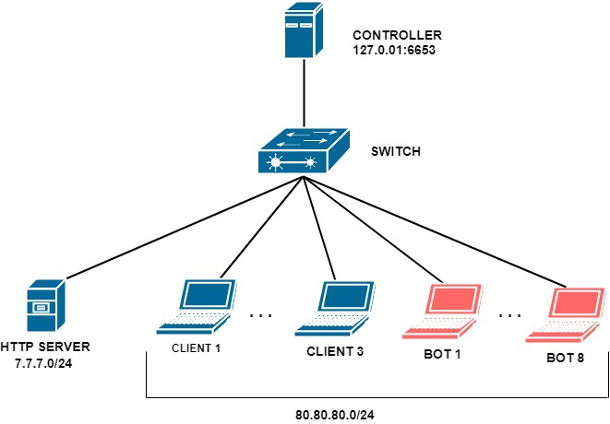
TESTING SYSTEM

Slide 13
Testing environment
Bots continuously request an HTTP connection to the server.
Clients send periodic requests.
The server is multithreaded.
A. Le Caldare, E. Sassu, E. Scarselli
13
Notes:
Even if the Bots send requests continuously, the Server is always able to respond, because it opens a new thread for each request, so the server does not stop even if it is bombarded with requests

Slide 14
Testing environment
When the server is under attack:
it changes its address;
It notifies the Controller about the attack.
A. Le Caldare, E. Sassu, E. Scarselli
14
Notes:
Even if the Bots send requests continuously, the Server is always able to respond, because it opens a new thread for each request, so the server does not stop even if it is bombarded with requests

Slide 15
Testing environment
When the server changes address:
Clients can forward to the new server address,
Bots can’t switch to the new address.
A. Le Caldare, E. Sassu, E. Scarselli
15
Notes:
Even if the Bots send requests continuously, the Server is always able to respond, because it opens a new thread for each request, so the server does not stop even if it is bombarded with requests

Slide 16
Testing environment
Even if the Bots send requests continuously, the Server is always able to reply and it does not stop, even if it is flooded with requests.
A. Le Caldare, E. Sassu, E. Scarselli
16
Notes:
Even if the Bots send requests continuously, the Server is always able to respond, because it opens a new thread for each request, so the server does not stop even if it is bombarded with requests

Slide 17
Testing environment
Bots continually request an HTTP connection to the server.
Clients send periodic requests.
The server is multithreaded.
When the server is under attack:
it changes its address;
It notifies the Controller about the attack.
When the server changes address:
clients can forward the address of the server
while the bots do not
Even if the Bots send requests continuously, the Server is always able to respond and it does not stop even if it is bombarded with requests.
Notes:
Even if the Bots send requests continuously, the Server is always able to respond, because it opens a new thread for each request, so the server does not stop even if it is bombarded with requests

