Slide 1

SDN-Oriented DDoS Blocking Scheme for Botnet-Based Attacks
Antonio LE CALDARE
Edoardo SASSU
Elena SCARSELLI

Slide 2
How protection works

Slide 3
Model: standard request

Slide 4
Model: forward request, block bot

Slide 5
Why Learning Switch

Slide 6
Our Pseudocode
OF

Slide 7
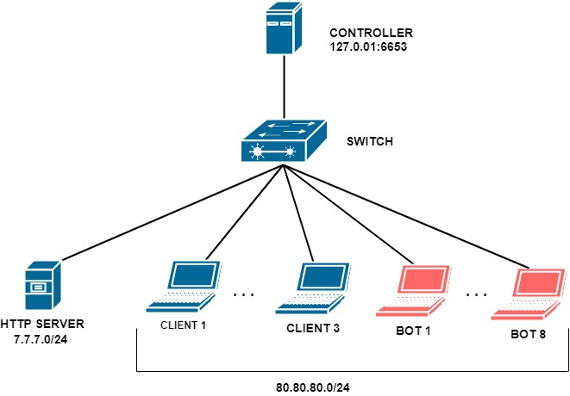
TESTING SYSTEM

