Slide 1

SDN-Oriented DDoS Blocking Scheme for Botnet-Based Attacks
Antonio LE CALDARE
Edoardo SASSU
Elena SCARSELLI

Slide 2
DDosDefence: Project Goal
Server protection from DDoS attacks
A Server (or more than one) is attached to an OpenFlow switch
The OpenFlow switch will perform filtering for malicious clients
An OpenFlow controller (DDoSDefence) will label clients into Bots or Clients
Threat Model
Bots are modelled as very simple programs, which cannot do other than repeating HTTP requests to a fixed address
Bots can perform KeepAlive requests to reuse connections
Bots cannot solve CAPTCHAs and, in general, complex problems

Slide 3
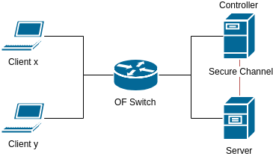
How protection works
Server changes the listening address to a new one when is under attack
The connections requests to the old server address are counted
If the number of connection requests of a client goes above a certain threshold θ, the client is classified as a bot and all its connections are dropped

Slide 4
DDoSDefence: Controller Interface
The controller provides two REST resources (only POST):
Init: required to initialize the controller, can be executed only one time and is required before enabling protection for the first time. Parameters:
Service port, for protected service
Public address pool, assignable to the server(s)
Threshold, for spotting bots
Management: used to enable or disable the protection. Parameters:
Enable, boolean

Slide 5
Learning Switch
The learning switch is used in order to avoid the re-implementation of L2 switching functionalities in our controller
Switch will perform also auto-learning functionalities.
For our purposes, this behaviour must be applied only to ARP and ICMP packets
ARP for enabling packets sending between clients and server;
ICMP for testing purposes (ping and error messages).
Our model does not include L3 forwarding
Packet coming from clients and server are forwarded by default to the switch.

Slide 6
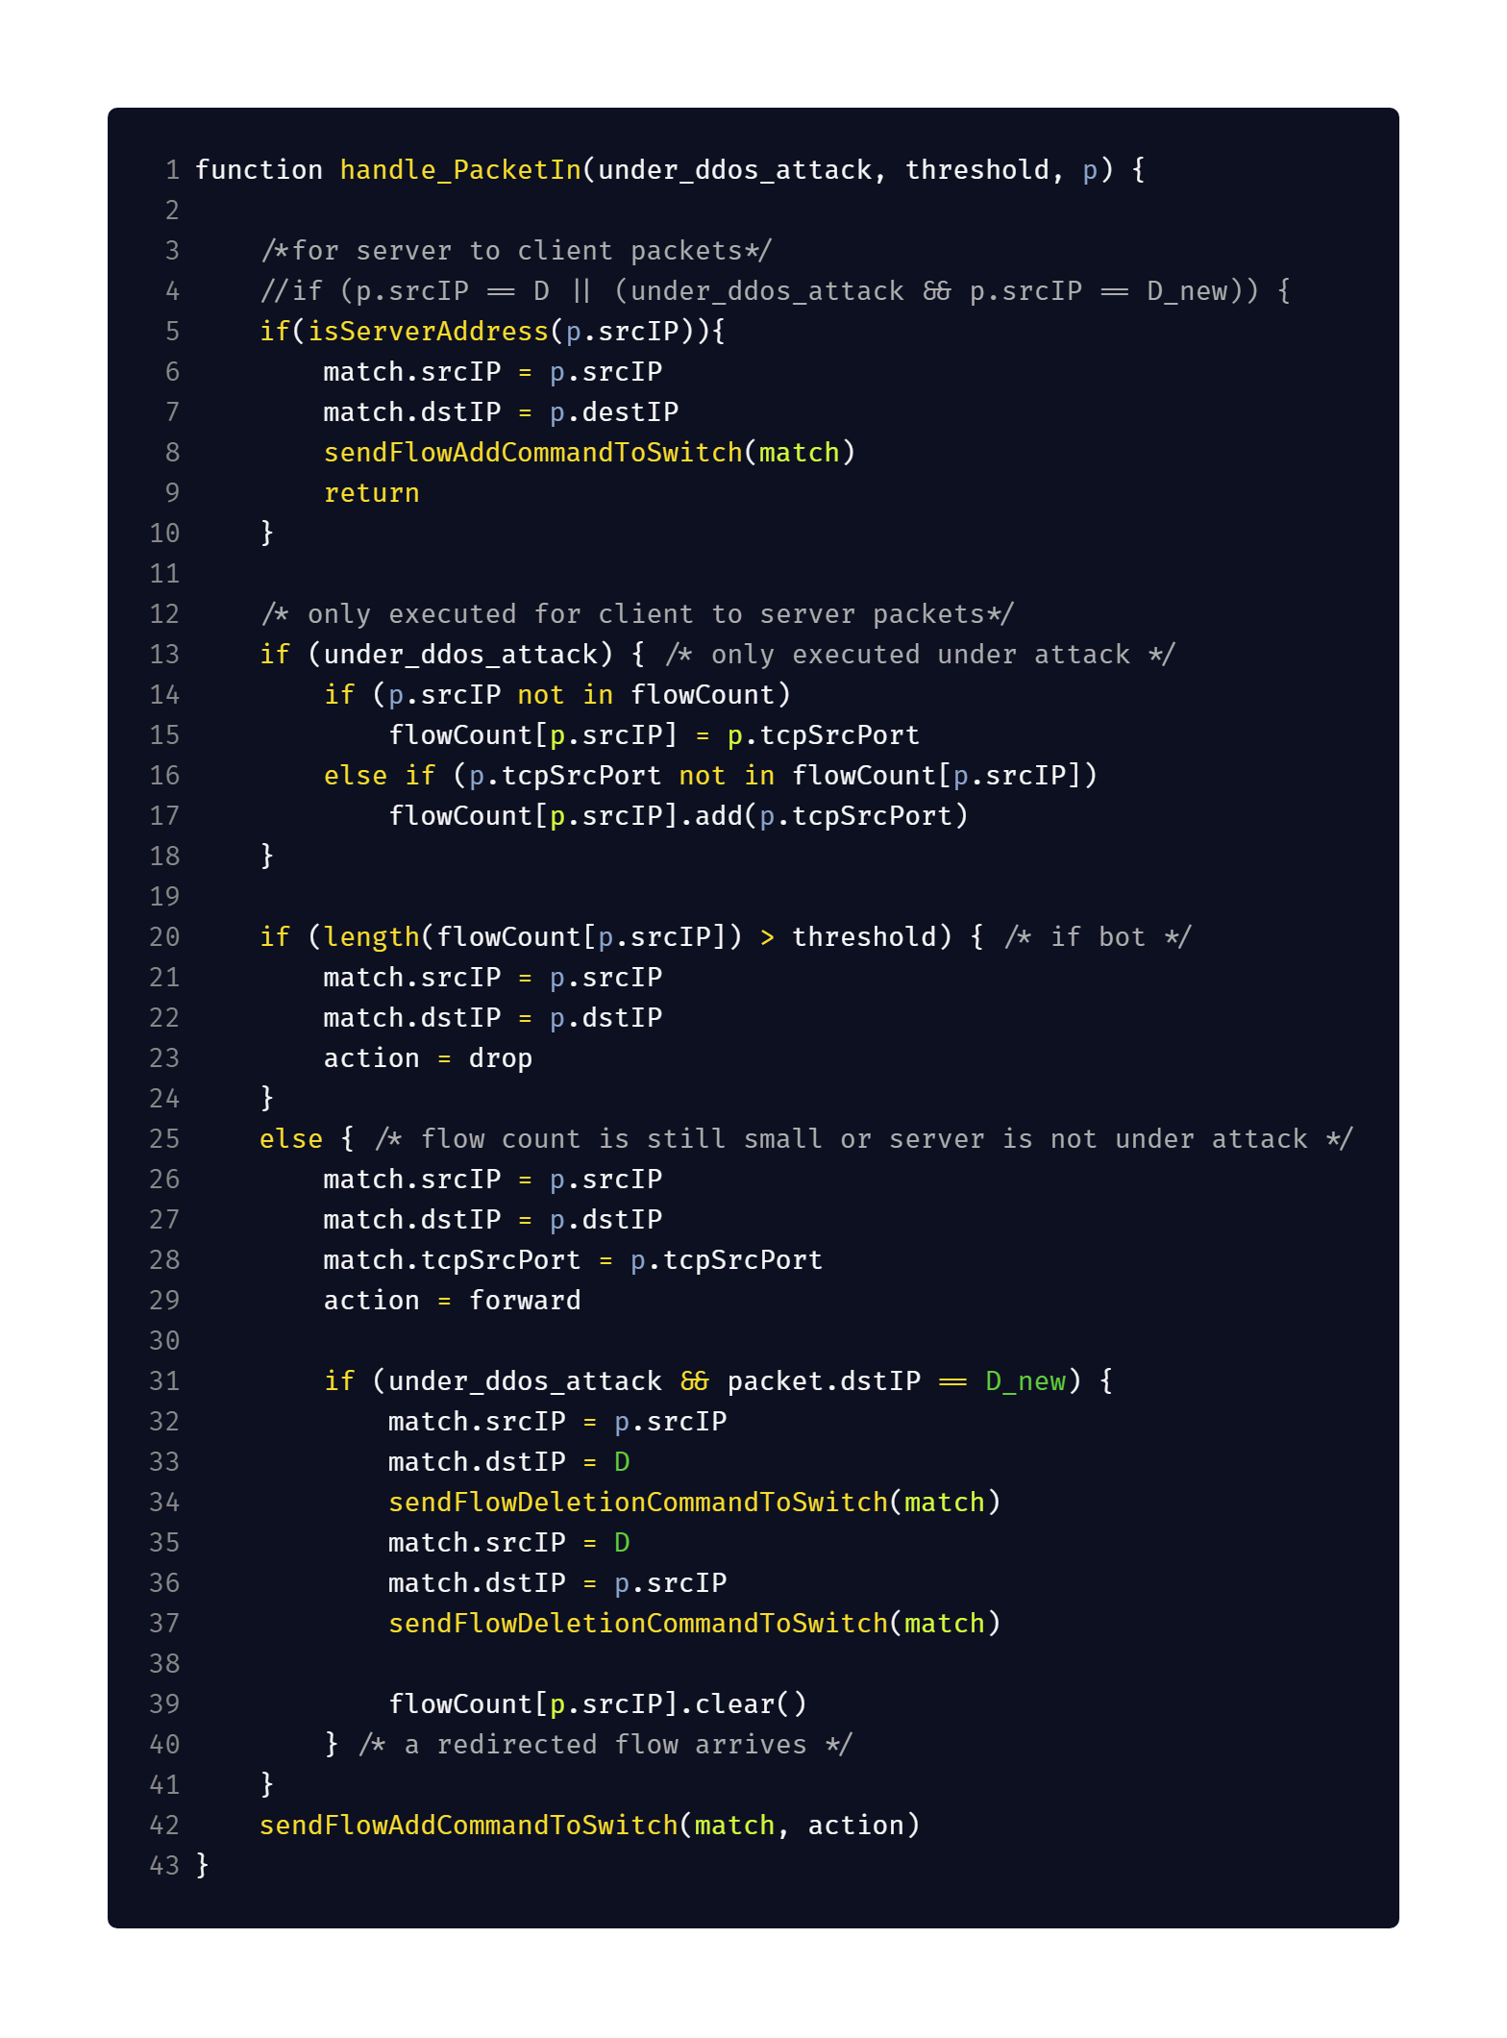
Our Pseudocode
Differences:
Add rules for packets coming from the server to clients.
Packets coming from server need only to be forwarded, then execution can stop after adding the server forwarding rule.

Slide 7
Our Pseudocode
Differences:
Checking for connection coming from clients to new server address must be done only when protection is enabled.
The dictionary of clients connecitons must be cleared when connection to new server address is detected.

Slide 8
Implementation Issues
Execution order of floodlight modules [1]
The normal rule (action.normal) does not work for non hybrid switches [2]
Learning switch:
Added method to ILearningSwitch to retrieve learned port from MAC address
Deleting rules types [3]
OFFlowDelete deletes rules matching at least the specified fields
OFFlowDeleteStrict deletes the rules that exactly looks like the match you specify
Testing is done in Python using mininet library and not mininet cli
Due to automating issues for command injection
Notes:
https://floodlight.atlassian.net/wiki/spaces/floodlightcontroller/pages/1343513/How+to+Write+a+Module#HowtoWriteaModule-OrderingModuleswhenProcessingOpenFlowMessages
Per il normal rule, hybrid switch implementano nativamente il livello due e quindi avrebbero fatto arp e switch https://www.opennetworking.org/wp-content/uploads/2014/10/openflow-spec-v1.3.3.pdf chapter 5.1
Il learning switch
https://floodlight.atlassian.net/wiki/spaces/floodlightcontroller/pages/1343547/How+to+use+OpenFlowJ-Loxigen

Slide 9
Implementation Issues
Execution order of floodlight modules [1]
The normal rule (action.normal) does not work for non hybrid switches [2]
Learning switch:
Added method to ILearningSwitch to retrieve learned port from MAC address
Deleting rules types [3]
OFFlowDelete deletes rules matching at least the specified fields
OFFlowDeleteStrict deletes the rules that exactly looks like the match you specify
Testing is done in Python using mininet library and not mininet cli
Due to automating issues for command injection
Notes:
https://floodlight.atlassian.net/wiki/spaces/floodlightcontroller/pages/1343513/How+to+Write+a+Module#HowtoWriteaModule-OrderingModuleswhenProcessingOpenFlowMessages
Per il normal rule, hybrid switch implementano nativamente il livello due e quindi avrebbero fatto arp e switch https://www.opennetworking.org/wp-content/uploads/2014/10/openflow-spec-v1.3.3.pdf chapter 5.1
Il learning switch
https://floodlight.atlassian.net/wiki/spaces/floodlightcontroller/pages/1343547/How+to+use+OpenFlowJ-Loxigen

Slide 10
Implementation Issues
Execution order of floodlight modules [1]
The normal rule (action.normal) does not work for non hybrid switches [2]
Learning switch:
Added method to ILearningSwitch to retrieve learned port from MAC address
Deleting rules types [3]
OFFlowDelete deletes rules matching at least the specified fields
OFFlowDeleteStrict deletes the rules that exactly looks like the match you specify
Testing is done in Python using mininet library and not mininet cli
Due to automating issues for command injection
Notes:
https://floodlight.atlassian.net/wiki/spaces/floodlightcontroller/pages/1343513/How+to+Write+a+Module#HowtoWriteaModule-OrderingModuleswhenProcessingOpenFlowMessages
Per il normal rule, hybrid switch implementano nativamente il livello due e quindi avrebbero fatto arp e switch https://www.opennetworking.org/wp-content/uploads/2014/10/openflow-spec-v1.3.3.pdf chapter 5.1
Il learning switch
https://floodlight.atlassian.net/wiki/spaces/floodlightcontroller/pages/1343547/How+to+use+OpenFlowJ-Loxigen

Slide 11
Implementation Issues
Execution order of floodlight modules [1]
The normal rule (action.normal) does not work for non hybrid switches [2]
Learning switch:
Added method to ILearningSwitch to retrieve learned port from MAC address
Deleting rules types [3]
OFFlowDelete deletes rules matching at least the specified fields
OFFlowDeleteStrict deletes the rules that exactly looks like the match you specify
Testing is done in Python using mininet library and not mininet cli
Due to automating issues for command injection
Notes:
https://floodlight.atlassian.net/wiki/spaces/floodlightcontroller/pages/1343513/How+to+Write+a+Module#HowtoWriteaModule-OrderingModuleswhenProcessingOpenFlowMessages
Per il normal rule, hybrid switch implementano nativamente il livello due e quindi avrebbero fatto arp e switch https://www.opennetworking.org/wp-content/uploads/2014/10/openflow-spec-v1.3.3.pdf chapter 5.1
Il learning switch
https://floodlight.atlassian.net/wiki/spaces/floodlightcontroller/pages/1343547/How+to+use+OpenFlowJ-Loxigen

Slide 12
Implementation Issues
Execution order of floodlight modules [1]
The normal rule (action.normal) does not work for non hybrid switches [2]
Learning switch:
Added method to ILearningSwitch to retrieve learned port from MAC address
Deleting rules types [3]
OFFlowDelete deletes rules matching at least the specified fields
OFFlowDeleteStrict deletes the rules that exactly looks like the match you specify
Testing is done in Python using mininet library and not mininet cli
Due to automating issues for command injection
Notes:
https://floodlight.atlassian.net/wiki/spaces/floodlightcontroller/pages/1343513/How+to+Write+a+Module#HowtoWriteaModule-OrderingModuleswhenProcessingOpenFlowMessages
Per il normal rule, hybrid switch implementano nativamente il livello due e quindi avrebbero fatto arp e switch https://www.opennetworking.org/wp-content/uploads/2014/10/openflow-spec-v1.3.3.pdf chapter 5.1
Il learning switch
https://floodlight.atlassian.net/wiki/spaces/floodlightcontroller/pages/1343547/How+to+use+OpenFlowJ-Loxigen

Slide 13
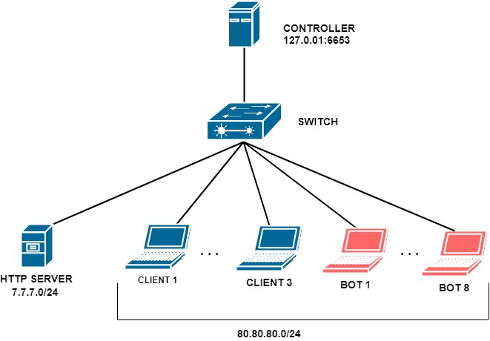
TESTING MODEL
Notes:
Il nostro modulo è stato testato usando un set di script da noi prodotti.
Abbiamo creato un ambiente come quello in figura, composto da un server HTTP, 3 client, 8 bot e uno switch con controller.
Il server ha un indirizzo nel range di 7.7.7.0/24 i client e i bot 80.80.80.0/24 e il controller aspetterà per le connessioni OpenFlow PACKET_IN su 120.0.0.1:6653.

Slide 14
Testing environment
3 Clients and 8 Bots
Simulated with start_client.sh and start_bot.sh, using raw netcat
1 HTTP Server
Implemented in Python
Multithreaded
will perform both forward and normal servicing
Notes:
I due scenari sono simulati usando due script separati: start_client e start_bot.
Start_bot inizia una connessione per volta e prova a riconnettersi se la perde, un altro bot ancora potrebbe inizare una connessione in modo asincrono, questo andrebbe ad incrementare il contatore del numero di connessioni del server.
Start_client deve essere in grado di fare il forwarding, ma questo deve essere abbastanza complesso da non poter essere fatto da un bot, abbiamo risolto questo problema facendo in modo che lo script del bot ignori il forwarding.

Slide 15
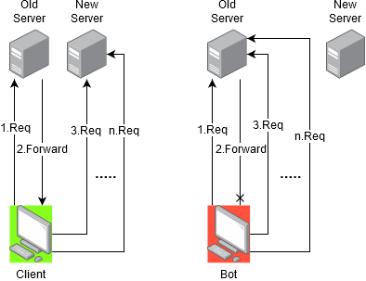
Testing environment
Clients and Bots continuously request an HTTP connection to the server, however:
Clients can solve CAPTCHAs and get forwarded to the new server address
Bots, instead, will not be able to solve the problem and will keep doing requests on old server address
Notes:
I client connessi al server possono essere client regolari o maliziosi. Sia i client che i bot mandano continuamente richieste HTTP al server, la differenza è che il client potrà risolvere il forwarding mentre il bot non può eseguire operazioni complesse come il captcha per il forwarding e quindi continuerà a fare richieste sul vecchio indirizzo.
Non sono necessarie regole di routing o di inoltro complesse perché lo switch risolverà il problema di indirizzamento utilizzando le tabelle di switching del layer 2. L’unica regola che serve è quella per mandare i pacchetti originati dai device emulati attraverso l’interfaccia connessa allo switch. ARP assicura di impostare l’indirizzo MAC di destinazione corretto sul pacchetto di origine.

Slide 16
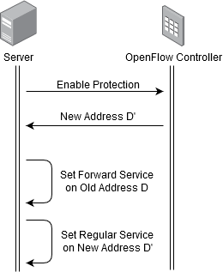
Testing environment
When the server is under attack:
it notifies the Controller to enable the protection using REST Interface
it changes its address to the one provided by the Controller
it keeps the old address, where it will perform CAPTCHA forward to the new address
In our implementation, both forwarding and normal services are hosted on the same machine
However DDoSDefence Controller implementation can work also with multiple machines
Notes:
Quando la protezione è disabilitata ogni pacchetto viene forwardato al server e ogni risposta del server viene mandata al client. Quando il server si accorge di essere sotto attacco notifica al controller di abilitare la protezione attraverso l’interfaccia REST e il server cambia il suo indirizzo con uno nuovo fornito dal controller, mantenendo il vecchio indirizzo in cui verrà eseguito il captcha per il forwarding al nuovo indirizzo. Quando la protezione è abilitata, avremo lo stesso tipo di risposta sia per i client che per i server solamente fino a quando il numero di connessioni è minore della soglia prestabilita. Superata la soglia il client viene identificato come bot e le vecchie entrate della tabella vengono eliminate tramite una regola di timeout. Se è il client ad effettuare le richieste con la protezione attiva, allora passerà al nuovo indirizzo D’ e le vecchie regole sono droppate.

Slide 17
Testing environment
The testing environment is implemented using a python script
Providing a GUI
Using mininet library
Automating nodes command injection
Executing enable protection procedure on behalf of server
Through console command injection
Using requests library for executing REST API requests (for initialization and enable protection)
GUI displays one console for each Client/Bot
Reporting HTTP request result for each node
GUI can also display OpenFlow Switch flow table entries
Notes:
Quindi, ricapitolando, l’ambiente di test è creato utilizzando le librerie mininet di python. Lo script fornisce una graphic user interface che può eseguire la procedura di abilitazione della protezione tramite l’utilizzo di comandi da console oppure tramite la libreria request per l’esecuzione delle richieste REST api per l’inizializzazione e l’abilitazione della protezione. L’interfaccia grafica mostra una consolle per ogni client e bot nella quale ognuno di loro riporta la risposta alla richiesta HTTP. Nell’interfaccia grafica che adesso andremo a vedere viene fornito un set di pulsanti per avviare il test, abilitare la protezione ed eseguire dei test generici come il ping.

