Slide 1

SDN-Oriented DDoS Blocking Scheme for Botnet-Based Attacks
Antonio LE CALDARE
Edoardo SASSU
Elena SCARSELLI

Slide 2
DDosDefence: Project Goal
Server protection from DDoS attacks
A Server (or more than one) is attached to an OpenFlow switch
The OpenFlow switch will perform filtering for malicious clients
An OpenFlow controller (DDoSDefence) will label clients into Bots or Clients
Threat Model
Bots are modelled as very simple programs, which cannot do other than repeating HTTP requests to a fixed address
Bots can perform KeepAlive requests to reuse connections
Bots cannot solve CAPTCHAs and, in general, complex problems

Slide 3
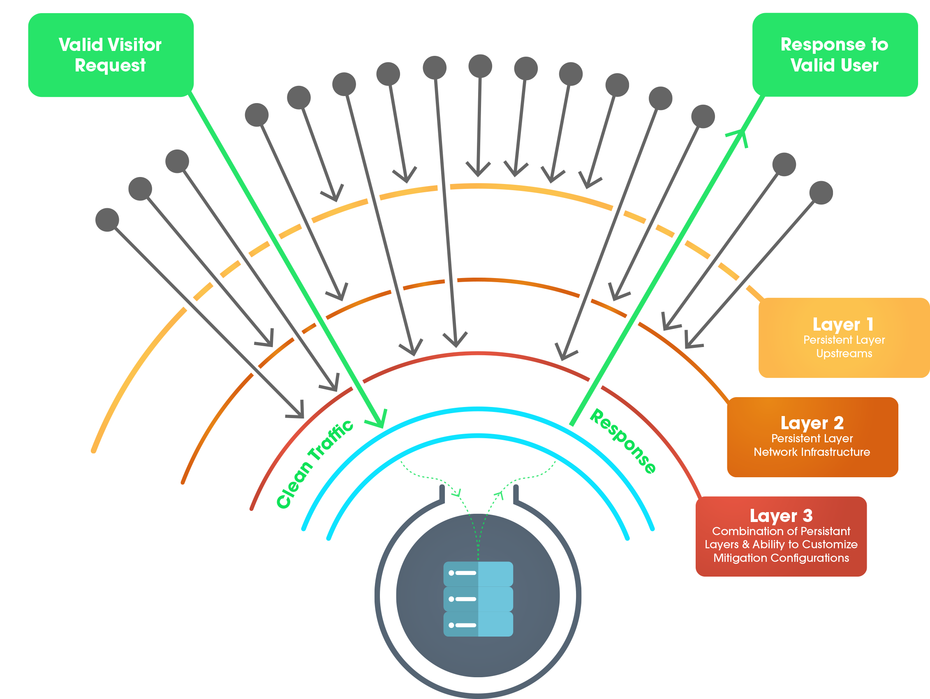
How protection works
Server changes the listening address to a new one when is under attack
The connections requests to the old server address are counted
If the number of connection requests of a client goes above a certain threshold θ, the client is classified as a bot and all its connections are dropped

Slide 4
DDoSDefence: Controller Interface
The controller provides two REST resources (only POST):
Init: required to initialize the controller, can be executed only one time and is required before enabling protection for the first time. Parameters:
Service port, for protected service
Public address pool, assignable to the server(s)
Threshold, for spotting bots
Management: used to enable or disable the protection. Parameters:
Enable, boolean

Slide 5
Learning Switch
The learning switch is used in order to avoid the re-implementation of L2 switching functionalities in our controller
Switch will perform also auto-learning functionalities.
For our purposes, this behaviour must be applied only to ARP and ICMP packets
ARP for enabling packets sending between clients and server;
ICMP for testing purposes (ping and error messages).
Our model does not include L3 forwarding
Packet coming from clients and server are forwarded by default to the switch.

Slide 6
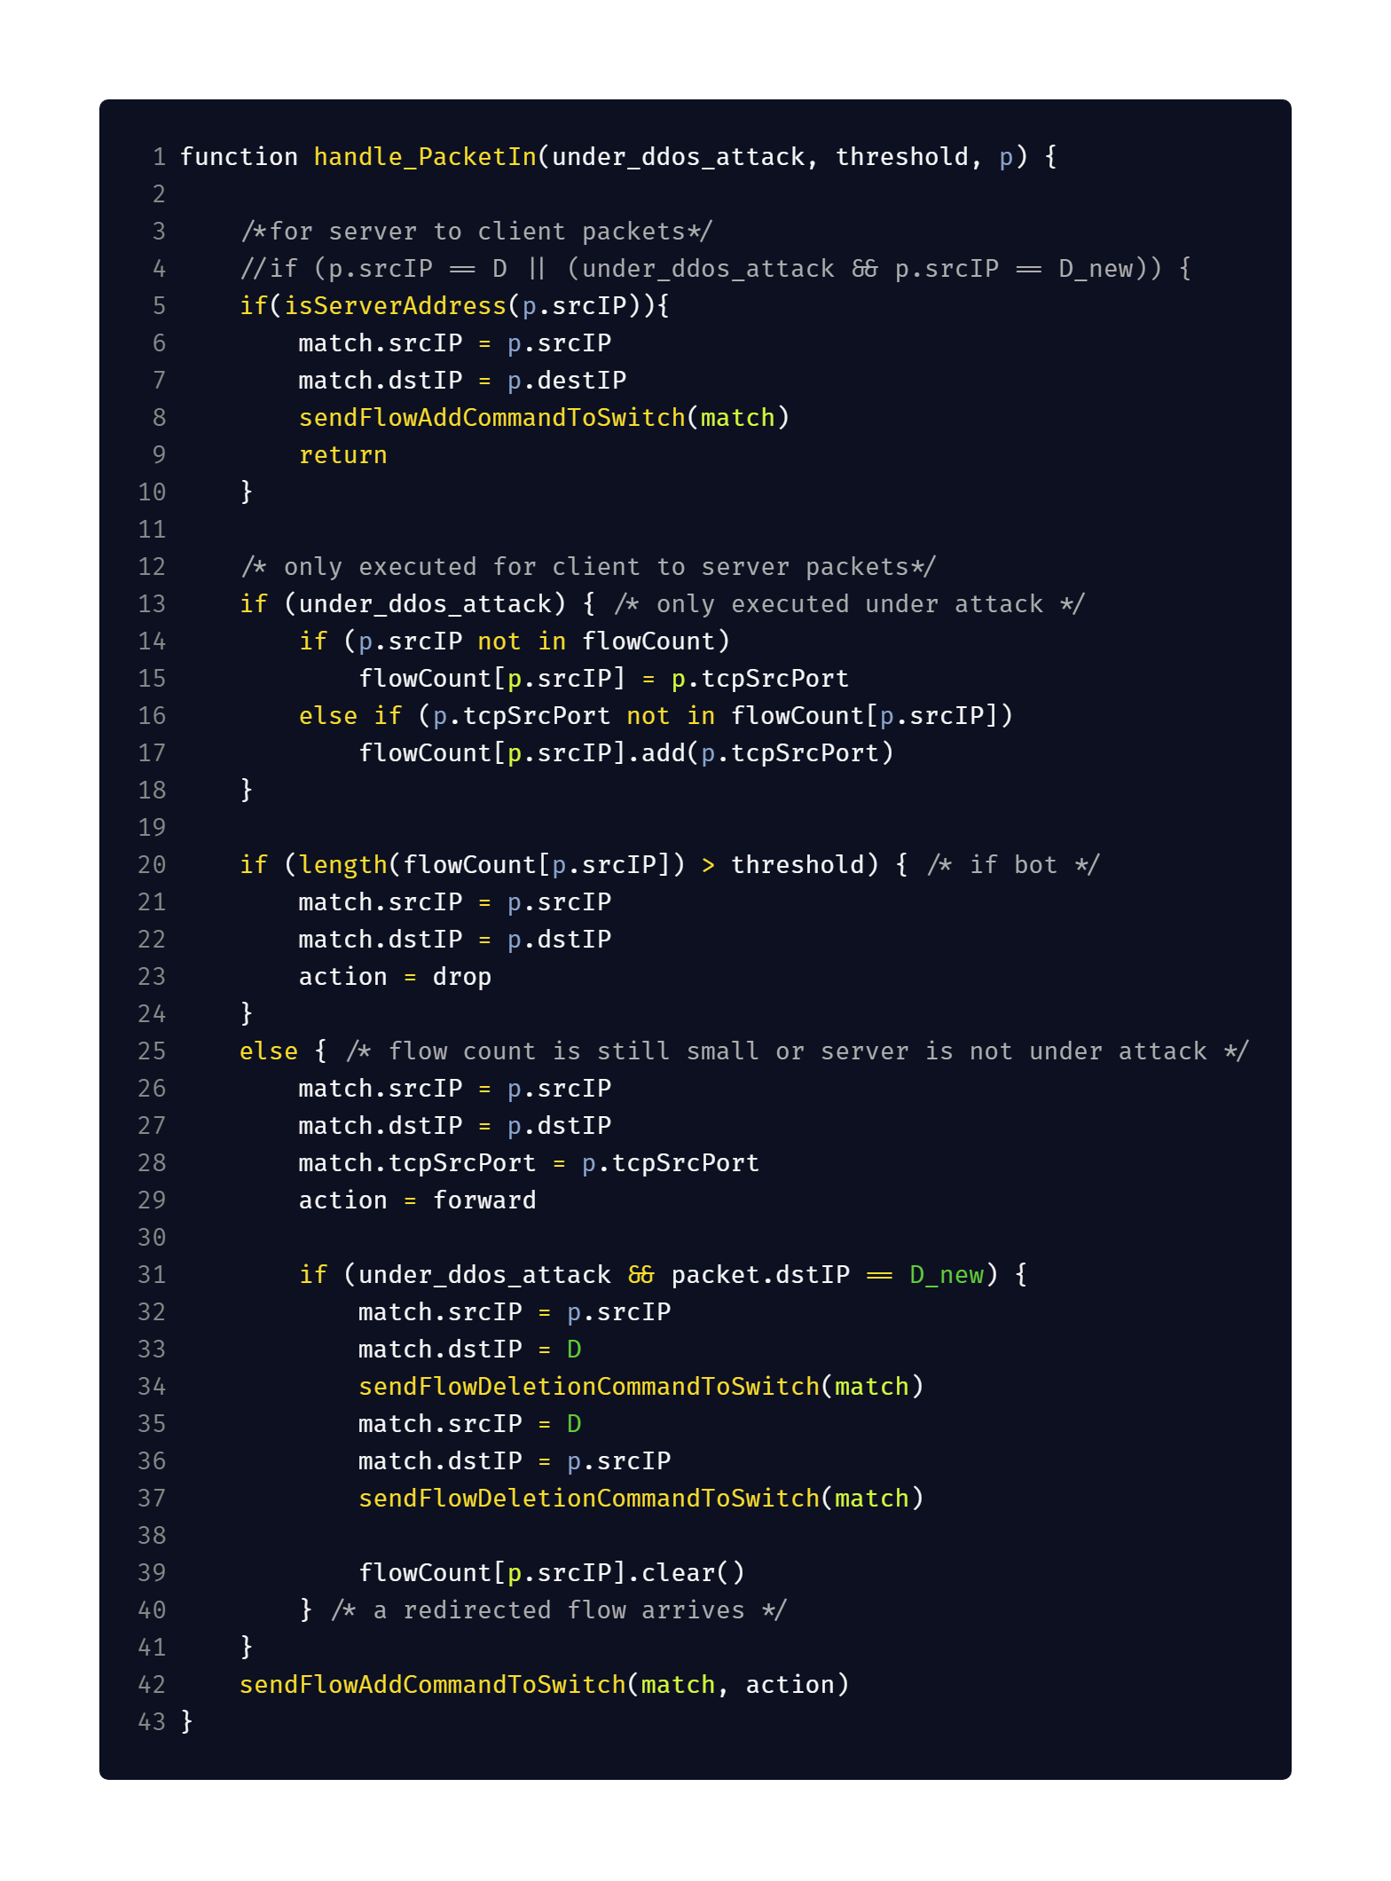
Our Pseudocode
Differences:
Add rules for packets coming from the server to clients.
Packets coming from server need only to be forwarded, then execution can stop after adding the server forwarding rule.

Slide 7
Our Pseudocode
Differences:
Checking for connection coming from clients to new server address must be done only when protection is enabled.
The dictionary of clients connecitons must be cleared when connection to new server address is detected.

Slide 8
Implementation Issues
Execution order of floodlight modules [1]
The normal rule (action.normal) does not work for non hybrid switches [2]
Learning switch:
Added method to ILearningSwitch to retrieve learned port from MAC address
Deleting rules types [3]
OFFlowDelete deletes rules matching at least the specified fields
OFFlowDeleteStrict deletes the rules that exactly looks like the match you specify
Testing is done in Python using mininet library and not mininet cli
Due to automating issues for command injection
Notes:
https://floodlight.atlassian.net/wiki/spaces/floodlightcontroller/pages/1343513/How+to+Write+a+Module#HowtoWriteaModule-OrderingModuleswhenProcessingOpenFlowMessages
Per il normal rule, hybrid switch implementano nativamente il livello due e quindi avrebbero fatto arp e switch https://www.opennetworking.org/wp-content/uploads/2014/10/openflow-spec-v1.3.3.pdf chapter 5.1
Il learning switch
https://floodlight.atlassian.net/wiki/spaces/floodlightcontroller/pages/1343547/How+to+use+OpenFlowJ-Loxigen

Slide 9
Implementation Issues
Execution order of floodlight modules [1]
The normal rule (action.normal) does not work for non hybrid switches [2]
Learning switch:
Added method to ILearningSwitch to retrieve learned port from MAC address
Deleting rules types [3]
OFFlowDelete deletes rules matching at least the specified fields
OFFlowDeleteStrict deletes the rules that exactly looks like the match you specify
Testing is done in Python using mininet library and not mininet cli
Due to automating issues for command injection
Notes:
https://floodlight.atlassian.net/wiki/spaces/floodlightcontroller/pages/1343513/How+to+Write+a+Module#HowtoWriteaModule-OrderingModuleswhenProcessingOpenFlowMessages
Per il normal rule, hybrid switch implementano nativamente il livello due e quindi avrebbero fatto arp e switch https://www.opennetworking.org/wp-content/uploads/2014/10/openflow-spec-v1.3.3.pdf chapter 5.1
Il learning switch
https://floodlight.atlassian.net/wiki/spaces/floodlightcontroller/pages/1343547/How+to+use+OpenFlowJ-Loxigen

Slide 10
Implementation Issues
Execution order of floodlight modules [1]
The normal rule (action.normal) does not work for non hybrid switches [2]
Learning switch:
Added method to ILearningSwitch to retrieve learned port from MAC address
Deleting rules types [3]
OFFlowDelete deletes rules matching at least the specified fields
OFFlowDeleteStrict deletes the rules that exactly looks like the match you specify
Testing is done in Python using mininet library and not mininet cli
Due to automating issues for command injection
Notes:
https://floodlight.atlassian.net/wiki/spaces/floodlightcontroller/pages/1343513/How+to+Write+a+Module#HowtoWriteaModule-OrderingModuleswhenProcessingOpenFlowMessages
Per il normal rule, hybrid switch implementano nativamente il livello due e quindi avrebbero fatto arp e switch https://www.opennetworking.org/wp-content/uploads/2014/10/openflow-spec-v1.3.3.pdf chapter 5.1
Il learning switch
https://floodlight.atlassian.net/wiki/spaces/floodlightcontroller/pages/1343547/How+to+use+OpenFlowJ-Loxigen

Slide 11
Implementation Issues
Execution order of floodlight modules [1]
The normal rule (action.normal) does not work for non hybrid switches [2]
Learning switch:
Added method to ILearningSwitch to retrieve learned port from MAC address
Deleting rules types [3]
OFFlowDelete deletes rules matching at least the specified fields
OFFlowDeleteStrict deletes the rules that exactly looks like the match you specify
Testing is done in Python using mininet library and not mininet cli
Due to automating issues for command injection
Notes:
https://floodlight.atlassian.net/wiki/spaces/floodlightcontroller/pages/1343513/How+to+Write+a+Module#HowtoWriteaModule-OrderingModuleswhenProcessingOpenFlowMessages
Per il normal rule, hybrid switch implementano nativamente il livello due e quindi avrebbero fatto arp e switch https://www.opennetworking.org/wp-content/uploads/2014/10/openflow-spec-v1.3.3.pdf chapter 5.1
Il learning switch
https://floodlight.atlassian.net/wiki/spaces/floodlightcontroller/pages/1343547/How+to+use+OpenFlowJ-Loxigen

Slide 12
Implementation Issues
Execution order of floodlight modules [1]
The normal rule (action.normal) does not work for non hybrid switches [2]
Learning switch:
Added method to ILearningSwitch to retrieve learned port from MAC address
Deleting rules types [3]
OFFlowDelete deletes rules matching at least the specified fields
OFFlowDeleteStrict deletes the rules that exactly looks like the match you specify
Testing is done in Python using mininet library and not mininet cli
Due to automating issues for command injection
Notes:
https://floodlight.atlassian.net/wiki/spaces/floodlightcontroller/pages/1343513/How+to+Write+a+Module#HowtoWriteaModule-OrderingModuleswhenProcessingOpenFlowMessages
Per il normal rule, hybrid switch implementano nativamente il livello due e quindi avrebbero fatto arp e switch https://www.opennetworking.org/wp-content/uploads/2014/10/openflow-spec-v1.3.3.pdf chapter 5.1
Il learning switch
https://floodlight.atlassian.net/wiki/spaces/floodlightcontroller/pages/1343547/How+to+use+OpenFlowJ-Loxigen

Slide 13
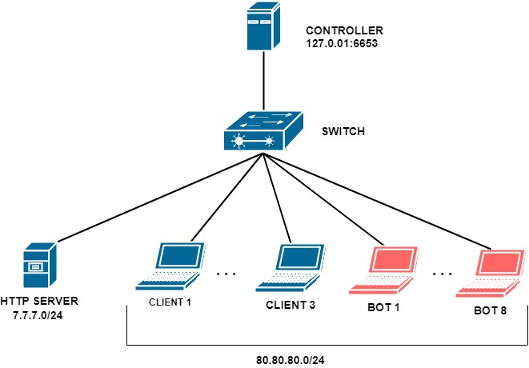
TESTING MODEL

Slide 14
Testing environment
3 Clients and 8 Bots
Simulated with start_client.sh and start_bot.sh, using raw netcat
1 HTTP Server
Implemented in Python
Multithreaded
will perform both forward and normal servicing
Notes:
Even if the Bots send requests continuously, the Server is always able to respond, because it opens a new thread for each request, so the server does not stop even if it is bombarded with requests

Slide 15
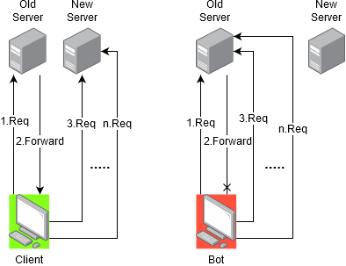
Testing environment
Clients and Bots continuously request an HTTP connection to the server, however:
Clients can solve CAPTCHAs and get forwarded to the new server address
Bots, instead, will not be able to solve the problem and will keep doing requests on old server address
Notes:
Even if the Bots send requests continuously, the Server is always able to respond, because it opens a new thread for each request, so the server does not stop even if it is bombarded with requests

Slide 16
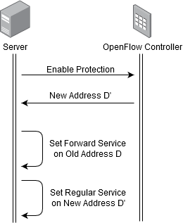
Testing environment
When the server is under attack:
it notifies the Controller to enable the protection using REST Interface
it changes its address to the one provided by the Controller
it keeps the old address, where it will perform CAPTCHA forward to the new address
In our implementation, both forwarding and normal services are hosted on the same machine
However DDoSDefence Controller implementation can work also with multiple machines
Notes:
Even if the Bots send requests continuously, the Server is always able to respond, because it opens a new thread for each request, so the server does not stop even if it is bombarded with requests

Slide 17
Testing environment
The testing environment is implemented using a python script
Providing a GUI
Using mininet library
Automating nodes command injection
Executing enable protection procedure on behalf of server
Through console command injection
Using requests library for executing REST API requests (for initialization and enable protection)
GUI displays one console for each Client/Bot
Reporting HTTP request result for each node
GUI can also display OpenFlow Switch flow table entries
Notes:
Even if the Bots send requests continuously, the Server is always able to respond, because it opens a new thread for each request, so the server does not stop even if it is bombarded with requests

