Slide 1
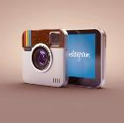
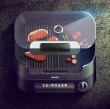



PRODUCT FEATURES
Your great subtitle in this line
Brand 1
Brand 2
Brand 3
Brand 4
Brand 5
Pharmacy
Restaurants
Only RSVP
Supermarket
For Personal Use
Only RSVP
No Vitamins
Call Before
All Food In Town
24 Hours Open

