Slide 1
Real-time emotion recognition on videos
Magda Kougkoula
Eleni Tapta

Slide 2
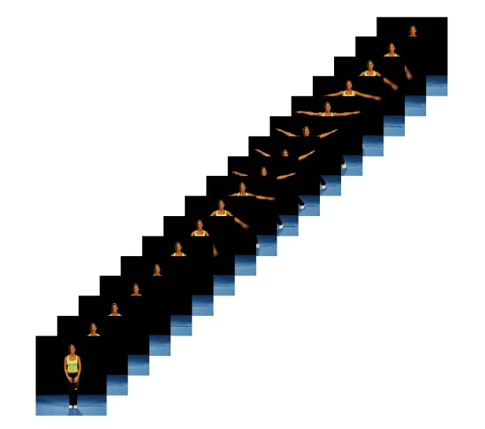
Overview
Emotion Recognition for Real-time video streaming
Videos are sequences of frames
Frame classification with CNN

Slide 3
CNN for Image Emotion Recognition
CNN Model development
Input
Data Augmentation
Output
Pre -Processing
Emotion Recognition

Slide 4
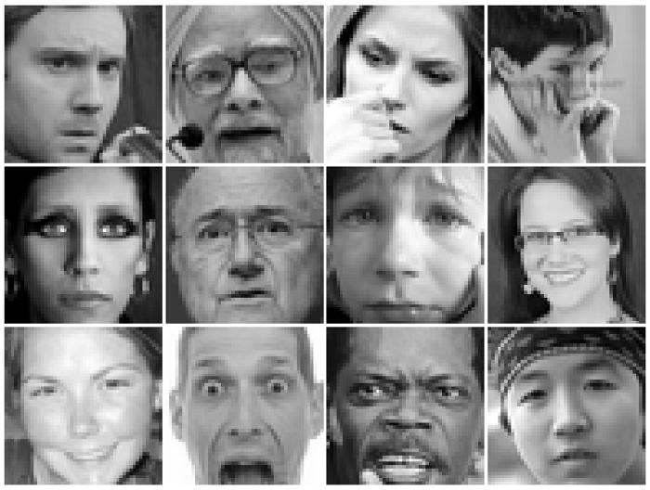
FER2013 Dataset
FER Kaggle Challenge
~36k labeled images
Size: 48×48
Grayscale (mostly)
May vary in viewpoint, lighting and scale

Slide 5

CMU-MOSEI Dataset
Multimodal Opinion Sentiment and Emotion Intensity
~3k videos / 1000 speakers

Slide 6
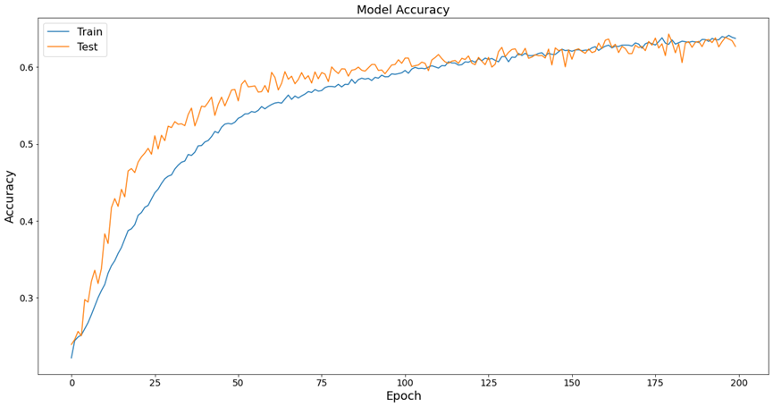
CNN Accuracy

Slide 7


Single Frame CNN Architecture
Loop over frames → Frame classification using CNN model
Pre-process each frame (Conversion to grayscale, Resize)
Face detection using OpenCV

Slide 8
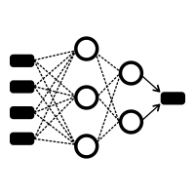
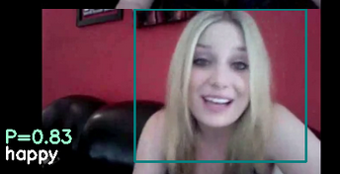

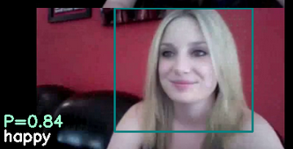
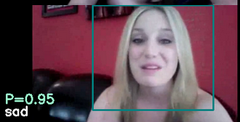

Frames Classification
Happy
CNN
Happy
CNN
Final Output: Happy
Happy
CNN
$$AVG \left(\frac{Probability}{Class Frequency}\right)×AVG \left(\frac{Probability}{Total Frames}\right)$$
Sad
CNN

Slide 9
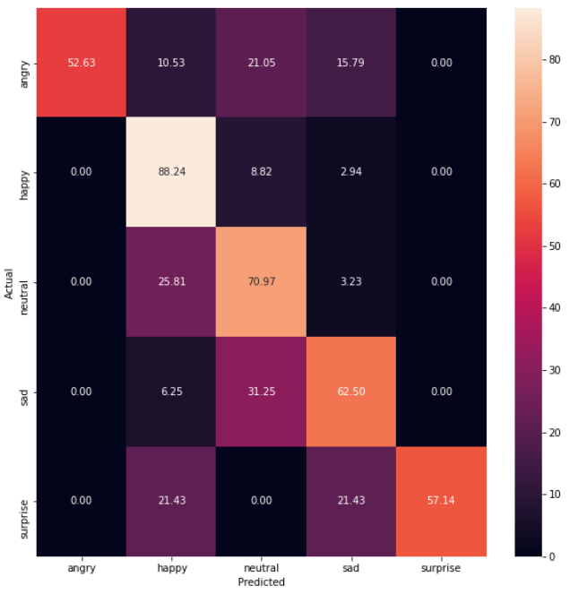
Test results
Test method on a subset of MOSEI videos (mostly reviews)

Slide 10
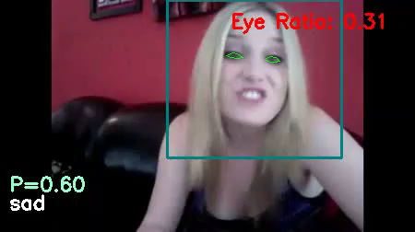
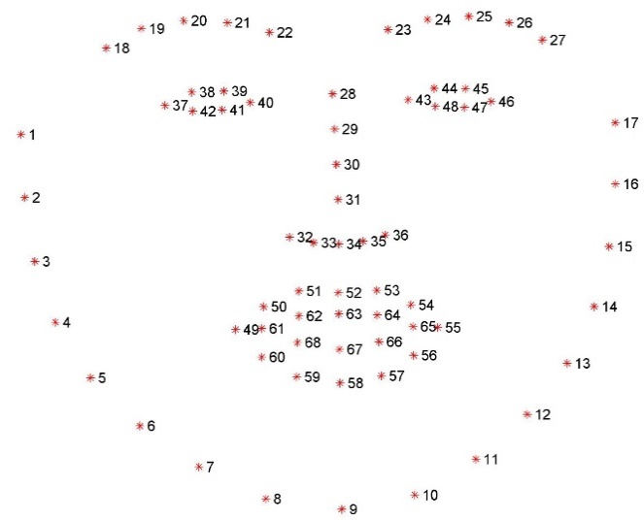

Facial Landmark Detection
Facial Landmark Detection using dlib

Slide 11
Next Steps
Overall fast process for real-time expression recognition
Applications: monitoring reaction or emotional state during interviews or during tasks (i.e. driving)
Misses sequential nature and additional details of video, such as eye movement, gestures etc. → RNN/LSTM model

