Slide 1
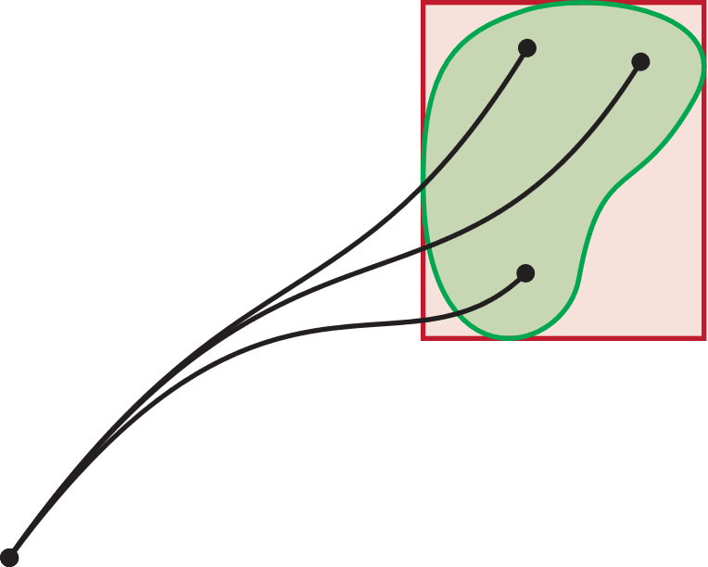
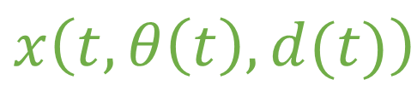
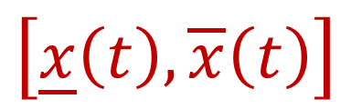

$$x\left(t, θ\left(t\right),d(t)\right)$$
$$\left[\underline{x}\left(t\right), \overline{x}\left(t\right)\right]$$
$$x\left(0\right)$$

Slide 2
$$x\left(t, θ\left(t\right),d(t)\right)$$
$$x\left(0\right)$$

