Slide 1

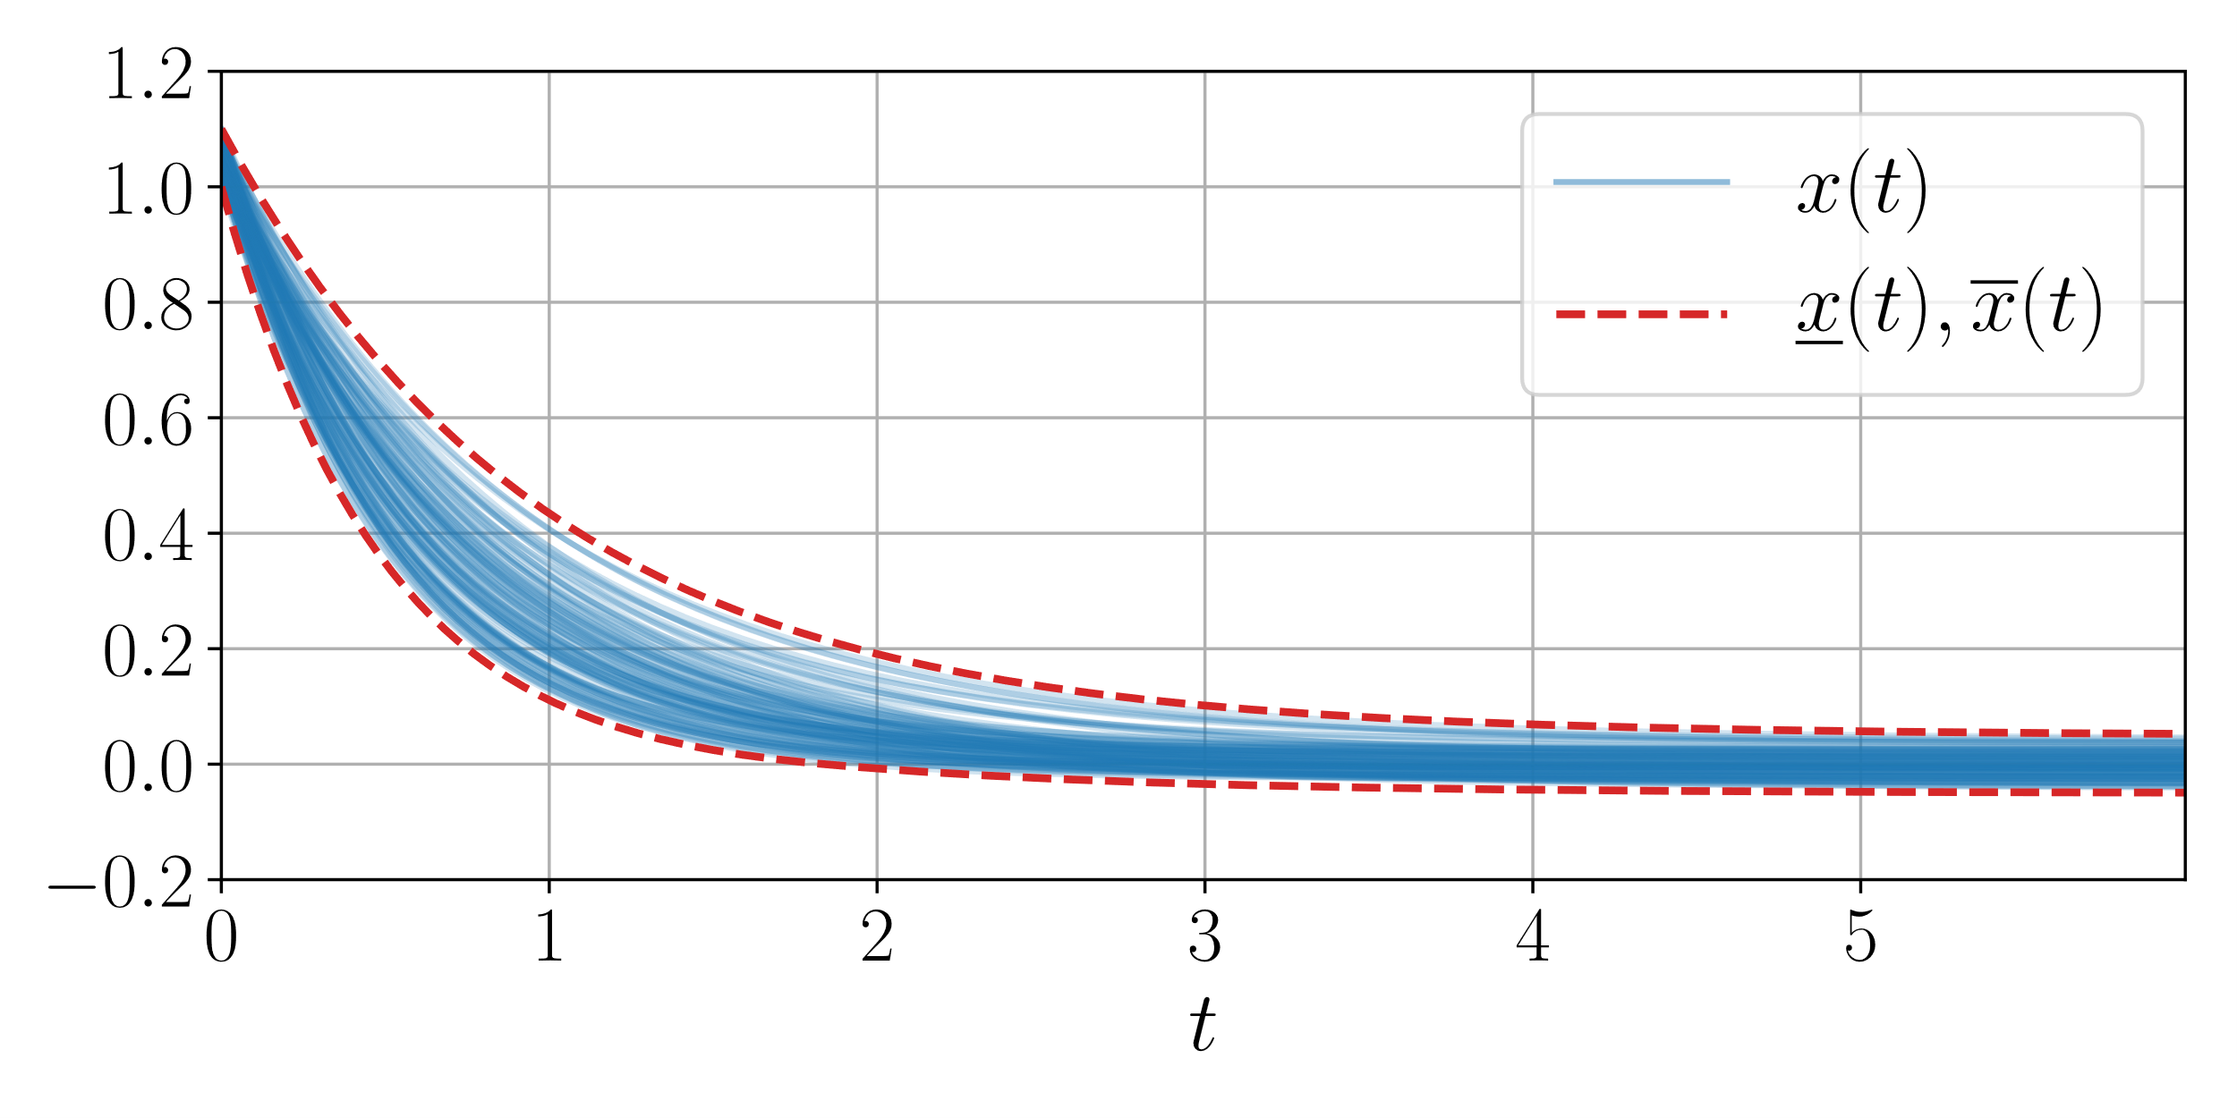
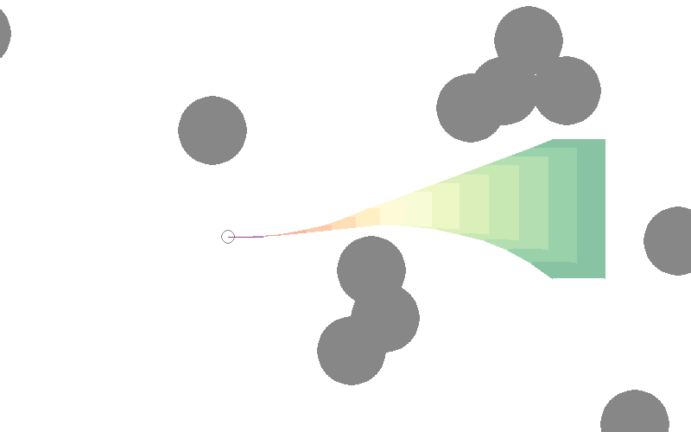
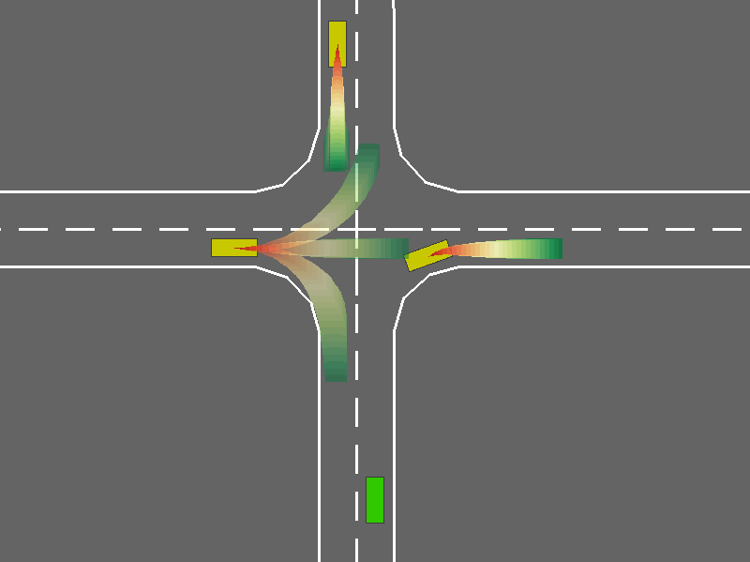
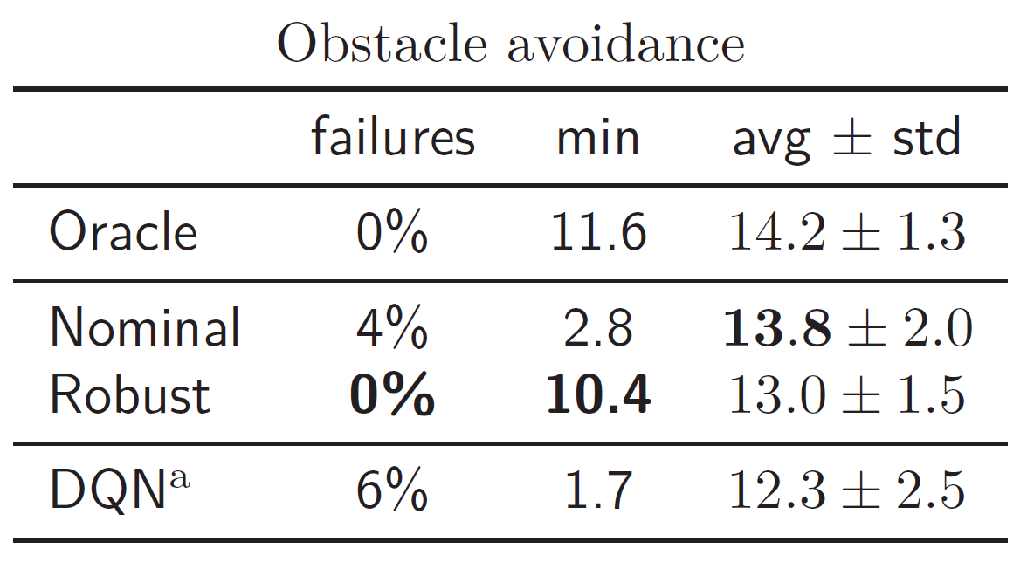
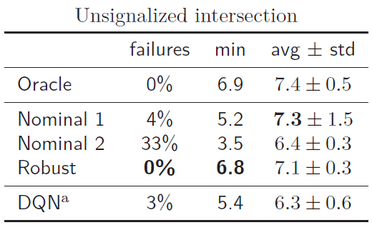
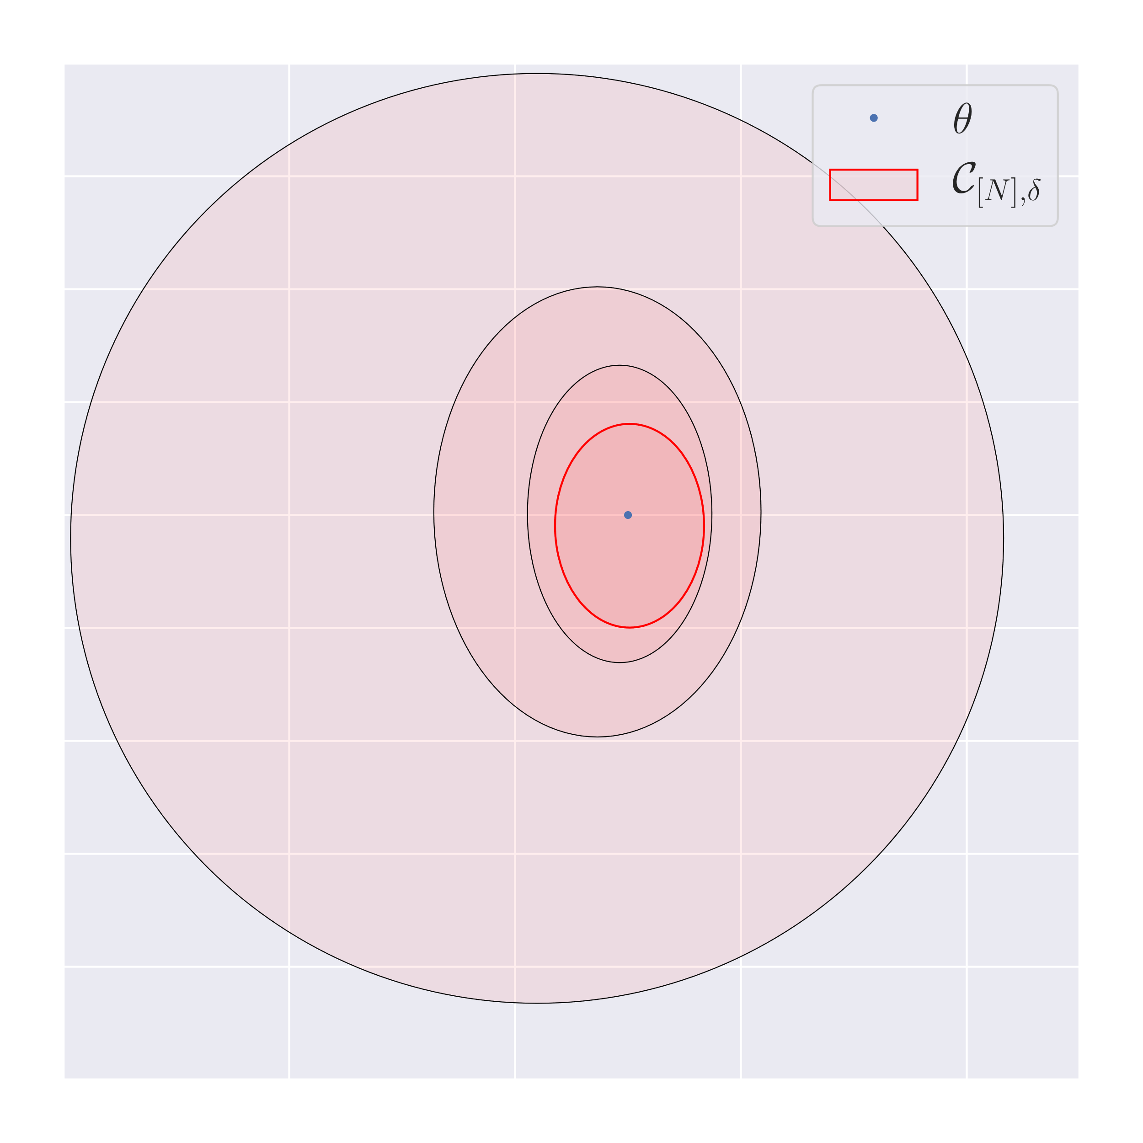
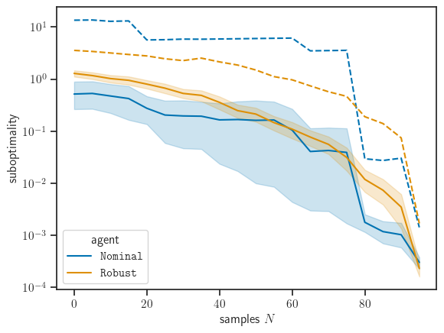





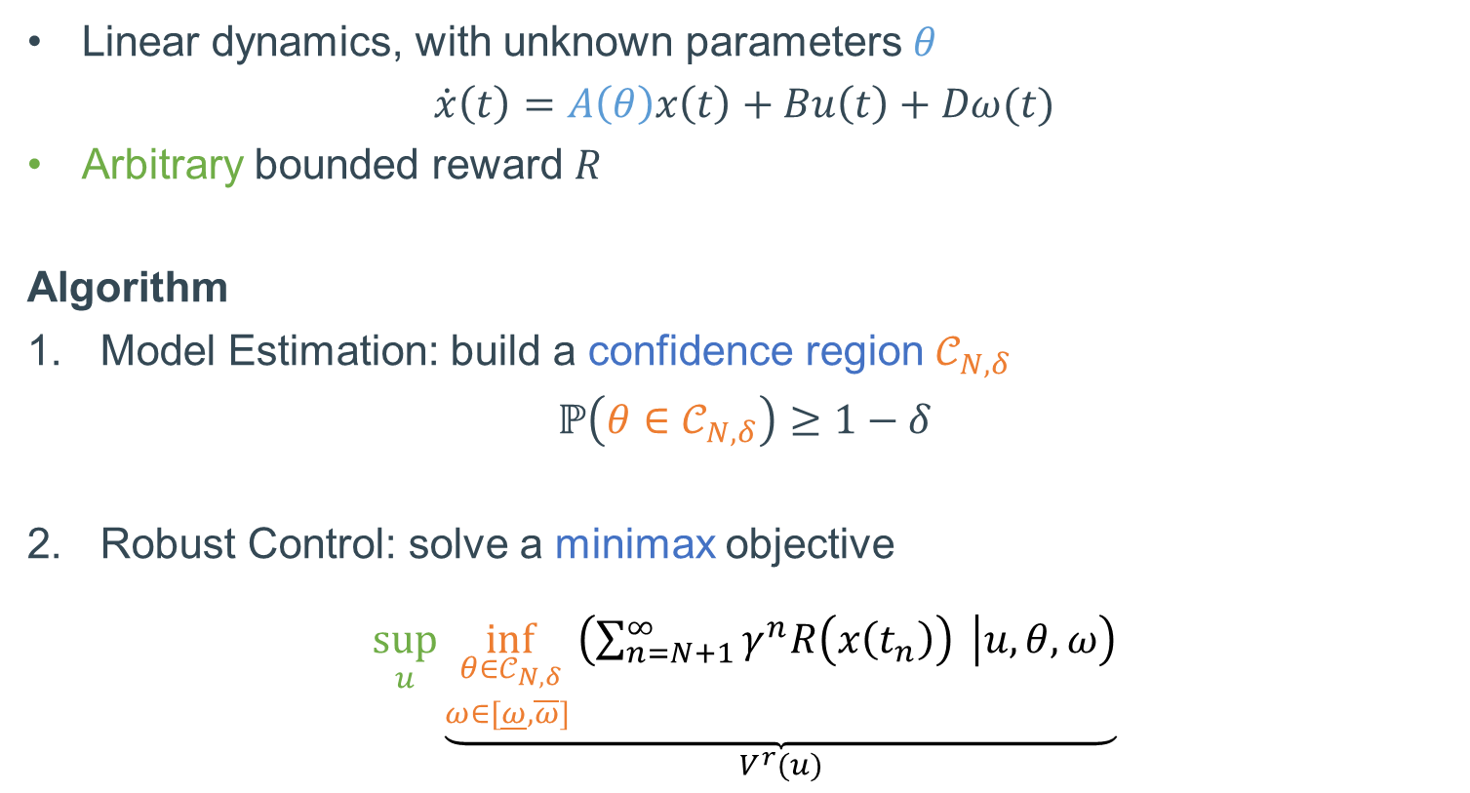

Robust-Adaptive Control of Linear Systems: beyond Quadratic Costs
Edouard Leurent, Denis Efimov, Odalric-Ambrym Maillard
Motivation
2.1. Interval Prediction
Theorem (Bounded suboptimality) Under two conditions:
Lipschitz reward R,
A stability condition for $A\left(θ_{N}\right)$,
we can bound the suboptimality with probability at least $1−δ$ by
$$\underset{suboptimality}{\underbrace{V\left(u^{⋆}\right)−V(u_{K})}}≤\underset{\begin{aligned}robustness to \\ disturbances\end{aligned}}{\underbrace{Δ_{ω}}}−\underset{\begin{aligned}estimation \\ error\end{aligned}}{\underbrace{𝒪\left(\frac{β_{N,δ}^{2} }{λ_{min}\left(G_{N,λ}\right)}\right)}}−\underset{\begin{aligned}planning \\ error\end{aligned}}{\underbrace{𝒪\left(K_{}^{−\frac{\log\left(κ\right)}{log 1/γ}}\right)}}$$
Corollary (Asymptotic near-optimality)
Under an additional persistent excitation assumption,
the stability condition can be relaxed to apply to the true system $A\left(θ\right)$
the model estimation error takes the more explicit form
$$\frac{β_{N,δ}^{2} }{λ_{min}\left(G_{N,λ}\right)}=𝒪\left(\frac{{log(N}^{d/2}/δ)}{N}\right)$$
which ensures asymptotic near-optimality as $N→∞$, $K→∞$.
Adaptive: estimate the dynamics along the way
Robust: avoid failures, prepare for the worst
Related work: Robust DP (finite states), quadratic costs (stabilization only)
Having observed $N$ samples, given $θ∈𝒞_{N,δ}$ we want to bound the trajectory
$$\underline{x}\left(t\right)≤x\left(t\right)≤\overline{x}\left(t\right), ∀t≥t_{N}.$$
Proposition (Predictor of Leurent et al., 2019) For $A\left(θ_{N}\right)$ Metzler,
$$\dot{\underline{x}}\left(t\right)=A\left(θ_{N}\right)\underline{x}\left(t\right)−ΔA_{+}{\underline{x}}^{−}\left(t\right)−ΔA_{−}{\overline{x}}^{+}\left(t\right)+Bu\left(t\right)+D^{+}\underline{ω}\left(t\right)−D^{−}\overline{ω}\left(t\right), \\ \overline{x}\left(t\right)=A\left(θ_{N}\right)\overline{x}\left(t\right)+ΔA_{+}{\overline{x}}^{+}\left(t\right)+ΔA_{−}{\underline{x}}^{−}\left(t\right)+Bu\left(t\right)+D^{+}\overline{ω}\left(t\right)−D^{−}\underline{ω}\left(t\right),$$
ensures the inclusion property.
Setting
Linear dynamics, with unknown parameters $θ$
$$\dot{x}\left(t\right)=A\left(θ\right)x\left(t\right)+Bu\left(t\right)+Dω(t)$$
Arbitrary bounded reward $R$
Algorithm
Model Estimation: build a confidence region $𝒞_{N,δ}$
$$ℙ\left(θ∈𝒞_{N,δ}\right)≥1−δ$$
Robust Control: solve a minimax objective
$$\sup_{u}\underset{V^{r}(u)}{\underbrace{\inf_{\begin{aligned}θ∈𝒞_{N,δ} \\ ω∈[\underline{ω},\overline{ω}] \end{aligned}}\left(\sum_{n=N+1}^{∞}{γ^{n}R\left(x\left(t_{n}\right)\right) } | u,θ,ω\right)}}$$
Experiments
Predicted intervals for a simple example.
1. Model Estimation
2.2. Robust Control
Structure assumption: $A\left(θ\right)=A+\sum_{i=1}^{d}{θ_{i}φ_{i}}$
Noise model: sub-Gaussian observations, bounded disturbance $ω\left(t\right)$
Theorem (Confidence Ellipsoid, adaptation of Abbasi-Yadkori et al., 2001)
With probability at least $1−δ$,
$${\left\|θ−θ_{N,λ}\right\|}_{G_{N,λ}}≤β_{N}\left(δ\right).$$
We approximate $V^{r}$ by a tractable pessimistic surrogate ${\hat{V}}^{r}$ using the predicted intervals:
$${\hat{V}}^{r}\left(u\right)= \sum_{n=N+1}^{∞}{γ^{n}\min_{\underline{x}\left(t_{n}\right) ≤ x ≤ \overline{x}\left(t_{n}\right)} R(x)}.$$
${\hat{V}}^{r}$is easily evaluable and can be optimized by Monte-Carlo Tree Search.
Theorem (Lower bound)
$$\underset{\begin{aligned}surrogate \\ value\end{aligned}}{\underbrace{{\hat{V}}^{r}\left(u\right)}}≤\underset{\begin{aligned}robust \\ value\end{aligned}}{\underbrace{V^{r}(u)}}≤\underset{\begin{aligned}true \\ performance\end{aligned}}{\underbrace{V(u)}}$$
If we find some good enough control sequence $u$ that attains a desirable (safe) level of predicted performance ${\hat{V}}^{r}$ while planning, it is guaranteed to perform at least as well when executed on the true system.
But the gap can lead to suboptimal behavior.
${\hat{V}}^{r}$
Mean (solid), 95% CI for the mean (shaded), and maximum (dashed) suboptimality with respect to the number of samples $N$.
The robust agent gets more efficient as it is more confident, while ensuring safety at all times.
The confidence ellipsoid shrinks as the number of samples $N$ increases.

