Slide 1
CSA3202: Natural Language Processing
Statistics 3 – Spelling Models
Typing Errors
Error Models
Spellchecking
Noisy Channel Methods
Probabilistic Methods
Bayesian Methods
November 2005
CSA3180: Statistics III

Slide 2
Introduction
Slides based on Lectures by Mike Rosner (2003/2004)
Chapter 5 of Jurafsky & Martin, Speech and Language Processing
http://www.cs.colorado.edu/~martin/slp.html
November 2005
CSA3180: Statistics III

Slide 3
Speech Recognition and Text Correction
Commonalities:
  Both concerned with problem of accepting a string of symbols and mapping them to a sequence of progressively less likely words
  Spelling correction: characters
  Speech recognition: phones
November 2005
CSA3180: Statistics III

Slide 4
Noisy Channel Model
Guess at original word
Original
Word
Source
Noisy
Channel
Noisy Word
Receiver
Language generated and passed through a noisy channel
Resulting noisy data received
Goal is to recover original data from noisy data
Same model can be used in diverse areas of language processing e.g. spelling correction, morphological analysis, pronunciation modelling, machine translation
Metaphor comes from Jelinek’s (1976) work on speech recognition, but algorithm is a special case of Bayesian inference (1763)
November 2005
CSA3180: Statistics III

Slide 5
Spelling Correction
Kukich(1992) breaks the field down into three increasingly broader problems:
  Detection of non-words (e.g. graffe)
  Isolated word error correction (e.g. graffe → giraffe)
  Context dependent error detection and correction where the error may result in a valid word (e.g. there → three)
November 2005
CSA3180: Statistics III

Slide 6
Spelling Error Patterns
According to Damereau (1964) 80% of all misspelled words are caused by single-error misspellings which fall into the following categories (for the word the):
  Insertion (ther)
  Deletion (th)
  Substitution (thw)
  Transposition (teh)
Because of this study, much subsequent research focused on the correction of single error misspellings
November 2005
CSA3180: Statistics III

Slide 7
Causes of Spelling Errors
Keyboard Based
  83% novice and 51% overall were keyboard related errors
  Immediately adjacent keys in the same row of the keyboard (50% of the novice substitutions, 31% of all substitutions)
Cognitive
  Phonetic seperate – separate
  Homonym there – their
November 2005
CSA3180: Statistics III

Slide 8
Bayesian Classification
Given an observation, determine which set of classes it belongs to
Spelling Correction:
  Observation: String of characters
  Classification: Word that was intended
Speech Recognition:
  Observation: String of phones
  Classification: Word that was said
November 2005
CSA3180: Statistics III

Slide 9
Bayesian Classification
Given string O = (o₁, o₂, …, o_{n}) of observations
Bayesian interpretation starts by considering all possible classes, i.e. set of all possible words
Out of this universe, we want to choose that word w in the vocabulary V which is most probable given the observation that we have O, i.e.:
ŵ = argmax _{w ∈ V} P(w | O)
where argmax _{x} f(x) means
“the x such that f(x) is maximised”
Problem: Whilst this is guaranteed to give us the optimal word, it is not obvious how to make the equation operational: for a given word w and a given O we don’t know how to compute P(w | O)
November 2005
CSA3180: Statistics III

Slide 10
Bayes’ Rule
Intuition behind Bayesian classification is use Bayes’ rule to transform P(w | O) into a product of two probabilities, each of which is easier to compute than P(w | O)
November 2005
CSA3180: Statistics III

Slide 11
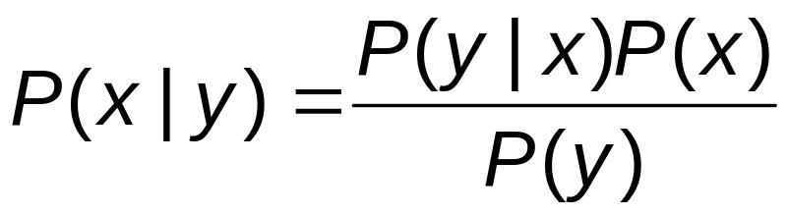
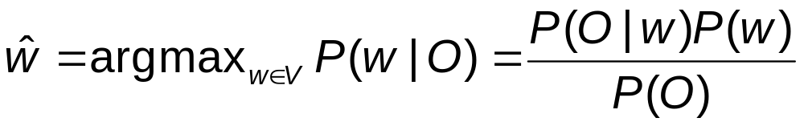
Bayes’ Rule
Bayes’ Rule
we obtain
P(w) can be estimated from word frequency
P(O | w) can also be easily estimated
P(O), the probability of the observation sequence, is harder to estimate, but we can ignore it
November 2005
CSA3180: Statistics III

Slide 12
PDF Slides
See PDF Slides on spell.pdf
Pages 11-20
November 2005
CSA3180: Statistics III

Slide 13
Confusion Set
The confusion set of a word w includes w along with all words in the dictionary D such that O can be derived from w by a single application of one of the four edit operations:
  Add a single letter.
  Delete a single letter.
  Replace one letter with another.
  Transpose two adjacent letters.
November 2005
CSA3180: Statistics III

Slide 14
Error Model 1
Mayes, Damerau et al. 1991
Let C be the number of words in the confusion set of w.
The error model, for all s in the confusion set of d, is:
P(O|w) = α if O=w,
(1- α)/(C-1) otherwise
α is the prior probability of a given typed word being correct.
Key Idea: The remaining probability mass is distributed evenly among all other words in the confusion set.
November 2005
CSA3180: Statistics III

Slide 15
Error Model 2: Church & Gale 1991
Church & Gale (1991) propose a more sophisticated error model based on same confusion set (one edit operation away from w).
Two improvements:
  Unequal weightings attached to different editing operations.
  Insertion and deletion probabilities are conditioned on context. The probability of inserting or deleting a character is conditioned on the letter appearing immediately to the left of that character.
November 2005
CSA3180: Statistics III

Slide 16
Obtaining Error Probabilities
The error probabilities are derived by first assuming all edits are equiprobable.
They use as a training corpus a set of space-delimited strings that were found in a large collection of text, and that (a) do not appear in their dictionary and (b) are no more than one edit away from a word that does appear in the dictionary.
They iteratively run the spell checker over the training corpus to find corrections, then use these corrections to update the edit probabilities.
November 2005
CSA3180: Statistics III

Slide 17
Error Model 3
Brill and Moore (2000)
Let Σ be an alphabet
Model allows all operations of the form
α → β, where α,β in Σ*.
P(α → β) is the probability that when users intends to type the string α they type β instead.
N.B. model considers substitutions of arbitrary substrings not just single characters.
November 2005
CSA3180: Statistics III

Slide 18
Model 3
Brill and Moore (2000)
Model also tries to account for the fact that in general, positional information is a powerful conditioning feature, e.g.
p(entler|antler) < p(reluctent|reluctant)
i.e. Probability is partially conditioned by the position in the string in which the edit occurs.
artifact/artefact; correspondance/correspondence
November 2005
CSA3180: Statistics III

Slide 19
Three Stage Model
Person picks a word.
physical
Person picks a partition of characters within word.
ph y s i c al
Person types each partition, perhaps erroneously.
f i s i k le
p(fisikle|physical) =
p(f|ph) * p(i|y) * p(s|s) * p(i|i) * p(k|c) * p(le|al)
November 2005
CSA3180: Statistics III

Slide 20
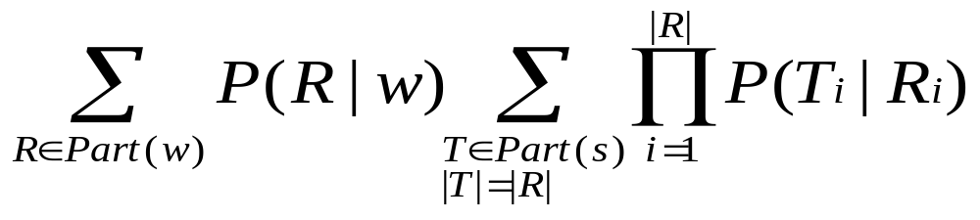
Formal Presentation
Let Part(w) be the set of all possible ways to partition string w into substrings.
For particular R in Part(w) containing j continuous segments, let R_{i} be the i^{th} segment.
Then P(s|w) =
November 2005
CSA3180: Statistics III

Slide 21
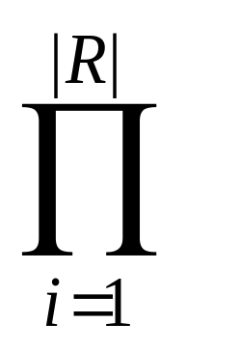
Simplification
By considering only the best partitioning of s and w
this simplifies to
P(s | w) =
max _{R}
P(T_{i}|R_{i})
P(R|w)
November 2005
CSA3180: Statistics III

Slide 22
Training the Model
To train model, need a series of (s,w) word pairs.
begin by aligning the letters in (si,wi) based on MED.
For instance, given the training pair (akgsual, actual), this could be aligned as:
  a c t u a l
  a k g s u a l
November 2005
CSA3180: Statistics III

Slide 23
Training the Model
This corresponds to the sequence of editing operations
a→a c→k ε→g t→s u→u a→a l→l
To allow for richer contextual information, each nonmatch substitution is expanded to incorporate up to N additional adjacent edits.
For example, for the first nonmatch edit in the example above, with N=2, we would generate the following substitutions:
November 2005
CSA3180: Statistics III

Slide 24
Training the Model
  a c t u a l
  a k g s u a l
  c → k
  ac → ak
  c → kg
  ac → akg
  ct → kgs
We would do similarly for the other nonmatch edits, and give each of these substitutions a fractional count.
November 2005
CSA3180: Statistics III

Slide 25
Training the Model
We can then calculate the probability of each substitution α → β as
count(α → β)/count(α).
count(α → β) is simply the sum of the counts derived from our training data as explained above
Estimating count(α) is harder, since we are not training from a text corpus, but from a a set of (s,w) tuples (without an associated corpus)
November 2005
CSA3180: Statistics III

Slide 26
Training the Model
From a large collection of representative text, count the number of occurrences of α.
Adjust the count based on an estimate of the rate with which people make typing errors.
November 2005
CSA3180: Statistics III

