Slide 1


eleven Hackathon
Natural language processing with Python
To the attention of the Data Sciences
& Business Analytics master students
February 8th, 2021

Slide 2












Natural language processing offers specific tools to leverage the opportunities offered by the abundance of textual data
Textual data is omnipresent
Textual data poses unique challenges
Textual data offer enormous potential for task automation
Online reviews
Models do not understand text, only numbers
Classification
Customer support
Text can be in different languages
Summarization
Call for tenders
Question answering
Contracts
Text is of very high dimensionality
Financial reports
Translation
…
…
…

Slide 3



Sentiment analysis, topic modelling and classification
Classification
Nostalgic
Proud
« I spent a year studying abroad in Paris with my friends during college. We didn’t learn much French, but it was the most fun I’ve ever had »
Happy
Angry
Sad
Examples: analysis of online user reviews, analysis of customer support emails

Slide 4

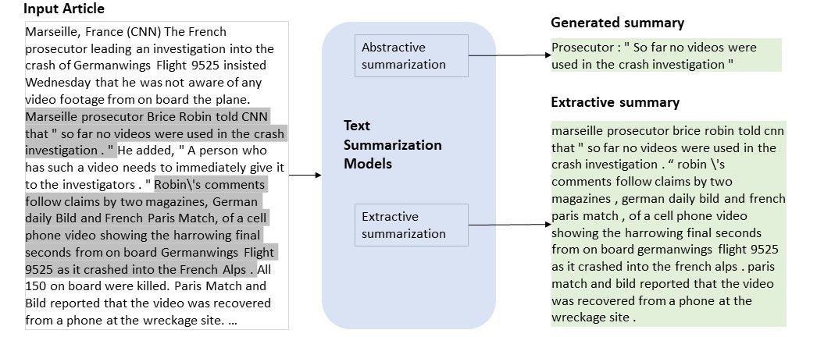
Text summarization
Text summarization
Abstractive summarization generates new text
Extractive summarization selects passages from the input
Examples: summarization of financial reports, calls for tenders, etc.

Slide 5
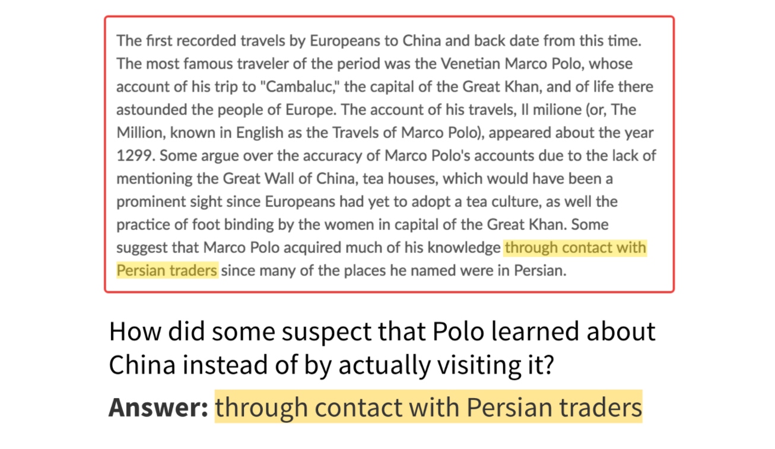
Question answering
Question answering
Extractive question answering
Examples: automatic analysis of documents with predefined questions

Slide 6

Machine translation
Machine translation
Examples: automatic generation of documents in several languages

Slide 7
The most common NLP tasks involve either text classification, text generation, or text extraction
No text generation
Text generation
Classification task
Classification
Text classification
Summarization
Extractive summarization
Abstractive summarization
Generative tasks
Question answering
Extractive question answering
Abstractive question answering
Translation
Extractive tasks
Machine translation

Slide 8



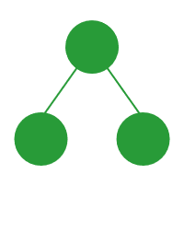











Natural language processing pipeline
Data processing
Feature computation
Tokenization and numericalization
Model
Data cleaning
Tokenization
One-hot encoding
Task-specific model
Ask whether the data can be simplified without loosing meaning. Is it necessary to keep casing, punctuation, numbers, etc?
Split documents into tokens (e.g. words)
Encode each numeric token as a vector of zeros and one
Neural networks
Hidden markov models
Bayes classifiers
...
Vocabulary definition
Stopword removal
Term frequency
Remove words that do not carry meaning
From a set of documents, define and index the universe of possible tokens
Compute the sum of one-hot encodings for all tokens in a document
Stemming
Numericalization
Modern NLP pipeline
Convert words to their stem to reduce vocabulary size
Convert tokens to their numerical index in the vocabulary
Feature embeddings + task-specific model
Python packages

Slide 9



Process the data in order to simplify it without loosing meaning
Data processing
Word case
Punctuation
Special characters
Data cleaning
Watch out for proper nouns, words in all caps, …
Watch out for emojis, …
Watch out for hashtags in Tweets, …
Convert to lowercase?
Remove punctuation?
Replace numbers by a special token <NUM>?
Other special characters that should not be dropped?
Prepositions
Pronouns & articles
Conjunctions
Stopword removal
at, by, on, as, from …
I, me, mine, my, the …
and, but, for, or, so …
NLP packages have built-in lists of words that may carry little meaning, in different languages. Be sure to always review them before using to make sure they are not too aggressive.
Verb conjugation
Plural & possessive
Parts of speech
Stemming or lemmatization
fly, flies, flew, flown
flights, flight’s
fly, flying, flight
Stemming truncates word endings. It may loose meaning but is computationally easy. Use these techniques when building your own vocabulary to avoid having too many words.
fly
flight
fly

Slide 10

Data processing: an example from twitter
Data processing
“Your VOTE on Tuesday, November 3rd is going to SAVE OUR COUNTRY. We are going to defeat the Marxists, Socialists, Rioters, Flag-Burners, and Left-wing Extremists! Get out and VOTE! #MAGA”
Example: Trump tweet
Data cleaning
import string
tweet = ''.join([c.lower() for c in tweet
if c not in string.punctuation])
Convert to lowercase?
Remove punctuation?
Replace numbers by a special token <NUM>?
Other special characters that should not be dropped?
“your vote on tuesday november 3rd is going to save our country we are going to defeat the marxists socialists rioters flagburners and leftwing extremists get out and vote maga”
from nltk.tokenize import word_tokenize
from nltk.corpus import stopwords
set(stopwords.words('english'))
tweet = ' '.join([w for w in word_tokenize(tweet)
if not w in stopwords.words()])
Stopword removal
“vote tuesday november 3rd going save country going defeat marxists socialists rioters flagburners leftwing extremists get vote”
NLP packages have built-in list of words that carry very little meaning, in different languages.
from nltk.stem.porter import *
stemmer = PorterStemmer()
tweet = ' '.join([stemmer.stem(w)
for w in word_tokenize(tweet)])
Stemming or lemmatization
Stemming truncates word endings. It may loose meaning but is computationally easy. Use these techniques when building your own vocabulary to avoid having too many words.
“vote tuesday november 3rd going save countri going defeat marxists socialists rioters flagburners leftwing extremists get vote”

Slide 11




Turn texts into a list of token indices
Tokenization
Example: tokenizing “I am happy”
Tokenization
Words only
Character bigrams
Words, N-grams, character N-grams, …
More complex algorithms (e.g. SentencePiece)
Define special tokens: <PAD> for padding sequences to the same length, <EOS> to mark end of sentence, …
[‘I’, ‘am’, ‘happy’]
[‘I ’, ‘ a’, ‘am’, ‘m ’, ‘ h’, ‘ha’, ‘ap’, ‘pp’, ‘py’]
Words, with sentence delimiters
[‘<SOS>’, ‘I’, ‘am’, ‘happy’, ‘<EOS>’]
Process each example in the dataset
Basic vocabulary
{‘<SOS>’: 0, ‘happy’: 1, ‘I’: 2, ‘am’: 3}
Define a vocabulary
Avoiding rare words
The vocabulary is the set of tokens in the dataset
Rare tokens may be deleted and replaced by a special token <UNK> (for unknown)
Each remaining token is linked to a numerical index
If “happy” is a rare word: {‘<SOS>’: 0, ‘<UNK>’: 1, ‘I’: 2, ‘am’: 3}
Tokenized input
Numericalize each example
[‘I’, ‘am’, ‘happy’]
Numerical input
Vocabulary
[2, 3, 1]
For each example in the dataset, turn the list of tokens into a list of numbers using the vocabulary
{‘<SOS>’: 0, ‘happy’: 1, ‘I’: 2, ‘am’: 3}

Slide 12

Tokenization and numericalization: twitter example
Tokenization
“vote tuesday novemb 3rd go save countri go defeat marxist socialist rioter flagburn leftw extremist get vote”
Tokenization
from nltk.tokenize import word_tokenize
tweet = [w for w in word_tokenize(tweet)]
Words, N-grams, character N-grams, …
More complex algorithms (e.g. SentencePiece)
Define special tokens: <PAD> for padding sequences to the same length, <EOS> to mark end of sentence, …
['vote', 'tuesday', 'novemb', '3rd', 'go', 'save', 'countri', 'go', 'defeat', 'marxist', 'socialist', 'rioter', 'flagburn', 'leftw', 'extremist', 'get', 'vote']
Process each example in the dataset
“vote tuesday novemb 3rd go save countri go defeat marxist socialist rioter flagburn leftw extremist get vote”
“vote tuesday novemb 3rd go save countri go defeat marxist socialist rioter flagburn leftw extremist get vote”
In this example, the dataset (or “corpus”) is a set of tweets
corpus = [[stemmer.stem(w.lower()) for w in word_tokenize(doc)
if not (w in list(string.punctuation)+stopwords.words())
for doc in corpus]
Define a vocabulary
vocab = set([w for doc in corpus for w in doc])
word2idx = {w:idx for idx, w in enumerate(vocab)} idx2word = {idx:w for idx, w in enumerate(vocab)}
The vocabulary is the set of tokens in the dataset
Rare tokens may be deleted and replaced by a special token <UNK> (for unknown)
Each remaining token is associated to a numerical index
“vote tuesday novemb 3rd go save countri go defeat marxist socialist rioter flagburn leftw extremist get vote”
“vote tuesday novemb 3rd go save countri go defeat marxist socialist rioter flagburn leftw extremist get vote”
In this example, the dictionary ends up with 592 words
['vote', 'tuesday', 'novemb', '3rd', 'go', 'save', 'countri', 'go', 'defeat', 'marxist', 'socialist', 'rioter', 'flagburn', 'leftw', 'extremist', 'get', 'vote']
Numericalize each example
indices = [word2idx.get(w,-1) for w in tweet]
For each example in the dataset, turn the list of tokens into a list of numbers using the vocabulary
[185, 474, 300, 469, 63, 460, 429, 63, 84, 533, 29, 200, 416, 395, 185]

Slide 13
Turn the list of token indices into input features for a model
Feature Computation
vote
tuesday
…
extremist
get
vote
185
474
…
416
395
185
Index 0
0
0
0
0
0
0
One-hot encoding for each token
…
…
…
…
…
…
import numpy as np
indices = np.array(indices)
# Create one-hot matrix
size = (indices.max()+1, indices.size)
one_hot = np.zeros(size)
cols = np.arange(indices.size)
one_hot[indices, cols] = 1
# Compute the document-term vector
doc_vector = np.sum(one_hot, axis=1)
Index 185
1
0
0
0
1
2
Dimension: 592
…
…
…
…
…
…
0
0
0
1
0
Sum over tokens
1
Index 395
…
…
…
…
…
…
…
Index 416
0
0
1
0
0
1
…
…
…
…
…
Document-term vector
…
Index 474
0
1
0
0
0
1
…
…
…
…
…
…
Index 591
0
0
0
0
0
0

Slide 14




Use pre-trained embeddings to improve performance
Feature Computation
One-hot encoding poses several problems
The solution is to learn word embeddings
Learning is hard
Meaningful word vectors in lower dimension
No meaningful information about words’ meanings is captured in the input space as all words are equidistant.
A model is trained to be able to predict words from their context, using a compressed representation (embedding).
Learning is slow
Embeddings can be used off-the-shelf
The input space can be very big depending on vocabulary size, which increases computation time and makes learning slow.
Embedding models are pre-trained on large corpuses (e.g. Wikipedia) and learned vectors are available for anyone to use.
Advanced methods give contextual embeddings
Should the embedding for “bank” be the same here?
Sentence 1: “A bank is a financial institution”
Sentence 2: “He swam to the bank across the river”
Traditional embeddings
Word2vec
fastText
GloVe
Contextual embeddings
ELMo
BERT
GPT-2
…
…

Slide 15
Word embedding example
Feature Computation
Typical dimension: 30,000
(size of English vocabulary)
Typical dimension: 300
(size of word2vec vectors)
0
0
0
…
0.049
0
-0.112
One-hot encoding
Word2vec embedding
1
vote
…
0
0.087
…
0.094
0
0
import gensim.downloader as api
vectors = api.load('word2vec-google-news-300')
embedding = vectors['vote']
0

Slide 16
Most Word embedding models are trained to predict words from their context
Feature Computation
Example: continuous bag of words (CBOW) approach to building the training data
Sentences from the training corpus
Extraction of training examples using a sliding window
Final training dataset
Context (input)
Target
I am _______these fine leather jackets
(I, am, these fine)
selling
Goal: predict “selling”
I am selling these fine leather jackets
I am selling _____ fine leather jackets
(am, selling, fine, leather)
these
Goal: predict “these”
I am selling these ____ leather jackets
(selling, these, leather, jackets)
fine
Goal: predict “fine”

Slide 17

Embedding models are mostly based on neural network language models (NNLM)
Feature Computation
Example: word2vec is a neural network with one hidden layer trained using the CBOW approach
Input layer
Output layer
I am selling these fine leather jackets
Hidden layer
=
embedding vector for the target
0
1
Sliding window
0
I am _______these fine leather jackets
(selling, these, leather, jackets)
Document-term encoding
Prediction objective
…
…
…
fine
I am selling _____ fine leather jackets
Goal: predict “selling”
I am selling these ____ leather jackets
1
Goal: predict “these”
Training data
Goal: predict “fine”
1
0
Typical dimension
30,000
Typical dimension
300
Typical dimension
30,000
Word2vec embeddings will be similar for words occurring in similar contexts

Slide 18
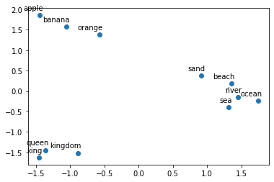
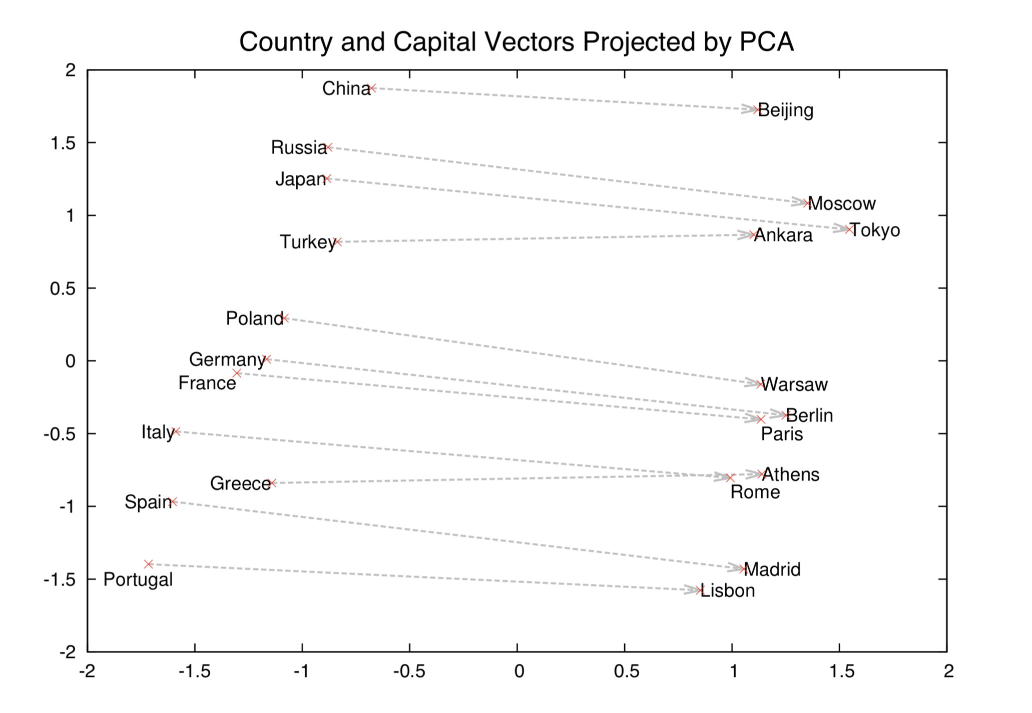
As a result, Word embeddings incorporate information about word meaning
Feature Computation
Distance in the embedding space is meaningful…
… which allows for meaningful vector arithmetic
2D PCA of word2vec embeddings for several words
2D PCA of word2vec embeddings for countries and capitals
Words that are lexically close are also near each other in the embedding space
Semantic relationship from county to capital city is captured in word2vec embedding space:
“Rome = Paris – France + Italy”

Slide 19










Modern NLP pipeline
Modern NLP pipeline
Choose pre-trained embeddings
Fine-tune a model
Pick a dataset
Speed vs. context
Proprietary
Classification
Traditional methods (e.g. word2vec) are faster at training and evaluation but may result in lower performance.
Tailored to the use case
Expensive to build if it does not exist
Add a fully connected layer with right amount of output neurons
Need for text generation
Open
Generative tasks
Some embeddings are good at text generation (e.g. BART or GPT-2) while others are better at information extraction (e.g. BERT).
Easily accessible
Large choice: hundreds of labeled text datasets exist online
Probably not exactly suited to the precise task
License and copyright may prevent use in a production setting
Add fully connected layer with as many neurons as size of vocab (next word prediction)
Language requirements
Extractive tasks
Newer embeddings might only be available in English. Some models support multiple languages.
The last fully connected layer predicts the position of start and end tokens
…
Python packages

Slide 20




Pick an embedding method and fine-tune a model to a task-appropriate dataset
Modern NLP pipeline
Example: movie reviews classification
Choose pre-trained embeddings
from transformers import AutoModelForSequenceClassification
AutoTokenizer
name = 'camembert-base'
model = AutoModelForSequenceClassification.from_pretrained(name)
tokenizer = AutoTokenizer.from_pretrained(name)
What task do I want to achieve?
What is the speed requirement (training & evaluation)?
What language will my data be in?
import datasets
dataset = datasets.load_dataset('allocine')
dataset = dataset.map(lambda x: tokenizer(x['review']))
Iterate to improve performance
Pick a dataset and process it
Do I have proprietary data for my problem?
Which open datasets can relate to my task?
Use for POC or in production (license & copyright)?
How was the data processed when training embeddings?
from transformers import Trainer, TrainingArguments
training_args = TrainingArguments(output_dir='./logs')
trainer = Trainer(
model=model,
args=training_args,
train_dataset=dataset['train’],
)
trainer.train()
Fine-tune the model
Train the model
Evaluate performance

