Slide 1
Total Orders
1M
 | Year
O | 2019
O | 2020
O | 2021
O | 2022
O | 2023
Power BI Desktop
Total Revenue
$983.14M
AOV
$983.14
Revenue YoY %
39.54%
O 2025
Total Revenue Trend
Total Revenue by Date
$70M
$64M
$60M
$61M
$50M
$50M
$40M
$38M
$30M
$25M
$25M
$20M
$16M
$20M
$10M
$10M
$10M
$11M
$14M
$14M
$14M
$2M
$2M
$2M
$2M
$9M
$9M
$11M
$0M
$6M
$6M
$5M
$6M
2019年
2020年
2021年
2022年
2023年
2024年
2025年
Revenue by Category
Monthly Revenue Trend
Sum of revenue by category
Total Revenue by Month Year
0.8bn
0.73bn
0.6bn
$50M
0.4bn
$25M
$25M
$25M
$6M $6M
$7M
$6M
$8M
$8M
$6M
$6M
$2M
$3M $3M
$2M $2M
$2M
$3M
$10M
$2M
$3M $3M
$2M
$10M
$2M
$6M
_{$5M} $7M $8M
$6M $6M $6M
$6M $24M
$6M
$9M $8M
$9M
0.2bn
0.11bn
$0M
$6M
0.07bn
0.03bn
0.02bn
0.01bn
0.01bn
2019-01
2019-02
2019-03
2019-04
2019-05
2019-06
2019-07
2019-08
2019-09
2019-10
2019-11
2019-12
2020-01
2020-02
2020-03
2020-04
2020-05
2020-06
2020-07
2020-08
2020-09
2020-10
2020-11
2020-12
2021-01
2021-02
2021-03
2021-04
2021-05
2021-06
2021-07
2021-08
2021-09
2021-10
2021-11
2021-12
2022-01
2022-02
2022-03
2022-04
2022-05
2022-06
2022-07
2022-08
2022-09
2022-10
2022-11
2022-12
2023-01
2023-02
2023-03
0.0bn
electronics
furniture
fashion
home_goods
auto
toys
books

Slide 2
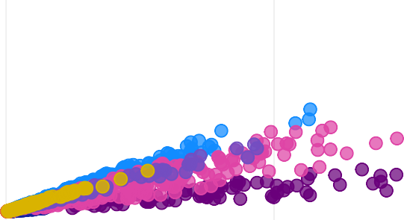
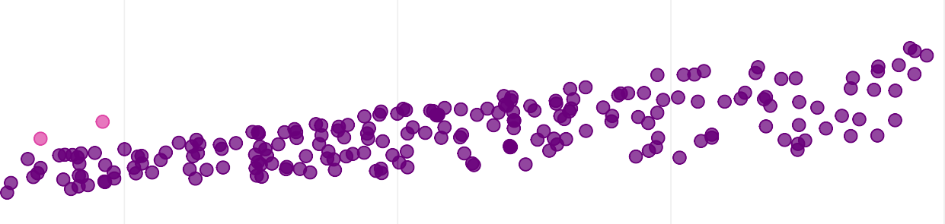
 | Year
O | 2019
O | 2020
O | 2021
O | 2022
O | 2023
Revenue by Category
Power BI Desktop
Top 10 Products by Revenue
Sum of revenue by category
Sum of revenue by product_name
0.8bn
0.73bn
Nimbus Headphones M767
Apex P960 Smartwatch Nova Monitor A779 Orion P631 Tablet
Apex Headphones S938 Nova M311 Tablet Pulse X774 Smartwatch Apex Tablet X807
Nova P896 Camera Nimbus A208 Camera
4.9M
4.9M
4.9M
0.6bn
4.9M
4.8M
4.8M
4.8M
0.4bn
O
2025
0.2bn
4.8M
0.11bn
0.07bn
4.8M
0.03bn
0.02bn
0.01bn
0.01bn
4.8M
0.0bn
electronics
furniture
fashion
home_goods
auto
toys
books
0M
1M
2M
3M
4M
5M
category
Category Profitability
Sum of revenue, Sum of gross_profit and Average of gross_margin_pct by category
O O
auto books electronics fashion furniture
home_goods toys
1.0bn
O O
0.13bn
62.40%
55.14%
40.64%
49.24%
50%
O O
0.5bn
39.99%
0.73bn
18.12%
25.45%
O
0.0bn
electronics
Sum of gross_profit
0.11bn
0%
furniture
Average of gross_margin_pct
fashion
home_goods
auto
toys
books
Sum of revenue
Revenue vs Gross Profit
Sum of revenue, Sum of gross_profit, Average of gross_margin_pct and Sum of units_sold by product_name and category
Monthly Product Revenue Trend
Sum of revenue by Month Year
Sum of gross_profit
64M
1M
50M
61M
50M
50M
36M
25M
24M
25M
38M
18M
15M 14M
14M 14M
12M 11M
11M
11M
25M
20M
18M
14M
14M
11M
10M
10M
9M
9M 9M 9M 9M 9M
0M
0M
16M
14M
14M
14M
12M
11M
11M 11M 11M
10M
0M
1M
2M
Sum of revenue
3M
4M
5M
2025-11
2025-12
2024-11
2024-12
2023-12
2023-11
2019-12
2022-12
2019-11
2022-11
2025-08
2025-07
2025-05
2024-08
2024-07
2024-05
2025-03
2025-02
2025-06
2025-10
2025-09
2025-04
2025-01
2023-07
2024-03
2024-09
2024-06
2024-02
2023-08
2024-04
2024-01
2024-10
2023-05
2020-11
2021-11
2021-12
2020-12
2023-04
2023-10
2023-02
2023-09
2023-01
auto
books
electronics
fashion
furniture
home_goods
toys

Slide 3

Year
Repeat vs One-time Customers
Customer Revenue by Type and Sum of orders by Customer Type
Power BI Desktop
Customer Revenue Concentration
Customer Revenue Concentration % by Customer Group
O | 2019
O | 2020
O | 2021
O | 2022
O | 2023
O | 2024
O | 2025
50%
46.21%
43.8M (4.45%)
40%
30%
28.31%
Repeat One-time
20%
16.81%
10%
4.67%
939.34M (95.55%)
0%
Top 1%
Top 5%
Top 10%
Top 20%
Customer Revenue by Segment
Sum of revenue, Sum of orders and Average of aov by customer_segme…
Customer Lifetime Analysis
Average of revenue, Average of order_count and Count of customer_unique_id by Lifetime…
Monthly Customer Revenue Trend
Sum of revenue, Sum of orders and Average of aov by Month Year
70M
0.7bn
5K
4.6K
64M
61M
0.63bn
60M
0.6bn
4K
3.6K
50M
50M
0.5bn
50M
38M
3K
3.0K
40M
0.4bn
36M
25M 25M
2.4K
30M
0.3bn
2K
20M
25M
20M
18M
18M
16M
14M
14M
14M
14M
14M
12M
11M 11M
0.2bn
0.18bn
0.18bn
1.1K
10M
15M
14M
14M
14M
12M
1K
11M 11M 11M
0.1bn
0M
2025-11
2025-12
2024-11
2024-12
2023-12
2023-11
2019-12
2022-12
2019-11
2022-11
2025-08
2025-07
2025-05
2024-08
2024-07
2024-05
2025-03
2025-02
2025-06
2025-10
2025-09
2025-04
2025-01
2023-07
2024-03
2024-09
2024-06
2024-02
2023-08
2024-04
0.0bn
Consumer
VIP
Corporate
0K
0-90 days
91-365 days
1-2 years
2-3 years
3+ years

Slide 4

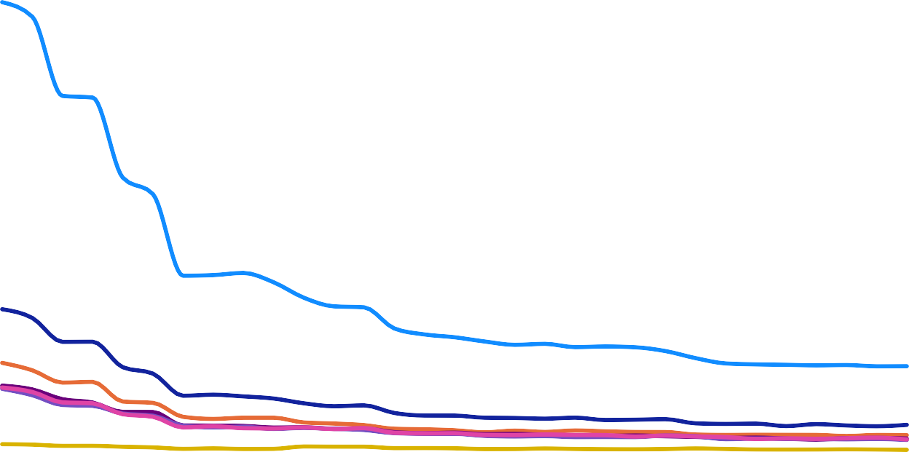




Year
Top 10 Sellers by Revenue
Payment Method Mix
Sum of payment_value, Average of avg_installments and Sum of …
Monthly Payment Value by Payment Method
Sum of payment_value and Sum of orders by Month Year and payment_type
Power BI Desktop
O 2019
O 2020
O 2021
O 2022
O 2023
O 2024
O 2025
Sum of revenue, Sum of orders, Sum of units_sold and Average of aov b…
West Ltd
40M
37M
38M
4.0M
Johnson Ltd
4.0M
30M
30M
Swanson and Sons
4.0M
88.51M (7.24%)
91.81M (7.51%)
30M
Gomez and Sons
4.0M
credit_card paypal
apple_pay bank_transfer voucher debit_card
boleto
22M
23M
94.24M (7.71%)
20M
Thomas and Sons
4.0M
1.22bn
15M
15M
Patel PLC
3.9M
12M
11M
15M
12M
10M
118.8M (9.72%)
10M
8M _{7M}
9M 9M
7M
13M
12M
10M
9M
9M 9M
^{9M 8M} 7M 7M 7M
7M 7M
White Ltd
3.9M
6M _{5M}
5M
6M
7M
5M 5M 5M
5M _{4M}
10M
9M 9M
9M
620.22M (50.75%)
^{4M} 4M 4M 4M _{3M}
4M 7M 7M
Meyer-Roberts
2.1M
6M
4M _{3M}
2M 3M 3M 2M 2M 2M 2M 2M 2M 2M 2M 2M 2M 2M 2M 2M 1M 1M 1M 1M 1M 1M 1M 1M
1M 1M 1M 1M _{3M 3M} 0M _{3M}
^{2M 2M 2M 2M 2M 2M 2M 2M} 1M 2M 1M 1M 1M 1M 1M 1M 1M 1M 1M 1M 1M
Macdonald PLC
2.1M
193.71M (15.85%)
0M
0M 1M
2025-11
2025-12
2024-11
2024-12
2023-12
2023-11
2019-12
2022-12
2019-11
2022-11
2025-08
2025-05
2025-07
2024-08
2024-07
2024-05
2025-03
2025-02
2025-06
2025-10
2025-09
2025-04
2025-01
2023-07
2023-08
2024-03
2024-06
2024-09
2023-05
2024-02
2024-04
Ryan, Brown and Figueroa
2.1M
0M
2M
4M
apple_pay
bank_transfer
boleto
credit_card
debit_card
paypal
voucher
Actual vs Estimated Delivery Time
Average of avg_delivery_days, Average of avg_estimated_days and Average of late_rate_pct…
Customer Review Score Distribution
Sum of orders, Average of late_rate_pct and Average of avg_deli…
Delivery Performance by Review Score
Average of avg_delivery_days, Average of late_rate_pct, Sum of orders and Average of avg_estim…
10
9.7
9.6 9.6
9.50 9.50
9.6 9.5 9.5 9.5 9.5 9.5 9.5
_{9.48} 9.50 _{9.54 9.49}
9.5 9.5 9.5 9.5
9.48
9.6
0.5M
0.47M
100
10000.00%
9.53
9.49
9.52
9.47
9.5
9.49
9.48
9.51
9.51
80
8
9.47
9.47
9.46
9.48 9.48 ₉
9.44
.47
9.46
9.46
0.4M
9.4
6
0.3M
60
9.3
4
0.23M
40
4181.33%
9.2
2
0.2M
9.1
20
17
0.12M
11
7
0.00%
7
0.00%
7
0.00%
0
2020-05
2021-05
2023-07
2023-05
2025-07
2022-07
2022-08
2024-05
2025-08
2022-05
2025-05
2023-08
2024-08
2019-05
2019-01
2019-07
2024-07
2021-09
2021-04
2020-01
2024-03
2024-01
2023-09
2020-07
2022-09
2025-10
2021-03
2019-06
9.0
0.1M
0.07M
0.05M
0
1
2 3
Average of late_rate_pct
4
5
Average of avg_delivery_days
Average of avg_estimated_days
0.0M
1
2
3
4
5
Average of avg_delivery_days

