Slide 1
The Book of Judges
Summary & Key Themes
Old Testament Overview
Period of Israel’s History

Slide 2
Background
After Joshua, before monarchy
~400 years
No central king
Judges 21:25
Author: Samuel
Two Key phrases repeated in Judges.
The children of Israel did evil in the sight of the Lord – 7 times (2:11, 3:7, 3:12, 4:1, 6:1, 10:6, 13:1)
In those days Israel had no king – 4 times (17:6, 18:1, 19:1, 21:25)
Everyone did what was right his own eyes (17:6, 21:15)

Slide 3
Background (Contd)
Israelites started serving Baals and Ashtoreth, Canaanite Gods (2:13). Incorporating Canaanite Gods into Israel and marrying Canaanites (3:6).
There are many Gods name Baal
Baal-Zebub: Lord of the Flies - 2 Kings 1:2-3, 16 *See Matthew 12:24-27, Luke 11:15*
Baal-Peor: Deuteronomy 4:3
Baal-Berith: Lord of the Covenant – Judges 9:4
Baal-Melqart: 1 King 16:31-32
Baalim (The Baals): I Samuel 7:4
Baal-Gad: Joshua 12:7
Baal-Hamon: Song of Solomon 8:11
Baal-Hermon: 1 Chron 5:23
Baal-Perazim: 1 Chronicles 14:11
Baal-Zephon: Numbers 33:7
Baal – Hazor: 2 Samuel 13:23
Ashtoreth was a female fertility God of Canonites.

Slide 4
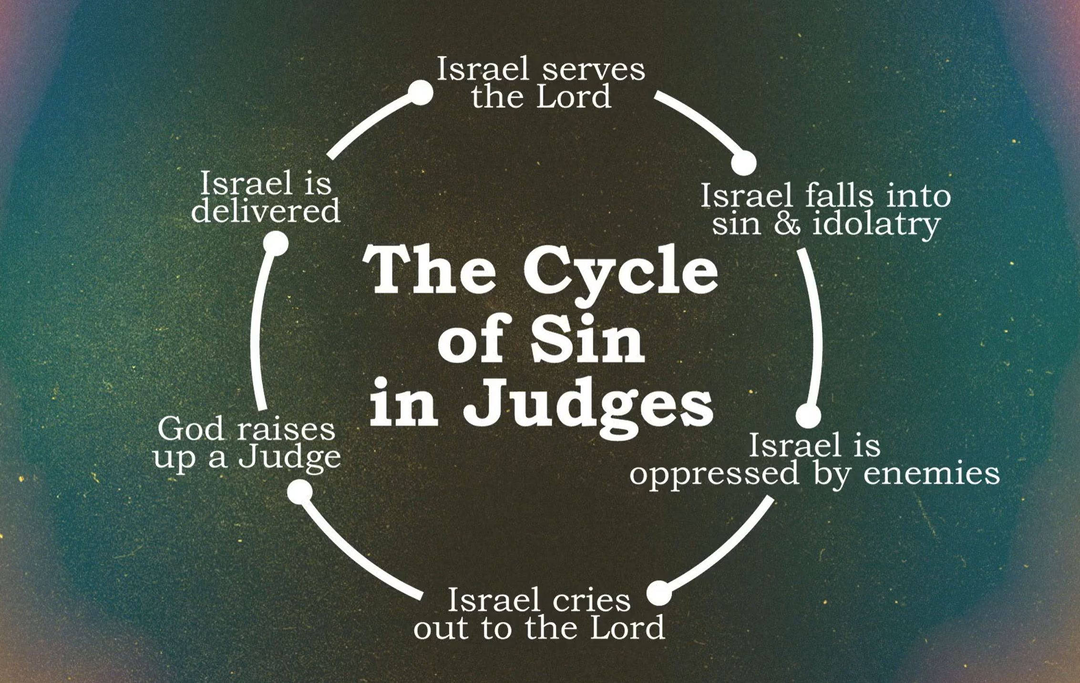
The cycle of Sin in Judges

Slide 5
Judges Chapter 1
After Joshua’s death, Israel asks the Lord who should lead them into battle against the Canaanites
Judah leads the conquest — with Simeon, they defeat the Canaanites and Perizzites at Bezek
Victories in the south — Judah captures Jerusalem, Hebron, Debir, and the Negev region
Caleb and Othniel — Caleb offers his daughter Achsah to Othniel (Caleb’s brother’s son, Caleb’s nephew) for conquering Kiriath-sepher
Incomplete conquest — Benjamin, Manasseh, Ephraim, Zebulun, Asher, Naphtali, and Dan all fail to fully drive out the Canaanites resulting in fighting that were not needed in the future.
Result: Judges 2:1-3 – They became a thorn on their sides.
Key theme — Partial obedience leads to compromise; sets the stage for the cycle of disobedience throughout Judges

Slide 6
Judges Chapter 2
Angel of the Lord at Bokim — God rebukes Israel for making covenants with the Canaanites and not tearing down their altars; the people weep.
Theophany (appearance of God) and Christophany (Appearance of Christ)
Joshua’s generation passes — Joshua dies at 110; a new generation arises that does not know the Lord or what He did for Israel
Israel turns to idolatry — They forsake the God of their fathers and serve the Baals and Ashtoreths, provoking the Lord to anger
God’s judgment and mercy cycle — God hands them over to raiders and enemies; when they cry out, He raises up judges to deliver them
Repeated rebellion — After each judge dies, the people return to even worse corruption than before, refusing to give up their evil practices
Nations left as a test — God leaves the remaining nations to test whether Israel will obey His commands as their fathers did
Key theme — Introduces the sin cycle (sin → oppression → cry → deliverance → relapse) that defines the entire book of Judges

Slide 7
Who Were the Judges?
Othniel – First judge, defeated Cushan-Rishathaim of Aram
Ehud – Left-handed deliverer, defeated Moab
Shamgar – Struck down 600 Philistines with an oxgoad
Deborah – Prophetess and judge, led victory with Barak
Gideon – Defeated Midian with just 300 men
Tola – Judged Israel 23 years
Jair – Judged Israel 22 years, had 30 sons
Jephthah – Defeated the Ammonites, known for his vow
Ibzan – Judged Israel 7 years from Bethlehem
Elon – Judged Israel 10 years
Abdon – Judged Israel 8 years
Samson – Supernatural strength, final sacrifice against Philistines

Slide 8
Major Judges
Othniel, Ehud, Deborah, Gideon, Jephthah, Samson
Are there other Judges that Book of Judges does not discuss?
Samuel – 1 Samuel 7:15-17
Eli – 1 Samuel 4:18
Joel, Abijah (Samuel’s 2 sons) – 1 Samuel 8:1-3

Slide 9
Othniel
Israel’s First Judge • Judges 3:7–11
Son of Kenaz, nephew of Caleb — from the tribe of Judah; conquered Kiriath-sepher and married Caleb’s daughter Achsah
Empowered by the Spirit of the LORD — God raised him up as a deliverer when Israel cried out during 8 years of oppression
Defeated Cushan-Rishathaim — king of Aram-Naharaim (Mesopotamia), who had oppressed Israel for eight years
40 years of peace — his victory brought rest and stability to the land for an entire generation
Set the pattern for all judges — sin → oppression → cry to God → deliverance → rest

Slide 10
Ehud
Left-Handed Deliverer • Judges 3:12–30
Left-handed Benjaminite, son of Gera — raised up by God as a deliverer after Israel served Eglon king of Moab for 18 years
Crafted a double-edged sword — concealed it on his right thigh and used it to assassinate Eglon in his private upper room. Eglon was a fat man who could not escape. Ehud thrusted his sword that was hidden into the belly of Eglon.
Rallied Israel at the hill country of Ephraim — seized the fords of the Jordan against Moab and struck down about 10,000 strong, able-bodied warriors
80 years of peace — his victory brought the longest period of rest recorded in the book of Judges
God uses unexpected means — a left-handed man with a hidden weapon shows that deliverance comes through God’s power, not human strength

Slide 11
Deborah & Barak
Prophetess & Military Leader • Judges 4–5
Only female judge in Israel — a prophetess who held court under the Palm of Deborah between Ramah and Bethel in the hill country of Ephraim
Summoned Barak son of Abinoam — commanded him to take 10,000 men from Naphtali and Zebulun to Mount Tabor against Sisera’s army
Defeated Sisera’s 900 iron chariots — God routed Sisera and his entire army by the sword before Barak; Sisera fled on foot
Jael killed Sisera — wife of Heber the Kenite drove a tent peg through his temple as he slept, fulfilling Deborah’s prophecy that glory would go to a woman
Sang a victory hymn — the Song of Deborah (Judges 5) celebrates God’s deliverance and brought 40 years of peace to the land

Slide 12
Shamgar
Oxgoad Warrior • Judges 3:31
Son of Anath — his name and parentage suggest possible connections to the city of Beth-anath in Naphtali; little else is known about his background
Struck down 600 Philistines with an oxgoad — a farming tool about 8 feet long with a metal tip, used for driving oxen; not a conventional weapon of war
Delivered Israel from the Philistines — the first mention of the Philistines as oppressors in Judges, foreshadowing the major conflict that would dominate Samson’s era
Recorded in a single verse — Judges 3:31 is his entire account, making him the most briefly mentioned of all the judges, yet his act of deliverance was mighty
God uses humble instruments — like Ehud’s left hand and Gideon’s torches, Shamgar’s oxgoad shows that victory belongs to the Lord, not to weapons of war

Slide 13
Gideon
Mighty Warrior of Faith • Judges 6–8
Called by the Angel of the LORD — found threshing wheat in a winepress to hide it from the Midianites; told “The LORD is with you, mighty warrior”
Tested God with the fleece — asked for signs with a wool fleece on the threshing floor, and God confirmed His calling twice
Army reduced from 32,000 to 300 — God thinned the ranks so Israel could not boast that their own strength saved them
Defeated Midian with trumpets and torches — the 300 men surrounded the camp with jars, torches, and trumpets; God set the enemy against each other
40 years of peace — his victory ended 7 years of Midianite oppression, though he later made an ephod that became a snare to Israel
Abimelech tried to be king and he killed 70 of his brothers to eliminate competition. He died after a woman dropped an millstone on his head during a battle to put down rebellion.

Slide 14
Tola, Jair, Jephthah, Ibzan, Elon & Abdon
Judges of Israel • Judges 10–12
Tola Judges 10:1–2
Son of Puah, from the tribe of Issachar. Rose up to save Israel after Abimelech’s destructive reign. Lived in Shamir in the hill country of Ephraim and judged Israel for 23 years.
Jair Judges 10:3–5
A Gileadite who judged Israel for 22 years. Had 30 sons who rode 30 donkeys and controlled 30 towns in Gilead, called Havvoth-jair. Buried in Kamon.
Jephthah Judges 11–12:7
A mighty warrior and son of Gilead, cast out by his brothers but recalled to lead Israel against Ammon. Defeated the Ammonites but is remembered for his tragic vow. Judged Israel for 6 years.
Ibzan Judges 12:8–10
From Bethlehem, he had 30 sons and 30 daughters. Sent his daughters abroad in marriage and brought in 30 wives for his sons. Judged Israel for 7 years.
Elon Judges 12:11–12
A Zebulunite who judged Israel for 10 years. Little is recorded about his tenure, but his faithful service kept Israel stable. Buried in Aijalon in the land of Zebulun.
Abdon Judges 12:13–15
Son of Hillel, from Pirathon in Ephraim. Had 40 sons and 30 grandsons who rode 70 donkeys — a sign of wealth and status. Judged Israel for 8 years.

Slide 15
Samson
Nazirite Strongman • Judges 13–16
Set apart from birth as a Nazirite — an angel announced his birth to his barren mother, forbidding wine, unclean food, and cutting his hair
Supernatural strength from the Spirit of the LORD — killed a lion bare-handed, struck down 1,000 Philistines with a donkey’s jawbone, and carried Gaza’s city gates to a hilltop
Entangled by Delilah — she pressed him daily until he revealed the secret of his strength; the Philistines shaved his head and his power left him
Captured, blinded, and enslaved — the Philistines gouged out his eyes and forced him to grind grain in prison, but his hair began to grow back
Final sacrifice brought greatest victory — at a Philistine feast to Dagon, he pushed apart the temple pillars, killing more enemies in death than in life

Slide 16
Spiritual Condition
Moral decline
Idolatry
Disunity
Corruption

Slide 17
Key Themes
Justice & mercy
Consequences of sin
Repentance
Leadership matters

Slide 18
Key Lesson
Without God = chaos
True deliverance from God
Need for a righteous King

Slide 19
Group Activity
Judges 21:25 – In those days there was no king in Israel; everyone did what was right in his own eyes.
What are the people doing in our times that they think is right in their own eyes when Bible says it is wrong?
Think about being politically correct, some people think they are right in their views and not Word of God.
Identify at least 5 items. More the better!
Select a group leader to explain your points

