Slide 1
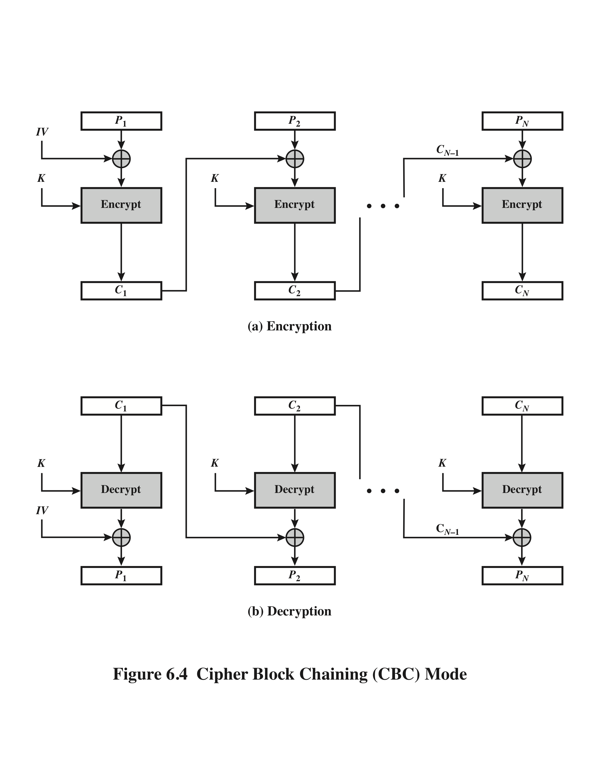
Cipher Block Chaining (CBC)
Notes:
To overcome the security deficiencies of ECB, we would like a technique in which
the same plaintext block, if repeated, produces different ciphertext blocks. A
simple way to satisfy this requirement is the cipher block chaining (CBC ) mode
(Figure 6.4). In this scheme, the input to the encryption algorithm is the XOR of the
current plaintext block and the preceding ciphertext block; the same key is used for
each block. In effect, we have chained together the processing of the sequence of
plaintext blocks. The input to the encryption function for each plaintext block bears
no fixed relationship to the plaintext block. Therefore, repeating patterns of b bits
are not exposed. As with the ECB mode, the CBC mode requires that the last block
be padded to a full b bits if it is a partial block.
For decryption, each cipher block is passed through the decryption algorithm.
The result is XORed with the preceding ciphertext block to produce the plaintext
block.
To produce the first block of ciphertext, an initialization vector (IV) is XORed
with the first block of plaintext. On decryption, the IV is XORed with the output
of the decryption algorithm to recover the first block of plaintext. The IV is a data
block that is the same size as the cipher block.
The IV must be known to both the sender and receiver but be unpredictable
by a third party. In particular, for any given plaintext, it must not be possible to
predict the IV that will be associated to the plaintext in advance of the generation
of the IV. For maximum security, the IV should be protected against unauthorized
changes. This could be done by sending the IV using ECB encryption. One reason
for protecting the IV is as follows: If an opponent is able to fool the receiver into
using a different value for IV, then the opponent is able to invert selected bits in the
first block of plaintext.
So long as it is unpredictable, the specific choice of IV is unimportant.
SP800-38A recommends two possible methods: The first method is to apply the
encryption function, under the same key that is used for the encryption of the plaintext,
to a nonce . The nonce must be a data block that is unique to each execution of
the encryption operation. For example, the nonce may be a counter, a timestamp, or
a message number. The second method is to generate a random data block using a
random number generator.
In conclusion, because of the chaining mechanism of CBC, it is an appropriate
mode for encrypting messages of length greater than b bits.
In addition to its use to achieve confidentiality, the CBC mode can be used for
authentication. This use is described in Chapter 12.

