Slide 1
Padding Attacks POODLE

Slide 2
POODLE Attack Overview
Attacker
MitM
4
HTTPS Server
Oracle
3
Client
Browser
5
6
1. Client browses Attacker HTTP server
2. Attacker server injects HTTPS request generator
3. Client sends HTTPS request with secret cookie
Attacker intercepts and modifies HTTPS request
4. Attacker forward modified HTTPS request
5. HTTPS server acts as oracle
Attacker deciphers byte
6. Attacker updates request generator
Trigger client to update request, repeating steps
2
1
Attacker
HTTP Server

Slide 3
SSLv3 Vulnerability 1
Padding scheme: only the last padding byte is examined, so an oracle will accept any padding as long as the last byte is between 0..(b-1)

Slide 4
SSLv3 Vulnerability 2
MAC then encrypt: SSLv3 HMAC does not account for the padding, so a full block of padding at the end of an encrypted message may be replaced with an arbitrary block of data, and if the block of data contains a final byte equal to 15 (or (blocksize-1)), the oracle will accept the message as valid, since it recognizes the padding as correct, and the MAC in the previous blocks is unaffected

Slide 5
POODLE Attack Steps
Diagram

Slide 6
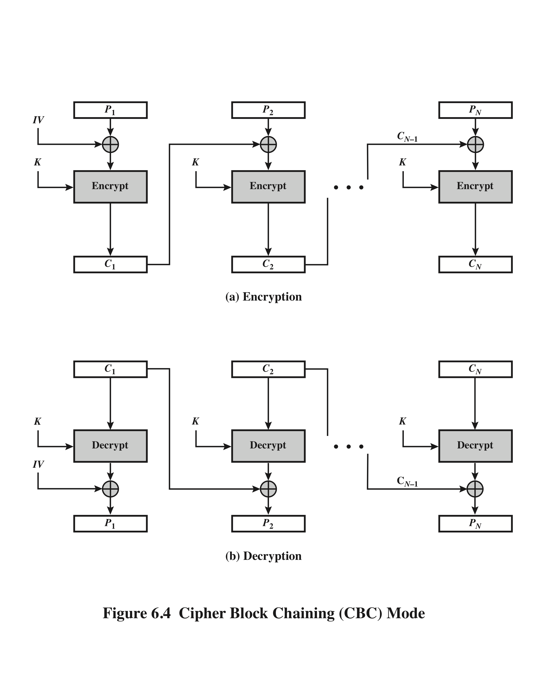
16-byte blocks
padding (full block)
Pi-1
Pi
xxxxx15
After Oracle success, attacker knows:
1. D_{K}(C_{i})[15] ⊕ C_{n-­1}[15] = 15
2. D(C_{i}) = P_{i} ⊕ C_{i-1}
3. D(C_{i})[15] = P_{i}[15] ⊕ C_{i-1}[15] Bitwise
4. (P_{i}[15] ⊕ C_{i-1}[15]) ⊕ C_{n­1}[15] = 15 Substitute
5. P_{i}[15] ⊕ C_{i-1}[15] ⊕ C_{n­1}[15] = 15
6. P_{i}[15] = 15 ⊕ C_{n­1}[15] ⊕ C_{i­1}[15]
Ci-1
Ci
Ci
Cn-1
Ci
Ci-1
Dk(Ci)
Dk(Ci)
2., 3.
1.
Pi
Pn-1
xxxxx15

Slide 7
Defense Idea: Record Splitting
Now running the attack with the browser implementing 6/n-6 record splitting anytime it receives a message length where length(message +MAC) % 16 ==0, i.e. a message that would result in a full block of padding. Upon identifying this condition, the browser splits the record into two records. The first record contains the first 6 bytes of the plaintext message, and the second record contains the remaining n-6 bytes. Both records are then independently MAC’d, padded, and encrypted. The effect is that the 20-byte MAC is pushed into the final message block, so that both messages contain 10 bytes of MAC, and 6 bytes of padding. This now decreases the probability that an attacker can replace the final block and achieve a successful match of both the final byte of padding AND 10 bytes of MAC in the last block from 1/256 to 1/2⁸⁸ = 3.23x10⁻²⁷. This makes a successful attack much less likely. As seen below, the attacker is not successful after 3,000 oracle requests. Of course the ultimate solution is to disable SSLv3 altogether, as modern browsers have now done, but this record splitting may server as an effective interim solution. In fact, the Opera browser did implement some kind of anti-POODLE record splitting in its browser for a short period before SSLv3 was entirely deprecated, but I don’t have any information on their approach or algorithm.

